Slide 1

A Brief Analysis: Relationship between selecting an undergraduate major and its income potential
Notes:
Relationship between picking an undergrad major and income potential

Slide 2
Overview
Research Question:
How does selecting an undergraduate major affect your earning potential at the start of your career and 10-15 years later (“mid-career” stage)
Data sets used:
Main
Data on 50 majors and their median starting and mid-career incomes (WSJ)
Supplementary
Data on % of college freshmen intending to major in STEM from 1995-2012 (NSF)
Data on 3.5k U.S. Tuition by college (U.S. Dept. of Education)

Slide 3
Preparing the Data
Converted salary information e.g. $40,000 into a usable numbers (from factor to numerical)
Used Gsub to remove “,” and $, in order to convert to a numeric
Grouped 50 majors into a larger buckets (e.g. STEM, Social Science, Arts & Humanities)
Used later to help generate charts
Added a column to indicate whether the major is a popular oneat BU (1 if it is a popular major at BU, 0 if it isn’t)
Used later in charts
Simplified column names to make it more readable
E.g. “Mid.Career.90th.Percentile.Salary” to “Mid-Career 90th PCTL”
Ordered rows by major category, major, starting median, mid-career median for readability

Slide 4
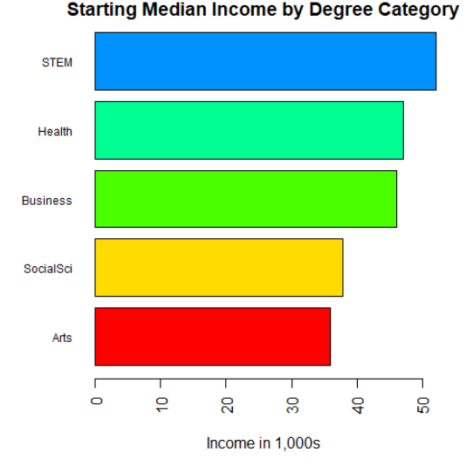
Categorical Variables (Bar plot)
As a person starts their career:
Stem is the highest starting median income
Health & Business are in the next tier
Social sciences & arts are slightly behind

Slide 5
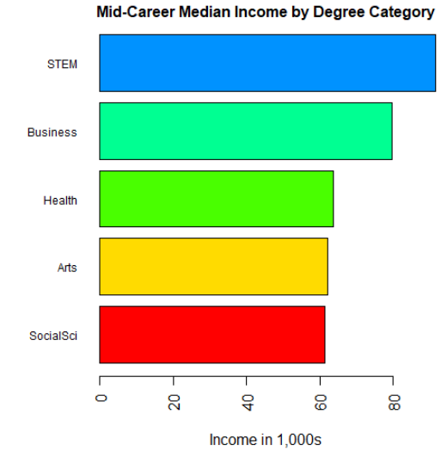
Categorical Variables (Bar plot)
In 10-15 years, these will be the median incomes
Naturally every group’s income has increased
Not much of an ordinal change, although business long term exceeds the earning potential of health

Slide 6
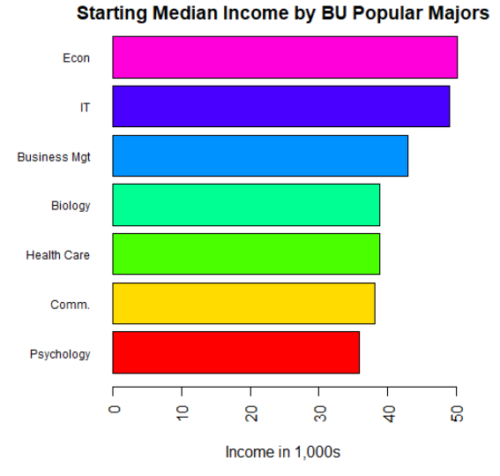
Categorical Variables (Bar plot)
Drilling into starting incomes by BU majors
Not huge discrepancies between the most popular majors

Slide 7
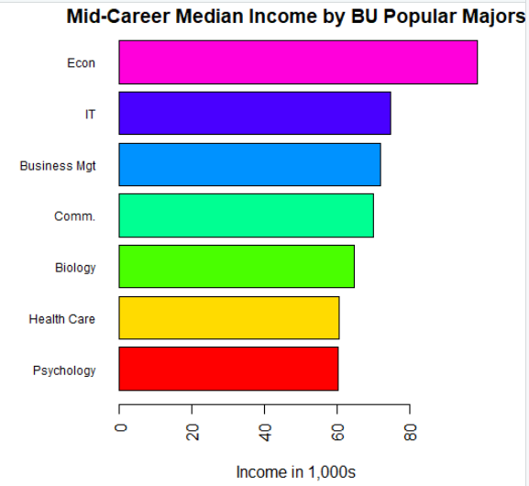
Categorical Variables (Bar plot)
Econ is separating itself from the pack from 10-15 years
Communications also gets a hefty boost!
Psychology is stagnant relative to others

Slide 8
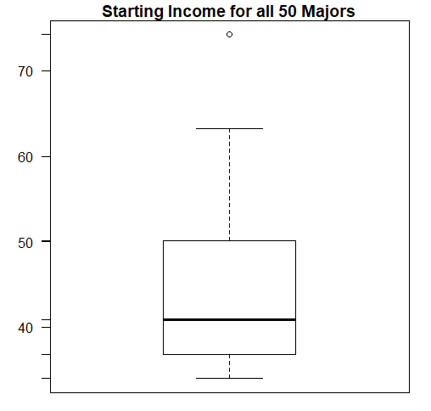
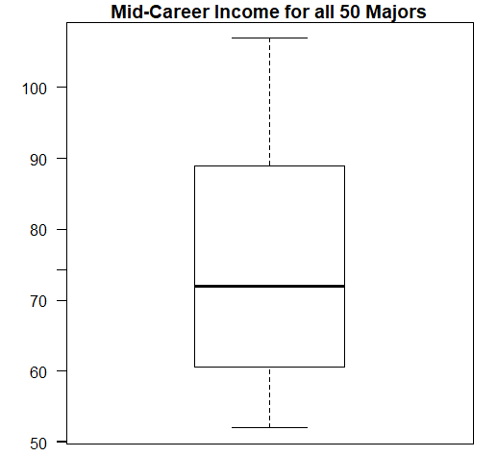
Numerical Variables (Box Plots)
The outlier is a physician’s assistant major
Middle 50% and range expanded!

Slide 9
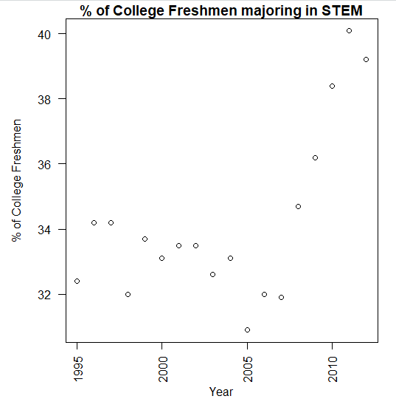
Numerical Variables (Dot Plot)
Each dot is a numerical percentage of total college freshmen wanting to major in STEM
Slowly decreasing interest in STEM from 1995 to 2005
Large interest in the field in most recent years

Slide 10
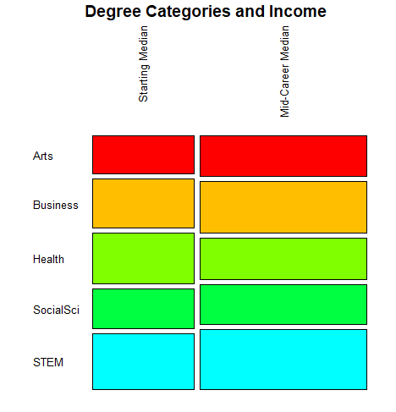
Multivariate Data (Mosaic Plots)
Similar data to what we’ve seen before, but a different visual representation
E.g. Health is prominent in starting median income, but dwindles 10-15 years later as compared to some of the others

Slide 11
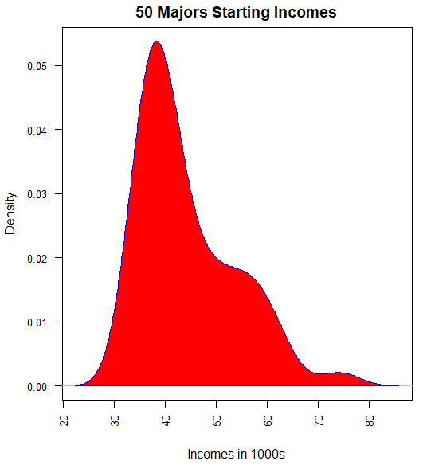
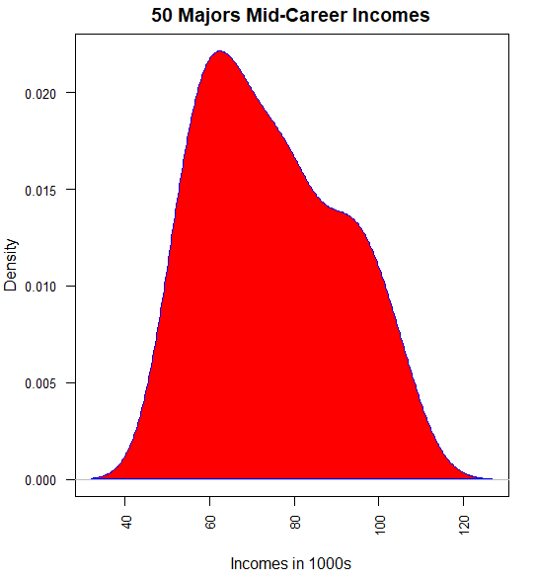
Density Plots
Both numerical variables approximate a normal dist., for starting incomes, most salaries are tightly around 40k, as years progress, the distribution is more evenly dispersed

Slide 12
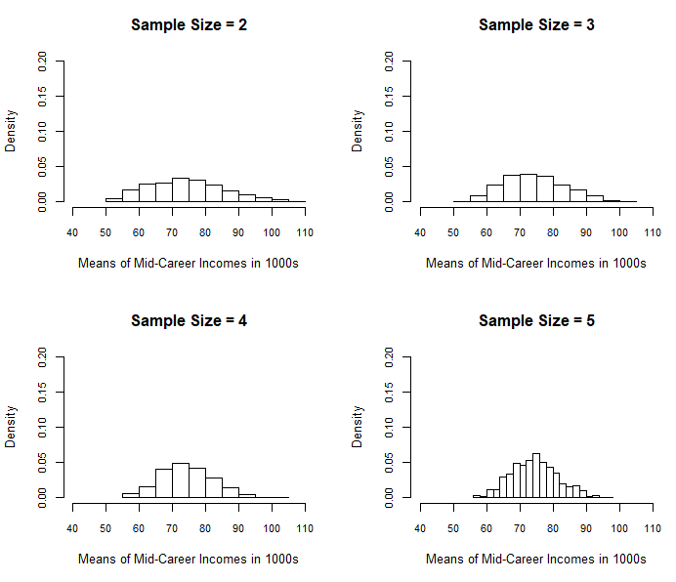
Central Limit Theorem (Bar Plots)
(Dataset: 50 Majors - Mid Career Incomes)
As the CLT states, a distribution of sample means will begin to approximate a normal distribution.
The mean of the sample mean distribution will also approx. the population(dataset mean ~74.786k)
As the sample size increases, the variance will decrease
For sample size = 2, the distribution is spread out and closer to uniform than normal (sd ~11,403)
For sample size = 5, the distribution is tight around the mean with a clearly defined normal dist. (sd ~7026)

Slide 13
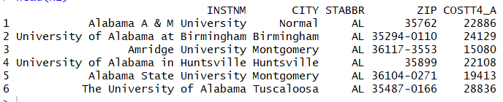
Large Tuition Data for Sampling
This is a large dataset (3.5k) on college tuitions. Using sampling methods to approximate the dataset mean, variance, and standard deviation.
Dataset mean: 23,464.12
Dataset var: 225,615,879
Dataset sd: 15,020.52
We will compare the dataset characteristics with the sampling characteristics !

Slide 14
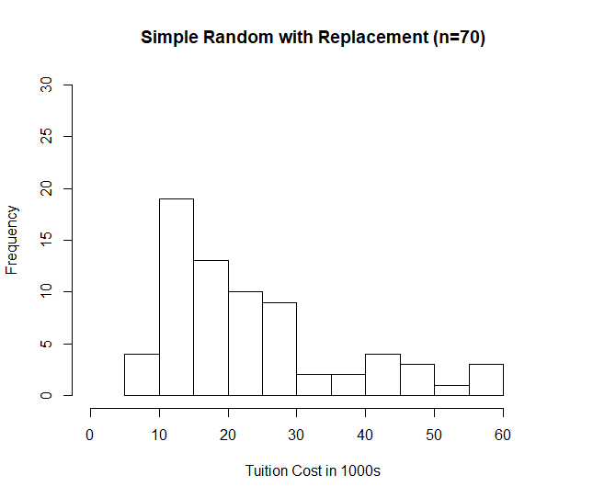
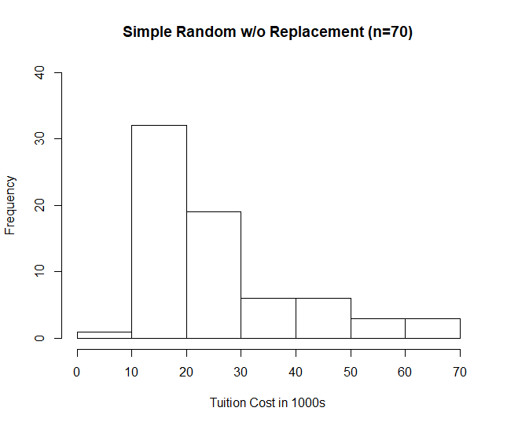
Sampling Methods (Simple Random Sampling)

Slide 15
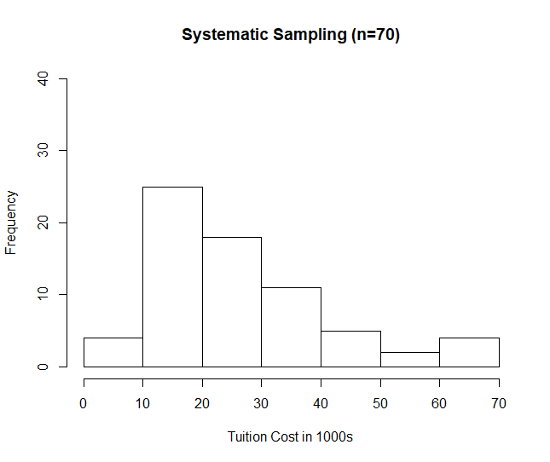
Sampling Methods (Systematic Sampling)

Slide 16
Sampling Methods (Conclusion)

Slide 17
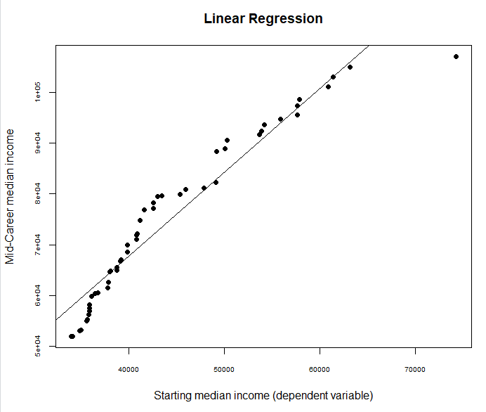
Linear Regression
Does starting median income affect income 10-15 years later?
There is clearly a positive correlation, but need to dig deeper in order to analyze a causal effect. et.

Slide 18

Thank you. Any Questions?
dal2111@bu.edu
David Jan-Liu

