Slide 1

A Brief Analysis: Relationship between selecting an undergraduate major and its income potential
Notes:
Relationship between picking an undergrad major and income potential

Slide 2
Overview
General Research Question:
How does selecting an undergraduate major affect your earning potential at the start of your career and 10-15 years later (“mid-career” stage)
Data sets used:
Main
Data on 50 majors and their median starting and mid-career incomes (WSJ)
Supplementary
Data on % of college freshmen intending to major in STEM from 1995-2012 (NSF)
Data on 3.5k U.S. Tuition by college (U.S. Dept. of Education)

Slide 3
Agenda
Preparing the Data
Categorical Variables
Numerical Variables
Distribution of data
Central Limit Theorem (CLT)
Demonstrating the CLT using n trials and k samples of the mid-career income variable
Sampling Methods
Comparing various sampling methods and how their characteristics compare to the “population” dataset
Simple Linear Regression
Relationship of starting salary predicting mid-career salary

Slide 4
Preparing the Data
Converted salary information e.g. $40,000 into a usable numbers (from factor to numerical)
Used Gsub to remove “,” and $, in order to convert to a numeric
Grouped 50 majors into a larger buckets (e.g. STEM, Social Science, Arts & Humanities)
Used later to help generate charts
Added a column to indicate whether the major is a popular one at BU (1 if it is a popular major at BU, 0 if it isn’t)
Used later in charts
Simplified column names to make it more readable
E.g. “Mid.Career.90th.Percentile.Salary” to “Mid-Career 90th PCTL”
Ordered rows by major category, major, starting median, mid-career median for readability

Slide 5
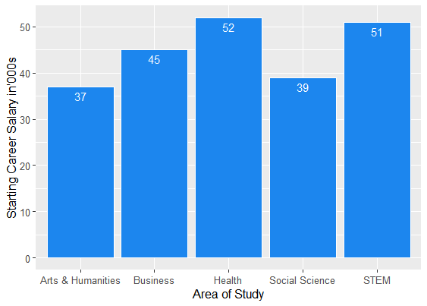
Categorical Variables (Bar plot)
As a person starts their career:
Health and STEM are the highest starting median incomes
Followed by Business, Social Sciences, and the Arts

Slide 6
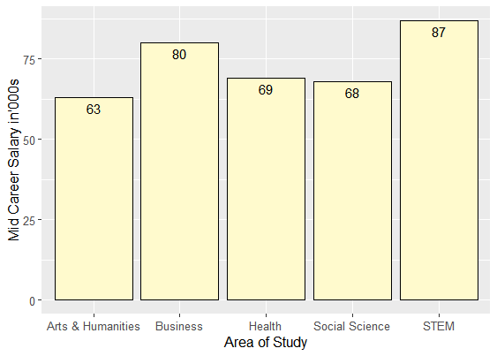
Categorical Variables (Bar plot)
In 10-15 years:
Naturally every group’s income have increased due to experience
A career in health drops as being the top salary
STEM and Business hold the top spots
Social Sciences and Arts are still in the lower ordinal positions

Slide 7
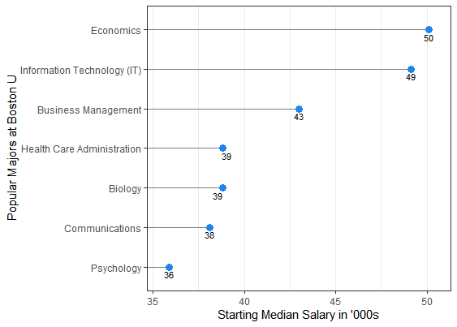
Categorical Variables (Bar plot)
Looking at Starting Incomes of popular majors at BU:
Economics and IT take the top spots
Business management in the second tier
The remaining majors are very similar

Slide 8
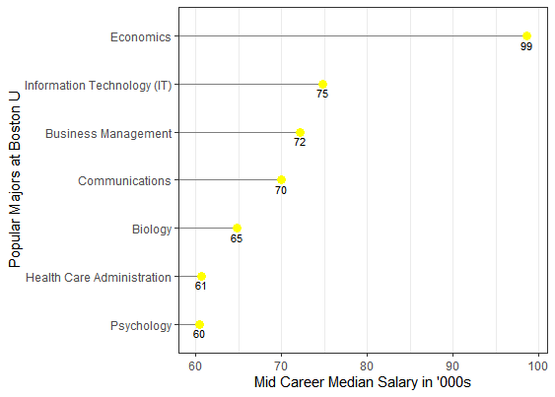
Categorical Variables (Bar plot)
Looking at Mid-Career Incomes of popular majors at BU:
Very obvious separation in top incomes from Economics Majors after 10-15 years
IT and Business are still among the high earners
The remaining majors are still very similar

Slide 9
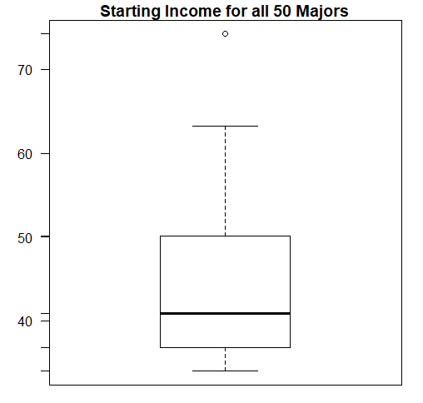
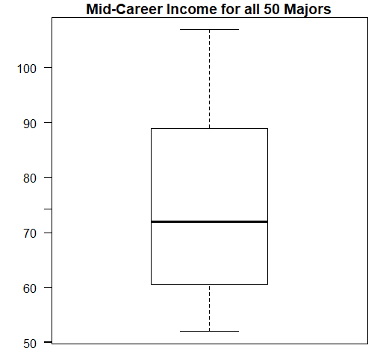
Numerical Variables (Box Plots)
The outlier is a physician’s assistant major
Middle 50% and range expanded!

Slide 10
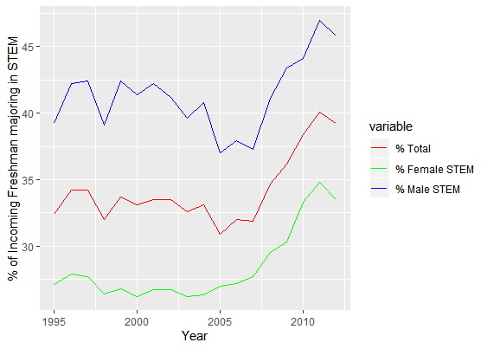
Numerical Variables (Dot Plot)
The overall trend has been decreasing interest in STEM from 1995 to ~2007
Notable low interest has been 1997 and from 2005-2007
After ~2007, interest has seen 10%+ growth in STEM majors
An interesting aspect would be to see how international students have affected this trend

Slide 11
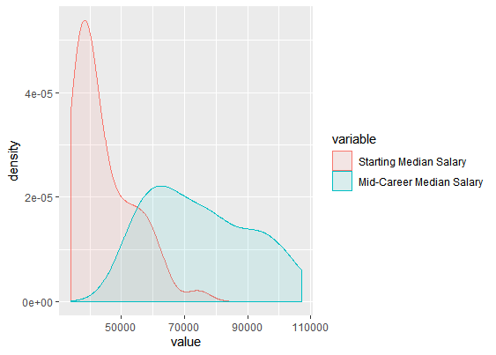
Density Plot
Both numerical variables approximate normal distributions
For starting incomes, most salaries are tightly around 40k
As years progress into the mid-career, the distribution is more evenly dispersed

Slide 12
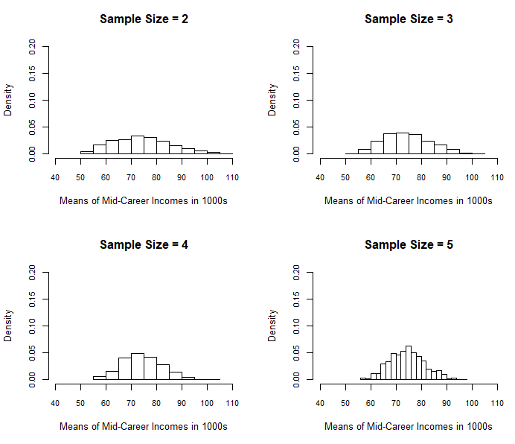
Central Limit Theorem (Bar Plots)
(Dataset: 50 Majors - Mid Career Incomes)
As the CLT states, a distribution of sample means will begin to approximate a normal distribution.
The mean of the sample mean distribution will also approx. the population(dataset mean ~74.786k)
As the sample size increases, the variance will decrease
For sample size = 2, the distribution is spread out and closer to uniform than normal (sd ~11,403)
For sample size = 5, the distribution is tight around the mean with a clearly defined normal dist. (sd ~7026)

Slide 13
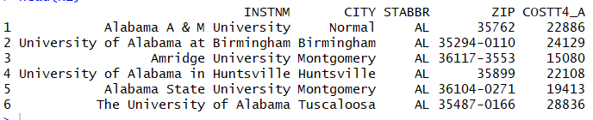
Large Tuition Data for Sampling
This is a large dataset (3.5k) on college tuitions. Using sampling methods to approximate the dataset mean, variance, and standard deviation.
Dataset mean: 23,464.12
Dataset var: 225,615,879
Dataset sd: 15,020.52
We will compare the dataset characteristics with the sampling characteristics !

Slide 14
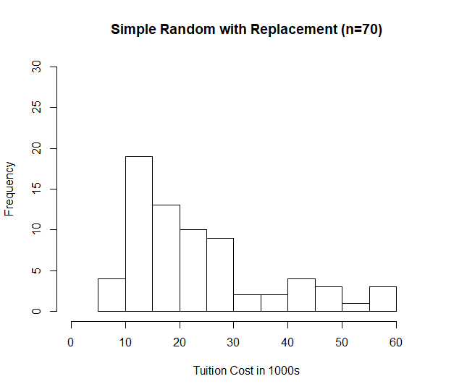
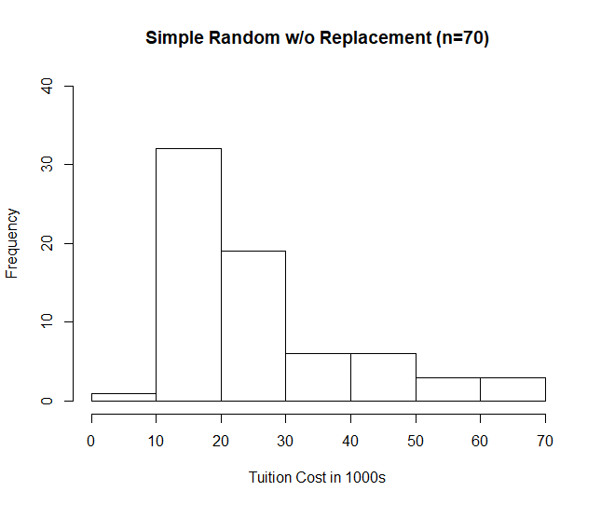
Sampling Methods (Simple Random Sampling)

Slide 15
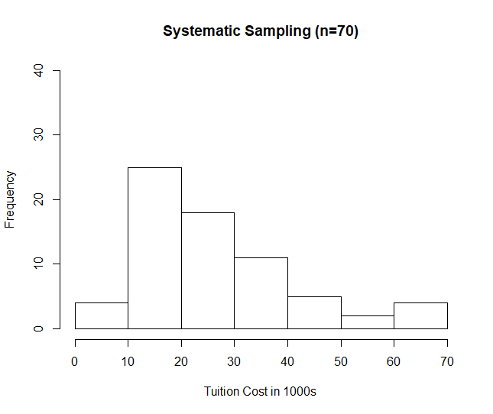
Sampling Methods (Systematic Sampling)

Slide 16
Sampling Methods (Conclusion)

Slide 17
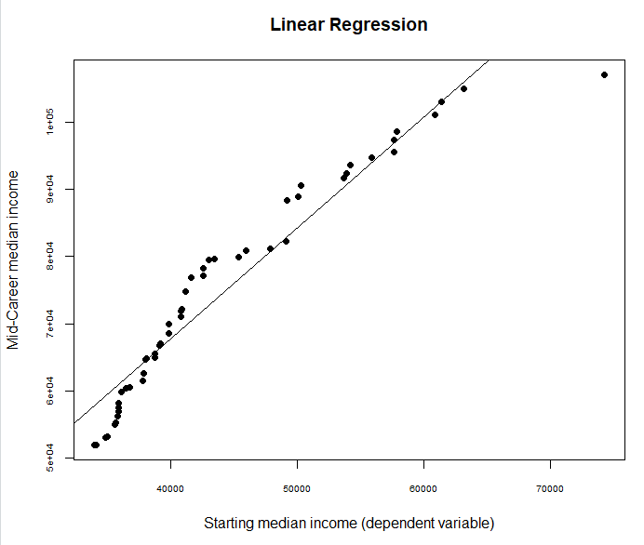
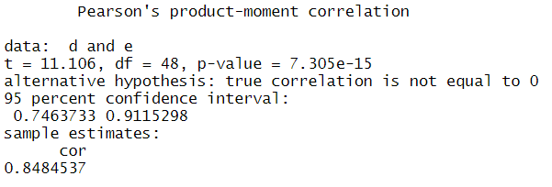
Linear Regression
Does starting median income affect income 10-15 years later?
There is clearly a positive correlation of .85, with a p-value<.05 (reject the null hypothesis)
We can say that the effect of a high starting salary on a mid-career salary is not due to pure randomness, however, much more work is needed to understand its effect

Slide 18

Thank you. Any Questions?
dal2111@bu.edu
David Jan-Liu

