Slide 1
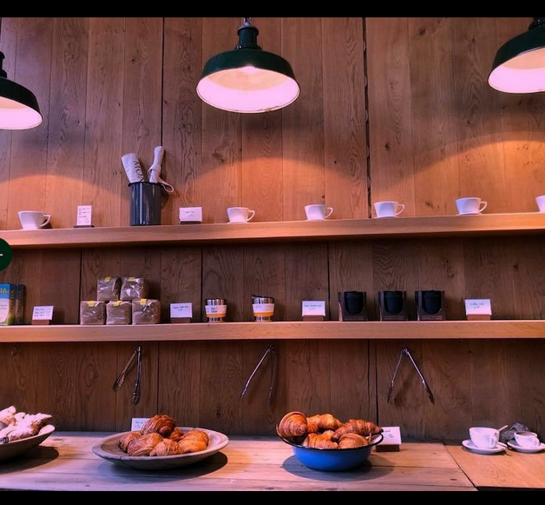
Café Analytics Pilot — Project Presentation
A data-driven analysis of café branch performance,
Exploratory analysis of sales trends, and customer behavior

Slide 2

📊 Dashboard Highlights
Total Sales: £210.50 | Profit Estimate: £63.15 | Transactions: 60
Average Spend per Customer: £3.51
Top Drinks: Macchiato & Espresso dominate
Payment Split: 51.5% Card, 48.5% Cash
Sales recovering toward early 2025, mild upward trend

Slide 3
🏪 Branch Performance
Woking: £94.50 – Highest performing branch
Guildford: £55.00 – Solid mid-tier performer
Epsom: £43.50 – Consistent local performance
Redhill: £17.50 – Underperforming – requires attention

Slide 4
Recommendations
Focus support on Redhill branch – local promotions and outreach
Expand Macchiato & Espresso offerings – highlight signature drinks
Introduce digital loyalty schemes to boost repeat visits
Launch off-peak offers to address seasonal dips.
Prepare for cloud scalability (Azure SQL / automated ETL pipeline)

Slide 5
Technical Summary
All personal data anonymised during ingestion (names, card numbers removed)
Pilot uses local CSV storage and Power BI for visualization
Scalable to cloud-based infrastructure for multi-branch integration
ETL process built in Python (extract, transform, load)

