Slide 2
Generators – let us set up your project!
Arkadyuti Sarkar
Ayan Dalal
MAY 26, 2017

Slide 3
Agenda
What? Why? How?
What is Yeoman? Why not Yeoman?
Demo
Code walk
Repo details
Good-to-have features
Q/A session

Slide 4
What are Generators?
Generators are an awesome way to kick start your application.

Slide 5
What are Generators?
Generators are an awesome way to kick start your application.
Generator

Slide 6

What are Generators?
Generators are an awesome way to kick start your application.
Prompts
calls prompts
answers
Generator

Slide 7
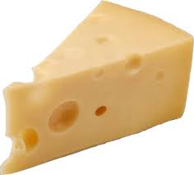
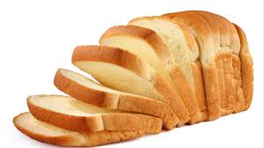
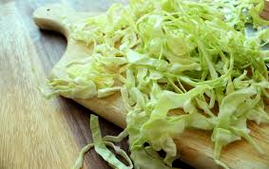
What are Generators?
Generators are an awesome way to kick start your application.
Generator

Slide 8

What are Generators?
Generators are an awesome way to kick start your application.
Generator

Slide 9
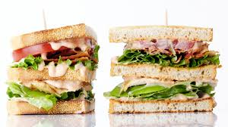
What are Generators?
Generators are an awesome way to kick start your application.
Generator
Generated project
YUMMY!! :P

Slide 10
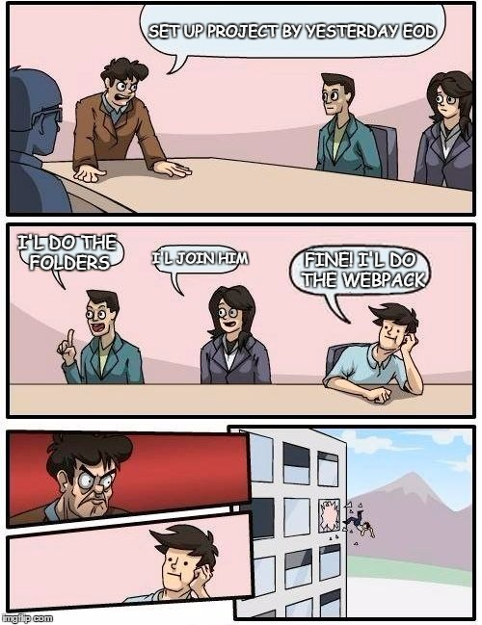
Why Generators?
Setting up a new project from scratch!
A hectic job!

Slide 11
Why Generators?
Setting up a new project from scratch!
A hectic job!
Time consuming

Slide 12
Why Generators?
Setting up a new project from scratch!
A hectic job!
Time consuming
Complex folder structure

Slide 13
Why Generators?
Setting up a new project from scratch!
A hectic job!
Time consuming
Complex folder structure
Configuration of files

Slide 14
Why Generators?
Setting up a new project from scratch!
A hectic job!
Time consuming
Complex folder structure
Configuration of files
Innumerous trial-n-errors!

Slide 15
How?

Slide 16
What is Yeoman?
A kind of a middleware which takes our code and talks to node(fs) to scaffold our application.

Slide 17
What is Yeoman?
A kind of a middleware which takes our code and talks to node(fs) to scaffold our application.
Why not Yeoman?
Heavy
Abstraction
Less customizable
Not server-side compatible

Slide 18
What is Yeoman?
Snapshot of package.json
"dependencies": {
"async": "^1.0.0",
"chalk": "^1.0.0",
"cli-list": "^0.1.1",
"configstore": "^1.0.0",
"cross-spawn": "^3.0.1",
"figures": "^1.3.5",
"fullname": "^2.0.0",
"got": "^5.0.0",
"humanize-string": "^1.0.0",
"inquirer": "^0.11.0",
"insight": "^0.7.0",
"lodash": "^3.2.0",
"meow": "^3.0.0",
"npm-keyword": "^4.1.0",
"opn": "^3.0.2",
"package-json": "^2.1.0",
"parse-help": "^0.1.1",
"read-pkg-up": "^1.0.1",
"repeating": "^2.0.0",
"root-check": "^1.0.0",
"sort-on": "^1.0.0",
"string-length": "^1.0.0",
"tabtab": "^1.3.0",
"titleize": "^1.0.0",
"update-notifier": "^0.6.0",
"user-home": "^2.0.0",
"yeoman-character": "^1.0.0",
"yeoman-doctor": "^2.0.0",
"yeoman-environment": "^1.6.1",
"yosay": "^1.0.0"
}
"devDependencies": {
"gulp": "^3.6.0",
"gulp-coveralls": "^0.1.0",
"gulp-eslint": "^2.0.0",
"gulp-exclude-gitignore": "^1.0.0",
"gulp-istanbul": "^0.10.4",
"gulp-mocha": "^2.0.0",
"gulp-nsp": "^2.1.0",
"gulp-plumber": "^1.0.0",
"mocha": "^2.1.0",
"mockery": "^1.4.0",
"nock": "^8.0.0",
"nsp": "^2.2.0",
"proxyquire": "^1.0.1",
"registry-url": "^3.0.0",
"sinon": "^1.12.1"
}
A kind of a middleware which takes our code and talks to node(fs) to scaffold our application.
Why not Yeoman?
Heavy
Not server-side compatible
30 + 15 = 45!!!!!!

Slide 19
DEMO

Slide 20
CODE-WALK

Slide 21
Good-to-have features
“Due to time constraints, this is all we could do. But we plan to make it a much bigger project with many more features.”

Slide 22
Good-to-have features
“Due to time constraints, this is all we could do. But we plan to make it a much bigger project with many more features.”
Create sub-generators to generate components, or change file configurations.

Slide 23
Good-to-have features
“Due to time constraints, this is all we could do. But we plan to make it a much bigger project with many more features.”
Create sub-generators to generate components, or change file configurations.
Add trending frameworks like Angular2, Preact.

Slide 24
Good-to-have features
“Due to time constraints, this is all we could do. But we plan to make it a much bigger project with many more features.”
Create sub-generators to generate components, or change file configurations.
Add trending frameworks like Angular2, Preact.
Support universal rendering.

Slide 25
Good-to-have features
“Due to time constraints, this is all we could do. But we plan to make it a much bigger project with many more features.”
Create sub-generators to generate components, or change file configurations.
Add trending frameworks like Angular2, Preact.
Support universal rendering.
Provide basic test cases with required testing frameworks(chai,mocha).

Slide 26
Good-to-have features
“Due to time constraints, this is all we could do. But we plan to make it a much bigger project with many more features.”
Create sub-generators to generate components, or change file configurations.
Add trending frameworks like Angular2, Preact.
Support universal rendering.
Provide basic test cases with required testing frameworks(chai,mocha).
“You are most welcome to add your own ideas & contributions!!”

Slide 27
FEEL FREE TO CONTRIBUTE!

Slide 28
FEEL FREE TO CONTRIBUTE!
Please do visit!
Share your ideas and feedback!
Lets work together to make it a bigger project!
http://bit.ly/node-generator

Slide 29
FEEL FREE TO CONTRIBUTE!
Please do visit!
Share your ideas and feedback!
Lets work together to make it a bigger project!
http://bit.ly/node-generator
Repo url - http://bit.ly/node-generator
Clone, contribute & raise PR!
Don’t forget to star us if liked our work ;)

Slide 30
Questions? Feedback?

Slide 31
Thank You
Reach out to us -
Arkadyuti Sarkar
asarkar2@sapient.com
Ayan Dalal
adalal4@sapient.com

