Slide 1
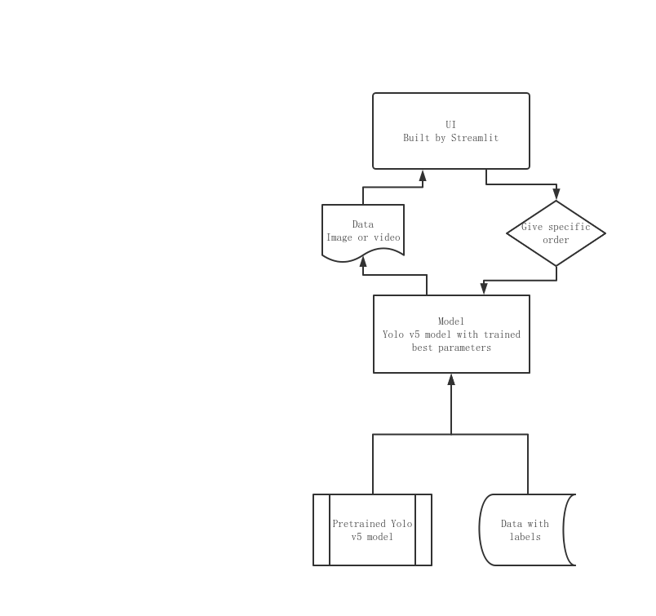

Slide 2
We use model to detect fire from a image, and the model will tell us there is a fire or not.
We try to use Yolo model to identify fire in the image
Finally, we can detect fire from video

