Slide 1



CREDIT RISK ANALYSIS USING SAS ENTERPRISE MINER
GROUP 01
PRASHANTH GOWDA
PREETA BORKAR
RAHUL RAVESH
SHOBHIT DALAL
TAMANNA SAHOO

Slide 2
BUSINESS PROBLEM
The business faces a problem in determining whether a customer is
risky or not.
Problem
Desired Outcome
Bank is not able to identify whether a customer is risky or not
Bank is able to identify the risky customers
Question
What are the factors affecting the credit score of a customer?

Slide 3

OBJECTIVE
To build predictive decision models using SAS enterprise
miner that will be the best indicator of whether a customer is risky or
not based on the FICO score.
Compare regression analysis, decision tree model and neural
network and select the one that predicts accurately based on the
input data.

Slide 4
PROJECT GOALS
Decide whether a customer is risky or not
Data modelling and analyses
Analyze the factors affecting the credit score

Slide 5

DATA
Source & Description:
The data is a credit line billing testing data from CITI BANK database
from their test environment. It gives the information about the business
line credit card information.
The data set contains customer’s unique id, their monthly credit card
bill amount, how many times they have defaulted to pay the bill on
time (delinquency), their FICO score based on various attributes,
credit limit, utilization of their credit limit, etc.

Slide 6
DATA
Target Variable:
We have chosen FICO Score/ Credit score (FICO_SCORE_VAL in data set) as the target variable as it will help to determine whether a customer is risky or not.
FICO takes credit information and uses it to create scores that will help business to predict behavior, such as how likely someone is to pay their bills on time (or not), or whether they are able to handle a larger credit line. Scores developed by FICO can also be used to forecast which accounts are most likely to end up included in bankruptcy, or which ones are likely to be most profitable.

Slide 7
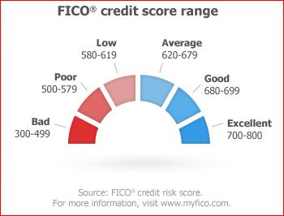
DATA
Nature of target variable:
Fico score ranges from 300 – 850. The business (CITIBANK) has decided FICO score less than 400 to be risky. We have considered the same categorization and considered customers below 400 as risky. Citibank further categorizes the risky customers (FICO score less than 400) into ranges -1 to 5 (-1 being the most risky)

Slide 8

DATA
Training and Validation Data
Number of customers: 1000
Years for which data has been taken: 2010 – 2013 (4 Years)
Number of records: 42091
Initial number of variables: 50
Data Partition
Training data: 70% of the data is used
as training data
Validation data: 30% of the data is used
as validation data

Slide 9

VARIABLE SELECTION
Target Variable: FICO_SCORE_VAL
Initial number of predictor variables: 50
To reduce the curse of dimensionality, we have employed the following preprocessing techniques:
Manual or intuitive methods
Variable Categorization
Transform Variables

Slide 10
PREPROCESSING TECHNIQUES
Manual or Intuitive methods:
All variables were checked for any sort of preliminary data inconsistency.
The dataset had many columns with missing values as they were PI values, or were not recorded for certain years.
Eg : SSN Number, Salary
2) Some columns were discarded as they were irrelevant to predict
FICO score
Eg : INT_REBATE_AMT, CYCLE_INTEREST_CR_AMT
3) Variables with same values for all rows or almost all rows.
Eg : PER_NUM, RETN_OFFER_GRP_ID
Converted nominal data into binary values by creating columns for
each value and rejecting one of the column for avoiding
multicollinearity in SAS miner.

Slide 11
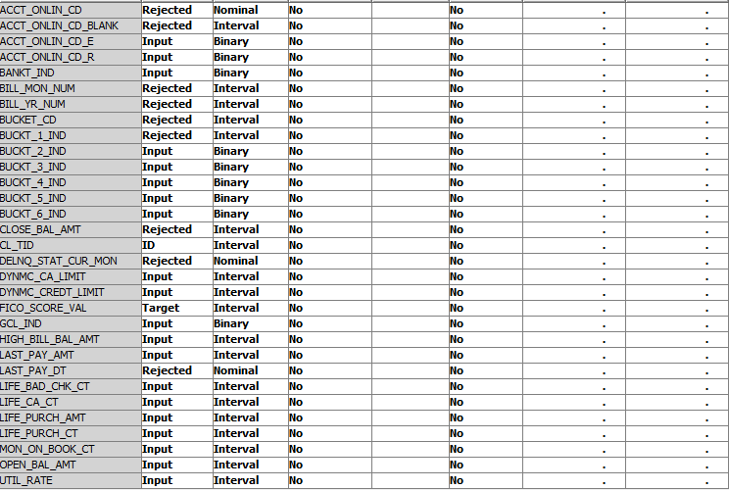
PREPROCESSING TECHNIQUES
Variable Categorization:
Derivative variables were discarded.
Eg: Interest rate, interest paid, offer.

Slide 12
PREPROCESSING TECHNIQUES
Transform Variables:
Our target variable (FICO score) had interval values. Hence,
we converted it to binary by using the SAS enterprise miner
node Transform Variable.
The formula under train properties has been given as:
FICO score<400 - customer is risky (1)
FICO score>400 - customer is not risky (0)

Slide 13
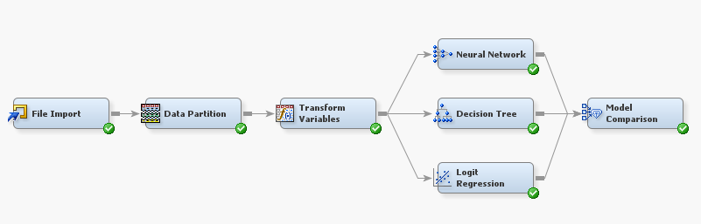
SAS MODEL

Slide 14

CLASSIFICATION TECHNIQUES
We have used the following three classification techniques :
Logistic Regression
Decision trees
Neural Networks
Decision Tree: The significance level has been set to 0.05.
Regression: The model selection under train properties has been set to stepwise.

Slide 15
CLASSIFICATION TECHNIQUES
Decision Trees
Logistic Regression
Neural Networks
Which is the best model?

Slide 16
MODEL COMPARISON
ROC Curve
Observation 1: Out of the three models the ROC curve for decision
Tree is higher as compared to neural network and regression.

Slide 17
MODEL COMPARISON
Fit Statistics
Observation 2: Out of the three models i.e., Regression, Neural and
Decision Tree, the model with least misclassification rate for training
and validation data is decision tree. Also, it has the least root ASE
(Average Square Error)

Slide 18
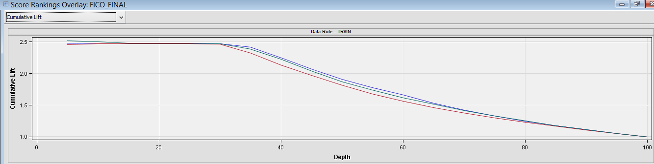
MODEL COMPARISON
Cumulative Lift
Decision tree has highest cumulative lift
Observation 3: Out of the three models, the model with highest
Cumulative lift is decision tree.

Slide 19
MODEL COMPARISON
Logistic Regression
Neural Networks
Decision Trees

Slide 20
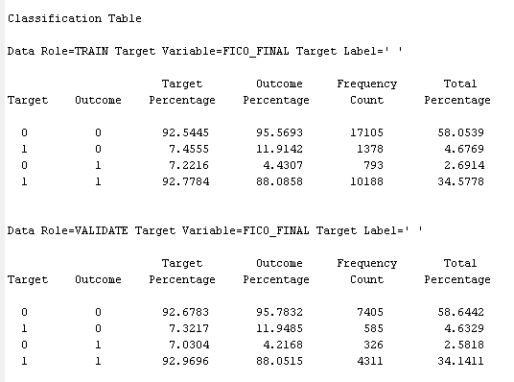
DECISION TREE
The accuracy for training data is 92.62% and misclassification error is 7.38%
The accuracy for validation data is 92.78% and misclassification error is 7.22%

Slide 21
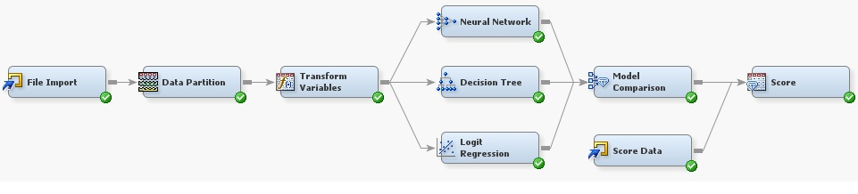
SCORING
Scoring Data
Number of customers: 100
Years for which data has been taken: 2010 – 2013 (4 Years)
Number of records: 4128

Slide 22
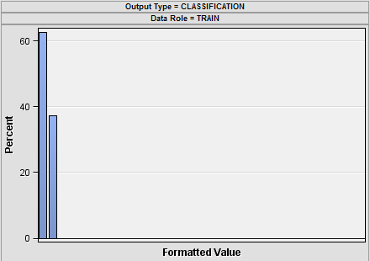
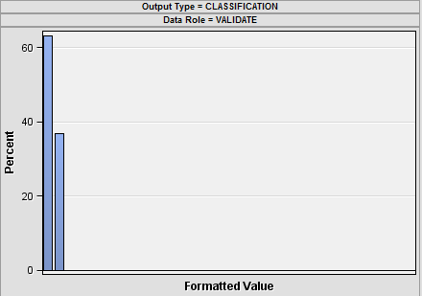
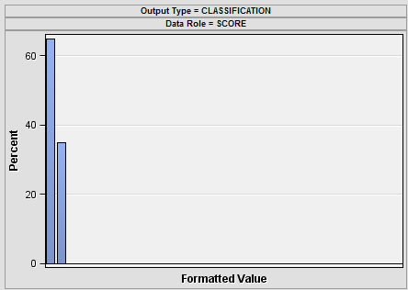
SCORING
Training data output shows that 62.73% of the total values are 0 and 37.27% as 1
Validation data shows that 63.28% of the total values are 0 and 36.72% as 1
Score data shows that 65.04% of the total values are 0 and 34.96% as 1

Slide 23
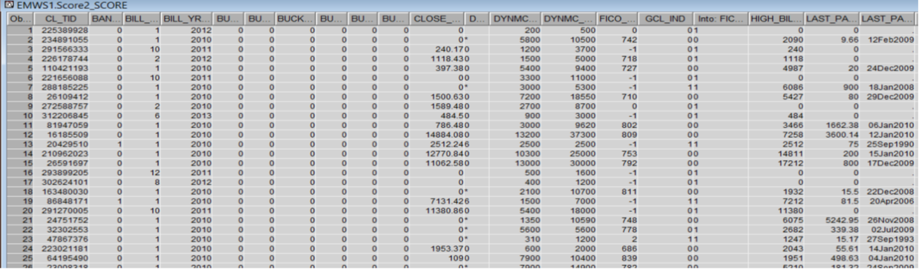
SCORING

Slide 24
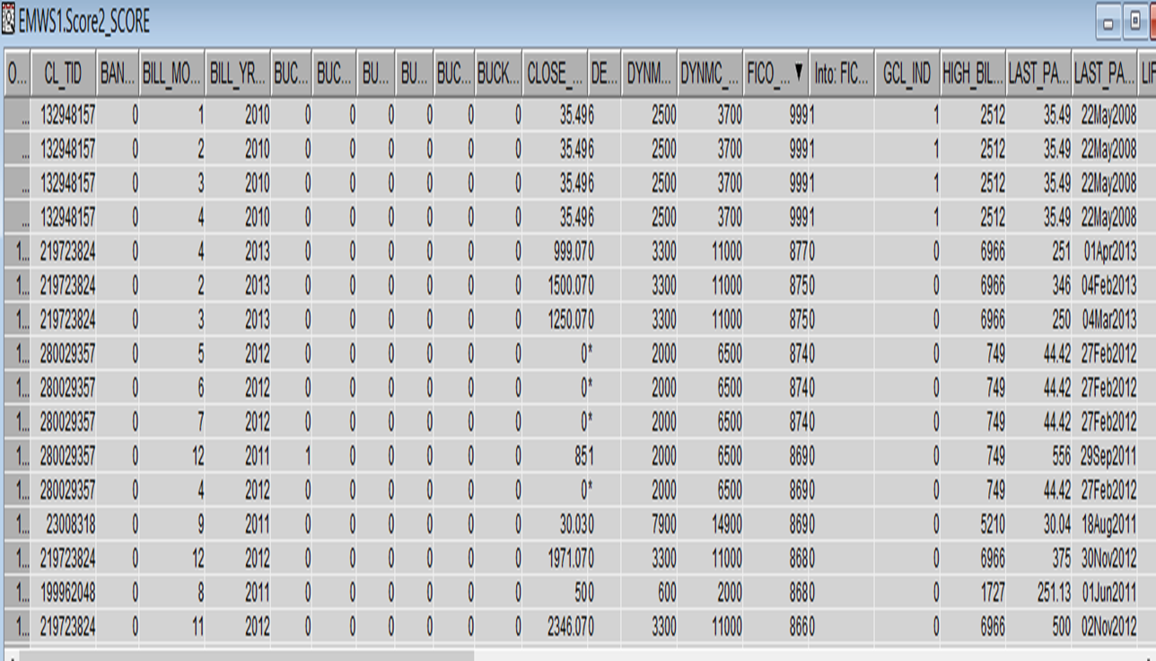
EXAMPLES OF MISCLASSIFICATION

Slide 25
EXAMPLES OF MISCLASSIFICATION

Slide 26
VALUE TO BUSINESS
CITIBANK is able to predict the risky customers by using our
model
They can use this model to take decision whether a customer’s
credit limit should be increased or decreased based on his/her
credit score

Slide 27
THINGS TO BE DONE…
Predicting actual FICO score of the customer – We will predict
the interval value of the FICO score of each customer

Slide 28


