Slide 1
DevOps Tools
Introduction to Docker, Kubernetes, Terraform, Jenkins pipeline

Slide 2
Objectives
Docker Container
Container Orchestration (Kubernetes)
Infrastructure as Code (Terraform)
Pipeline as Code (Jenkins)

Slide 3
What is Docker Container
Standardized packaging for software and dependencies
Isolate apps from each other
Share the same OS Kernel
Works with all major Linux and Windows Server

Slide 4
Container Vs VM
VM
CONTAINER
App A
App B
App C
App A
App B
App C
Bins/Libs
Bins/Libs
Bins/Libs
Bins/Libs
Bins/Libs
Bins/Libs
Guest OS
Guest OS
Guest OS
Hypervisor
Docker Daemon
Host OS
Host OS
Infrastructure
Infrastructure

Slide 5
Hand-on Demo
Download and Install Docker Engine
Create Dockerfile
Build docker image
Run docker container

Slide 6
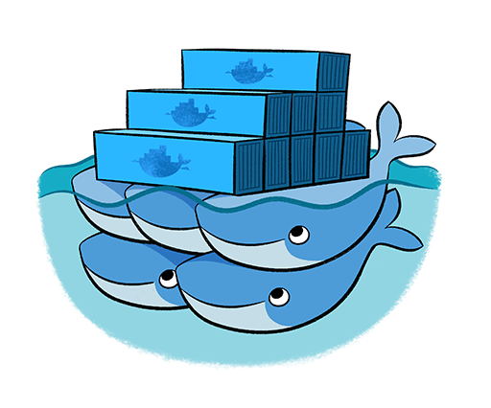
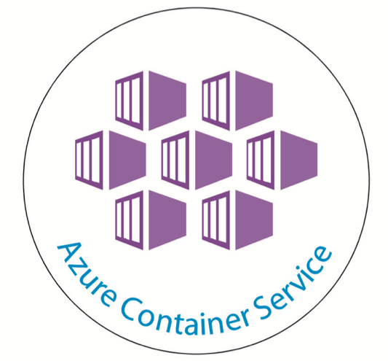



Container Orchestration – K8S
Kubernetes
Docker Swarm
OpenShift
Amazon ECS & EKS
Google Container Engine
Azure Container Service

Slide 7
Kubernetes Architecture
Node
Kube-proxy
Master
UI
Controller
Kubelet
Docker
Scheduler
Dashboard
API Server
Node
CLI
Kube-proxy
Etcd
kubectl
Kubelet
Docker

Slide 8
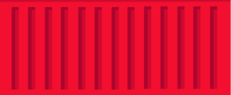
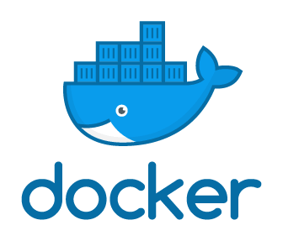

What is Pod
Container
Container
Container
App1
App1
App2
Pod1
Pod2
Docker Engine
Kubernetes - Node

Slide 9
Deploying application on K8S
UI/CLI
Master
Pod 1
Pod 3
App1
App1
API
API
Manifest
Pod 2
App1
Container Image
Docker Engine
Kubernetes - Node

Slide 10
How to write Manifest
apiVersion: v1
Kind: Pod
metadata:
name: myapp-pod
labels:
app: myapp
Spec:
Kind | Version
Pod | v1
Service | v1
ReplicaSet | apps/v1
Deployment | apps/v1

Slide 11
Hands-on Demo
Setup Kubernetes Cluster
How to create deployment manifest file
Deploy application through command line
Deploy application through dashboard

Slide 12
Pipeline as Code - Jenkins
Pipeline used to create and control workflow based on the code written in Jenkinsfile.

Slide 13
Jenkins – Sample Pipeline
Declarative Pipeline
Scripted Pipeline
pipeline {
agent any
stages {
stage ('First Stage') {
steps {
echo 'First Stage'
}
}
stage ('Second Stage') {
steps {
echo 'Second Stage'
}
}
stage ('Third Stage') {
steps {
echo 'Third Stage'
}
}
}
}
node {
stage ('First Stage') {
echo 'First Stage’
}
stage ('Second Stage') {
echo 'Second Stage’
}
stage ('Third Stage') {
echo 'Third Stage’
}
}

Slide 14
Jenkins - Pipeline execution
Pipeline consist of multiple stages.
Build, Code Quality, Unit Test, build Container, etc
Each stage have one or more steps
Different commands to runs on it.

Slide 15

Jenkins - Master-Slave
Slave
Jenkins
Master
Slave
Slave

