Slide 1
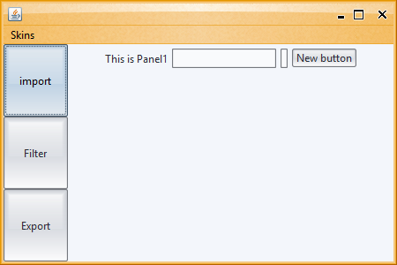

Slide 2
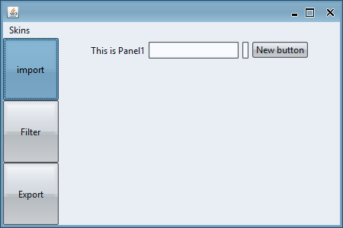
SubstanceModerateLookAndFeel

Slide 3
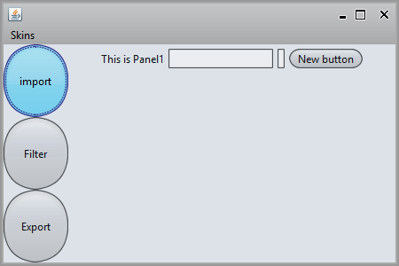
MistAquaLookAndFeel

Slide 4
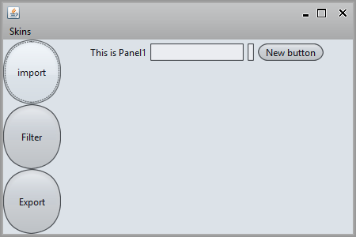
MistSilverLookAndFeel

Slide 5
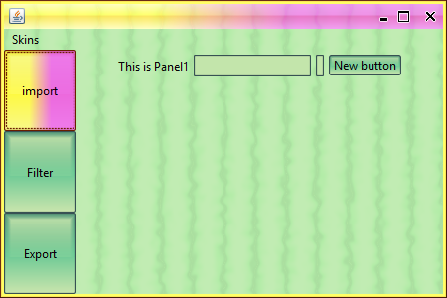
MangoLookAndFeel

Slide 6
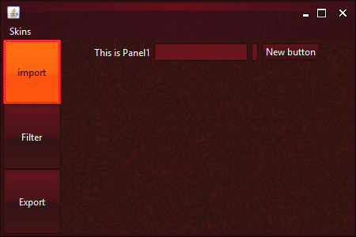
MagmaLookAndFeel

Slide 7
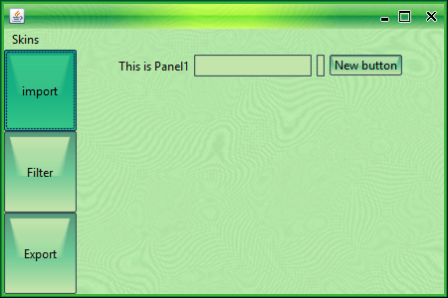
GreenMagicLookAndFeel

Slide 8
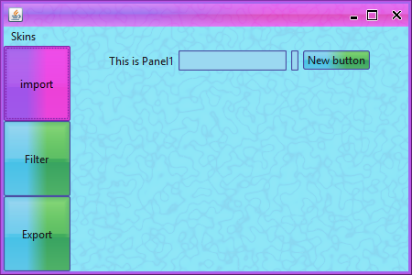
FindingNemoLookAndFeel

Slide 9
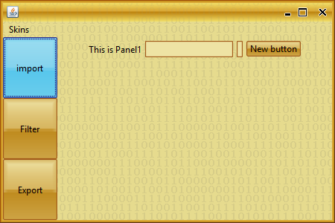
FieldOfWheatLookAndFeel

Slide 10
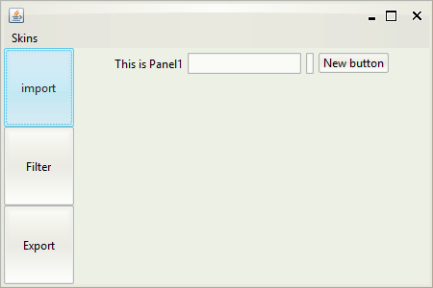
CremeLookAndFeel

Slide 11
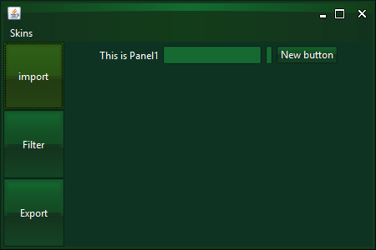
EmeraldDuskLookAndFeel

Slide 12
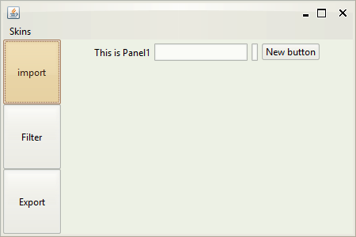
CremeCoffeeLookAndFeel

Slide 13
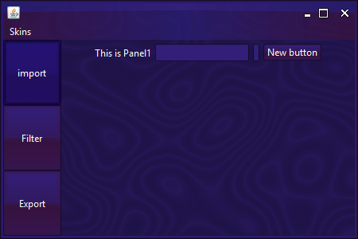
ChallengerDeepLookAndFeel

Slide 14
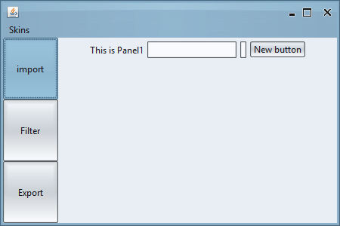
BusinessBlueSteelLookAndFeel

Slide 15
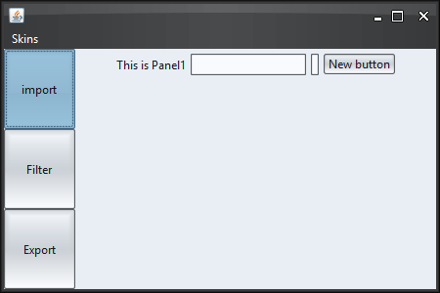
BusinessBlackSteelLookAndFeel

Slide 16
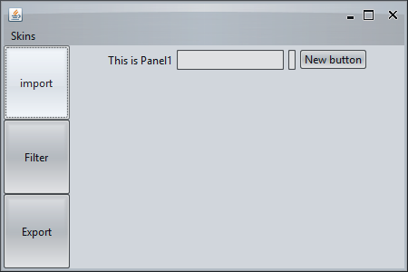
BusinessLookAndFeel

Slide 17
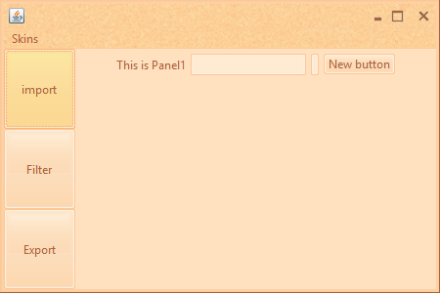
AutumnLookAndFeel

Slide 18
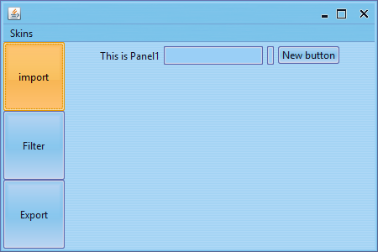
OfficeBlue2007LookAndFeel

Slide 19
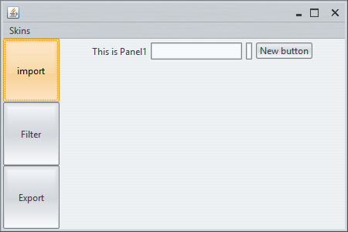
OfficeSilver2007LookAndFeel

Slide 20
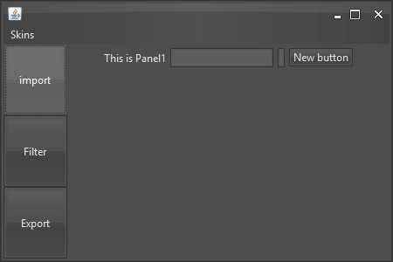
RavenGraphiteGlassLookAndFeel

Slide 21
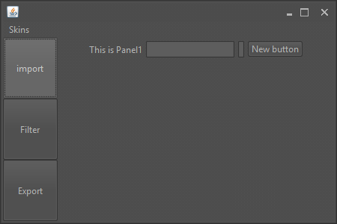
RavenGraphiteLookAndFeel

Slide 22
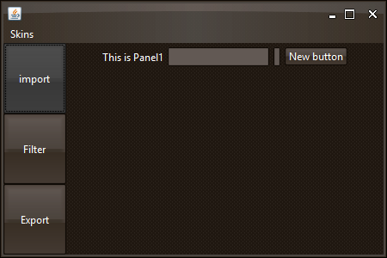
RavenLookAndFeel

Slide 23
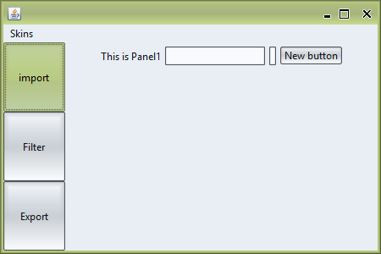
SaharaLookAndFeel

