Slide 1
Nephological semantics: Using token-based vector space models
for large-scale analyses of lexical variation and change
Semántica nefológica:
Uso de modelos vectoriales a nivel de instancia
para análisis de variación y cambio léxicos a gran escala
Mariana Montes & Karlien Franco
RU Quantitative Lexicology and Variational Linguistics

Slide 2
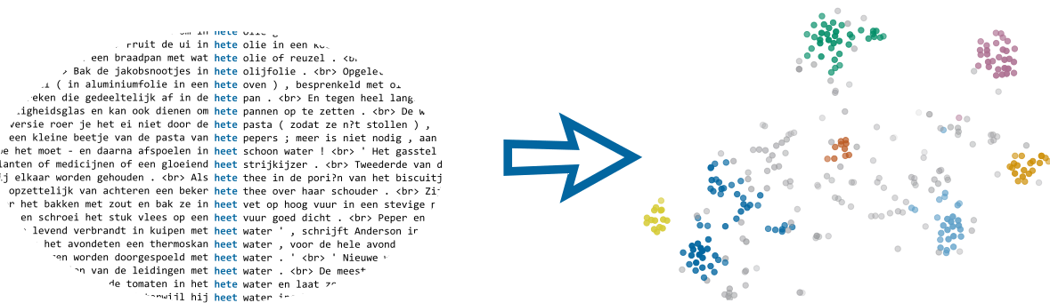
Introduction
Introducción
Notes:
Mariana/Karlien?
semantics
clouds
example?
I’m thinking of something like this:
In this talk we are going to introduce some of the work done in the Nephological Semantics project at KU Leuven.
At the center we have a technique that extracts information from corpora (like the concordance we see on the left)
and turns it into a visual representation of the relationships between the attestations of a word (like the plot on the right).
With this presentation we will introduce both:
- the theoretical background of our research, namely cognitive sociolinguistics;
- and the basics of the methodological approach, distributional semantics.
We will also illustrate with a case study of two Dutch words meaning ‘hot’.

Slide 3
Outline
Contenidos
Background
Cognitive semantics &
Cognitive Sociolinguistics
Empirical research
Distributional semantics
Semasiological variation
Semasiology and prototypicality effects
Case-study: heet ‘hot’
Onomasiological variation
Envelope of variation
Case-study: heet & warm ‘hot’
Marco teórico-metodológico
Semántica cognitiva
& Sociolingüística Cognitiva
Investigación empírica
Semántica distribucional
Variación semasiológica
Semasiología y efectos de prototipicidad
Caso: heet ‘caliente’
Variación onomasiológica
Contexto variable
Caso: heet & warm ‘caliente’

Slide 4
BACKGROUND
MARCO TEÓRICO Y METODOLÓGICO
Part I:
Notes:
Karlien from here?

Slide 5
Cognitive semantics & Cognitive Sociolinguistics
Semántica cognitiva & sociolingüística cognitiva
Notes:
Karlien

Slide 6
Cognitive semantics
Semántica cognitiva
meaning is central to language and linguistic structure
maximalist view on meaning:
dynamic & flexible
perspectival
encyclopedic & non-autonomous
based on usage and experience
el significado es central al lenguaje y la estructura lingüística
perspectiva maximalista del significado:
dinámico y flexible
perspectivizado
enciclopédico y no autónomo
basado en el uso y la experiencia
Geeraerts (2006)
Notes:
Karlien
The background of the case-studies that we’ll be talking about today is CS. CS is a theory of semantics so it’s not all that surprising that what it starts from is meaning - meaning is central to lang and lx structure. However, if you consider other approaches to lx, like generative approaches, where language is seen as a collection of syntactic rules and how they combine, this is a point that can’t be stressed enough. Rather than considering language as a system of rules, CS really gives a central role to meaning and to how lx structures are used to express or highlight certain aspects of meaning.
In line with this view, CS - and CL in general - defines meaning in a very maximalist way. So rather than - again like in generative approaches - attempting to draw a line between competence and performance, or between semantic and pragmatics, CS assumes that it is impossible to draw such a line, but that meaning cannot be reduced to truth values or necessary and sufficient conditions.
There are four more specific characteristics of the view on meaning in CS that are often mentioned, for example by Geeraerts in the into to his volume on Basic Readings in CL. The first is that meaning is dynamic and flexible. This characteristic emphasises the point that meanings can change, depending on the situation you’re in or even who you’re speaking with. A simple example of the dynamicness and flexibility of language can be found if you think of the word ‘mouse’. Since we’re all sitting at computers, an obvious interpretation of this word is the computer mouse that you might be holding in your hand. But obviously, this meaning hasn’t always existed - it only came about in the last few decades. In addition the first meaning that you think of for this word, mouse, might be very different when you se that your cat’s on the hunt for a mouse - it’s not so likely that your cat would be on the hunt for a computer mouse. While the fact that meanings are flexible might be an obvious fact for linguistics, it is still a crucial notion to emphasize: meaning is not a static, unmutable, clearly definable extralinguistic property.
The second characteristic of meaning in CS is that meaning is perspectival: everything we say is embodied and mirrors a perspective that we have of reality. Geeraerts uses spatial concepts to explain this characteristic. Say that you’ve put your bike near the front entrance to your house but you’re in your back garden. If someone asks you where your bike is, you could both say ‘my bike is in front of the house’ - emphasising the viewpoint of someone looking at your house from the street - or ‘my bike is behind the house’ - emphasising your own perspective on the scene.
Thirdly, meaning is considered enyclopaedic and non-autonomous. This characteristic relates to the fact that words or concepts are not just defined by linguistic knowledge - as a dictionary definition, in a set of necessary and sufficient conditions - but also by non-linguistic knowledge that we have about and experience that we’ve gained with the world. Human beings are not just walking brains, but we exist in a specifical social and cultural environment and everything we know about the world influences how we talk and think about things.
Finally, CL is a usage-based theory. This means that there is a general belief that meaning and language are not innate properties of humans, but that they are acquired through usage and experience.
See Geeraerts 2006: 3-6 [CL: basic readings]

Slide 7
CL as a usage-based theory
LC como teoría basada en el uso
usage-based entails empirical
empirical entails (socio-)lectal variation
attention for language variation
basada en el uso implica empírica
empírica implica variación (socio)lectal
atención a la variación lingüística
a.o. Bybee & Hopper (2001), Dabrowska & Divjak (2015), Geeraerts (2005), Kemmer & Barlow (2000), Tomasello (2001)
Notes:
Following this fourth point - that meaning is based on usage and experience - there were a number of scholars in CL, some of whom are mentioned at the bottom of this slide, who emphasized that for a usage-based theory to take itself seriously, it needs to base itself on empirical data for linguistic analyses. To understand how language is constructed and how it varies or changes, naturalistic language data have to be taken into account.
However, once a researcher starts taking into account naturalistic, empirical data rather than relying on introspective methods, they immediately have to deal with the fact that empirical data is always sociolectally structured.

Slide 8

CL as a usage-based theory
LC como teoría basada en el uso
usage-based entails empirical
empirical entails (socio-)lectal variation
attention for language variation
basada en el uso implica empírica
empírica implica variación (socio)lectal
atención a la variación lingüística
a.o. Bybee & Hopper (2001), Dabrowska & Divjak (2015), Geeraerts (2005), Kemmer & Barlow (2000), Tomasello (2001)
Notes:
Any dataset that you may find will be influenced by linguistic idiosyncrasies of the language users in the data. This is of course a point that will seem very familiar for anyone who has ever worked in the field of sociolinguistics. There, the aim of the field is to analyze linguistic data in function of social properties of the language users involved.

Slide 9

CL as a usage-based theory
LC como teoría basada en el uso
usage-based entails empirical
empirical entails (socio-)lectal variation
attention for language variation
basada en el uso implica empírica
empírica implica variación (socio)lectal
atención a la variación lingüística
a.o. Bybee & Hopper (2001), Dabrowska & Divjak (2015), Geeraerts (2005), Kemmer & Barlow (2000), Tomasello (2001)
Notes:
For example, by their gender or their socio-economic background. But lectal variation can be broader than just related to the macro-social categories that are typically studied in Labovian sociolinguistics. For example, style-differences may play a role as well, as has been shown in research on register effects and in research on communities of practice. Or geographic location may play a role, which is typically studied in dialectology and dialectometry. Because we believe that there language variation can be structured along any of these axes, we prefer to talk about lectal variation, rather than sociolectal variation.
So to take empirical research seriously, it is important to pay attention to language variation: since empirical materials will always be lectally stratified, variation within the data cannot be excluded from the analysis.

Slide 10

CL as a usage-based theory
LC como teoría basada en el uso
usage-based entails empirical
empirical entails (socio-)lectal variation
attention for language variation
basada en el uso implica empírica
empírica implica variación (socio)lectal
atención a la variación lingüística
a.o. Bybee & Hopper (2001), Dabrowska & Divjak (2015), Geeraerts (2005), Kemmer & Barlow (2000), Tomasello (2001)
Notes:
For example, by their gender or their socio-economic background. But lectal variation can be broader than just related to the macro-social categories that are typically studied in Labovian sociolinguistics. For example, style-differences may play a role as well, as has been shown in research on register effects and in research on communities of practice. Or geographic location may play a role, which is typically studied in dialectology and dialectometry. Because we believe that there language variation can be structured along any of these axes, we prefer to talk about lectal variation, rather than sociolectal variation.
So to take empirical research seriously, it is important to pay attention to language variation: since empirical materials will always be lectally stratified, variation within the data cannot be excluded from the analysis.

Slide 11
Cognitive sociolinguistics
Sociolingüística cognitiva
basic tenets:
framework of CL
attention for lectal variation
empirical research
principios básicos:
marco de LC
atención a la variación lectal
investigación empírica
a.o. Geeraerts (2005)
Notes:
The theoretical framework that we’re working in, cognitive sociolx, then, takes all these things together. First, it works against the theoretical background of CL, giving a central place to meaning in its most maximalist form. Second, it also explicitely focusses on the lectal features that correlate with language variation. And finally, it is programmatically usage-based, relying solely on empirical data for linguistic analyses.

Slide 12
Empirical research
Investigación empírica
Notes:
Mariana

Slide 13
Empirical research
Investigación empírica
data-driven
observational/experimental
hypothesis testing, formulation, operationalization
empirical cycle
back and forth between data analysis, interpretation, hypothesis formulation...
basada en datos
observacional/experimental
testeo, formulación y operacionalización de hipótesis
ciclo empírico
ida y vuelta entre análisis de datos, interpretación, formulación de hipótesis...
Geeraerts (2010b)
Notes:
Karlien? Mariana?
I can do it (Mariana) OK!

Slide 14
Corpus-based and quantitative methods
Métodos basados en corpus y cuantitativos
corpora as collections of naturalistic data
empirical & usage-based
lectal variation
extensional perspective
corpus como colecciones de datos naturalísticos
empíricos y basados en el uso
variación lectal
perspectiva extensional
Notes:
Karlien? Mariana?

Slide 15
Empirical vs. quantitative methods?
¿Métodos empíricos vs. cuantitativos?
does empirical entail quantitative?
it does for making objective inferences from large amounts of data (like large corpora)
added benefit of information about relative frequencies (e.g. structural weight of different senses of a word)
¿empírico implica cuantitativo?
sí, al hacer inferencias objetivas de grandes cantidades de información (p. ej. grandes corpus)
beneficio extra de la información sobre frecuencias relativas (p. ej. peso relativo de los distintos significados de una palabra)
Notes:
Karlien? Mariana?

Slide 16
Distributional semantics
Semántica distribucional
Notes:
Definitely Mariana from here!

Slide 17
Distributional hypothesis
Hipótesis distribucional
similarity of distribution correlates
with similarity of meaning
=
words that co-occur with similar words
are semantically similar
(“You shall know a word by the company it keeps”)
similitud de distribución se correlaciona con similitud de significado
=
palabras que co-ocurren con palabras similares son semánticamente similares
(“Dime con qué palabras andas y te diré qué palabra eres.”)
Harris (1954), Firth (1957)

Slide 18

Vector space models
Modelos de espacios vectoriales
word vectors: numerical representations of words
vectores de palabras: representaciones numéricas de las palabras
target (nodo) | language/n | word/n | english/j | speak/v | flemish/j | eat/v
linguistics/n | 4.37 | 0.99 | 3.16 | 0.41 | 0 | 0
Data: Global World Englishes Corpus

Slide 19

Vector space models
Modelos de espacios vectoriales
word vectors: numerical representations of words
vectores de palabras: representaciones numéricas de las palabras
target (nodo) | language/n | word/n | english/j | speak/v | flemish/j | eat/v
linguistics/n | 4.37 | 0.99 | 3.16 | 0.41 | 0 | 0
Data: Global World Englishes Corpus

Slide 20

Vector space models
Modelos de espacios vectoriales
word vectors: numerical representations of words
vectores de palabras: representaciones numéricas de las palabras
target (nodo) | language/n | word/n | english/j | speak/v | flemish/j | eat/v
linguistics/n | 4.37 | 0.99 | 3.16 | 0.41 | 0 | 0
Data: Global World Englishes Corpus

Slide 21
Type level vectors
Vectores de nivel tipo
each row is the vector of a word
aggregating over all its occurrences
each column is a context feature
values are PMI
cada fila es el vector de una palabra
agrupando todas sus ocurrencias
cada columna es un elemento del contexto
los valores son PMI
target (nodo) | language/n | word/n | english/j | speak/v | flemish/j | eat/v
linguistics/n | 4.37 | 0.99 | 3.16 | 0.41 | 0 | 0
lexicography/n | 3.51 | 2.18 | 2.19 | 2.09 | 0 | 0
computational/j | 1.60 | 0.08 | -1.00 | -1.80 | 0 | 0
research/n | 0.20 | -0.84 | -0.50 | -0.38 | 0.04 | -0.68
chocolate/n | -1.72 | -0.53 | -0.73 | -1.13 | 1.28 | 3.08
Data: Global World Englishes Corpus

Slide 22
Type level vectors
Vectores de nivel tipo
each row is the vector of a word
aggregating over all its occurrences
each column is a context feature
values are PPMI (negative values become 0)
cada fila es el vector de una palabra
agrupando todas sus ocurrencias
cada columna es un elemento del contexto
los valores son PPMI (valores negativos van a 0)
target (nodo) | language/n | word/n | english/j | speak/v | flemish/j | eat/v
linguistics/n | 4.37 | 0.99 | 3.16 | 0.41 | 0 | 0
lexicography/n | 3.51 | 2.18 | 2.19 | 2.09 | 0 | 0
computational/j | 1.60 | 0.08 | 0 | 0 | 0 | 0
research/n | 0.20 | 0 | 0 | 0 | 0.04 | 0
chocolate/n | 0 | 0 | 0 | 0 | 1.28 | 3.08
Data: Global World Englishes Corpus

Slide 23
Token level vectors
Vectores de nivel caso
(1) Would you like to study linguistics?
(2) They study this in computational linguistics too.
(3) I eat chocolate while I study.
(1) ¿Te gustaría estudiar lingüística?
(2) También estudian esto en lingüística computacional.
(3) Cuando estudio como chocolate.
(1) Would you like to study linguistics?
context word | language/n | word/n | english/j | speak/v | flemish/j | eat/v
linguistics/n | 4.37 | 0.99 | 3.16 | 0.41 | 0 | 0
For frequencies and examples in Spanish:
slides.marianamontes.me/investigandopolisemia.html

Slide 24
Token level vectors
Vectores de nivel caso
(1) Would you like to study linguistics?
(2) They study this in computational linguistics too.
(3) I eat chocolate while I study.
(1) ¿Te gustaría estudiar lingüística?
(2) También estudian esto en lingüística computacional.
(3) Cuando estudio como chocolate.
(1) They study this in computational linguistics too.
context word | language/n | word/n | english/j | speak/v | flemish/j | eat/v
linguistics/n | 4.37 | 0.99 | 3.16 | 0.41 | 0 | 0
computational/j | 1.60 | 0.08 | 0 | 0 | 0 | 0

Slide 25
Merging vectors
Fusión de vectores
(1) They study this in computational linguistics too.
context word | language/n | word/n | english/j | speak/v | flemish/j | eat/v
linguistics/n | 4.37 | 0.99 | 3.16 | 0.41 | 0 | 0
computational/j | 1.60 | 0.08 | 0 | 0 | 0 | 0
target | language/n | word/n | english/j | speak/v | flemish/j | eat/v
study₂ | 5.97 | 1.07 | 3.16 | 0.41 | 0 | 0
Schütze (1998), Heylen et al (2012, 2015)

Slide 26
Token level vectors
Vectores de nivel caso
(1) Would you like to study linguistics?
(2) They study this in computational linguistics too.
(3) I eat chocolate while I study.
(1) ¿Te gustaría estudiar lingüística?
(2) También estudian esto en lingüística computacional.
(3) Cuando estudio como chocolate.
target | language/n | word/n | english/j | speak/v | flemish/j | eat/v
study₁ | 4.37 | 0.99 | 3.16 | 0.41 | 0 | 0
study₂ | 5.97 | 1.07 | 3.16 | 0.41 | 0 | 0
study₃ | 0 | 0 | 0 | 0 | 1.28 | 3.08

Slide 27
Original text
Texto original
Token-context matrix
Matriz de casos y contextos
Distance matrix
Matriz de distancias
t-SNE visualization
Visualización con t-SNE
(1) Would you like to study linguistics?
(2) They study this in computational linguistics too.
(3) I eat chocolate while I study.
target | language/n | word/n | english/j | speak/v | flemish/j | eat/v
study₁ | 4.37 | 0.99 | 3.16 | 0.41 | 0 | 0
study₂ | 5.97 | 1.07 | 3.16 | 0.41 | 0 | 0
study₃ | 0 | 0 | 0 | 0 | 1.28 | 3.08
target | study₁ | study₂ | study₃
study₁ | 0 | 0.01 | 1
study₂ | 0.01 | 0 | 1
study₃ | 1 | 1 | 0
t-SNE: Van der Maaten & Hinton (2008)

Slide 28
SEMASIOLOGICAL VARIATION
VARIACIÓN SEMASIOLÓGICA
Part II:
Notes:
Karlien from here?

Slide 29
Semasiology and prototypicality effects
Semasiología y efectos de prototipicidad

Slide 30
Semasiology
Variación semasiológica
from the form to its meaning(s)
de la forma a sus significados
conflictive
conflictivo
heet
of high temperature
de alta temperatura
new, popular
nuevo, popular
spicy
picante
Notes:
An idea (which I jotted down but don’t know where) was to have a similar schema to Dirk’s jeans example: the lemma on top, its meanings below, and then on the onomasiological side we can add the other lemma and to which meanings it corresponds. Will we do that with heet?
In that case, the (non-exhaustive) meanings can be:
- ‘conflictive’ (in idiomatic expressions such as hete hangijzer and hete aardappel),
- ‘recent/new/popular’ (hete nieuws), and
- ‘of high temperature’ (hete zomer, hete koffie)
Only the third one is shared with warm (actually, you can even find warme zomer and warme (kop) koffie), which in addition has ‘affectionate’ (warme hart) and ‘passionate’ (iemand warm maken voor iets), which it doesn’t share

Slide 31
Semasiology
Variación semasiológica
polysemy
homonymy
vagueness
no systematic distinction
polisemia
homonimia
vaguedad
no hay una distinción sistemática
Geeraerts (1993), Taylor (1992), Tuggy (1993)
Notes:
Now if we think of semas. variation, we are dealing with the fact that a single word can have more than one meaning. In fact, there are several ways in which a word can have or acquire meaning.
On the one hand, some words or word forms just have multiple meanings that are not related to each other, or -some would say- hard-coded in the lexicon. For example, a bank can be both a financial institution, or a piece of furniture for sitting. In this case, we would talk about polysemy or even homonymy, because the financial and furniture meanings are distinct enough from each other to be considered unrelated.
On the other hand, due to the flexible nature of language, words can be pragmatically used in a novel context so that its original meaning is extended or changed. An example would be that I say ‘my bank called me last night to say that they found my credit card’. Who do you think I’m referring to here, @Mariana?
A financial institution is inanimate: it is not a person so it cannot call someone, nor can it find a creditcard somewhere. Instead, I’m using the word ‘bank’ in this context to mean that a person who works at my bank called me. This meaning is arguably not ‘hard-coded’ in the lexicon; it is derivable from the “encoded” sense of ‘bank’ - namely the financial institution. You can infer it using your knowledge of the world and by considering the context of the clause. In traditional approaches to semantics, this would be considered as an example of pragmatics rather than of semantics per se.
These are the types of effects that we’re interested in when we’re investigating semasiological variation. And it’s quite useful to know these things, or to get your computer to recognise these things: if you want to have a computer automatically understand a piece of text, it needs to be able to understand which meaning of ‘bank’ the text is referring to, and it needs to be able to make these types of pragmatic inferences.
However, there’s an additional complication: research in CL has shown that the distinction between polysemy/homonymy and vagueness is actually not as simple as it seems here. But we won’t go into that in more detail today; the references are shown below.

Slide 32
Prototypicality effects
Efectos de prototipicidad
differences in salience & flexibility
at the intensional and extensional level
diferencias de saliencia y flexibilidad
nivel intensional y extensional
 | extensional (exemplars - ejemplos) | intensional (definition - definición)
salience saliencia | differences of typicality (core/periphery) diferencias en tipicalidad (centro/periferia) | clustering into family resemblance structures agrupamientos en estructuras de relaciones de familia
flexibility flexibilidad | fuzziness at the edges, membership uncertainty fronteras difusas, membresía incierta | absence of necessary-and-sufficient conditions ausencia de condiciones necesarias y suficientes
see (ver) Geeraerts (2010a: 183-199)
Notes:
Next to the fact that different types of semasiological variation exist, it’s also important to take into account that not all meanings of a word are equally salient and, as the bank example already showed, that the meanings of words are flexible. These properties are generally described as prototypicality effects in CL.
In fact, prototypicality effects are considered a crucial aspect of meaning in Cognitive Linguistics. Four types of prototype effects have been distinguished that can be organized along two dimensions, although they don’t always have to co-occur. First, prototypicality effects relate to salience, i.e. differences in typicality or representativeness between referents belonging to a category, on the one hand, and flexibility, which is indeterminacy concerning the boundaries of a category on the other. Second, prototypicality effects work both on the intensional, or definitional level, and on the extensional or referential, level. These two dimensions cross-classify as shown in this table adapted from Geeraerts (2010).
A standard example from prototype theory is the category of ‘fruit’. @Mariana: what would you consider the most typical type of fruit? But you would also agree that a pineapple is a fruit, right? It’s clear that there’s a difference in typicality between apples and pineapples for this category. This is what differences in extensional salience are about (top-left cell).
Now let’s look at the bottom left cell, differences in extensional flexibility. @Mariana, If you think of folk classifications, you would agree that fruits would often be the things that are the edible, seed-bearing parts of trees, right? So what would you do about an olive if you know that an olive is exactly that: the edible seed-bearing part of the olive tree, just like apples are those of apple trees? It’s not so clear that every person would consider an olive to be a type of fruit. This is exactly what extensional flexibility is about: decisions about what counts as an exemplar for a category are not always clear-cut.
Next, let’s consider the top right cell, differences in intensional salience. First, let’s consider some of the attributes that are often shared between different types of fruits, like that they’re sweet, that they are typically cooked with sugar, that they have a hard skin etc. . It turns out that the more typical types of fruit share more attributes that are typical for the category, like edibility, sweetness etc. How about the less prototypical members? Olives are not really sweet right? And further,, the less prototypical members also share attributes with other categories. For example, a lemon, a less typical type of fruit, is not sweet, whereas more typical fruits (apples, bananas, strawberries) are. This is usually explained by the notion of family resemblance structures.
Finally, intensional flexibility shows up in the fact that no set of necessary and sufficient conditions can be constituted for the category ‘fruit’. For instance, the most typical types of fruits have a skin that is harder than their soft inside - think of the skin of apples and pears for instance. However, imposing this as a definitional criterion on the category excludes other objects that would in a folk modelbe considered types of fruits, such as strawberries.

Slide 33
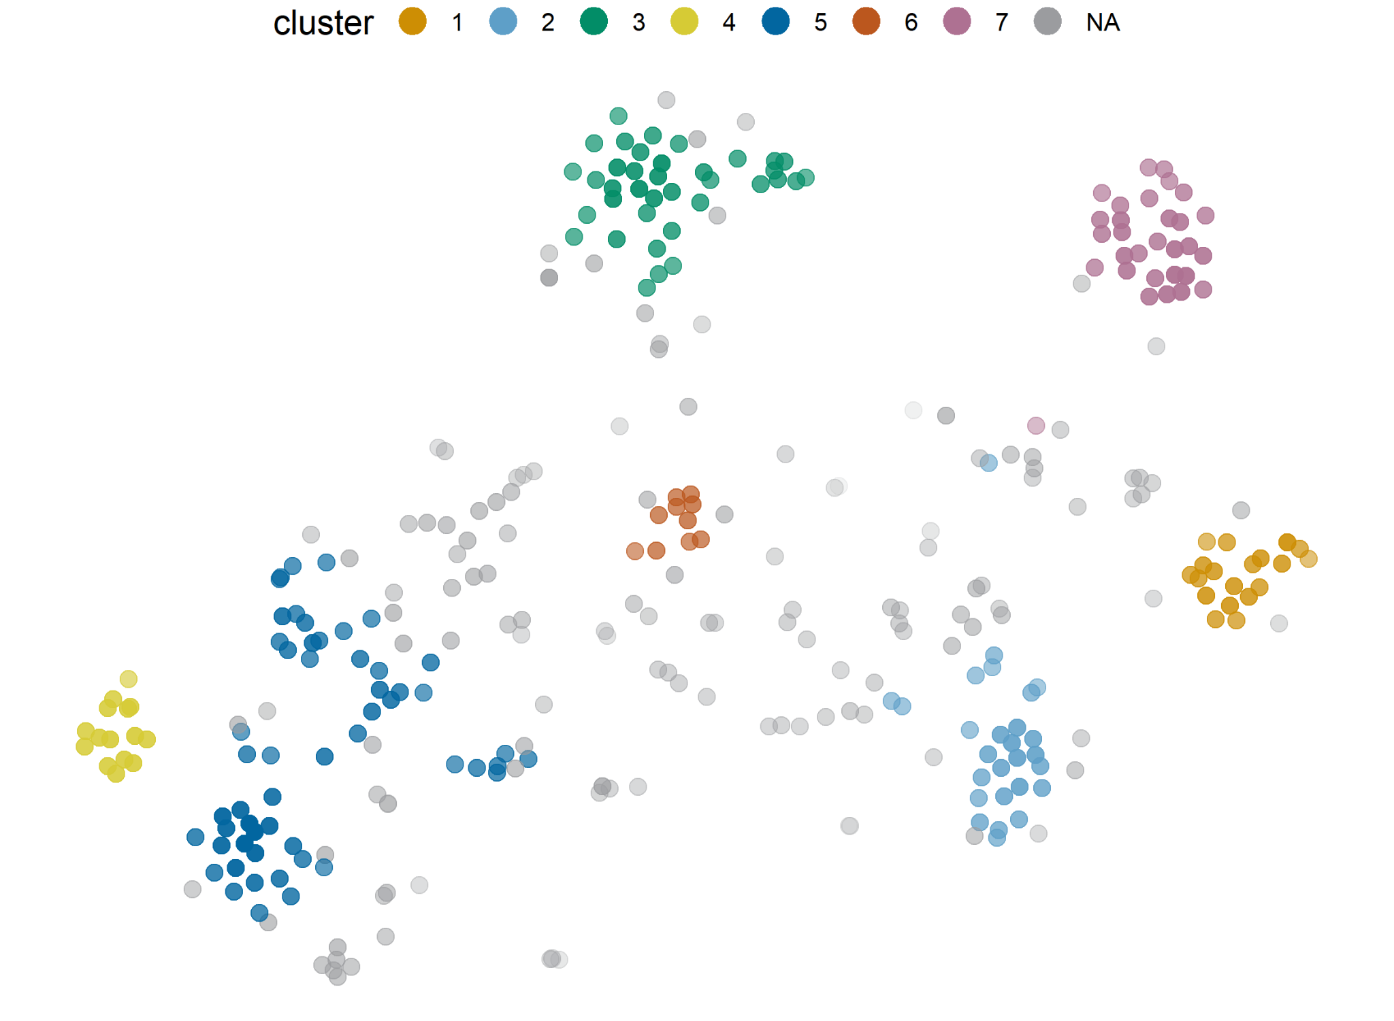
Case-study: heet ‘hot’
Caso: heet ‘caliente’
Notes:
Mariana from here, but I think with translations from Karlien?

Slide 34
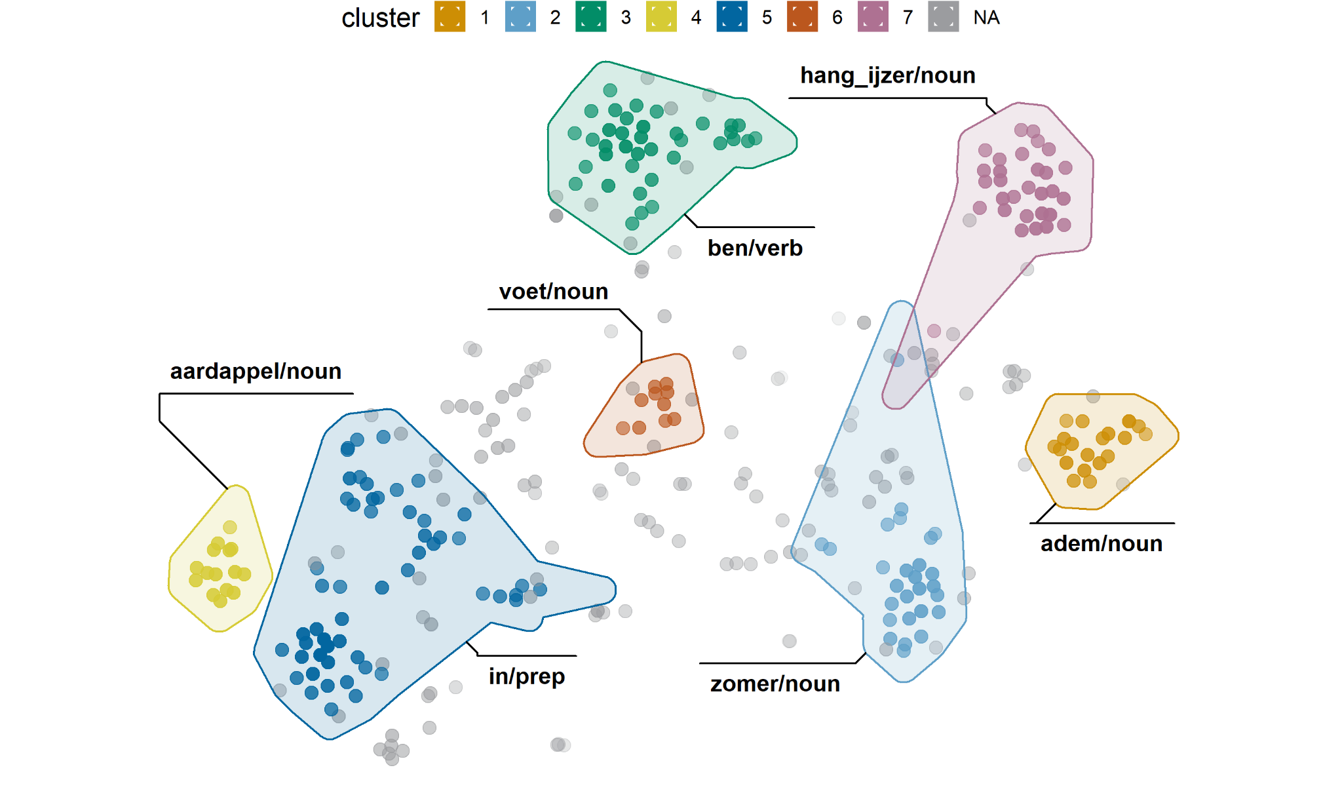
adem | breath (noun) | aliento
zomer | summer | verano
ben | to be | ser/estar
aardappel | potato | papa
in | in | en
voet | foot | pie
hang_ijzer | pot hanger | gancho de hierro
NA | (noise tokens) | (ruido)
Notes:
in/prep: mostly cooking contexts: in een hete oven, in hete olie, hete thee in de poriën van het biscuitje…
ben/verb: variety of senses. Other than the ‘het ijzer smeden terwijl het heet is’, they are mostly sentences with pronouns (hij, ze, het, dat…) and, basically, predicative rather than attributive uses :)

Slide 35
adem | In de middenmoot voelt 't Nieuw Slachthuis de hete adem van Everslaar in de nek. | In the middle group, The New Slaughterhouse feels Everslaar’s hot breath in their neck. | En el grupo intermedio,, El Nuevo Matadero siente el aliento de Everslaar en la nuca.
aardappel | En wie krijgt de hete aardappel van Nationale Opvoeding en de stakende leraars toegeworpen? | And who will end up with the hot potato of National Education and the teachers on strike? | ¿Y a quién le va a caer la papa caliente de la Educación Nacional y los docentes en paro?
in | Braad het vlees in een braadpan aan in de hete boter of olie. | Sear the meat in a pot in hot butter or oil. | Sella la carne en una olla en manteca o aceite caliente.
zomer | Het onderzoek was ingesteld nadat in de hete zomer van 2003 door een tekort aan koelwater het licht langdurig dreigde uit te vallen... | The investigation had been initiated after in the hot summer of 2003, because of lack of cooling water, there threatened to be a lack of electricity for a long time | Habían iniciado la investigación después de que en el caluroso verano de 2003, a causa de la falta de agua refrigerante, había riesgo de cortes de luz por un largo tiempo.
voet | De man grijpt geheugenverlies aan als het hem te heet onder de voeten wordt... | The man pretends to get memory loss if it gets too hot under his feet... | El hombre pretende pérdida de memoria si se vuelve caliente bajo sus pies...
hangijzer | Een van de heetste hangijzers in het debat over de vergroening van het belastingstelsel is de ecotax. | One of the hottest pot hangers in the debate over the tax system going greener is the ecotax. | Uno de los ganchos de hierro más calientes en el debate sobre el “enverdecimiento” del sistema impositivo es el eco-impuesto.
ben | ...alsof het nog niet heet genoeg is hier. | ...as if it wasn’t hot enough here. | ...como si no estuviera suficientemente caluroso acá.
Notes:
NOTE: The translations are literal, I think it’s best to explain the idiomatic expressions orally…
We can do this slide together

Slide 36
ONOMASIOLOGICAL VARIATION
VARIACIÓN ONOMASIOLÓGICA
Part III:
Notes:
Mariana until slide 42?

Slide 37
Envelope of variation
Contexto variable

Slide 38
Onomasiological variation
Variación onomasiológica
from the concepts to the forms
from the concepts to the forms
conflictive
conflictivo
heet
new, popular
nuevo, popular
spicy
picante
of high temperature
de alta temperatura

Slide 39
Onomasiological variation
Variación onomasiológica
from the concepts to the forms
from the concepts to the forms
conflictive
conflictivo
heet
warm
new, popular
nuevo, popular
passionate
apasionado
spicy
picante
of high temperature
de alta temperatura
affectionate
cariñoso

Slide 40
Onomasiological variation
Variación onomasiológica
from the concepts to the forms
from the concepts to the forms
conflictive
conflictivo
heet
warm
new, popular
nuevo, popular
passionate
apasionado
spicy
picante
of high temperature
de alta temperatura
affectionate
cariñoso
Notes:
The final point here should be that the question to ask is: who uses which form (heet/warm) in which situation?
Indeed. And with the description of the clouds we can see that there are situations where there is no actual choice, and others where there are preferences - it’s in those cases where we need to dig deeper to figure out what other factors (who, etc.) influence that choice. Right?

Slide 41
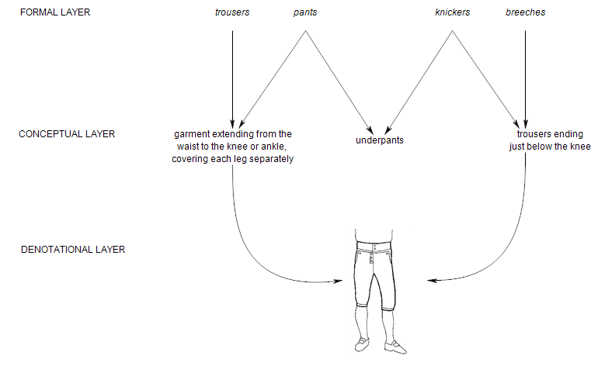
Geeraerts (2016)
Notes:
Karlien
Analyzing onomasiological variation is further complicated by the fact that, due to the perspectival nature of meaning, language users need to make choices at different levels, which are represented by the conceptual and formal layers here. This figure, from Geeraerts 2016, represents how language users may go about naming the thing at the referential layer. Let’s first consider the outer two arrows.

Slide 42
Geeraerts (2016)
Notes:
First, the language user has to decide whether they want to conceptualize the referent at the denotational layer as breeches, i.e. trousers ending just below the knee (right arrow), or as a more general type of garment, trousers, i.e. any type of garment extending from waist to ankles covering the legs separately (left arrow). There is a taxonomical relationship involved here: breeches are a specific type of trousers, namely trousers with shorter legs. So the language user needs to decide whether to use the more general concept, which can be named by trousers, or the more specific one, which can be called breeches. This decision is very likely influenced by contextual factors (though the amount of research into this specific question is relatively limited). For example, if there are two trousers in the room and the speaker wants to ask their interlocutor to give them the pants with short legs, they will likely chose the more specific concept ‘breeches’. If however, there is one pair of pants in the room, but also a skirt, they might chose the more general concept ‘trousers’ to get their message across.
This first step is what we call conceptual onomasiological variation: the situation where multiple lexical categories or concepts can apply to a single referent.
In contrast, the situation that Mariana was describing before, where the concept is already decided upon - of high temperature - but the question is which specific word that exists for the concept is used, is a further step. This is what we call formal onomasiological variation.
Formal onomasiological variation is showcased on the figure in the choice between trousers and pants. Both words can be used for the same concept, namely the more general concept of garment extending from waist to ankles covering both knees. However, the former word, trousers, is more typical for British English, whereas the latter word, pants, is more typical for American English. So there’s a lectal difference here.

Slide 43
Geeraerts (2016)
Notes:
In contrast, the situation that Mariana was describing before, where the concept is already decided upon - of high temperature - but the question is which specific word that exists for the concept is used, is a further step. This is what we call formal onomasiological variation. This is also the layer that is typically used in sociolinguistics research on alternations, and then it is traditionally called the envelope of variation.
Formal onomasiological variation is showcased on the figure in the choice between trousers and pants, and in the choice between breeches and knickers. Both trousers and pants can be used for the same concept, namely the more general concept of garment extending from waist to ankles covering both knees; they are synonymous. And knickers and breeches are also synonyms. Interestingly, trousers, is more typical for British English, whereas the latter word, pants, is more typical for American English. So there’s a lectal difference here.

Slide 44
Geeraerts (2016)
Notes:
The figure shows a final complication, of a nature that we’ve already discussed before. Next to the conceptual onomasiological variation and the formal onomasiological variation shown, we also see examples of semasiological variation. More specifically, both pants and knickers are polysemous: they can both also refer to another concept that is not appropriate for the referent on the denotational layer, namely underpants.

Slide 45

x
Geeraerts (2016)
Notes:
The aim of the distributional model that we will show later is then exactly to disentangle all this information, so that we can analyze only the level of formal onomasiological variation, or the envelope of variation. The model will try to use contextual information so that the tokens belonging to the target concept ‘of high temperature’ are automatically distinguished from other uses of the words heet and warm. Or if we would apply the vector space model to the figure here, the aim would be to focus on only the tokens of trousers and pants that refer to ‘garment extending from waist to knee covering both legs’ but not on tokens of pants referring to ‘underpants’.

Slide 46
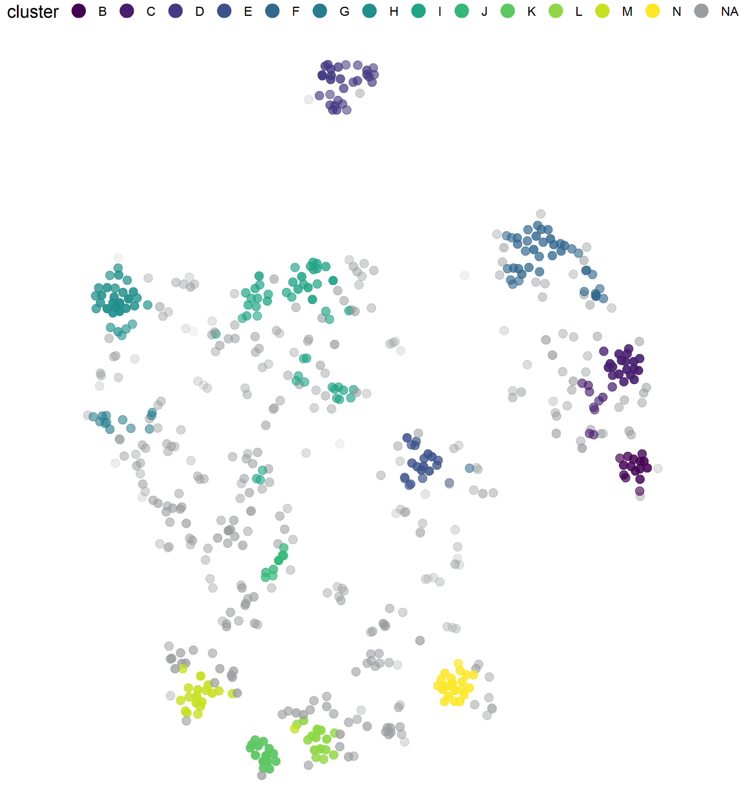
Case-study: heet & warm ‘hot’
Caso: heet & warm ‘caliente’
Notes:
Mariana

Slide 47
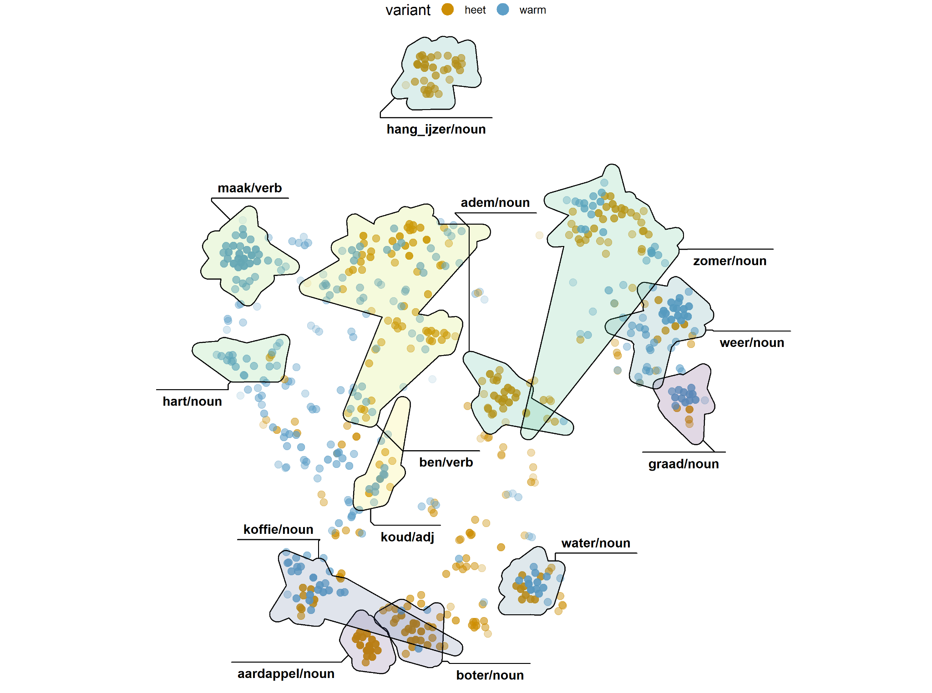
heet
adem | breath (noun) | aliento
aardappel | potato | papa
hang_ijzer | pot hanger | gancho de hierro
boter | butter | manteca
warm
hart | heart | corazón
weer | weather | clima
graad | degree | grado
maak | to make | hacer
heet + warm
koud | cold | frío
koffie | coffee | café
water | water | agua
zomer | summer | verano
ben | to be | ser/estar
Notes:
Very high F-score of context words: aardappel, adem, hangijzer, graad, koud, water
Reasonable F-score (0.7 <= F-score < 0.9): hart, weer, maak, zomer
Lower F-score (but at least 0.4): boter, ben, koffie
other context words include:
boter-cluster: bak, olie, in, oven, ui, vet, giet, room, aluminium_folie… (but only those up to oven occur more than once in the sample)
ben-cluster: te, het, als, onder… but also voet and smeed, with high precision but low freq --- so, seems to be a similar situation to the ‘heet’ one before
koffie-cluster: kop, thee, chocolademelk, broodje, pannenkoek, appel_taart (very high precision but low freq)
Other notes:
- graad seems to refer mostly to weather
- I will clarify that warm+maak does not correspond to ‘it is warm (weather)’ (which is what happens when combining with hacer in Spanish)

Slide 48
Preference for warm
graad | ...bedenk dan dat de koe het nog tien graden warmer heeft. | ...think that for the cow it is still ten degrees warmer. | ...pienso que para la vaca está unos diez grados más caluroso.
weer | Het warme weer deed de voorbije twee dagen de gemoederen tussen buren hoog oplaaien... | The warm weather made tempers between the neighbours flare the past two days... | El clima cálido de los dos días pasados agitaron los ánimos entre los vecinos...
hart | Een elitair bestuur had te weinig contact met de gewone burger die een warm hart heeft voor Ierland. | An elitist administration had too little contact with the common citizen, who had a warm heart for Ireland. | Un gobierno elitista tenía demasiado poco contacto con el ciudadano común, que tenía un corazón cálido hacia Irlanda.
maak | Stages kunnen zeker een element zijn om jongeren warm te maken voor het ondernemen... | Internships can certainly be an element to make the youths warm towards business... | Las pasantías ciertamente pueden ser un elemento para volver a los jóvenes cálidos hacia los emprendimientos...
Notes:
NOTE: The translations are literal, I think it’s best to explain the idiomatic expressions orally…
Maybe add as text: those with preference for heet match the previous examples (boter is mostly covered by the old in cluster)

Slide 49
koud | Ik word niet heet of koud van al die insinuaties. | I don’t get hot nor cold from those insinuations. | Esas insinuaciones no me ponen ni caliente ni frío.
 | De Duitser zal er niet warm of koud van worden. | The German won’t get hot nor cold from that. | No lo pone ni caliente ni frío al alemán.
koffie | ...in het café waar hij, zo schreef hij eens, het ochtendgloren afwachtte 'met hete koffie en verse kranten'. | ...in the café where he, as he wrote, awaited dawn ‘with hot coffee and fresh newspapers’. | ...en el café donde, según escribió, espera el amanecer ‘con café caliente y periódicos frescos’.
 | ...kan je in het parochiehuis voor 3 euro genieten van 2 lekkere pannenkoeken en een warme kop koffie... | ...in the parish house you can enjoy 2 delicious pancakes and a hot cup of coffee for 3 euros... | ...en la parroquia podés disfrutar 2 deliciosos panqueques y una taza de café caliente por 3 euros.
water | Sauna's en zwembaden moeten voorzorgen nemen als het regelmatig doorspoelen van de leidingen met heet water. | Saunas and pools have to take precautions, such as regularly cleaning the pipes with hot water. | Los saunas y las piscinas tienen que tomar precauciones, como la limpieza regular de las cañerías con agua caliente.
 | De plant groeit explosief in voedselrijk en warm water. | The plant grows explosively in nutrient-rich and warm water. | La planta crece explosivamente en agua rica en nutrientes y cálida.
zomer | Cijfers van het OCMW wijzen erop dat de hete zomer in Antwerpen niet tot meer overlijdens heeft geleid. | Numbers from the OCMW indicate that the hot summer in Antwerp did not lead to more deaths. | Las cifras del OCMW indican que el verano caluroso en Amberes no llevó a un mayor número de muertes.
 | Door de warme zomer zijn er in 2003 tussen de duizend en veertienhonderd mensen meer overleden dan normaal... | Because of the warm summer, in 2003 between a thousand and fourteen hundred more people than usual passed away. | A causa del verano caluroso, en 2003 han fallecido entre 1000 y 1400 personas más de lo normal.
ben | ...maar als het heet is, wil hij gewone spaghetti met look, olijfolie en Parmezaanse kaas... | ...but if it’s hot, he wants normal spaghetti with garlic, olive oil and Parmesan cheese... | ...pero si hace calor, quiere espaguetis comunes con ajo, aceite de oliva y queso Parmesano...
 | De overlevenden kwamen terug, pezig en bruin, want het was daar warm geweest... | The survivors came back, wiry and brown, because it had been hot there... | Los supervivientes regresaron, esbeltos y bronceados, porque había hecho calor allí...
Notes:
NOTE: The translations are literal, I think it’s best to explain the idiomatic expressions orally…
Maybe to explain: OCMW = Openbaar Centrum voor Maatschappelijk Welzijn = Public Centre for Social Welfare = Centro Público para el Bienestar Social

Slide 50
Linguistics of temperature
Lingüística de la temperatura
temperature values
temperature frames
tactile
bodily sensation
ambient
evaluated entities
e.g. water
grados de temperatura
marcos de temperatura
táctil
sensación corporal
ambiente
entidades evaluadas
p.ej. agua
Koptjevskaja-Tamm (2015)...
Notes:
Present this with something along the lines of:
It seems like there is a lot of work going into producing the plots (and there is) but this is just the beginning.
What can you do with this data? How can you interpret it?
In the case of temperature terms, we can combine our insights about the collocational preferences of and competition between heet and warm
with what we know of the linguistics of temperature.

Slide 51
heet
adem | breath (noun) | aliento
aardappel | potato | papa
hang_ijzer | pot hanger | gancho de hierro
boter | butter | manteca
warm
hart | heart | corazón
weer | weather | clima
graad | degree | grado
maak | to make | hacer
heet + warm
koud | cold | frío
koffie | coffee | café
water | water | agua
zomer | summer | verano
ben | to be | ser/estar
Notes:
Very high F-score of context words: aardappel, adem, hangijzer, graad, koud, water
Reasonable F-score (0.7 <= F-score < 0.9): hart, weer, maak, zomer
Lower F-score (but at least 0.4): boter, ben, koffie
other context words include:
boter-cluster: bak, olie, in, oven, ui, vet, giet, room, aluminium_folie… (but only those up to oven occur more than once in the sample)
ben-cluster: te, het, als, onder… but also voet and smeed, with high precision but low freq --- so, seems to be a similar situation to the ‘heet’ one before
koffie-cluster: kop, thee, chocolademelk, broodje, pannenkoek, appel_taart (very high precision but low freq)
Other notes:
- graad seems to refer mostly to weather
- I will clarify that warm+maak does not correspond to ‘it is warm (weather)’ (which is what happens when combining with hacer in Spanish)

Slide 52
Initial insights
Primeras observaciones
all three dimensions of temperature are needed to explain heet vs warm
quantitative methods highlight the fuzziness of actual language use
las tres dimensiones de la temperatura son necesarias para explicar heet vs warm
los métodos cuantitativos resaltan lo caótico del uso del lenguaje
Notes:
None of the three dimensions is enough, and still the actual use is a matter of weights, probabilities, tendencies...

Slide 53
Thank you!
¡Muchas gracias!
Dr. Mariana Montes | mariana.montes@kuleuven.be
Dr. Karlien Franco | karlien.franco@kuleuven.be
QLVL Research group Grupo de investigación | https://www.arts.kuleuven.be/ling/qlvl
Visualization tool Visualización | https://qlvl.github.io/NephoVis/

Slide 54
REFERENCES/BIBLIOGRAFÍA
Bybee, Joan & Paul J. Hopper. 2001. Frequency and the Emergence of Linguistic Structure.. Amsterdam: Benjamins.
Dabrowksa, Ewa & Dagmar Divjak.(2015 Handbook of Cognitive Linguistics.. Berlin/Boston: De Gruyter Mouton.
Firth, John Rupert. 1957. A synopsis of linguistic theory 1930-1955. In John Rupert Firth (ed.), Studies in Linguistic Analysis, 1–32. Oxford: Blackwell.
Geeraerts, Dirk. 1993. Vagueness’s puzzles, polysemy’s vagaries. Cognitive Linguistics 4. 223–272.
Geeraerts, Dirk. 2005. Lectal variation and empirical data in Cognitive Linguistics. In Francisco José Ruiz de Mendoza Ibáñez & M. Sandra Peña Cervel (eds.), Cognitive linguistics: internal dynamics and interdisciplinary interaction, 163–189. Berlin; New York: Mouton de Gruyter.
Geeraerts, Dirk (ed.). 2006. Cognitive linguistics: basic readings. Berlin; New York: Mouton de Gruyter.
Geeraerts, Dirk. 2010a. Theories of lexical semantics. Oxford; New York: Oxford University Press.
Geeraerts, Dirk. 2010b. The doctor and the semantician. In Dylan Glynn & Kerstin Fischer (eds.), Quantitative methods in cognitive semantics: corpus-driven approaches, 63–78. Berlin; New York: De Gruyter Mouton.
Geeraerts, Dirk.(2016. Entrenchment as onomasiological salience. In Schmid, H.-J. (ed.), Entrenchment and the psychology of language learning. How we reorganize and adapt linguistic knowledge. 153–174. Berlin; Boston: De Gruyter Mouton.
Harris, Zellig S. 1954. Distributional structure. Word. Taylor & Francis 10(2–3). 146–162.
Heylen, Kris, Dirk Speelman & Dirk Geeraerts. 2012. Looking at word meaning. An interactive visualization of Semantic Vector Spaces for Dutch synsets. In Proceedings of the eacl 2012 Joint Workshop of LINGVIS & UNCLH, 16–24. Avignon.
Heylen, Kris, Thomas Wielfaert, Dirk Speelman & Dirk Geeraerts. 2015. Monitoring polysemy: Word space models as a tool for large-scale lexical semantic analysis. Lingua 157. 153–172.
Kemmer, Suzanne & Michael Barlow. 2000. Introduction: A usage-based conception of language. In Barlow, M. & Kemmer, S. (eds.). Usage-based Models of Language. Stanford: CSLI Publications. vii - xxviii.
Koptjevskaja-Tamm, Maria (ed.). 2015. The linguistics of temperature. Amsterdam; Philadelphia: John Benjamins Publishing Company.
Schütze, Hinrich. 1998. Automatic Word Sense Discrimination. Computational Linguistics 24(1). 97–123.
van der Maaten, Laurens & Geoffrey Hinton. 2008. Visualizing Data using t-SNE. Journal of Machine Learning Research 9. 2579–2605.
Taylor, John R. 1992. How many meanings does a word have? Stellenbosch Papers in Linguistics 25, 133-168.
Tomasello, Michael. 2001. First steps toward a usage-based theory of language acquisition. Cognitive Linguistics, 11, 61–82.
Tuggy, David. 1993. Ambiguity, polysemy, and vagueness. Cognitive Linguistics 4. 273–90.

