Slide 1
Investigating Recollection with Sherlock
Diego Alba

Slide 2

Dataset: Sherlock Movie
Transcript for scene descriptions
Transcript for recollection (n = 17)

Slide 3
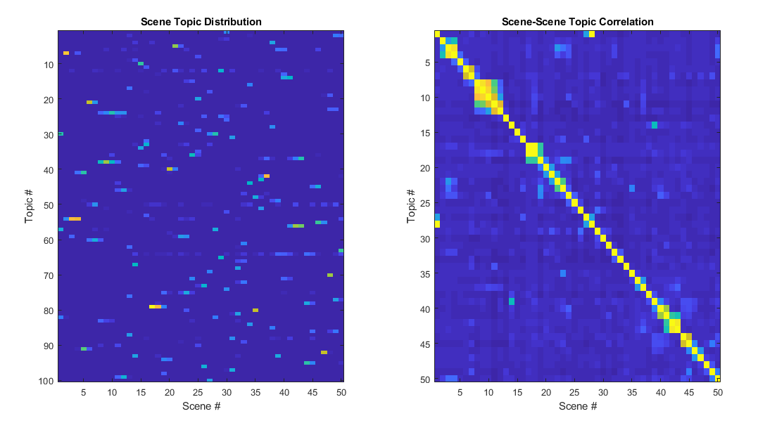
Process Data and Train LDA Model
a)
b)

Slide 4
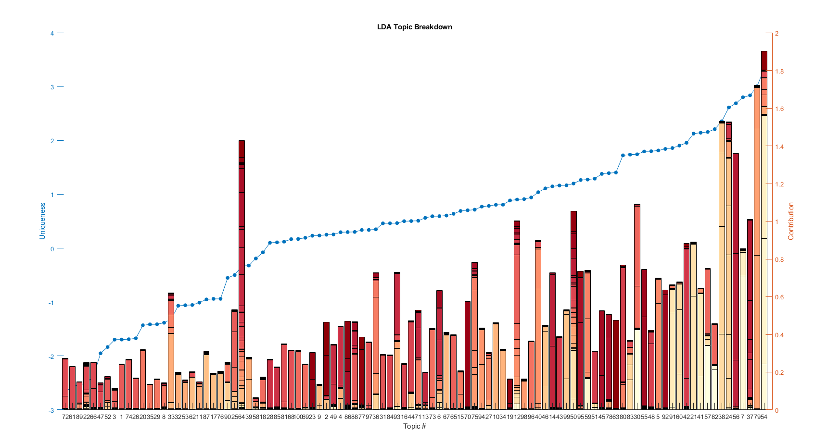

Slide 5
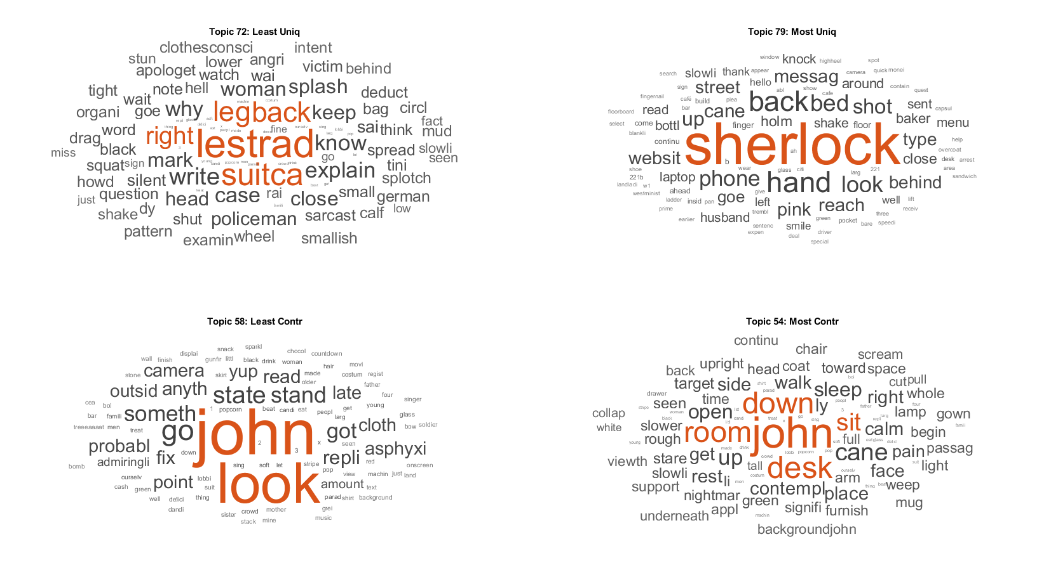

Slide 6
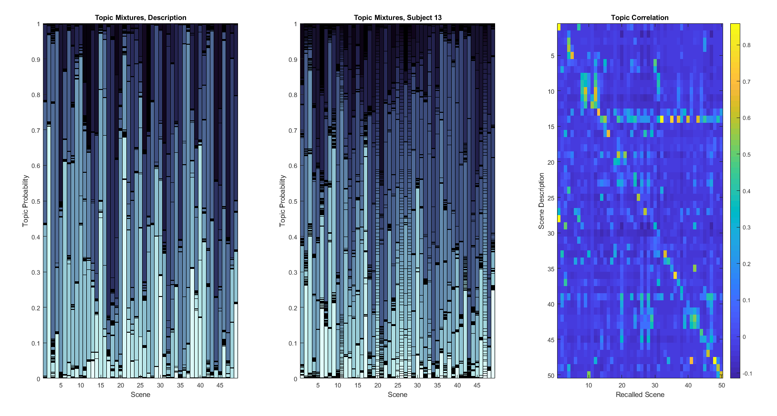

Slide 7


Slide 8
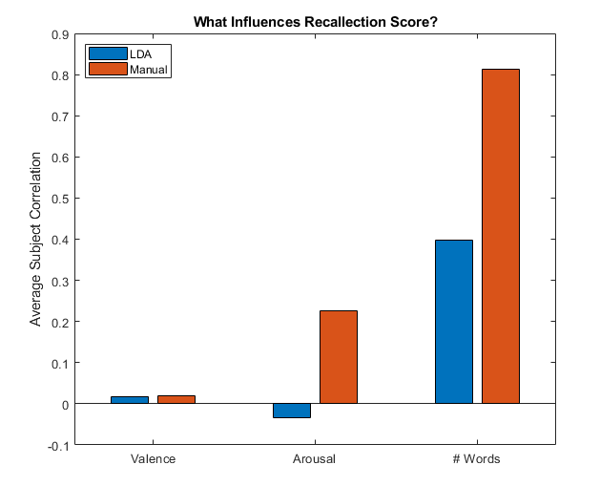

Slide 9
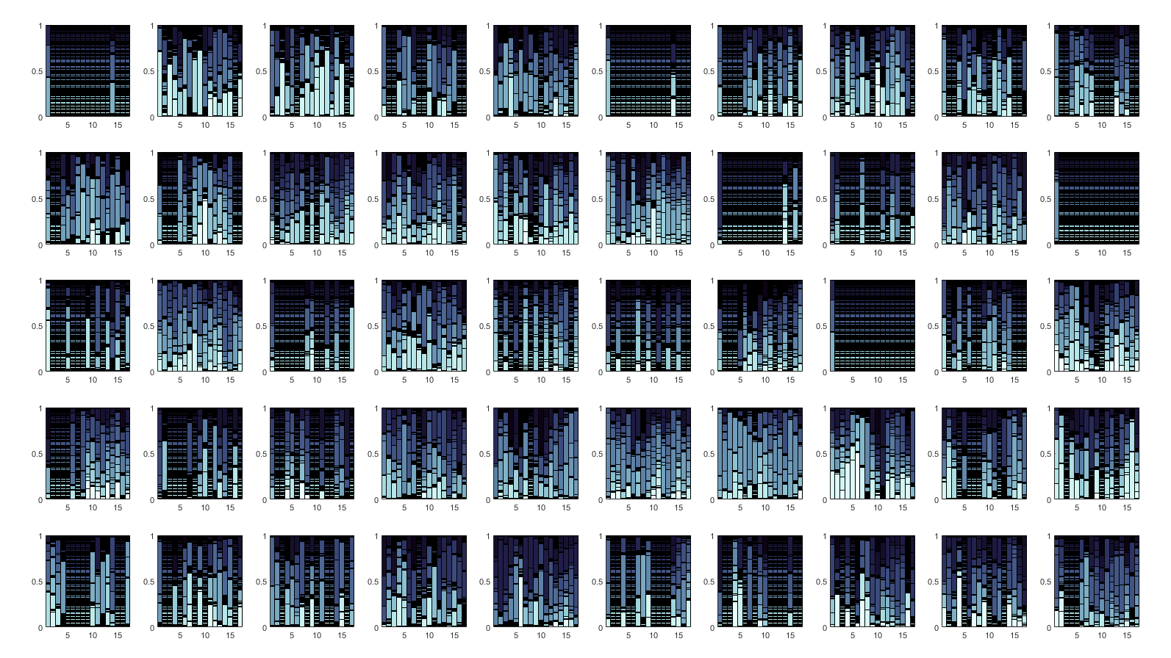

Slide 10
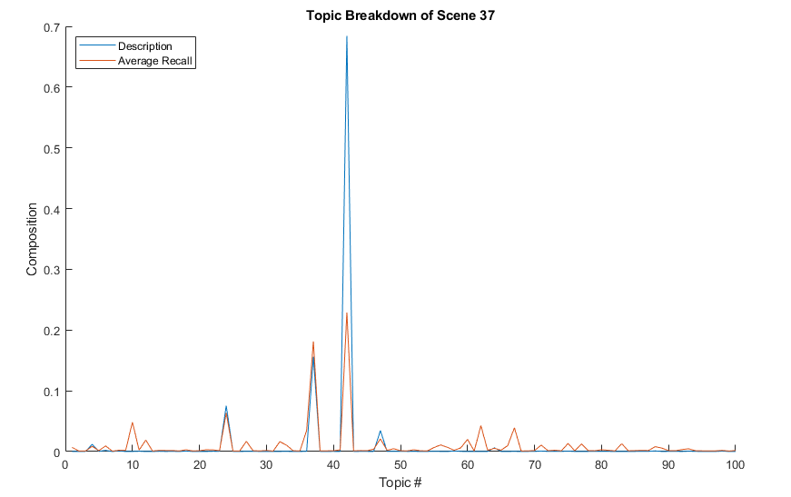
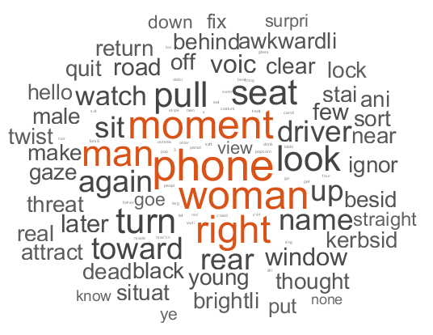

Slide 11
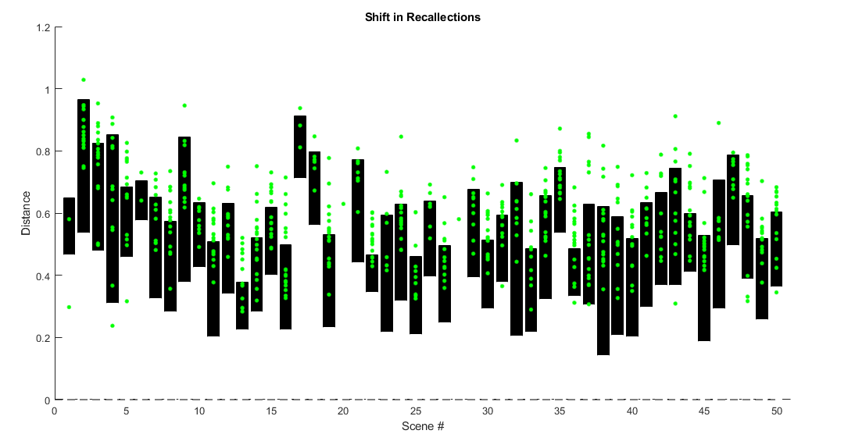

Slide 12
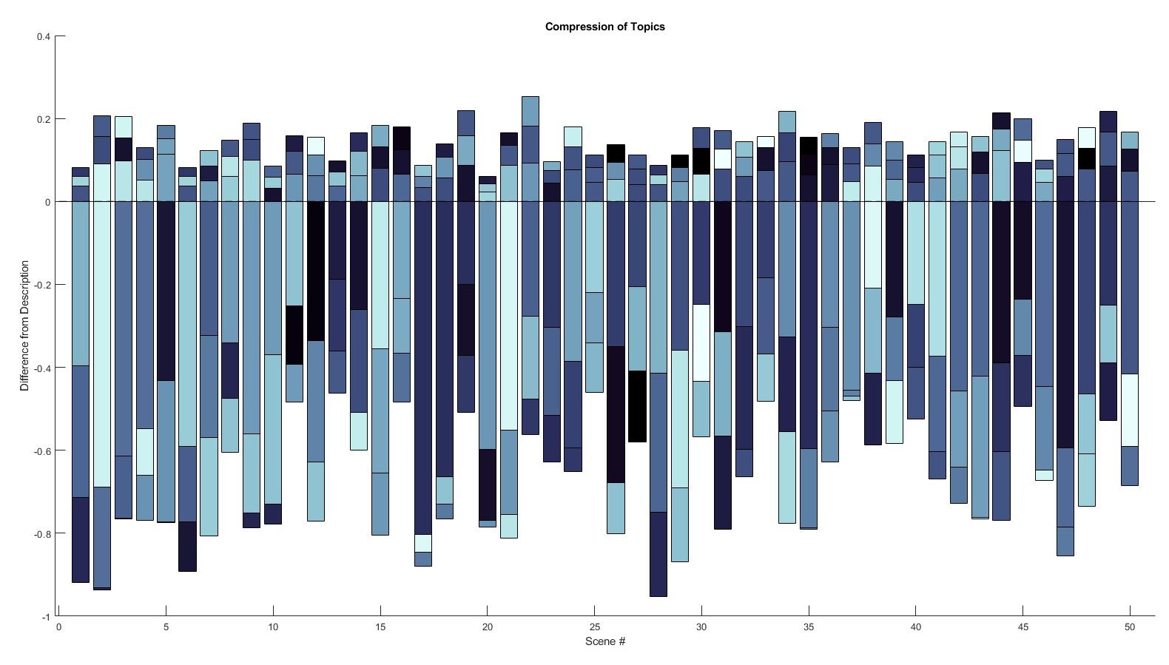

Slide 13
