Slide 1

JavaScript, Sixth Edition
Chapter 3
Building Arrays and Controlling Flow

Slide 2
Objectives
In this chapter, you will:
Store data in arrays
Use while statements, do/while statements, and for statements to repeatedly execute code
Use continue statements to restart looping statements
Use if statements, if/else statements, and switch statements to make decisions
Nest one if statement in another
JavaScript, Sixth Edition

Slide 3
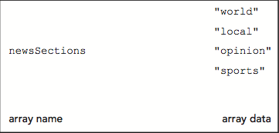
Storing Data in Arrays
Array
  Set of data represented by a single variable name
Figure 3-1 Conceptual illustration of an array
JavaScript, Sixth Edition

Slide 4
Declaring and Initializing Arrays
Array literal
  most common way to create an array
  declares a variable and specifies array as content
Syntax
  var name = [value1, value2, value3, …];
Example:
  Create an array named newsSections containing 4 strings as elements
  var newsSections = ["world","local","opinion","sports"];
JavaScript, Sixth Edition

Slide 5
Declaring and Initializing Arrays (cont’d.)
Element
  Each piece of data contained in an array
Index
  Element’s numeric position within the array
  Array element numbering
    Starts with index number of zero (0)
Reference element using its index number
  Example: to reference the 2nd element in the newsSections array
  ^{newsSections[1]}
JavaScript, Sixth Edition

Slide 6
Declaring and Initializing Arrays (cont’d.)
Assigning values to individual array elements
  Include the array index for an individual element
Example:
  Add value "entertainment" as fifth element of newsSections array
newsSections[4] = "entertainment";
JavaScript, Sixth Edition

Slide 7
Declaring and Initializing Arrays (cont’d.)
Can create an array without any elements
  Add new elements as necessary
  Array size can change dynamically
    ^{var colors = [];}
    ^{colors[2] = "yellow";}
JavaScript values assigned to array elements
  Can be different data types
JavaScript, Sixth Edition

Slide 8
Accessing Element Information
To access an element’s value:
  Include brackets and element index
Examples:
var sec1Head = document.getElementById("section1");
var sec2Head = document.getElementById("section2");
var sec3Head = document.getElementById("section3");
sec1Head.innerHTML = newsSections[0]; // "world"
sec2Head.innerHTML = newsSections[1]; // "local"
sec3Head.innerHTML = newsSections[2]; // "opinion"
JavaScript, Sixth Edition

Slide 9
Modifying Elements
To modify values in existing array elements
  Include brackets and element index
Can change a value assigned to an array element
Example:
^{newsSections[4] = "living";}
JavaScript, Sixth Edition

Slide 10
Determining the Number of Elements in an Array
length property
  Returns the number of elements in an array
Syntax
  name.length;
JavaScript, Sixth Edition

Slide 11
Using the Array Object
JavaScript represents arrays with the Array object
  Contains a special constructor named Array()
Constructor
  Special function type used as the basis for creating reference variables
Syntax
  var newsSections = new Array(6);
Array literals preferred
  Easier
JavaScript, Sixth Edition

Slide 12
Referencing Default Collections of Elements
getElementsByTagName() method
  Can reference web page element by looking up all elements of a certain type in document and referencing one element in that collection
  Resulting collection uses syntax similar to arrays
Example:
document.getElementsByTagName("li")[2]
JavaScript, Sixth Edition

Slide 13
Repeating Code
Loop statement
  Control flow statement repeatedly executing a statement or a series of statements
    While a specific condition is true or until a specific condition becomes true
Three types of loop statements
  while statements
  do/while statements
  for statements
JavaScript, Sixth Edition

Slide 14
while Statements
while statement
  Repeats a statement or series of statements
    As long as a given conditional expression evaluates to a truthy value
Syntax
      while (expression) {
      statements
      }
Iteration
  Each repetition of a looping statement
JavaScript, Sixth Edition

Slide 15
while Statements (cont’d.)
Counter
  Variable incremented or decremented with each loop statement iteration
Examples:
  while statement using an increment operator
  while statement using a decrement operator
  while statement using the *= assignment operator
JavaScript, Sixth Edition

Slide 16
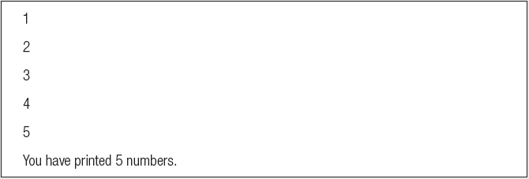
while Statements (cont’d.)
var count = 1;
while (count <= 5) {
document.write(count + "<br />");
count++;
}
document.write("<p>You have printed 5 numbers.</p>");
Result in browser:
JavaScript, Sixth Edition

Slide 17
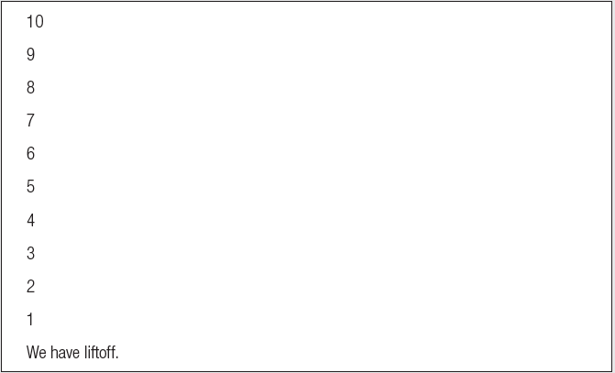
while Statements (cont’d.)
var count = 10;
while (count > 0) {
document.write(count + "<br />");
count--;
}
document.write("<p>We have liftoff.</p>");
Result in browser:
JavaScript, Sixth Edition

Slide 18
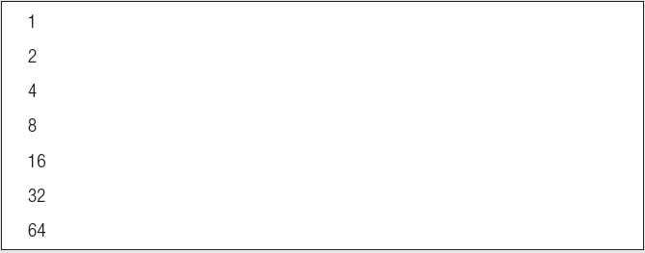
while Statements (cont’d.)
var count = 1;
while (count <= 100) {
document.write(count + "<br />");
count *= 2;
}
Result in browser:
JavaScript, Sixth Edition

Slide 19
while Statements (cont’d.)
Infinite loop
  Loop statement that never ends
    Conditional expression: never false
  Example:
var count = 1;
while (count <= 10) {
window.alert("The number is " + count + ".");
}
JavaScript, Sixth Edition

Slide 20
while Statements (cont’d.)
Example:
  assigning array element values to table cells:
function addColumnHeaders() {
var i = 0;
while (i < 7) {
document.getElementsByTagName("th")↵
[i].innerHTML = daysOfWeek[i];
i++;
}
}
JavaScript, Sixth Edition

Slide 21
do/while Statements
do/while statement
  Executes a statement or statements once
  Then repeats the execution as long as a given conditional expression evaluates to a truthy value
Syntax
do {
statements;
} while (expression);
JavaScript, Sixth Edition

Slide 22
do/while Statements (cont’d.)
Examples:
var count = 2;
do {
document.write("<p>The count is equal to " +↵
count + ".</p>");
count++;
} while (count < 2);
var count = 2;
while (count < 2) {
document.write("<p>The count is equal to " +↵
count + ".</p>");
count++;
}
JavaScript, Sixth Edition

Slide 23
do/while Statements (cont’d.)
Example:
  adding days of week with a do/while statement instead of a while statement
var i = 0;
do {
document.getElementsByTagName("th")[i].innerHTML =↵
daysOfWeek[i];
i++;
} while (i < 7);
JavaScript, Sixth Edition

Slide 24
for Statements
for statement
  Repeats a statement or series of statements
    As long as a given conditional expression evaluates to a truthy value
  Can also include code that initializes a counter and changes its value with each iteration
Syntax
for (counter_declaration; condition; counter_operation) {
statements
}
JavaScript, Sixth Edition

Slide 25
for Statements (cont’d.)
Steps when JavaScript interpreter encounters a for loop
  1. Counter variable declared and initialized
  2. for loop condition evaluated
  3. If condition evaluation in Step 2 returns truthy value:
    for loop statements execute, Step 4 occurs, and the process starts over again with Step 2
  If condition evaluation in Step 2 returns falsy value:
    for statement ends
    Next statement following the for statement executes
  4. Update statement in the for statement executed
JavaScript, Sixth Edition

Slide 26
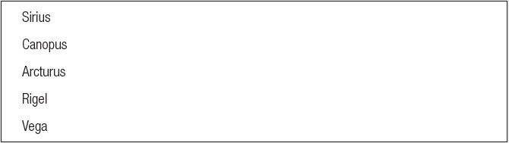
for Statements (cont’d.)
var brightestStars =
["Sirius", "Canopus", "Arcturus", "Rigel", "Vega"];
for (var count = 0; count < brightestStars.length; count++) {
document.write(brightestStars[count] + "<br />");
}
Result in browser:
JavaScript, Sixth Edition

Slide 27
for Statements (cont’d.)
for statement
  More efficient than a while statement
Examples:
var count = 1;
while (count < brightestStars.length) {
document.write(count + "<br />");
count++;
}
for (var count = 1; count < brightestStars.length; count++) {
document.write(count + "<br />");
}
JavaScript, Sixth Edition

Slide 28
for Statements (cont’d.)
Example:
  addColumnHeaders() function with a for statement instead of a do/while statement
function addColumnHeaders() {
for (var i = 0; i < 7; i++) {
document.getElementsByTagName("th")[i].innerHTML↵
= daysOfWeek[i];
}
}
JavaScript, Sixth Edition

Slide 29
Using continue Statements to Restart Execution
continue statement
  Halts a looping statement
    Restarts the loop with a new iteration
  Used to stop a loop for the current iteration
    Have the loop to continue with a new iteration
Examples:
  for loop with a continue statement
JavaScript, Sixth Edition

Slide 30
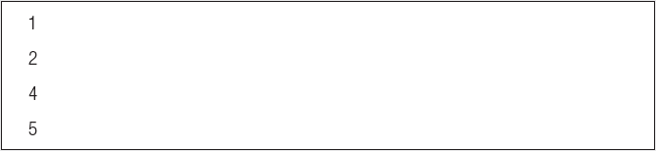
Using continue Statements to Restart Execution (cont’d.)
for (var count = 1; count <= 5; count++) {
if (count === 3) {
continue;
}
document.write("<p>" + count + "</p>");
}
Result in browser:
JavaScript, Sixth Edition

Slide 31
Making Decisions
Decision making
  Process of determining the order in which statements execute in a program
Decision-making statements, decision-making structures, or conditional statements
  Special types of JavaScript statements used for making decisions
if statement
  Most common type of decision-making statement
JavaScript, Sixth Edition

Slide 32
if Statements
Used to execute specific programming code
  If conditional expression evaluation returns truthy value
Syntax
if (condition) {
statements;
}
}After the if statement executes:
  Any subsequent code executes normally
JavaScript, Sixth Edition

Slide 33
if Statements (cont’d.)
Use a command block to construct a decision-making structure containing multiple statements
Command block
  Set of statements contained within a set of braces
JavaScript, Sixth Edition

Slide 34
if/else Statements
Executes one action if the condition is true
  And a different action if the condition is false
Syntax for an if . . . else statement
if (expression) {
statements
}
else {
statements
}
JavaScript, Sixth Edition

Slide 35
if/else Statements (cont’d.)
Example:
var today = "Tuesday"
if (today === "Monday") {
document.write("<p>Today is Monday</p>");
}
else {
document.write("<p>Today is not Monday</p>");
}
JavaScript, Sixth Edition

Slide 36
Nested if and if/else Statements
Nested decision-making structures
  One decision-making statement contains another decision-making statement
Nested if statement
  An if statement contained within an if statement or within an if/else statement
Nested if/else statement
  An if/else statement contained within an if statement or within an if/else statement
JavaScript, Sixth Edition

Slide 37
Nested if and if/else Statements (cont’d.)
Example:
var salesTotal = 75;
if (salesTotal > 50) {
if (salesTotal < 100) {
document.write("<p>The sales total is↵
between 50 and 100.</p>");
}
}
JavaScript, Sixth Edition

Slide 38
else if constructions
Compact version of nested if/else statements
  combine an else statement with its nested if statement
  requires fewer characters
  easier to read
JavaScript, Sixth Edition

Slide 39
else if constructions (cont'd.)
nested if/else version
if (gameLocation[i] === "away") {
paragraphs[1].innerHTML = "@ ";
}
else {
if (gameLocation[i] === "home") {
paragraphs[1].innerHTML = "vs ";
}
}
else if version
if (gameLocation[i] === "away") {
paragraphs[1].innerHTML = "@ ";
}
else if (gameLocation[i] === "home") {
paragraphs[1].innerHTML = "vs ";
}
JavaScript, Sixth Edition

Slide 40
else if constructions (cont'd)
Used to create backward-compatible event listeners:
var submitButton = document.getElementById("button");
if (submitButton.addEventListener) {
submitButton.addEventListener("click", submitForm,↵
false);
}
else if (submitButton.attachEvent) {
submitButton.attachEvent("onclick", submitForm);
}
JavaScript, Sixth Edition

Slide 41
switch Statements
Controls program flow by executing a specific set of statements
    Dependent on an expression value
Compares expression value to value contained within a case label
case label
  Represents a specific value
  Contains one or more statements that execute:
    If case label value matches the switch statement’s expression value
JavaScript, Sixth Edition

Slide 42
switch Statements (cont’d.)
Syntax
switch (expression) {
case label:
statements;
break;193
case label:
statements;
break;
...
default:
statements;
break;
}
JavaScript, Sixth Edition

Slide 43
switch Statements (cont’d.)
default label
  Executes when the value returned by the switch statement expression does not match a case label
When a switch statement executes:
  Value returned by the expression is compared to each case label
    In the order in which it is encountered
break statement
  Ends execution of a switch statement
  Should be final statement after each case label
JavaScript, Sixth Edition

Slide 44
switch Statements (cont’d.)
function city_location(americanCity) {
switch (americanCity) {
case "Boston":
return "Massachusetts";
break;
case "Chicago":
return "Illinois";
break;
case "Los Angeles":
return "California";
break;
case "Miami":
return "Florida";
break;
case "New York":
return "New York";
break;
default:
return "United States";
break;
}
}
document.write("<p>" + city_location("Boston") + "</p>");
JavaScript, Sixth Edition

Slide 45
Summary
Array
  Set of data represented by a single variable name
  Index: element’s numeric position within the array
  Can access and modify array elements
  length property
    number of elements in an array
JavaScript, Sixth Edition

Slide 46
Summary (cont’d.)
Loop statements
  while statements, do/while statements, and for statements
  Iteration: each repetition of a looping statement
  Counter: variable
    Incremented or decremented with each iteration of a loop statement
  continue statement
    Restarts a loop with a new iteration
JavaScript, Sixth Edition

Slide 47
Summary (cont’d.)
Decision making
  Determining the order in which statements execute in a program
May execute in a linear fashion
  if statement,if/else statement, else if construction
    Nested decision-making structures
  switch statement and case labels
  break statement: used to exit control statements
  Command block
    Set of statements contained within a set of braces
    May repeat the same statement, function, or code section
JavaScript, Sixth Edition

