Slide 1

JavaScript, Sixth Edition
Chapter 7
Using Object-Oriented JavaScript

Slide 2
Objectives
When you complete this chapter, you will be able to:
Explain basic concepts related to object-oriented programming
Use the Date, Number, and Math objects
Define your own custom JavaScript objects
JavaScript, Sixth Edition

Slide 3
Introduction to Object-Oriented Programming
Object-oriented programming
  Allows reuse of code without having to copy or recreate it
JavaScript, Sixth Edition

Slide 4
Reusing Software Objects
Object-oriented programming (OOP)
  Creating reusable software objects
    Easily incorporated into multiple programs
Object
  Programming code and data treated as an individual unit or component
  Also called a component
Data
  Information contained within variables or other types of storage structures
JavaScript, Sixth Edition

Slide 5
Reusing Software Objects (cont’d.)
Objects range from simple controls to entire programs
Popular object-oriented programming languages
  C++, Java, Visual Basic
JavaScript, Sixth Edition

Slide 6
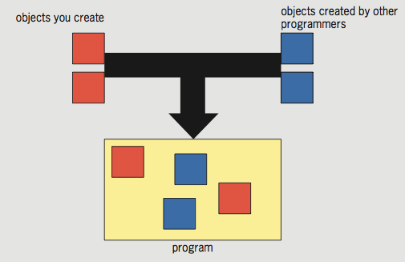
Reusing Software Objects (cont’d.)
Figure 7-1 Programming with objects
JavaScript, Sixth Edition

Slide 7
What Is Encapsulation?
Encapsulated objects
  Code and data contained within the object itself
Encapsulation places code inside a “black box”
Interface
  Elements required for program to communicate with an object
Principle of information hiding
  Any methods and properties other programmers do not need to access should be hidden
JavaScript, Sixth Edition

Slide 8
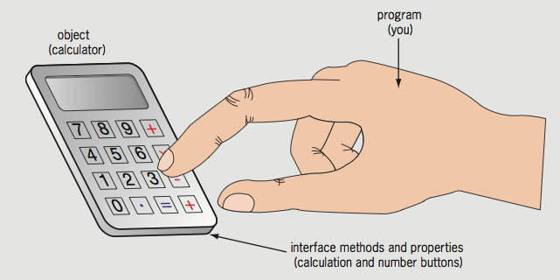
What Is Encapsulation? (cont’d.)
Advantages of encapsulation
  Reduces code complexity
  Prevents accidental bugs and stealing of code
Programming object and its interface
  Compare to a handheld calculator
Figure 7-2 Calculator interface
JavaScript, Sixth Edition

Slide 9
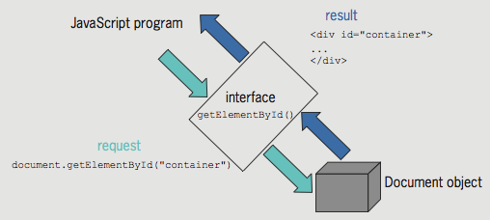
What Is Encapsulation? (cont’d.)
Document object is encapsulated (black box)
  getElementById() method
    Part of the interface JavaScript uses to communicate with the Document object
Microsoft Word: example of an object and its interface
Figure 7-3 Using the interface for the Document object
JavaScript, Sixth Edition

Slide 10
Understanding Classes
Classes
  Grouping of code, methods, attributes, etc., making up an object
Instance
  Object created from an existing class
Instantiate: create an object from an existing class
Instance of an object inherits its methods and properties from a class
Objects in the browser object model
  Part of the web browser
  No need to instantiate them to use them
JavaScript, Sixth Edition

Slide 11
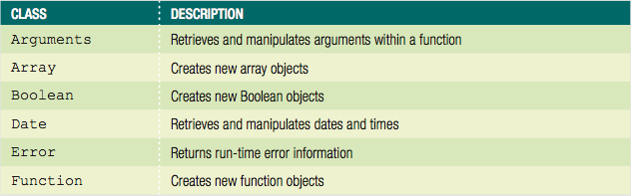
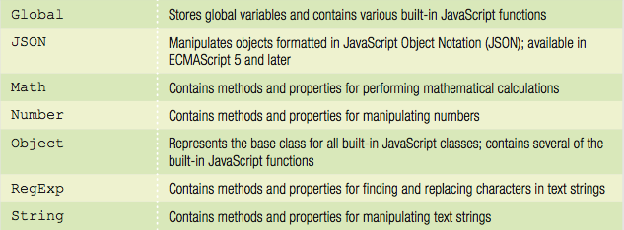
Using Built-In JavaScript Classes
Table 7-1 Built-in JavaScript classes
JavaScript, Sixth Edition

Slide 12
Using Built-In JavaScript Classes (cont’d.)
Instantiating an object
  Some of the built-in JavaScript objects used directly in code
  Some objects require programmer to instantiate a new object
  Example: Math object’s PI(π) property in a script
// calculate the area of a circle based on its radius
^{function calcCircleArea() {}
var r = document.getElementById("radius").value;
var area = Math.PI * Math.pow(r, 2); // area is pi times ↵
^{radius squared}
^{return area;}
}
JavaScript, Sixth Edition

Slide 13
Using Built-In JavaScript Classes (cont’d.)
Instantiating an object (cont’d.)
  Can instantiate Array object using array literal
    Example: ^{var deptHeads = [];}
  Can instantiate empty generic object using object literal
    Example: ^{var accountsPayable = {};}
    Generic object literal uses curly braces around value
  Can't use object literal for Date object
    Must use constructor
    Example: ^{var today = new Date();}
JavaScript, Sixth Edition

Slide 14
Using Built-In JavaScript Classes (cont’d.)
Performing garbage collection
  Garbage collection
    Cleaning up, or reclaiming, memory reserved by a program
  Declaring a variable or instantiating a new object
    Reserves memory for the variable or object
  JavaScript knows when a program no longer needs a variable or object
    Automatically cleans up the memory
JavaScript, Sixth Edition

Slide 15
Using the Date, Number, and Math Classes
Three of most commonly used JavaScript classes:
  Date, Number, and Math
JavaScript, Sixth Edition

Slide 16
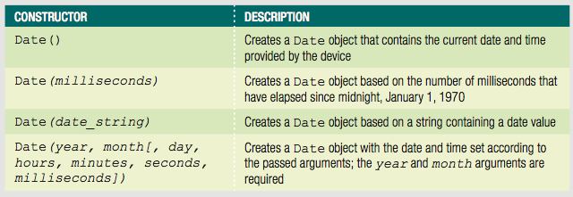
Manipulating the Date and Time with the Date Class
Date class
  Methods and properties for manipulating the date and time
  Allows use of a specific date or time element in JavaScript programs
Table 7-2 Date class constructors
JavaScript, Sixth Edition

Slide 17
Manipulating the Date and Time with the Date Class (cont’d.)
Example:
  ^{var today = new Date();}
  Month and year date representation in a Date object
  Stored using numbers matching actual date and year
Days of the week and months of the year
  Stored using numeric representations
    Starting with zero: similar to an array
Example:
  var independenceDay = new Date(1776, 6, 4);
JavaScript, Sixth Edition

Slide 18
Manipulating the Date and Time with the Date Class (cont’d.)
After creating a new Date object
  Manipulate date and time in the variable using the Date class methods
Date and time in a Date object
  Not updated over time like a clock
  Date object contains the static (unchanging) date and time
    Set at the moment the JavaScript code instantiates the object
JavaScript, Sixth Edition

Slide 19
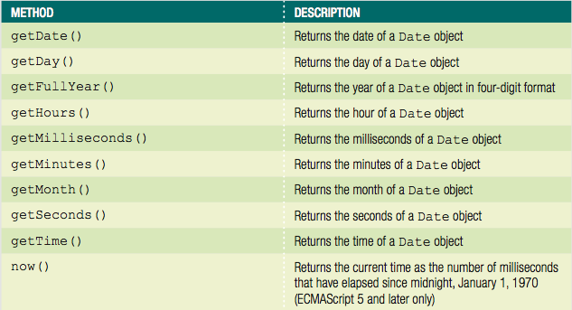
Manipulating the Date and Time with the Date Class (cont’d.)
Table 7-3 Commonly used methods of the Date class (continues)
JavaScript, Sixth Edition

Slide 20
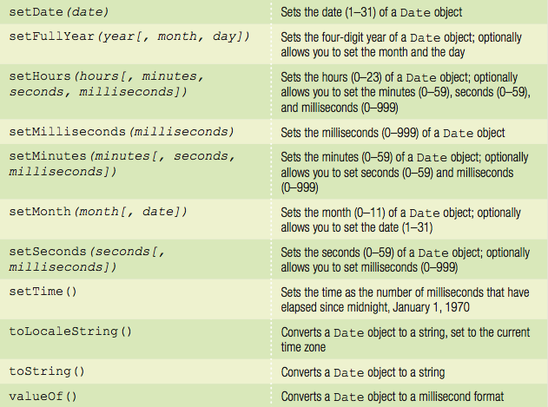
Manipulating the Date and Time with the Date Class (cont’d.)
Table 7-3 Commonly used methods of the Date class
JavaScript, Sixth Edition

Slide 21
Manipulating the Date and Time with the Date Class (cont’d.)
Each portion of a Date object can be retrieved and modified using the Date object methods
  Examples:
    var curDate = new Date();
    curDate.getDate();
Displaying the full text for days and months
  Use a conditional statement to check the value returned by the getDay() or getMonth() method
  Example:
    if/else construct to print the full text for the day of the week returned by the getDay() method
JavaScript, Sixth Edition

Slide 22
Manipulating the Date and Time with the Date Class (cont’d.)
^{var today = new Date();}
^{var curDay = today.getDay();}
^{var weekday;}
^{if (curDay === 0) {}
^{weekday = "Sunday";}
^{} else if (curDay === 1) {}
^{weekday = "Monday";}
^{} else if (curDay === 2) {}
^{weekday = "Tuesday";}
^{} else if (curDay === 3) {}
^{weekday = "Wednesday";}
^{} else if (curDay === 4) {}
^{weekday = "Thursday";}
^{} else if (curDay === 5) {}
^{weekday = "Friday";}
^{} else if (curDay === 6) {}
^{weekday = "Saturday";}
}
JavaScript, Sixth Edition

Slide 23
Manipulating the Date and Time with the Date Class (cont’d.)
Example: include an array named months
  12 elements assigned full text names of the months
^{var today = new Date();}
var months = ["January","February","March",↵
^{"April","May","June",↵}
^{"July","August","September",↵}
"October","November","December"];
var curMonth = months[today.getMonth()];
JavaScript, Sixth Edition

Slide 24
Manipulating Numbers with the Number Class
Number class
  Methods for manipulating numbers and properties containing static values
    Representing some numeric limitations in the JavaScript language
  Can append the name of any Number class method or property
    To the name of an existing variable containing a numeric value
JavaScript, Sixth Edition

Slide 25
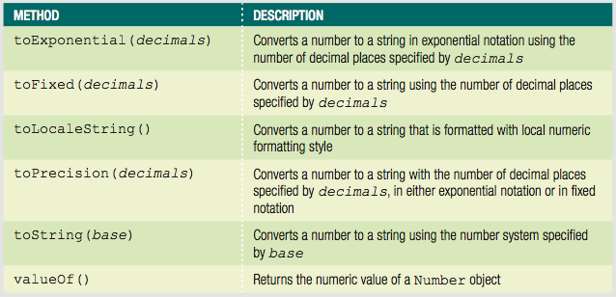
Manipulating Numbers with the Number Class (cont’d.)
Using Number class methods
Table 7-4 Number class methods
JavaScript, Sixth Edition

Slide 26
Manipulating Numbers with the Number Class (cont’d.)
Using Number class methods (cont’d.)
  Primary reason for using any of the “to” methods
    To convert a number to a string value with a specific number of decimal places
  toFixed() method
    Most useful Number class method
  toLocaleString() method
    Converts a number to a string formatted with local numeric formatting conventions
JavaScript, Sixth Edition

Slide 27
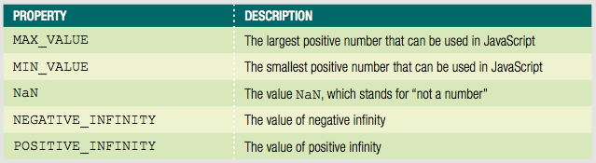
Manipulating Numbers with the Number Class (cont’d.)
Accessing Number class properties
Table 7-5 Number class properties
JavaScript, Sixth Edition

Slide 28
Performing Math Functions with the Math Class
Math class
  Methods and properties for mathematical calculations
Cannot instantiate a Math object using a statement such as: var mathCalc = new Math();
  Use the Math object and one of its methods or properties directly in the code
Example:
^{var curNumber = 144;}
var squareRoot = Math.sqrt(curNumber); // returns 12
JavaScript, Sixth Edition

Slide 29
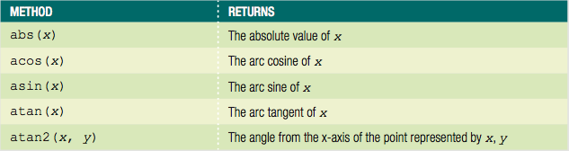
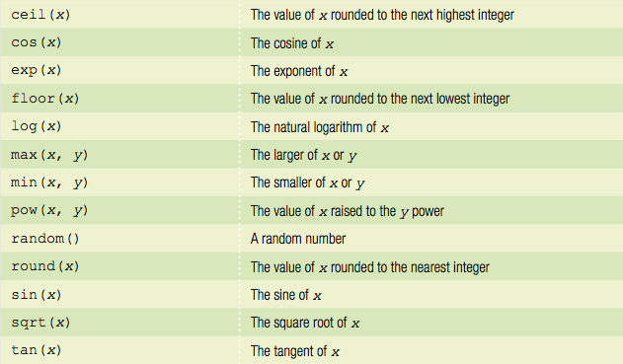
Performing Math Functions with the Math Class (cont’d.)
Table 7-6 Math class methods
JavaScript, Sixth Edition

Slide 30
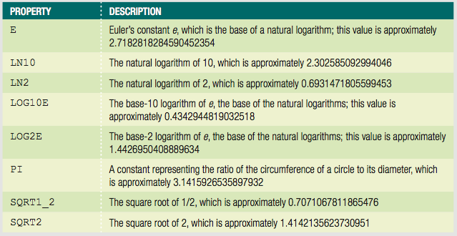
Performing Math Functions with the Math Class (cont’d.)
Table 7-7 Math class properties
JavaScript, Sixth Edition

Slide 31
Performing Math Functions with the Math Class (cont’d.)
Example:
  Use the PI property to calculate the area of a circle based on its radius
    Code uses the pow() method to raise the radius value to second power, and the round() method to round the value returned to the nearest whole number
^{var radius = 25;}
var area = Math.PI * Math.pow(radius, 2);
var roundedArea = Math.round(area); // returns 1963
JavaScript, Sixth Edition

Slide 32
Defining Custom JavaScript Objects
JavaScript: not a true object-oriented programming language
  Cannot create classes in JavaScript
  Instead, called an object-based language
Can define custom objects
  Not encapsulated
  Useful to replicate the same functionality an unknown number of times in a script
JavaScript, Sixth Edition

Slide 33
Declaring Basic Custom Objects
Use the Object object
  ^{var objectName = new Object();}
  ^{var objectName = {};}
Can assign properties to the object
  Append property name to the object name with a period
JavaScript, Sixth Edition

Slide 34
Declaring Basic Custom Objects (cont'd.)
Add properties using dot syntax
  Object name followed by dot followed by property name
  Example:
InventoryList.inventoryDate = new Date(2017, 11, 31);
JavaScript, Sixth Edition

Slide 35
Declaring Basic Custom Objects (cont'd.)
Can assign values to the properties of an object when object first instantiated
Example:
^{var PerformanceTickets = {}
customerName: "Claudia Salomon",
^{performanceName: "Swan Lake",}
^{ticketQuantity: 2,}
performanceDate: new Date(2017, 6, 18, 20)
}
JavaScript, Sixth Edition

Slide 36
Declaring Sub-Objects
Value of a property can be another object
  called a sub-object
  Example–order object with address sub-object:
    ^{var order = {}
    ^{orderNumber: "F5987",}
    ^{address: {}
    ^{street: "1 Main St",}
    ^{city: "Farmington",}
    ^{state: "NY",}
    ^{zip: "14425"}
    }
    };
JavaScript, Sixth Edition

Slide 37
Referring to Object Properties as Associative Arrays
Associative array
  An array whose elements are referred to with an alphanumeric key instead of an index number
Can also use associative array syntax to refer to the properties of an object
With associative arrays
  Can dynamically build property names at runtime
JavaScript, Sixth Edition

Slide 38
Referring to Object Properties as Associative Arrays (cont'd.)
Can use associative array syntax to refer to the properties of an object
Example:
  ^{var stopLightColors = {}
  ^{stop: "red",}
  ^{caution: "yellow",}
  ^{go: "green"}
  };
  ^{stopLightColors["caution"];}
JavaScript, Sixth Edition

Slide 39
Referring to Object Properties as Associative Arrays (cont'd.)
Can easily reference property names that contain numbers
  Example:
    ^{var order = {}
    ^{item1: "KJ2435J",}
    ^{price1: 23.95,}
    ^{item2: "AW23454",}
    ^{price2: 44.99,}
    ^{item3: "2346J3B",}
    ^{price3: 9.95}
    };
JavaScript, Sixth Edition

Slide 40
Referring to Object Properties as Associative Arrays (cont'd.)
Can easily reference property names that contain numbers (cont'd.)
  To create order summary:
^{for (var i = 1; i < 4; i++) {}
document.getElementById("itemList").innerHTML +=↵
"<p class='item'>" + order["item" + i] + "</p>";
document.getElementById("itemList").innerHTML +=↵
"<p class='price'>" + order["price" + i] + "</p>";
}
JavaScript, Sixth Edition

Slide 41
Referring to Object Properties as Associative Arrays (cont'd.)
Can also write generic code to add new object properties that incorporate numbers
  Example—adding items to shopping cart:
totalItems += 1; // increment counter of items in order
currentItem = document.getElementById("itemName").innerHTML;
currentPrice = document.getElementById("itemPrice").innerHTML;
newItemPropertyName = "item" + totalItems; // "item4"
newPricePropertyName = "price" + totalItems; // "price4"
order.newItemPropertyName = currentItem; // order.item4 = (name)
order.newPricePropertyName = currentPrice;
^{// order.price4 = (price);}
    Allows for as many items as user wants to purchase
JavaScript, Sixth Edition

Slide 42
Creating Methods
Object method simply a function with a name within the object
Two ways to add method to object
  Provide code for method in object
  Reference external function
JavaScript, Sixth Edition

Slide 43
Creating Methods (cont'd.)
Specify method name with anonymous function as value
  Example:
^{var order = {}
^{items: {},}
^{generateInvoice: function() {}
^{// function statements}
}
};
JavaScript, Sixth Edition

Slide 44
Creating Methods (cont'd.)
Specify method name with existing function as value
  Example:
  Reference to existing function cannot have parentheses
^{function processOrder() {}
^{// function statements}
}
^{var order = {}
^{items: {},}
^{generateInvoice: processOrder}
};
JavaScript, Sixth Edition

Slide 45
Enumerating custom object properties
Custom objects can contain dozens of properties
To execute the same statement or command block for all the properties within a custom object
  Use the for/in statement
  Looping statement similar to the for statement
Syntax
  ^{for (variable in object) {}
  ^{statement(s);}
  }
JavaScript, Sixth Edition

Slide 46
Enumerating custom object properties (cont'd.)
for/in statement enumerates, or assigns an index to, each property in an object
Typical use:
  validate properties within an object
JavaScript, Sixth Edition

Slide 47
Enumerating custom object properties (cont’d.)
Example—checking for empty values:
^{var item={}
^{itemNumber: "KJ2435J",}
^{itemPrice: 23.95,}
^{itemInstock: true,}
itemShipDate: new Date(2017, 6, 18),
};
^{for (prop in order) {}
^{if (order[prop] === "") {}
^{order.generateErrorMessage();}
}
}
JavaScript, Sixth Edition

Slide 48
Deleting Properties
Use the delete operator
Syntax
    delete object.property
Example:
  ^{delete order.itemInStock;}
JavaScript, Sixth Edition

Slide 49
Defining Constructor Functions
Constructor function
  Used as the basis for a custom object
  Also known as object definition
JavaScript objects
  Inherit all the variables and statements of the constructor function on which they are based
All JavaScript functions
  Can serve as a constructor
JavaScript, Sixth Edition

Slide 50
Defining Constructor Functions (cont’d.)
Example:
  Define a function that can serve as a constructor function
    function Order(number, order, payment, ship) {
    ^{this.customerNumber = number;}
    ^{this.orderDate = order;}
    ^{this.paymentMethod = payment;}
    ^{this.shippingDate = ship;}
    }
JavaScript, Sixth Edition

Slide 51
Adding Methods to a Constructor Function
Can create a function to use as an object method
  Refer to object properties with this reference
  Example:
  ^{function displayOrderInfo() {}
  var summaryDiv = document.getElementById("summarySection");
  summaryDiv.innerHTML += ("<p>Customer: " +↵
  ^{this.customerNumber + "</p>");}
  summaryDiv.innerHTML += ("<p>Order Date: " +↵
  this.orderDate.toLocaleString()+ "</p>");
  summaryDiv.innerHTML += ("<p>Payment: " +↵
  ^{this.paymentMethod + "</p>");}
  summaryDiv.innerHTML += ("<p>Ship Date: " +↵
  this.shippingDate.toLocaleString() + "</p>");
  }
JavaScript, Sixth Edition

Slide 52
Using the prototype Property
After instantiating a new object
  Can assign additional object properties
    Use a period
New property only available to that specific object
prototype property
  Built-in property that specifies the constructor from which an object was instantiated
  When used with the name of the constructor function
    Any new properties you create will also be available to the constructor function
JavaScript, Sixth Edition

Slide 53
Using the prototype Property (cont’d.)
Object definitions can use the prototype property to extend other object definitions
  Can create a new object based on an existing object
JavaScript, Sixth Edition

Slide 54
Summary
Object-oriented programming (or OOP)
  The creation of reusable software objects
Reusable software objects
  Called components
Object
  Programming code and data treated as an individual unit or component
Objects are encapsulated
Interface represents elements required for a source program to communicate with an object
JavaScript, Sixth Edition

Slide 55
Summary (cont’d.)
Principle of information hiding
Code, methods, attributes, and other information that make up an object
  Organized using classes
Instance
  Object created from an existing class
An object inherits the characteristics of the class on which it is based
Date class contains methods and properties for manipulating the date and time
JavaScript, Sixth Edition

Slide 56
Summary (cont’d.)
Number class contains methods for manipulating numbers and properties
Math class contains methods and properties for performing mathematical calculations
Can define custom object
  object literal
Can create template for custom objects
  constructor function
this keyword refers to object that called function
prototype property specifies object's constructor
JavaScript, Sixth Edition

