Slide 1
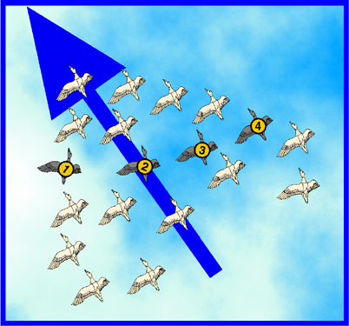
The Particle Swarm Optimization Algorithm
Decision Support
2010-2011
Andry Pinto
Hugo Alves
Inês Domingues
Luís Rocha
Susana Cruz

Slide 2
Summary
Introduction to Particle Swarm Optimization (PSO)
Origins
Concept
PSO Algorithm
PSO for the Bin Packing Problem (BPP)
Problem Formulation
Algorithm
Simulation Results

Slide 3


Introduction to the PSO: Origins
Inspired from the nature social behavior and dynamic movements with communications of insects, birds and fish

Slide 4
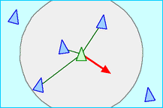
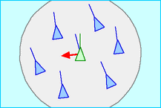
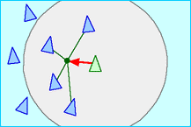
Introduction to the PSO: Origins
In 1986, Craig Reynolds described this process in 3 simple behaviors:
Separation
avoid crowding local flockmates
Alignment
move towards the average heading of local flockmates
Cohesion
move toward the average position of local flockmates

Slide 5

Introduction to the PSO: Origins
Application to optimization: Particle Swarm Optimization
Proposed by James Kennedy & Russell Eberhart (1995)
Combines self-experiences with social experiences

Slide 6
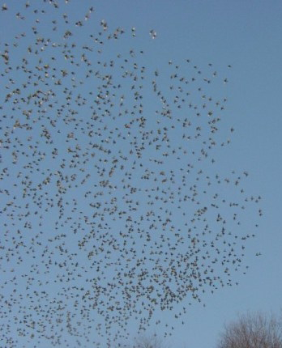
Introduction to the PSO: Concept
Uses a number of agents (particles) that constitute a swarm moving around in the search space looking for the best solution
Each particle in search space adjusts its “flying” according to its own flying experience as well as the flying experience of other particles

Slide 7
Introduction to the PSO: Concept
Collection of flying particles (swarm) - Changing solutions
Search area - Possible solutions
Movement towards a promising area to get the global optimum
Each particle keeps track:
its best solution, personal best, pbest
the best value of any particle, global best, gbest

Slide 8
Introduction to the PSO: Concept
Each particle adjusts its travelling speed dynamically corresponding to the flying experiences of itself and its colleagues
Each particle modifies its position according to:
its current position
its current velocity
the distance between its current position and pbest
the distance between its current position and gbest

Slide 9
Particles Adjust their positions according to a ``Psychosocial compromise’’ between what an individual is comfortable with, and what society reckons
My best perf.
p_{i}
Here I am!
The best perf. of my neighbours
x
p_{g}
v
Notes:
This may be the most important slide of this presentation, for it summarizes the core of the method.
Let’s take a bit time to comment it.
You are a particle. Sorry, I don’t mean you are quite stupid, but it is just to explain how it works.
(By the way, Jim Kennedy has designed a nice game in which you compete with such stupid particles. I have it here, and if we have time, you will see it is almost impossible to beat it.)
You can compute how good is your position (that is to say you can compute the objective function at the place you are). You remember the best position you ever found (and the objective function value). You can ask your neighbours for this information they also have memorized, and choose the best one.
Now, you have three tendancies,
- audacious, following your own way (just using your own velocity)
- conservative, going back more or less towards your best previous position
- sheeplike, going more or less towards your best neighbour
What PSO formalizes is how to combine these tendancies in order to be globally efficient.

Slide 10
Introduction to the PSO: Algorithm - Neighborhood
geographical
social

Slide 11
Introduction to the PSO: Algorithm - Neighborhood
global

Slide 12
Initialization. Positions and velocities
Notes:
Here you have another nice search space.
First step: you put some particles on it. You can do it at random or on a regular way, or both. How many? In practice, for most real problems with dimension between 2 and 100, a swarm size of 20 particles works quite good.
There are some mathematical ways to give an estimation, but a bit beyond the scope of this talk. Also, as we will see some variants use an adaptive swarm size.
Second step: you define a velocity for each particle, usually at random. You can set all initial velocities to zero but, experimentally, it is usually not the best choice.
Remember that what we call “velocity” is in fact a move, just because time is discretized.

Slide 13
Introduction to the PSO: Algorithm - Parameterss
Algorithm parameters
A : Population of agents
p_{i} : Position of agent a_{i} in the solution space
f : Objective function
v_{i} : Velocity of agent’s a_{i}
V(a_{i}) : Neighborhood of agent a_{i} (fixed)
The neighborhood concept in PSO is not the same as the one used in other meta-heuristics search, since in PSO each particle’s neighborhood never changes (is fixed)

Slide 14
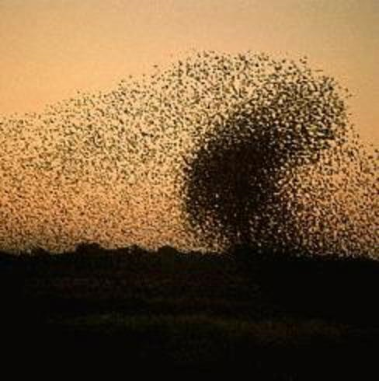
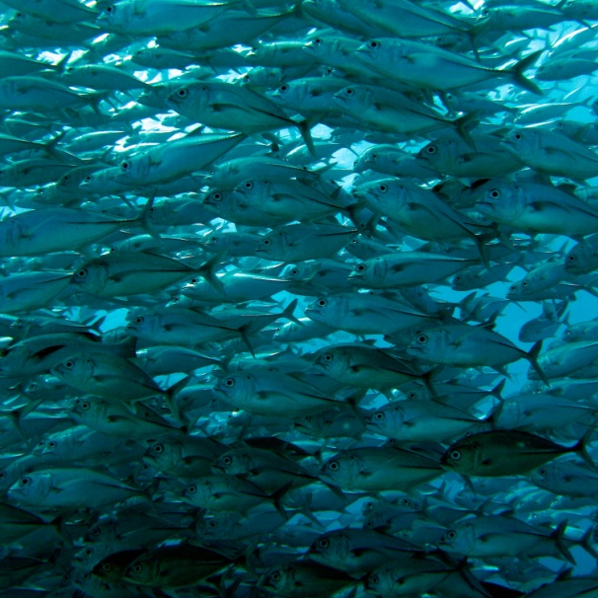
Introduction to the PSO: Algorithm
[x*] = PSO()
P = Particle_Initialization();
For i=1 to it_max
For each particle p in P do
fp = f(p);
If fp is better than f(pBest)
pBest = p;
end
end gBest = best p in P;
For each particle p in P do
v = v + c1*rand*(pBest – p) + c2*rand*(gBest – p);
p = p + v; end end

Slide 15
Introduction to the PSO: Algorithm
Particle update rule
p = p + v
with
v = v + c₁ * rand * (pBest – p) + c₂ * rand * (gBest – p)
where
p: particle’s position
v: path direction
c₁: weight of local information
c₂: weight of global information
pBest: best position of the particle
gBest: best position of the swarm
rand: random variable
Notes:
c1, c2 : The balance factors between the effect of self-knowledge and social knowledge in moving the particle towards the target. Usually the value 2 is suggested for both factors in the literature)
rand :A random number between 0 and 1, and different at each iteration
w : Inertia weight
pbest : The best position of a particle
gbest : The best position within the swarm
prtvel : The velocity of jth particle in ith iteration
prtpos : The position of jth particle in ith iteration

Slide 16
Introduction to the PSO: Algorithm - Parameters
Number of particles usually between 10 and 50
C₁ is the importance of personal best value
C₂ is the importance of neighborhood best value
Usually C₁ + C₂ = 4 (empirically chosen value)
If velocity is too low → algorithm too slow
If velocity is too high → algorithm too unstable

Slide 17
Introduction to the PSO: Algorithm
Create a ‘population’ of agents (particles) uniformly distributed over X
Evaluate each particle’s position according to the objective function
If a particle’s current position is better than its previous best position, update it
Determine the best particle (according to the particle’s previous best positions)

Slide 18
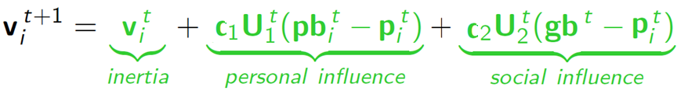

Introduction to the PSO: Algorithm
Update particles’ velocities:
Move particles to their new positions:
Go to step 2 until stopping criteria are satisfied

Slide 19
Introduction to the PSO: Algorithm
Particle’s velocity:
1. Inertia
Makes the particle move in the same direction and with the same velocity
Improves the individual
Makes the particle return to a previous position, better than the current
Conservative
2. Personal Influence
3. Social Influence
Makes the particle follow the best neighbors direction

Slide 20
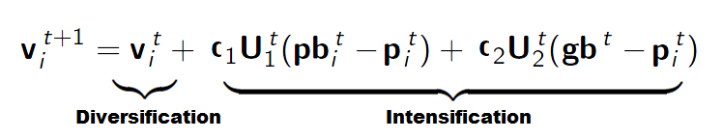
Introduction to the PSO: Algorithm
Intensification: explores the previous solutions, finds the best solution of a given region
Diversification: searches new solutions, finds the regions with potentially the best solutions
In PSO:

Slide 21
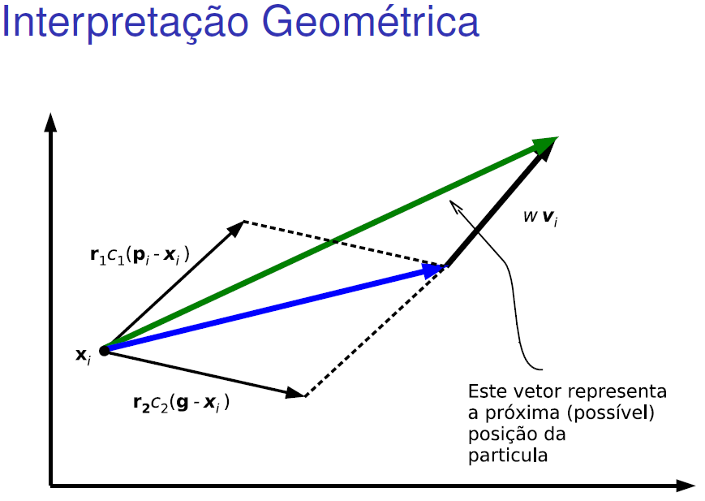

Slide 22
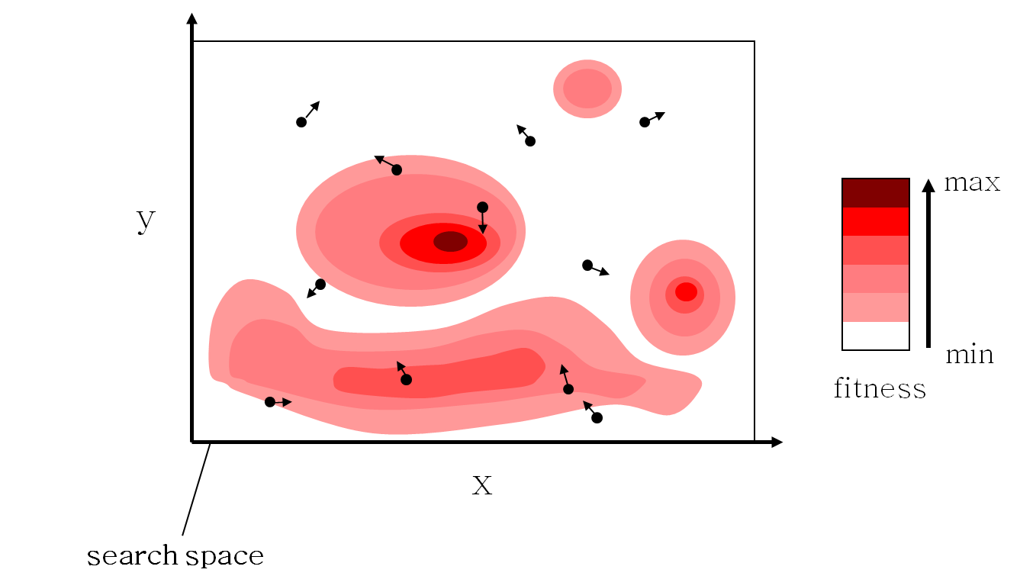
Introduction to the PSO: Algorithm - Example

Slide 23
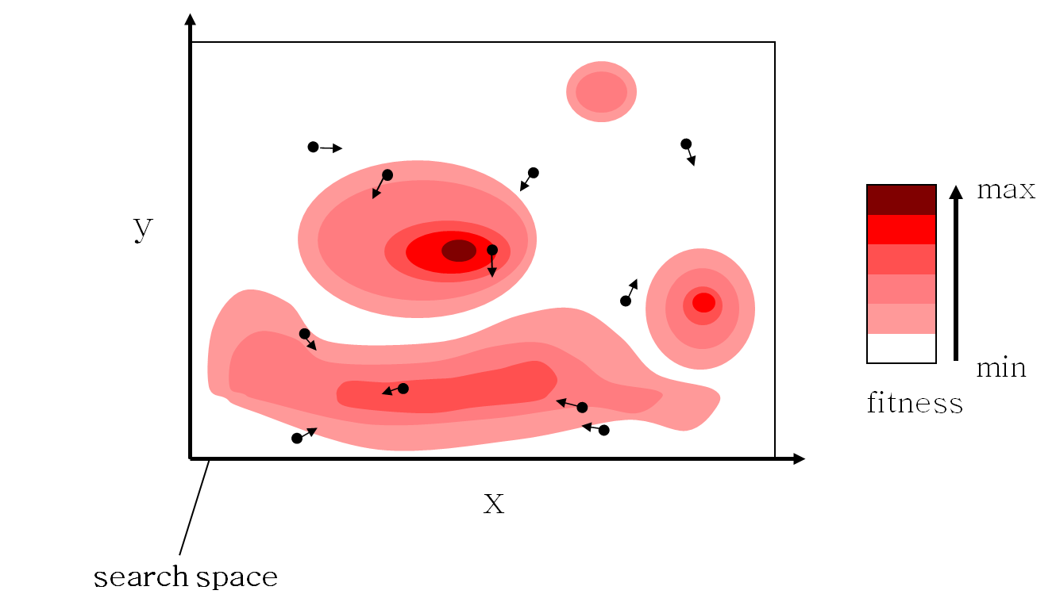
Introduction to the PSO: Algorithm - Example

Slide 24
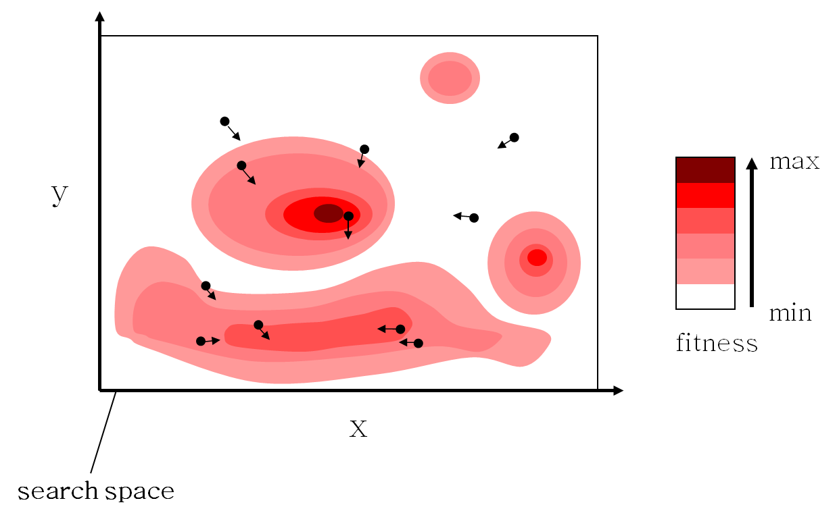
Introduction to the PSO: Algorithm - Example

Slide 25

Introduction to the PSO: Algorithm - Example

Slide 26

Introduction to the PSO: Algorithm - Example

Slide 27
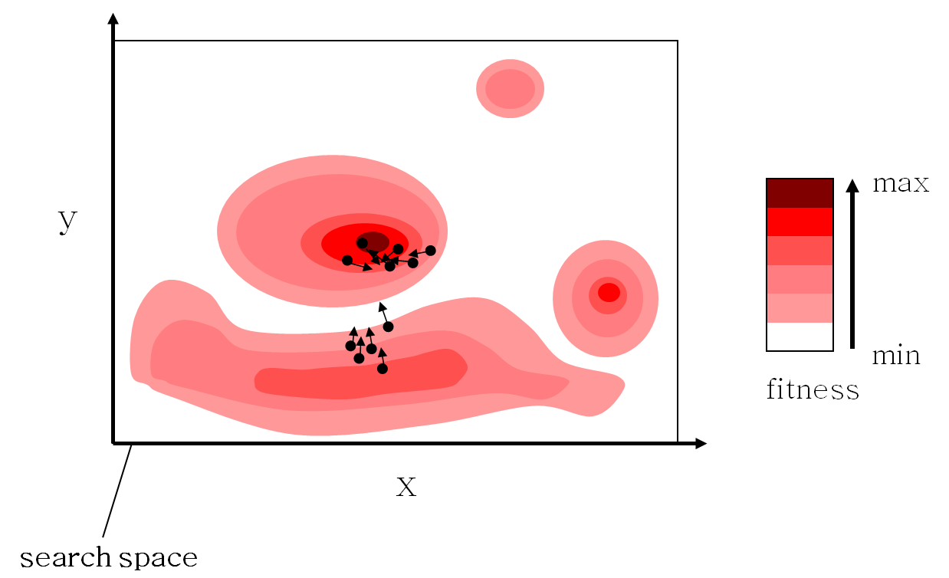
Introduction to the PSO: Algorithm - Example

Slide 28
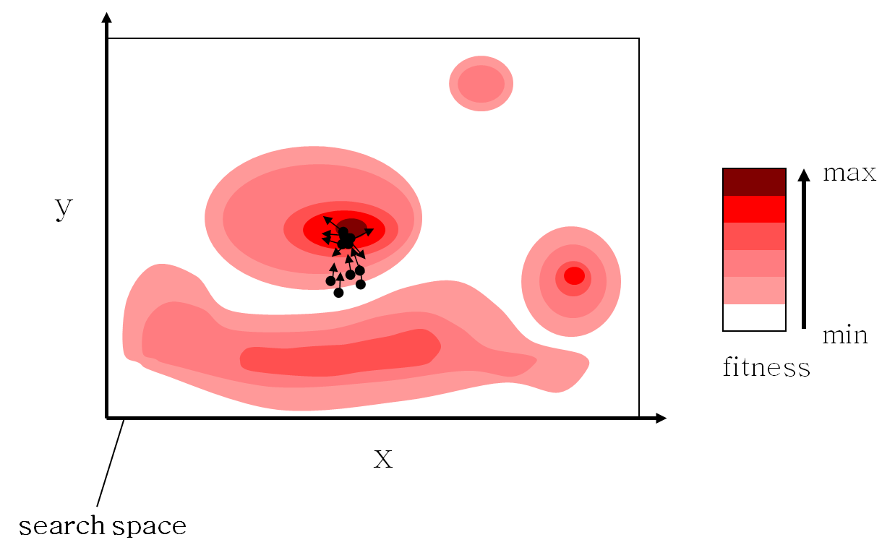
Introduction to the PSO: Algorithm - Example

Slide 29

Introduction to the PSO: Algorithm - Example

Slide 30
Exemplo: 1ª Iteração
Problema de minimização
2
3
1
Inicialização as posições
Criando o vetor de velocidades
melhor partícula
outra partícula

Slide 31
Exemplo: 2ª Iteração
Problema de minimização
2
3
1
1
Atualizando as posições
Modificando o vetor de velocidades
melhor partícula
outra partícula

Slide 32
Termo de inércia

Slide 33
Posição atual (x)
Melhor posição do indivíduo (pbest)
Melhor posição individual (pbest)

Slide 34
Posição atual (x)
Melhor posição do indivíduo (pbest)
Melhor posição global (gbest)
Melhor posição global (gbest)

Slide 35
Introduction to the PSO: Algorithm Characteristics
Advantages
Insensitive to scaling of design variables
Simple implementation
Easily parallelized for concurrent processing
Derivative free
Very few algorithm parameters
Very efficient global search algorithm
Disadvantages
Tendency to a fast and premature convergence in mid optimum points
Slow convergence in refined search stage (weak local search ability)

Slide 36
Introduction to the PSO: Different Approaches
Several approaches
2-D Otsu PSO
Active Target PSO
Adaptive PSO
Adaptive Mutation PSO
Adaptive PSO Guided by Acceleration Information
Attractive Repulsive Particle Swarm Optimization
Binary PSO
Cooperative Multiple PSO
Dynamic and Adjustable PSO
Extended Particle Swarms
…
Davoud Sedighizadeh and Ellips Masehian, “Particle Swarm Optimization Methods, Taxonomy and Applications”.
International Journal of Computer Theory and Engineering, Vol. 1, No. 5, December 2009

Slide 37
Some functions often used for testing real-valued optimisation algorithms
Griewank
Rastrigin
Rosenbrock
Notes:
Let us see now a few examples with some very well known test functions.
Of course far more tests have been done and there is now absolutely no doubt that PSO is efficient.

Slide 38
... and some typical results
Optimum=0, dimension=30
Best result after 40 000 evaluations
Notes:
For each test the dimension of the search space is 30, and we stop the run after 40000 evaluations.
As you can see, PSO is not bad at all, compared to a classical evolutionary algorithm.
Of course, this example is quite old, and there is now some better evolutionary or genetic algorithms, but there is also some better PSO versions.
As usually, it does not make sense to simply say “PSO is better”, or “GAs are better”, so, please, consider this slide just as an illustration of the fact that PSO is at least as good as some better known methods.

Slide 39
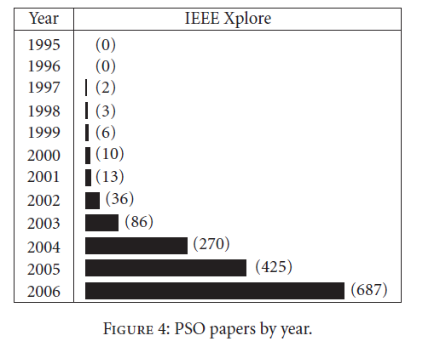
This is from Poli, R. (2008). "Analysis of the publications on the applications of particle swarm optimisation". Journal of Artificial Evolution and Applications 2008: 1–10.

Slide 40
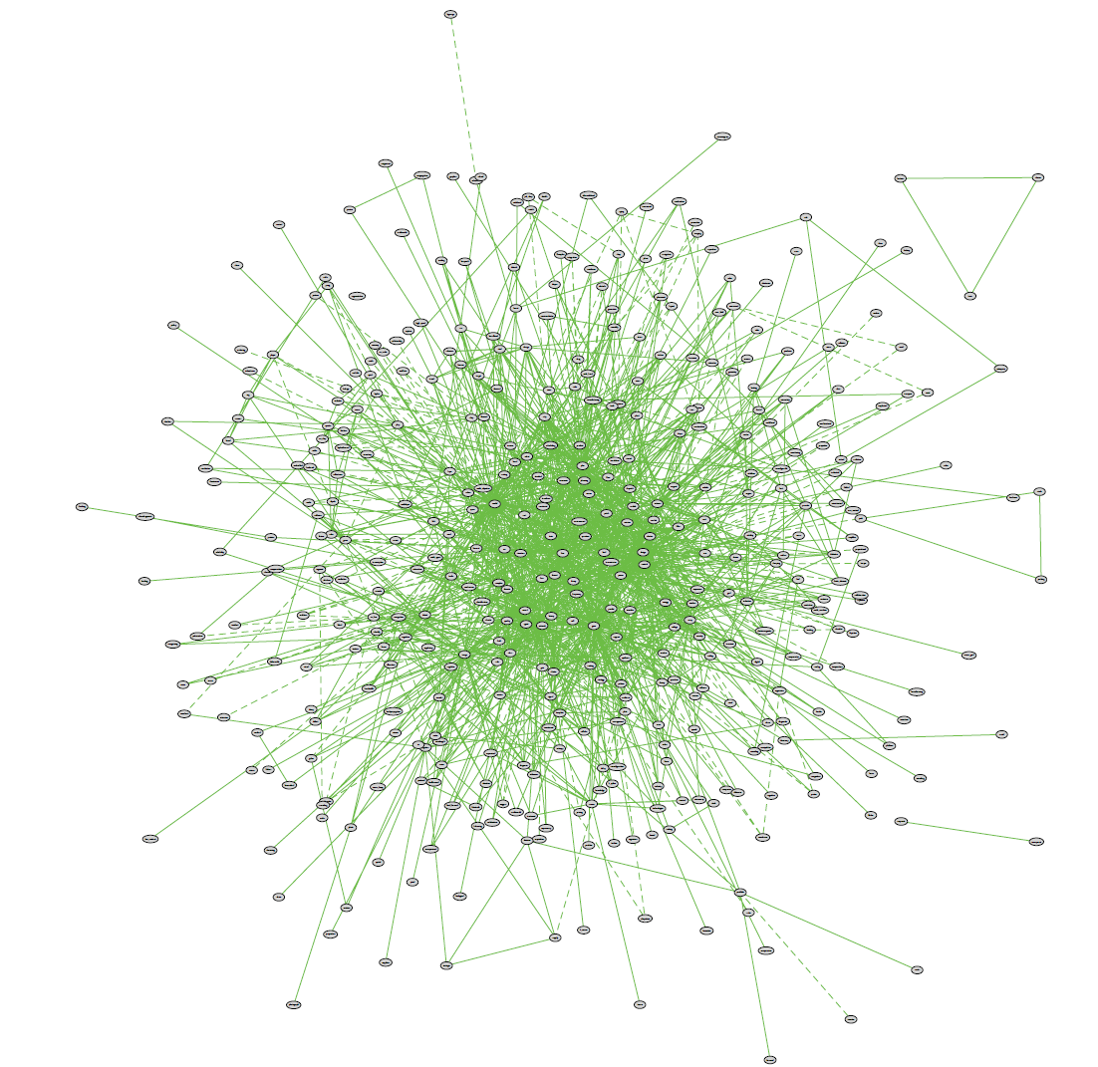
So is this

Slide 41
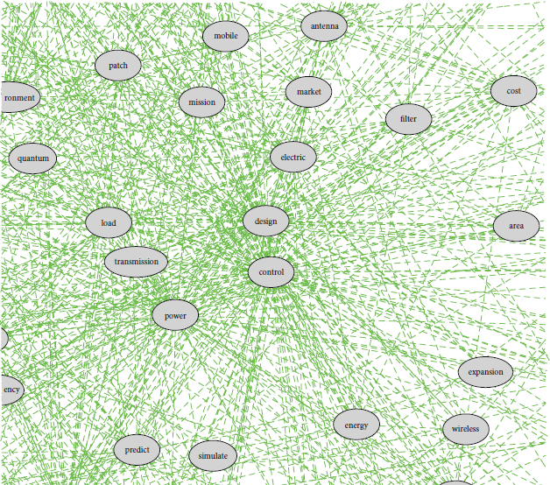
So is this

Slide 42
Adaptive swarm size
There has been enough improvement
I try to kill myself
although I'm the worst
I try to generate a new particle
I'm the best
but there has been not enough improvement
Notes:
This is a more recent and sophisticated attempt.
I don’t give here the precise formulas, just the underlying metaphors.
On this slide “improvement” means “improvement in the particle’s neighbourhood”, and “I try” means success is depending on the current swarm size, according to a probability rule.
The good point is you don’t have anymore to “guess” what could be the best swarm size, or to launch a lot of runs to find it, for you can perfectly begin with a very small swarm, and let it increase and decrease by itself.
Note that by using the same kind of metaphor, it is also possible to adapt the neighbourhood size.

Slide 43
Adaptive coefficients
rand(0…b)(p-x)
αv
The better I am, the more I follow my own way
The better is my best neighbour, the more I tend to go towards him
Notes:
You can also use adaptive coefficients. The theory gives a range of admissible values, in order to have a non divergent process.
Same remark as before: you don’t have anymore to try and try again in order to find a good set of coefficients.

Slide 44
PSO for the BPP: Introduction
On solving Multiobjective Bin Packing Problem Using Particle Swarm Optimization
D.S Liu, K.C. Tan, C.K. Goh and W.K. Ho
2006 - IEEE Congress on Evolutionary Computation
First implementation of PSO for BPP

Slide 45
PSO for the BPP: Problem Formulation
Multi-Objective 2D BPP
Maximum of I bins with width W and height H
J items with w_{j} ≤ W, h_{j} ≤ H and weight ψ_{j}
Objectives
Minimize the number of bins used K
Minimize the average deviation between the overall centre of gravity and the desired one

Slide 46
PSO for the BPP: Initialization
Usually generated randomly
In this work:
Solution from Bottom Left Fill (BLF) heuristic
To sort the rectangles for BLF:
Random
According to a criteria (width, weight, area, perimeter..)

Slide 47
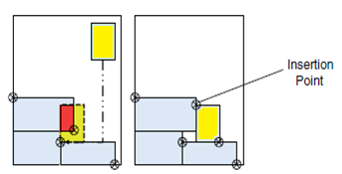
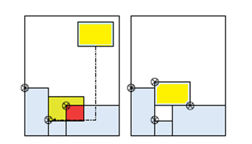
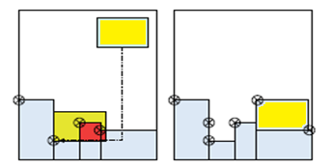
PSO for the BPP: Initialization BLF
Item moved to the right if
intersection detected at the top
Item moved to the top if
intersection detected at the right
Item moved if there is a lower available space for insertion

Slide 48
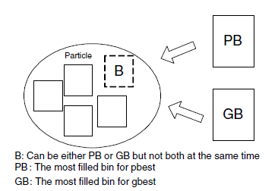


PSO for the BPP: Algorithm
Velocity depends on either pbest or gbest: never both at the same time
OR

Slide 49
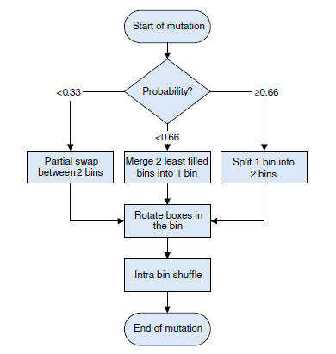
PSO for the BPP: Algorithm
1st Stage:
Partial Swap between 2 bins
Merge 2 bins
Split 1 bin
2nd Stage:
Random rotation
3rd Stage:
Random shuffle
Mutation modes for a single particle

Slide 50
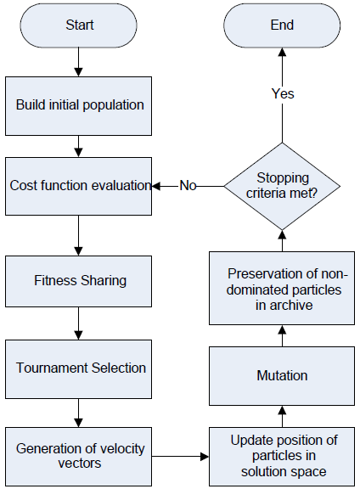
PSO for the BPP: Algorithm
H hybrid
M multi
O objective
P particle
S swarm
O optimization
The flowchart of HMOPSO

Slide 51
PSO for the BPP: Problem Formulation
6 classes with 20 instances randomly generated
Size range:
Class 1: [0, 100]
Class 2: [0, 25]
Class 3: [0, 50]
Class 4: [0, 75]
Class 5: [25, 75]
Class 6: [25, 50]
Class 2: small items → more difficult to pack

Slide 52
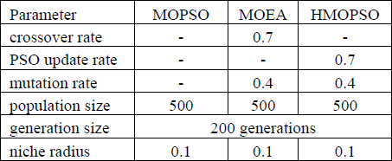
PSO for the BPP: Simulation Results
Comparison with 2 other methods
MOPSO (Multiobjective PSO) from [1]
MOEA (Multiobjective Evolutionary Algorithm) from [2]
Definition of parameters:
[1] Wang, K. P., Huang, L., Zhou C. G. and Pang, W., “Particle Swarm Optimization for Traveling Salesman Problem,” International Conference on Machine Learning and Cybernetics, vol. 3, pp. 1583-1585, 2003.
[2] Tan, K. C., Lee, T. H., Chew, Y. H., and Lee, L. H., “A hybrid multiobjective evolutionary algorithm for solving truck and trailer vehicle routing problems,” IEEE Congress on Evolutionary Computation, vol. 3, pp. 2134-2141, 2003.

Slide 53
PSO for the BPP: Simulation Results
Comparison on the performance of metaheuristic algorithms against the branch and bound method (BB) on single objective BPP
Results for each algorithm in 10 runs
Proposed method (HMOPSO) capable of evolving more optimal solution as compared to BB in 5 out of 6 classes of test instances

Slide 54
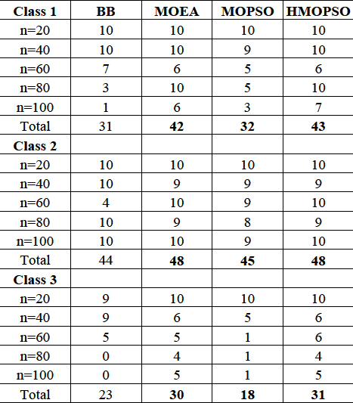
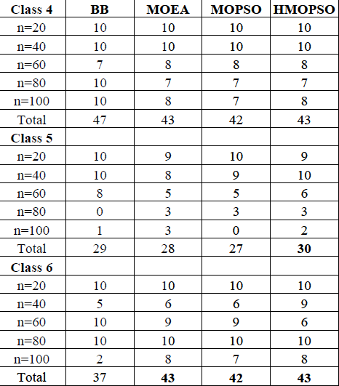
PSO for the BPP: Simulation Results
Number of optimal solution obtained

Slide 55
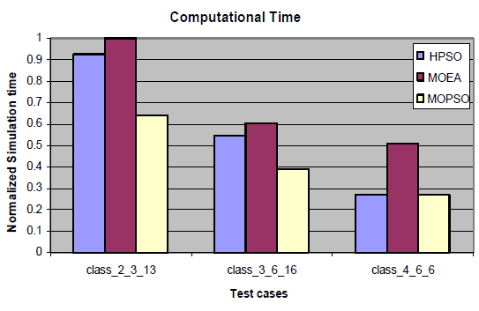
PSO for the BPP: Simulation Results
Computational Efficiency
stop after 1000 iterations or no improvement in last 5 generations
MOPSO obtained inferior results compared to the other two

Slide 56
PSO for the BPP: Conclusions
Presentation of a mathematical model for MOBPP-2D
MOBPP-2D solved by the proposed HMOPSO
BLF chosen as the decoding heuristic
HMOPSO is a robust search optimization algorithm
Creation of variable length data structure
Specialized mutation operator
HMOPSO performs consistently well with the best average performance on the performance metric
Outperforms MOPSO and MOEA in most of the test cases used in this paper

Slide 57
The Particle Swarm Optimization Algorithm
?

