Slide 1
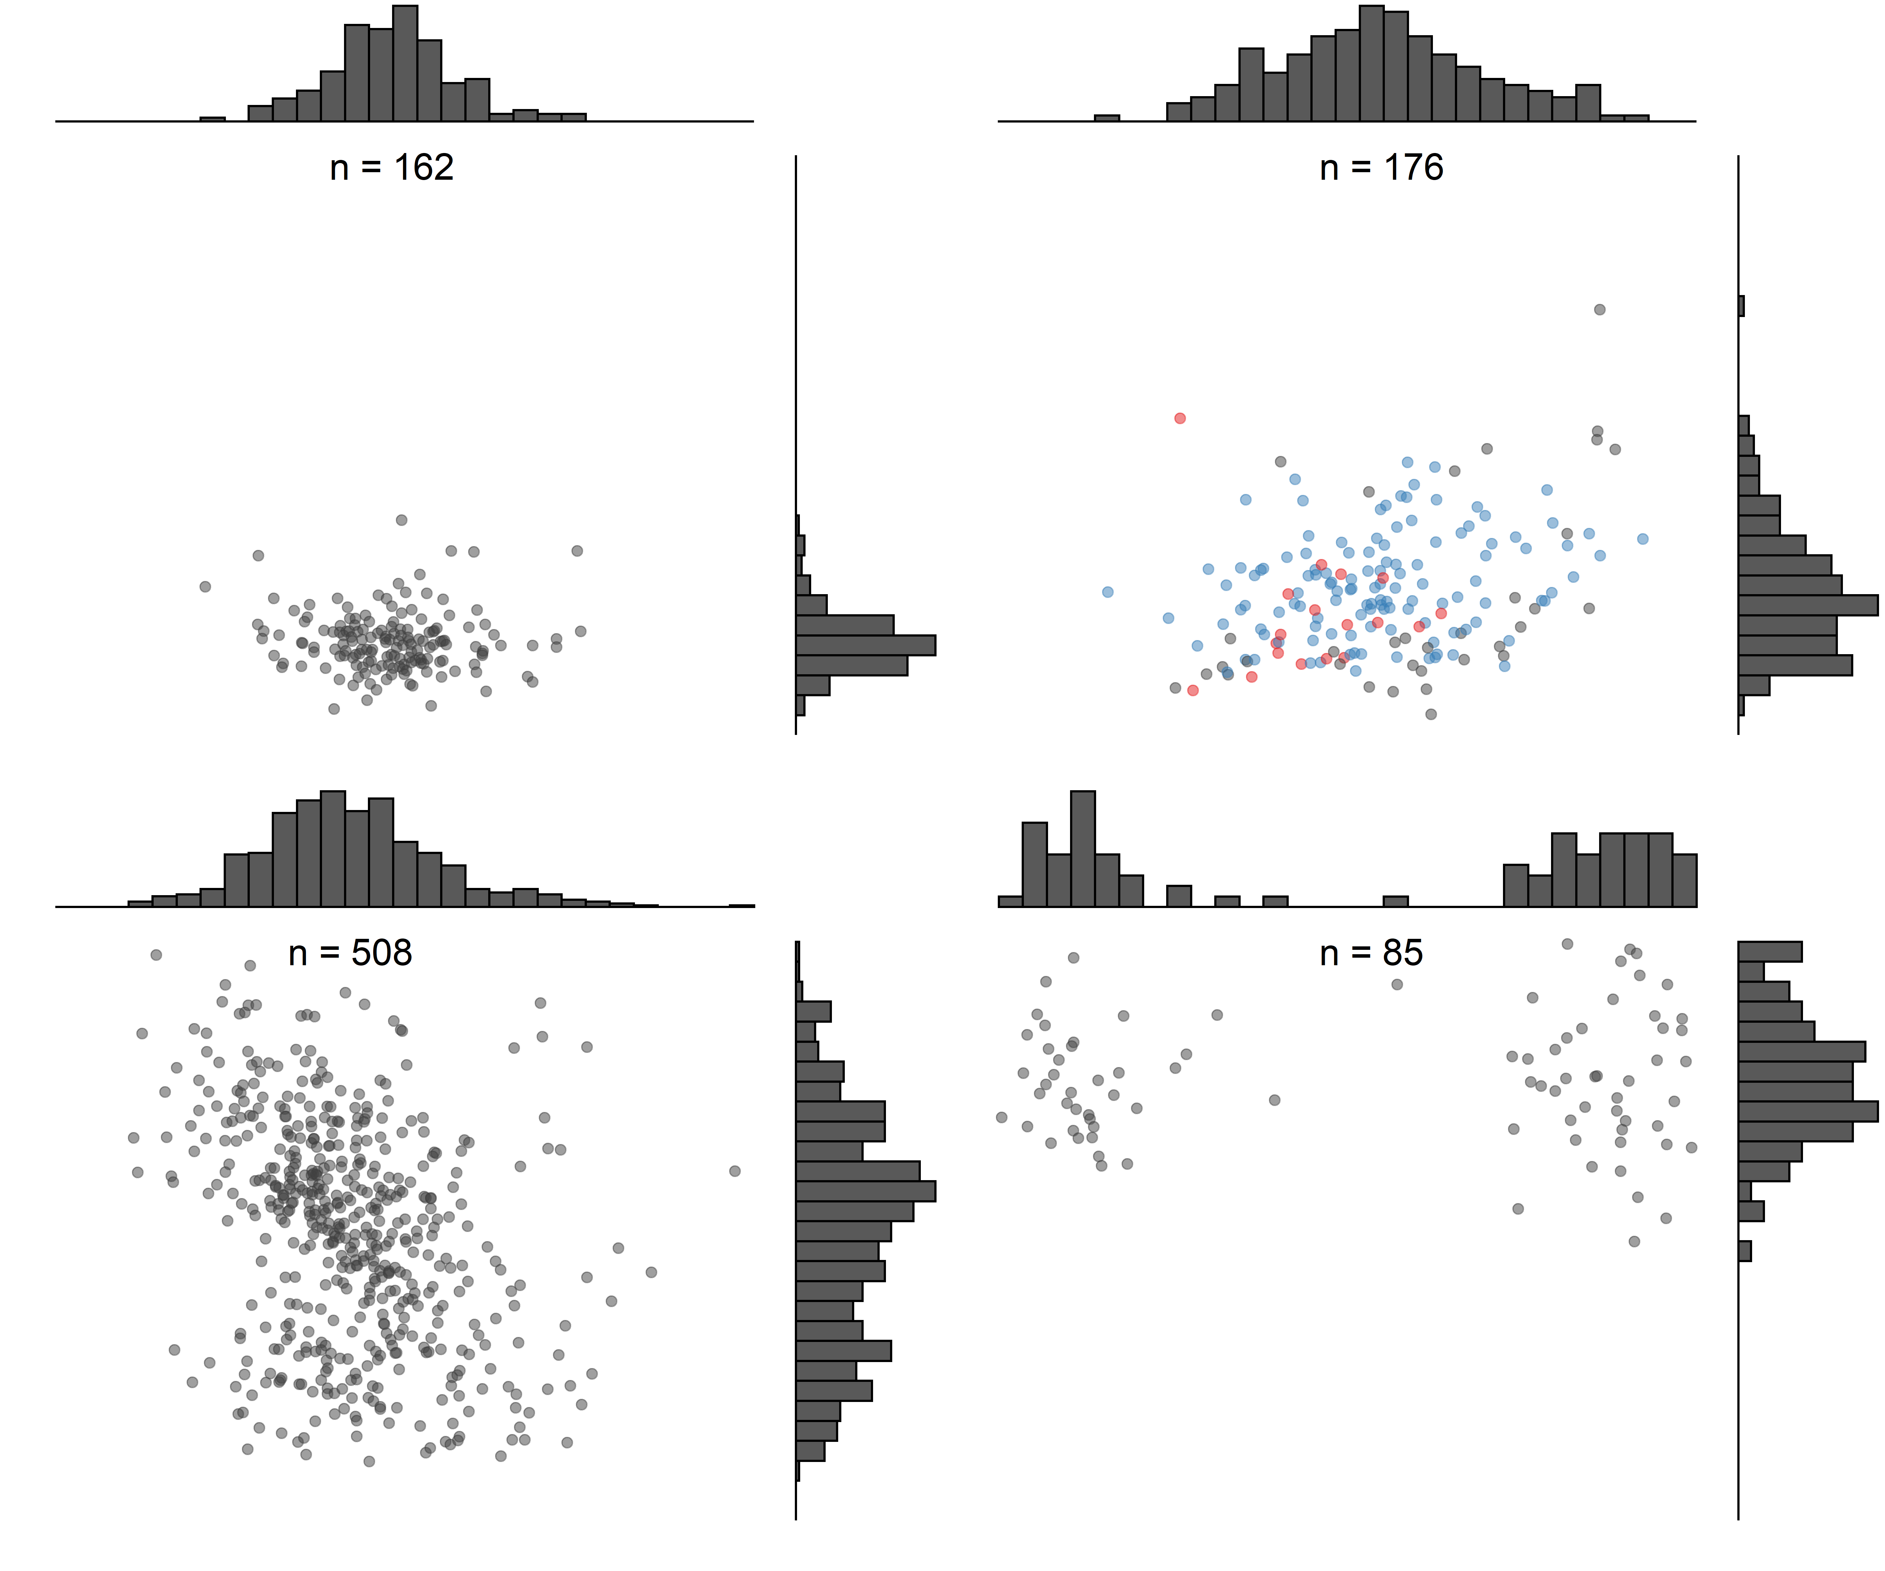
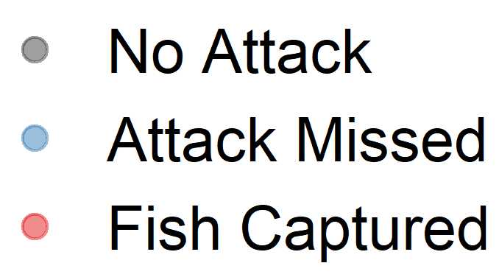
No Turtle
Turtle
River Herring
Resident Fishes
Notes:
All individual elements of figure

Slide 2
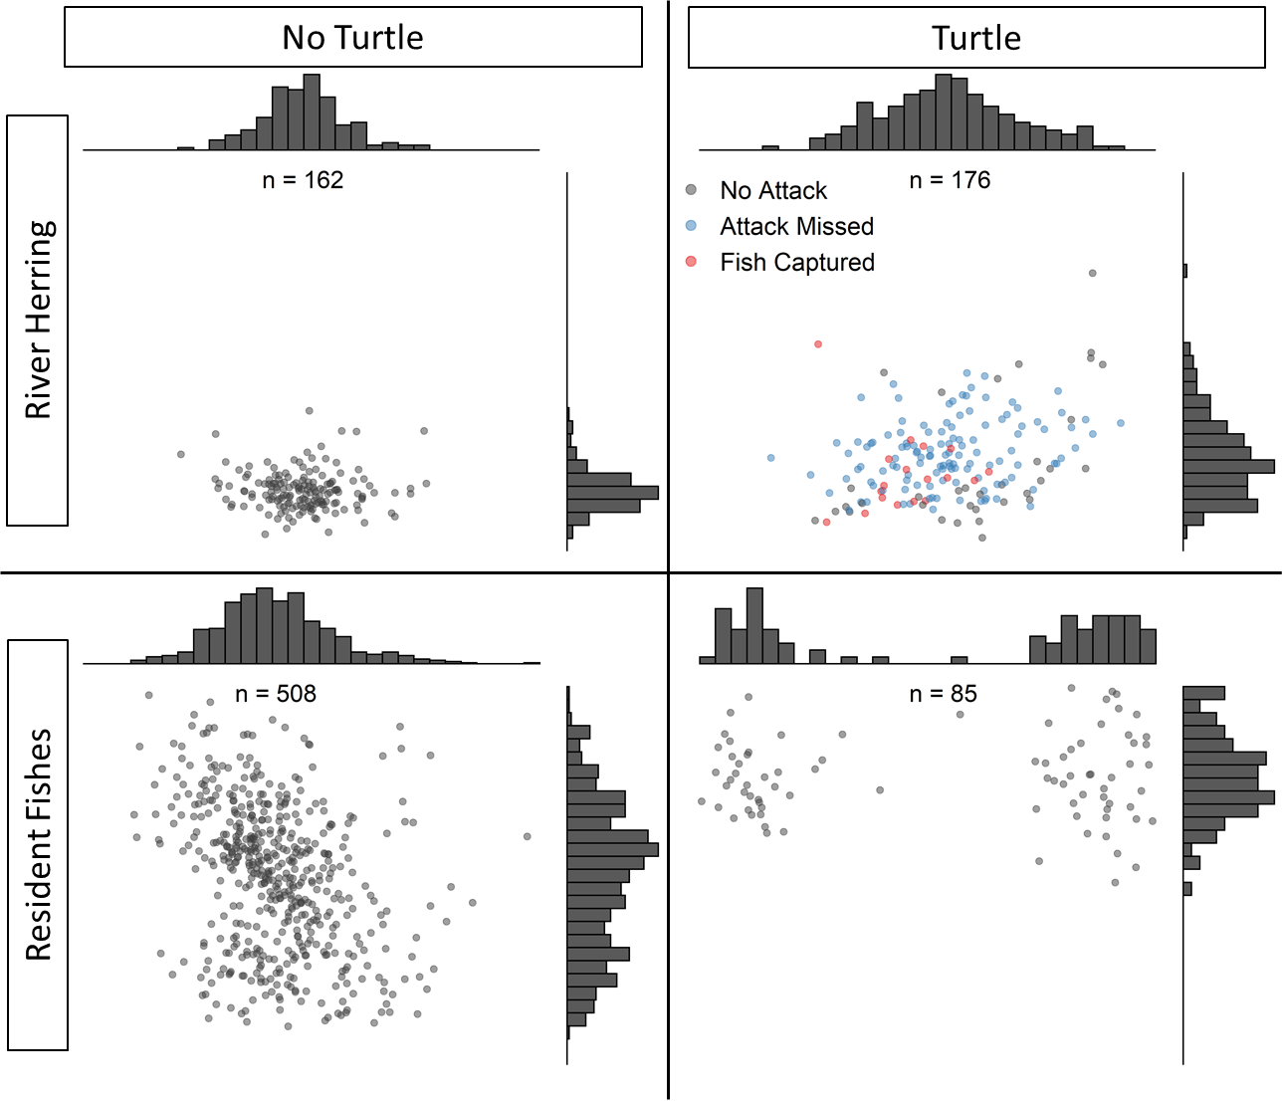
Notes:
Copy and paste all elements from slide 1 into slide 2 “paste as picture” so this is one image. Then copy and paste this image into manuscript.

