Slide 1


Escape From Tarkov: Bullet Damage, Penetration, & Durability Drain
By Samuel Kashiwase and Dale Alabastro

Slide 2
What’s the system about?
An informative program for EFT
User chooses specific bullet from given list:
AR, AK, generic rifle, generic pistol
From there, user choose info display:
Damage vs Body
Penetration vs Armor
Durability vs Firearm
User can repeat program if needed

Slide 3
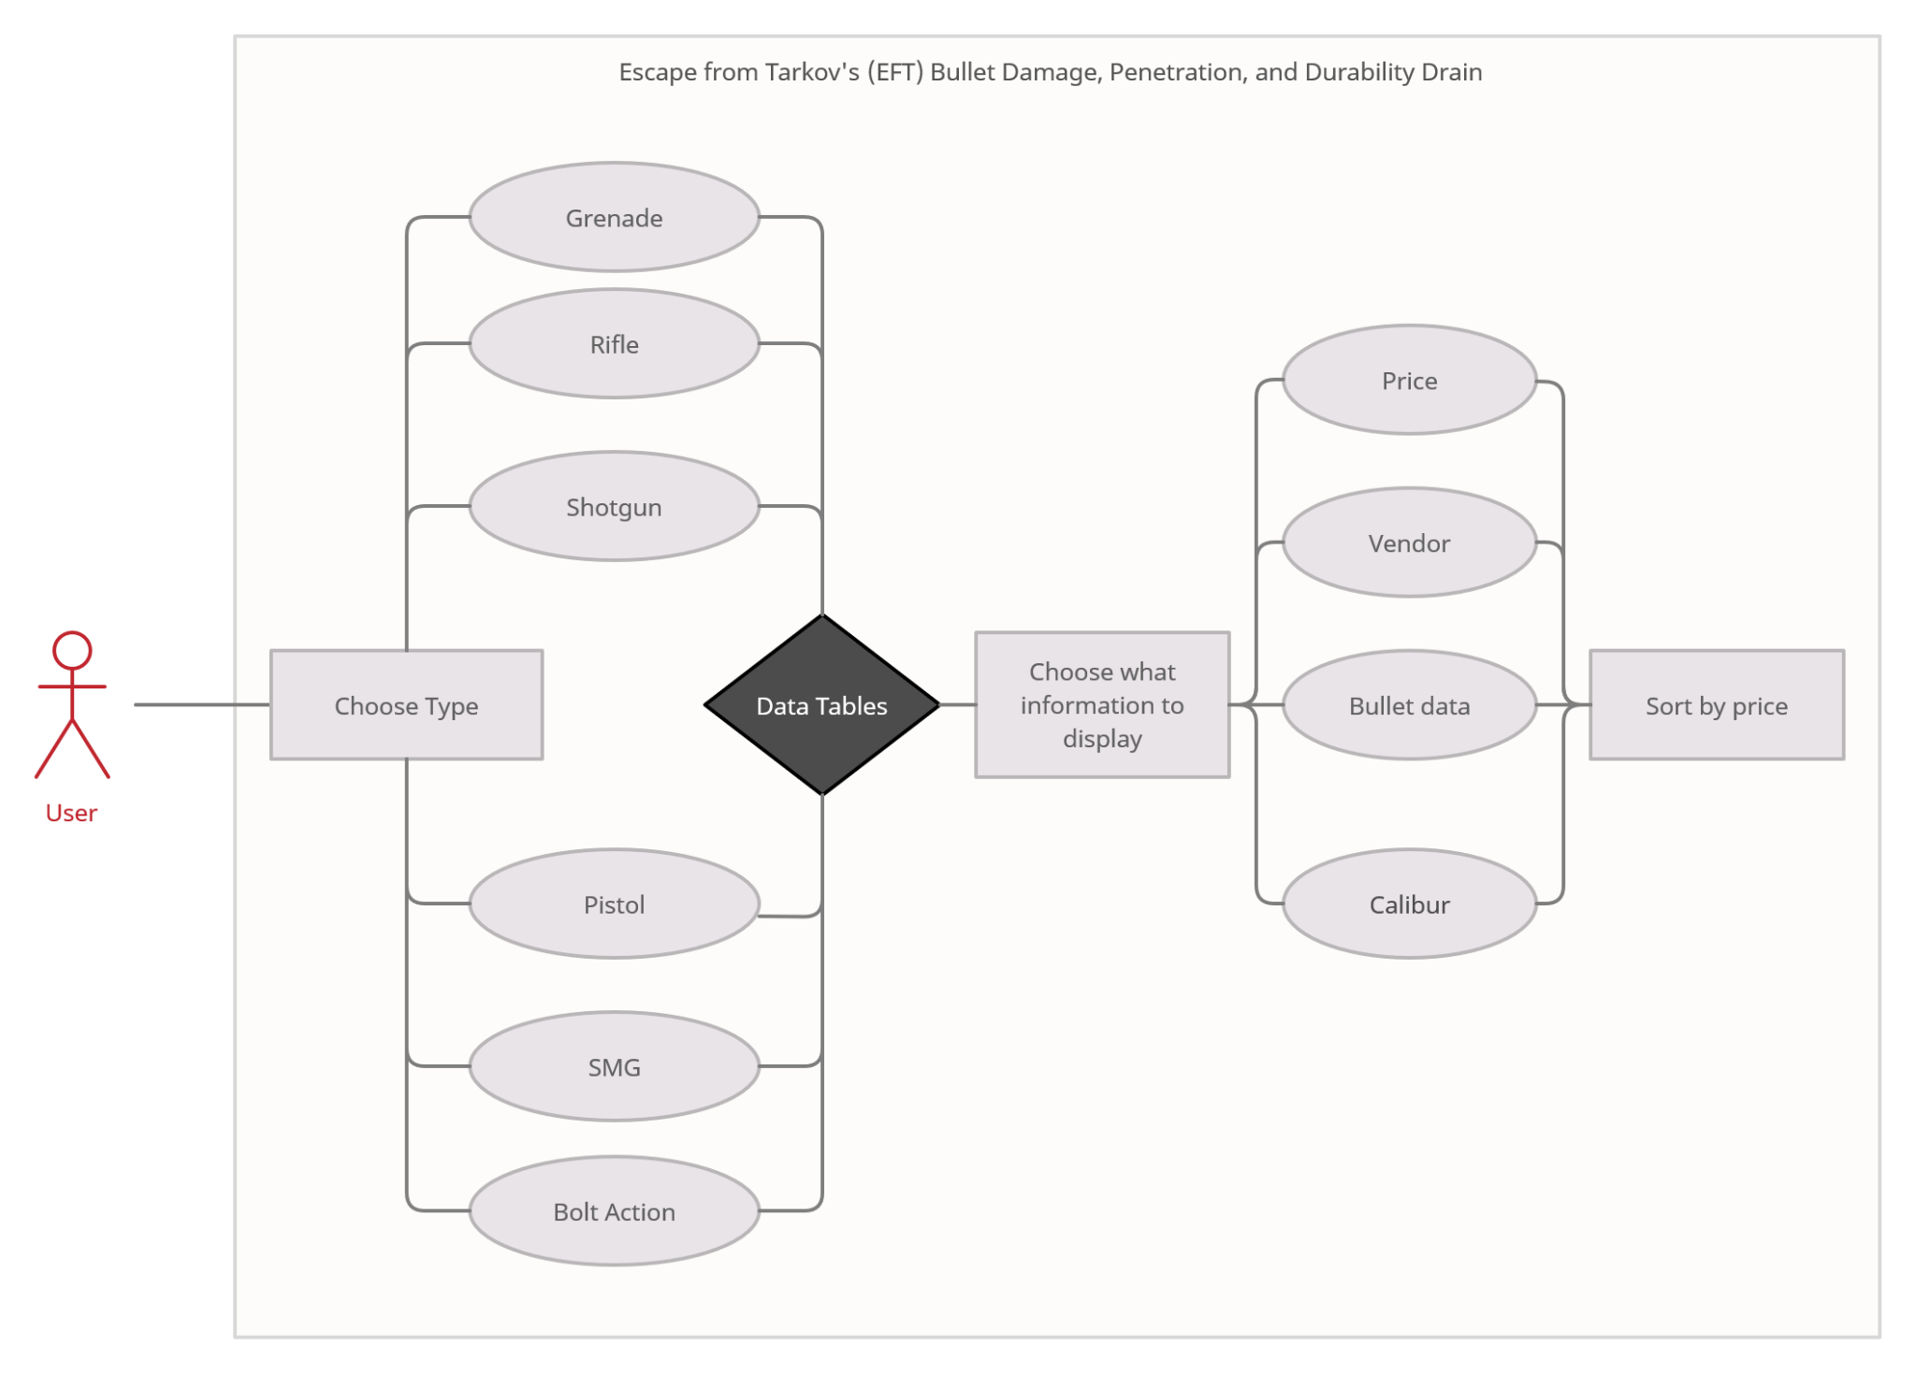
Use case diagram

Slide 4
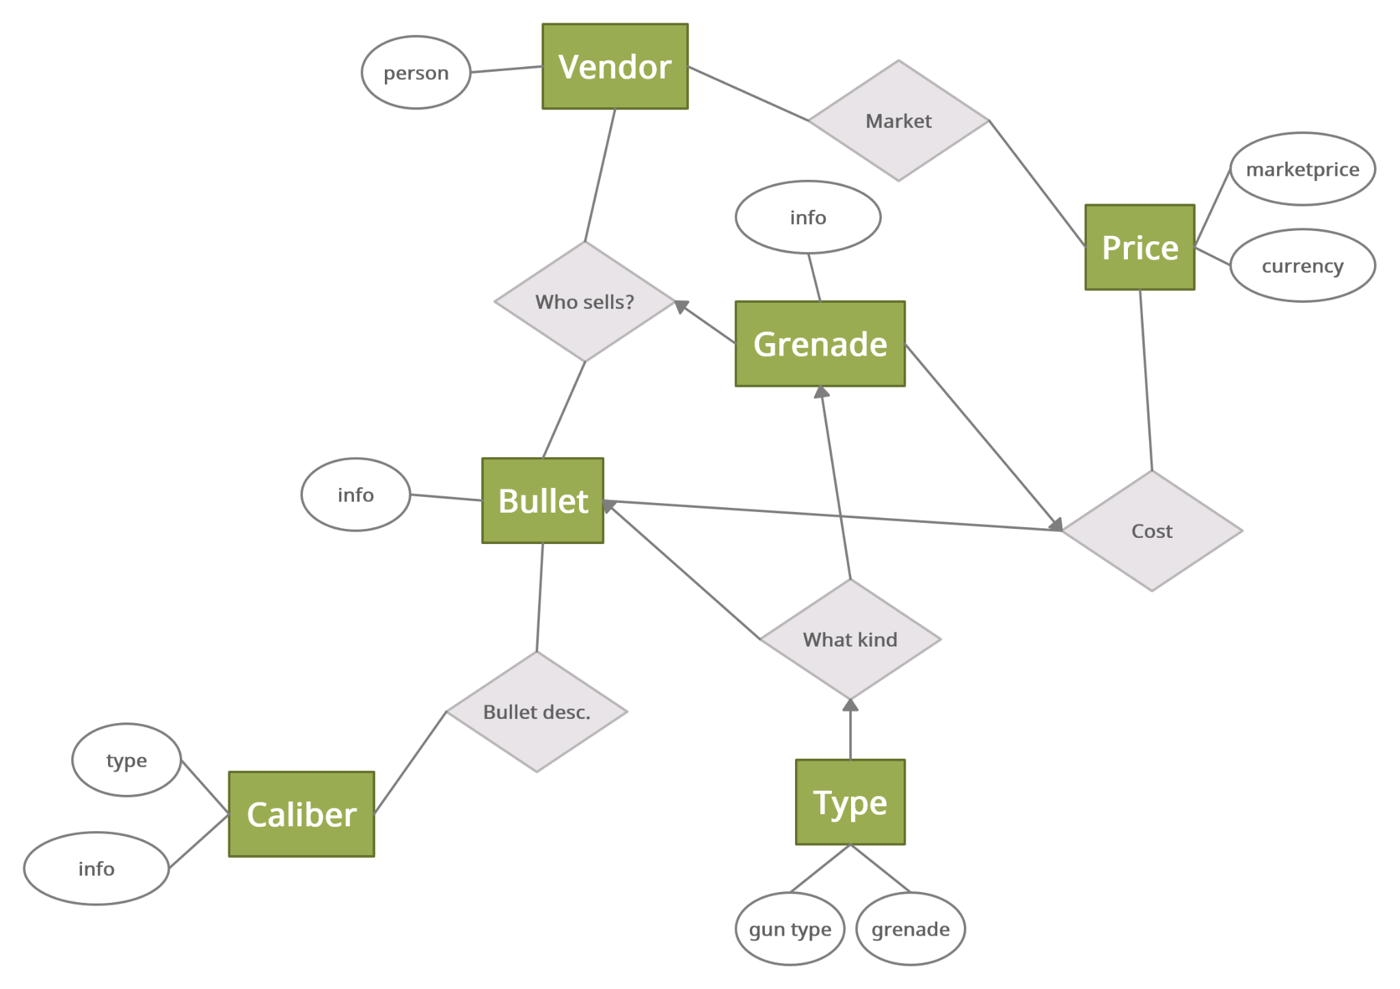
E/R Diagram

Slide 5
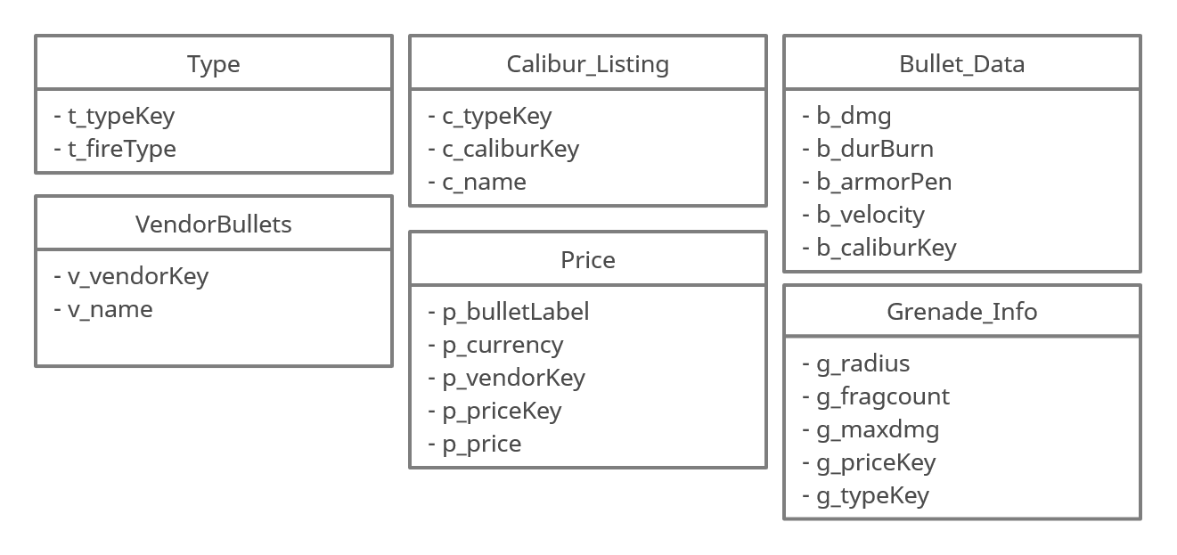
Relational Schema

Slide 6
Implementation
IDE
VisualCode Studio
Database
SQLite3
User Interface
HTML, CSS, PHP

