Slide 1
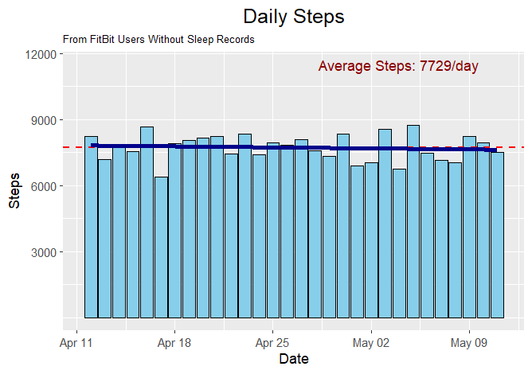
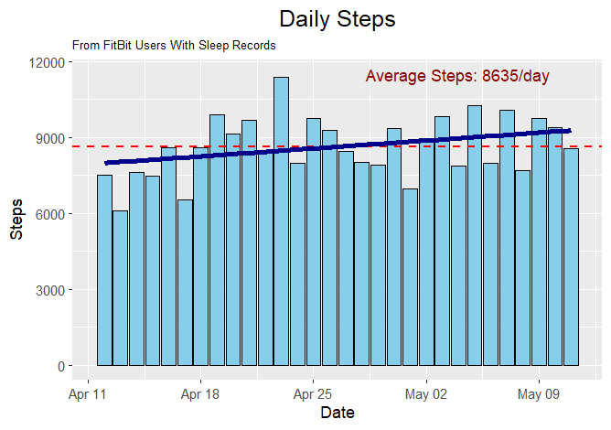
Business Task: Analyze general customer usage of fitness tracking devices to uncover trends and generate insights that can be applied to Bellabeat’s Time watch and improve its overall sales.
Main Recommendation:
1) Promote the reliance and consistent usage of the Time watch to improve fitness results

Slide 2
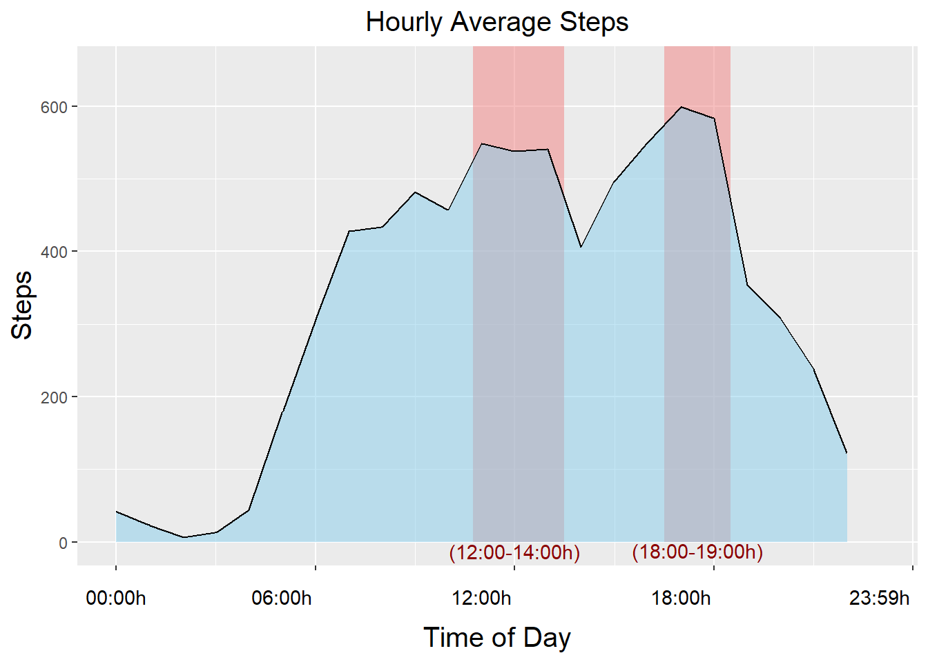
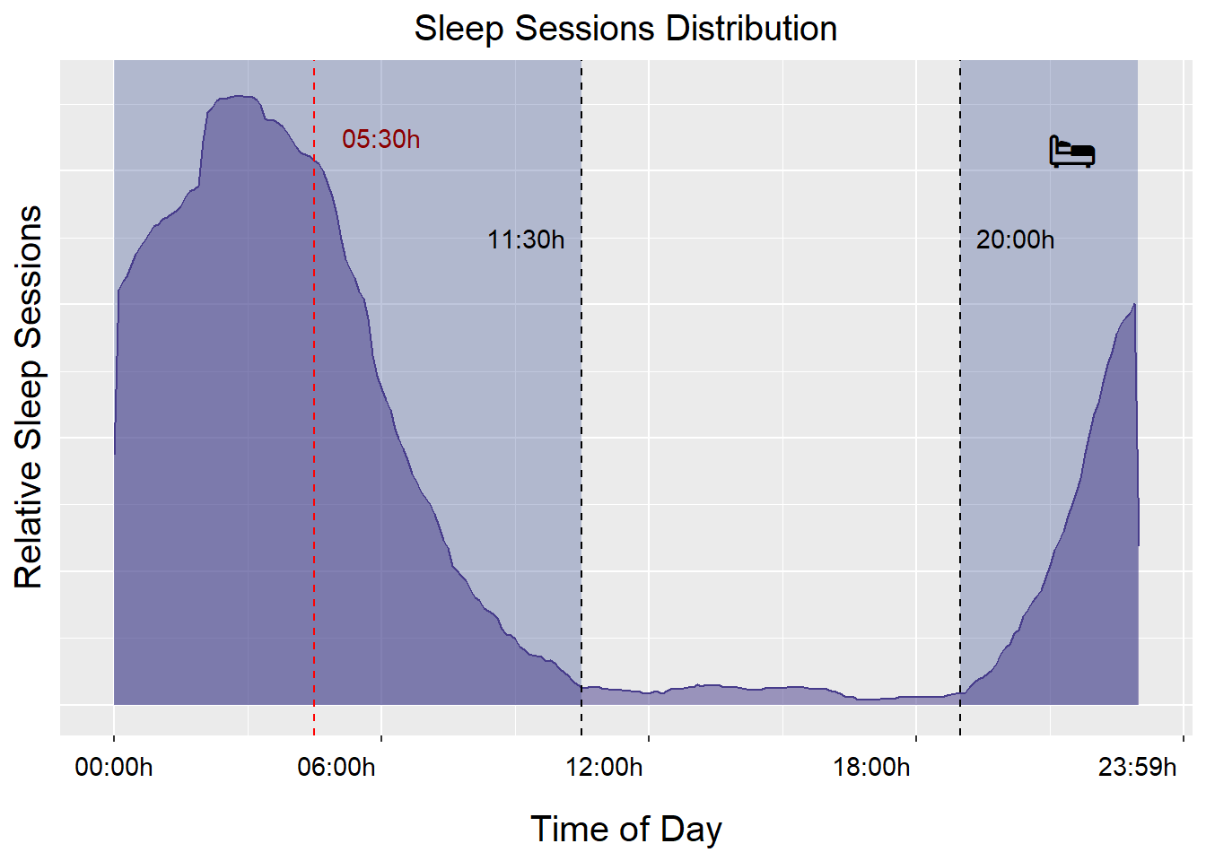
Other recommendations:
2) Match the timing of marketing strategies to coincide with the average schedules and peak activity times of users
3) Appeal to the broader population by highlighting the sleep tracking capabilities of the Time watch
Link to full study: https://dalealberto.github.io/Case_Study_GDA/

