Slide 1

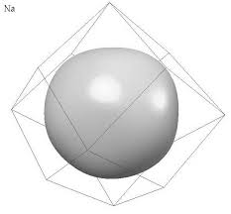
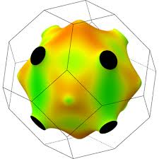
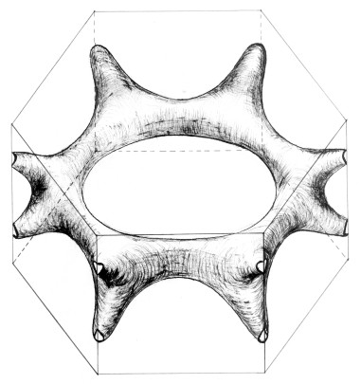
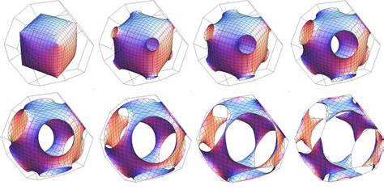
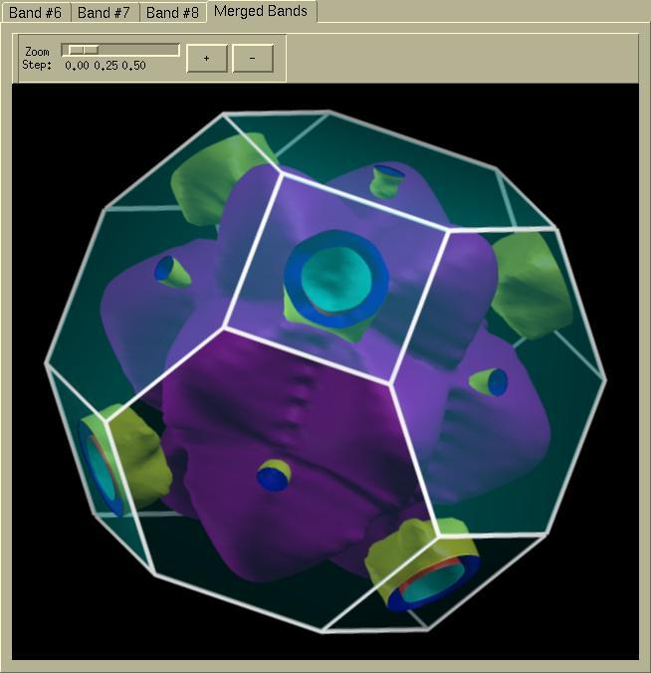
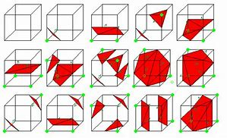
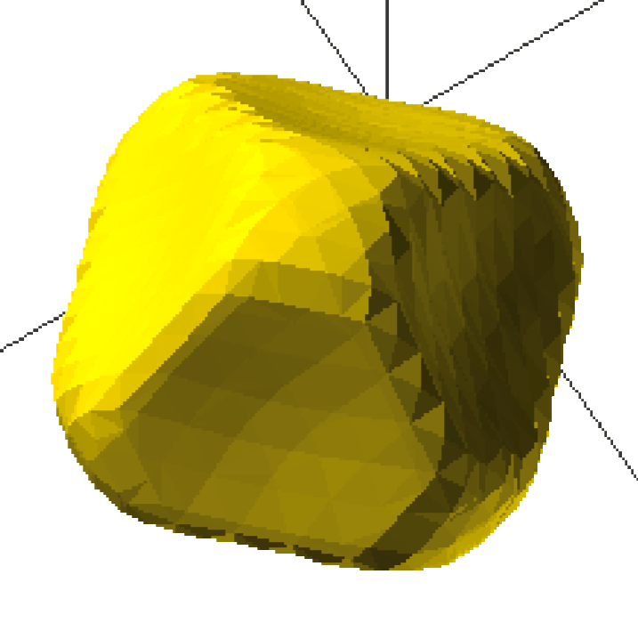
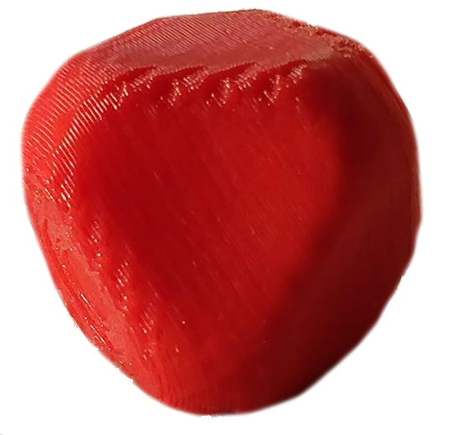

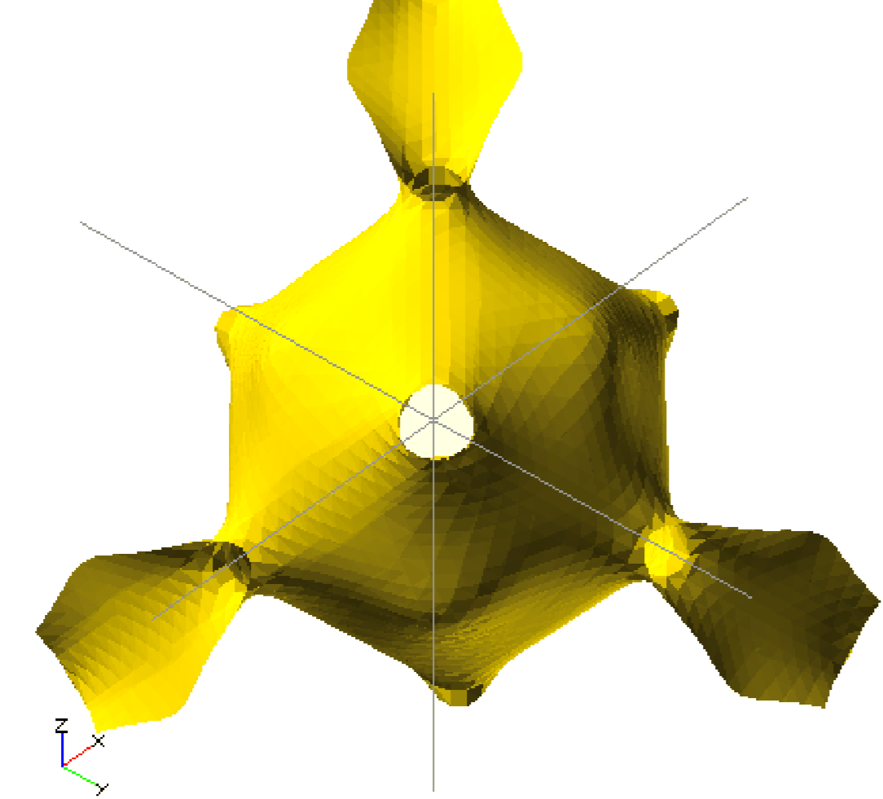
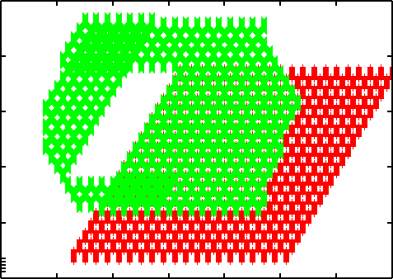
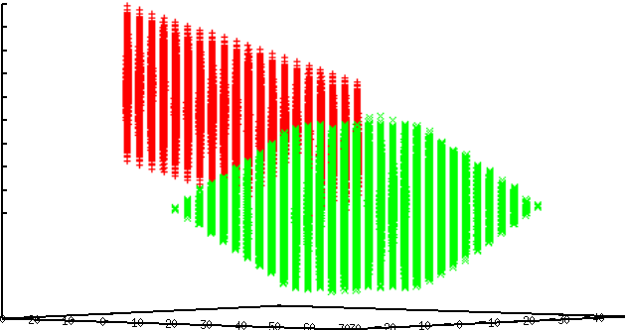
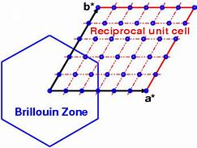
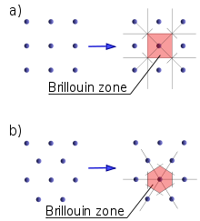
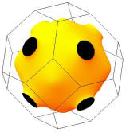
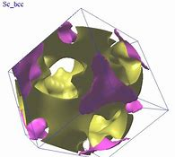

http://maces.ucmerced.edu/
Title: Generalizing Firmi, code for 3D-printing Fermi surfaces
Authors: Brian Hungerman, David Strubbe
A Fermi surface (a surface in momentum space enclosing all the occupied electronic states) is an abstract, yet fundamental property of metals. It is a tool to describe and predict properties of a metal, including:
Conductivity / Superconductivity
Electron-phonon interactions
Many-body physics
Na Co Mg
Thus, understanding of Fermi surfaces is essential, and Firmi (http://faculty.ucmerced.edu/dstrubbe/Firmi/) offers a unique hands-on teaching tool.
In the past five months, research has been conducted to generalize the program, allowing for modeling of more metals and use-cases.
INTRODUCTION / MOTIVATION
Select a metal’s XCrySDen Fermi surface file, containing data on Fermi energies across its unit cell.
Utilize the Marching Cubes algorithm via Fortran, forming a polygonal shape across the energy gradient where it equals a defined Fermi energy.
Export the resulting polygonised isosurface to any computer-aided design program (in our case, OpenSCAD).
Print on any 3D printer (in our case, MakerBot) and enjoy!
➔ ➔ ➔
Pb Pb
http://www.xcrysden.org/ http://marchingcubes.org/ http://www.openscad.org/ https://www.makerbot.com/
METHODS
Firmi worked well for lead’s Fermi surface calculations, but
failed for other elements (e.g. copper).
Copper’s “exploded” isosurface (right):
The two problems to solve:
- Shifting “flaps” from unit cell into Brillouin Zone
Capping holes where Fermi surface touches edges of Brillouin Zone
Visual representations of Brillouin Zone
(http://www.xcrysden.org/doc/XSF.html)
Copper’s “flaps” indicated surfaces outside the first primitive unit cell were being considered and plotted due to an incorrect definition of the Brillouin Zone in code.
Using test cases of various lattice vectors, a simple distance optimization algorithm was implemented, shifting points from the unit cell given from XCrySDen into the Brillouin Zone.
Test cases were visualized via gnuplot (http://gnuplot.info/).
Left: a set of lattice vectors 60°apart from each other correct form a hexagonal Brillouin zone, except for a hole missing in the right side
Right: lead’s lattice vectors correctly form a Brillouin Zone that leaves the 3D surface unchanged.
Ongoing work is being done to determine why the hole exists in the hexagonal Brillouin zone through visualizing the output of the algorithms at various stages during runtime.
DISCUSSION / RESULTS
DISCUSSION / RESULTS
Allowing for more metals to be modeled.
Finishing Brillouin Zone definition.
Capping Fermi surfaces that are not
enclosed in Brillouin Zone.
Thanks to the MACES Undergraduate Research Fellowship for funding and the UC Merced Venture Lab for 3D printing access
FUTURE WORK
ACKNOWLEDGEMENTS

