Slide 1
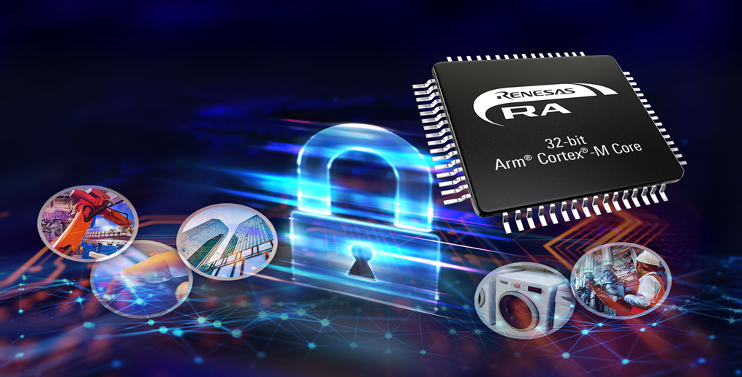
RS-D620
Power sequencer POC
Dale drinkard
Notes:
Renesas, a leading microcontroller supplier, has just introduced a low power microcontroller group, RA2. The RA2L1 MCUs are general purpose microcontrollers that incorporate the ARM Cortex-M23, the latest low power and high performance CPU, as well as a fast 12-bit ADC, powerful motor control PWM timers, multiple serial communications including CAN, cap touch hardware, and security functions. Taking advantage of these advanced features, the RA2 MCUs are ideal options in a wide variety of applications that include home appliance, industrial and building automation, medical and healthcare, and consumer human-machine-interface (HMI) IoT applications.

Slide 2
OVERVIEW
    Motivation:
      AI compute complexes require sequencing and fault management of many different power supplies
      TI has a line of sequencers called the UCD91xxx. It is not difficult to determine that these stand-alone products are essentially an MCU. These sequencers are priced substantially higher than the MCU
        The product is configured through a GUI (Sequencer Studios)
      Renesas wishes to introduce a competitive product based on the RA6T2 with a 100pin and a 64pin option
        These will be marketed as a stand-alone sequencer like the TI model
        These devices will behave, and are fashioned after, the UCD91xxx line.
        A similar GUI is also under development.
    Approach:
      A ground-up effort to support sequencing and fault management with additional features where possible.
      Based on implementing behavior of the TI part through their publicly available material

Slide 3
Architecture (software stack)
    The POC is comprised of the following layers
      application: APP
        This layer will be removed in final product. Its purpose is to provide debug and development capabilities,
      app_sequencer: PowerController
        This is the main-line sequencer which implements the top-level state sequencer for the device.
      power_module
        Contains the API calls for handling rail configurations
        Contains logic for storage-retrieval of configuration data from data flash
      comm_bus: PB_Comm
        Handles Pmbus (or UART) communications for configuration data

Slide 4
POC demo setup (using existing EK-RA6M5)
    For demonstration purposes before specialized boards are available, two EK-RA6M5 boards will be used to demonstrate cascading. The PMbus is mimicked using a UART. The uart operates in half-duplex by Tri stating the TX line until the board is ready to transmit. For development only, the application layer communicates with separate UART channels to dump internal registers and provide debug messaging. One sequencer is deemed the “master” (by a configuration bit) and the rest “slaves”. The master generates a 5 khz (200uS) clock to the slave devices. Boards are distinguishable by their strapped address.

Slide 5
GUI
    Neurealm (a consulting third-party) is developing a GUI. This GUI has the same look and feel as Sequencer Studio

