Slide 1

compute.rhino3d Rhino as a Geometry Server Dale Fugier ▪ dale@mcneel.com
Notes:
Thanks for coming. I know there are other really good workshops going on. I appreciate your interest.

Slide 2
What’s Good…
Rhino and Grasshopper are great for creating geometry.
RhinoCommon, the .NET SDK for Rhino, is powerful and (relatively) easy to use.
openNURBS is great for serializing geometry.
Rhino3dmIO is the .NET version of openNURBS.
Notes:
We hear that the combination of Rhino and Grasshopper are pretty capable of creating geometry. We’ve often told of projects being done with Rhino and Grasshopper. It’s pretty exciting for us to see what all is being done.
And from how widely it’s used, openNURBS is great for reading and writing this geometry to disk, specifically 3dm files. If you are familiar with openNURBS, it’s our free C++ source code that lets you read and write Rhino 3dm files. OpenNURBS was our first open-source project. The code compiles on Windows, macOS, Linux, iOS, and Android. It’s used in various third-party applications like ArchiCAD, SolidWorks, Inventor, SketchUp and many other products to read or write 3dm files directly.
When I speak of openNURBS, I am also referring to Rhino3dmIO.

Slide 3
What Needs Work…
Lots of people working on integrating Rhino with other applications:
Desktop
Web and cloud
Headless?
openNURBS, and Rhino3dmIO, limitations:
No closet point or intersection calculations.
No surface tessellation (meshing).
No Booleans or interpolations.
No area and mass property calculations.
Other…
Notes:
One thing we heard from last year’s AEC Tech conference, and from other conferences, is that everyone seems to be working on project sharing and interoperability between platforms (Revit, Rhino/Grasshopper, AutoCAD, Excel, ETABs, Tekla, etc.).
The other think we heard was that, as good as openNURBS was, it wasn’t as good Rhino All the “good stuff” in in the Rhino SDK.
There are lot of people working in this area.
At last year’s AEC Hackathon, I wrote a project called “Rockfish”, which essentially created a “server” plug-in that ran in Rhino 5 that would accept incoming requests for geometry calculations from non-Rhino .NET clients.
Anyway, it was clear we need to do more work this area.

Slide 4
Rhino Inside™
Allows Rhino and Grasshopper to be embedded in other products.
A development project for developers.
Rhino runs inside other 64-bit Windows applications.
Rhino 7 WIP (Work in Progress)
Notes:
After shipping Rhino 6, we began working on some tools to help with what I just mentioned. One of the impotent tools to come out of this is Rhino Inside.
The Rhino Inside technology allows Rhino and Grasshopper to be embedded within other products.
Rhino Inside is a development project for developers.
Rhino 7 WIP (Work in Progress) can now run inside other 64-bit Windows applications such as Revit, AutoCAD, and potentially inside Solidworks, Photoshop, Excel, etc.

Slide 5
Rhino Inside™
Rhino 5 and prior:
Rhino.exe
Rhino WIP:
Rhino.exe
RhinoCore.dll

Slide 6
Rhino Inside™
Possible to:
Start Rhino and Grasshopper in another product.
Call directly into the host's native APIs from a Grasshopper or a Rhino plug-in.
Access Rhino's APIs through the host application.
Grasshopper definitions can be opened and previewed in Rhino within the same process as the parent.
Object can be natively created by Rhino or Grasshopper within the parent product.

Slide 7
Rhino Inside™
More information
https://www.rhino3d.com/inside
Samples repository on GitHub
https://github.com/mcneel/rhino.inside
Join the discussion
https://discourse.mcneel.com/c/serengeti/inside

Slide 8
Samples
Samples on GitHub
Console application
CAD application

Slide 9
Compute
It’s a Geometry Server.
It’s Client Libraries.
It’s open source.
It’s Work in Progress.
Notes:
What is Compute?

Slide 10
Compute
Rhino Compute Service is an accessible geometry calculator.
A standalone .NET Web Server.
Allows access to the Rhino's geometry library through a stateless REST API via the McNeel cloud.
Based on the Rhino Inside technology to embed Rhino advanced geometry calculation inside an online web service.

Slide 11
Potential Uses
Perform geometry calculations through a cloud-based REST API.
Access RhinoCommon API calls from outside Rhino.
Access to additional RhinoCommon functions not available in openNURBS:
Closest point and intersection calculations.
Surface tessellation (meshing).
Booleans and interpolations.
Area and mass property calculations.
Other…
Local Compute servers can be instantiated for private calculations or parallel computational farms.

Slide 12
Directions
Feedback and learning.
Large-scale testing with iRhino3D.
Private instances.
Add file translation and Grasshopper services.
Support for other online languages.
JavaScript
Python
Open source.

Slide 13
Compute Clients
Two components (e.g. library or package) required:
Rhino3dm
compute-rhino3d

Slide 14
rhino3dm
A set of standalone libraries based on the OpenNURBS geometry library with a RhinoCommon style.
Provides the ability to access and manipulate geometry through .NET , Python or JavaScript applications independent of Rhino.
rhino3dm.NET (a.k.a. Rhino3dmIO) you already know.

Slide 15
Functionality
Create, interrogate, and store all geometry types supported in Rhino.
Points, point clouds, NURBS curves and surfaces, Breps, meshes, annotations and extrusions.
Work with non-geometry classes supported in Rhino.
Layers, object attributes, transforms and viewports.
Read and write all of the above information to and from the .3dm file format.
Use as a client to make calls into the Rhino Compute Server for advanced manipulation of geometry objects.
Available on Windows, macOS, and Linux.

Slide 16
rhino3dm
openNURBS
rhino3dm.net
rhino3d.py
rhino3dm.js

Slide 17
rhino3dm.net
A .NET Assembly (DLL) .
Includes openNURBS, plus an additional layer to assist unmanaged code to be called from managed code using P/Invoke.
Available as a NuGet package on Windows and macOS.

Slide 18
rhino3dm.py
A Python package that can be used on all current versions of CPython (both 2.7 and 3.7).
Includes openNURBS, plus additional C++ to Python bindings, compiled to a C-extension library.
Available on Windows, macOS, and Linux.

Slide 19
rhino3d.js
A JavaScript library with an associated rhino3dm.wasm (WebAssembly).
Includes openNURBS, plus additional C++ to JavaScript bindings, compiled to WebAssembly.
WebAssembly now available technology in all major browsers and node.js.

Slide 20
compute-rhino3d
Add classes available in RhinoCommon, but not available through Rhino3dm.
Makes calls to Rhino Compute Services for these functions.
Handles all the transaction authorizations and JSON data conversion.
Simple function calls.

Slide 21
compute-rhino3d
openNURBS
rhino3dm.net
rhino3d.py
rhino3dm.js
RhinoCompute.cs
compute-rhino3d.py
compute-rhino3d.js

Slide 22
.NET Client
An Internet connection.
A PC running Windows or Mac.
One of the IDEs from Microsoft:
Visual Studio 2017 for Windows
Visual Studio 2017 for Mac
* It is recommended that you install the Typical installation.

Slide 23
.NET Requirements
Rhino3dmIO.Desktop (rhino3dm.net)
.NET wrapper for openNURBS.
Available as a NuGet package.
RhinoCompute.cs
Adds classes available in RhinoCommon, but not available through Rhino3dmIO.
Makes calls into Compute for these functions.
NewtonSoft.Json
Popular JSON library. Compute communicates using a JSON format in the body of a REST POST.
Available as a NuGet Package.

Slide 24
.NET Sample
Launch Visual Studio
Create a new Console App (.NET Framework) project.
Add the Rhino3dmIO.Desktop NuGet package.
Add the NewtonSoft.Json NuGet package.
Add the RhinoCompute.cs file from:
https://www.rhino3d.com/compute
Notes:
Visual Studio for Mac:
Console Project (Other > .NET)
Options > Build >Compiler > Platform Target = x64
Nuget (Prelease) for Rhino3dmIO.Desktop

Slide 25
.NET Sample
To use the Rhino Compute Service, you will need an authorization token.
https://www.rhino3d.com/compute/login
Notes:
Right-click on “Raw” from GitHub and “Save link as”

Slide 26
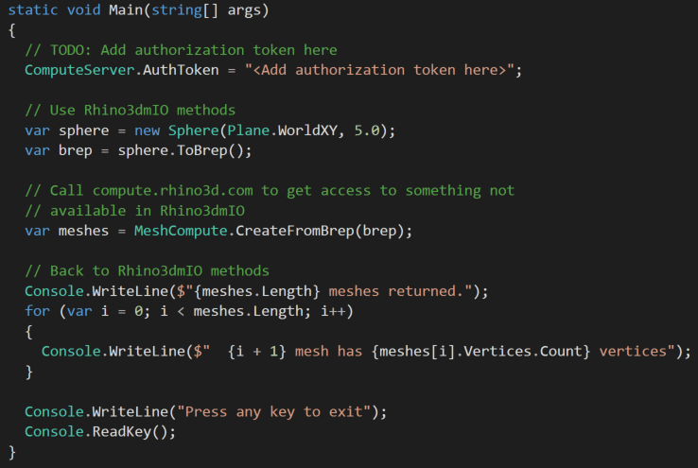
.NET Sample

Slide 27
Python Client
Open source:
https://github.com/mcneel/rhino3dm
Available on all platforms (Windows, macOS, Linux) through PyPi.org.
pip install rhino3dm
Package providing convenience functions to call compute.rhino3d.com also available.
pip install compute-rhino3d
Notes:
The Python Package Index (PyPI) is a repository of software for the Python programming language.

Slide 28
Python Sample
# Read render mesh from 3dm file
import rhino3dm
model = rhino3dm.File3dm.Read('mymodel.3dm')
brep = model.Objects[0].Geometry
face = brep.Faces[0]
mesh = face.GetMesh(rhino3dm.MeshType.Any)
print(len(mesh.Faces))

Slide 29
Python Sample
# Sample get bounding box of remote objects
from rhino3dm import *
import requests # pip install requests
url = "https://files.mcneel.com/TEST/Rhino Logo.3dm"
req = requests.get(url)
model = File3dm.FromByteArray(req.content)
for i in range(len(model.Objects)):
geometry = model.Objects[i].Geometry
bbox = geometry.GetBoundingBox()
print("{}, {}".format(bbox.Min, bbox.Max))

Slide 30
Python Sample
Additional samples:
https://github.com/mcneel/rhino3dm
Notes:
Tkinter = “Tk Interface”

Slide 31
JavaScript Client
Open source:
https://github.com/mcneel/rhino3dm
Available on all platforms (Windows, macOS, Linux).
rhino3dm.js:
<script async type="text/javascript" src="https://files.mcneel.com/rhino3dm/js/latest/rhino3dm.js"></script>
compute-rhino3dm.js:
<script async type="text/javascript" src="https://files.mcneel.com/rhino3dm/js/latest/compute-rhino3dm.js"></script>

Slide 32
JavaScript Sample
Additional samples:
https://github.com/mcneel/rhino3dm
https://codepen.io/dalefugier/

Slide 33
Compute Server
A REST API exposing Rhino's geometry core.
Two web services:
compute.geometry - provides the REST API.
compute.frontend - provides authentication, request stashing (saving POST data for diagnostics), logging, and configuration of request and response headers.
compute.frontend creates the compute.geometry process, monitors its health, and restarts compute.geometry as necessary.

Slide 34
Compute Server
Nancy
Lightweight, low-ceremony, framework for building HTTP based services on .NET.
Available as a NuGet package.
http://nancyfx.org
TopShelf
An easy service hosting framework for building Windows services using .NET.
Available as a NuGet package.
http://topshelf-project.com

Slide 35
Open Source
Latest deployable builds available on AppVeyor:
https://ci.appveyor.com/project/mcneel/compute-rhino3d/branch/master/artifacts
Source available on GitHub:
https://github.com/mcneel/compute.rhino3d

Slide 36
Links
Rhino Development
https://developer.rhino3d.com/
Rhino Inside
https://www.rhino3d.com/inside
Rhino Compute
https://www.rhino3d.com/compute
rhino3dm
https://www.rhino3d.com/rhino3dm

Slide 39
WebAssembly
A new type of code that can be run in modern web browsers.
A low-level assembly-like language with a compact binary format that runs with near-native performance
Provides languages such as C/C++ with a compilation target so that they can run on the web.
Designed to run alongside JavaScript.

Slide 40
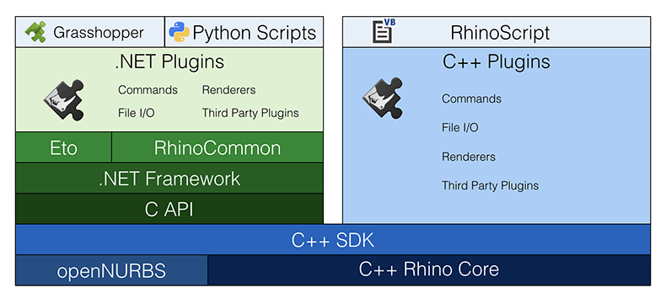
Rhino Stack
Notes:
Rhino Developer Stacks - .NET Stack and C++ Stack
C++ Rhino Core - The C++ Core of Rhino is the oldest and broadest set of code. This is where the runtime document is managed, where all the OpenGL viewport drawing code exists, and it’s where the computational geometry code written by our mathematicians lives. Many of Rhino’s commands are here.
openNURBS - Our free C++ source code that lets you read and write Rhino 3dm files - all the way back to version 1. openNURBS was our first open-source project. The code compiles on Windows, macOS, Linux, iOS, and Android. It’s used in various third-party applications like ArchiCAD, SolidWorks, Inventor, SketchUp and many other products to read or write 3dm files directly.
RhinoCommon – This is our .NET SDK for Rhino, built atop the portions of the .NET framework that are common on both Windows and macOS (via Mono). RhinoCommon allows developers to run .NET code on both Rhino for Windows and Rhino for Mac.
Rhino3dmIO - A flavored version of RhinoCommon that uses openNURBS. This allows you to write .NET applications that can read/write the .3dm file format.

