Slide 1
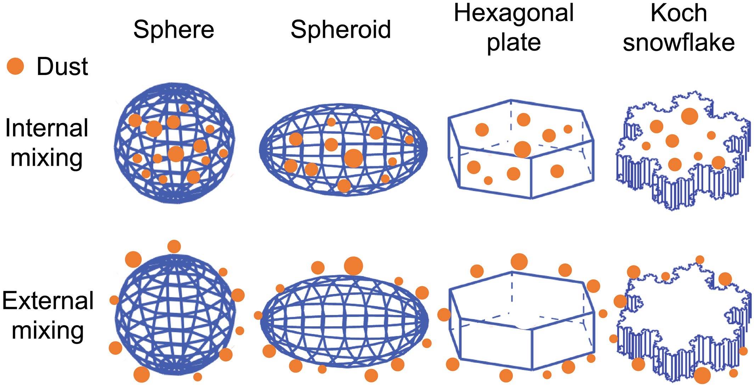
Enhanced Snow Absorption and Albedo Reduction by Dust‐Snow Internal Mixing: Modeling and Parameterization
Notes:
Demonstration of dust‐snow internal (i.e., dust mixed inside snow grains; top row) and external (i.e., dust mixed outside snow grains; bottom row) mixing for four typical snow grain shapes used in this study, including sphere, spheroid, hexagonal plate, and Koch snowflake.
IF THIS IMAGE HAS BEEN PROVIDED BY OR IS OWNED BY A THIRD PARTY, AS INDICATED IN THE CAPTION LINE, THEN FURTHER PERMISSION MAY BE NEEDED BEFORE ANY FURTHER USE. PLEASE CONTACT WILEY'S PERMISSIONS DEPARTMENT ON PERMISSIONS@WILEY.COM OR USE THE RIGHTSLINK SERVICE BY CLICKING ON THE 'REQUEST PERMISSIONS' LINK ACCOMPANYING THIS ARTICLE. WILEY OR AUTHOR OWNED IMAGES MAY BE USED FOR NON-COMMERCIAL PURPOSES, SUBJECT TO PROPER CITATION OF THE ARTICLE, AUTHOR, AND PUBLISHER.

