Slide 1
Programming Assignment #2: Structure from Motion
EE735 Computer Vision 2013
TA: Hyowon Ha
hwha@rcv.kaist.ac.kr

Slide 2
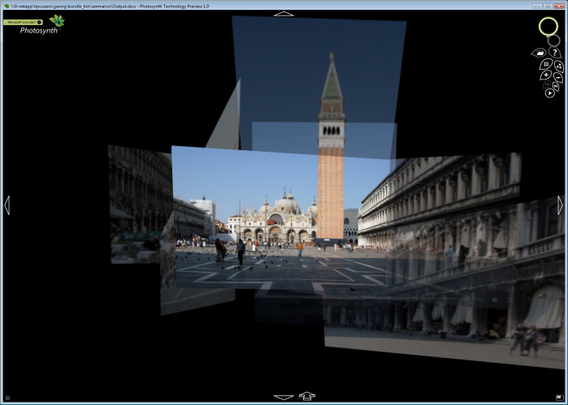
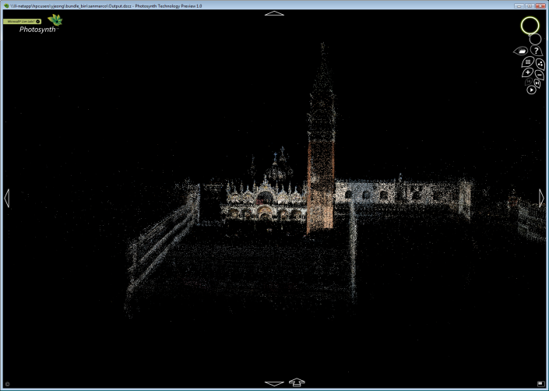
To Make : PhotoSynth
Input
Freely taken images with overlapped scenery
Output
camera pose and 3D structure of the scene
Implementation issues
Feature extraction and matching
Camera motion(pose) estimation
Outlier removal using RANSAC
3D Reconstruction using triangulation
LM-based non-linear optimization and bundle adjustment
Reference
http://photosynth.net
N.Snavely et al., “Photo Tourism: Exploring photo collections in 3D”, SIGGRAPH 2006

Slide 3
1. Feature Extraction and Matching
SIFT
Easy to use in Matlab. Strongly recommended.
http://www.vlfeat.org
GPU-SIFT
In C++. System requirements – certain level of NVIDIA graphic card
http://www.cs.unc.edu/~ccwu/siftgpu
※ Your own implementation will get extra credit.

Slide 4
2. Camera Motion from Essential Matrix
How can we estimate ‘E’
given a set of match points {x, x’}?
8,7-point algorithm for F (ref. HZ 11)
Calibrated 5-point algorithm for E
(ref. http://vis.uky.edu/~stewe/FIVEPOINT/ You can use it.
: David Nister, An Efficient Solution to the Five-Point Relative Pose Problem)
※ Your own implementation will get extra credit.
Decompose E into [R|t]s
(ref. HZ 9.6)

Slide 5
3. RANSAC – What is RANSAC ? (Toy Problem)
Model: line
Required number of samples for each hypothesis: 2 points
1. Randomly generate sets of 2 points
2. Generate line(hypothesis) and evaluate using other points with pre-defined threshold
3. Choose the most supportive hypothesis having most inliers.
2 points
threshold
3 points
6 points
2 points

Slide 6
3. RANSAC – Motion using ‘E’
Model: ‘E’, essential matrix
Required number of samples for each hypothesis: 5 points (for 5-point algorithm)
1. Randomly generate sets of 5 points
2. Generate E(hypothesis) and evaluate using other points with pre-defined threshold – epipolar distance
3. Choose the most supportive hypothesis having most inliers.
Basic assumption:
Inliers are consistent
Outliers are randomly generated
Inlier and Outlier – True and False {x, x’} matches
For the Essential Matrix
Inliers: Correct ‘E’
Outliers: Random/Wrong ‘E’
(ref: HZ 11.6)

Slide 7
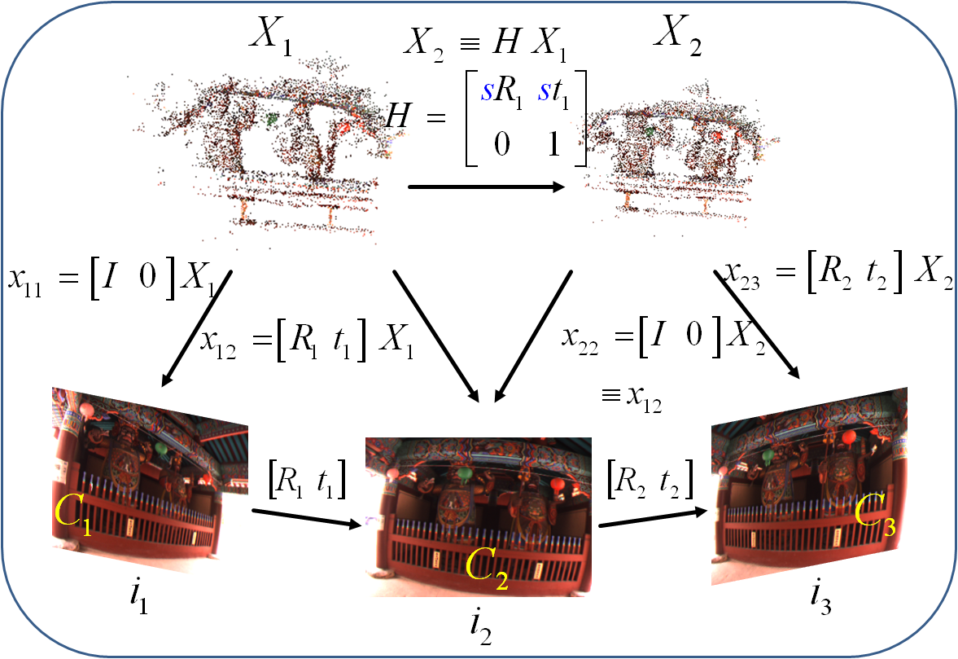




4. 3D Reconstruction using Triangulation
$$x_{ij}=PX_{ij}$$
$${x′}_{ij}=P′X_{ij}$$
$$x_{ij}×PX_{ij}=0$$
$${x′}_{ij}×P{′X}_{ij}=0$$

Slide 8
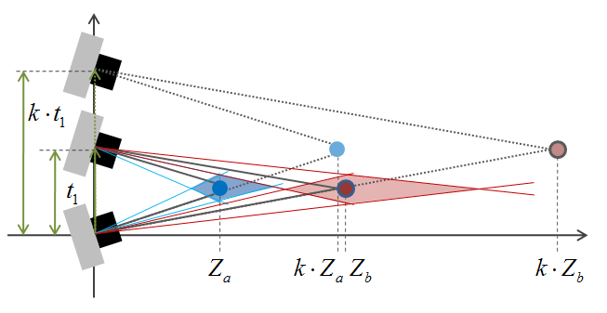
Relation between Multiple Views
Scale ambiguity exists.

Slide 9
5. Pose Estimation for 3rd view and after
How can we estimate ‘P=[R|t]’
given a set of match points {x,X}?
6-point DLT algorithm (ref. HZ 7.1)
3-point algorithm
※ Your own implementation will get extra credit.

Slide 10
6. Growing
For every new frame,
Pose estimation with RANSAC using {x,X} matches
Triangulations for newly shown points
Re-triangulations for previously triangulated points when new image measurements show up
Non-linear optimizations
Levenberg-Marquardt
Bundle adjustment

Slide 11
7. LM optimization (optional)
Levenberg-Marquardt Nonlinear Least Squares
Damped Newton method
Optimal solution on L-2 norm (squared distance)
Geometric error minimization(ex: image reprojection error, epipolar constraint(line-point distance))
Can be used for F-matrix, E-matrix, Pose, and Triangulation.
References
Levenberg, A Method for the Solution of Certain Non-Linear Problems in Least Squares
Lourakis, http://www.ics.forth.gr/~lourakis/levmar/

Slide 12
8. Bundle Adjustment (optional)
Bundle Adjustment using LM
Minimize squared sum of image reprojection error
Camera poses and 3D points are simultaneously optimized
An imperative component when a large-scale reconstruction is being considered
References
Triggs, Bundle Adjustment: A Modern Synthesis
Lourakis, The Design and Implementation of a Generic Sparse Bundle Adjustment Software Package Based on the Levenberg-Marquardt Algorithm
Lourakis, http://www.ics.forth.gr/~lourakis/sba/

Slide 13
Overall Strategy
Given a set of images,
Correspondence search, Relating images
1. Extract SIFT from every image and find putative matches
2. Outliers should be rejected by applying RANSAC
Initialization Step
3. Find the best image pair(simply, has the maximum matches or take the base-line into account)
4. Estimate motion(R and t) and Reconstruct 3D points for the selected image pair. The camera coordinate of one camera is used for the world coordinate.
Growing Step
5. Search images which have enough points seeing the reconstructed 3D point
6. Compute pose(R and t) for those images and reconstruct more 3D points seen from more than two images
Bundle Optimization
Repeat the Growing step until every camera is included.

Slide 14
Additional Information
To simplify the problem
We bail the self-calibration part out
All images are captured by one known camera (camera intrinsic matrix K will be provided in a txt file)
A fancy visualization is not necessary
Like traveling images or traversing the whole reconstruction
Visualizing cameras and points are enough
You can choose between Matlab (easy), OpenGL, and VRML

Slide 15
Auxiliary References
Phillp Torr’s Structure from Motion toolkit
Includes F-matrix estimation, RANSAC, Triangulation and etc.
http://cms.brookes.ac.uk/staff/PhilipTorr/
Noah Snavely’s Bundler
The implementation of ‘Photo Tourism’ paper, which is exactly same as our goal
http://phototour.cs.washington.edu/bundler/
OpenCV
You could find more through Googling

Slide 16
Book Reference
Multiple-View Geometry (HZ)
Basic Projective Geometry (ch. 2,3)
Camera Models and Calibration (ch. 6,8)
Epipolar Geometry and Implementation (ch. 9, 11)
Triangulation (ch. 12)
Computer Vision: Algorithms and Applications (S)
Structure from Motion (ch. 7)

Slide 17
Submission
Due : November 13
To : Hyowon Ha (hwha@rcv.kaist.ac.kr)
Submission should include…
Report
Source code
Readme file explaining how to execute the program
Report should include…
Your understanding of each steps of algorithms
Indication of the parts that you implemented on your own and the parts you used open source code
The origin of the source code if you have used any

Slide 18
Evaluation
The completion and understanding of the whole system will be most important
You can use any open source code in block-size level (for example, feature extraction/ feature matching/ 8-point algorithm to get ‘E’ / RANSAC / 6-point algorithm for [R|t]…)
Your own implementation will get extra credit.
You should construct and arrange the whole program by yourself.
Copying the whole system will receive no points
Ex) bundler code for photo tourism project
You can refer it, but implement on your own!

