Slide 1
Inverting the Jacobian and Manipulability
Howie Choset
(with notes copied from Rob Platt)

Slide 2

The Inverse Problem
Quick review of linear algebra
Forward Kinematics is in general many to one (if more joint angles than DOF in WS),
non linear
Inverse Kinematics is in general one to many (have a choice), non linear
Forward differential kinematics, linear, many to one, etc. based on # of DOF and WS
Inverse is “easier” because linear, but this many to one issue comes up

Slide 3
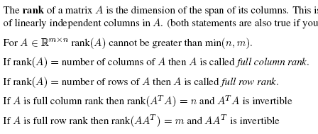
The Inverse Problem
Quick review of linear algebra

Slide 4











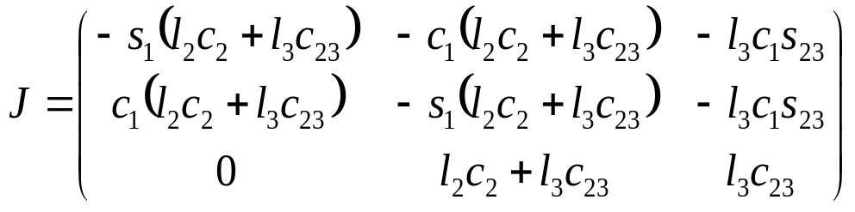





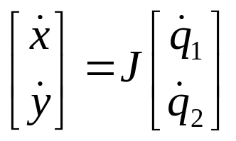
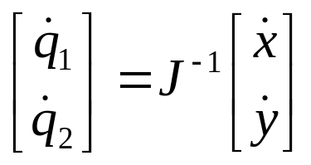
Cartesian control
Let’s control the position (not orientation) of the three link arm end effector:
We can use the same strategy that we used before:

Slide 5










Cartesian control
joint ctlr
joint position sensor
However, this only works if the Jacobian is square and full rank…
All rows/columns are linearly independent, or
Columns span Cartesian space, or
Determinant is not zero

Slide 6




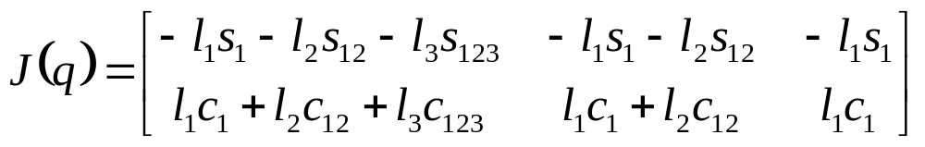





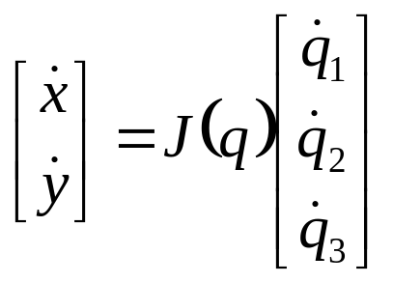



Cartesian control
What if you want to control the two-dimensional position of a three-link manipulator?
Two equations of three variables each…
This is an under-constrained system of equations.
multiple solutions
there are multiple joint angle velocities that realize the same EFF velocity.

Slide 7



Generalized inverse
If the Jacobian is not a square matrix (or is not full rank), then the inverse doesn’t exist…
what next?
We have:
We are looking for a matrix such that:

Slide 8



Generalized inverse
Two cases:
Underconstrained manipulator (redundant)
Overconstrained
Generalized inverse:
for the underconstrained manipulator: given , find any vector s.t.
for the overconstrained manipulator: given , find any vector s.t. Is minimized

Slide 9







Jacobian Pseudoinverse: Redundant manipulator
Psuedoinverse definition: (underconstrained)
Given a desired twist, , find a vector of joint velocities, , that satisfies while minimizing
Minimize joint velocities
Minimize subject to :
Use lagrange multiplier method:
This condition must be met when is at a minimum subject to

Slide 10
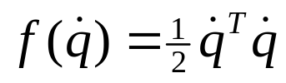

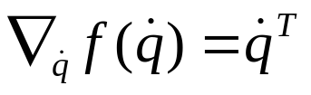



Jacobian Pseudoinverse: Redundant manipulator
Minimize
Subject to

Slide 11

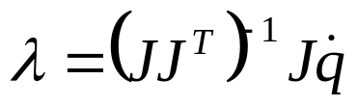


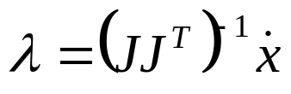
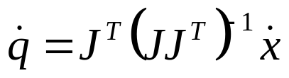
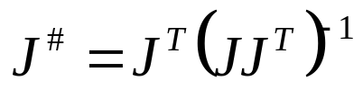

Jacobian Pseudoinverse: Redundant manipulator
I won’t say why, but if is full rank, then is invertible
So, the pseudoinverse calculates the vector of joint velocities that satisfies while minimizing the squared magnitude of joint velocity ( ).
Therefore, the pseudoinverse calculates the least-squares solution.

Slide 12
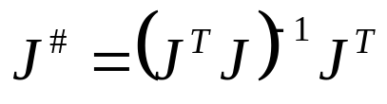

Calculating the pseudoinverse
The pseudoinverse can be calculated using two different equations depending upon the number of rows and columns:
Underconstrained case (if there are more columns than rows (m<n))
Overconstrained case (if there are more rows than columns (n<m))
If there are an equal number of rows and columns (n=m)
These equations can only be used if the Jacobian is full rank; otherwise, use singular value decomposition (SVD):

Slide 13


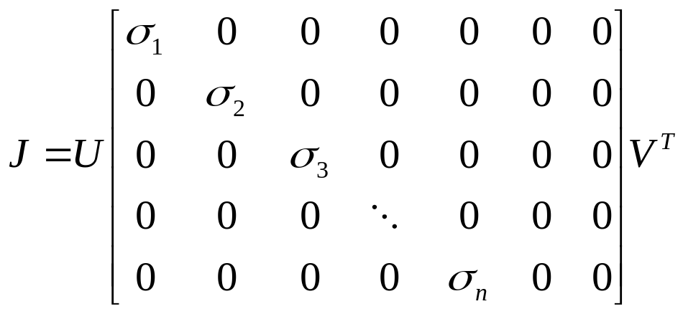



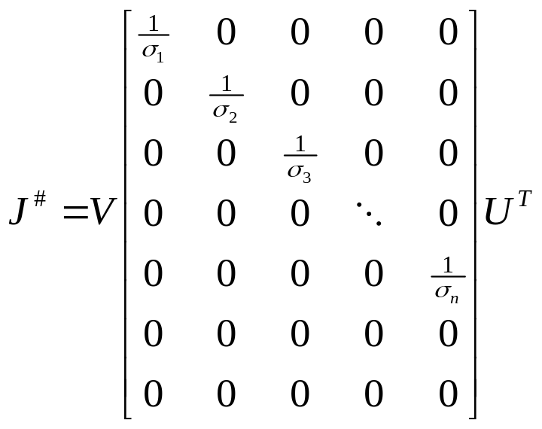

Calculating the pseudoinverse using SVD
Singular value decomposition decomposes a matrix as follows:
is a diagonal matrix of singular values:

Slide 14


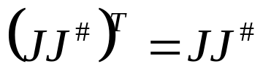
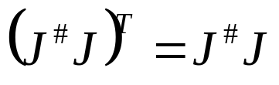
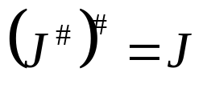
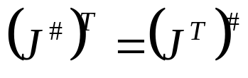
Properties of the pseudoinverse
Moore-Penrose conditions:
Generalized inverse: satisfies condition 1
Reflexive generalized inverse: satisfies conditions 1 and 2
Pseudoinverse: satisfies all four conditions
Other useful properties of the pseudoinverse:

Slide 15



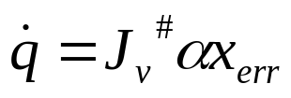
Controlling Cartesian Position
joint ctlr
joint position sensor
Procedure for controlling position:
Calculate position error:
Multiply by a scaling factor:
Multiply by the velocity Jacobian pseudoinverse:

Slide 16


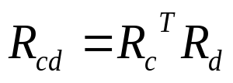




Controlling Cartesian Orientation
How does this strategy work for orientation control?
Suppose you want to reach an orientation of
Your current orientation is
You’ve calculated a difference:
How do you turn this difference into a desired angular velocity to use in ?
joint ctlr
joint position sensor

Slide 17

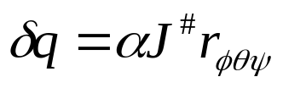
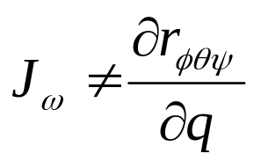
Controlling Cartesian Orientation
You can’t do this:
Convert the difference to ZYZ Euler angles:
Multiply the Euler angles by a scaling factor and pretend that they are an angular velocity:
Remember that in general:
joint ctlr
joint position sensor

Slide 18
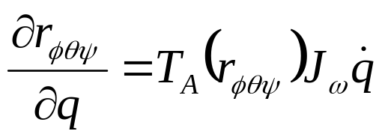
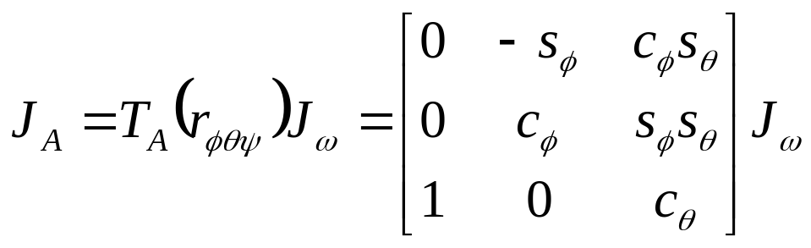
The Analytical Jacobian
If you really want to multiply the angular Jacobian by the derivative of an Euler angle, you have to convert to the “analytical” Jacobian:
For ZYZ Euler angles
Gimbal lock: by using an analytical Jacobian instead of the angular velocity Jacobian, you introduce the gimbal lock problems we talked about earlier into the Jacobian – this essentially adds “singularities” (we’ll talk more about that in a bit…)

Slide 19



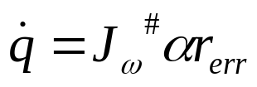
Controlling Cartesian Orientation
The easiest way to handle this Cartesian orientation problem is to represent the error in axis-angle format
Axis angle delta rotation
Procedure for controlling rotation:
Represent the rotation error in axis angle format:
Multiply by a scaling factor:
Multiply by the angular velocity Jacobian pseudoinverse:

Slide 20
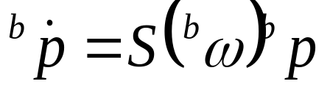
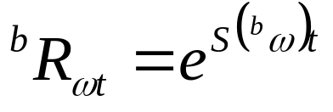
Controlling Cartesian Orientation
Why does axis angle work?
Remember Rodrigues’ formula from before:
axis
angle
Compare this to the definition of angular velocity:
The solution to this FO diff eqn is:
Therefore, the angular velocity gets integrated into an axis angle representation

Slide 21
Jacobian Transpose Control
The story of Cartesian control so far:

Slide 22
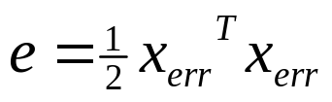
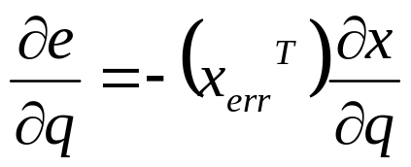

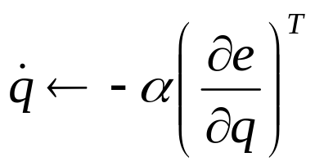

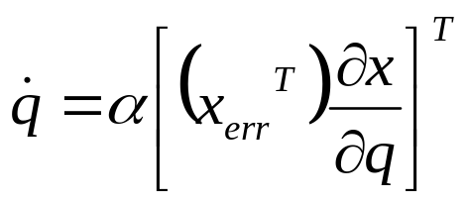
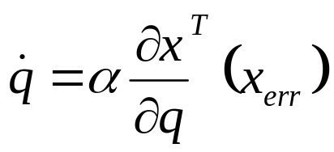
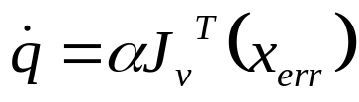
Jacobian Transpose Control
Start with a squared position error function (assume the poses are represented as row vectors)
Here’s another approach:
Position error:
Gradient descent: take steps proportional to in the direction of the negative gradient.

Slide 23
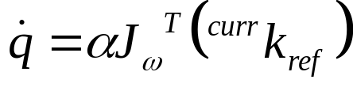
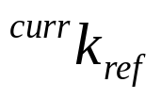
Jacobian Transpose Control
The same approach can be used to control orientation:
orientation error: axis angle orientation of reference pose in the current end effector reference frame:

Slide 24

Jacobian Transpose Control
So, evidently, this is the gradient of that
Jacobian transpose control descends a squared error function.
Gradient descent always follows the steepest gradient

Slide 25


Jacobian Transpose v Pseudoinverse
What gives?
Which is more direct? Jacobian pseudoinverse or transpose?
or
They do different things:
Transpose: move toward a reference pose as quickly as possible
  One dimensional goal (squared distance meteric)
Pseudoinverse: move along a least squares reference twist trajectory
  Six dimensional goal (or whatever the dimension of the relevant twist is)

Slide 26

Jacobian Transpose v Pseudoinverse
The pseudoinverse moves the end effector in a straight line path toward the goal pose using the least squared joint velocities.
The goal is specified in terms of the reference twist
Manipulator follows a straight line path in Cartesian space
The transpose moves the end effector toward the goal position
In general, not a straight line path in Cartesian space
Instead, the transpose follows the gradient in joint space

Slide 27


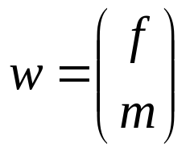
Using the Jacobian for Statics
Up until now, we’ve used the Jacobian in the twist equation,
Interestingly, you can also use the Jacobian in a statics equation:
Joint torques
Cartesian wrench:
force
moment (torque)

Slide 28








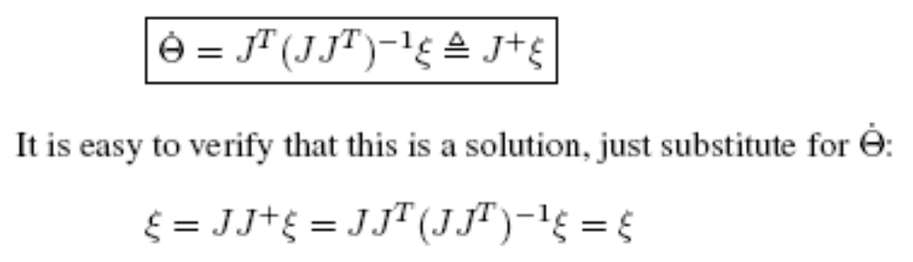
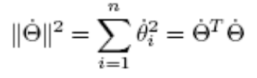
When J is not invertible: Case 1
minimizes

Slide 29

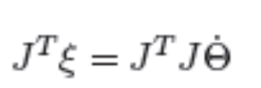
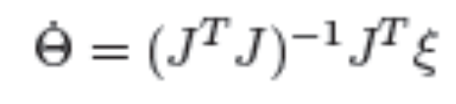
When is J not invertible: Case 2

Slide 30


Singularities
for most configurations

Slide 31
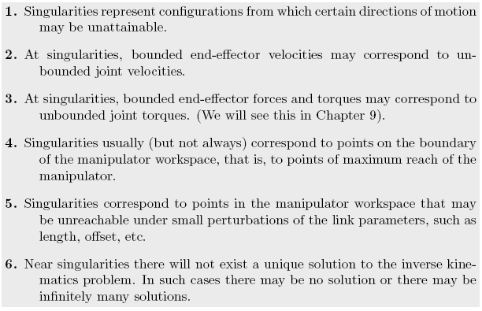
Singularities

Slide 32
Manipulability
A measure of the Jacobian
Configuration dependent
Maybe it is a measure of how far away from a singularity
Norms
  Scalar
  Vector
  Matrix

Slide 33
Manipulability Ellipsoid
Can we characterize how close we are to a singularity?
Yes – imagine the possible instantaneous motions are described by an ellipsoid in Cartesian space.
Can’t move much this way
Can move a lot this way

Slide 34

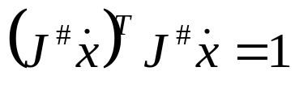
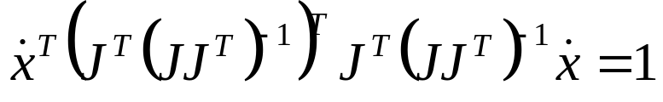
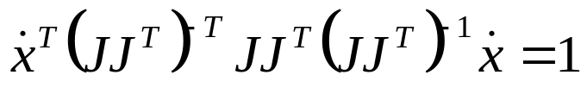
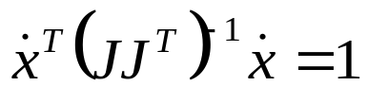
Manipulability Ellipsoid
The manipulability ellipsoid is an ellipse in Cartesian space corresponding to the twists that unit joint velocities can generate:
A unit sphere in joint velocity space
Project the sphere into Cartesian space
The space of feasible Cartesian velocities

Slide 35


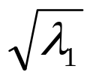

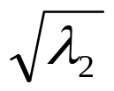
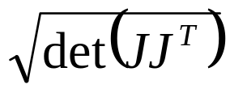
Manipulability Ellipsoid
You can calculate the directions and magnitudes of the principle axes of the ellipsoid by taking the eigenvalues and eigenvectors of
The lengths of the axes are the square roots of the eigenvalues
Yoshikawa’s manipulability measure:
You try to maximize this measure
Maximized in isotropic configurations
This measures the volume of the ellipsoid

Slide 36


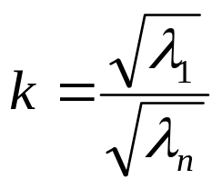
Manipulability Ellipsoid
Another characterization of the manipulability ellipsoid: the ratio of the largest eigenvalue to the smallest eigenvalue:
Let be the largest eigenvalue and let be the smallest.
Then the condition number of the ellipsoid is:
The closer to one the condition number, the more isotropic the ellispoid is.

Slide 37
Manipulability Ellipsoid
Isotropic manipulability ellipsoid
NOT isotropic manipulability ellipsoid

Slide 38




Force Manipulability Ellipsoid
You can also calculate a manipulability ellipsoid for force:
A unit sphere in the space of joint torques
The space of feasible Cartesian wrenches

Slide 39



Manipulability Ellipsoid
Principle axes of the force manipulability ellipsoid: the eigenvalues and eigenvectors of:
has the same eigenvectors as :
But, the eigenvalues of the force and velocity ellipsoids are reciprocals:
Therefore, the shortest principle axes of the velocity ellipsoid are the longest principle axes of the force ellipsoid and vice versa…

Slide 40
Velocity and force manipulability are orthogonal!
Force ellipsoid
Velocity ellipsoid
This is known as force/velocity duality
You can apply the largest forces in the same directions that your max velocity is smallest
Your max velocity is greatest in the directions where you can only apply the smallest forces

Slide 41








Manipulability Ellipsoid: Example
Solve for the principle axes of the manipulability ellipsoid for the planar two link manipulator with unit length links at
Principle axes:

Slide 42


Eigenvalues and Vectors
Eigenvectors are the directions that a linear mapping just scales a vector
Ax = sx where A is a matrix, s is a scalar
Det (Ax) = Det (sx) ➔
Eigenvectors
Ellipsoid analogy

Slide 43





Singular Values
Eigenvalues are for squares (remember the determinant)
This square matrix has eigenvalues and vectors

Slide 44


Singular Value Decomposition

