Slide 1
Processing
프로세싱을 이용한 바람개비 만들기

Slide 2
프로세싱을 이용한 바람개비 만들기
Setup, draw 함수를 사용해본다.
RGB를 이용해 색을 설정해본다.
Background(r,g,b); fill(r,g,b);
OpenGL => pushMatrix(); popMatrix();
Vertex(x,y);
FrameCount 변수를 사용해 회전시킨다.

Slide 3
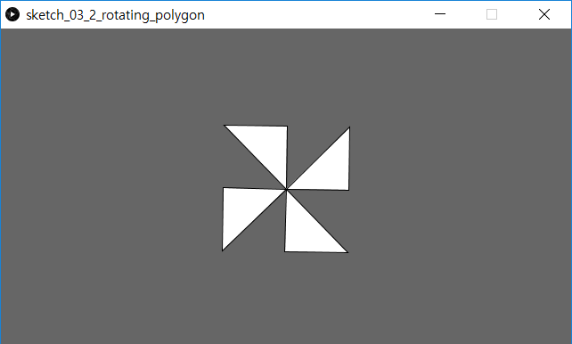
이진헌
void baramGB(float r)
{
beginShape();
vertex(0,0);
vertex(r,r);
vertex(r*2,0);
endShape(CLOSE);
beginShape();
vertex(0,0);
vertex(0,r*2);
vertex(-r,r);
endShape(CLOSE);
beginShape();
vertex(0,0);
vertex(-r,-r);
vertex(-r*2,0);
endShape(CLOSE);
beginShape();
vertex(0,0);
vertex(r,-r);
vertex(0,-r*2);
endShape(CLOSE);
}
void polygon(float x, float y, float radius, int npoints)
{
float angle = TWO_PI / npoints;
beginShape();
for (float a = 0; a < TWO_PI; a += angle)
{
float sx = x + cos(a) * radius;
float sy = y + sin(a) * radius;
vertex(sx, sy);
}
endShape(CLOSE);
}
void setup()
{
size(640, 360);
}
void draw()
{
background(102);
pushMatrix();
translate(width*0.5, height*0.5);
rotate(frameCount / 50.0); // 50? 200?
baramGB(50);
popMatrix();
}

Slide 4
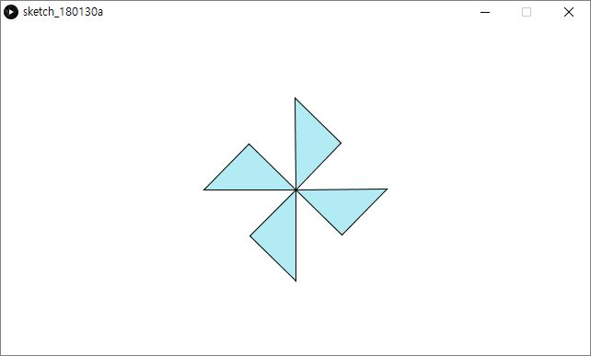
김현주
void baram(float radius) {
fill(178, 235, 244);
beginShape();
vertex(0, 0);
vertex(radius*2, 0);
vertex(radius, radius);
endShape(CLOSE);
beginShape();
vertex(0, 0);
vertex(0, radius*2);
vertex(-radius, radius);
endShape(CLOSE);
beginShape();
vertex(0, 0);
vertex(-radius*2, 0);
vertex(-radius, -radius);
endShape(CLOSE);
beginShape();
vertex(0, 0);
vertex(0, -radius*2);
vertex(radius, -radius);
endShape(CLOSE);
}
void setup() {
size(640, 360);
}
void draw() {
background(255);
pushMatrix();
translate(width*0.5, height*0.5);
rotate(frameCount / 200.0);
baram(50);
popMatrix();
}

Slide 5
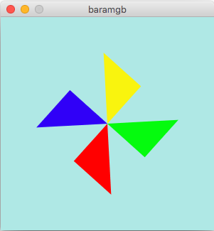
이윤혜
void baramGB(float radius){
beginShape();
fill(255, 0, 0);
vertex(0,0);
vertex(radius*2,0);
vertex(radius,radius);
endShape(CLOSE);
beginShape();
fill(48, 0, 247);
vertex(0,0);
vertex(0,radius*2);
vertex(-radius,radius);
endShape(CLOSE);
beginShape();
fill(249, 244, 14);
vertex(0,0);
vertex(-radius*2,0);
vertex(-radius,-radius);
endShape(CLOSE);
beginShape();
fill(5, 251, 14);
vertex(0,0);
vertex(0,-radius*2);
vertex(radius,-radius);
endShape(CLOSE);
}
void setup() {
size(300,300); //set canvas size
}
void draw() {
background(175, 232, 229);//set bgColor by RGB
noStroke(); //no edge
pushMatrix(); //openGL
translate(width*0.5, height*0.5); //set position
rotate(frameCount/40.0); //float
baramGB(50);
popMatrix(); //like reset
}

Slide 6
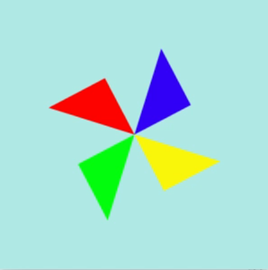

rotate(frameCount/40.0);
rotate(frameCount/8.0);

