Slide 1
Winter Workshop Arduino I/O – Week 3
한림대학교 융합전공
김승찬
2018/1/30
Notes:
717006

Slide 2
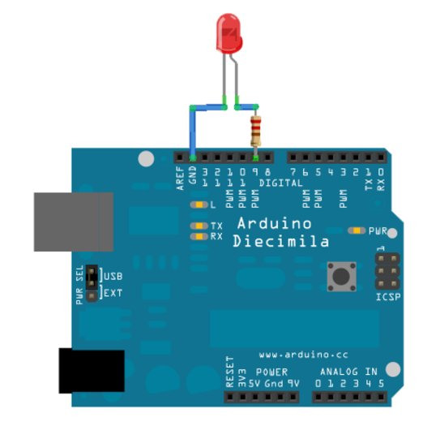

?
컴퓨터(키보드)로 밝기를 제어하려면?
Serial Communication

Slide 3
이번 주 연습
00-SerialSendCharacter
01-SerialReceiveFromArduino
02-SerialReceiveAndSend

Slide 4
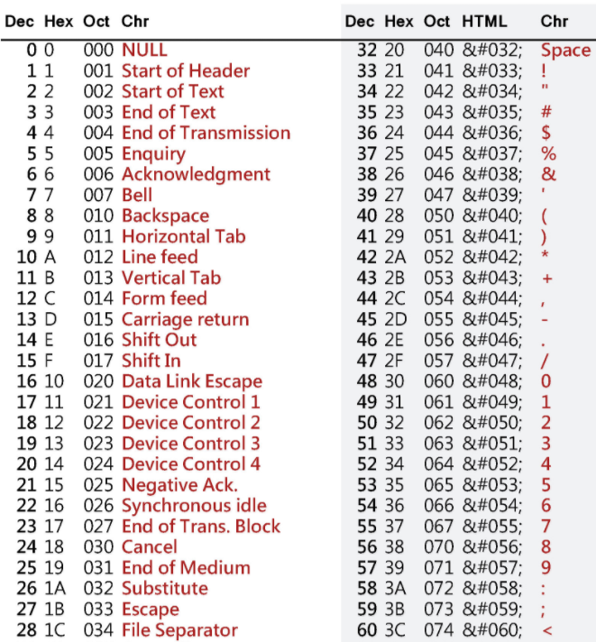
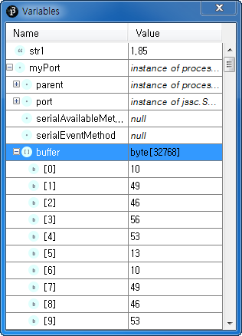
How to read float variable from serial port?
Use println() on the Arduino. This will send an 'end of line' character.
Notes:
https://processing.org/discourse/beta/num_1254511350.html
https://web.archive.org/web/20120722220457/https://processing.org/discourse/beta/num_1254511350.html

Slide 5
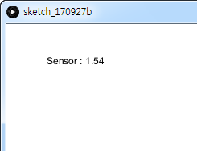
int lf = 10; // Linefeed in ASCII
void draw() {
while (myPort.available() > 0) {
String str1 = myPort.readStringUntil(lf);
if (str1 != null)
{
float num=float(str1);
String buf = String.format("Sensor : %.2f", num);
background(255);
fill(0);
text(buf, 50,50);
}
}
}

Slide 6
감사합니다

