Slide 1





JavaScript Done Right

Slide 2

About me - Dale Lotts 李大乐
Lived in Shanghai China for two years (Oct 2011-Sept 2013)
Serial Entrepreneur
Software Architect at Pearson VUE for 15 years
Technical Coach for
Working on a start up for the chauffeured transportation industry
Technical Areas of interest include Automation, Domain Specific Languages, Compilers, Adaptive Testing, Natural Language Processing, etc.
Hobbies: Photography, airplanes, motorcycles, water skiing, SCUBA Diving, etc.
dale.lotts@mail.com | 612-208-9601

Slide 3

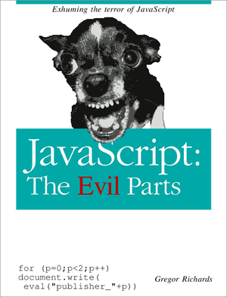
JavaScript doesn’t have to be messy!

Slide 4
Philosophy
Decouple DOM manipulation from application logic
Application testing is equal to application writing
Decouple client side of application from server side
Make common tasks trivial and difficult tasks possible*

Slide 5
Declarative markup
ng:include
Include HTML partials
ng:repeat
Loop over collections
ng:show / ng:hide
Show or hide nodes based on a condition.
ng:class
Add or remove classes from nodes.
ng:click / ng:change
Handle user interactions with the page.

Slide 6
Expression evaluation and filters
Expressions
{{user.name}}
Filters
{{user.dateRegistered | date: 'MM/yyyy'}}
Extensible
#user.name#

Slide 7
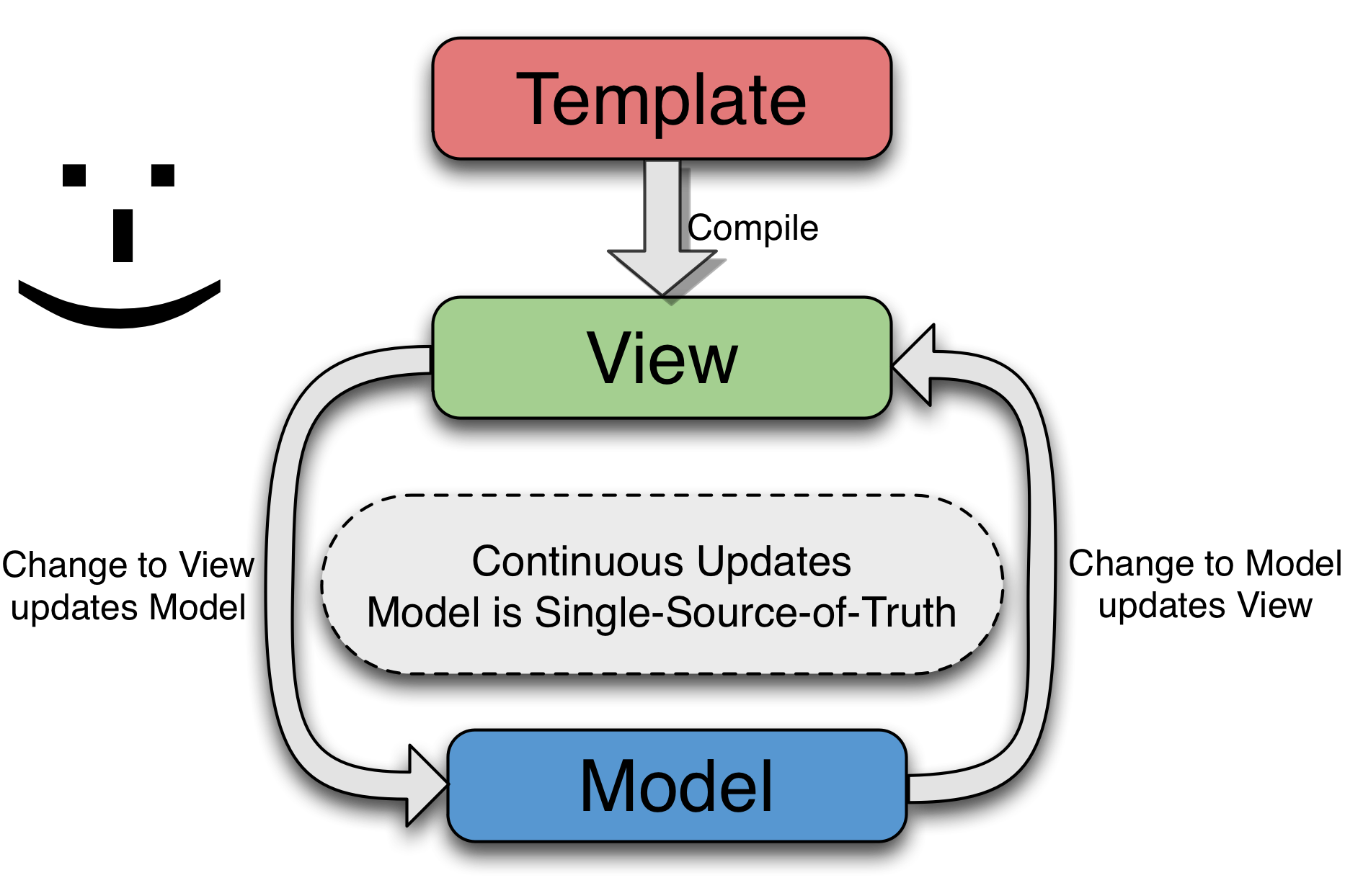
Two-way data binding
Form controls
<input name="echo"> {{echo}}
Automatic evaluation
<button ng-click="value = value + 1">
{{value}}

Slide 8
Model-View-Controller
<form ng:controller="ProfileController" data-ng-submit="save()">
h2>Hello, {{user.name}}.</h2>
<p>You can edit your profile details below.</p>
<label>Email <input name="user.email"></label>
<label>Address <textarea name="user.address"></textarea></label>
<input type="submit" value="Save">
</form>
<script>
function ProfileController() {
this.user = {name: ‘dale', email: ‘dale.lotts@gmail.com'};
this.save = function() {
// Ajax request to save the user
};
};
</script>

Slide 9

Dependency Injection
Automatic injection
function ProfileController($resource, activityService_) { ... };
Explicit injection
function ProfileController(myResource, myService) { ... };
ProfileController.$inject = ['$resource', 'activityService'];

Slide 10
$resource
Like ORM for REST
Supports caching, bulking and JSONP
Mocks provided for testing
<script>
// $resource is automatically injected by name.
function ProfileController($resource) {
var Users = $resource('/users/me');
this.user = Users.get();
this.save = function() {
Users.save(this.user);
};
};
</script>

Slide 11
Service abstraction
Deﬁne services for use in your controllers
Easily swapped out for testing
angular.service('profileService', function($resource) {
return $resource('profiles/:id');
});
function ProfileController(profileService_) {
// ...
});

Slide 12
No more global state
Controllers
Services
Filters
Scopes
<form data-ng-controller="ProfileController" ...>
<h2>Hello, {{user.name}}.</h2>
<div data-ng-repeat="comment in user.Comments">
<h4>{{comment.parentPost.title}}</h4>
<span data-ng-click="hide(comment)">Remove</span>
<p>{{comment.text}}</p>
</div>
</form>

Slide 13
Testability
No DOM manipulation
Many mocks provided
Easily mock out services
Angular objects are not special
Your object do not extend Angular Objects
Protractor, Karma, and Jasmine integration

Slide 14
Extend HTML
Attributes
<input name="tags" data-autocomplete="tagList">
<button data-icon="ui-icon-gear">Click Me</button>
Define your own tags
<profileEditor data-profile="user“ />

Slide 15


Directives
Reusable behavior with (optionally) independent Scope
<datetimepicker data-ng-model="data.embeddedDate" .../>
Angular directive = ~350 LOC < 24 hours to implement ~100% branch and line coverage No DOM manipulation!
jQuery plugin > 1600 LOC Mostly DOM manipulation / selectors
dalelotts.github.io/angular-bootstrap-datetimepicker/

Slide 16
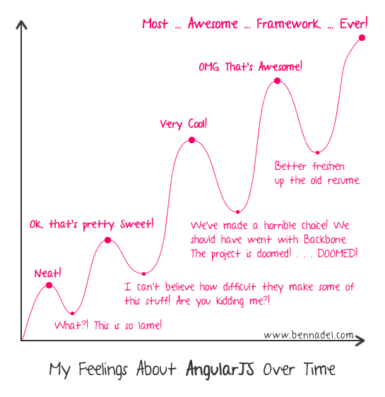
Most…Awesome…Framework…Ever!
Notes:
Is there an algorithmic solution?

Slide 17
What now?
Give Angular a try!
Angularjs.org
Writing directives video: youtu.be/WqmeI5fZcho
Angular UI - many useful directives: angular-ui.github.io
Angular Tutorials: Egghead.io
Select an MV* framework: todomvc.com
If you aren’t embarrassed by the code you wrote last year,
you haven’t learned anything since then!

