Slide 1


Cloud Design Patterns
Dale Morson
Senior Cloud Systems Developer

Slide 2
What is a Cloud Design Pattern?
A software design pattern is a reusable solution (template) to commonly occurring issues.
A cloud design pattern is the design of an architecture in the cloud that supports the software design pattern.
Useful for building highly reliable, scalable, secure applications and services within the cloud.
Software architects choose a pattern for their software.
Architects design the solutions that meet the patterns requirements.
Cloud Systems Developers are responsible for building and delivering the cloud infrastructure to implement the chosen solution.
Notes:
https://levelup.gitconnected.com/cloud-design-patterns-explained-simply-113c788b33ff

Slide 3
Basic Patterns
Bulkhead
Retry
Throttling
Queue-based load levelling
…
https://learn.microsoft.com/en-us/azure/architecture/patterns/
Notes:
https://www.techtarget.com/searchcloudcomputing/tip/5-cloud-design-patterns-to-create-resilient-applications
https://learn.microsoft.com/en-us/azure/architecture/patterns/

Slide 4
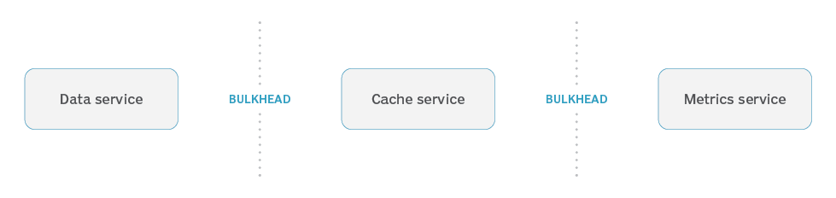
Bulkhead
Simple pattern to ensure that if one element fails, others will continue to function. Isolate failures, build resiliency and respond to failure.
Applications that can operate in “offline mode” are good examples of the bulkhead pattern. Cache external API data.
Use PaaS or serverless to respond to failure and scale resources.
Cloud providers use availability zones and regions to provide further resiliency.

Slide 5
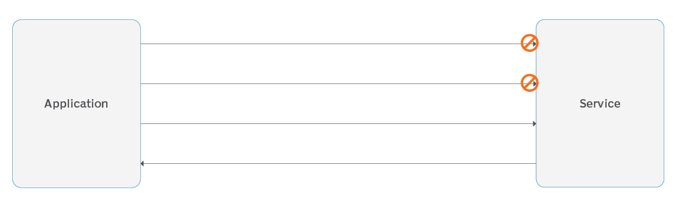
Retry
Simple pattern to ensure failed requests are re-sent.
Common cloud design pattern to deal with third-party interactions and expect failures.
Works only if sender and receiver support retries.

Slide 6
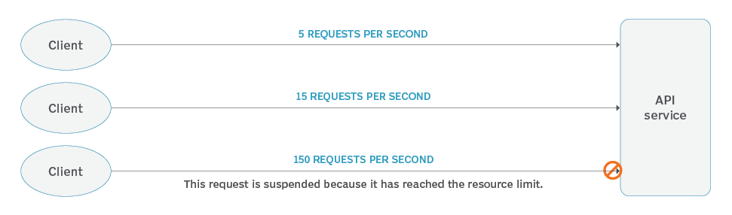
Throttling
Set and force limits on how frequent a single client can use a service or endpoint to keep one “noisy neighbour” from negatively impacting the application for everyone.
Most cloud based services that support APIs/HTTPS requests will have some sort of throttling.

Slide 7
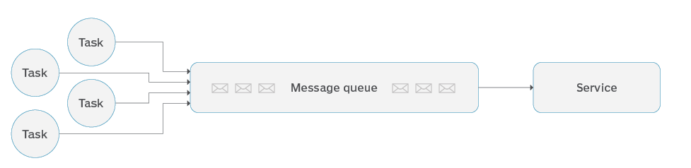
Queue-based Load Levelling
Common cloud design pattern to help with scaling as an application grows.
Rather than process a request on delivery, queue the intended operation. Good for applications that don’t need immediate results such as sending emails or calculating values.

Slide 8
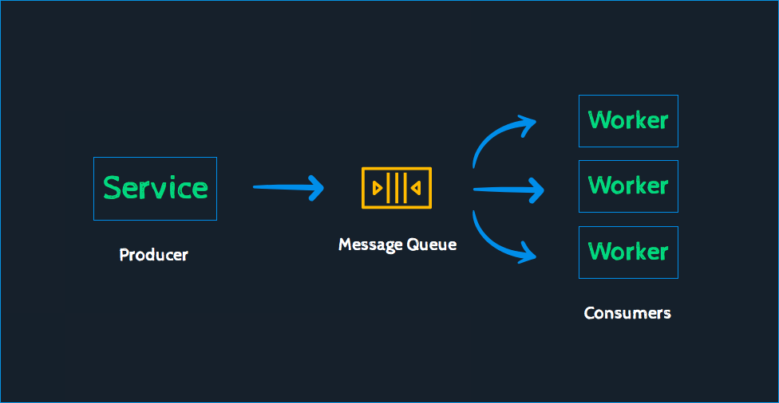
Queue-based Load Levelling
DEMO

Slide 9
More Reading
https://www.bmc.com/blogs/aws-cloud-design-patterns/
https://learn.microsoft.com/en-us/azure/architecture/patterns/
https://learn.microsoft.com/en-us/azure/architecture/framework/resiliency/design-checklist

