Slide 1
Computer Vision Project
Daniel Paredes

Slide 2
Outline
Introduction
Feature Detectors and Descriptors
  Harris + FREAK
  SURF
RANSAC
Pose Estimation
  Fundamental Matrix
  Essential Matrix
  Triangulation
Results

Slide 3
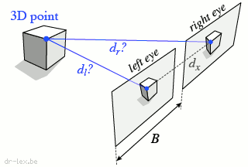
Introduction

Slide 4
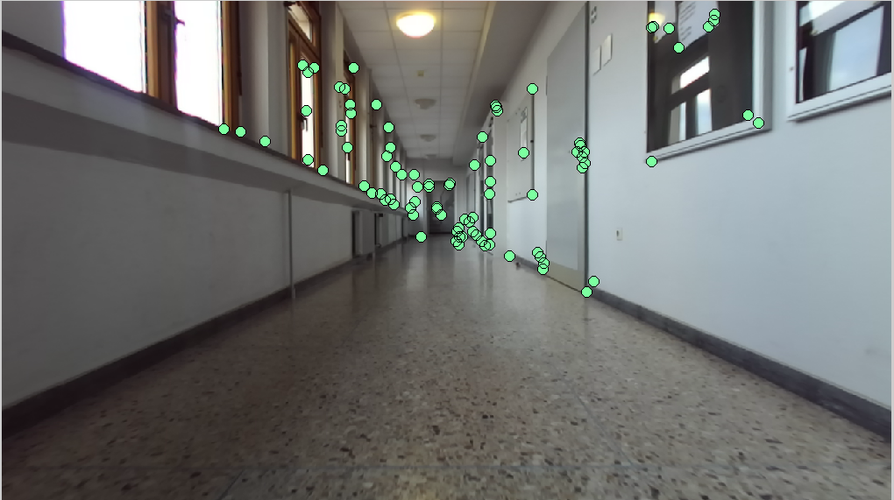
Introduction
Feature Points

Slide 5
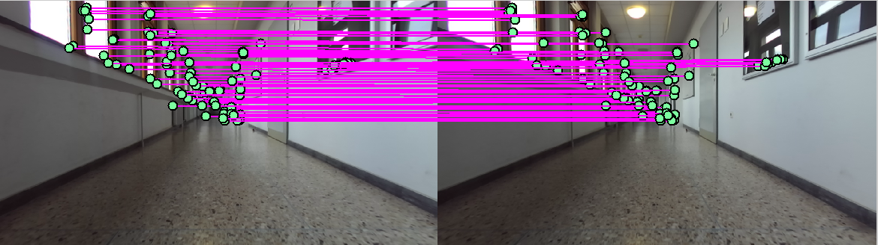
Introduction
Feature Points
Match Points

Slide 6
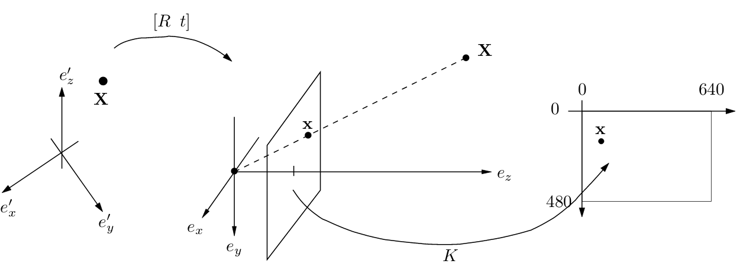
Introduction
Feature Points
Match Points
Find Transformations

Slide 7
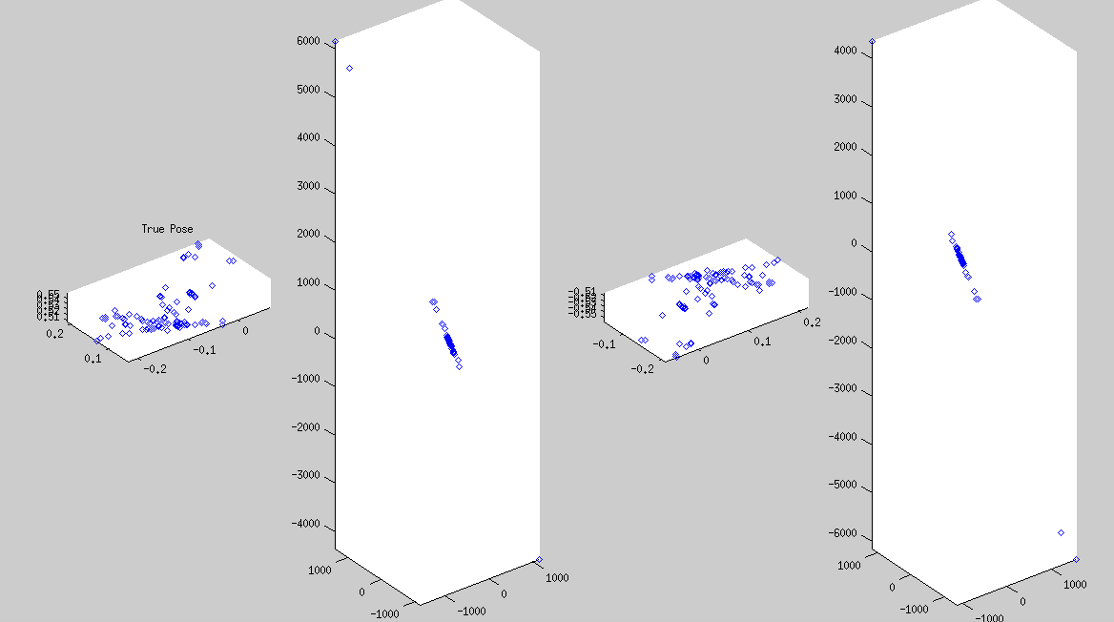
Introduction
Feature Points
Match Points
Find Transformations
3D Triangulation

Slide 8
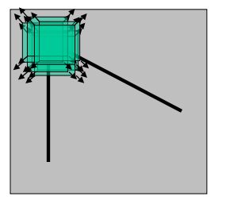
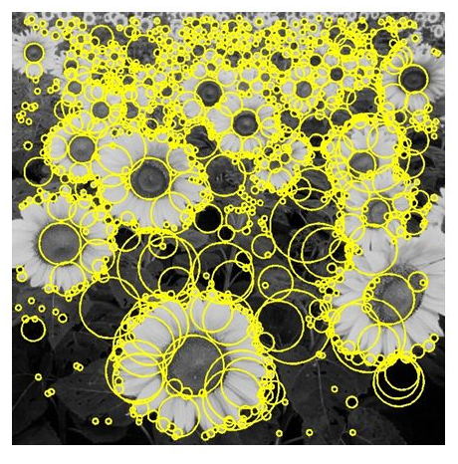
Feature Detectors
[http://hristoalexiev.blogspot.com]
Harris
Corner Detector
SURF detector
Blob detector

Slide 9
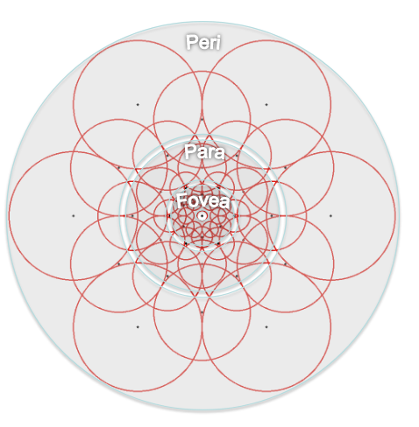
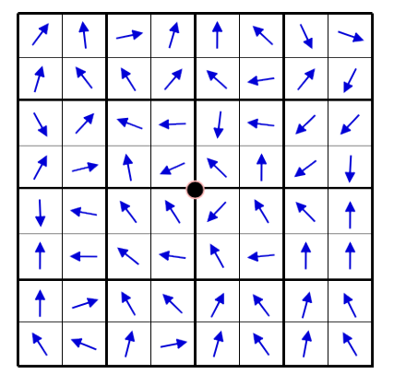
Feature Detectors + Feature Descriptors
+
[http://hristoalexiev.blogspot.com]
[FREAK-Alahi.2012]
SURF: Feature Detector and Descriptor
Harris
Corner Detector
FREAK:
Feature Descriptor

Slide 10
Harris Corner Detector + FREAK

Slide 11
Feature Detectors: Harris Detector
Detects points, in which the gradient changes in two orthogonal directions
[http://hristoalexiev.blogspot.com]
Harris
Corner Detector

Slide 12
Feature Detectors: Harris Detector
Five steps:
1. Color to grayscale
2. Spatial derivative calculation
3. Structure tensor setup
4. Harris response calculation
5. Non-maximum suppression
[http://hristoalexiev.blogspot.com]
Harris
Corner Detector

Slide 13
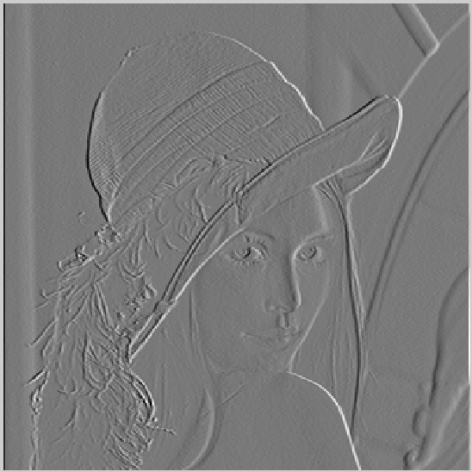
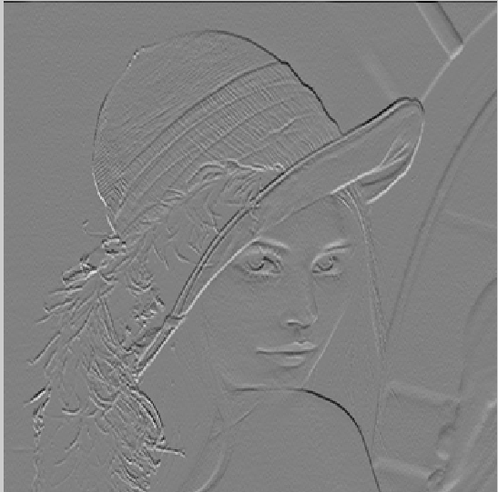
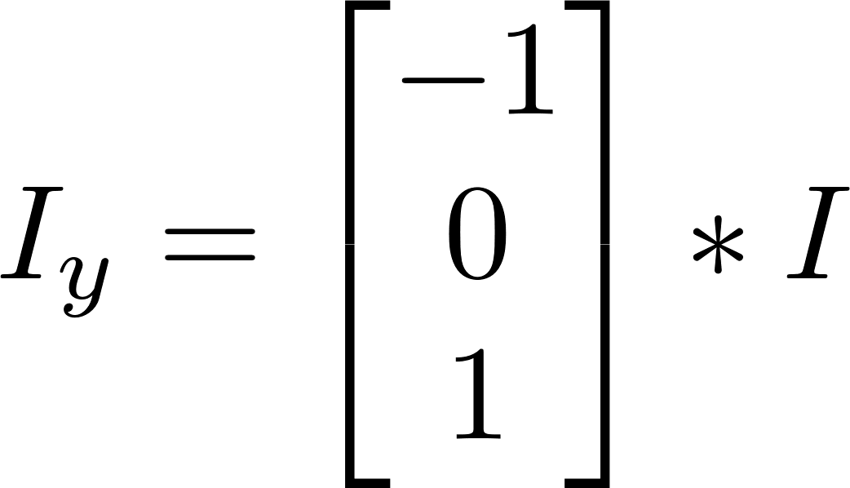
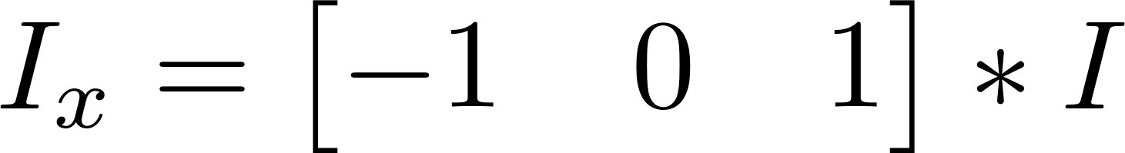
Feature Detectors: Harris Detector
2. Image gradients:

Slide 14
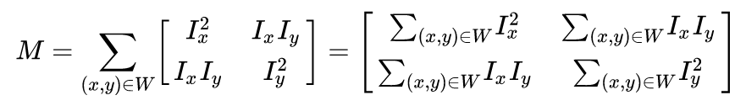
Feature Detectors: Harris Detector
3. Structure tensor setup

Slide 15

Feature Detectors: Harris Detector
4. Harris response calculation
𝜆₁ , 𝜆₂ are the eigenvalues of M

Slide 16
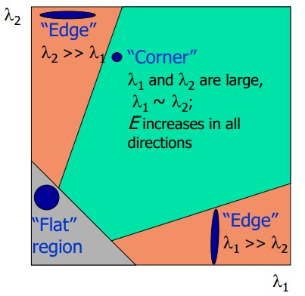
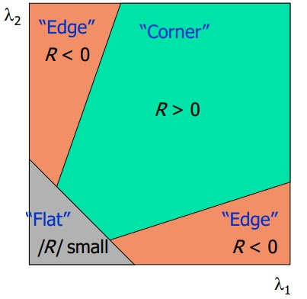
Feature Detectors: Harris Detector
4. Harris response calculation

Slide 17
Feature Detectors: Harris Detector
4. Non-maximum suppression
Filter to find the maximum values within a window of size W
Several points with R>0 can be very close

Slide 18
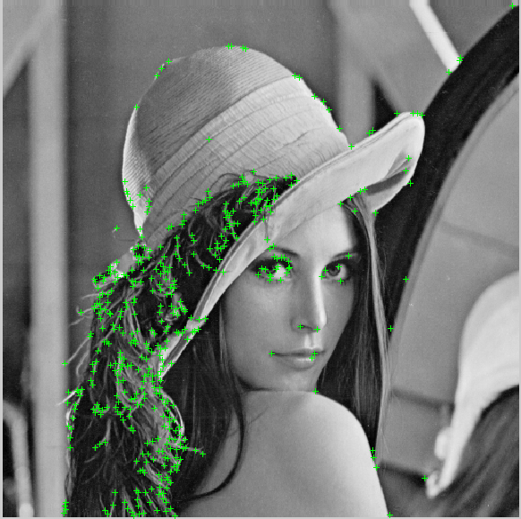
Feature Detectors: Harris Detector

Slide 19
Feature Descriptor: FREAK
+
[http://hristoalexiev.blogspot.com]
[FREAK-Alahi.2012]
FREAK:
Feature Descriptor
Harris
Corner Detector

Slide 20
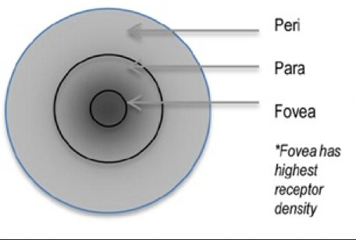
Feature Descriptor: FREAK
FREAK:
Fast REtinA
Keypoint
[FREAK-Alahi.2012]
[www.embedded-vision.com]

Slide 21
Feature Descriptor: FREAK
Sampling Pattern
[FREAK-Alahi.2012]

Slide 22
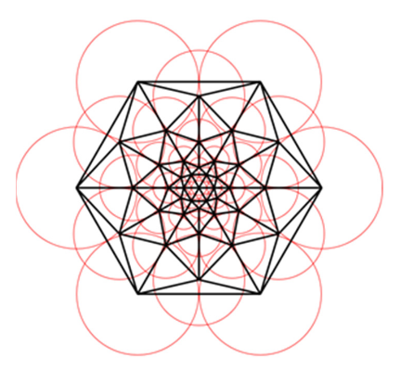
Feature Descriptor: FREAK
Paired Points:
Discard correlated Points
Maximizing variance of pairs
[FREAK-Alahi.2012]

Slide 23
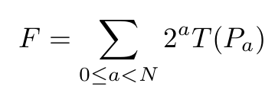
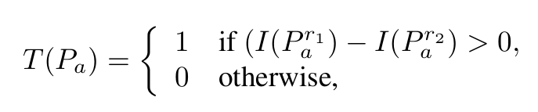
Feature Descriptor: FREAK
[FREAK-Alahi.2012]
Descriptor of size N, with P_{a} pairs

Slide 24
SURF

Slide 25
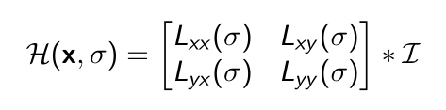
Feature Detectors: SURF detector
x = (x,y) is a point in an image I.
The Hessian is given by:

Slide 26
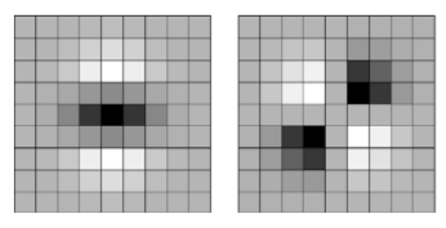
Feature Detectors: SURF detector
[SURF-Bay.2008]
L_{yy}
L_{xy}

Slide 27
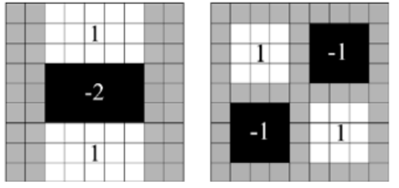
Feature Detectors: SURF detector
[SURF-Bay.2008]
Approximation!
D_{yy}
D_{xy}

Slide 28
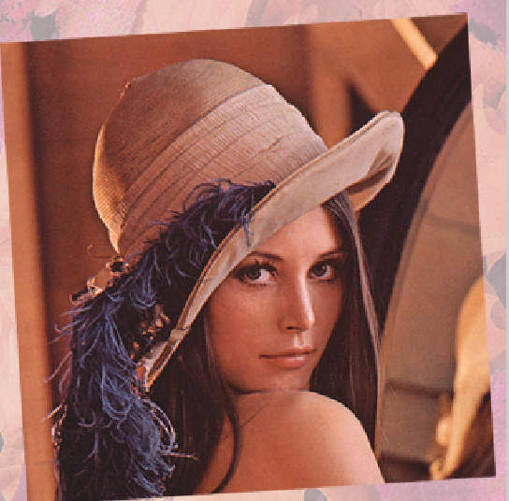
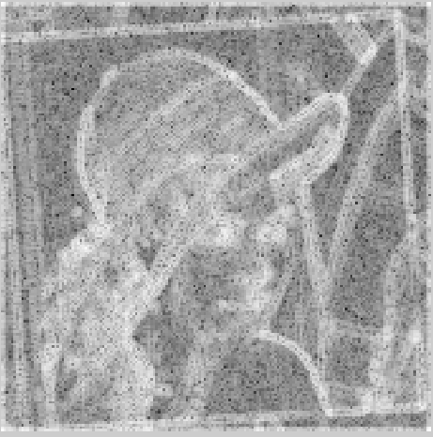
Feature Detectors: SURF detector
Candidates:
det(H) = D_{xx}D_{yy} - (0.9D_{xy})²

Slide 29
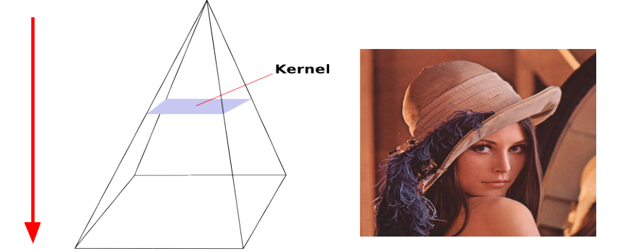
Feature Detectors: SURF detector
Scaling

Slide 30
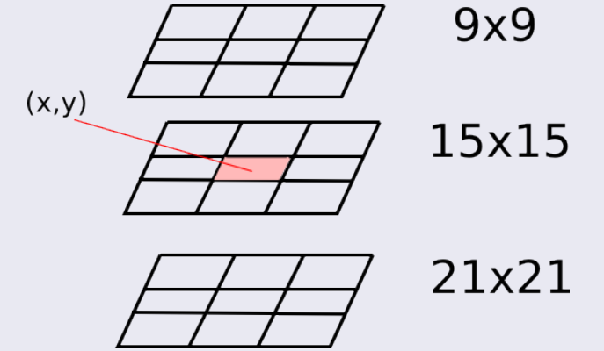
Feature Detectors: SURF detector
Scaling
3D Non-maximum suppression

Slide 31
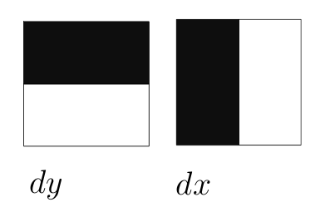
Feature Descriptor: SURF
-1
-1
+1
+1
Haar Wavelet Filters

Slide 32
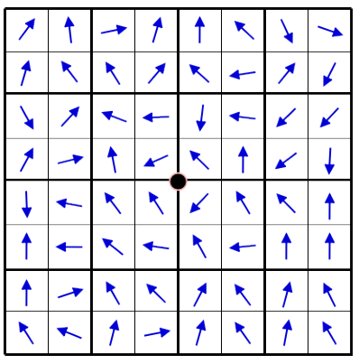
Feature Descriptor: SURF
For each detected feature
1 Interested Area
Divided 4x4 Sub-areas

Slide 33
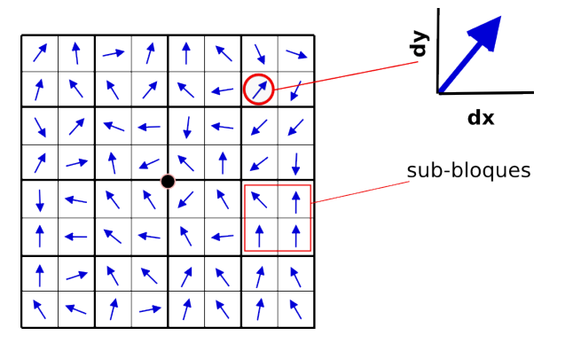
Feature Descriptor: SURF
Sub-Area
For each Sub-Area:
D = [ ∑dx , ∑dy, ∑|dx| , ∑|dy| ]

Slide 34
Feature Descriptor: SURF
Each point has a descriptor of 64 values
Sub-Area
For each Sub-Area:
D = [ ∑dx , ∑dy, ∑|dx| , ∑|dy| ]

Slide 35
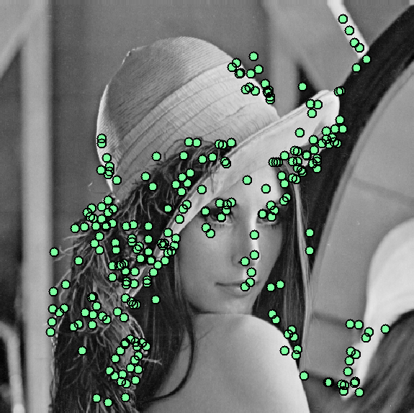
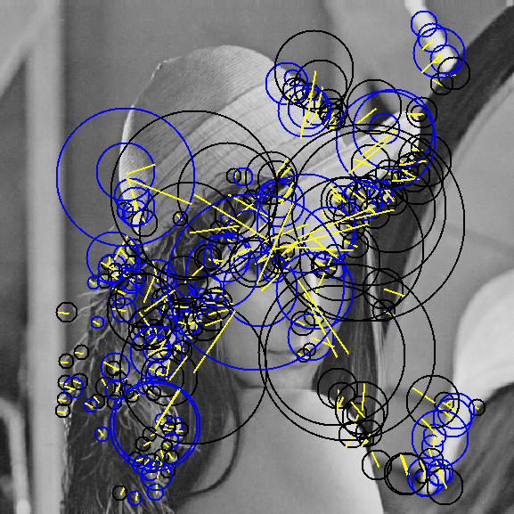
Example: SURF
Feature Detector
Feature Descriptor

Slide 36
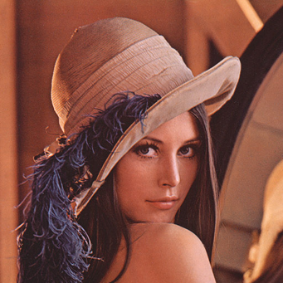

Comparison: Harris-FREAK vs SURF
LENA - Rotation and Scaling

Slide 37
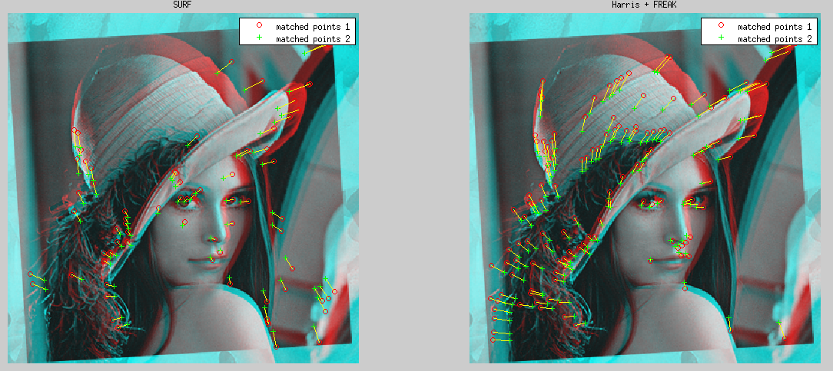
Comparison: Harris-FREAK vs SURF

Slide 38
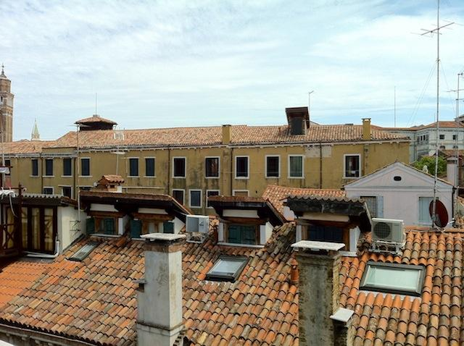
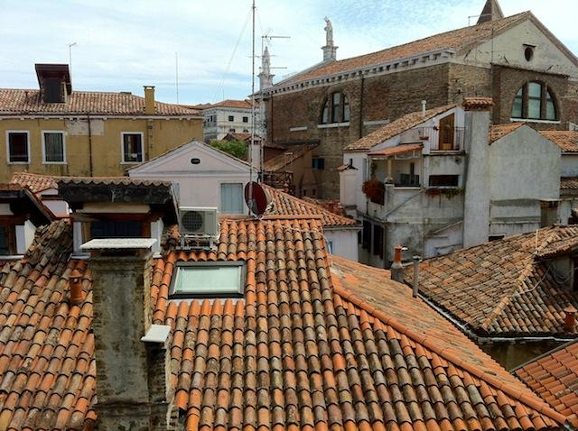
Comparison: Harris-FREAK vs SURF
ROOFS - Perspective

Slide 39
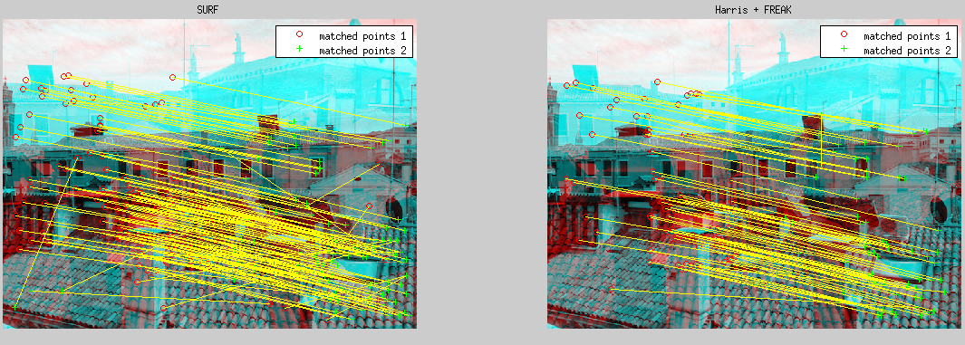
Comparison: Harris-FREAK vs SURF

Slide 40
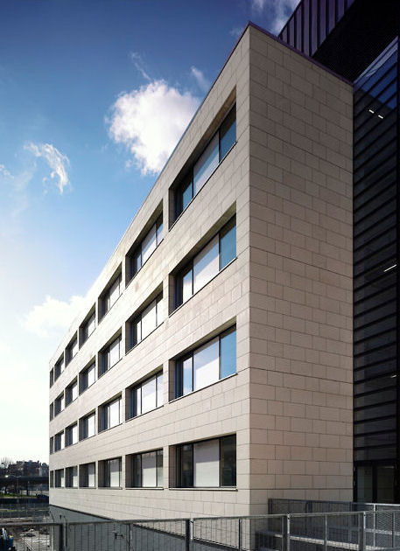
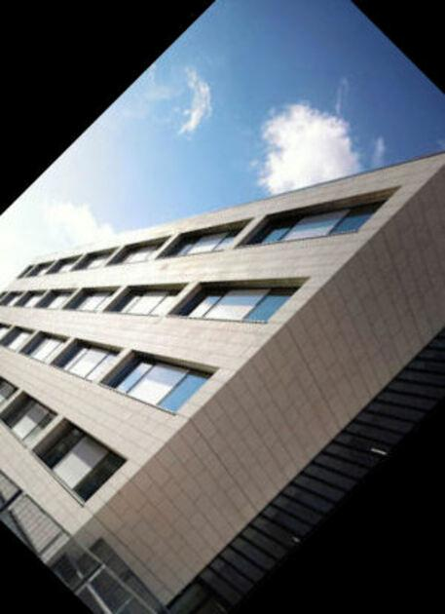
Comparison: Harris-FREAK vs SURF
BUILDING - Rotation

Slide 41
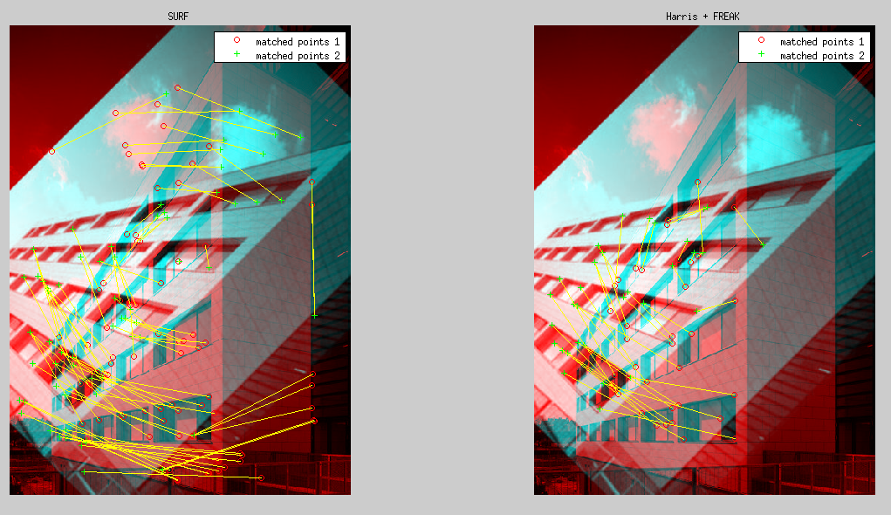
Comparison: Harris-FREAK vs SURF

Slide 42
Comparison: Harris-FREAK vs SURF
Number of features
 | Lena | Roof | Building
SURF | 521 306 | 1557 1061 | 109 130
Harris + FREAK | 362 263 | 2124 1646 | 274 274

Slide 43
Comparison: Harris-FREAK vs SURF
Matched Features
 | Lena | Roof | Building
SURF | 79 | 135 | 72
Harris + FREAK | 34 | 77 | 135

Slide 44
Comparison: Harris-FREAK vs SURF
Time in sec
 | Lena | Roof | Building
SURF | 0.1206 0.0555 | 0.1020 0.0767 | 0.0222 0.0244
Harris + FREAK | 0.2472 0.1326 | 0.2225 0.1873 | 0.0938 0.0907

Slide 45
Comparison: Harris-FREAK vs SURF
SURF is faster
Harris detects more features
SURF get more matches

Slide 46
RANSAC

Slide 47
RANSAC
Refinement of matching points
Select a random subset of the original data.
Model fitting with subset - Least Squares Regression
Test Model with full data - Get number of Inliers
If the number of inliers < threshold, keep trying

Slide 48
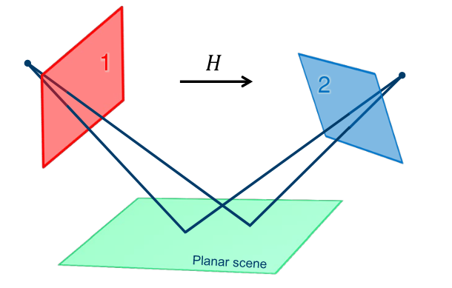
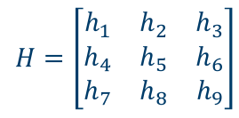
RANSAC - Homography
u
u’
Hu = u’
[https://www.uio.no/]

Slide 49
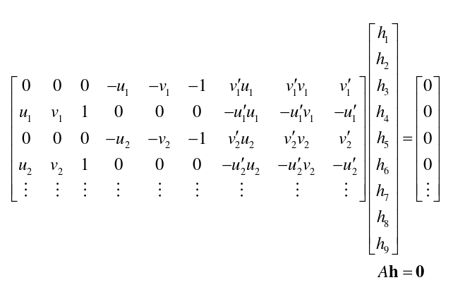
RANSAC - Homography

Slide 50
RANSAC
Random subset - At least 4 Point
Model fitting: minimize || Ah - 0 ||
Solution: SVD(A) = USV^{T}, h = v₉
Inliers: all points such that
dist( u’ , uH_{est} ) + dist( u, H⁻¹u’ ) > threshold
If the number of inliers < threshold, keep trying

Slide 51
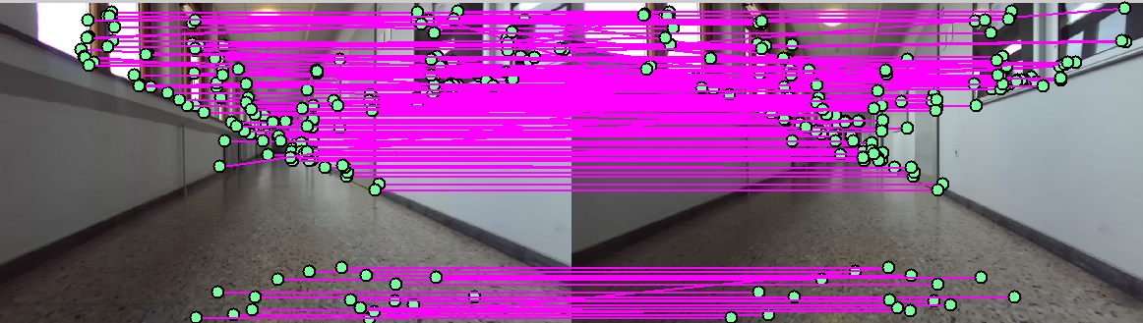
RANSAC: Pre match - SSD
287 Points
296 Points
180 Matches

Slide 52
RANSAC:
287 Points
296 Points
91 Matches

Slide 53
Pose Estimation

Slide 54
Pose Estimation: Fundamental Matrix
It maps points in image 1 to lines in image 2
Encapsulates the geometry between two views
Require any knowledge of the camera's internal parameter

Slide 55
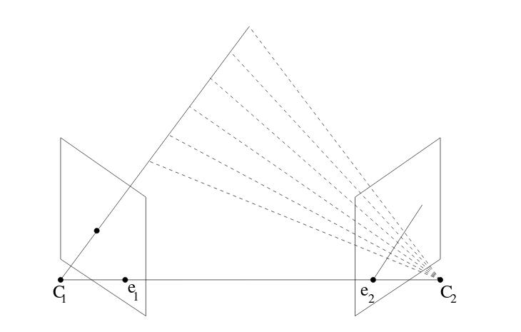
Pose Estimation: Fundamental Matrix
x₂^{T}Fx₁=0
x₁

Slide 56
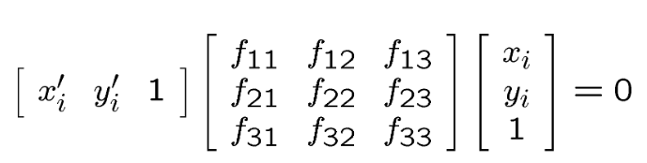
Pose Estimation: Fundamental Matrix

Slide 57
Pose Estimation: Fundamental Matrix
How do we find F?

Slide 58
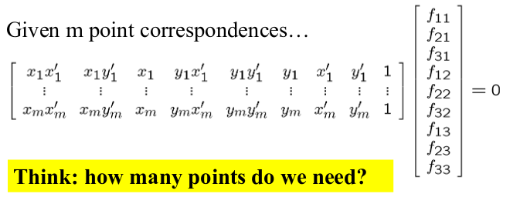
Pose Estimation: Fundamental Matrix
The Eight Point Algorithm
Af = 0

Slide 59
Pose Estimation: Fundamental Matrix
The Eight Point Algorithm
min || Af ||²
such that || f ||² = 1
Solution: SVD(A) = USV^{T}, f = v₉

Slide 60
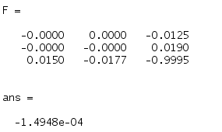
Pose Estimation: Fundamental Matrix
x₂^{T}Fx₁=0

Slide 61

Pose Estimation: Essential Matrix
[http://www.maths.lth.se]
P = K [ R | t ]

Slide 62
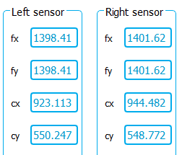

Pose Estimation: Essential Matrix
P = K [ R | t ]

Slide 63
Pose Estimation: Essential Matrix
P = K [ R | t ]
E = K₂^{T}FK₁
Relates normalized image points

Slide 64
Pose Estimation: Essential Matrix
P = K [ R | t ]
K⁻¹x = [ R | t ] X
x’ = [R | t ] X
x’ = P’ X
E = K₂^{T}FK₁
Relates normalized image points
Normalized image coordinates have the origin at the optical center of the image

Slide 65

Pose Estimation: Rotation and Translation
The Essential Matrix for a pair of cameras of the form:
P’₁ = [ I 0 ] and P’₂ = [ R t ]
E = [t]_{x}R = SR

Slide 66


Pose Estimation: Rotation and Translation
E = [t]_{x}R = SR
If [ U,~,V] = svd(E)
S₁ = -UZU^{T}, S₂ = -S₁
R₁ = -UW^{T}V^{T} , R₂ = UWV^{T}

Slide 67
Pose Estimation: Rotation and Translation
E = [t]_{x}R = SR
There are 4 possible solutions for P₂’
P₂’ = [ R₁ t ]
P₂‘ = [ R₁ -t ]
P₂‘ = [ R₂ t ]
P₂‘ = [ R₂ -t ]

Slide 68
Pose Estimation: Rotation and Translation
E = [t]_{x}R = SR
There are 4 possible solutions for P₂’
P₂’ = [ R₁ t ]
P₂‘ = [ R₁ -t ]
P₂‘ = [ R₂ t ]
P₂‘ = [ R₂ -t ]
We have to test them all!!

Slide 69

Pose Estimation: Linear Triangulation
Recall:
x₁ = P₁X
x₂ = P₂X
X
x₁
x₂

Slide 70


Pose Estimation: Linear Triangulation
Recall:
x₁ = P₁X
x₂ = P₂X
X
Solve: AX = 0
Solution: SVD(A) = USV^{T}, X = v₄
x₁
x₂

Slide 71
Pose Estimation: Linear Triangulation
Recall:
x₁ = P₁X
x₂ = P₂X
X
For each point!
Solve: AX = 0
Solution: SVD(A) = USV^{T}, X = v₄
x₁
x₂

Slide 72


Pose Estimation: Linear Triangulation
[https://web-dr.tis.plymouth.ac.uk]

Slide 73
Pose Estimation: Linear Triangulation

Slide 74
Pose Estimation: Linear Triangulation

Slide 75

Pose Estimation: Linear Triangulation
X-Y view

Slide 76
Pose Estimation: Linear Triangulation
X-Y view

