Slide 1
Part 2 Introduction to Sampling Samplics: Survey Sampling from A to Z in Python
Mamadou S. Diallo
AAPOR 2022
11 May 2022

Slide 2
Outline
Brief overview of sampling
Key sampling steps
Sample size calculation
Sample selection
Weight adjustment
Parameter estimation
Software for sampling

Slide 3
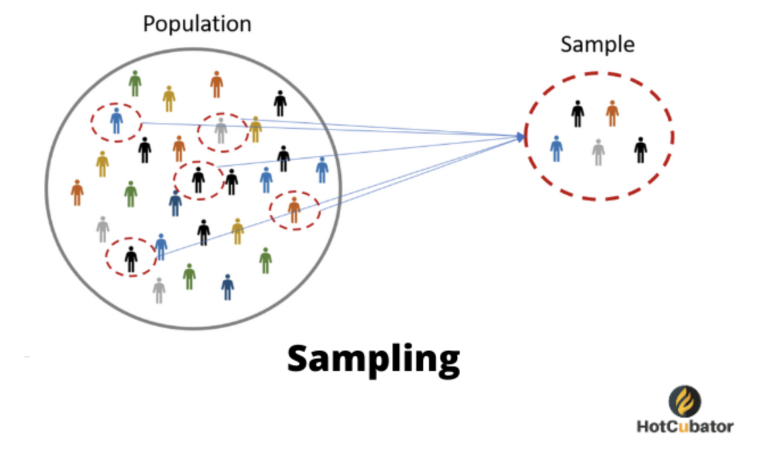
Overview of sampling What is survey sampling
Survey sampling is the process of selecting a set of elements from a target population, measure information on the set, and generalize measurements to the target population.

Slide 4
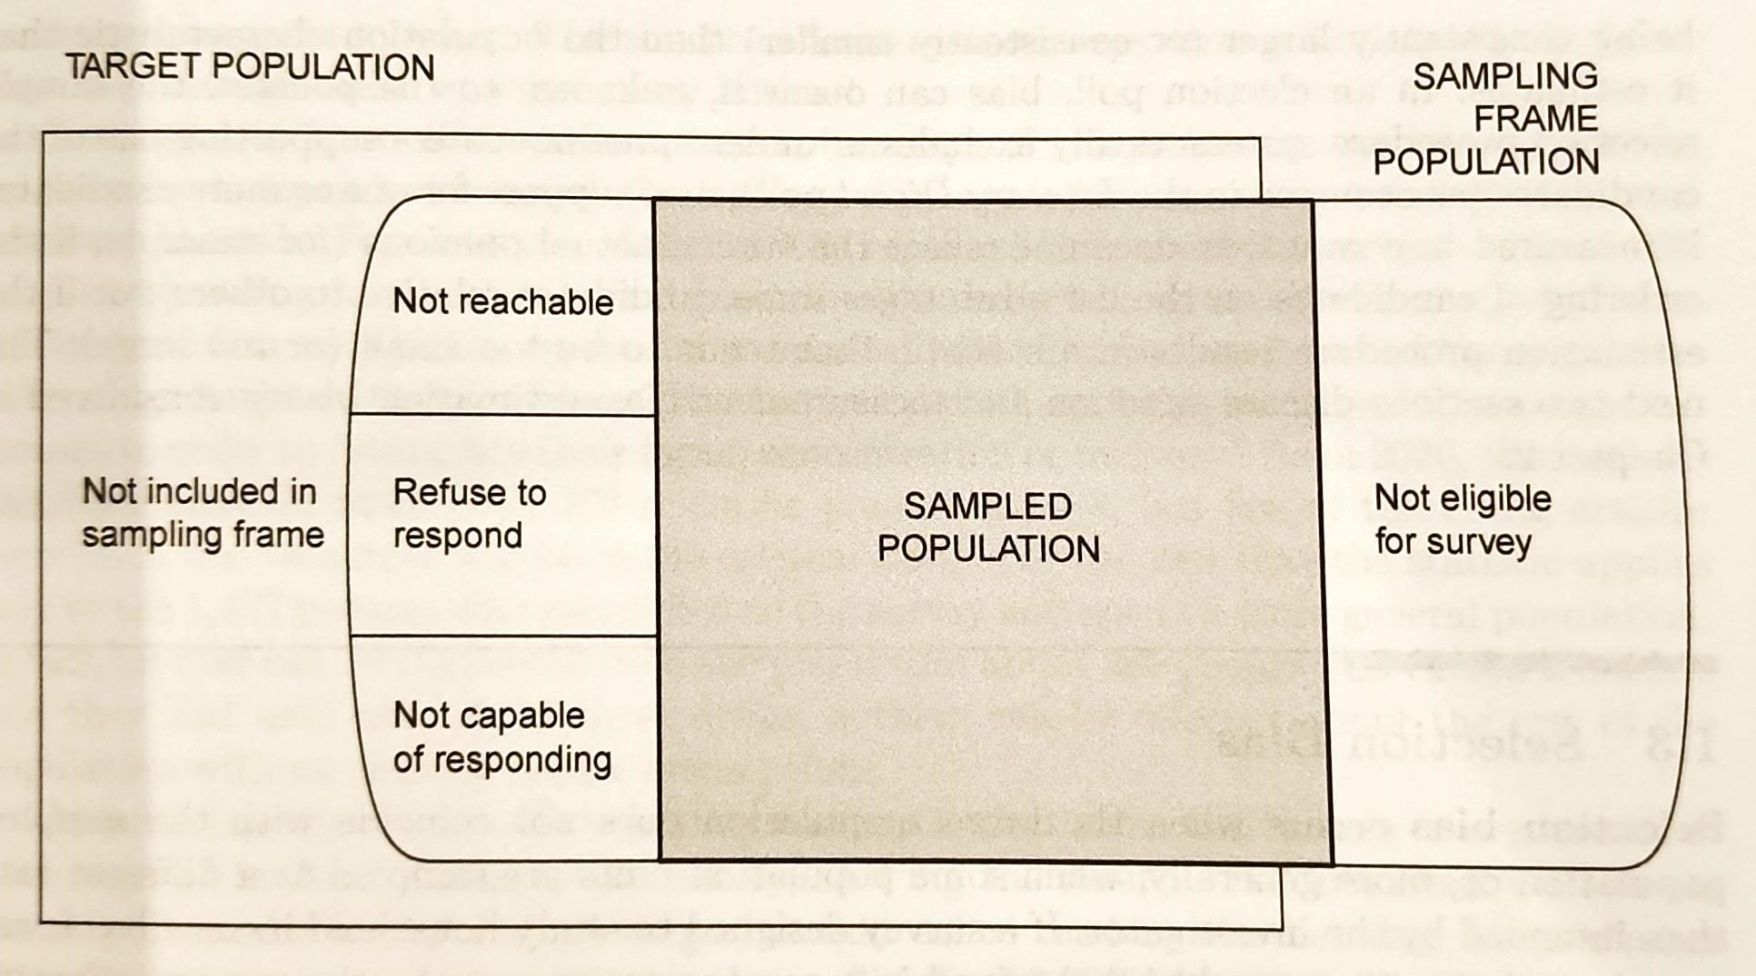
Overview of sampling Populations (target vs sampled) and sampling frame
Source: Sampling – Design and Analysis, Third Edition, Sharon L. Lohr

Slide 5
Overview of sampling Probability sampling
Random selection mechanism
Sample units are selected with know probabilities of inclusion
Mismatch between the target and sampled populations will lead to bias (presence of units with zero probability of selection)
Sample weight is the mechanism used to generalize from the sample to the target population
Interpretation: number of units from the population represented by one sampling unit
Design sample weight obtained from the sampling method
Further adjustments to account for non-response and other post-selection information
Survey-based estimates to account for the variability due to sampling
Randomness comes from the selection/inclusion mechanism

Slide 6
Sample size calculation General approach
Sample size calculation is often one of the first steps
Common approach for calculating sample size
Reduce the variables of interest to a single or handful of variables
Set expected precisions for each parameter of interest
Compute minimum required sample, n, to achieve expected precisions
Iterate step 3 until sample size meet cost and operational requirements

Slide 7
Sample size calculation Common approach for calculating sample size
For a single parameter
Set the expected/desired precision
Find an equation to calculate the minimum sample size n
Estimate unknown quantities needed to resolve for n
Often, step 3 is done for the basic situation. If so, further adjustments may be required for
Finite population
Non-response
Complexity of the sampling design
Etc.

Slide 8
Sample selection Types of selection
Simple random sampling (SRS)
Simplest selection approach
All samples of size n have the same probability of selection
Systematic sampling
Randomly order the sampling units
Chose a random start and select every k^{th} element
Cluster sampling
Group observations into large sampling units called clusters
Select clusters using equal or inequal probabilities of selection
Stratified sampling
Partition the population into subgroups called strata
Independently select samples within each stratum

Slide 9
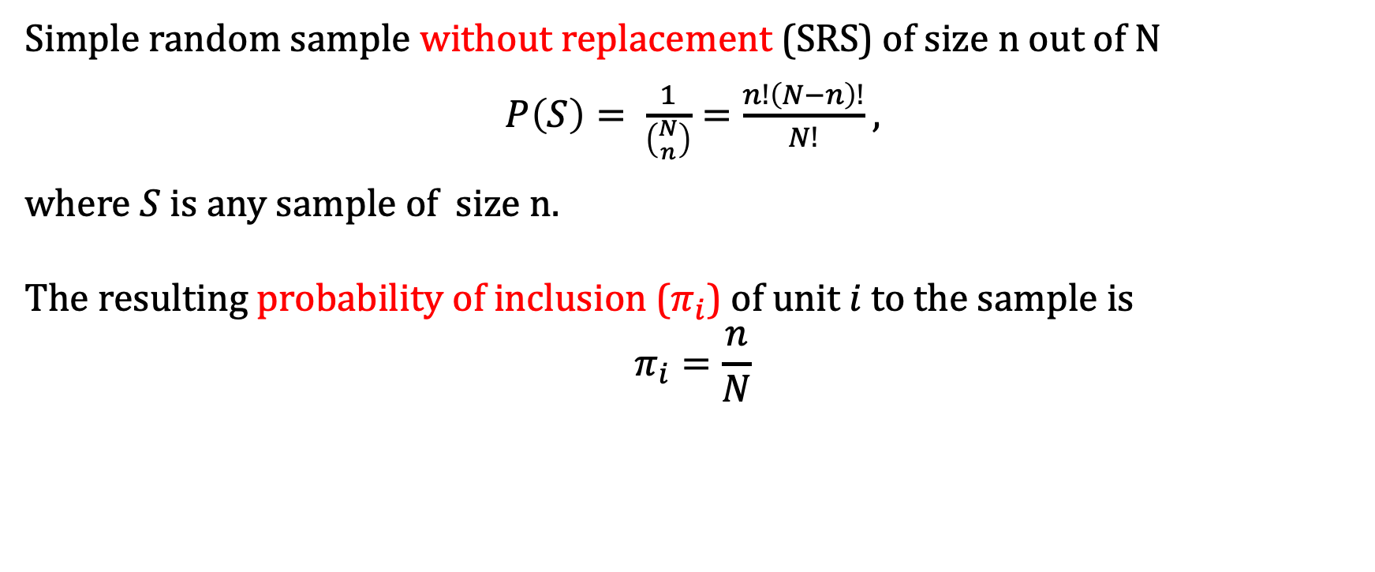
Sample selection Simple random sampling (SRS)
Simple random sample without replacement (SRS) of size n out of N
$P\left(S\right)= \frac{1}{\left({N \atop n}\right)}=\frac{n!\left(N−n\right)!}{N!}$ ,
where $S$ is any sample of size n.
The resulting probability of inclusion ($π_{i}$) of unit $i$ to the sample is
$$π_{i}=\frac{n}{N}$$

Slide 10
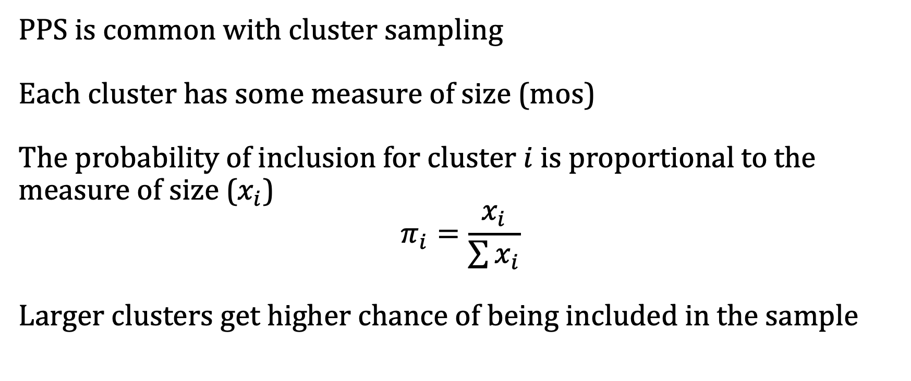
Sample selection Probability proportional to size (PPS)
PPS is common with cluster sampling
Each cluster has some measure of size (mos)
The probability of inclusion for cluster $i$ is proportional to the measure of size ($x_{i}$)
$$π_{i}=\frac{x_{i}}{\sum{x_{i}}}$$
Larger clusters get higher chance of being included in the sample

Slide 11
Sample selection Multi-stage sampling: a common complex design
For operational or cost reasons, it is often not practical or feasible to directly select population units.
Multi-stage sampling is a generalization of cluster sampling where the clustering is done at multiple levels and population units are selected at the last step.
For example, many large national household surveys use the following two-stage sampling
Divide the country into geographic areas called primary sampling units (PSUs)
Select a sample of PSUs
From each selected PSU, list all households called secondary sampling units (SSUs)
Select a sample of households to conduct the survey

Slide 12
Sample weight adjustment Generalization of sample results
The sample weight is one of the main mechanism used to generalize findings from the sample to the target population
The usual interpretation of the sample weight is the number of units in the population represented by the selected unit
Usual approach is
Obtain the initial (design) weight from the final probability of selection
Adjust the design weight to account for non-response (nonresponse weight)
If applicable, adjust the nonresponse weight to calibrate sample distribution of key auxiliary variables to their known population distribution

Slide 13
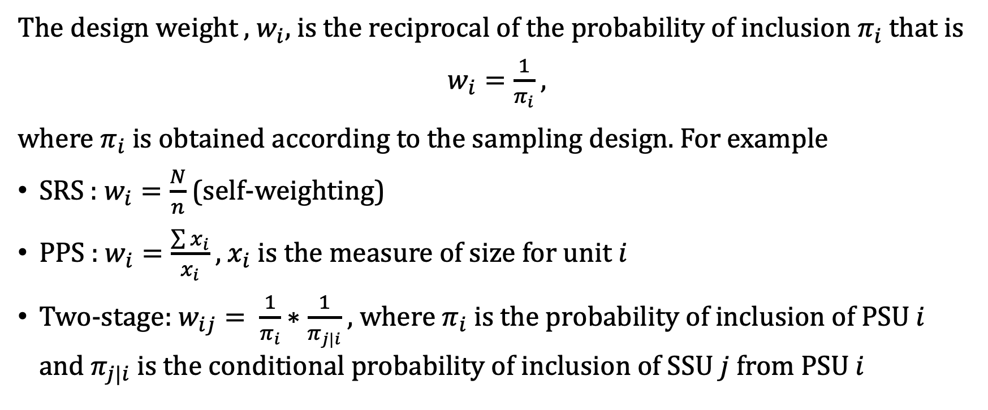
Sample weight adjustment Design weight
The design weight , $w_{i}$, is the reciprocal of the probability of inclusion $π_{i}$ that is
$w_{i}=\frac{1}{π_{i}}$ ,
where $π_{i}$ is obtained according to the sampling design. For example
SRS : $w_{i}=\frac{N}{n}$ (self-weighting)
PPS : $w_{i}=\frac{\sum{x_{i}}}{x_{i}}$ , $x_{i}$ is the measure of size for unit $i$
Two-stage: $w_{ij}= \frac{1}{π_{i}}∗\frac{1}{π_{j|i}}$ , where $π_{i}$ is the probability of inclusion of PSU $i$ and $π_{j|i}$ is the conditional probability of inclusion of SSU $j$ from PSU $i$

Slide 14
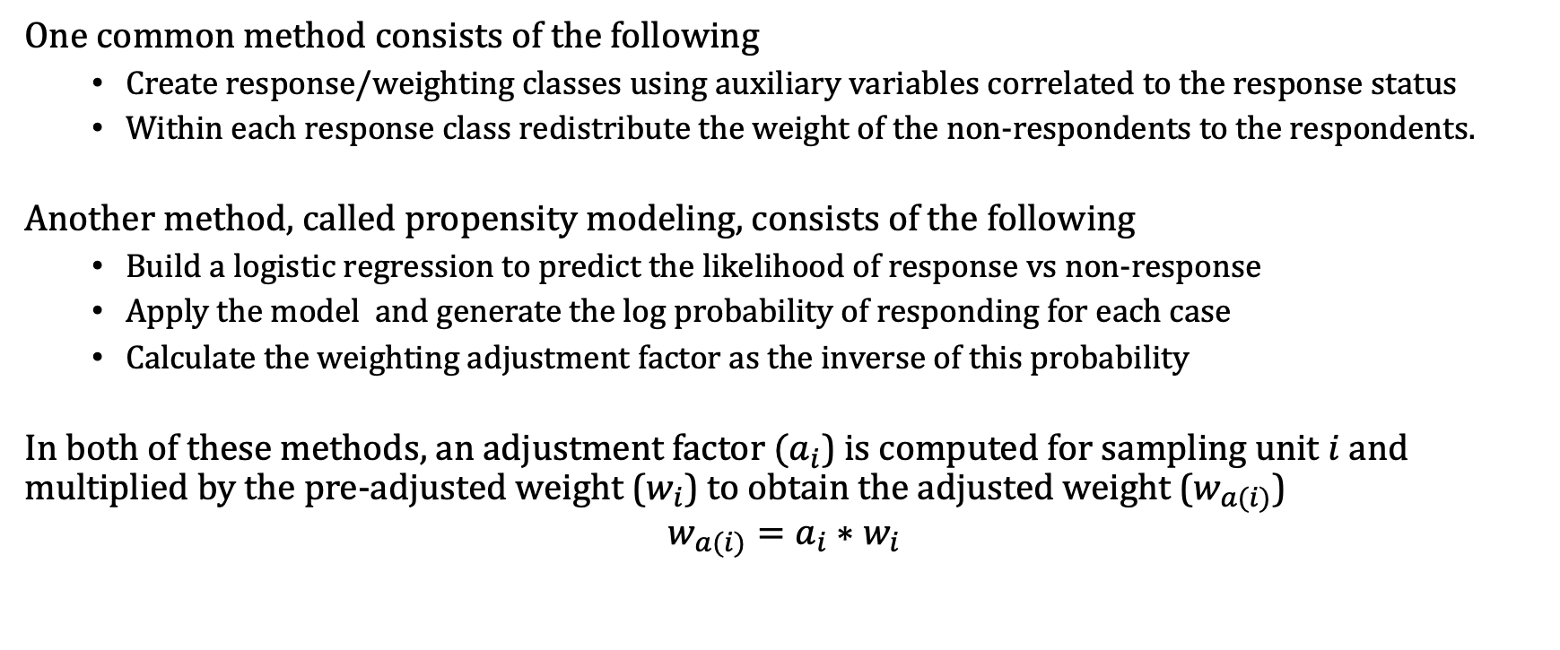
Sample weight adjustment Weight adjustments for non-response
One common method consists of the following
Create response/weighting classes using auxiliary variables correlated to the response status
Within each response class redistribute the weight of the non-respondents to the respondents.
Another method, called propensity modeling, consists of the following
Build a logistic regression to predict the likelihood of response vs non-response
Apply the model and generate the log probability of responding for each case
Calculate the weighting adjustment factor as the inverse of this probability
In both of these methods, an adjustment factor $(a_{i}$) is computed for sampling unit $i$ and multiplied by the pre-adjusted weight ($w_{i}$) to obtain the adjusted weight ($w_{a(i)}$)
$$w_{a(i)}={a_{i}∗w}_{i}$$

Slide 15
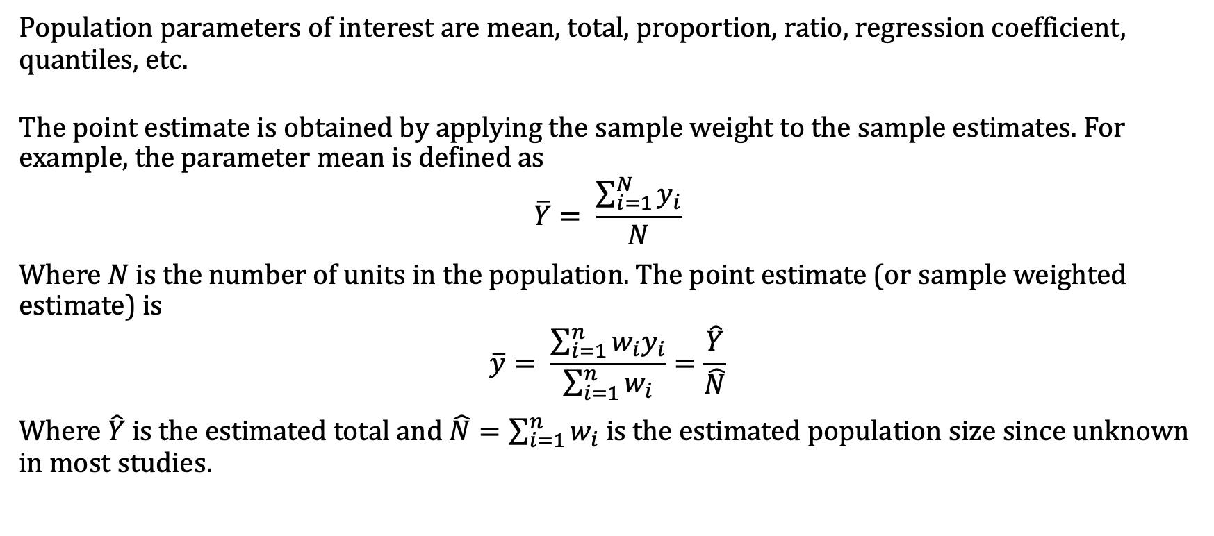
Parameter estimation Point estimates
Population parameters of interest are mean, total, proportion, ratio, regression coefficient, quantiles, etc.
The point estimate is obtained by applying the sample weight to the sample estimates. For example, the parameter mean is defined as
$$\overline{Y}= \frac{\sum_{i=1}^{N}{y_{i}}}{N}$$
Where $N$ is the number of units in the population. The point estimate (or sample weighted estimate) is
$$\overline{y}= \frac{\sum_{i=1}^{n}{{w_{i}y}_{i}}}{\sum_{i=1}^{n}{w_{i}}}=\frac{\hat{Y}}{\hat{N}}$$
Where $\hat{Y}$ is the estimated total and $\hat{N}=\sum_{i=1}^{n}{w_{i}}$ is the estimated population size since unknown in most studies.

Slide 16
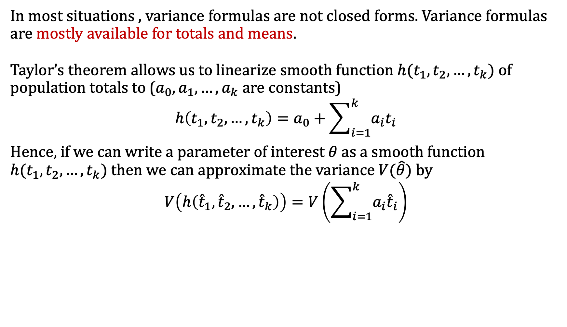
Parameter estimation Uncertainty estimates (linearization / Taylor series)
In most situations , variance formulas are not closed forms. Variance formulas are mostly available for totals and means.
Taylor’s theorem allows us to linearize smooth function $h(t_{1},t_{2},…,t_{k})$ of population totals to ($a_{0},a_{1},…,a_{k}$ are constants)
$$h\left(t_{1},t_{2},…,t_{k}\right)=a_{0}+\sum_{i=1}^{k}{a_{i}t_{i}}$$
Hence, if we can write a parameter of interest $θ$ as a smooth function $h(t_{1},t_{2},…,t_{k})$ then we can approximate the variance $V(\hat{θ})$ by
$$V\left(h\left({\hat{t}}_{1},{\hat{t}}_{2}, …,{\hat{t}}_{k}\right)\right)=V\left(\sum_{i=1}^{k}{a_{i}{\hat{t}}_{i}}\right)$$

Slide 17
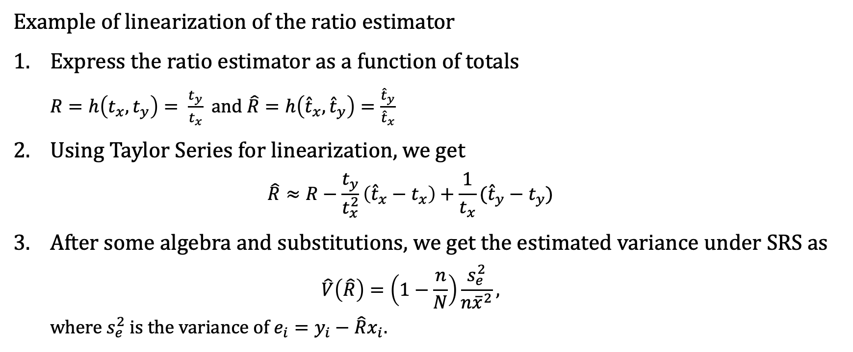
Parameter estimation Uncertainty estimates (linearization / Taylor series)
Example of linearization of the ratio estimator
Express the ratio estimator as a function of totals
$R=h\left(t_{x}, t_{y}\right)= \frac{t_{y}}{t_{x}}$ and $\hat{R}=h\left({\hat{t}}_{x},{\hat{t}}_{y}\right)=\frac{{\hat{t}}_{y}}{{\hat{t}}_{x}}$
Using Taylor Series for linearization, we get
$$\hat{R}≈R−\frac{t_{y}}{t_{x}^{2}}\left({\hat{t}}_{x}−t_{x}\right)+\frac{1}{t_{x}}({\hat{t}}_{y}−t_{y})$$
After some algebra and substitutions, we get the estimated variance under SRS as
$$\hat{V}\left(\hat{R}\right)=\left(1−\frac{n}{N}\right)\frac{s_{e}^{2}}{n{\overline{x}}^{2}},$$
where $s_{e}^{2}$ is the variance of $e_{i}=y_{i}−\hat{R}x_{i}.$

Slide 18
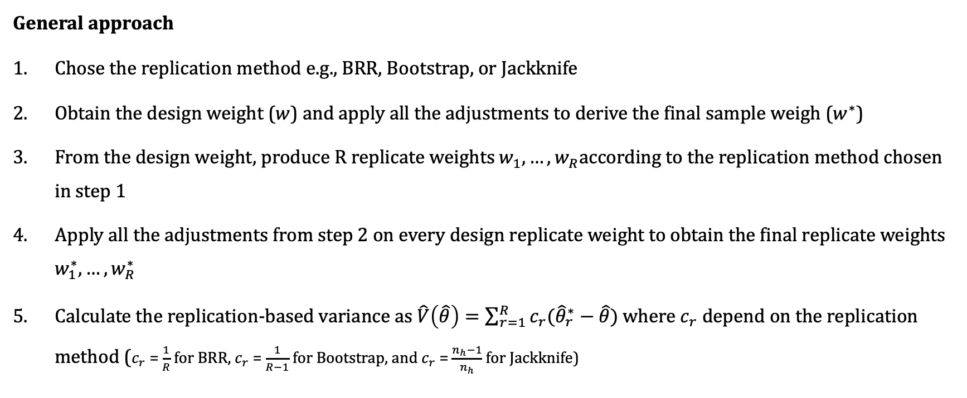
Parameter estimation Uncertainty estimates (Replication methods)
General approach
Chose the replication method e.g., BRR, Bootstrap, or Jackknife
Obtain the design weight ($w$) and apply all the adjustments to derive the final sample weigh ($w^{∗}$)
From the design weight, produce R replicate weights $w_{1}, …, w_{R}$according to the replication method chosen in step 1
Apply all the adjustments from step 2 on every design replicate weight to obtain the final replicate weights $w_{1}^{∗}, …, w_{R}^{∗}$
Calculate the replication-based variance as $\hat{V}\left(\hat{θ}\right)=\sum_{r=1}^{R}{c_{r}({\hat{θ}}_{r}^{∗}−\hat{θ})}$ where $c_{r}$depend on the replication method ($c_{r}$ = $\frac{1}{R}$ for BRR, $c_{r}$ = $\frac{1}{R−1}$ for Bootstrap, and $c_{r}$ = $\frac{n_{h}−1}{n_{h}}$ for Jackknife)

Slide 19
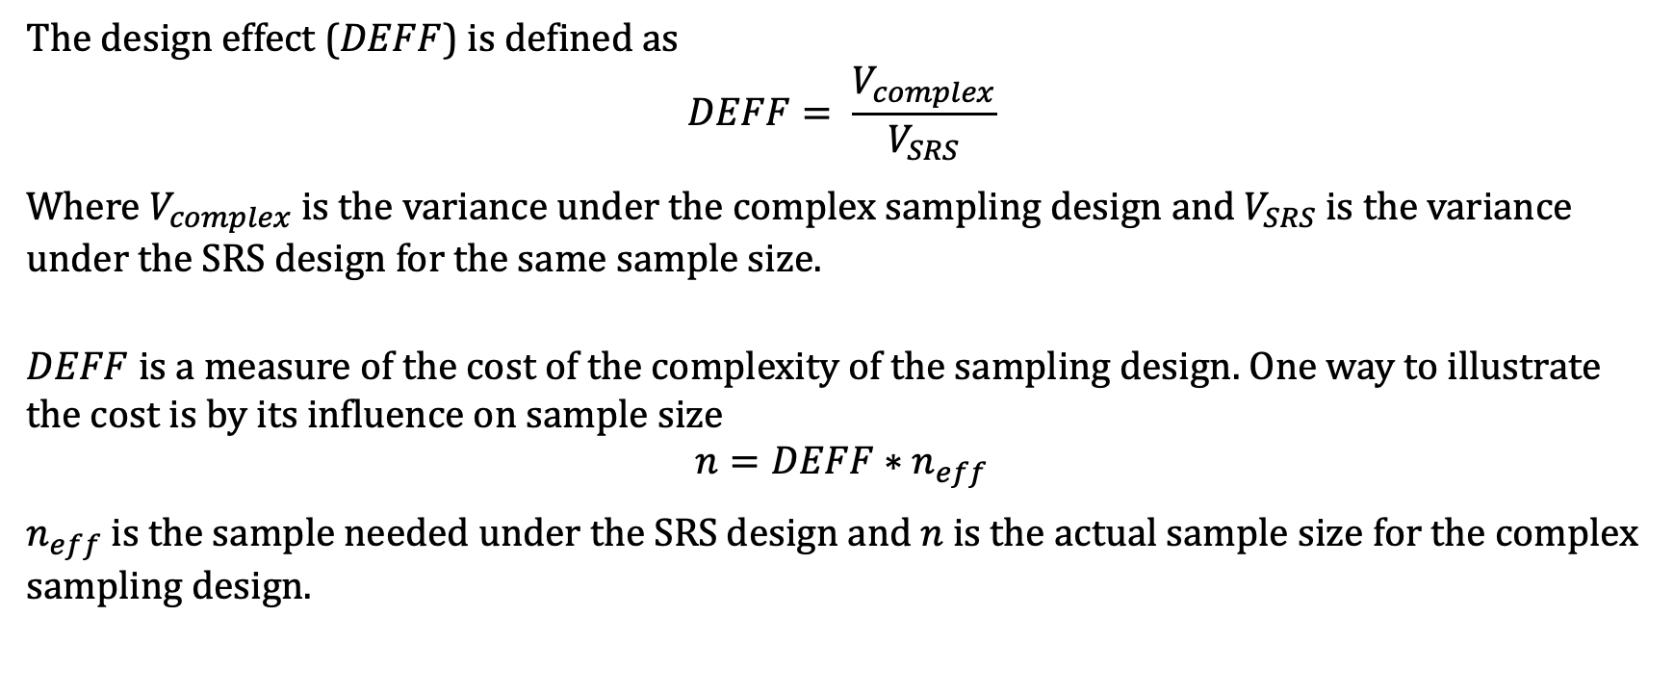
Design effect Measure of the cost of deviating from SRS
The design effect ($DEFF$) is defined as
$$DEFF= \frac{V_{complex}}{V_{SRS}}$$
Where $V_{complex}$ is the variance under the complex sampling design and $V_{SRS}$ is the variance under the SRS design for the same sample size.
$DEFF$ is a measure of the cost of the complexity of the sampling design. One way to illustrate the cost is by its influence on sample size
$$n=DEFF∗n_{eff}$$
$n_{eff}$ is the sample needed under the SRS design and $n$ is the actual sample size for the complex sampling design.

Slide 20
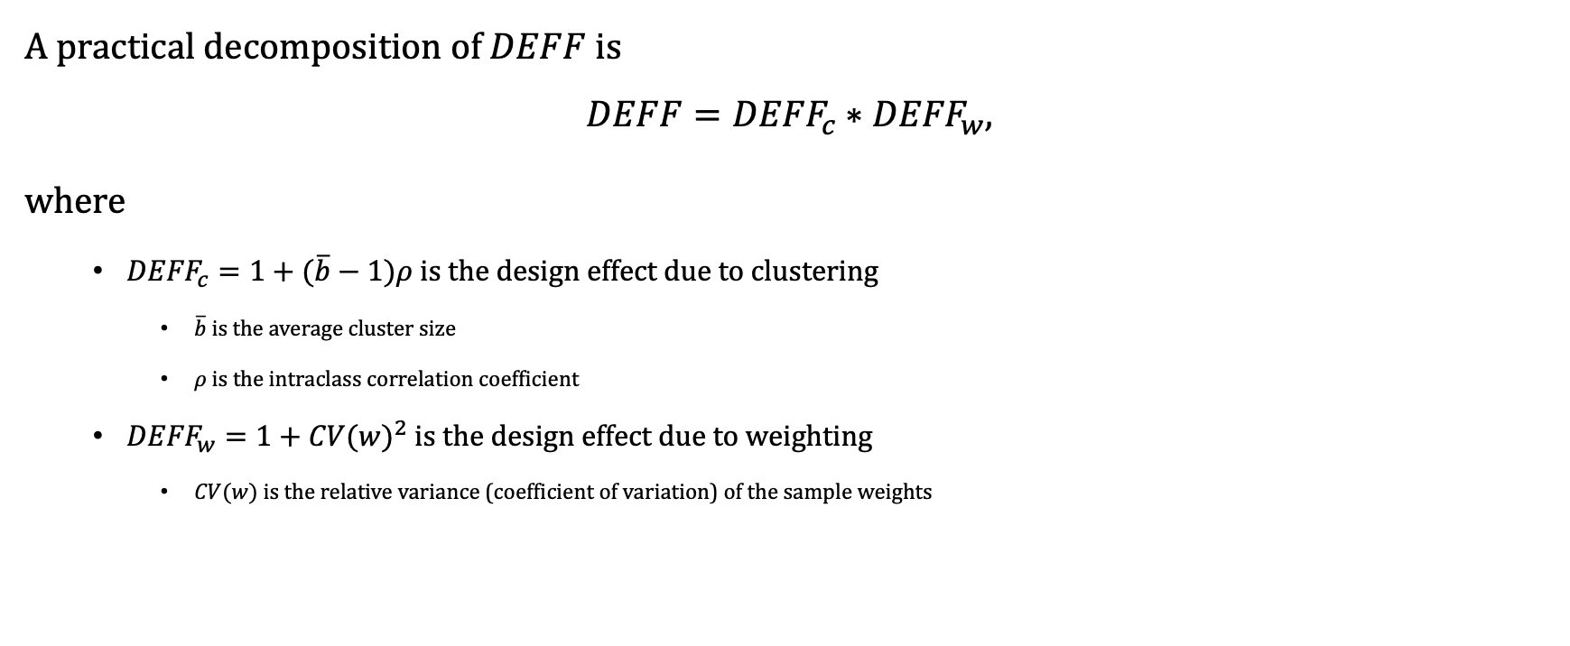
Design effect A useful decomposition
A practical decomposition of $DEFF$ is
$$DEFF={DEFF}_{c}∗{DEFF}_{w},$$
where
${DEFF}_{c}=1+(\overline{b}−1)ρ$ is the design effect due to clustering
$\overline{b}$ is the average cluster size
$ρ$ is the intraclass correlation coefficient
${DEFF}_{w}=1+{CV(w)}^{2}$ is the design effect due to weighting
$CV(w)$ is the relative variance (coefficient of variation) of the sample weights

Slide 21
Let’s use samplics!
Mamadou S. Diallo
msdiallo@samplics.org

