Slide 1
Part 1 Introduction to Python Samplics: Survey Sampling from A to Z in Python
Mamadou S. Diallo
AAPOR 2022
11 May 2022

Slide 2
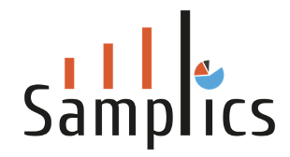





Who I am?
Experience. 15+ years in survey sampling and statistical analysis
Current
Creator and lead developer of Samplics
Chief Data Scientist and COO of The Saudi Center for Opinion Polling (SCOP)
Immunization Data Lead at UNICEF (2016 – 2021)
Senior statistician at Westat (2011 – 2016)
Mathematical Statistician at Statistics Canada (2006 – 2011)
Education.
PhD in Small Area Estimation at Carleton University, Ottawa, Canada, 2015
(under the direction of Prof. J.N.K Rao)

Slide 3
Plan of the tutorial
Introduction
Part I: Introduction to Python
Basic Python
Pandas: the Python DataFrame
Part II: Sampling using Python
Overview of Survey Sampling
Introduction to Samplics
Sample size calculation
Sample selection

Slide 4
Software for Survey Sampling From closed to open-source solutions
Closed or paid solutions*
SAS (https://www.sas.com/en_us/software/stat.html)
SPSS (https://www.ibm.com/products/spss-statistics)
Stata (https://www.stata.com/)
SUDAAN (https://www.rti.org/impact/sudaan-statistical-software-analyzing-correlated-data)
WesVAR (https://www.westat.com/capability/information-technology/wesvar)
Open-source solutions*
R survey (https://r-survey.r-forge.r-project.org/survey/)
EPI info (https://www.cdc.gov/epiinfo/index.html)
No Python based solution until now with samplics
https://samplics.readthedocs.io/en/latest/
*List may not be exhaustive

Slide 5
Samplics: A Python Library for Sampling Comprehensive solution but still under development
Sample Size Calculation
Estimation of proportions, means, and total
Comparisons of proportion, means, and total
Sample Selection
Simple Random Selection (SRS)
Systematic
Probability Proportional to Size (PPS)
Sample Weight adjustment
Non-response
Post-stratification and Calibration
Replicate weights
Parameter estimation
Taylor-based methods
Replicate-based methods
Regression
Categorical Data Analysis
Tabulation
T-test
Small Area Estimation
Area-level models
Unit-level models

Slide 6
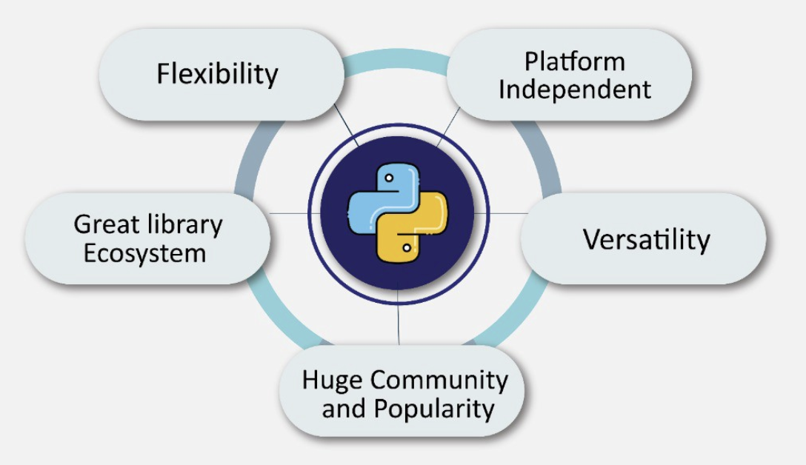
Why develop a Python solution? Python: one of the most used tool for data science/analysis
Source: https://medium.com/@-TutortAcademy/why-python-is-so-essential-for-machine-learning-1a7701f5270d

Slide 7
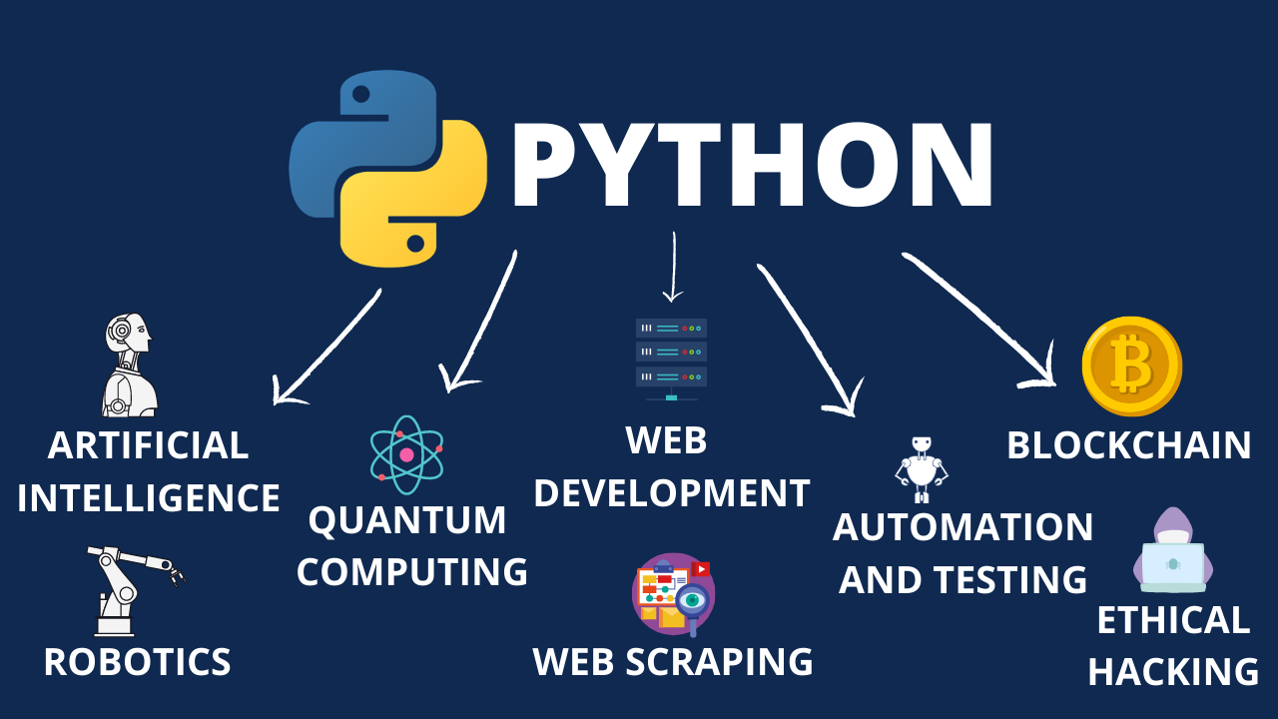
What is Python used for? Very broad use cases
Source: https://becominghuman.ai/why-is-python-so-popular-b01a006b2be4

Slide 8
Hands-on session Practice using the Jupyter notebooks
Basics of Python
https://www.python.org/
Download Python: https://www.python.org/downloads/
Pandas: the Python DataFrame
https://pandas.pydata.org/
Install pandas by typing pip install pandas in your terminal.
Jupyter lab
https://jupyter.org/
Follow the instructions for JupyterLab: https://jupyter.org/install

Slide 9
Let’s start!
Mamadou S. Diallo
msdiallo@samplics.org

