Slide 1
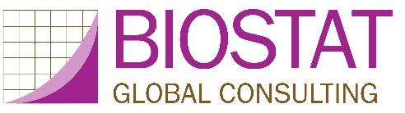
Organ Pipe Plots for Clustered Datasets
Visualize Disparities in Cluster-Level Coverage
Mary Prier & Dale Rhoda & Mary Kay Trimner
Stata Conference ● Columbus, OH ● July 19, 2018
(2019 - Slides updated to describe plotn and associated options)
(2020 – Slides updated to reflect possibility of negative ICC)
(2024 – Slides updated to reflect new footnote options & 2- or 3-category bar coloring)
(2026 – Slides updated for opplot 2.01)
Notes:
Abstract: Leo Tolstoy is famous for his novels and less well known for his ideas on survey data analysis. Concerning estimated proportions, he is said to have written: Covered strata are all alike; every poorly covered stratum is poorly covered in its own way. I describe a new command to make what we call organ pipe plots to visualize heterogeneity in binary outcomes in clustered data. The plots were conceived for vaccination coverage surveys but may be helpful in a wide variety of contexts. Imagine a survey where only 50% of sampled children are found to be vaccinated. Different programmatic responses would be appropriate if the vaccinated include all the children in half the clusters versus half the children in all the clusters. These plots have been used to identify neighborhoods that were surreptitiously and intentionally skipped over during vaccination campaigns. The talk will demonstrate the command and discuss similarities with Pareto plots from quality control and a visual connection to the intracluster correlation coefficient (ICC). Note that the ICC shares a connection to anarcho-pacifistic ideas in Tolstoy’s later novels: many students mention them … but few can describe them clearly.

Slide 2
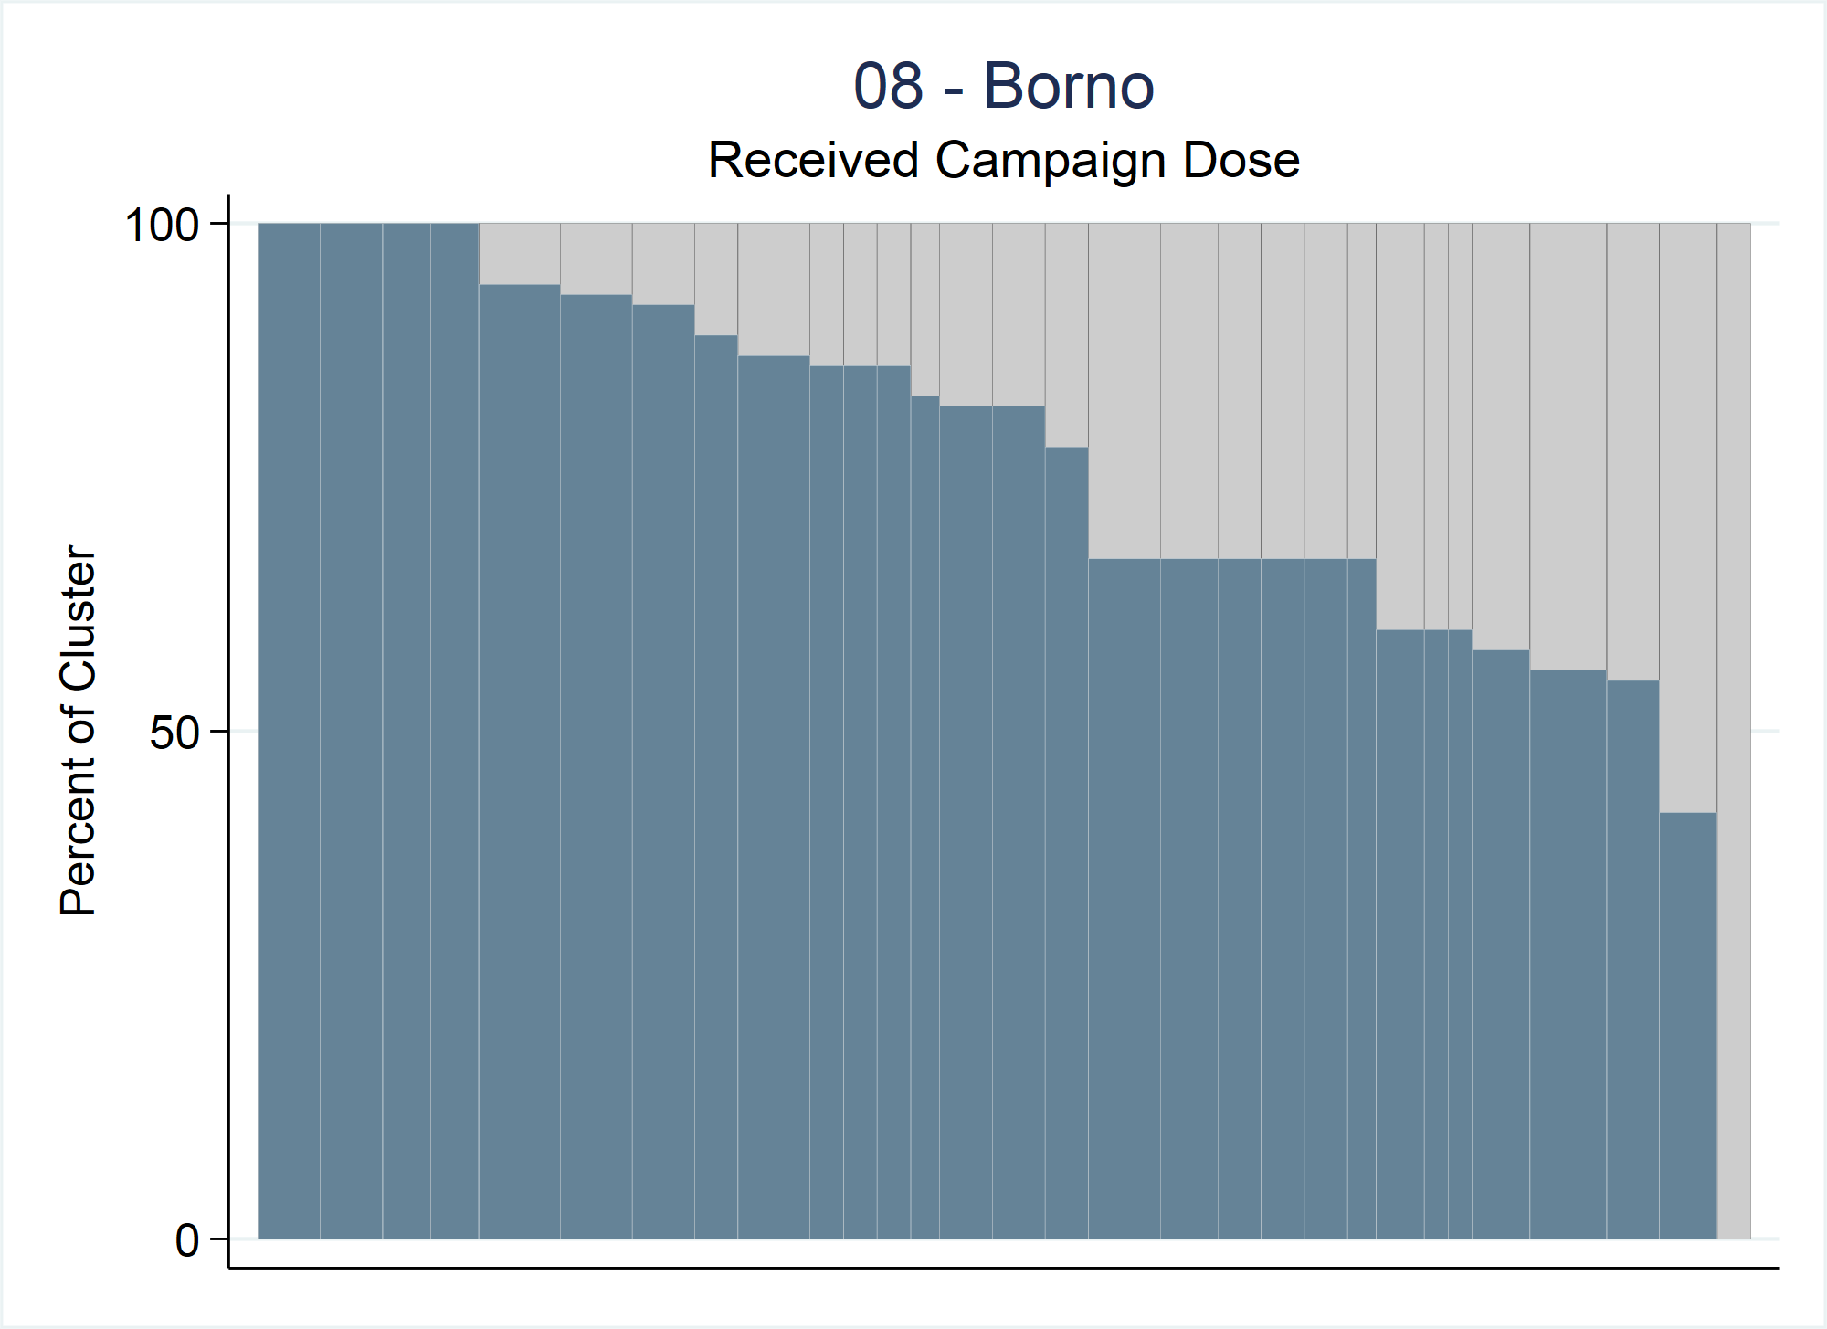
Organ Pipe Plot
Vertical bar chart summarizing a binary outcome in cluster survey data
Visualize heterogeneity among clusters
Notes:
An organ pipe plot is a special type of vertical bar chart. It plots a binary outcome in cluster survey data.
Each cluster is represented with a vertical bar.
The shaded portion of the bar represents the proportion of respondents in that cluster whose value of the binary variable is 1 (described informally here using the word coverage).
Clusters with the highest coverage are shown at the left side of the plot; coverage decreases monotonically from left to right.
These plots help people visualize heterogeneity among the clusters.
We work in the vaccination field where a value of 1 means that the child received a dose of vaccine – that is a good thing and shaded bars are a good thing…they indicate high vaccination coverage among children…bars not shaded are a bad thing as they indicate children are not vaccinated and susceptible to disease. For the purpose of this talk we will be thinking that values of 1 are a good thing, but the logic can easily be reversed if that’s what your data calls for.
This organ pipe plot is from a recent vaccination campaign in Nigeria. It shows the proportion of children who received a measles dose during the campaign in the state of Borno. Note that there are 30 bars in this plot representing the 30 clusters sampled in Borno.

Slide 3
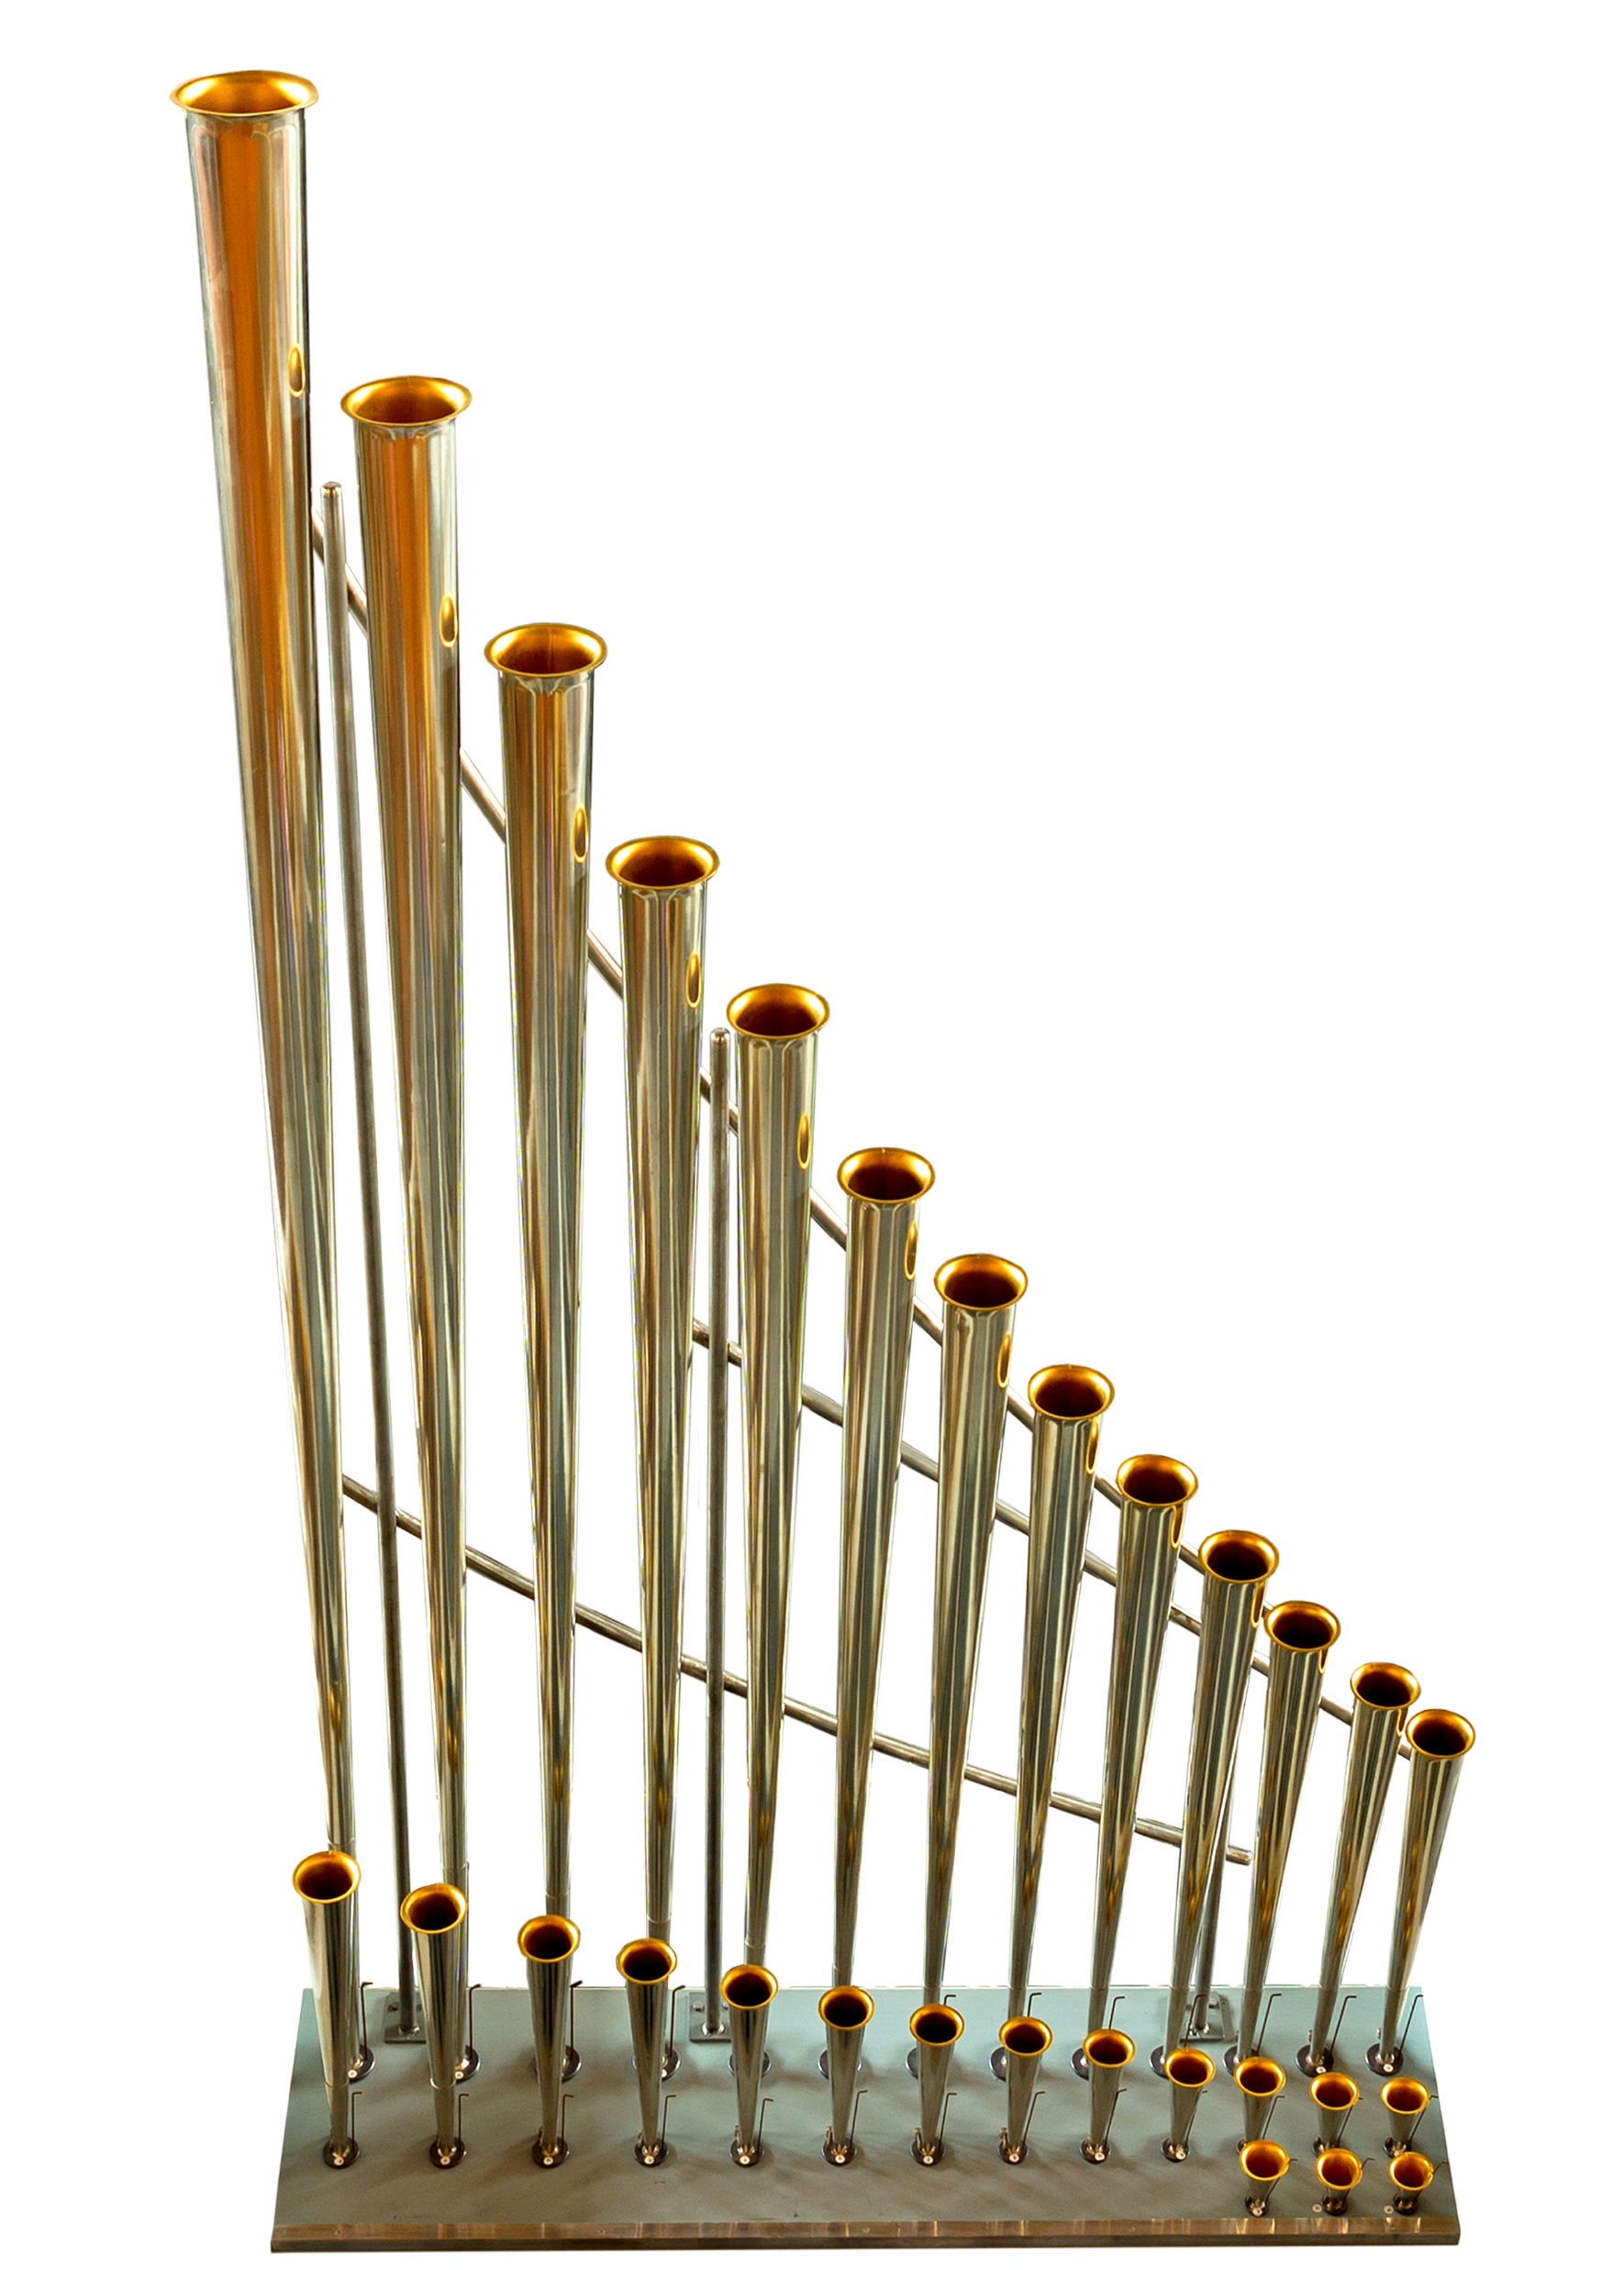
Organ Pipe Plot - Background
Name was inspired by pipes like these whose heights decrease from left-to-right
We developed these plots for vaccination coverage surveys
But they can be helpful in any type of cluster survey with binary outcomes
“OP Plot” for short

Slide 4
Summary Table Example
Stratum ID | # of Clusters | Total Sampled (N) | Estimated Vaccination Coverage | CI Half-Width
1 | 16 | 256 | 50% | 6.1%
2 | 16 | 256 | 50% | 13.2%
3 | 16 | 256 | 50% | 19.6%
4 | 16 | 256 | 50% | 24.5%
Notes:
Imagine you see this table in a final report from a stratified cluster survey. There were 4 strata, each with 16 clusters, and each cluster sampled 16 respondents for a total of 256 sampled respondents in each stratum.
The estimated vaccination coverage for each stratum was 50%, yet the CI widths vary greatly.
There is a rich and colorful story behind those point estimates of 50% coverage, and these plots help drill down to what’s going on within each stratum.

Slide 5
-1/15
Notes:
Here are the 4 corresponding OP plots.
The upper left OP plot shows a stratum in which 50% of the sampled children in each cluster are vaccinated while 50% are not.
The upper right OP plot shows a stratum at the other end of the spectrum…where half of the clusters have 100% of sampled children vaccinated and the other half found 0% vaccinated.
The bottom two plots show examples between these two extremes yet also have 50% sample coverage.
Different programmatic responses would be appropriate for each of these strata. For example, clusters where 0% of the sampled children are vaccinated would likely be first priority, followed by clusters that fell below a desired threshold for campaign success.
These plots help us understand the variability in cluster-level coverage which helps evaluate vaccination program performance and what problems there may be and where.

Slide 6
Clusters with Surprisingly Low Coverage
OP plots are also useful for identifying clusters with alarmingly low coverage…these are the bars with little to no shading
OP plots can be generated before survey weights are ready
  This results in unweighted plots
  Plots generated with weights are weighted plots
  (see slides on Bar Widths)
Finding clusters with low coverage before the survey is complete might provide immediate actionable information from the survey (i.e., send the mobile vaccination teams to those locations to mop up or revaccinate)

Slide 7
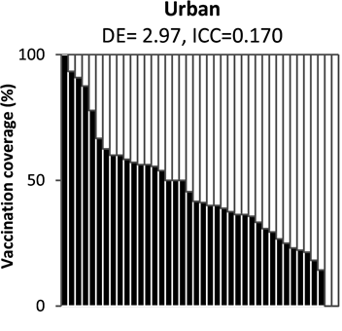
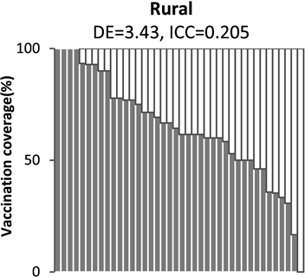
Jharkhand, India Measles Vaccination Campaign 2012
Scobie HM, Ray A, Routray S, Bose A, Bahl S, Sosler S, et al. (2015) Cluster Survey Evaluation of a Measles Vaccination Campaign in Jharkhand, India, 2012. PLoS ONE 10(5): e0127105. https://doi.org/10.1371/journal.pone.0127105
Notes:
For example…Jharkhand, India Measles Vaccination Campaign in 2012.
A vaccination campaign is when a particular vaccine (e.g., measles) is given to a large population (in this study children 9mo-10years) in a short amount of time. These may be done if there has been a recent outbreak or if a new vaccine has been added to the country’s vaccination schedule.
These two OP plots were used in the final report, and show coverage broken out by urban & rural areas.
Notice there are two clusters in the urban plot that found 0% of sampled children vaccinated. Using other variables in the survey dataset, it was found that the majority of the reasons why children were not vaccinated was because the caregiver was unaware of the campaign. This gives insight to program and survey leaders.
The rural OP plot shows one cluster with 0% of sampled children vaccinated. The majority of reasons why not vaccinated for this cluster was because the vaccination team did not come to the appointed site; they intentionally skipped over that cluster. Knowing this, program and survey leaders could learn why workers did this and decide whether to send them back and offer the vaccine.

Slide 8
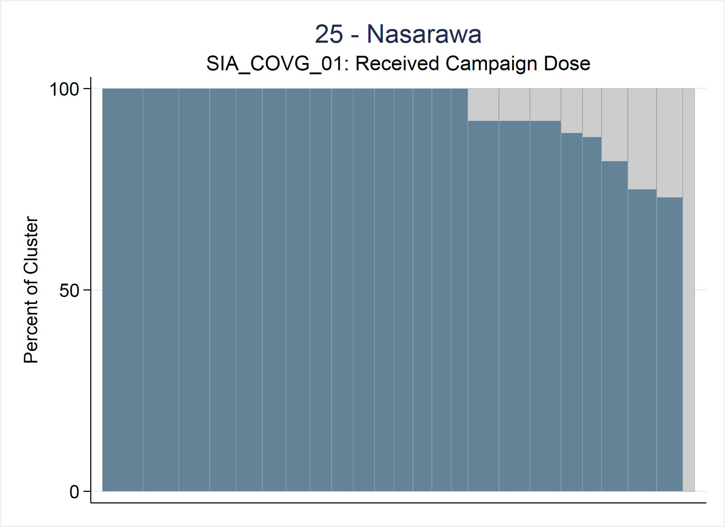
Nigeria Measles Vaccination Campaign 2017
Nasarawa, Nigeria had 248 respondents from 24 clusters
All reasons why child not vaccinated because there was a crisis as the town was attacked and they had to flee the area
Notes:
Another example of how OP plots can be helpful finding clusters with surprisingly low coverage comes from the Nigeria measles vaccination campaign in 2017.
The state of Nasarawa had high coverage for nearly all the clusters except one, where 0% of sampled children were found to be vaccinated.
All sampled caregivers cited that the town had been attacked and they were forced to flee the area during the time the campaign was set to occur.
With this information, program and survey leaders could send another vaccination team to that cluster after security has been restored.

Slide 9
Organ Pipe Plot – Stata Command
opplot yvar [if] [in] , CLUSTVAR(varname)
Note: When you download the opplot.ado command, it comes with an optional opplot_demo.do file that demonstrates the features described in these slides.
Notes:
To make an organ pipe plot, specify the opplot command. There are two required inputs: yvar and CLUSTVAR.
yvar: Binary variable taking values 0, 1, or missing (.); Only respondents whose values of yvar==1 are included in the numerator; All respondents are included in denominator (even those with a missing value)
CLUSTVAR(varname): Variable that holds the cluster ID
opplot 2.0: a missing yvar counts as 0 for respondents with a positive weight, and unless NOWARNings is specified opplot displays a warning when this happens (see the opplot 2.0 slides). Rows with a zero or missing weight are not represented in the plot or in the counts; zero-weight rows stay in the survey design only while the design effect is computed.

Slide 10
Organ Pipe Plot – Stata Command
opplot yvar [if] [in] , CLUSTVAR(varname)
[ STRATVAR(varname) STRATUM(string)
Notes:
Survey related variables:
STRATVAR(varname): The opplot command shows data for one stratum per plot. If your dataset contains data for more than 1 stratum, specify the stratum ID variable and use the stratum option.
STRATUM(string): The value of STRATVAR for which to make the plot.

Slide 11
Organ Pipe Plot – Stata Command
opplot yvar [if] [in] , CLUSTVAR(varname)
[ STRATVAR(varname) STRATUM(string) WEIGHTvar(varname) EQUALWIDTH
Notes:
There are three choices for the bar widths. Either the WEIGHTvar or EQUALWIDTH option is specified or neither are specified.

Slide 12
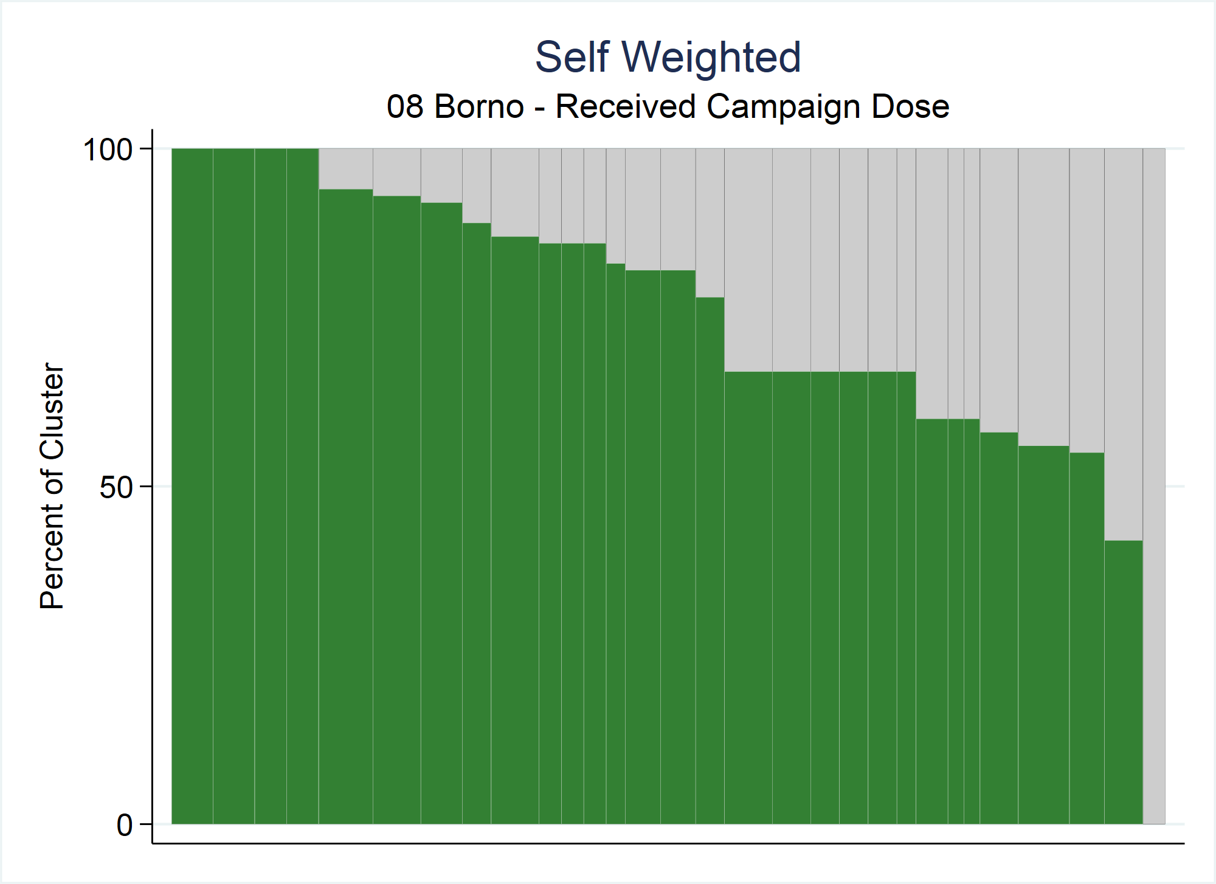
Notes:
If neither WEIGHTvar nor EQUALWIDTH options are specified, then the data are self-weighted (assumed to be equal); the bar widths are proportional to the number of respondents in the cluster, and the shaded proportion of the entire plot is equal to the unweighted sample coverage.

Slide 13
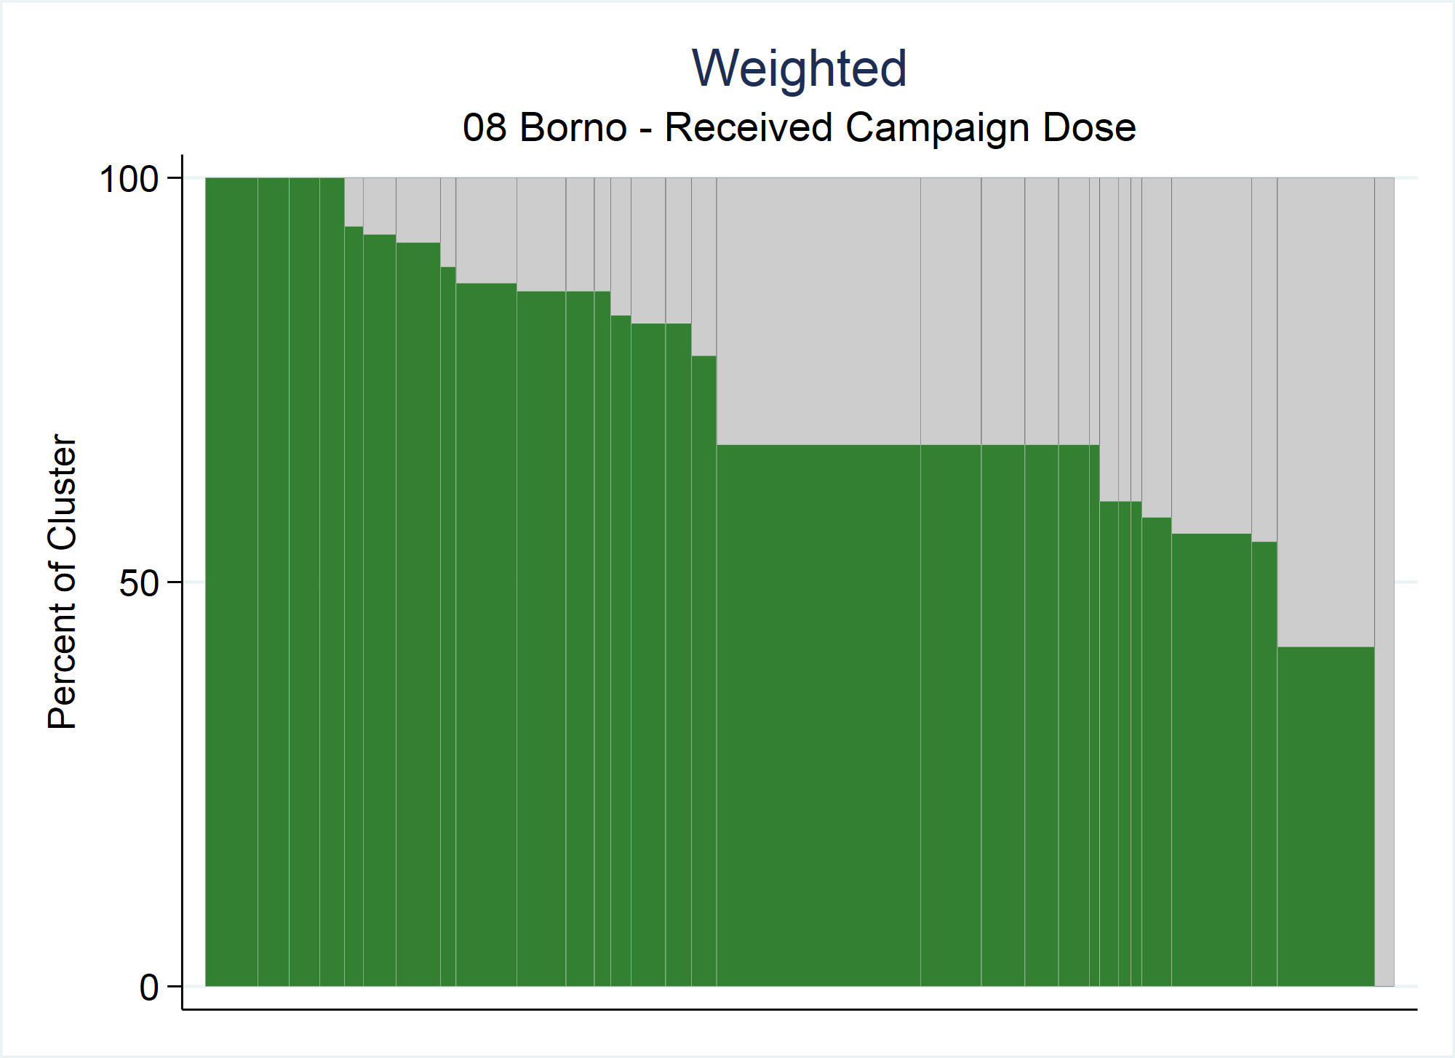
Notes:
If the WEIGHTvar(varname) option is specified then the user points to the variable in the dataset that holds the survey weight.
Weighted OP plots are the preferred method for 2 reasons:
The shaded proportion represents the weighted sample coverage estimate and
the width of each bar represents that cluster’s weighted proportion of the population
One downside of weighted OP plots is that some clusters can be very very narrow which makes it difficult to label the bars clearly.

Slide 14
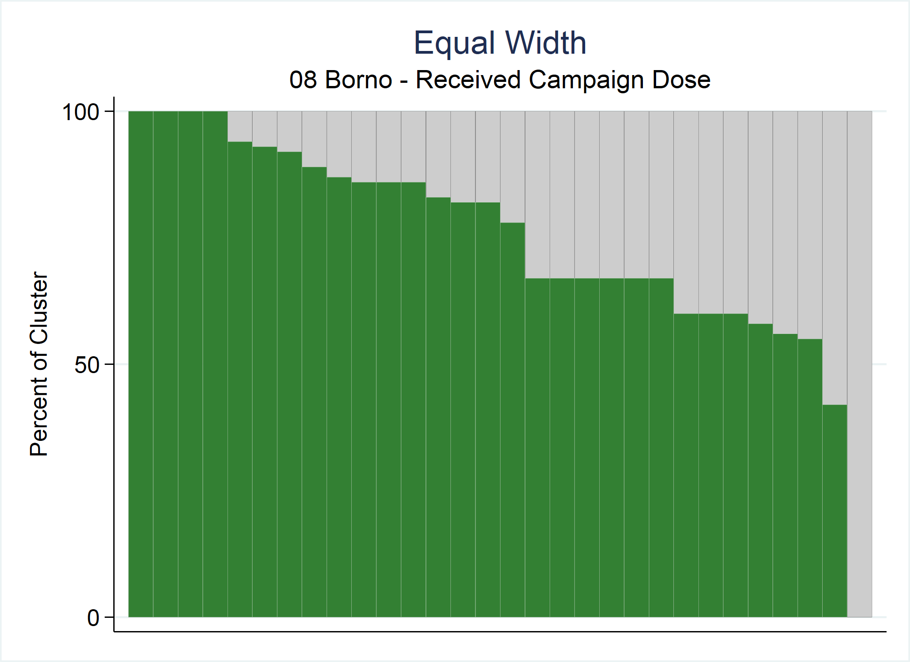
Notes:
If the EQUALWIDTH option is specified, then all the bars will appear with equal width, regardless of the number of respondents in the cluster and regardless of the values of the weightvar.
Regardless of which bar width option is used, the bar height will always be the same because the shaded proportion of each bar represents the proportion of respondents in that cluster whose value of the binary variable is 1.

Slide 15
Organ Pipe Plot – Bar Widths
Focus: Cluster ID=236; N=12
Bar height = 67%
Bar width = 3.9
Bar height = 67%
Bar width = 17.2
Bar height = 67%
Bar width = 3.3
Notes:
Compare all three of the OP plots from the previous slides at once…Notice that the bar height for cluster 236 (shown in yellow) is the same in each plot, 67%, but the bar widths all vary.

Slide 16
Organ Pipe Plot – Stata Command
opplot yvar [if] [in] , CLUSTVAR(varname)
[ STRATVAR(varname) STRATUM(string) WEIGHTvar(varname) EQUALWIDTH EXPORTSTRAtumname EXPORT(string) EXPORTWidth(integer)
Notes:
There are also options for exporting the image…

Slide 17
Organ Pipe Plot – Stata Command
opplot yvar [if] [in] , CLUSTVAR(varname)
[ STRATVAR(varname) STRATUM(string) WEIGHTvar(varname) EQUALWIDTH EXPORTSTRAtumname EXPORT(string) EXPORTWidth(integer) TWOWAY(string) TITLE(string) SUBtitle(string) FOOTnote(string) NOTE(string) XTITLE(string) YTITLE(string) XLABEL(string) YLABEL(string) SAVING(string) NAME(string) XSIZE(real) YSIZE(real)
Notes:
…as well as standard twoway options including titles, labels and sizes.

Slide 18
Organ Pipe Plot – Stata Command
opplot yvar [if] [in] , CLUSTVAR(varname)
[ STRATVAR(varname) STRATUM(string) WEIGHTvar(varname) EQUALWIDTH EXPORTSTRAtumname EXPORT(string) EXPORTWidth(integer) TWOWAY(string) TITLE(string) SUBtitle(string) FOOTnote(string) NOTE(string) XTITLE(string) YTITLE(string) XLABEL(string) YLABEL(string) SAVING(string) NAME(string) XSIZE(real) YSIZE(real) BARCOLOR1(string) BARCOLOR2(string) LINECOLOR1(string) LINECOLOR2(string)
Notes:
The user also has control of the bar and line colors of the plot.

Slide 19
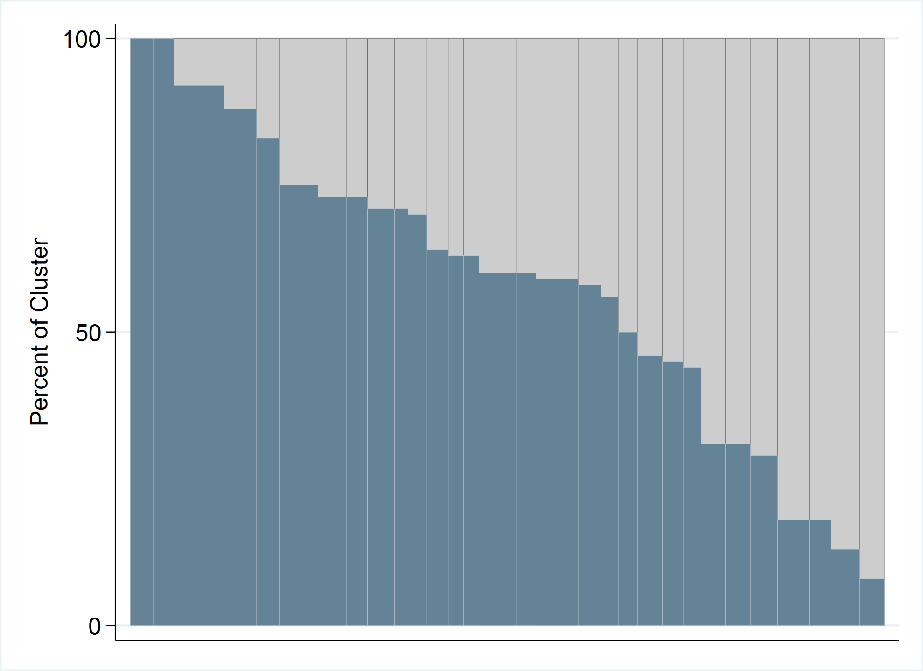
Stata Command, Optional Inputs (cont.)
BARCOLOR2(string)
LINECOLOR2(string)
BARCOLOR1(string)
LINECOLOR1(string)
Notes:
BARCOLOR1 and LINECOLOR1 correspond to the bottom bars while BARCOLOR2 and LINECOLOR2 correspond to the top bars.

Slide 20
Organ Pipe Plot – Stata Command
opplot yvar [if] [in] , CLUSTVAR(varname)
[ STRATVAR(varname) STRATUM(string) WEIGHTvar(varname) EQUALWIDTH EXPORTSTRAtumname EXPORT(string) EXPORTWidth(integer) TWOWAY(string) TITLE(string) SUBtitle(string) FOOTnote(string) NOTE(string) XTITLE(string) YTITLE(string) XLABEL(string) YLABEL(string) SAVING(string) NAME(string) XSIZE(real) YSIZE(real) BARCOLOR1(string) BARCOLOR2(string) LINECOLOR1(string) LINECOLOR2(string) SAVEDATA(string)
Notes:
The SAVEDATA(string) option saves a dataset that includes one row per bar in the plot; the left-most bar in the plot is represented by row 1 of the dataset and the right-most bar in the plot by the last row in the dataset.

Slide 21
Stata Command, SAVEDATA Optional Input
yvar | stratvar | stratum | cluster | clusterid | n_respondents | barorder | barwidth | cumulative_barwidth | barheight
got_sia_dose | stratumid | 7 | clusterid | 87 | 12 | 1 | 4.166667 | 4.166667 | 100
. | . | . | . |  |  |  |  |  | .
. | . | . | . |  |  |  |  |  | .
. | . | . | . |  |  |  |  |  | .
got_sia_dose | stratumid | 7 | clusterid | 76 | 5 | 17 | 1.736111 | 51.73611 | 100
got_sia_dose | stratumid | 7 | clusterid | 82 | 11 | 18 | 3.819444 | 55.55556 | 91
got_sia_dose | stratumid | 7 | clusterid | 67 | 11 | 19 | 3.819444 | 59.375 | 82
got_sia_dose | stratumid | 7 | clusterid | 73 | 15 | 20 | 5.208333 | 64.58334 | 80
got_sia_dose | stratumid | 7 | clusterid | 74 | 10 | 21 | 3.472222 | 68.05556 | 80
got_sia_dose | stratumid | 7 | clusterid | 75 | 10 | 22 | 3.472222 | 71.52778 | 80
got_sia_dose | stratumid | 7 | clusterid | 69 | 5 | 23 | 1.736111 | 73.26389 | 80
got_sia_dose | stratumid | 7 | clusterid | 70 | 9 | 24 | 3.125 | 76.38889 | 78
got_sia_dose | stratumid | 7 | clusterid | 64 | 8 | 25 | 2.777778 | 79.16666 | 75
got_sia_dose | stratumid | 7 | clusterid | 68 | 13 | 26 | 4.513889 | 83.68056 | 69
got_sia_dose | stratumid | 7 | clusterid | 66 | 12 | 27 | 4.166667 | 87.84722 | 58
got_sia_dose | stratumid | 7 | clusterid | 71 | 7 | 28 | 2.430556 | 90.27778 | 57
got_sia_dose | stratumid | 7 | clusterid | 81 | 10 | 29 | 3.472222 | 93.75 | 50
got_sia_dose | stratumid | 7 | clusterid | 77 | 18 | 30 | 6.25 | 100 | 11
Notes:
Here is an example of the dataset that is saved…
The dataset contains descriptive variables about the bars including the height and width, but, more importantly, it includes the clusterid and the number of respondents (n_respondents).
This dataset is useful for identifying the cluster ID for bars that show surprisingly low coverage. In this example, the last bar in the plot (plot not shown) had a bar height of 11%...meaning 11% of the children sampled were found to be vaccinated. We can see that this bar corresponds to cluster ID=77 and n=18 children were sampled.
If 11% is programmatically concerning, the stakeholders could decide to follow up and visit the area that corresponds to cluster 77 to ask some questions and learn why the outcomes there were lower than expected.
opplot 2.0 adds the variables n_outcome1, n_missing, sum_weights, category, lcthreshold and hcthreshold (see the SAVEDATA in opplot 2.0 slide).

Slide 22
Organ Pipe Plot – Stata Command
opplot yvar [if] [in] , CLUSTVAR(varname)
[ STRATVAR(varname) STRATUM(string) WEIGHTvar(varname) EQUALWIDTH EXPORTSTRAtumname EXPORT(string) EXPORTWidth(integer) TWOWAY(string) TITLE(string) SUBtitle(string) FOOTnote(string) NOTE(string) XTITLE(string) YTITLE(string) XLABEL(string) YLABEL(string) SAVING(string) NAME(string) XSIZE(real) YSIZE(real) BARCOLOR1(string) BARCOLOR2(string) LINECOLOR1(string) LINECOLOR2(string) SAVEDATA(string) PLOTN
Notes:
If PLOTN is specified, the plot will include a second y-axis and a line showing the number of respondents per cluster.

Slide 23
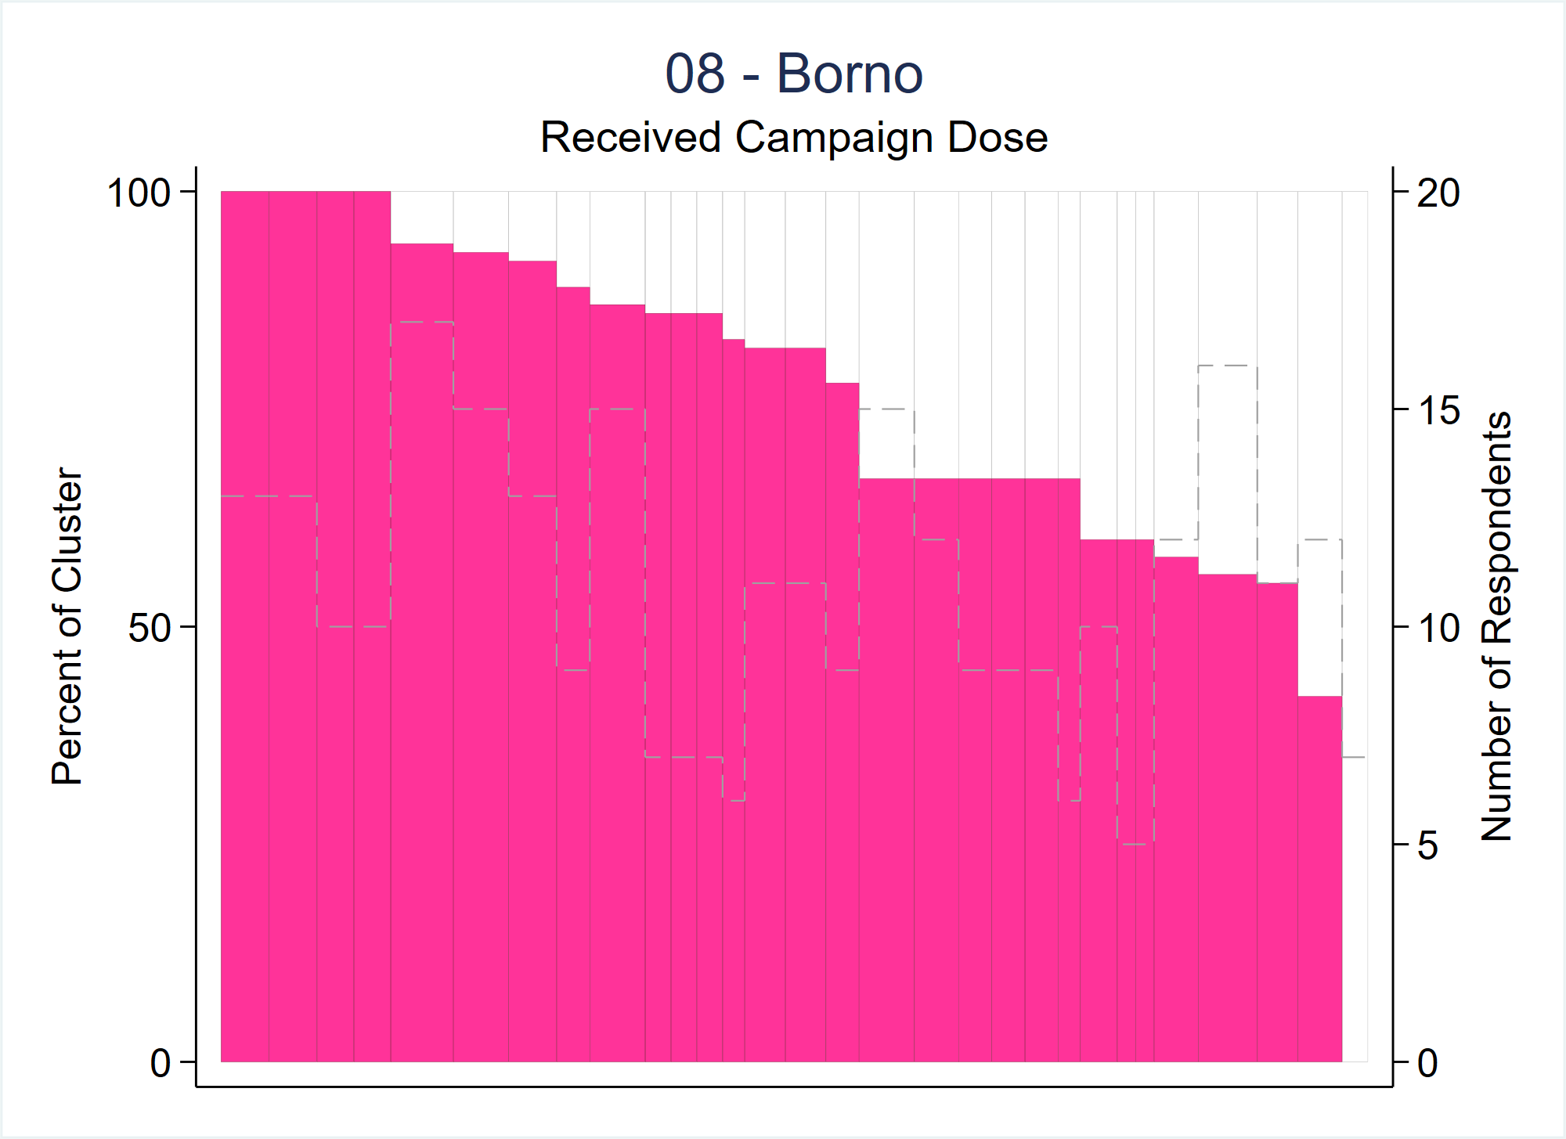
Stata Command, PLOTN Optional Input
Second y-axis
Dashed line shows the number of respondents in each cluster

Slide 24
Organ Pipe Plot – Stata Command
opplot yvar [if] [in] , CLUSTVAR(varname)
[ STRATVAR(varname) STRATUM(string) WEIGHTvar(varname) EQUALWIDTH EXPORTSTRAtumname EXPORT(string) EXPORTWidth(integer) TWOWAY(string) TITLE(string) SUBtitle(string) FOOTnote(string) NOTE(string) XTITLE(string) YTITLE(string) XLABEL(string) YLABEL(string) SAVING(string) NAME(string) XSIZE(real) YSIZE(real) BARCOLOR1(string) BARCOLOR2(string) LINECOLOR1(string) LINECOLOR2(string) SAVEDATA(string) PLOTN NLINEColor(string) NLINEWidth(string) NLINEPattern(string) YTITLE2(string) YROUND2(integer 5) ]
Notes:
User may specify the properties of the “plotn” line and of its axis title & labels using the options listed.
YROUND2(integer 5) affects the labels on the second y-axis if the user specifies the PLOTN option.
The scale will run from 0 up to the (maximum number of respondents in a cluster plus one) rounded up to the next multiple of YROUND2.
Default is to round up to the next multiple of 5.

Slide 25
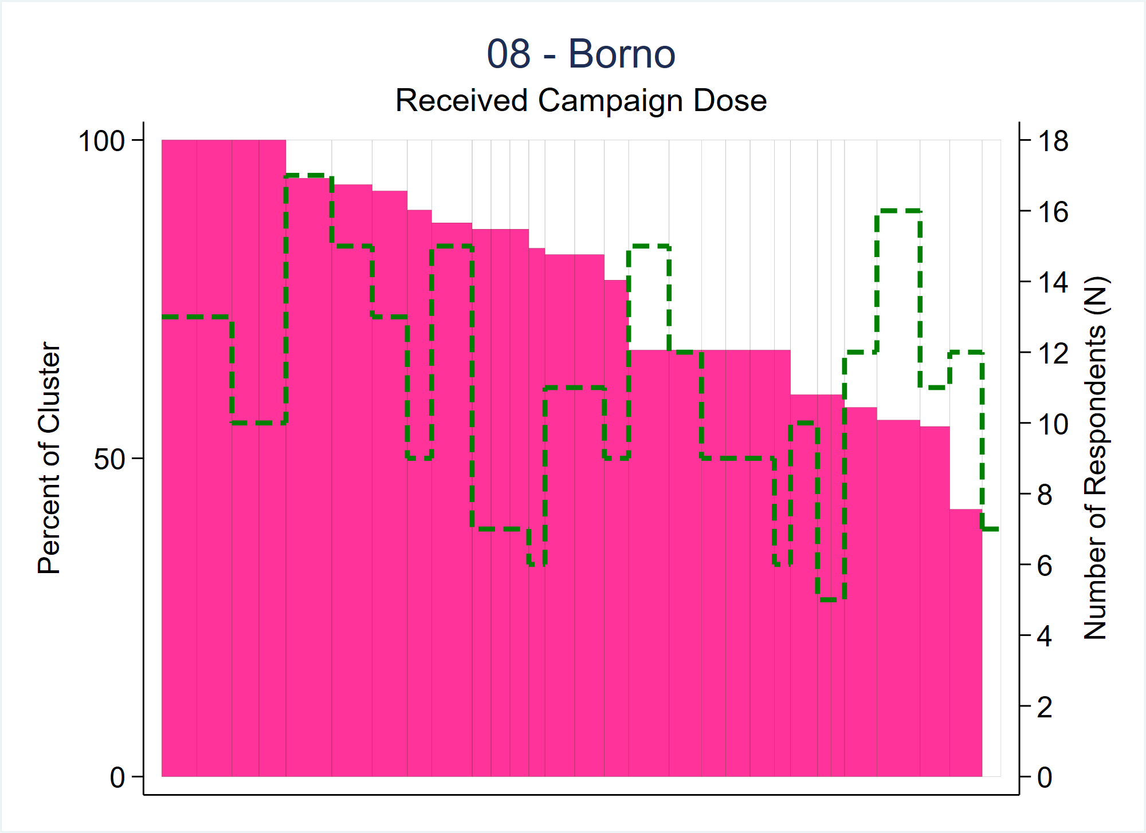
Stata Command, PLOTN Optional Input Cont.
Specified different axis title
& increment N by 2 (instead of the default 5)
Specified different line color, width & pattern

Slide 26
Notes about PLOTN
The dashed line helps show the heterogeneity of N in the stratum
Some clusters with low coverage may not be too alarming if N is very small
Consider making the opplot first without the PLOTN option, and then add it if there are clusters with low (or no) coverage
The sample size for each cluster can be checked either by the SAVEDATA or PLOTN options

Slide 27
Organ Pipe Plot – Stata Command
opplot yvar [if] [in] , CLUSTVAR(varname)
[ STRATVAR(varname) STRATUM(string) WEIGHTvar(varname) EQUALWIDTH EXPORTSTRAtumname EXPORT(string) EXPORTWidth(integer) TWOWAY(string) TITLE(string) SUBtitle(string) FOOTnote(string) NOTE(string) XTITLE(string) YTITLE(string) XLABEL(string) YLABEL(string) SAVING(string) NAME(string) XSIZE(real) YSIZE(real) BARCOLOR1(string) BARCOLOR2(string) LINECOLOR1(string) LINECOLOR2(string) SAVEDATA(string) PLOTN NLINEColor(string) NLINEWidth(string) NLINEPattern(string) YTITLE2(string) YROUND2(integer 5) LCTHRESHold(integer 999) HIGH(integer 100) BARCOLORHIGH1(string) BARCOLORMID1(string) BARCOLORLOW1(string) BARCOLORHIGH2(string) BARCOLORMID2(string) BARCOLORLOW2(string) LINECOLORHIGH1(string) LINECOLORMID1(string) LINECOLORLOW1(string) LINECOLORHIGH2(string) LINECOLORMID2(string) LINECOLORLOW2(string) ]
Notes:
New options added in 2024 - User may specify a low coverage threshold (LCTHRESHold) and HIGH coverage threshold (HIGH) to stratify the results into 3 different coverage categories – each shown with different colored bars.
Clusters with coverage <= the LCTHRESHold value will be considered part of the LOW category.
Clusters with coverage >= the HIGH value are part of the HIGH category; all others fall into the MID category.
If the LCTHRESHold and HIGH have the same value only 2 coverage categories will be displayed and clusters with coverage exactly equal to that threshold will be shown in the low category.
For each coverage category, the user can specify bar and line color options like those previously discussed for BARCOLOR1 and LINECOLOR1.
Since these slides were made, HIGH() was renamed HCTHRESHOLD() (version 1.25, 2025; HIGH() still works). Changed in opplot 2.0: LCTHRESHold() and HCTHRESHOLD() accept non-integer values, and giving only a high threshold below 100 produces two categories (high and mid).

Slide 28
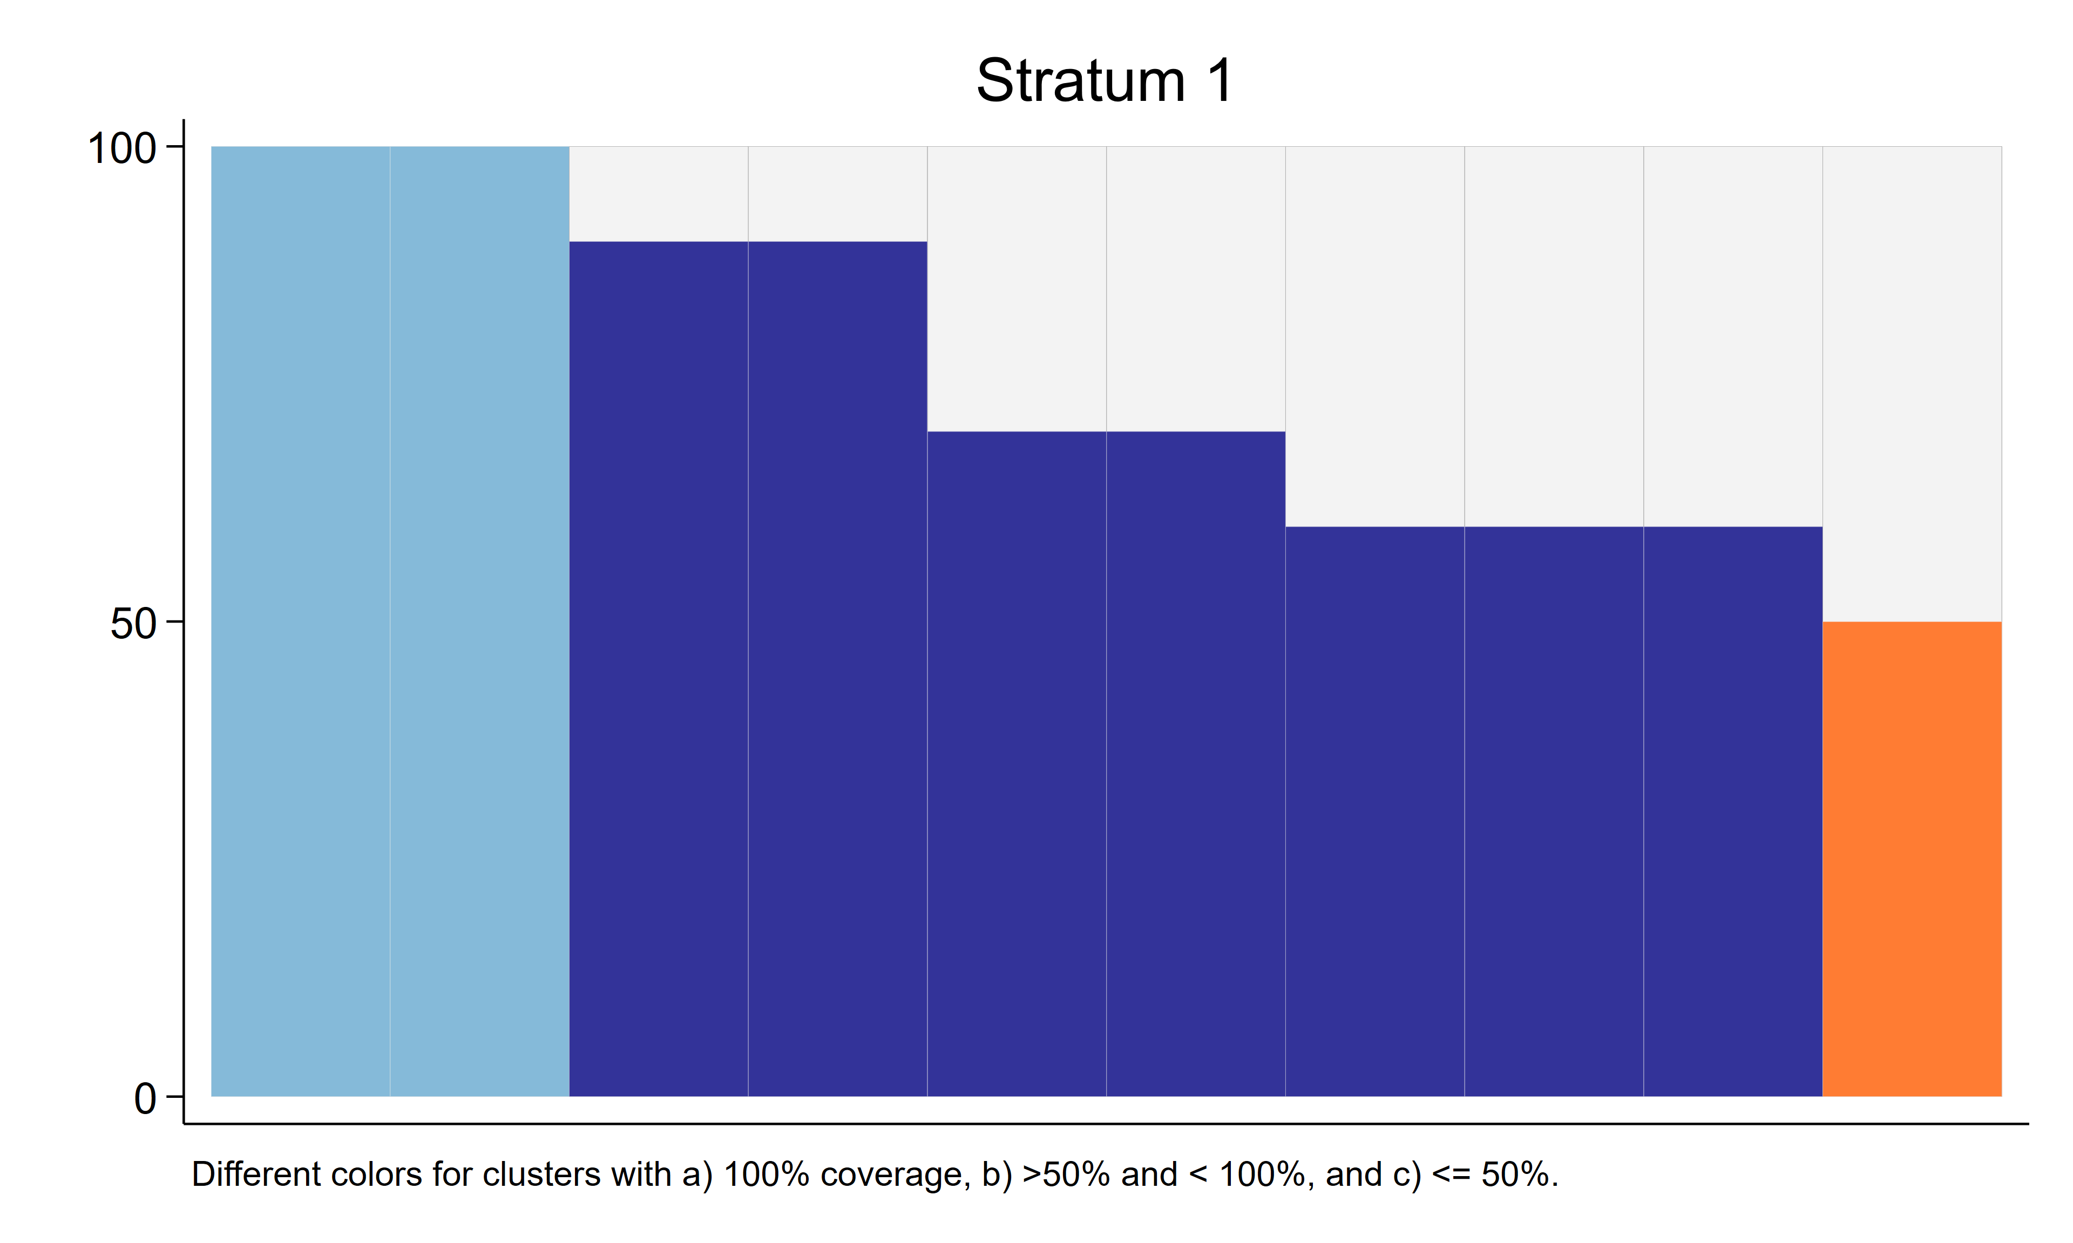
Stata Command, LCTHRESHold HIGH Optional Input Cont.
LCTHRESHold that is lower than the default HIGH value (Three coverage categories with default barcolor options)
Specified LCTHRESHold value of 50
HIGH not specified, default value of 100 used
Notes:
When the LCTHRESHold is different from the HIGH value this will result in three coverage categories: HIGH, MID and LOW.
The barcolors shown here are the default color options.
For this plot, we are interested in talking with survey stakeholders about three types of clusters: those where every sampled respondent had the outcome, those where 50% or fewer had the outcome (surprisingly low), and those with coverage more than 50% but less than 100%. The options to give them different colors help us prepare for those conversations.

Slide 29
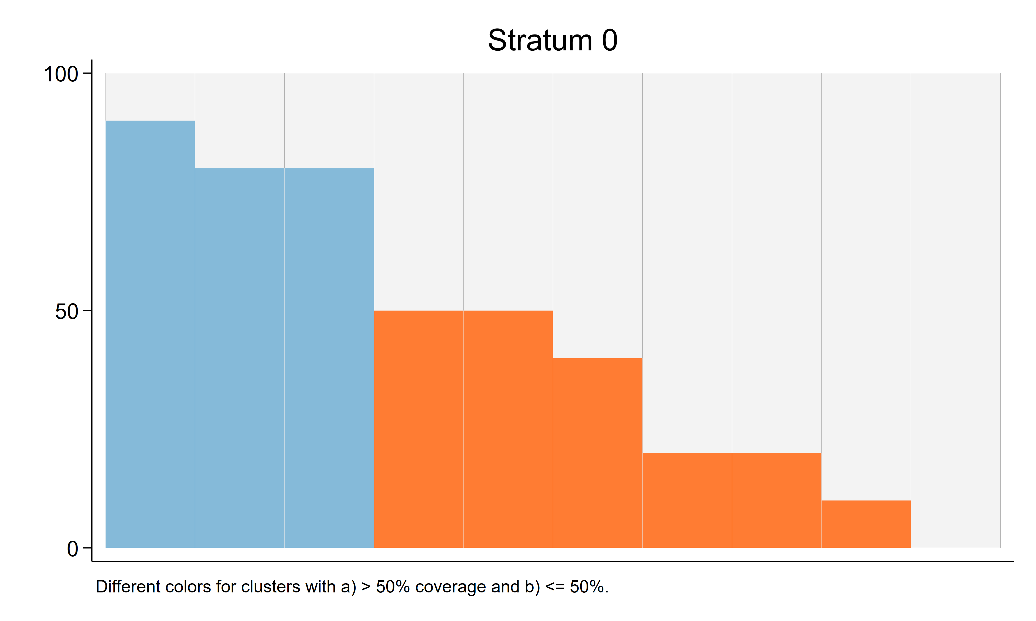
Stata Command, LCTHRESHold HIGH Optional Input Cont.
LCTHRESHold that is the same as the HIGH value (Two coverage categories with default barcolor options)
Specified LCTHRESHold value of 50
Specified HIGH value of 50
One cluster had 0% coverage
Notes:
When the LCTHRESHold and HIGH take on the same value, the plot will only show two coverage categories. If the coverage is equal to the HIGH and LCTHRESHold value it will be placed in the LOW coverage category.

Slide 30
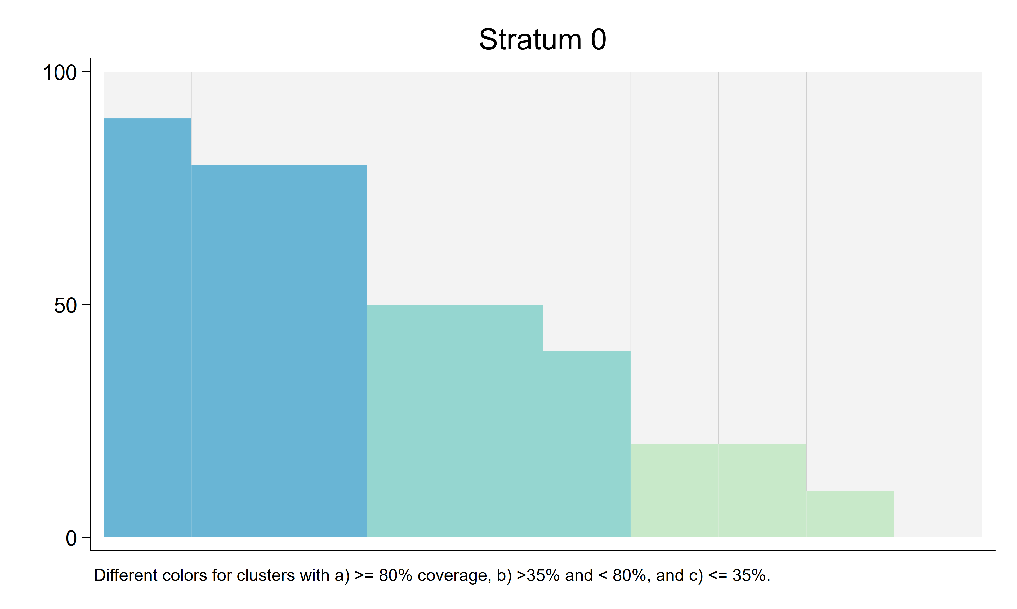
Stata Command, LCTHRESHold HIGH BARCOLORHIGH1 BARCOLORMID1 BARCOLORLOW1 Optional Input Cont.
LCTHRESHold that is lower than HIGH value (Three coverage categories with specified barcolor options)
Specified LCTHRESHold value of 35
Specified HIGH value of 80
One cluster had 0% coverage
Notes:
The user may change the bar colors by specifying barcolorhigh1, barcolormid1 and barcolorlow1.

Slide 31
Organ Pipe Plot – Stata Command
opplot yvar [if] [in] , CLUSTVAR(varname)
[ STRATVAR(varname) STRATUM(string) WEIGHTvar(varname) EQUALWIDTH EXPORTSTRAtumname EXPORT(string) EXPORTWidth(integer) TWOWAY(string) TITLE(string) SUBtitle(string) FOOTnote(string) NOTE(string) XTITLE(string) YTITLE(string) XLABEL(string) YLABEL(string) SAVING(string) NAME(string) XSIZE(real) YSIZE(real) BARCOLOR1(string) BARCOLOR2(string) LINECOLOR1(string) LINECOLOR2(string) SAVEDATA(string) PLOTN NLINEColor(string) NLINEWidth(string) NLINEPattern(string) YTITLE2(string) YROUND2(integer 5) LCTHRESHold(integer 999) HIGH(integer 100) BARCOLORHIGH1(string) BARCOLORMID1(string) BARCOLORLOW1(string) BARCOLORHIGH2(string) BARCOLORMID2(string) BARCOLORLOW2(string) LINECOLORHIGH1(string) LINECOLORMID1(string) LINECOLORLOW1(string) LINECOLORHIGH2(string) LINECOLORMID2(string) LINECOLORLOW2(string) FOOTNOTECOVG FOOTNOTEDEFF FOOTNOTEICC]
Notes:
New options added in 2024 – User can add the Estimated Coverage, Design Effect, and Intracluster Correlation Coefficient as footnotes to the plot.
These can be used in conjunction with the standard FOOTnote option.

Slide 32
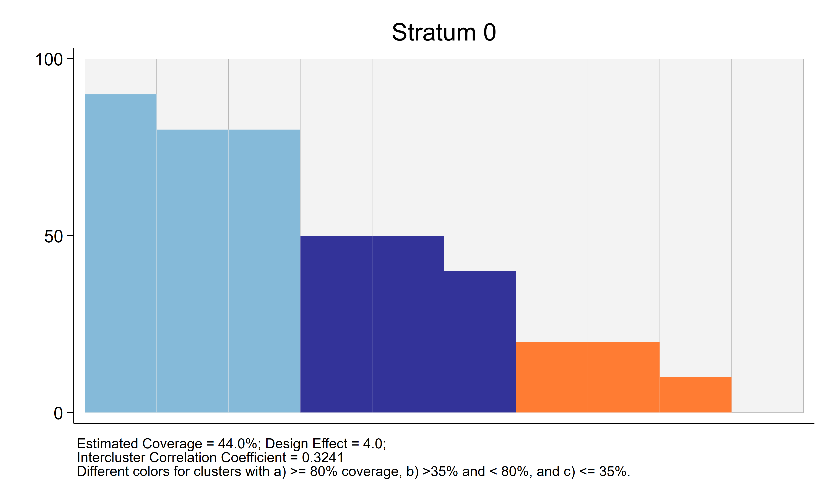
Stata Command, FOOTNOTECOVG FOOTNOTEDEFF FOOTNOTEICC NOTE
Specified all three optional footnotes: COVG, DEFF and ICC
Anything specified in NOTE will always appear below the COVG, DEFF and ICC
Notes:
The user can add the Estimated Coverage, Design Effect and Intracluster Correlation Coefficient to the plot by specifying FOOTNOTECOVG, FOOTNOTEDEFF and FOOTNOTEICC.
Additional footnotes can be added by using the NOTE option. These will always appear after the COVG, DEFF, and ICC footnotes.
In opplot 2.0 the footnote labels use VCQI's wording, 'Design effect' and 'Intracluster correlation coefficient', rather than every word capitalized.

Slide 33
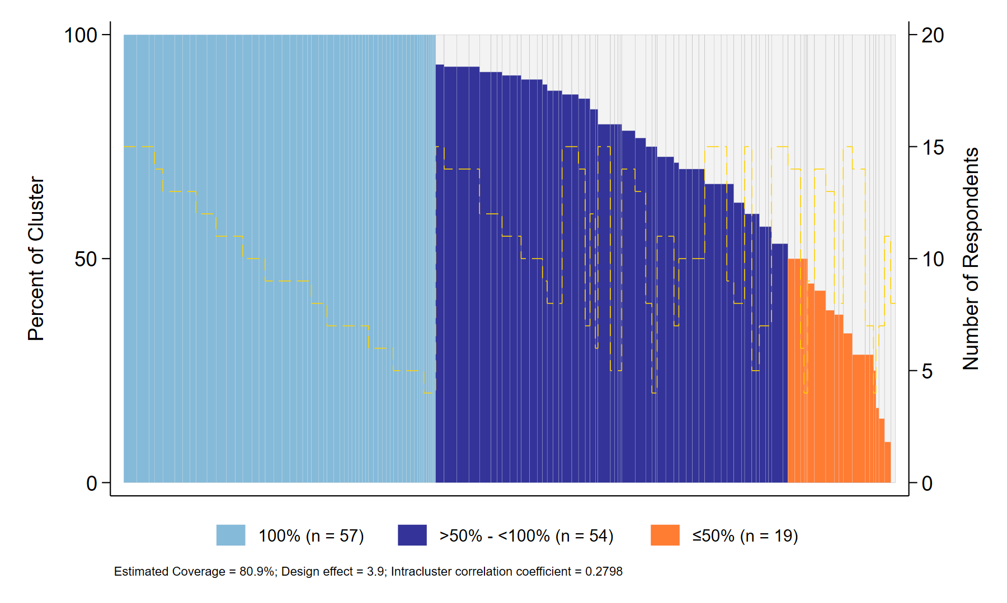
What's New in opplot 2.0 (2026)
Needs only official Stata 14.1 or later
Missing outcomes are counted as 0, and opplot says so in a warning (NOWARNings silences it)
Rows with a zero or missing weight are not represented
Coverage categories: thresholds need not be whole numbers, HCTHRESHOLD() below 100 alone gives two categories, optional legend (CATLEGEND)
Bar outlines are omitted automatically when there are more than 150 bars (BARLINEWidth() overrides); optional cluster ID labels (BARLABELS, BARLABSize())
Titles and notes may contain commas, several lines and text options
SAVEDATA adds each cluster's category and counts; results are returned in r()
No confidence intervals are reported
Notes:
Version 2.0 of opplot was released in 2026; version 2.01 added BARLABSize(). The following slides demonstrate each change; every plot in this section was made with opplot 2.0, and the commands shown on the slides are the commands that made them.
opplot no longer depends on any other VCQI program: the coverage, design effect and ICC in the footnotes are computed by opplot itself, so the SSC version runs on its own. (Inside VCQI it still writes to the VCQI log, and stops VCQI when it detects an error, using VCQI's own programs.) The plot on the right is the report-style example on a later slide.

Slide 34
Organ Pipe Plot – Stata Command (opplot 2.01)
opplot yvar [if] [in] , CLUSTVAR(varname)
[ STRATVAR(varname) STRATUM(string) STRATUMNAME(string) WEIGHTvar(varname) EQUALWIDTH
TITLE() SUBtitle() NOTE() FOOTnote() CAPTION() XTITLE() YTITLE() XLABEL() YLABEL() BARLABELS BARLABSize()
BARCOLOR1() BARCOLOR2() LINECOLOR1() LINECOLOR2() BARLINEWidth()
LCTHRESHold(#) HCTHRESHOLD(#) HIGH(#) LCLINE HCLINE CATLEGEND
BARCOLORHIGH1() ... LINECOLORLOW2() (twelve category color options)
PLOTN NLINEColor() NLINEWidth() NLINEPattern() YTITLE2() YROUND2(#)
FOOTNOTECOVG FOOTNOTEDEFF FOOTNOTEICC
NAME() SAVING() EXPORT() EXPORTWidth(#) EXPORTSTRAtumname SAVEDATA()
XSIZE(#) YSIZE(#) TWOWAY() NOWARNings ]
Red: added or changed since the 2024 slides. Capital letters show the shortest allowed abbreviation.
Notes:
This is the opplot 2.01 syntax. Options in red were added or changed after the 2024 version of these slides:
CAPTION(), LCLINE and HCLINE were added in version 1.24-1.25 (2025). CAPTION() adds a caption; LCLINE draws a dashed line at LCTHRESHold() (when it is given) and HCLINE at HCTHRESHOLD() (when it is below 100).
LCTHRESHold() and HCTHRESHOLD() now accept non-integer values. HCTHRESHOLD() replaced HIGH() in version 1.25 (2025); HIGH() still works. HCTHRESHOLD is written in capitals because it cannot be abbreviated.
CATLEGEND adds a legend for the coverage categories, BARLABELS labels the bars with cluster IDs (BARLABSize(), added in version 2.01, sets the label size), BARLINEWidth() controls the bar outlines, and NOWARNings silences the missing-outcome warning.
XLABEL() was accepted by earlier versions but ignored; opplot 2.0 uses it.
Text options (TITLE(), NOTE() and so on) accept quoted text with commas, several lines and suboptions such as size().

Slide 35
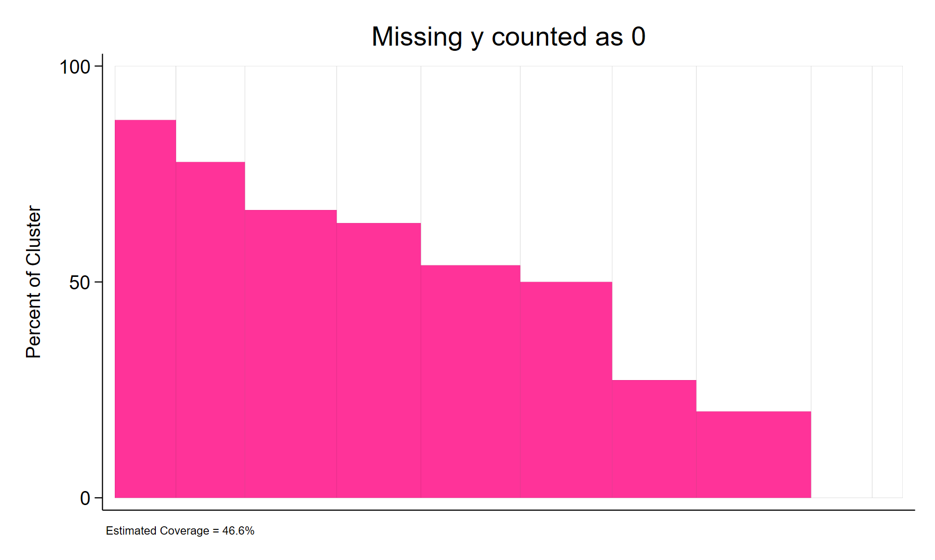
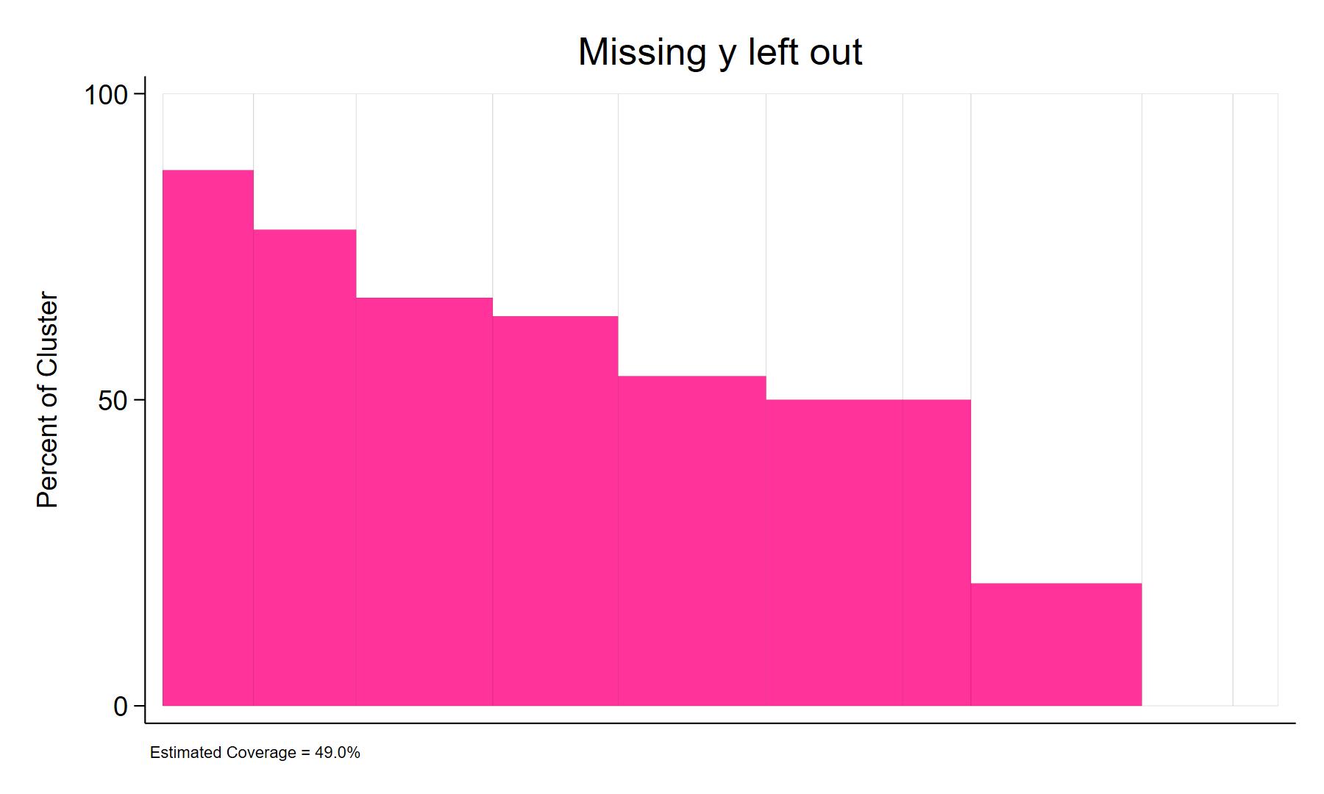
Missing Outcomes Are Counted as 0
5 of the 103 respondents in stratum 0 have a missing y. They count as 0: Estimated Coverage = 46.6%
Adding if !missing(y) leaves them out: 98 respondents, Estimated Coverage = 49.0%
opplot y, clustvar(clusterid) stratvar(stratumid) stratum(0) footnotecovg title(...)
opplot warning: 5 out of 103 respondents with a positive weight have a missing value of y (counted as 0).
Notes:
opplot counts a missing outcome as 0 for any respondent with a positive weight: the respondent is in the denominator but shows no evidence of the outcome. This applies to the bars, the categories, the footnote statistics and the stored results.
In this example the five missing values are all in cluster 3, so cluster 3's bar is lower on the left than on the right.
Unless NOWARNings is specified, opplot displays the warning shown at the bottom after drawing the plot. If a missing value means 'not part of the denominator' (e.g., a child who is not eligible), leave those respondents out with if !missing(y), as on the right.

Slide 36
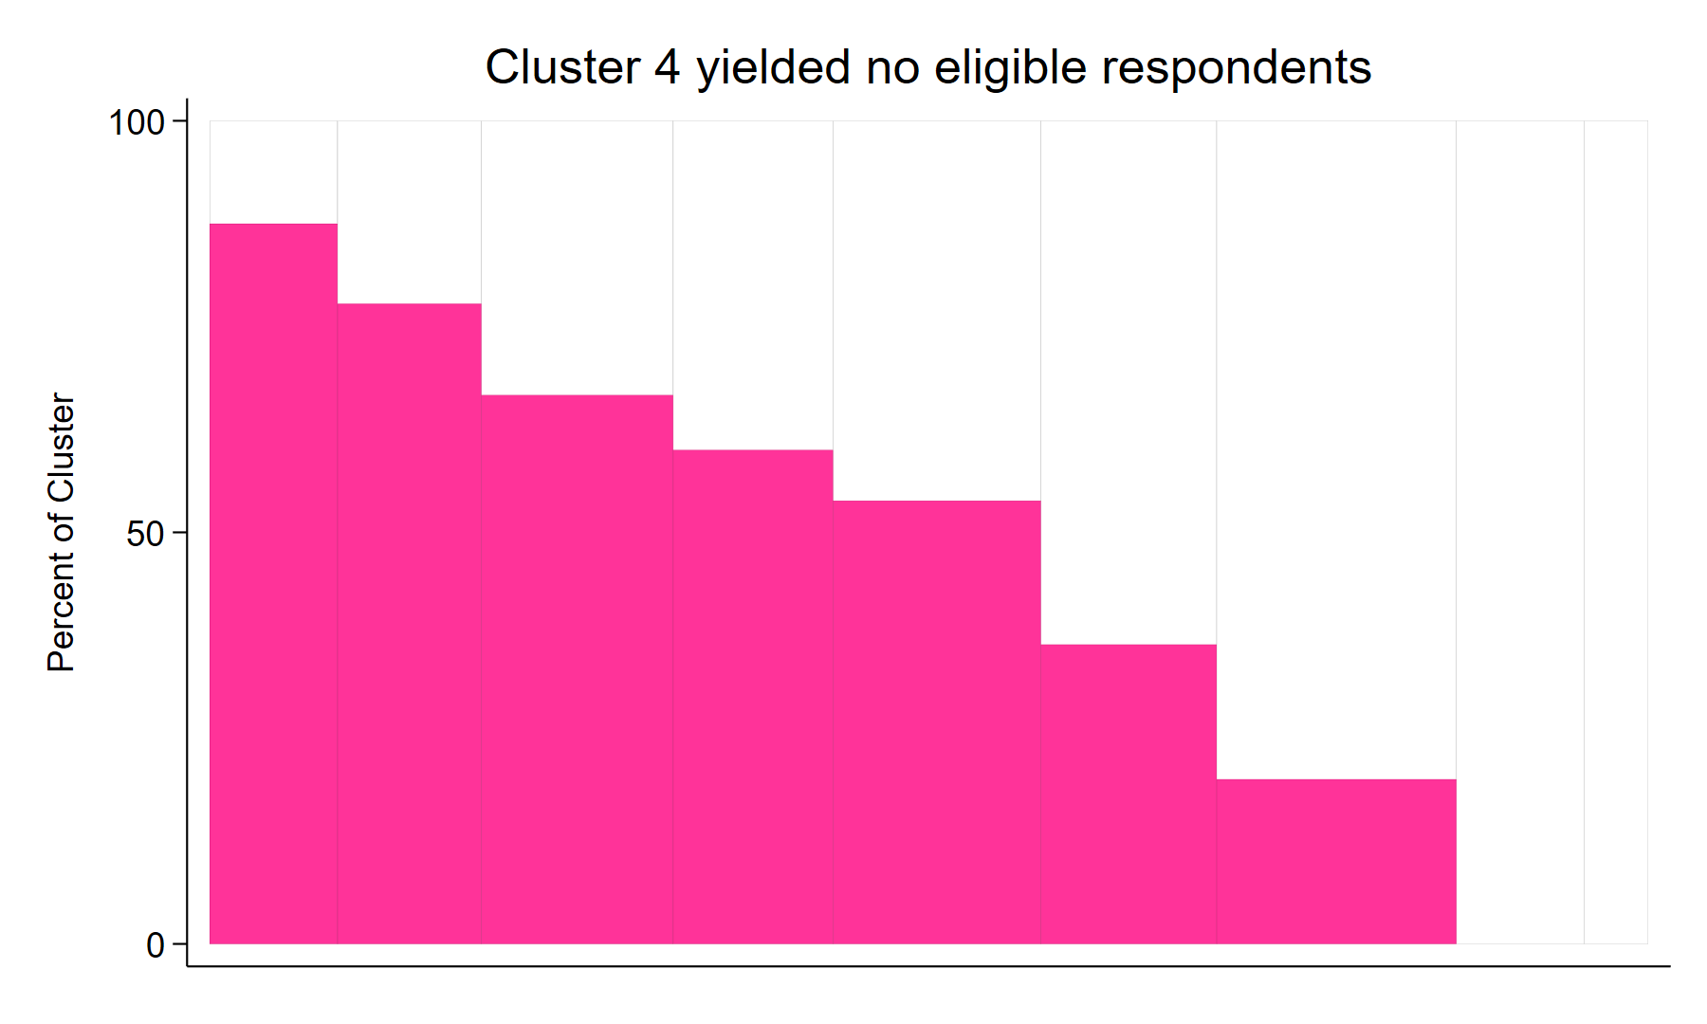
Zero or Missing Weights Are Not Represented
Cluster 4: all 11 rows have weight 0 (a sampled cluster with no eligible respondents) – no bar is drawn
Cluster 6: 2 rows have a missing weight – they are left out of its bar
9 bars and 90 respondents are shown: r(nclusters) = 9, r(N) = 90
opplot y, clustvar(clusterid) stratvar(stratumid) stratum(0) weightvar(weight) title(...)
opplot note: 13 observation(s) with a missing or zero weight (weight) are not represented in the plot.
Notes:
Rows with a missing or zero weight represent no respondents, so opplot leaves them out of everything it shows: bar widths and heights, the number of respondents, the coverage categories, the coverage and the ICC. A cluster made up only of such rows does not appear as a bar.
In VCQI such rows are typically placeholders for sampled clusters that yielded no eligible respondents. Zero-weight rows stay in the survey design while the design effect is computed, so that those clusters still count, as in VCQI; rows with a missing weight are left out entirely.
Outside VCQI, opplot displays the note shown at the bottom.

Slide 37
Report-Style Plot: Categories, Legend and Footnotes
LCTHRESHold(50): 100% light blue, more than 50% but less than 100% dark blue, 50% or less orange
CATLEGEND names the categories and counts the clusters: 57, 54 and 19
PLOTN NLINEColor(gold): number of respondents per cluster
FOOTNOTECOVG FOOTNOTEDEFF FOOTNOTEICC on one line (enlarged below)
opplot got_campaign_dose, clustvar(clusterid) weightvar(psweight) lcthreshold(50) catlegend plotn
nlinecolor(gold) footnotecovg footnotedeff footnoteicc savedata(campaign_bars)
Notes:
This plot uses three coverage categories: clusters where every sampled child was vaccinated in light blue, clusters with more than 50% but less than 100% in dark blue, and clusters with 50% or less in orange, with the number of children per cluster in gold.
The data are simulated: 130 clusters with survey weights, as in Part 4 of opplot_demo.do. The legend is optional (CATLEGEND); without it there is no legend, so explain the colors in a note or in the text of the report. The footnote reads: Estimated Coverage = 80.9%; Design effect = 3.9; Intracluster correlation coefficient = 0.2798.

Slide 38
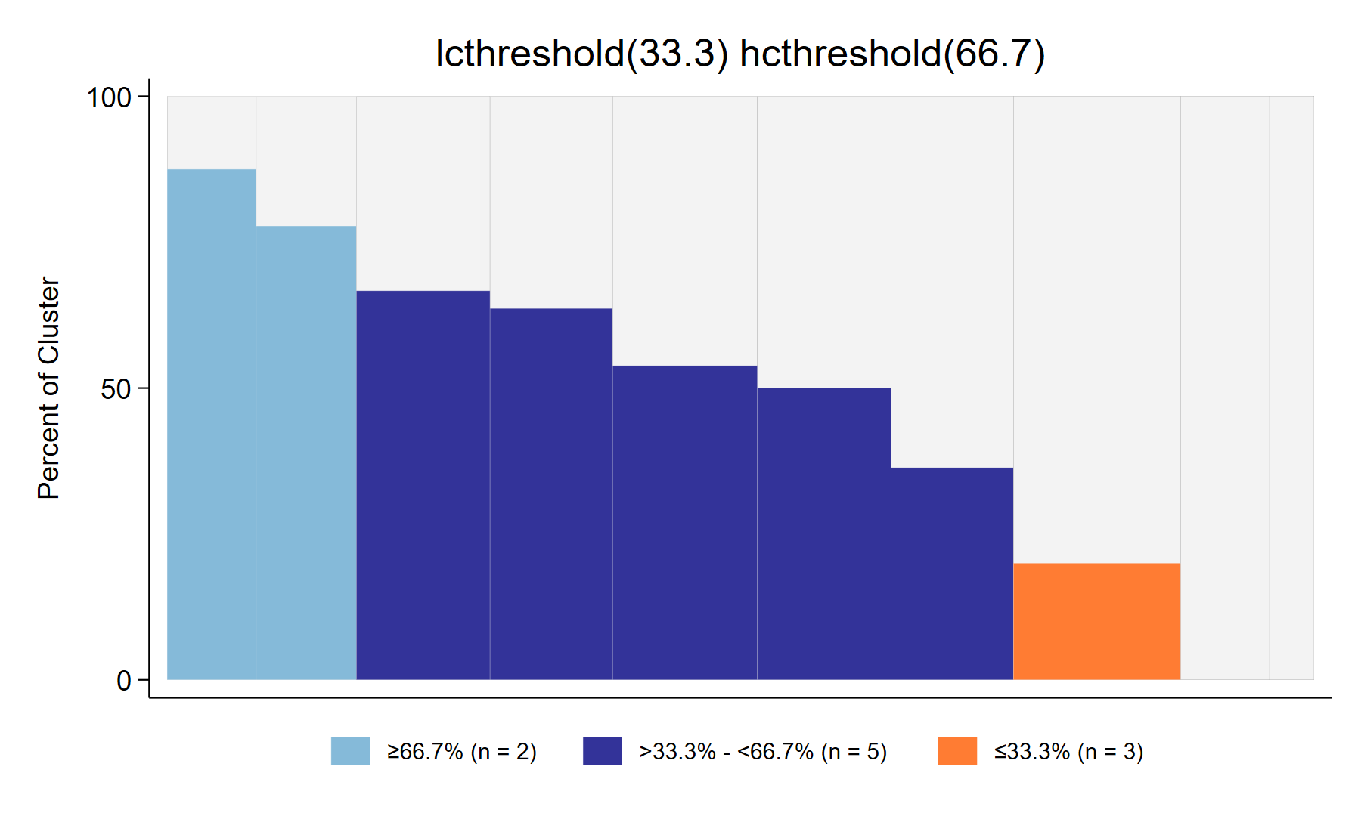
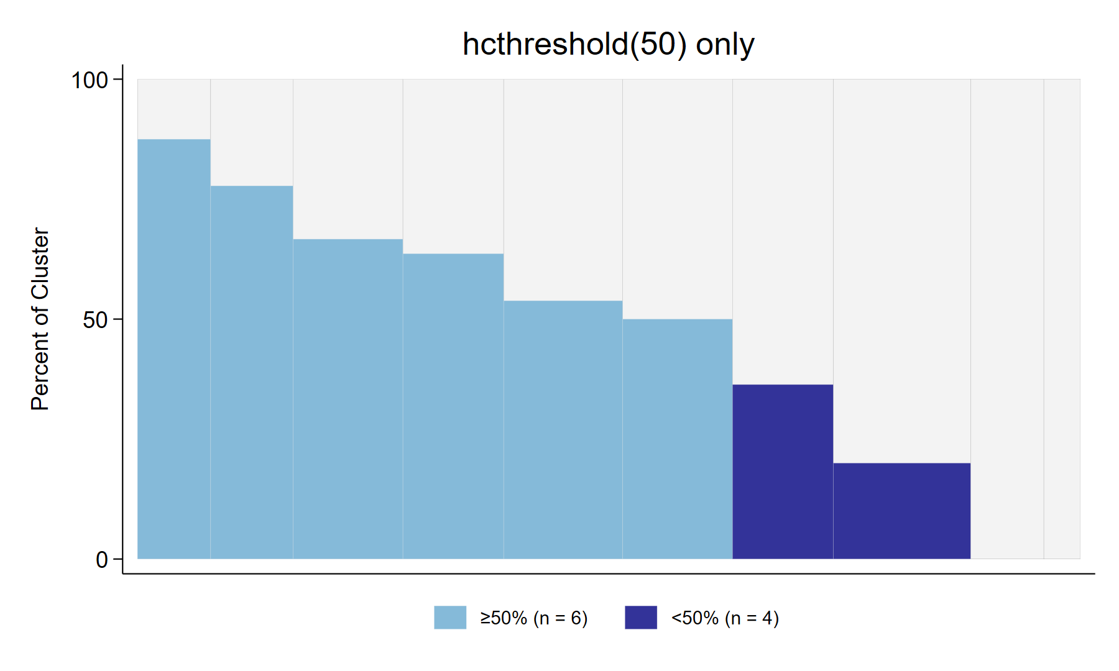
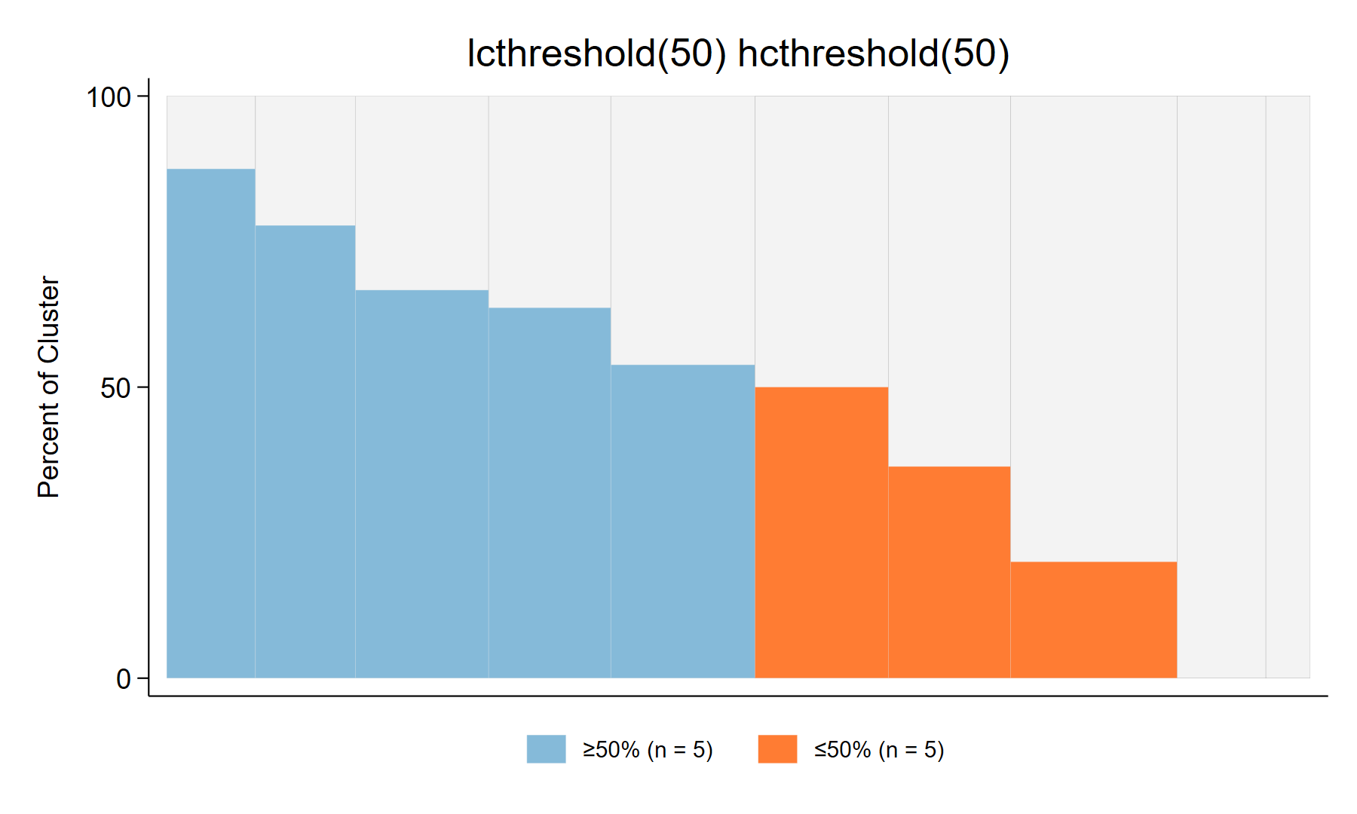


Coverage Categories: Thresholds and Ties
lcthreshold(33.3) hcthreshold(66.7): 2 high, 5 mid, 3 low. The third bar is 66.667%, below 66.7, so it is mid.
hcthreshold(50) alone: two categories. The cluster at exactly 50% is high: 6 high, 4 mid.
lcthreshold(50) hcthreshold(50): two categories. The cluster at exactly 50% is low: 5 high, 5 low.
High: coverage ≥ HCTHRESHOLD() (default 100); low: coverage ≤ LCTHRESHold(); mid: everything else
Thresholds need not be whole numbers; LCTHRESHold() may not exceed HCTHRESHOLD()
Notes:
All three plots use the same stratum (stratum 0 of the opplot_demo.do data), whose ten cluster heights are 87.5, 77.8, 66.7, 63.6, 53.8, 50.0, 36.4, 20.0, 0 and 0 percent (rounded to one decimal).
Left: thresholds that are not whole numbers. opplot compares each bar height, rounded to a thousandth of a percent, with the thresholds. The third bar is 66.667%, which is shown as 66.7% but is below hcthreshold(66.7), so it is in the middle category.
Middle: hcthreshold() alone (below 100) gives two categories, high and mid; a cluster exactly at the threshold is high.
Right: when lcthreshold() equals hcthreshold() there are also two categories, but a cluster exactly at the threshold is low.
In opplot 2.0, giving only hcthreshold() no longer creates a hidden 0% low category.

Slide 39
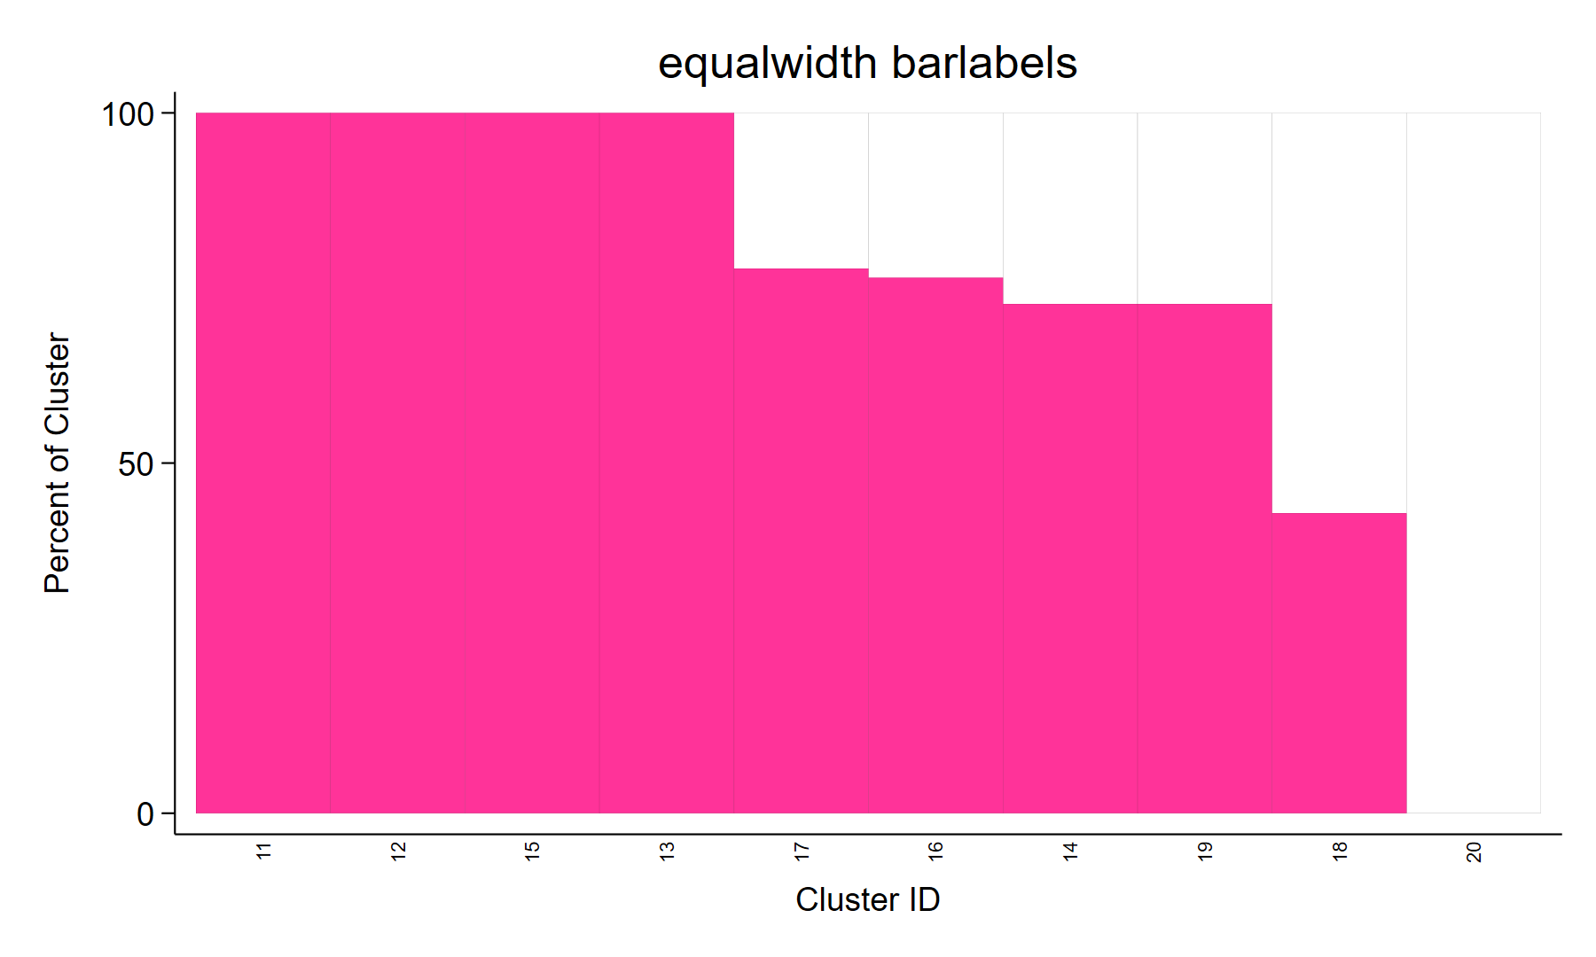
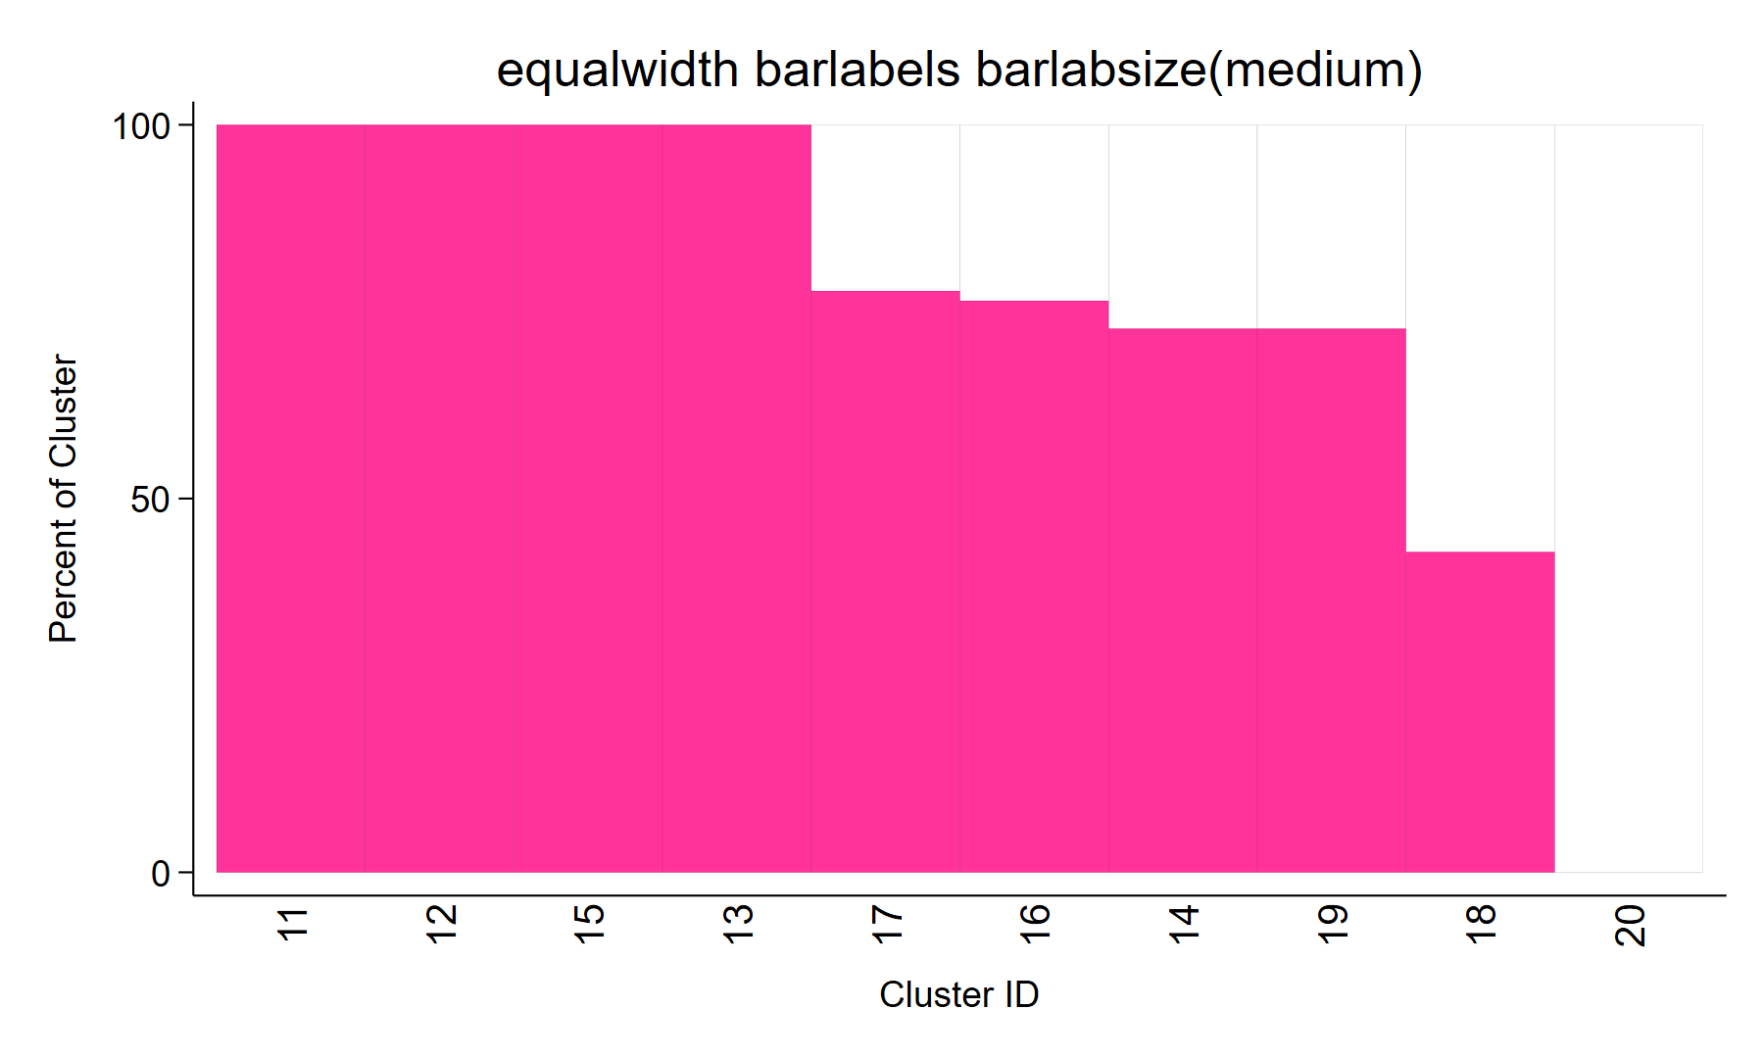
Labeling the Bars with Cluster IDs
BARLABELS labels each bar with its cluster ID (the value label, if there is one); most legible with EQUALWIDTH and up to a few dozen clusters
BARLABSize() sets the label size (default vsmall) and implies BARLABELS (new in opplot 2.01); XLABEL() overrides both
Left: opplot y, clustvar(clusterid) stratvar(stratumid) stratum(1) equalwidth barlabels xtitle("Cluster ID") title(...)
Right: opplot y, clustvar(clusterid) stratvar(stratumid) stratum(1) equalwidth barlabels barlabsize(medium) xtitle("Cluster ID") title(...)
Notes:
With equal widths the bars are easy to label. The labels read left to right in plot order, which is the same order as the rows of the SAVEDATA dataset.
The labels are vertical and vsmall by default (left). opplot 2.01 adds BARLABSize(), which takes any Stata text size, e.g., barlabsize(medium) (right) or barlabsize(*1.5); it implies BARLABELS. If the size is not a valid Stata size, Stata displays a note and uses its default size. If XLABEL() is also given, XLABEL() is used and opplot displays a note.
The Kenya 2016 plots in the back-up slides labeled the bars with the number of respondents; BARLABELS labels them with the cluster ID (or its value label) instead.

Slide 40
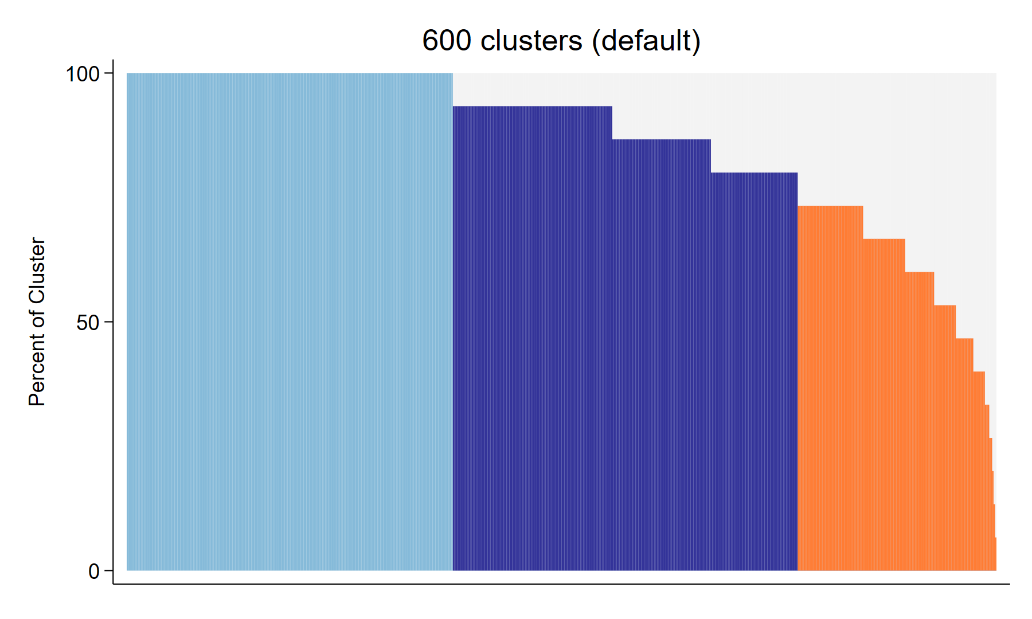
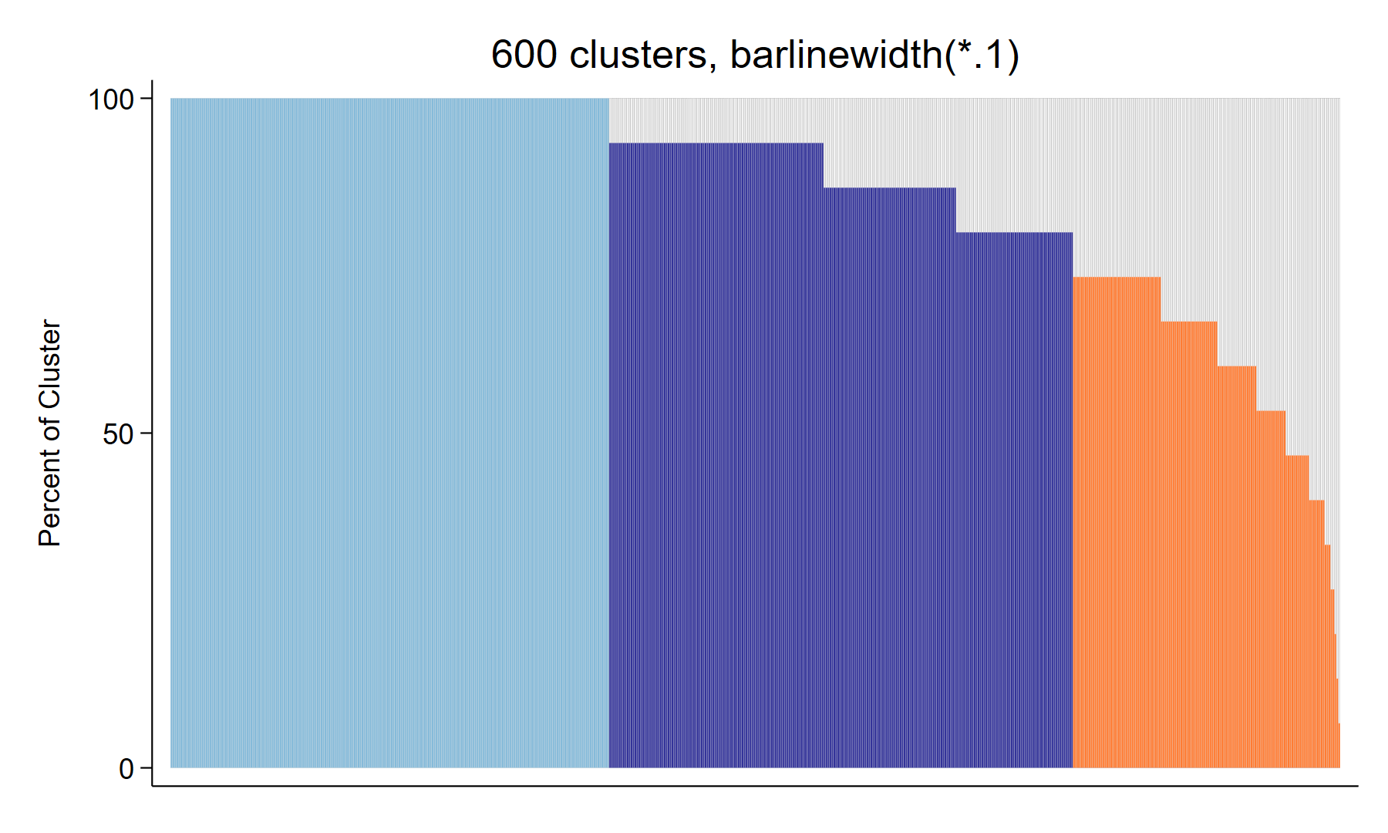
Many Clusters: Outlines Are Omitted Automatically
Default: thin outlines for up to 150 bars, none above 150 (checked: 150 bars → outlines, 151 → none)
BARLINEWidth() overrides either way, e.g., barlinewidth(*.1) on the right, or barlinewidth(none) on a small plot
Left: opplot y, clustvar(clusterid) lcthreshold(75) title(...)
Right: opplot y, clustvar(clusterid) lcthreshold(75) barlinewidth(*.1) title(...)
Notes:
With hundreds of clusters the thin lines between bars wash out the fill colors (right). opplot 2.0 therefore draws no outlines when there are more than 150 bars (left), unless BARLINEWidth() is specified. The count is the number of bars drawn, so clusters that are not represented (e.g., only zero-weight rows) do not count.
The data are simulated: 600 clusters of 15 respondents.

Slide 41
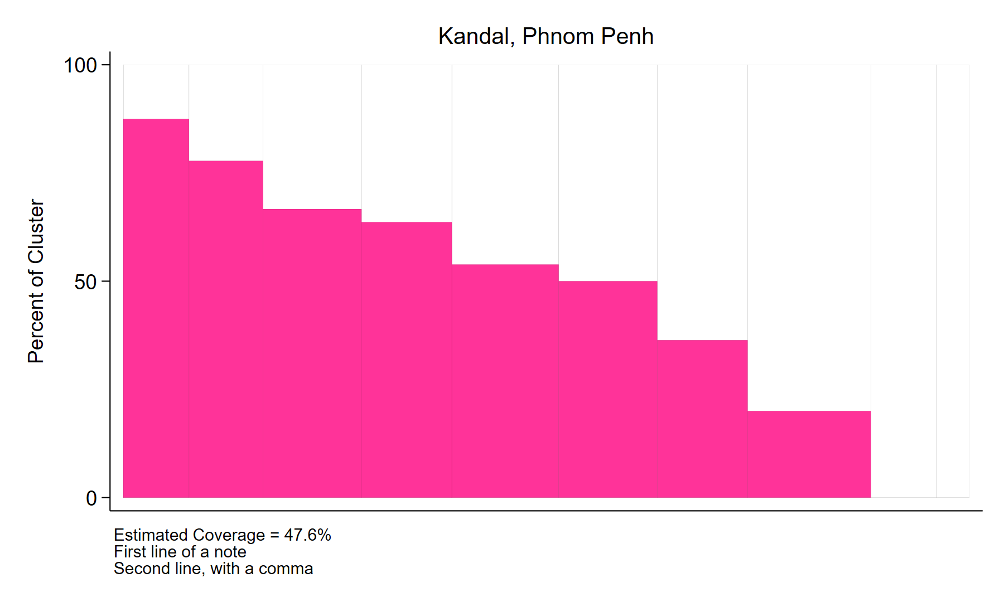
Titles and Notes with Commas and Several Lines
Quoted text may contain commas, several lines and suboptions such as size()
The footnote statistics line comes first, then FOOTnote() and NOTE() lines
Unquoted text in NOTE(), FOOTnote(), XTITLE() and YTITLE() is still taken literally, commas included
opplot y, clustvar(clusterid) stratvar(stratumid) stratum(0) title("Kandal, Phnom Penh", size(medium))
note("First line of a note" "Second line, with a comma", size(small)) footnotecovg
Notes:
In opplot 2.0, TITLE(), SUBtitle(), CAPTION(), XLABEL() and YLABEL() are passed to graph twoway as typed, so a title that contains a comma, such as a stratum name like 'Kandal, Phnom Penh', should be put in double quotes. NOTE() and FOOTnote() lines are added below the footnote statistics.
Notes are size(vsmall) unless you give a size yourself.

Slide 42
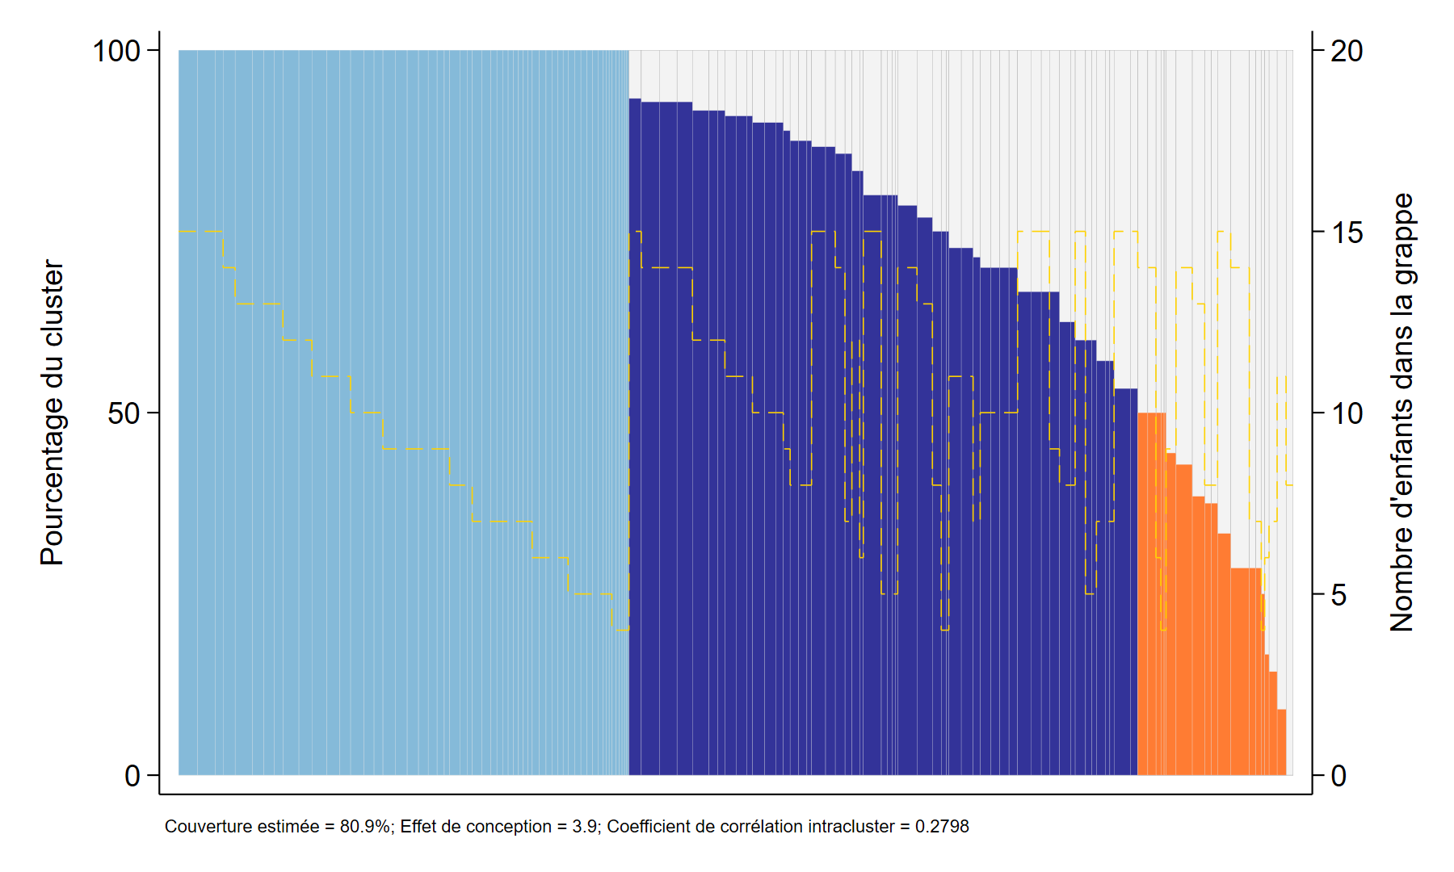
Labels in Another Language
global OS_316 Pourcentage du cluster
global OS_317 Nombre d'enfants dans la grappe
global OS_327 Couverture estimée
global OS_498 Effet de conception
global OS_493 coefficient de corrélation intracluster
Axis titles and footnote labels come from these globals
VCQI sets them in the user's language; if they are empty, opplot uses English
Footnote (enlarged)
Notes:
OS_316 is the left axis title, OS_317 the right axis title (PLOTN), and OS_327, OS_498 and OS_493 label the coverage, design effect and ICC footnotes. The first letter of the ICC label is capitalized; earlier versions capitalized every word, which produced 'Coefficient De Corrélation Intracluster' in French.
If opplot fills in English defaults because a global is empty, it clears them again when it finishes.

Slide 43
SAVEDATA in opplot 2.0
Variables (one row per bar, in plot order)
The three lowest bars of the report-style plot
yvar stratvar stratum cluster
<clustvar> n_respondents barorder
barwidth cumulative_barwidth barheight
n_outcome1 respondents with y = 1
n_missing missing y (counted as 0)
sum_weights sum of weights
category 1 high, 2 mid, 3 low
lcthreshold hcthreshold
clusterid barorder n_resp n_outcome1 barheight category
1019 128 7 1 14.3 low
1068 129 11 1 9.1 low
1113 130 8 0 0.0 low
Merge the categories back onto respondents
merge m:1 clusterid using campaign_bars, keepusing(category) nogen
tab category heard_of_campaign, row
category heard_of_campaign = 1
high 85.43% (of 460)
mid 77.31% (of 551)
low 72.83% (of 173)
Red: new in opplot 2.0. n_respondents counts only respondents with a positive weight.
Notes:
The saved dataset still has one row per bar, with the left-most bar in row 1, and keeps the variables shown on the earlier SAVEDATA slide. opplot 2.0 adds the variables in red. The category variable makes it easy to count clusters by category, list the low-coverage clusters, or map them.
The listing (abbreviated column names) and the cross-tabulation come from the simulated 130-cluster survey on the report-style slide; heard_of_campaign is a simulated questionnaire item. The dataset's notes record the coverage, DEFF, ICC, stratum and the number of missing outcomes.

Slide 44
Stored Results and One Plot per Stratum
return list after the report-style plot
A loop over strata
r(n_low) = 19
r(n_mid) = 54
r(n_high) = 57
r(lcthreshold) = 50
r(hcthreshold) = 100
r(icc) = .2797662688485554
r(deff) = 3.94420338266631
r(covg) = 80.91651520424944
r(nmissing) = 0
r(nclusters) = 130
r(N) = 1184
r(yvar) : "got_campaign_dose"
r(stratum) : "1"
forvalues r = 1/4 {
quietly opplot got_campaign_dose, clustvar(clusterid) ///
weightvar(psweight) stratvar(region) stratum(`r') ///
lcthreshold(50) name(region`r', replace)
di "Region `r': coverage = " %4.1f r(covg) "%; " ///
r(n_low) " of " r(nclusters) " clusters at or below 50%"
}
Region 1: coverage = 82.9%; 5 of 32 clusters at or below 50%
Region 2: coverage = 74.9%; 5 of 33 clusters at or below 50%
Region 3: coverage = 86.3%; 3 of 33 clusters at or below 50%
Region 4: coverage = 79.4%; 6 of 32 clusters at or below 50%
Notes:
opplot is now an r-class command. r(N) counts respondents with a positive weight; r(nmissing) counts those among them with a missing outcome; r(covg) is a percent. r(n_high), r(n_mid) and r(n_low) are returned only when coverage categories are used (r(n_low) is 0 when only an hcthreshold() below 100 is given). r(lcthreshold) is returned only when lcthreshold() is given. No confidence interval is returned.
The loop makes one plot per region. On the slide the opplot and display commands are split with /// for readability.

Slide 45
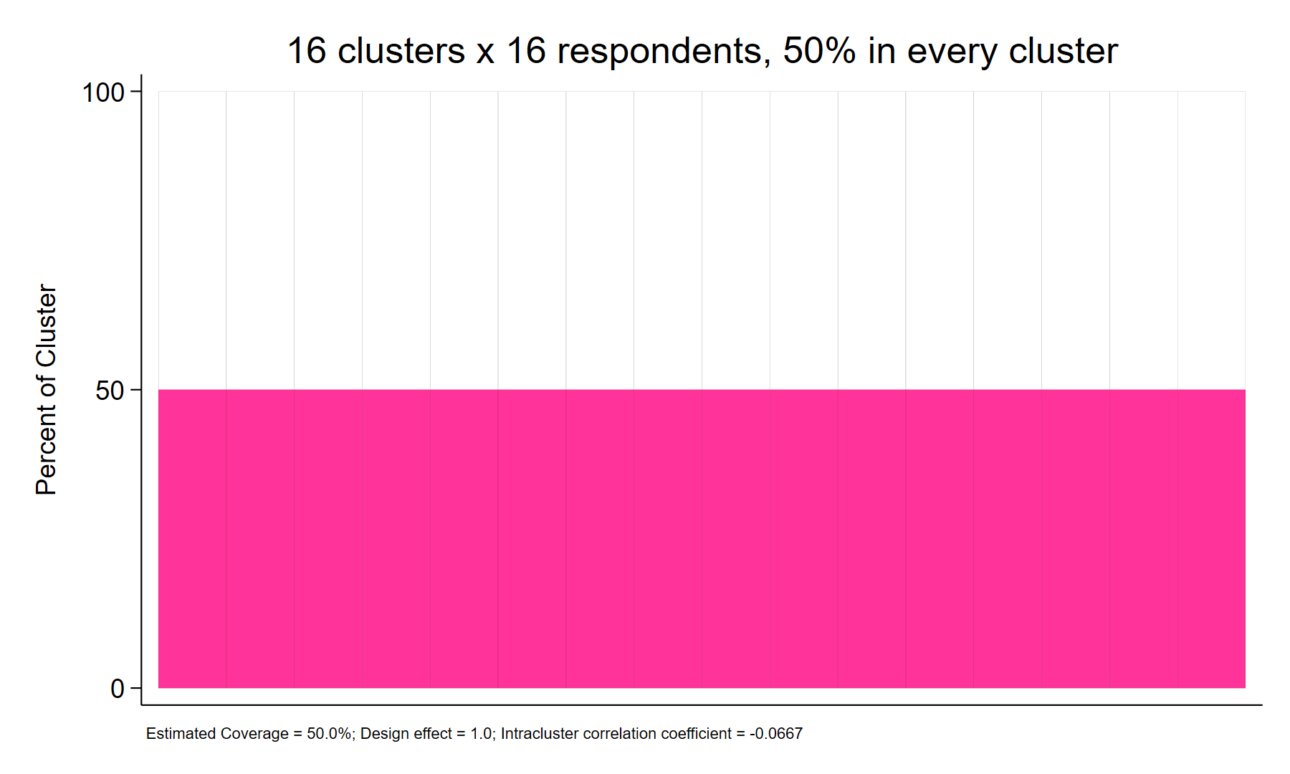
Footnote Statistics in opplot 2.0
Coverage: survey-weighted proportion (svy, subpop(positive weight): mean)
Design effect = (N − 1) / Neff, Neff = p(1 − p) / SE²; set to 1 when coverage is 0% or 100% or SE = 0
ICC: one-way ANOVA estimator, not truncated at 0
Equal coverage in every cluster gives ICC = −1/(m0 − 1): here −1/15 = −0.0667, DEFF = 1.0
No confidence intervals are reported
Footnote (enlarged)
* 16 clusters x 16 respondents, 8 with y = 1 in each
opplot y, clustvar(clusterid) footnotecovg footnotedeff footnoteicc title(...)
Notes:
opplot computes these statistics itself; earlier versions needed two VCQI programs (svypd and calcicc). The values match those programs.
N is the number of respondents with a positive weight. If the global macro VCQI_DEFF_TRUNCATE is not empty, a DEFF below 1 is set to 1. The ICC is computed without weights, among the respondents represented in the plot; m0 = (N − sum of squared cluster sizes / N)/(K − 1), which is 16 here, so the ICC is −1/15. This is the value shown as '-1/15' on the earlier four-panel slide.
If the data are already svyset, opplot uses that design for the coverage and DEFF (and says so outside VCQI); the ICC does not use the survey design. Otherwise opplot uses svyset clustvar [pweight=weightvar], singleunit(scaled) within the plotted stratum.

Slide 46
The Missing-Outcome Warning and NOWARNings
Default: after the plot, if respondents with a positive weight have a missing outcome
opplot warning: 5 out of 103 respondents with a positive weight have a missing value of y (counted as 0).
With NOWARNings (or nowarn): no warning; nothing else changes
Inside VCQI the same text goes to the screen and to the VCQI log (Warning), naming the caller and the command
opplot warning: 5 out of 60 respondents with a positive weight have a missing value of y (counted as 0); inside VCQI,
opplot.ado was called from RI_CONT_01B_06PO with this syntax: opplot y, clustvar(clusterid) plotn weightvar(w) ...
A VCQI log entry holds at most 2,045 characters; if the text would be longer, opplot names only the caller
opplot warning: ... (counted as 0); inside VCQI, opplot.ado was called from RI_CONT_01B_06PO.
No warning when nothing is missing, or with if !missing(y); rows with a zero or missing weight never count
Notes:
The first example is the warning from the Missing Outcomes slide. The VCQI example comes from a test that simulated a VCQI run with VCQI's own logging program; the command is shortened here with '...'. In that test the full log entry was 670 characters long.
The warning is displayed after the plot is drawn. NOWARNings suppresses it on the screen and in the VCQI log and changes nothing else (the plot and the stored results are the same).

Slide 47
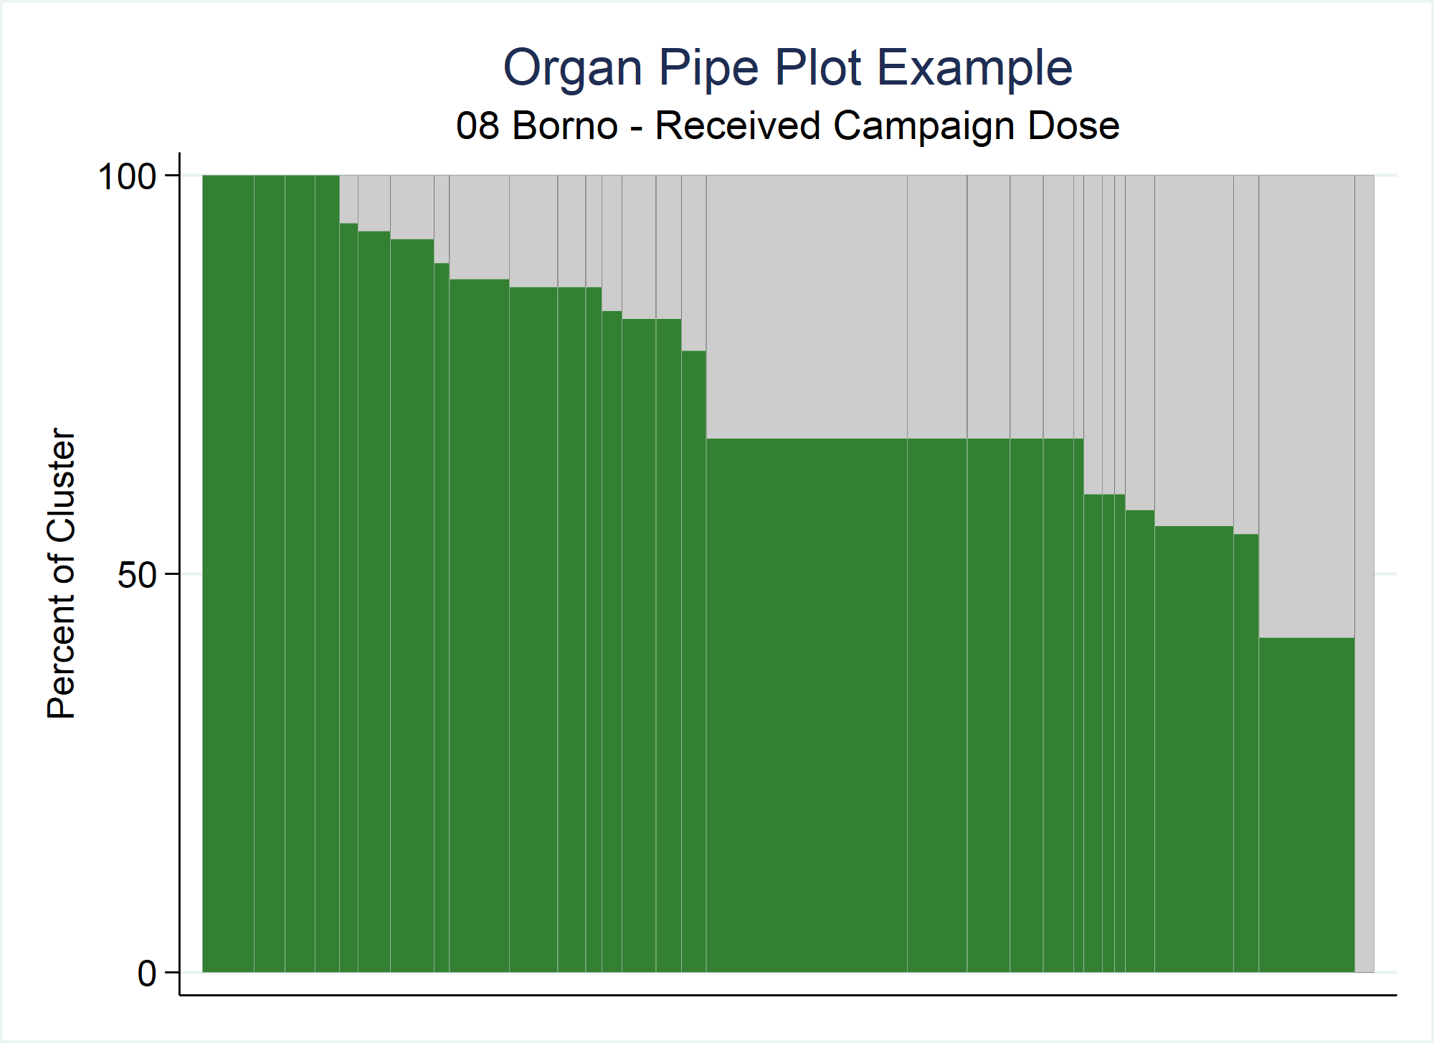
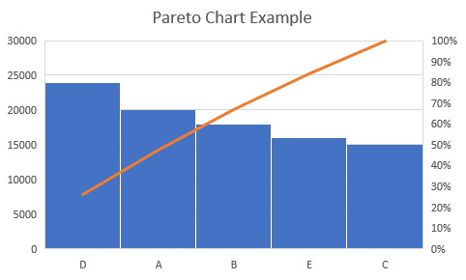
Organ Pipe Plots are not Pareto Charts
Both graphics sort bars in descending order
Pareto charts highlight important factor(s) among a large group of factors (often defects)
OP plots look for empty bars & shaded portion of the weighted plot is an estimate of vaccination coverage
Notes:
OP plots are not Pareto charts, which are commonly used in quality control studies.
Although both graphics sort bars in descending order, there are fundamental differences between the two.
Pareto charts highlight important factors among a large group of factors (often defects), and focus on the bars or categories on the left side of the chart to attribute failures to causes. They show category frequencies and a cumulative percentage line.
With OP WEIGHTED plots, we are interested in the overall proportion of the plot that is shaded (green in this example), as that represents an estimate of coverage in that stratum. Also, OP plots in the vaccination setting focus on the right side of the plot to spot clusters with surprisingly low coverage.
Superficially they may look similar but there is a different message…
Note: Stata has a Pareto dot plot as proposed by Wilkinson (2006) (command <pdplot> written by Nick Cox)

Slide 48
Visual Connection to the Intracluster Correlation Coefficient (ICC)
Due to time and budget constraints for household surveys, cluster sampling is usually preferred to simple random sampling
ICC is a measure of the correlation of responses within clusters
Ranges from [-1/(m-1),1] but for planning purposes, it practically ranges from [~0,1]
Surveyors have no control over the ICC -> it can only be estimated after the data have been collected
ICC affects the design effect (DEFF) -> affects sample size calculations -> affects CI widths
OP plot bar height variability is a visual representation of the ICC
Notes:
Due to time and budget constraints for household surveys, cluster sampling is usually preferred to simple random sampling.
When this happens, responses within a cluster are likely to be more correlated than if the responses were chosen at random.
ICC is a measure of the correlation of responses within clusters.
ICC ranges theoretically from -1/(m-1) to 1 (as on the slide) but practically in our line of work it ranges from values just below 0 up to 1. Values near (or slightly below) 0 imply responses are not correlated whereas values near 1 imply responses are very correlated.
Surveyors have no control over the ICC; it is a feature of the population.
In the beginning stages of survey planning, you need to estimate the ICC to incorporate into the design effect in the sample size calculation.
There is a domino effect -> the ICC affects the design effect (DEFF) which affects the sample size calculations which affect confidence interval widths.
Why is all of this important to this talk? The OP plot bar height variability is a visual representation of the ICC.

Slide 49
-1/15
Notes:
Recall these OP plots from earlier…
4 strata -> 16 clusters -> sampled 16 respondents -> total of 256 respondents per stratum
50% coverage estimated for each stratum.
Let’s look at them individually…

Slide 50
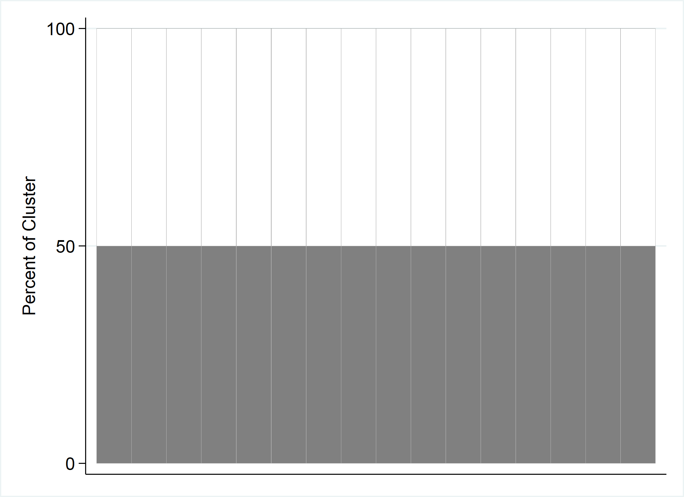
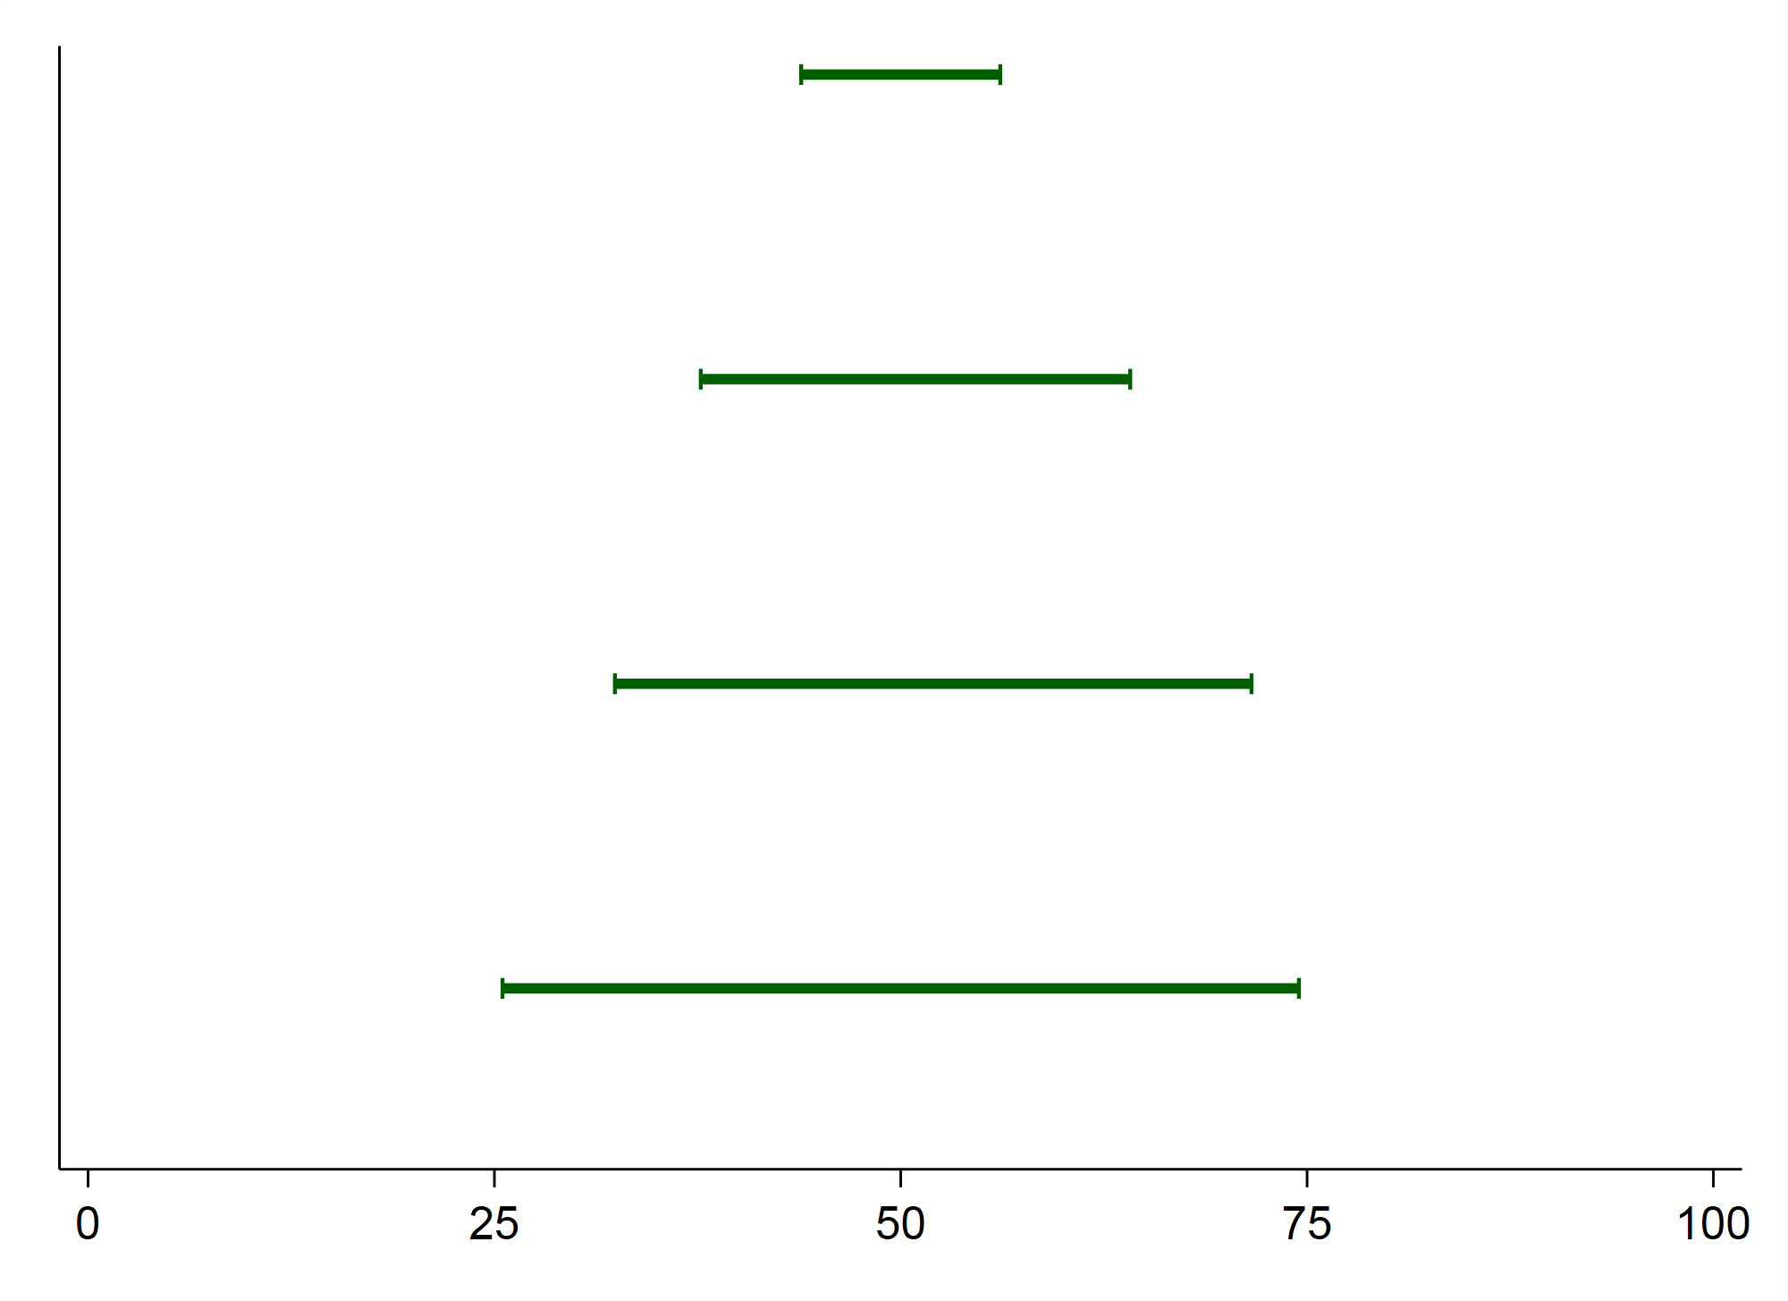
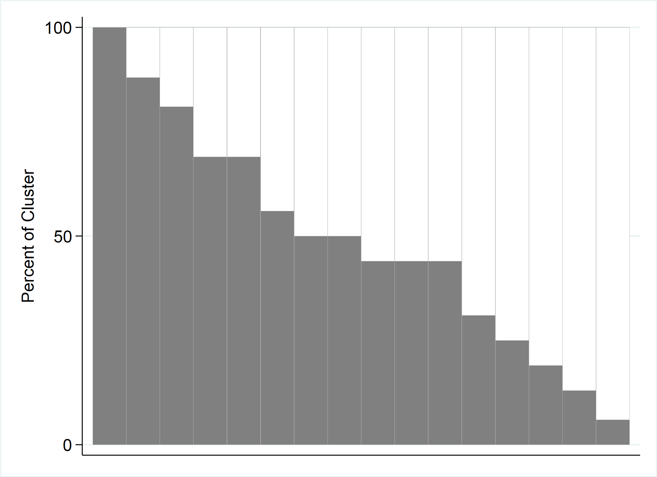
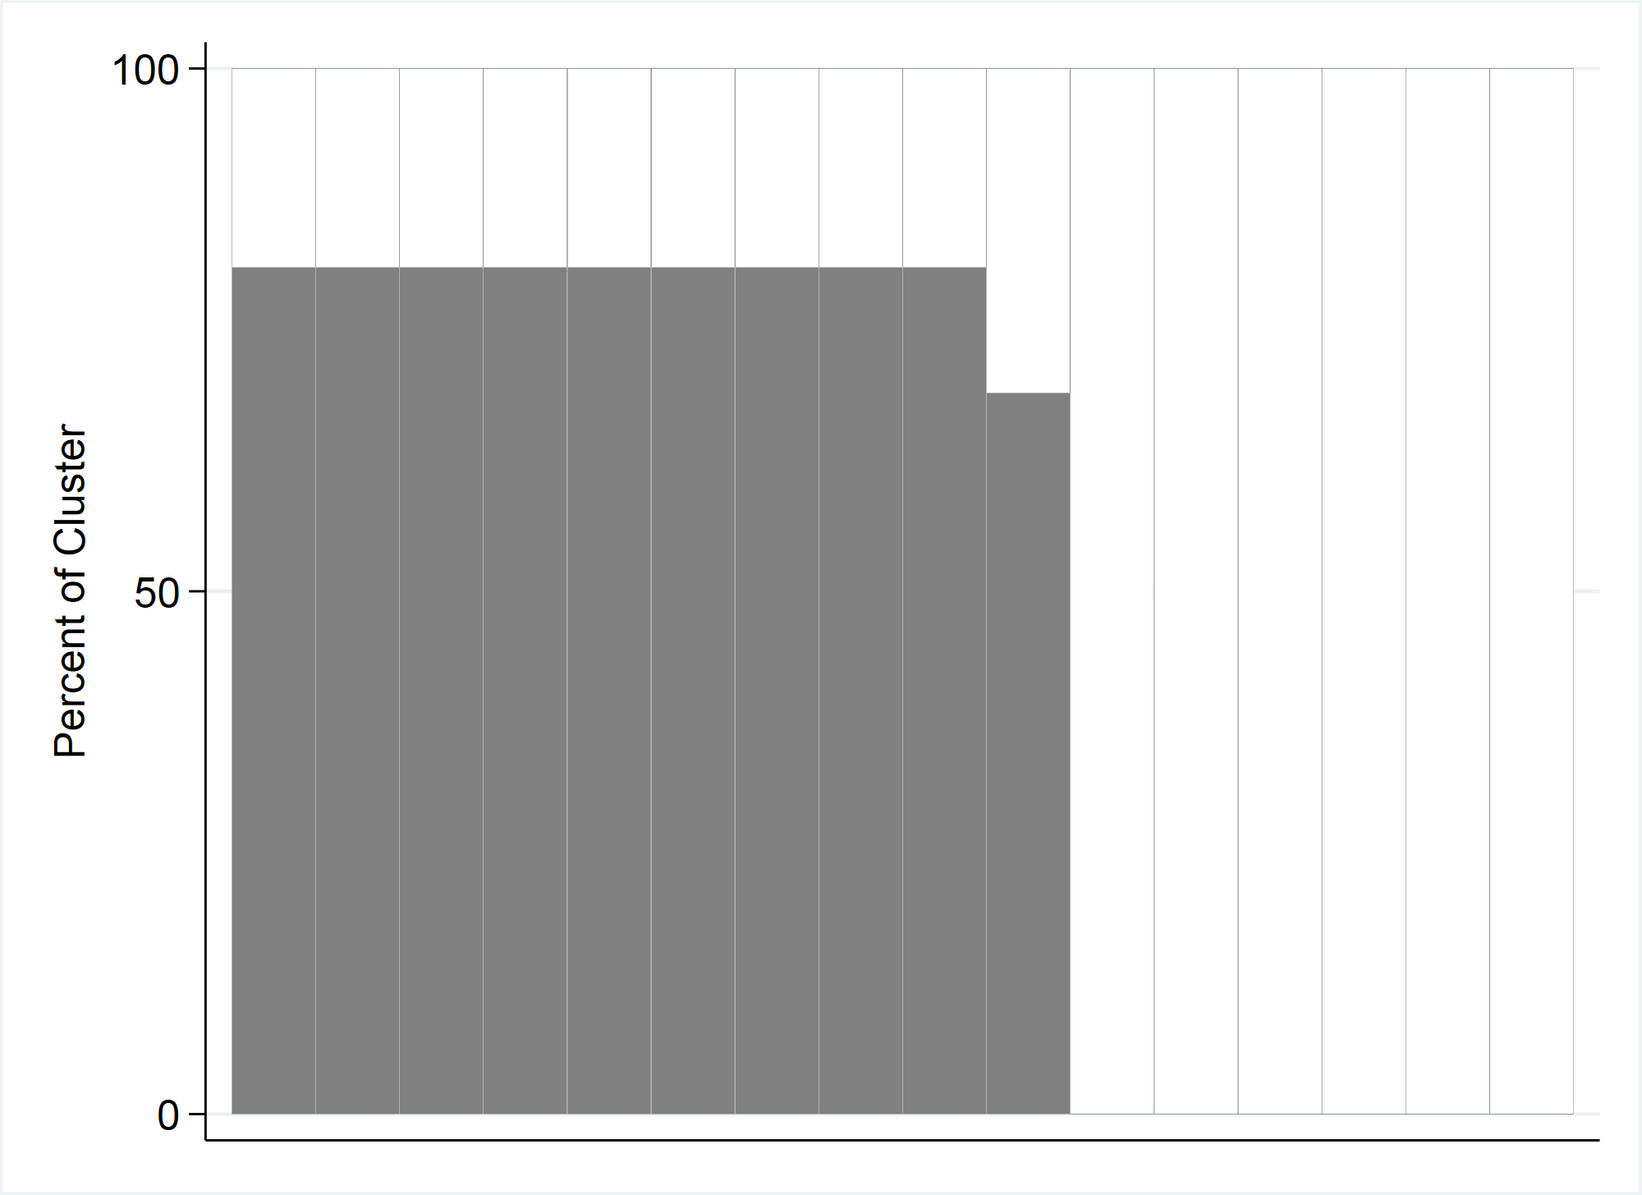
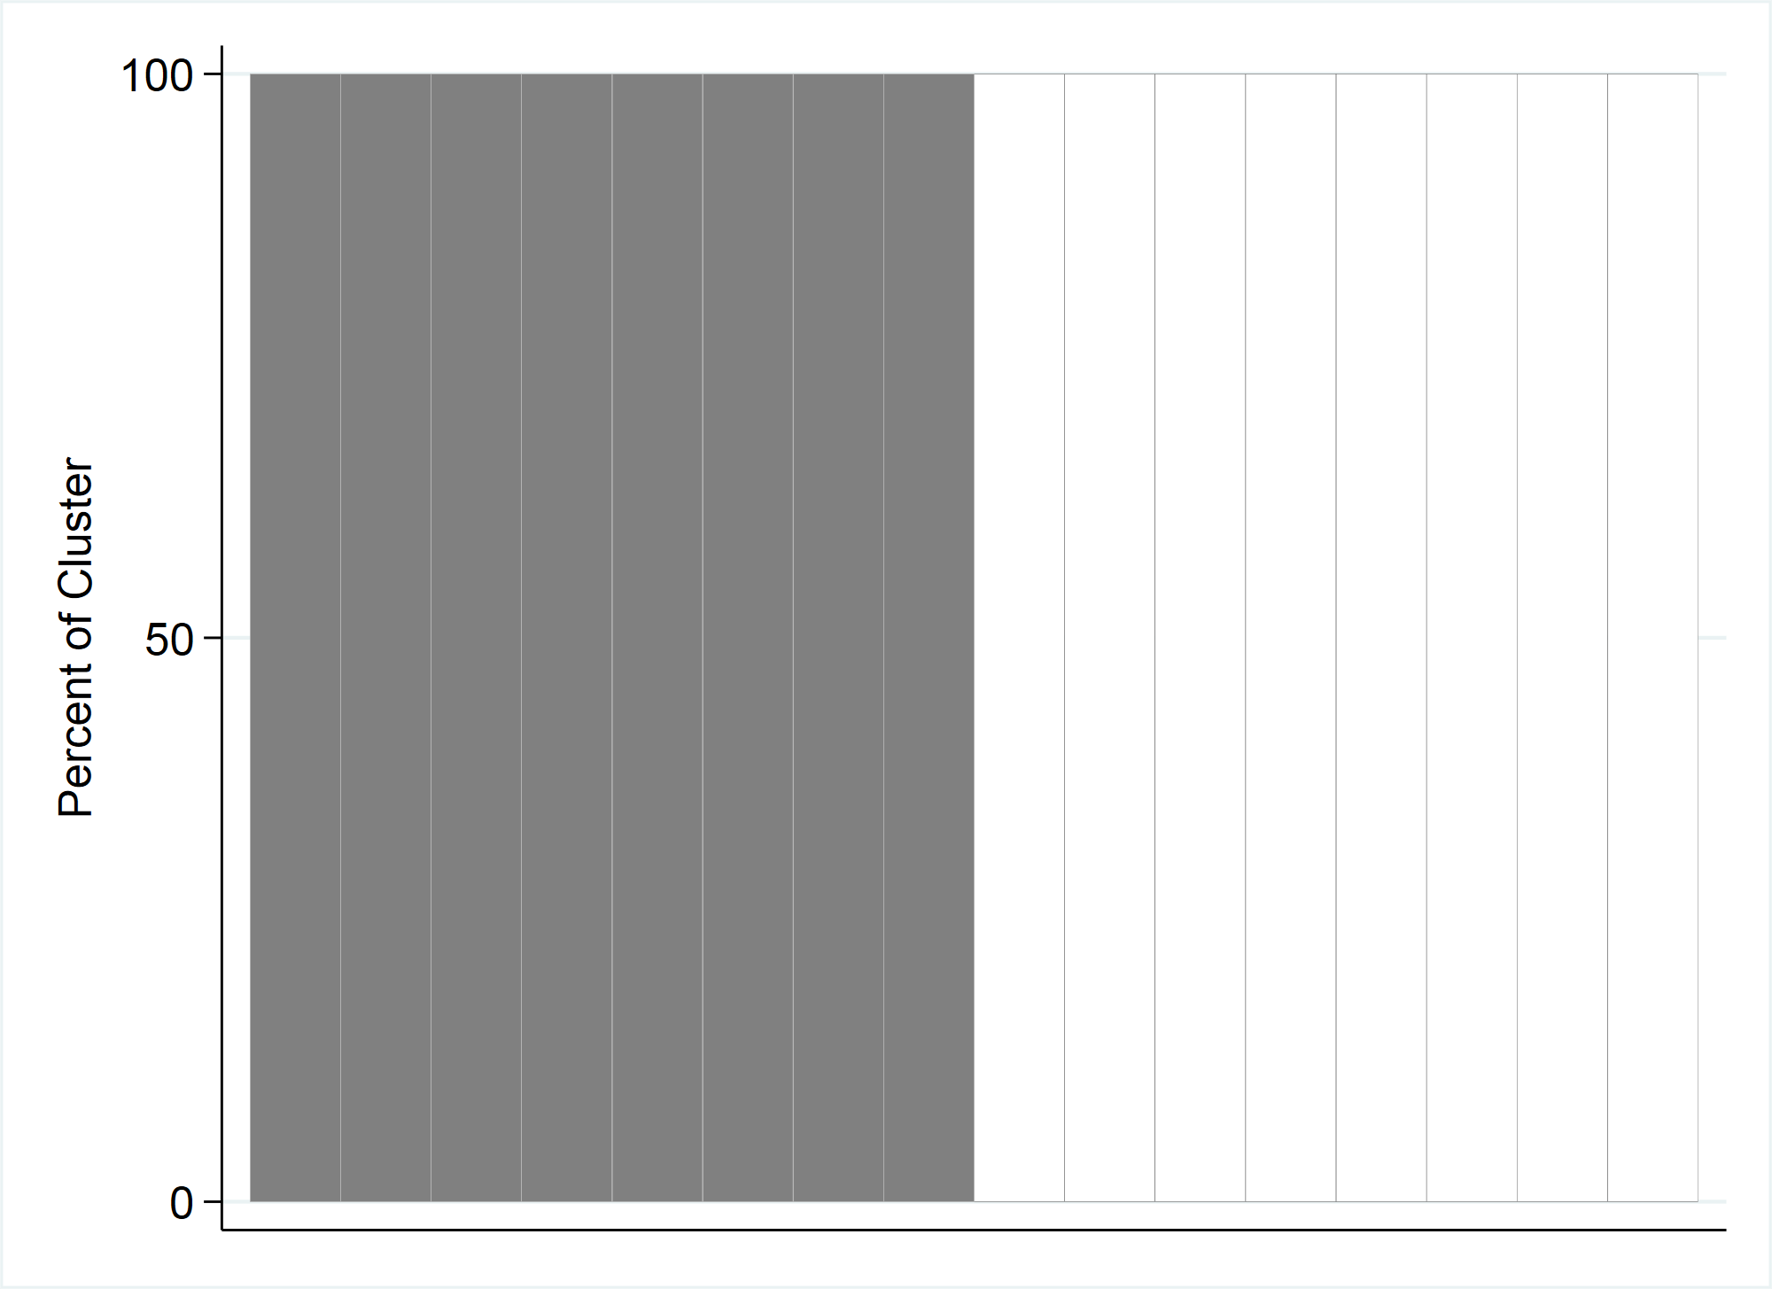
Visual Connection to the ICC
ESS = Effective Sample Size = N / DEFF
DEFF = Design Effect ≈ [1+ (m-1)*ICC]
where m is the avg # of respondents per cluster^
ICC = Intracluster Correlation Coefficient
N ESS DEFF ICC CI half width
256 256 1* 0* 6.1%
* When coverage is uniform across clusters, the ICC is slightly negative, but by convention is usually rounded up to 0 when reported. And by convention, we usually constrain DEFF to be no smaller than 1.0 when estimating proportions in a single stratum.
256 55 4.68 0.241 13.2%
256 25 10.26 0.593 19.6%
256 16 16 1 24.5%
^The avg # of respondents per cluster was m=16 for each stratum
Notes:
Although each stratum had the same number of respondents sampled, they all resulted in different CI widths because they all had different ICCs.
The top OP plot shows a stratum with homogeneous coverage -> ICC=0 -> DEFF=1 -> highest ESS possible-> tightest CI shown
Whereas the bottom OP plot shows a stratum at the other end of the spectrum where some clusters have 100% coverage and other clusters have 0% -> ICC near 1 -> DEFF near maximum possible value…which is 16 in this case…the avg # of respondents per cluster (m) -> ESS is the lowest possible in this scenario…16 -> CI width is the largest possible in this scenario
The two plots in the middle show different patterns of coverage -> ICC ranges between 0 and 1 -> DEFF ranges between 1 and 16…average number of respondents per cluster -> CI widths will be between the two extremes.
***Extra notes***
Note that small values of ICC correspond to small values of DEFF (vice versa)
DEFF = [1+ (m-1)*ICC][1 + CV_{w}²] (m is the average number of respondents per cluster and CV_{w} means coefficient of variation of the weights)
Note also that when coverage is equal across clusters, the ICC is technically = -1/(m-1) where m is the average number of respondents per cluster. A negative ICC would yield a DEFF smaller than one. When estimating vaccination coverage survey outcomes, we usually follow the convention described in Dean and Pagano 2015 and other publications, where the DEFF is constrained to be ≥ 1.
1.
Dean N, Pagano M. Evaluating Confidence Interval Methods for Binomial Proportions in Clustered Surveys. Journal of Survey Statistics and Methodology. 2015;3: 484–503. doi:10.1093/jssam/smv024
opplot's ICC footnote reports the negative value, e.g., -0.0667 (= -1/15) when all 16 clusters of 16 respondents have the same coverage; see the Footnote Statistics in opplot 2.0 slide.

Slide 51
Visual Connection to the ICC Takeaways
Estimate the ICC with care because it impacts the CI width
OP plot bar height variability is a visual representation of the ICC that can help you picture the correlation in that stratum
Pay it forward…after you finish your survey, make the OP plots and report the estimated ICC values, so that the next person (possibly you) planning the next survey has them as a baseline to start thinking about their ICC estimate for sample size calculations for that survey
Notes:
So…the visual connection to the ICC takeaways…
1. When planning a survey, you have to estimate the ICC. If there was a previous similar survey conducted, then you could start with those estimates for your sample size calculations. If not, think hard about the expected correlation of responses within clusters of each stratum and estimate the ICC accordingly, knowing that that estimate will impact the CI width.
2. The OP plot bar height variability is a visual representation of the ICC that can help you picture the correlation in that stratum.
3. Pay it forward…after you finish your survey, make the OP plots and report the estimated ICC values, so that the next person (possibly you) planning the next survey has them as a baseline to start thinking about their ICC estimate for sample size calculations for their survey.

Slide 52
Organ Pipe Plots – Real World Use
2018 WHO Vaccination Coverage Cluster Surveys Reference Manual
WHO has developed a freely available Stata package named Vaccination Coverage Quality Indicators (VCQI)
Kenya Measles-Rubella Vaccination Campaign 2016
(paper published June 2018)
Jharkhand, India Measles Vaccination Campaign 2012
(paper published May 2015)
Notes:
I highlighted a few examples of where organ pipe plots have been used, and here are a few more, including the 2018 WHO Vaccination Coverage cluster surveys reference manual and the WHO suite of Stata programs named vaccination coverage quality indicators (VCQI).

Slide 53
Where Do I Find It?
Link to our GitHub page here: www.biostatglobal.com
Or find it on SSC: Type ‘findit opplot’ or ‘ssc install opplot’ at the Stata prompt

Slide 54
Questions?
Dale.Rhoda@biostatglobal.com
Link to GitHub:
www.biostatglobal.com

Slide 55
Back-up slides…

Slide 56
Organ Pipe Plot – Bar Shading & Widths
 | Self-Weighted Data | Weighted Data (specify WEIGHTvar option) | Equal Bar Widths* (specify EQUALWIDTH option)
Shaded proportion of the bar (cluster) represents… | Proportion of respondents in that cluster whose value of yvar is equal to 1 | Proportion of respondents in that cluster whose value of yvar is equal to 1 | Proportion of respondents in that cluster whose value of yvar is equal to 1
Shaded proportion of the plot represents… | Sample coverage | Weighted sample coverage (Estimated population coverage) | Nothing
Bar widths represent… | Sample proportion represented by each cluster | Weighted proportion of population represented by each cluster | Nothing
*Specifying equal bar widths is helpful if user wants to label each cluster/bar in the plot

Slide 57
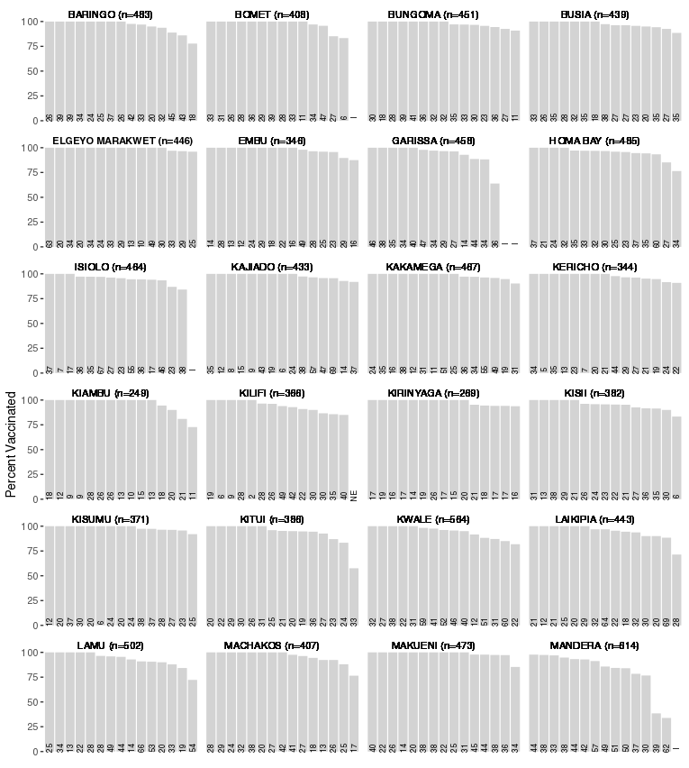
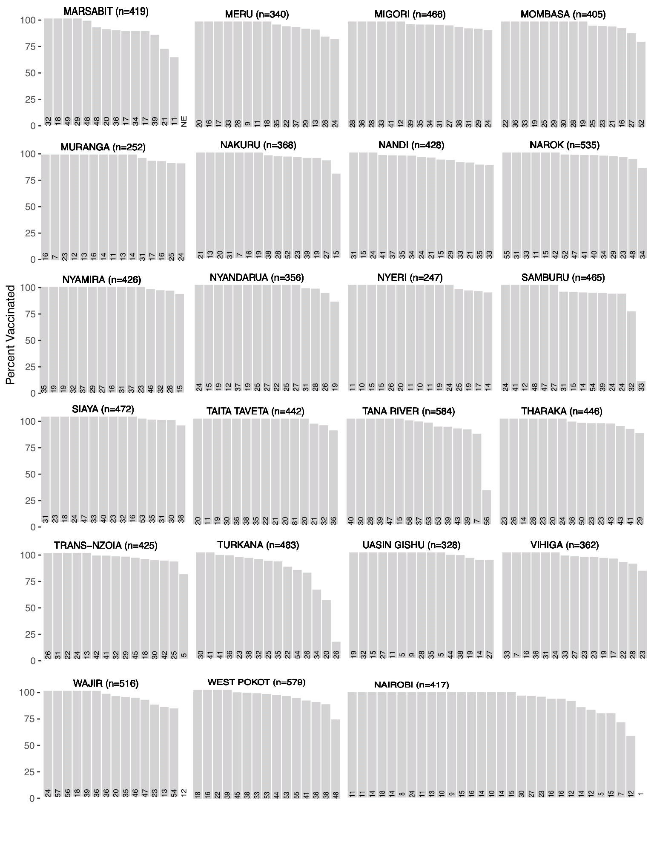
Kenya Measles Vaccination Campaign 2016
Notes:
Example of plots that used equal widths and annotated with sample size
Note: The idea of the OP plot was used but the command opplot was not used to generate these plots. These plots just illustrate equal widths and the use of labeling the bars.
Fig S1. Organ-pipe plots of unweighted measles-rubella campaign vaccination coverage by cluster and county
— Kenya 2016 (14). For each cluster, the total number of eligible children aged 9 months–14 years that were
enrolled in the survey is printed at the bottom of the bar.
opplot 2.0 can label each bar with its cluster ID or the value label of the cluster ID (BARLABELS). It has no built-in option to label the bars with the number of respondents; XLABEL() is passed to the graph if you want to supply your own labels. BARLABSize() (opplot 2.01) sets the size of the BARLABELS labels.

Slide 58
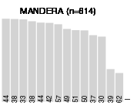
Kenya Measles Vaccination Campaign 2016
Notes:
One OP plot from the previous slide…zoomed in

