Slide 1
Projet de Bachelor

Slide 2
What is CFD?
CFD stands for computer fluid dynamics. We want to simulate the interaction of a fluid with surfaces defined by boundary conditions.
The fundamental equation describing the flow of an incompressible fluid is the Navier-Stokes equation. It is a partial differential equation.

Slide 3
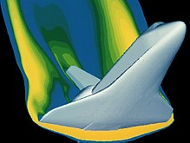
Simulation of the shuttle during reentry

Slide 4
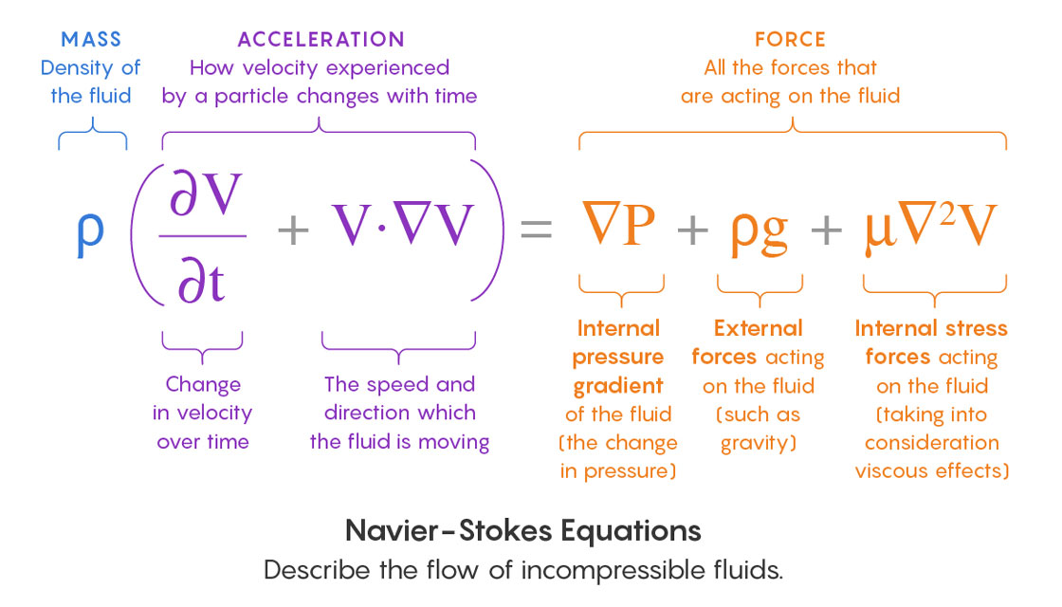
Navier-Stokes equation

Slide 5
Navier-Stokes equation
The Navier-Stokes equation is still ill-understood. One the seven Millenium Prizes by the Clay Institute is proving that solutions to the equation will always exist. That is, can the equation describe any fluid, from any starting conditions, indefinitely far into the future?

Slide 6
The key problem
Turbulence is the key problem. Turbulence happens when a smooth fluid flow starts to split into smaller eddies and vortices. Turbulent flow is characterized by chaotic (in the mathematical sense) change in pressure and flow velocity. We usually oppose turbulent flows to laminar flow which occurs when fluid flows in parallel layers without disruption between those layers.

Slide 7
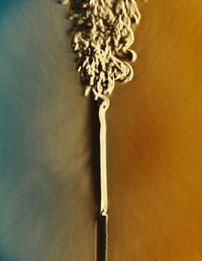
Laminar to turbulent transition
The plume from this candle goes from laminar to turbulent.

Slide 8
Reynlods number
The Reynlods number of a fluid is a dimensionless quantity that helps us predict flow pattern in different situation. More precisely it is the ratio of inertial forces to viscous forces.
More intuitively, fluids that have low Reynolds number will tend to have laminar flows, and high reynolds number will tend to have turbulent flows

Slide 9
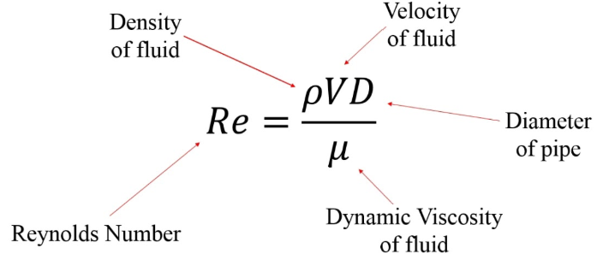
Reynolds number

Slide 10
Simulating fluid flow
In order to simulate fluid flows, we use a library called palabos. There are a number of different ways to simulate fluid flow. Palabos uses a method called Lattice Boltzmann which has a number of practical advantages over traditional CFD solvers.

Slide 11
Advantages of lattice Boltzmann
It can take full advantage of parallel architectures
The method originates from a molecular description of a fluid and can directly incorporate physical terms stemming from a knowledge of the interaction between molecules
Automated data pre-processing and mesh generation in a time that accounts for a small fraction of the total simulation.

Slide 12
Palabos in pratice
We define a number of boundary conditions that define the flow we are interested in simulating.
We then simulate the flow over a fixed size grid. The larger the grid, the more memory and computation is needed.

Slide 13
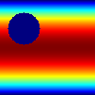
Example

Slide 14
The data
We use the previous example, named cylinder2d. We want to obtain parallel data with different grid size (say 100x100 and 200x200) where the position of the cylinder is identical and the reynolds number is also identical. Our hope is that by varying the reynolds number in a reasonably small range over a chosen level, we will be able to learn a transformation that can upsample a simulation over a small to one over a larger grid.

Slide 15
The model
We take inspiration from one of the first deep learning based Super-Resolution algorithm that was able to beat traditionnal methods. That model is called SRCNN (Super Resolution Convolutional Neural Network).

Slide 16
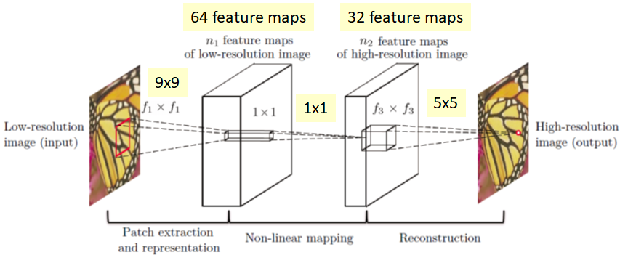
Architecture

Slide 17
The implementation
We use keras, which is a high level interface for ML libraries such as tensorflow or pytorch. The data is generated using the palabos library (which is in c++). We use a VM in the google cloud to access a GPU which greatly accelerates the training process.

Slide 18
The results
We obtain an MSE of 0.0105, compared with an MSE of 0.0190 with a classic bilinear interpolation, so the results are underwhelming to say the least.

Slide 19
Future directions
Increase and improve the quality of the data. Try considering other variables (we only consider velocity for the time being)

