Slide 1
Intro to Micro Service

Slide 2
什么是服务
类比饭店服务员
饭店就是服务框架
减少顾客等待时间，服务要马上上
客人来了，分配服务员服务，request/response
一个服务员：一个线程
每桌一个服务员全程等待式：多线程同步模型
一个服务员同时切换服务几桌：单线程异步模型
多服务员同时切换几桌: M/N模型
老板如何管理服务员：每来一桌上一个服务员1:1
共享10个服务员：进程池
吃完饭服务员服务结束：服务进程终止/任务终止，资源释放/返回线程池
服务员外包，食客来了服务员外包过来：依赖注入
老板雇佣服务员，老板负责创建服务员并管理服务员：框架负责创建服务线程并管理线程服务周期
服务员从窗口端菜：服务层从业务层获取数据
大厨做菜：数据生成/数据库
配菜送菜员：业务逻辑的实例。
服务员，配菜员，大厨这些职位：服务类，业务逻辑类，数据库处理类，类vs实例
组织按服务员，配菜员，大厨这样横向划分叫做宏服务，单体服务。饭店视为整体
按照桌划分，相关的服务员，配菜员，相关大厨打包到一起形成服务小组，一个饭店有多个服务小组，叫做微服务。纵向划分。
集中治理 vs 分布式治理

Slide 3
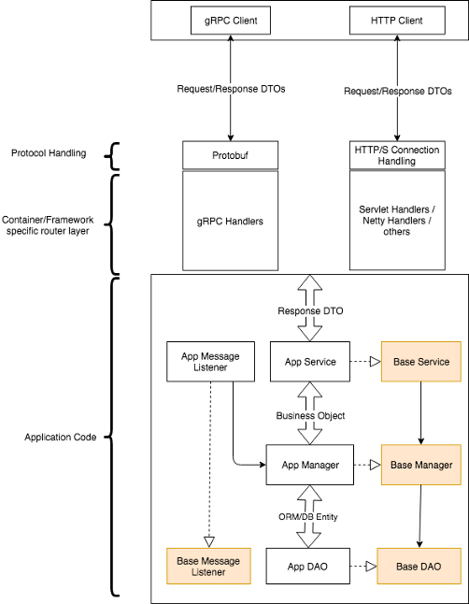
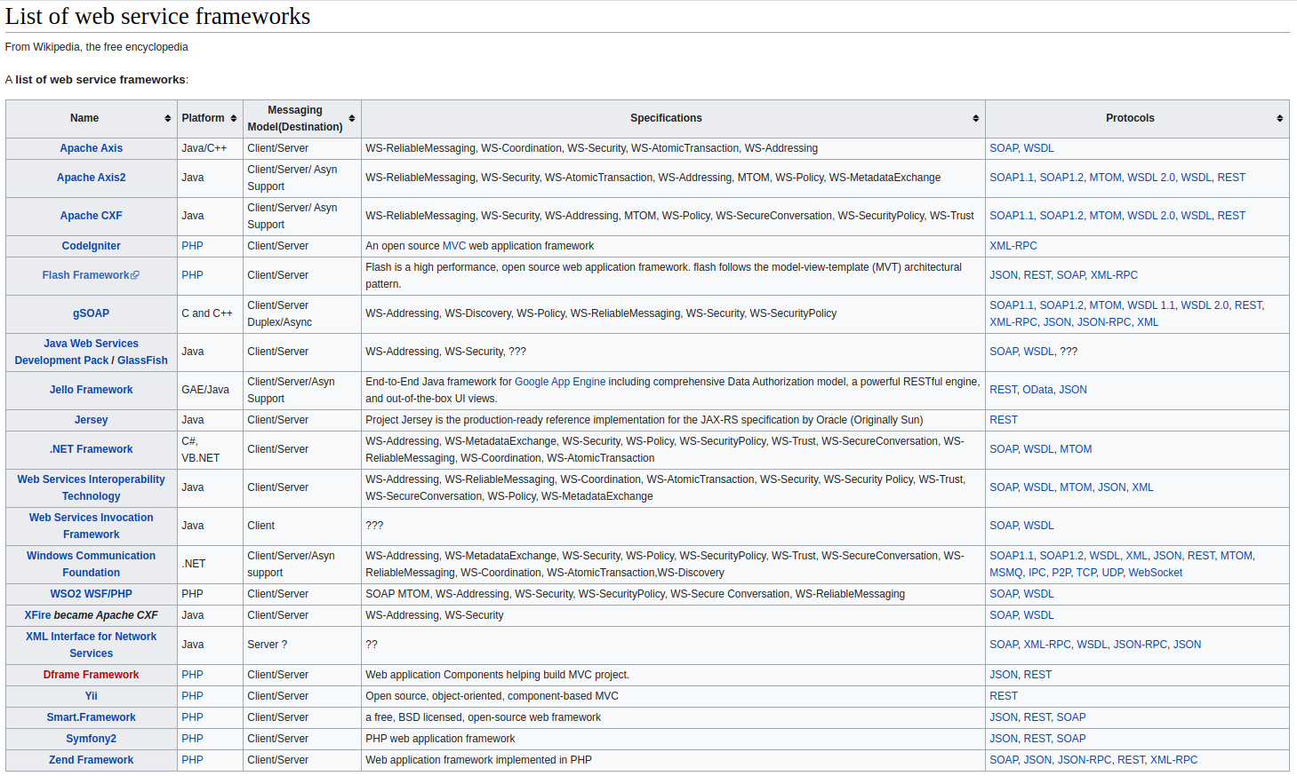
传统服务架构，随便看看

Slide 4
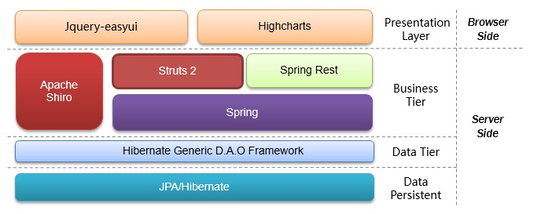
著名的SSH(spring struts hibernate)
反unix哲学

Slide 5
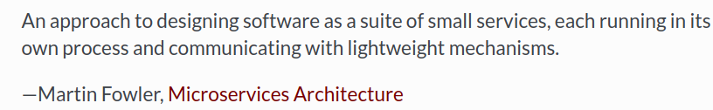
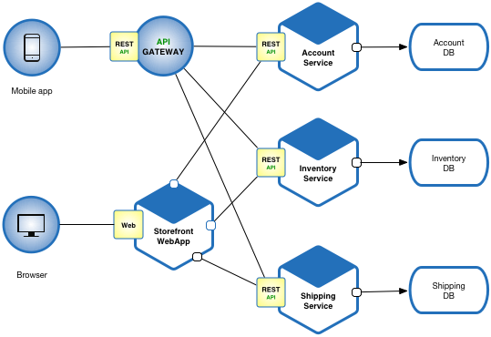
什么是微服务
伴随docker发展新生的话题
一种集成多个小服务的架构风格，主要特点：
模块化
高可维护性，可测试性
松耦合
独立可部署
根据业务逻辑划分
独立小团队管理

Slide 6
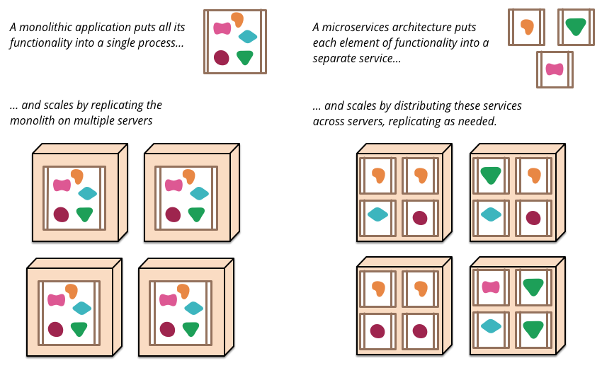
微服务 vs 宏服务：形态
https://martinfowler.com/articles/microservices.htmlhttps://martinfowler.com/articles/microservices.html

Slide 7
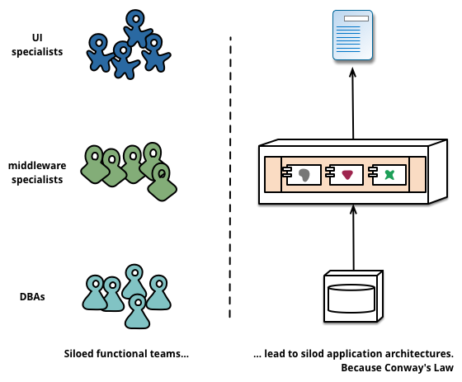
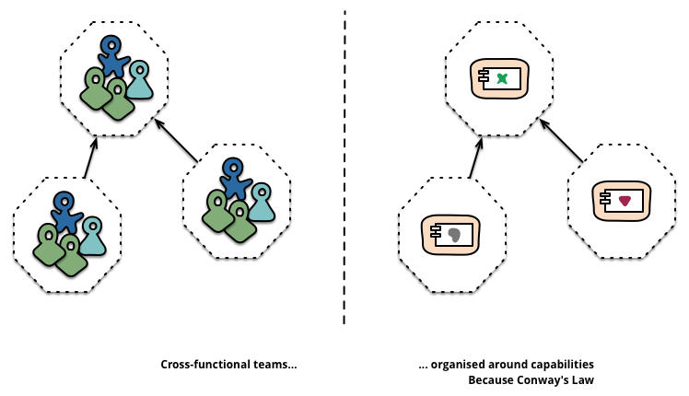
微服务 vs 宏服务：人力业务组织

Slide 8
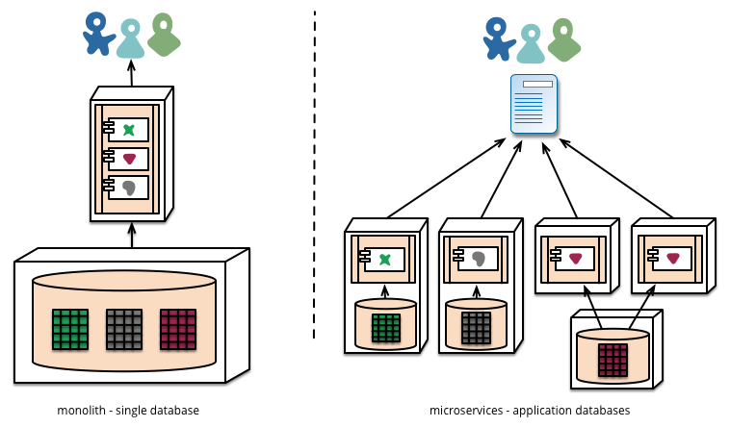
微服务 vs 宏服务：数据库划分

Slide 9
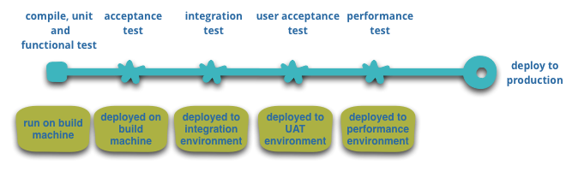
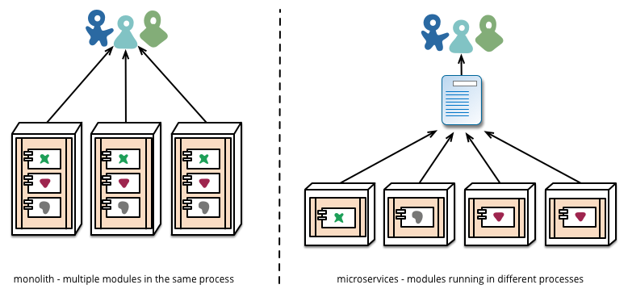
微服务 vs 宏服务：自动部署

Slide 10
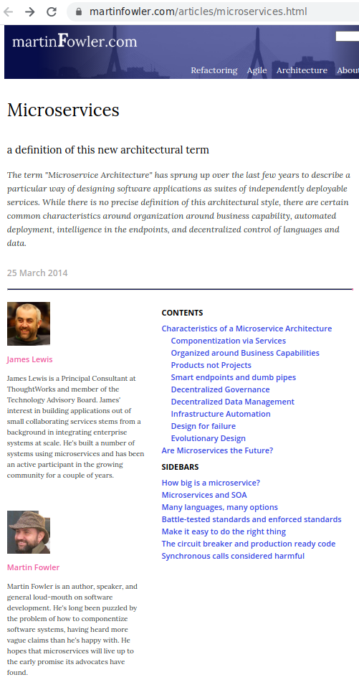

特点
Componentization via Services
vs library
out-of-process vs in-memory
explicite published interface
Organized around Business Capabilities
Products not Projects
Amazon's notation "you build, you run it"
connect users & developers
linkage business capabilities (meituan app)
Smart endpoints and dumb pipes
ESP, BPEL vs REST,RPC+lightweight MQ
Unix sense, act as filters, req+logic+rsp
MQ as message router only

Slide 11


特点
Decentralized Governance
mix different languages, database
version control, git
service contracts
Decentralized Data Management
Infrastructure Automation
Design for failure
monitoring
Evolutionary Design

Slide 12

Nameko's About Microservices
Compared with monolith service
Benefits
small and single-purpose.
unix's philosophy.
developer works on one service isnt require understanding rest things and rely on a higher-level of other services
Explicit published interface
boundary between service and callers
Individually depolyable
important for large system and long running
Specialization
specializaed instead of on-size-fits-all library can be customized and rely on

Slide 13
Nameko's About Microservices
Drawbacks
Overhead
RPC/messaging is more expensive than in-process method calls.
process spend a lot of time waiting on I/O
concurrency and eventlet. async style
Cross-service transactions
distributing transactions between processes is difficult
Corse-grained APIs
cross service boundaries is expensive and non-atomic
fewer, heavier calls vs many calls
Understanding interdependencies
Splitting application introduces the requirement to under standing how interaction among components

Slide 14
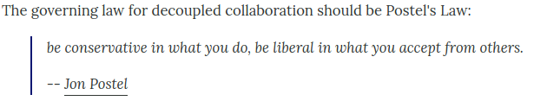
Service Evolution Pattern: TolerantReader Contract
Design for minimal breakage when evolution
Problem of schema-driven binding
e.g. add field not breaking API, but schema
solution: take the the elements you need, ignore other
make the minimal input assumption
robust allow the provider make more change not break your code

Slide 15

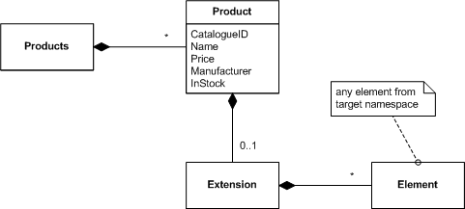
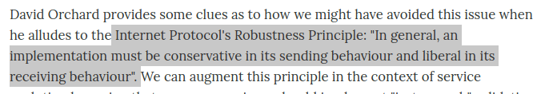
Service Evolution: Consumer-Driven
Schema Versioning
Backward compatibility check
Extension Points
Breaking Changes
conservative & liberal
Consumer-Driven Contracts
Provider Contracts
Customer Contracts

Slide 16
Consumer-Driven: Provider
For OUTPUT
Expotable elements:
Document schemas
Interfaces
message-oriented: simple operation + intelligent message
rpc: intelligent operation signatures
Conservations:
req/rep, fire & forget
stateful, remember the context, set of conversational gambits may envolved. e.g. booking a room
Policy
constraints
Quality of service characteristics(QOS)
Characteristics:
close & complete
singular and authoritative
bounded statbility and immutability

Slide 17
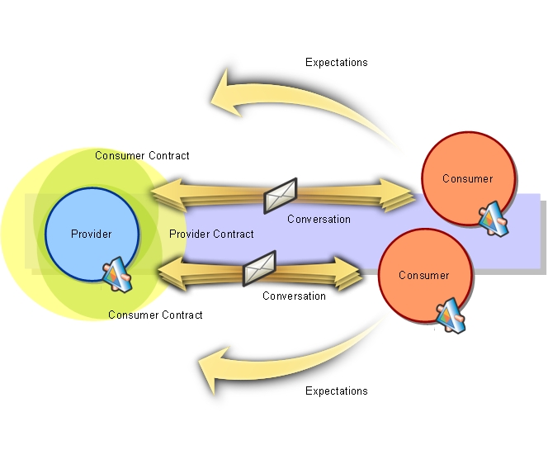
Consumer-Driven: Consumer
For INPUT
Custom expectation into provider
assertions/tests on different input cases
Chracteristics
Open and incomplete, function-oriented
Multiple and non-authoritative
bounded stability and immutability
Provider contracts emerge to meet hte consumer expections and demands. So called consumer-driven contracts

Slide 18
Consumer-Driven Implementation
Consumer expectations
captured by document
during design, development, testing of provider
unittest for assertion of each expectation
ensure contracts are described and enforced in a repeatable automated fashion
assertions ad runtime in the input/output pipeline of service
Communications will be conducted out-of-band and prior to any conversations the excise the business functionality of system.
contracts first

Slide 19
Consumer-Driven's Benefits
Focus the specification and delivery of service functionality around key business value drivers
provider is clean & minimal
only to the extent it is consumed
avoid over designed
evolution only when consumers express a clear need
Efficient in evolution
provider contracts gives fine-grained insight & rapid feedback
repository of knowlege and feedback mechanisum of lifecycle

Slide 20
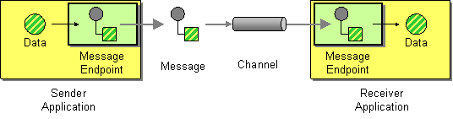

Event Collaboration
Driven by request
work like rpc,
a component needier make requests, get the response from other component
Driven by event
components raise events when thing change, other component listen the events and react appropriately
Different interaction paradiam between Components

Slide 21

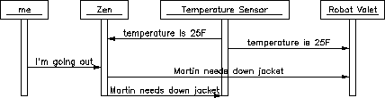
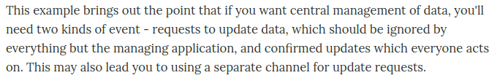
How it Works
Request
need to know the peer
Event
broadcast the event
dont know the receiver
Command vs Queue
where data stored. Data structured, history, accessibility...
replicated. Event cant wait you back online but requests cant.
Event Cascade
trigger one by one
Invisible call chain, something indirect happen
visualization tools, graph of event chains

Slide 22
Why Event Collaboration
Great strength/weakness is loosely coupling between components.
Easy to add new components
just listen to events on event bus
existing components without knowing the new arrivals
Keep each component simple
all is the events, dont care anyone else is listening
focus one component at a time for develop
Resilient to breakdowns
two-edged sword
continue operating(event style) or breaking down(request style)

Slide 23
Why not Event Collaboration
Component is simple, interactions are complex.
interactions are not clear by reading source code compared with request collabration
callback like
dont know who is listening untile run-time
find links in configuration data
hard to find understanding and debug e.g. mutliple terminal, seperate debug
automated tools display configuration at run time
lot replicated of data
each one stores all data it needs
saved also in user side
solution: shared memory

Slide 24
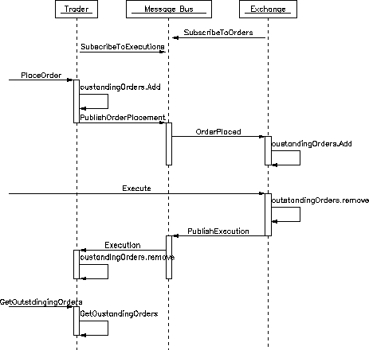
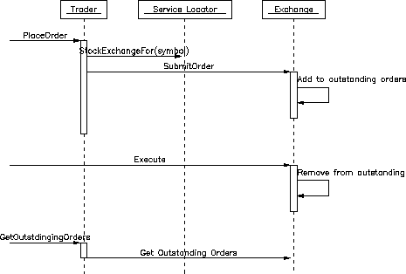
Example

Slide 25
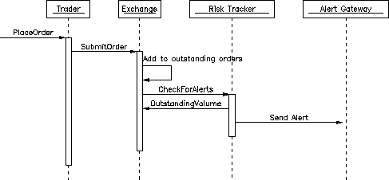
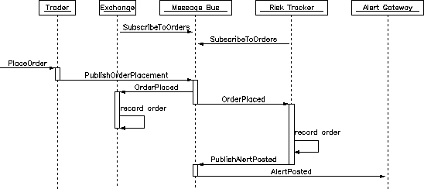

Slide 26
Compared with Requests collaboration
Implicit vs Explicit
Compile Time vs Runtime
Static vs Dynamic
no need modifing existing components
stated can be appropate maintained in each component, lower the amount of inter-component calls.
information in container can be message, state
The implicit behavior's dark side.
since you can't see it, you don't see what changes need to be made when you modify it. can also be hard to debug, again because the flow of logic isn't made explicit in code.
Can't evaluate the impact easily.
bad for evolution
callback hell, synchronization from multiple messaging source
Trade-off
some changes easier, but others harder.

Slide 27
conclusion
中庸之道。结合 Event & Request，每个模块应该根据实际情况提供RPC或者event_handler
以event为主，顶层设计采用event模块，实现松耦合。但不排除RPC手段，引入其带来的优势
严格控制event的模块数量以及他们之间的交互关系复杂度。
主模块不超过5个的时候event协作可以清晰的被定义
可视化信息流工具
共享内存/文件
无需返回值的地方message, 复杂返回值的地方用rpc
强耦合，层次化的耦合用RPC, 弱耦合用event

Slide 28
Learned
monolith service vs microservice
event vs requests
message vs state
contracts first
rpc/req-rsp contract
message/event contract
shared memory/files contract

Slide 29
Microservices: 和谐共处的小而美

