Slide 1
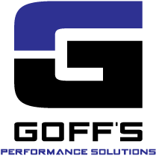



DalFort Capital Partners
Firm Overview
February 2026

Slide 2

DalFort Capital Partners (“DalFort”) Overview
Who We Are
Dallas‑based investment firm focused on building leading lower middle market industrial businesses by investing alongside founders, families, and entrepreneurs
Founded in 2016 with a long-term, growth-oriented investment philosophy
Experienced team with a deep history of partnering with companies through growth and transition, including founder succession, leadership development, and professionalization
Active investors with a track record of building multi-acquisition platforms
What We Look For and What We Bring
Businesses with strong core operations, differentiated products, and committed leadership
Fragmented end markets where scale, systems, and capability expansion create opportunity to build stronger, more competitive companies
Capital, experience, and resources to support organic growth and strategic add‑on acquisitions while assisting with post-close integration efforts
A repeatable approach to helping companies evolve from founder-led businesses into scaled platforms supported by improved leadership depth, systems, and org. structure
How We Partner with Operators
Management teams continue to lead day-to-day operations
We serve as a strategic partner on growth, acquisitions, and organizational evolution
Decisions are made collaboratively, with an emphasis on long-term value and business durability ensuring alignment between ownership and management on strategic priorities
Our involvement scales based on what the company and management team need
DalFort’s approach is collaborative rather than prescriptive, built around the specific needs of each business and its leadership team.
2

Slide 3
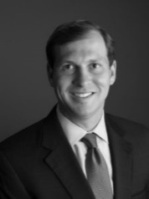
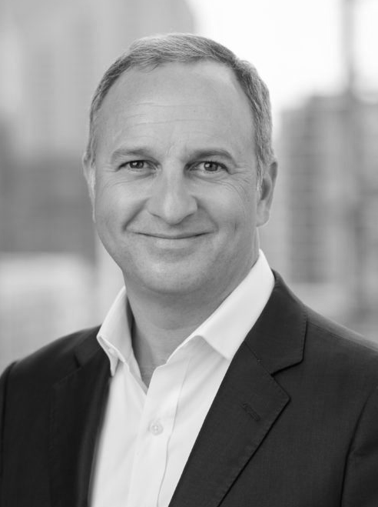
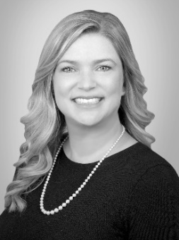
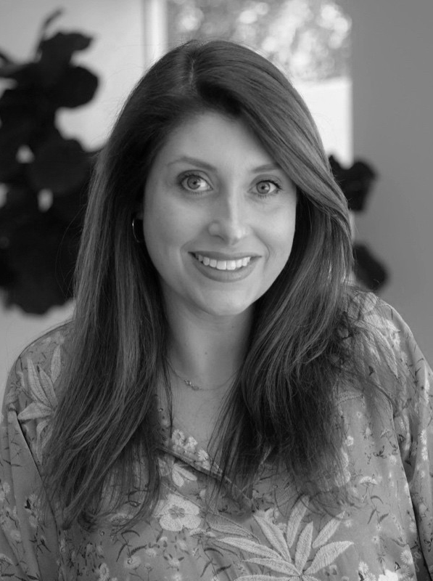
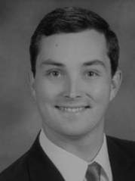
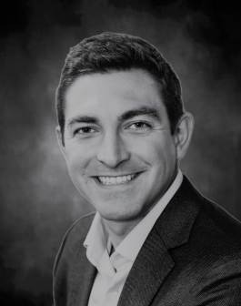
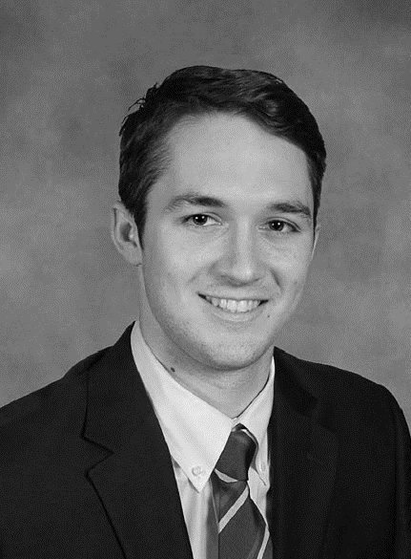
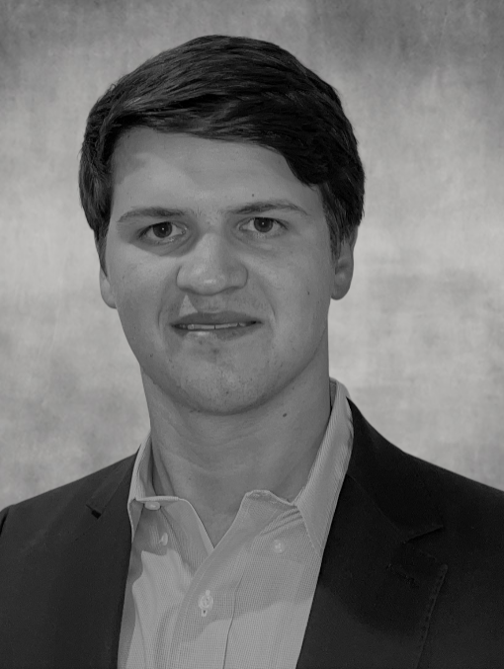
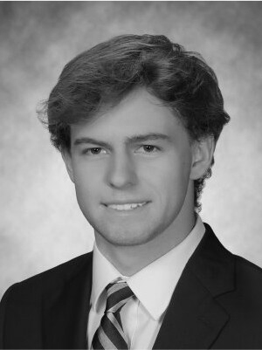
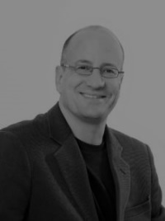
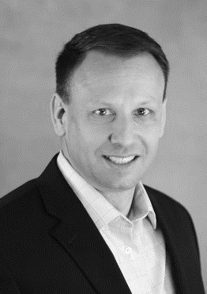
The DalFort Team
Bryan Bailey
Partner
Education
BBA University of Central Arkansas
MBA SMU
Past Experience
Capital Southwest Corp. (NASDAQ:CSWC)
Marquez Bela
Partner
Education
BA University of Texas
BBA University of Texas
Past Experience
Rosewood Private Investments
Capital Southwest Corp.
Covalent Capital
SKM Growth Investors
Goldman Sachs
Hillary Brown
Chief Financial Officer
Education
BBA Texas A&M
MS Texas A&M
Past Experience
Ernst & Young
Goldman Sachs
Kelly Cotner
Chief of Staff
Education
BA University of
Alabama
Past Experience
Texas Capital Bank
U.S. House of Representatives
Jack Lindsley
Vice President
Education
BBA Texas A&M
MS Texas A&M
Past Experience
Wells Fargo Securities
Preston Arnold
Vice President
Education
BBA Baylor University
Past Experience
Blue Sage Capital
Raymond James
Tyler Forcum
Senior Associate
Education
BBA SMU
Past Experience
Stronghold Investment
Management
BofA Securities
Wills Thompson
Associate
Education
BBA SMU
Jack Richards
Analyst
Education
BBA University of Missouri
Morris Wheeler
Senior Fund Advisor
Education
BA UMass
JD Yale Law School
Past Experience
VersaFlex
Cohesant
Drummond Road Capital
Rob Pawlak
Operating Partner
Education
BA University of Indiana
MBA University of Indiana
Current Board Seats
Key Polymer, API, Polymer Adhesives
Past Experience
VersaFlex
Raven Lining Systems

Slide 4


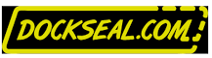
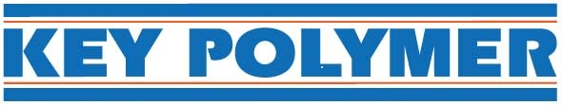














DalFort Investment Experience
Status | Platform | Company | Investment Date | Description
Current Investments |  |  | May 2023 | Manufacturer of duct sealants, adhesives, and fire-stopping materials
 |  |  | January 2025 | Manufacturer and formulator of solvent- and water-based adhesives
 |  |  | August 2025 | Manufacturer and formulator of two-part epoxy systems.
 |  |  | May 2023 | Manufacturer of doors, dock seals, dock shelters, curtains, and screens
 |  |  | January 2024 | Manufacturer of loading dock seals and shelters
 |  |  | August 2023 | Formulator and value-added distributor of specialty chemicals
 |  |  | October 2023 | Manufacturer and distributor of lubrication equipment and systems
Realized Investments |  |  | October 2019 | Manufacturer of water, urethane, and epoxy-based adhesives and sealants
 |  |  | December 2020 | Manufacturer of proprietary industrial lubricants and greases
 |  |  | September 2021 | Manufacturer of specialty chemicals, adhesives, and coatings
 |  |  | November 2022 | Manufacturer of custom, water-based coatings and adhesives
 |  |  | January 2025 | Manufacturer of custom engineered adhesives and sealants
 |  |  | December 2016 | Manufacturer of mechanical air movement and control products
 |  |  | September 2017 | Manufacturer of architectural louvers, brake metal, sunshades, and grilles
 |  |  | December 2019 | Manufacturer of air, sound, and evaporative cooling control products
 |  |  | October 2020 | Manufacturer of ultraviolet germicidal irradiation (UVGI) products
 |  |  | April 2021 | Manufacturer of shutters, dampers, louvers, and air movement equipment
 |  |  | March 2017 | Manufacturer of protective coatings, linings, joint fillers, and materials
 |  |  | December 2017 | Manufacturer of cementitious coatings, linings, primers, and sealers
 |  |  | September 2018 | Manufacturer and distributor of resinous floor and wall coatings
 |  |  | April 2019 | Manufacturer of spray-applied elastomers, foams and equipment

Slide 5
How DalFort Partners with Teams to Build Enduring Platforms
Our role is to support management teams with the resources, experience, and capital needed to execute ambitious growth plans.
Value Lever | How We Support | Illustrative Partner Outcomes
Strategic Add-Ons & Capability Expansion | Pursue targeted acquisitions that expand product offerings, deepen customer relationships, and open new channels and geographies. | VersaFlex completed 3 add-on acquisitions, expanding end markets and capabilities. United Enertech completed 4 add-ons, broadening its product portfolio and geographic reach. Key Polymer completed 4 add-ons, expanding its specialty formulations and customer base. Polymer Adhesives completed 2 add-ons, strengthening its position in HVAC and construction sealants. Goff’s Enterprises completed 1 add-on, vertically integrating seal and shelter product lines.
Leadership & Organizational Upgrade | Build high-impact leadership teams and governance structures to accelerate growth and professionalize founder-led businesses. | United Enertech recruited former presidents from Ruskin (JCI) and AWV, A Mestek Company. Key Polymer recruited a new President from Bostik, our prior CFO from VersaFlex, VP of Development, and a broader bench of senior leaders to drive growth and strategic execution. Goff’s Enterprises transitioned from a founder-led model by hiring a new CEO, VP of Sales, and CFO to professionalize leadership and strengthen financial oversight. Oil-Rite recruited a CFO and VP of Sales to enable financial oversight and drive commercial expansion.
Operational Efficiency & Facility Optimization | Streamline operations, rationalize footprints, and drive margin expansion through disciplined cost and asset initiatives. | VersaFlex rationalized its footprint from 7 facilities to 3, consolidating 4 plants into existing operations to optimize utilization and reduce overhead. Key Polymer consolidated 2 facilities into its existing footprint and began integrating a third production facility (Durant) in Q3 2025 to further enhance utilization and efficiency. Polymer Adhesives is actively integrating Fielco Adhesives’ plant into its existing Lafayette, TN facility.
Technology & Process Modernization | Deploy modern ERP systems, automation, and digital tools to improve visibility, control, and scalability. | VersaFlex implemented Macola ERP and OneStream for consolidated reporting and real-time visibility. United Enertech deployed Microsoft Dynamics ERP across its entire platform, modernizing core systems to support scalable growth and real-time decision-making. Key Polymer upgraded operations to BatchMaster, enhancing inventory control and production planning. Goff’s migrated from SAP to NetSuite with a custom CPQ to streamline quoting and sales conversion. DalFort implements annual audit and tax planning processes across all portfolio companies.

