Slide 1
Trouble shooting notes for E2E aptos DAPP

Slide 2
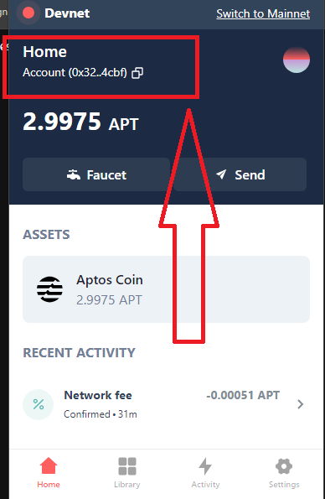

Slide 3
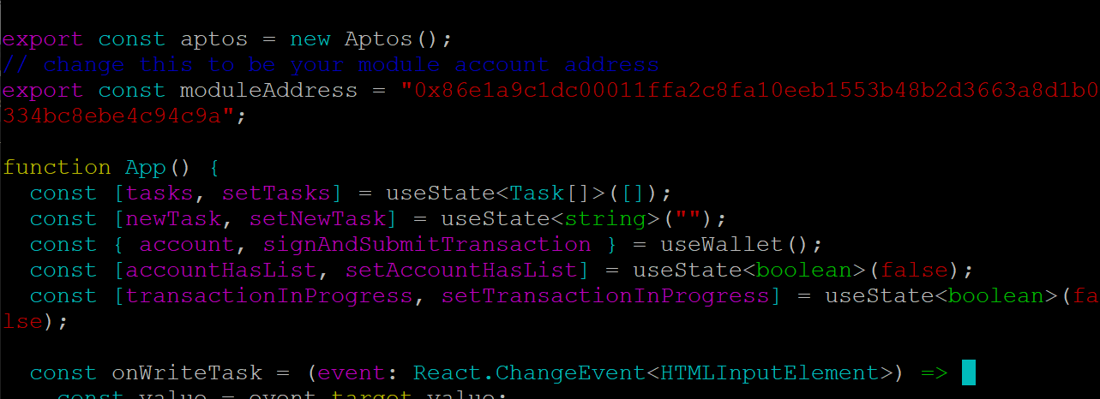

Slide 4
https://fullnode.devnet.aptoslabs.com/v1/accounts/f55cd6df0a44ae71196a932b6b1f9dea475de17e09d891fac75b22ac80a9318c/resource/0xf55cd6df0a44ae71196a932b6b1f9dea475de17e09d891fac75b22ac80a9318c::message::MessageHolder
Format:
https://fullnode.devnet.aptoslabs.com/v1/accounts/<petra wallet account address> /resource/<module_address/ generated contract address>::todolist::TodoList
https://fullnode.devnet.aptoslabs.com/v1/accounts/32d7b4d680421ab763089adc75404daa588ee3a043907a2d2359cd8ce7994cbf/resource/0xe3989b8a7d3b521b7a0debc7abd3be1bc31b8282f5cf7dc363fd3431320e1301::todolist::TodoList

Slide 5
