Slide 1
Heroku How to generate an authorization key

Slide 2
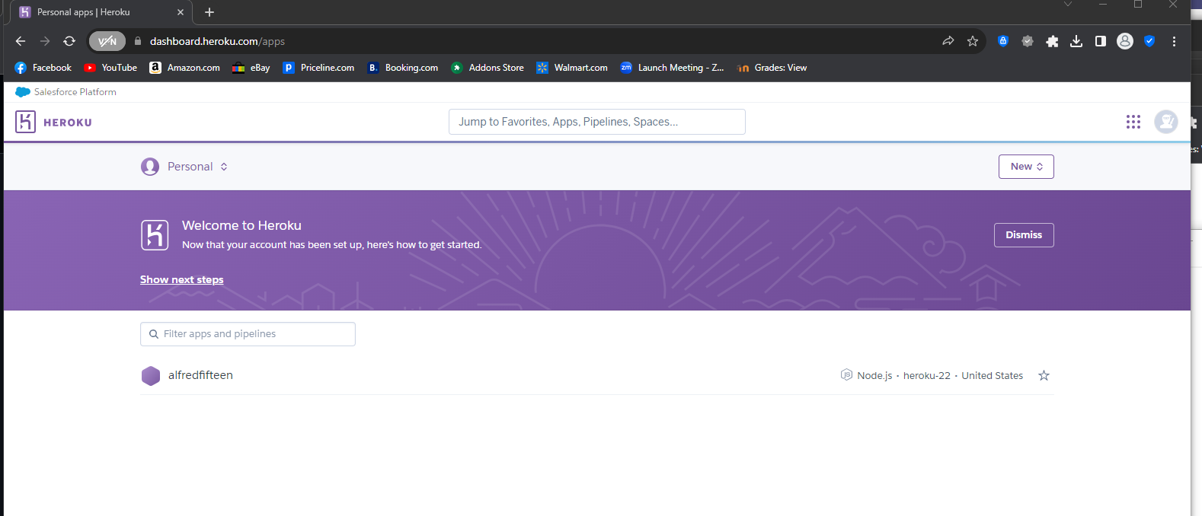
Click rightmost icon

Slide 3
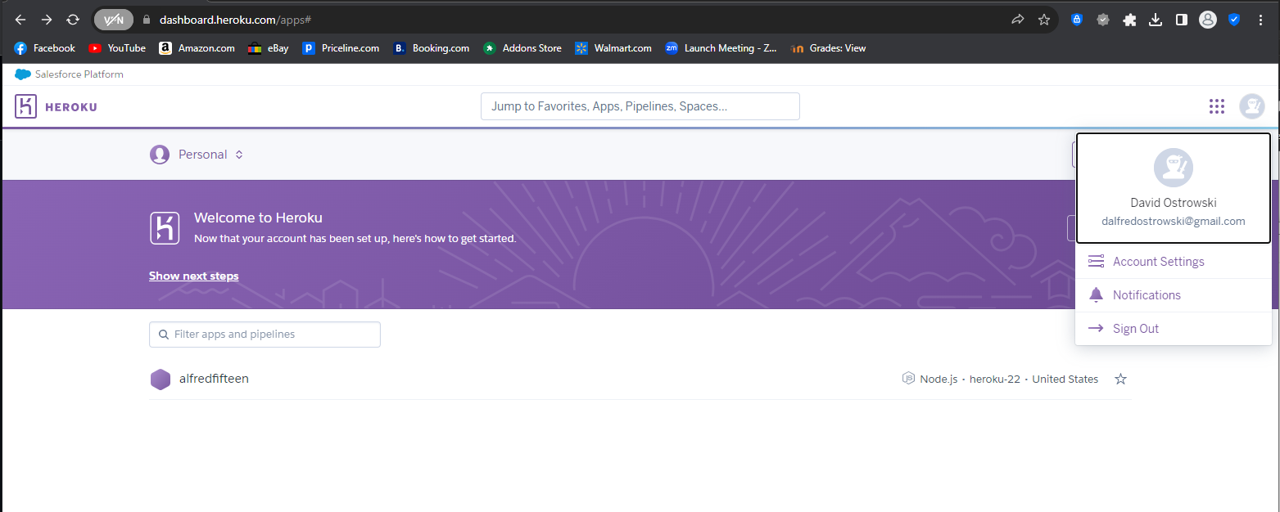
Click account settings

Slide 4
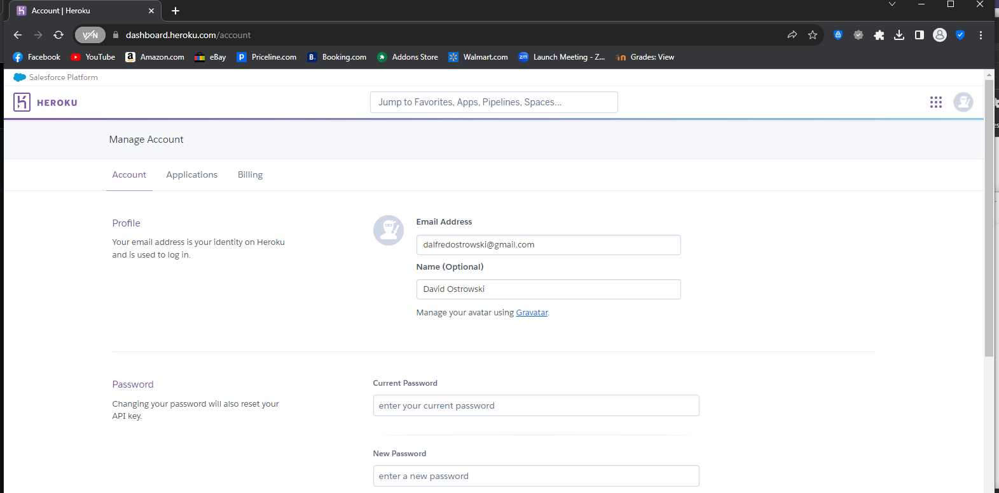
Click
applications

Slide 5
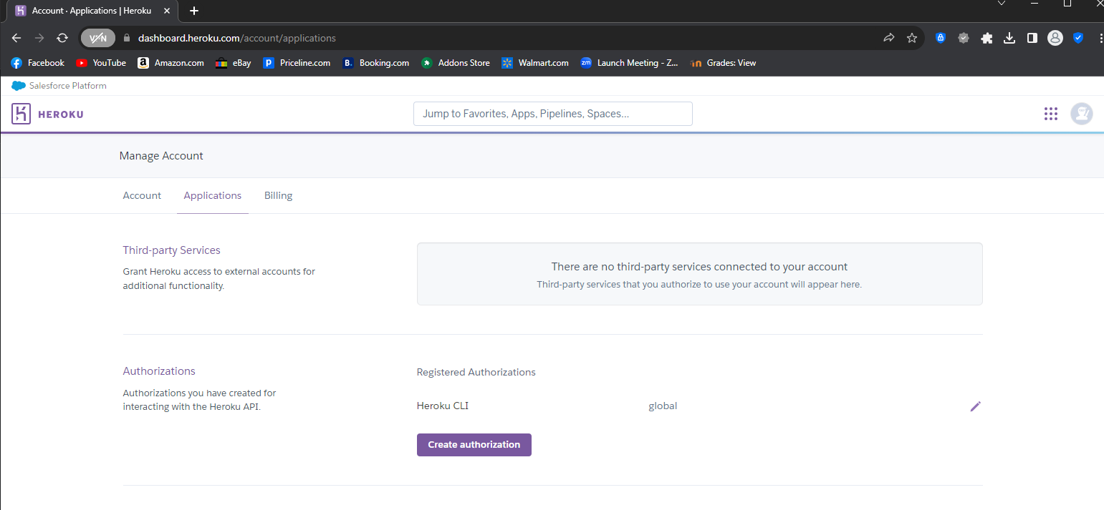
Choose
“create
Authorization”

Slide 6
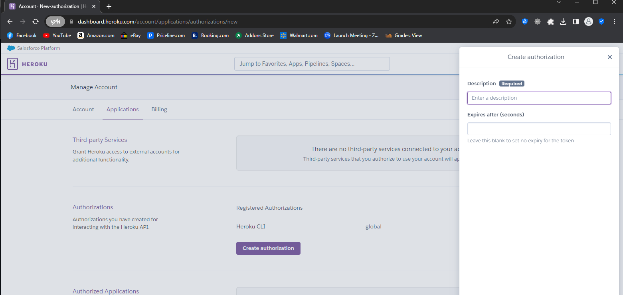
Enter text for
description
Your authorization code will appear here
(cut / paste for ‘password’ as described in video!)
Click create
(not shown here but is below on page)

