Slide 1
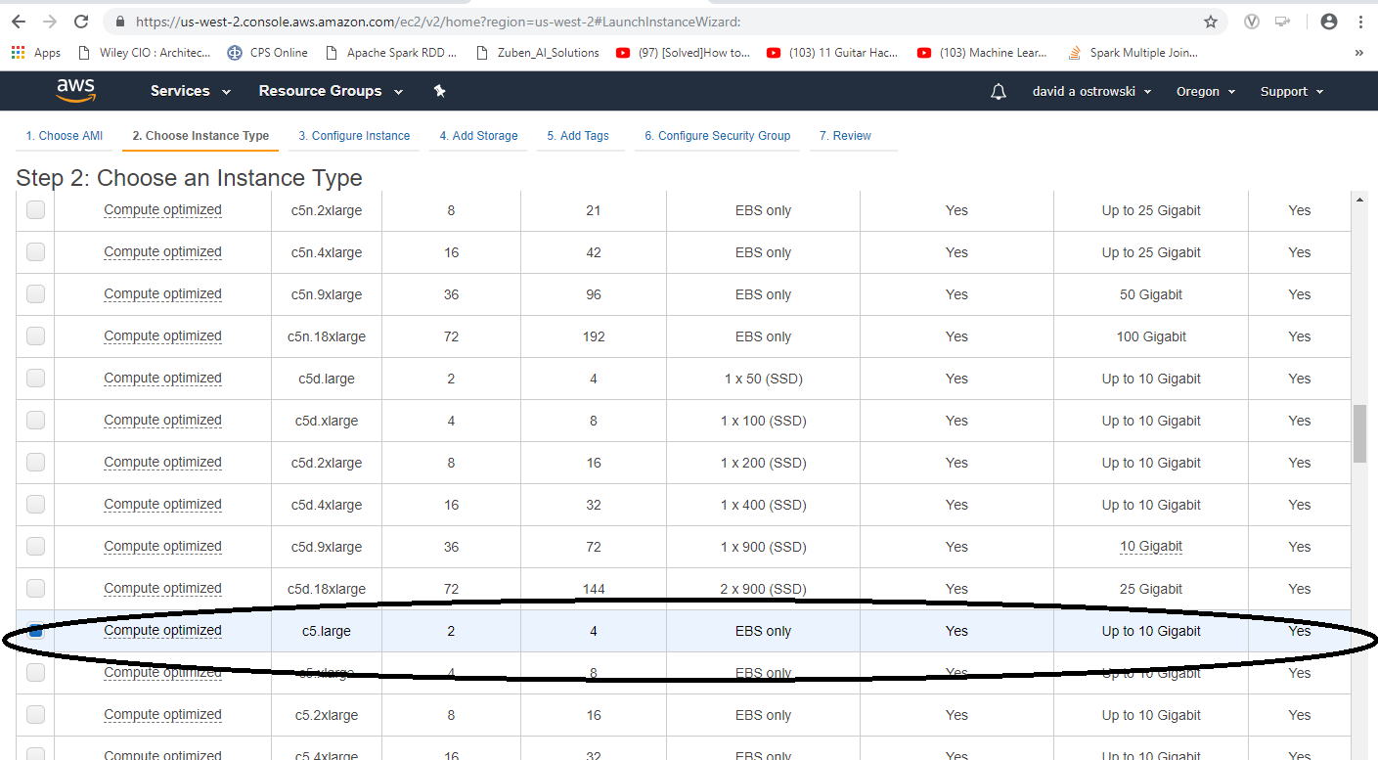
“my” installation

Slide 2
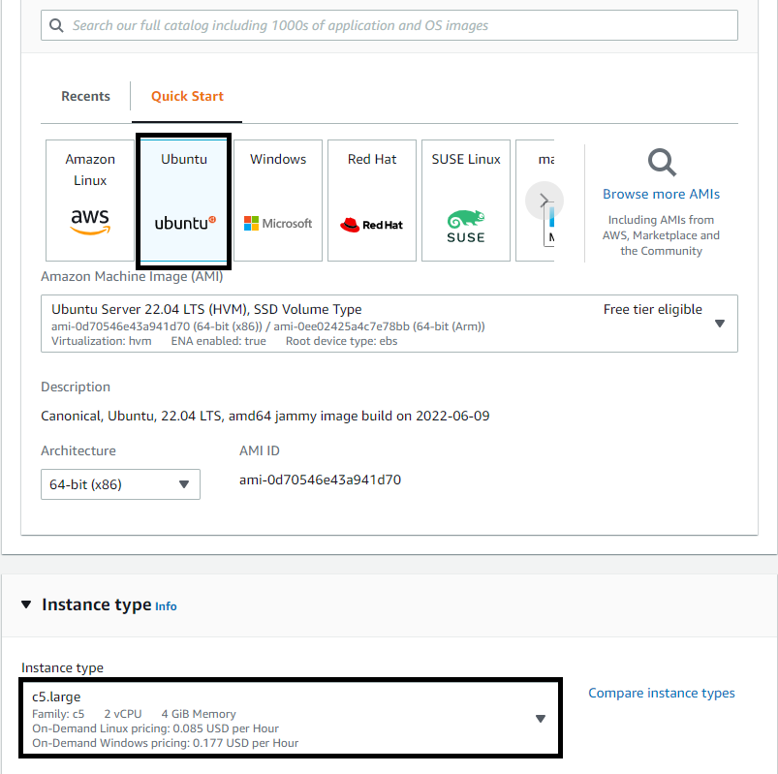
Starting steps
I used a c5.large

Slide 3
curl -sL https://deb.nodesource.com/setup_14.x -o nodesource_setup.sh
sudo bash nodesource_setup.sh
sudo apt install nodejs
sudo apt install npm <- skip this – just giving errors
npm install webpack@3.0.0
npm install webpack-cli@3.0.8 --legacy-peer-deps
npm install node-gyp@3.6.2
npm install truffle@5.1.39
npm install web3
npm install create-react-app

Slide 4
./node_modules/.bin/create-react-app packt
npm s
./node_modules/.bin/ganache-cli --port 8545 --chainId 5777 –h

Slide 5
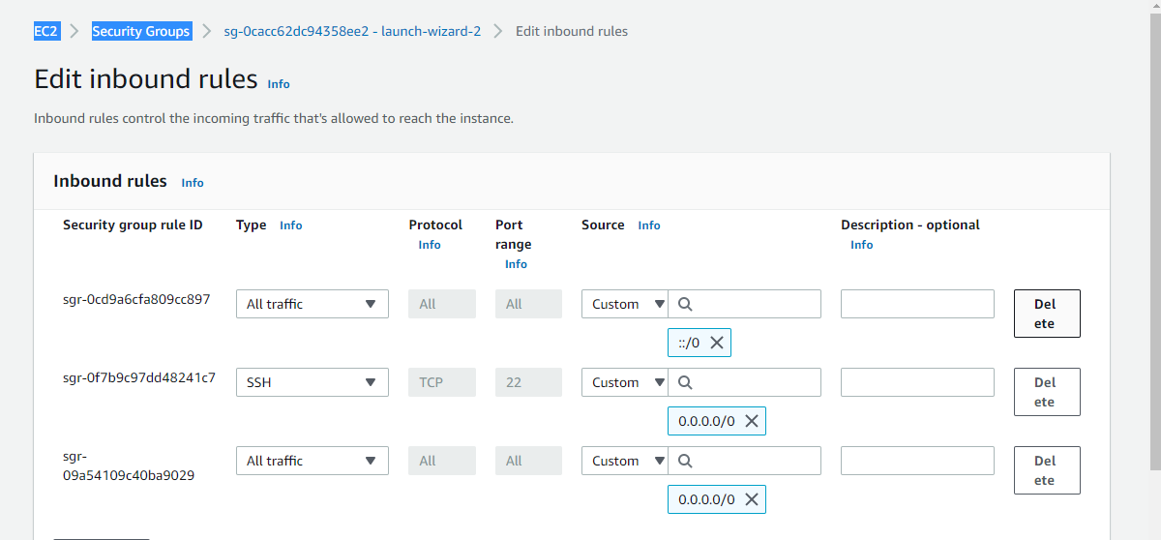
Edit my security rules

Slide 6
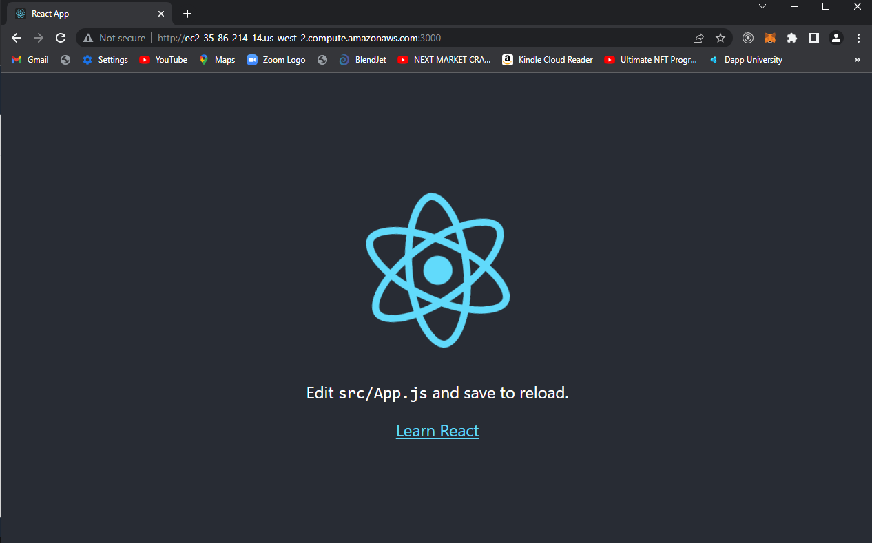

Slide 7
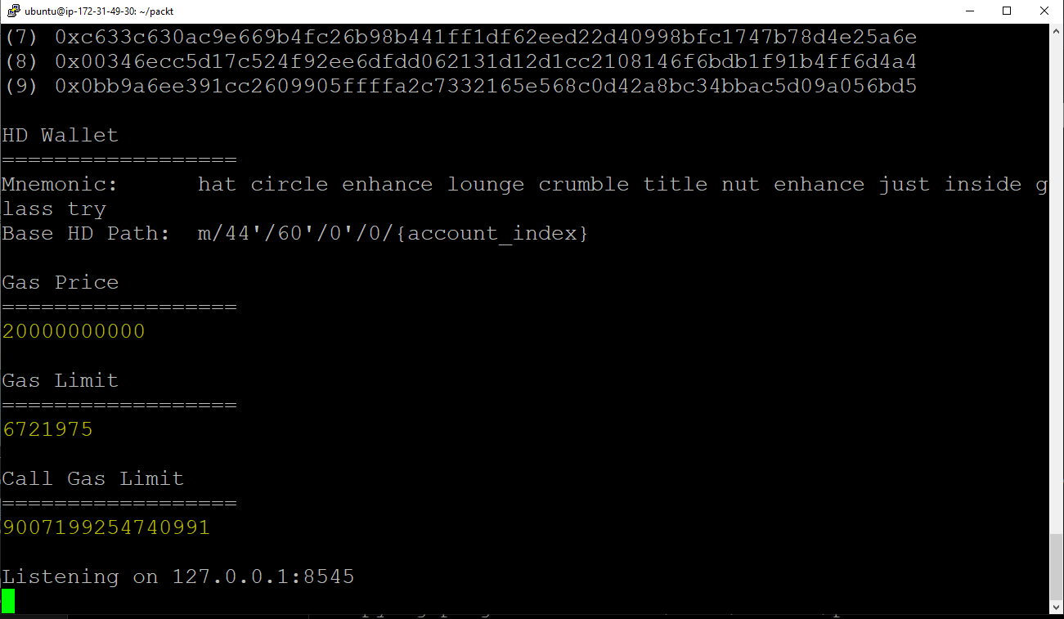

Slide 8
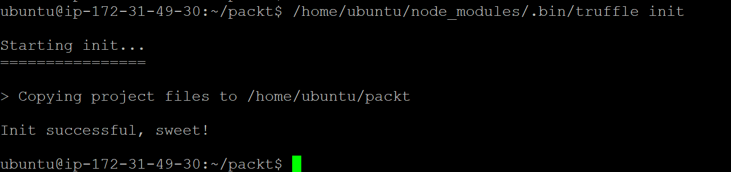

Slide 9
Edit the truffle-config.js

Slide 10
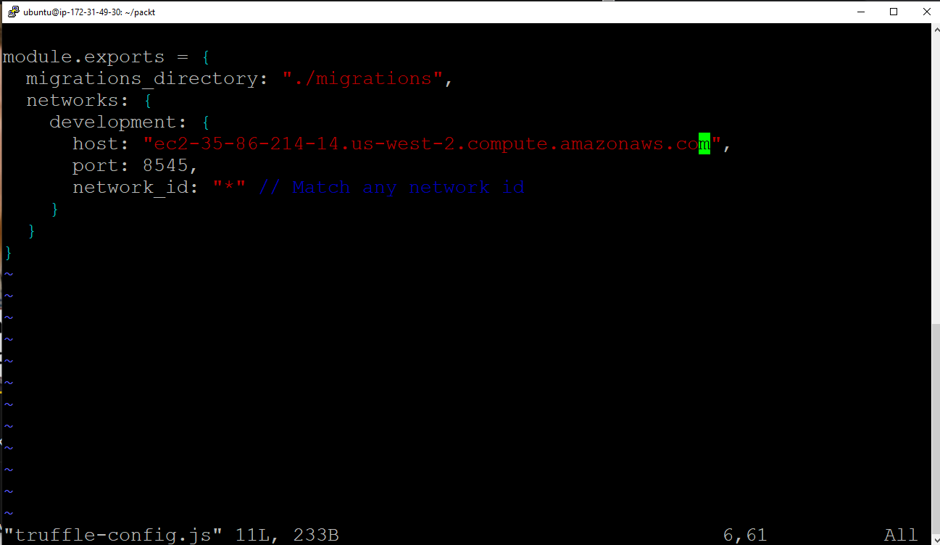

Slide 11
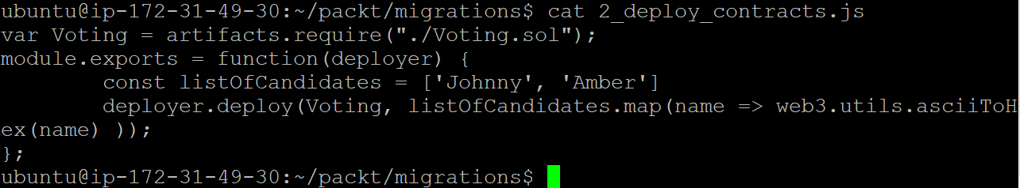
Goto migrations directory and add “2_deploy_contracts.js” file

Slide 12
Review so far….
1. run through basic install(s)
2. create base (root) project directory
3. from root project directory:
/home/ubuntu/node_modules/.bin/truffle init
This will create contracts
It will include the Migrations.sol
This will create migrations
1_* file
Copy it to make a 2_(deploy) file

Slide 13
My last problem - below was that it needed a parameter in the migration (deploy) file
ubuntu@ip-172-31-15-252:~/packt2/migrations$ cat 2_deploy_contracts.js
var Voting = artifacts.require("./Voting.sol");
module.exports = function(deployer) {
const listOfCandidates = ['Johnny', 'Amber']
deployer.deploy(Voting, listOfCandidates.map(name => web3.utils.asciiToHex(name) ));
};
ubuntu@ip-172-31-15-252:~/packt2/migrations$

Slide 14
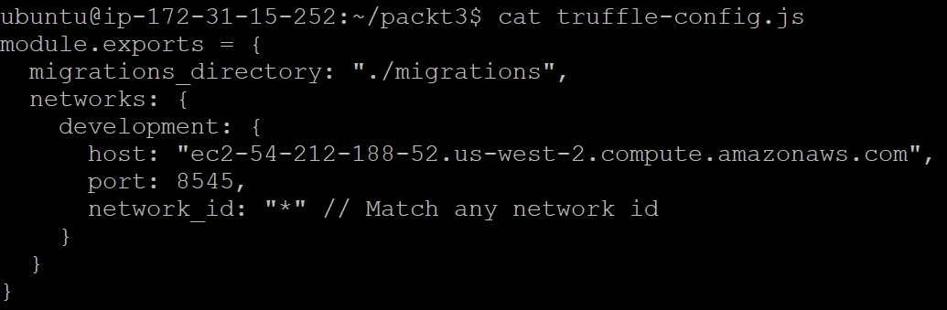

Slide 15
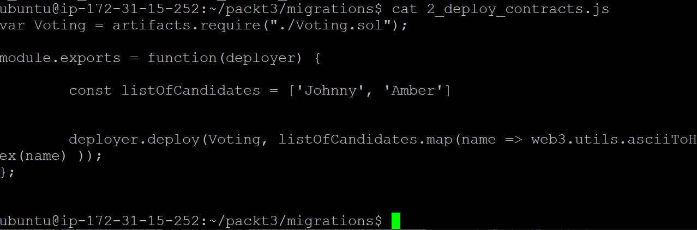

Slide 16
Now put my contract file

Slide 17
pragma solidity ^0.6.4;
// We have to specify what version of compiler this code will compile with
contract Voting {
/* mapping field below is equivalent to an associative array or hash.
The key of the mapping is candidate name stored as type bytes32 and value is
an unsigned integer to store the vote count
*/
mapping (bytes32 => uint256) public votesReceived;
/* Solidity doesn't let you pass in an array of strings in the constructor (yet).
We will use an array of bytes32 instead to store the list of candidates
*/
return false;
}
}

Slide 18
bytes32[] public candidateList;
/* This is the constructor which will be called once when you
deploy the contract to the blockchain. When we deploy the contract,
we will pass an array of candidates who will be contesting in the election
*/
constructor(bytes32[] memory candidateNames) public {
candidateList = candidateNames;
}
// This function returns the total votes a candidate has received so far
function totalVotesFor(bytes32 candidate) view public returns (uint256) {
require(validCandidate(candidate));
return votesReceived[candidate];
}
// This function increments the vote count for the specified candidate. This
// is equivalent to casting a vote
function voteForCandidate(bytes32 candidate) public {
require(validCandidate(candidate));
votesReceived[candidate] += 1;
}
function validCandidate(bytes32 candidate) view public returns (bool) {
for(uint i = 0; i < candidateList.length; i++) {
if (candidateList[i] == candidate) {
return true;
}
}

Slide 19
You should now have your two Json files (Voting, Migration)
When I run the truffle migration and deploy under the ‘build’ directory I have a *.json with the appropriate ABI and contract number

Slide 20
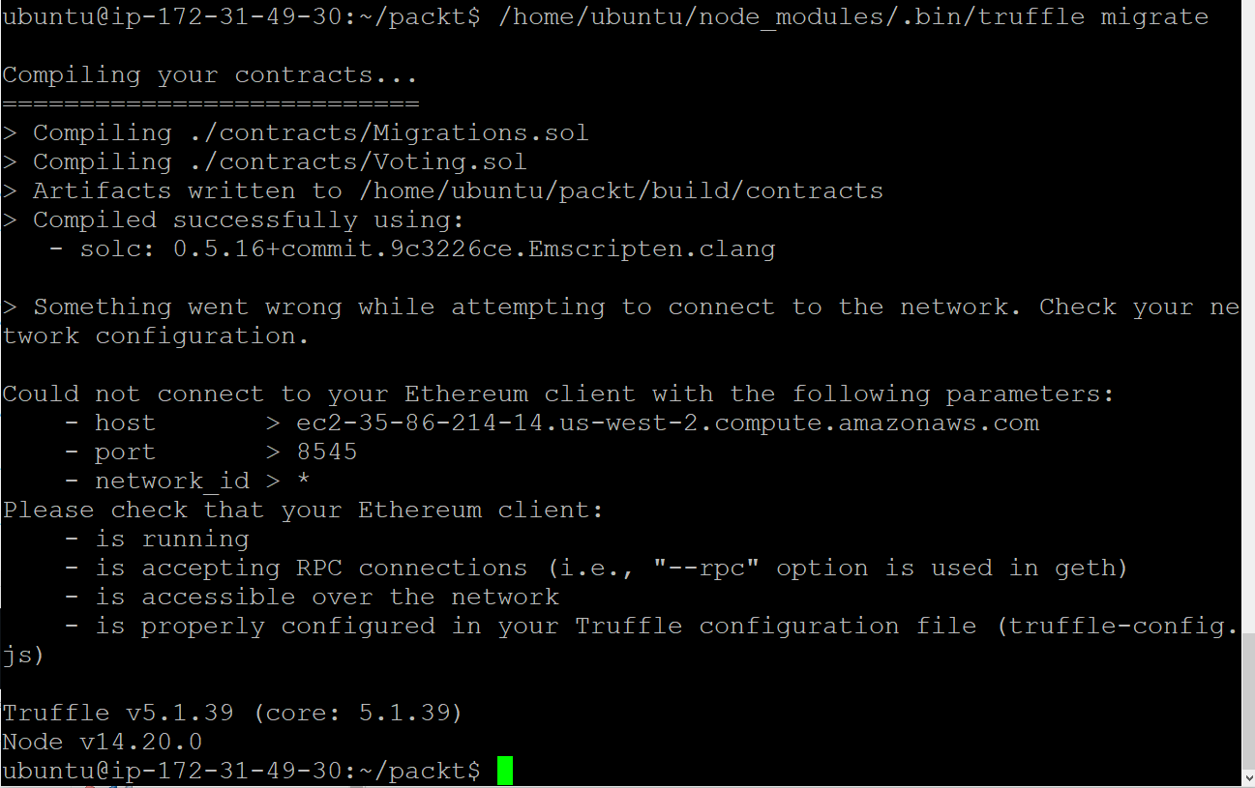

Slide 21
Solution!
Do NOT forget the –h before the amazon DNS!

Slide 22
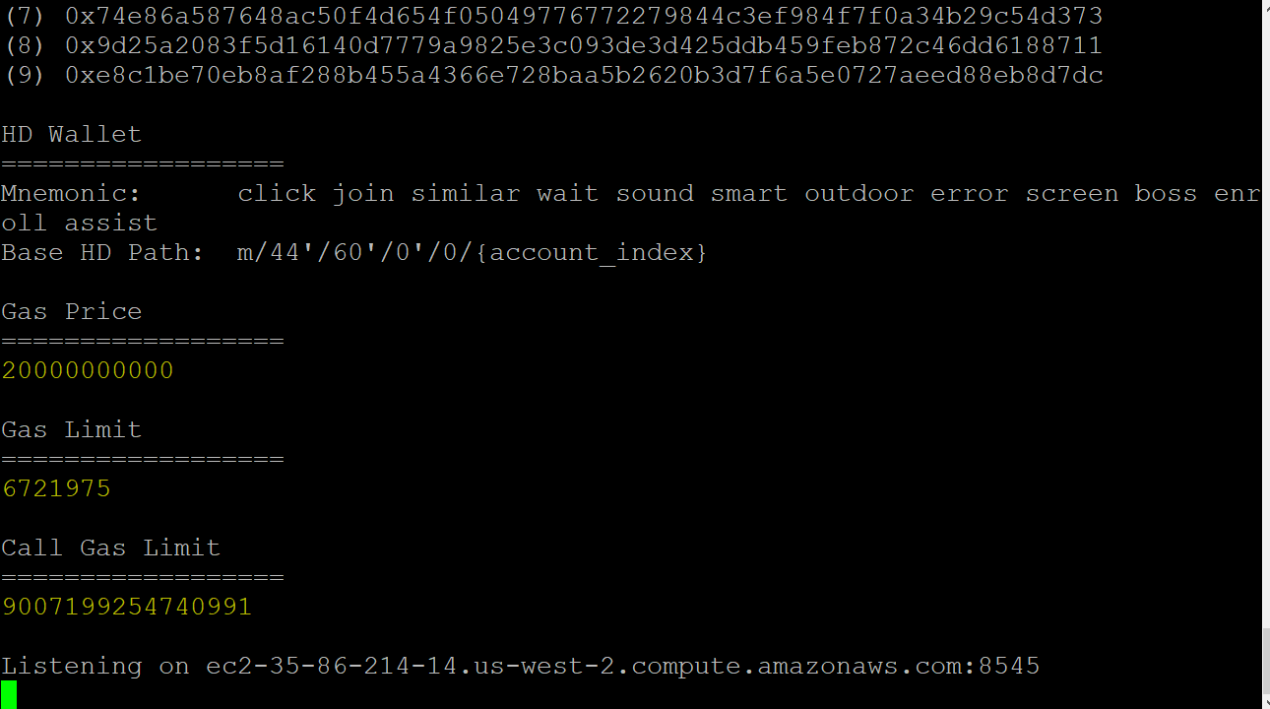
You should have the ‘listening’ message at the bottom!”

Slide 23
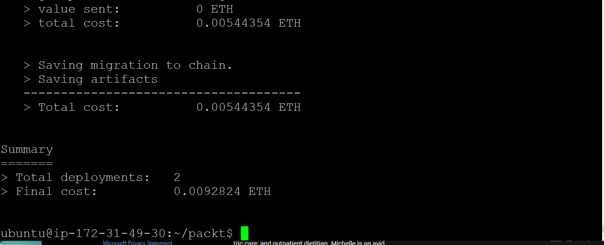

Slide 24
Now, set up my App.js
I need the compiled JSON
I need the ABI
Both are found in the newly generated Voting.json (compiled contrac JSON file)

Slide 25
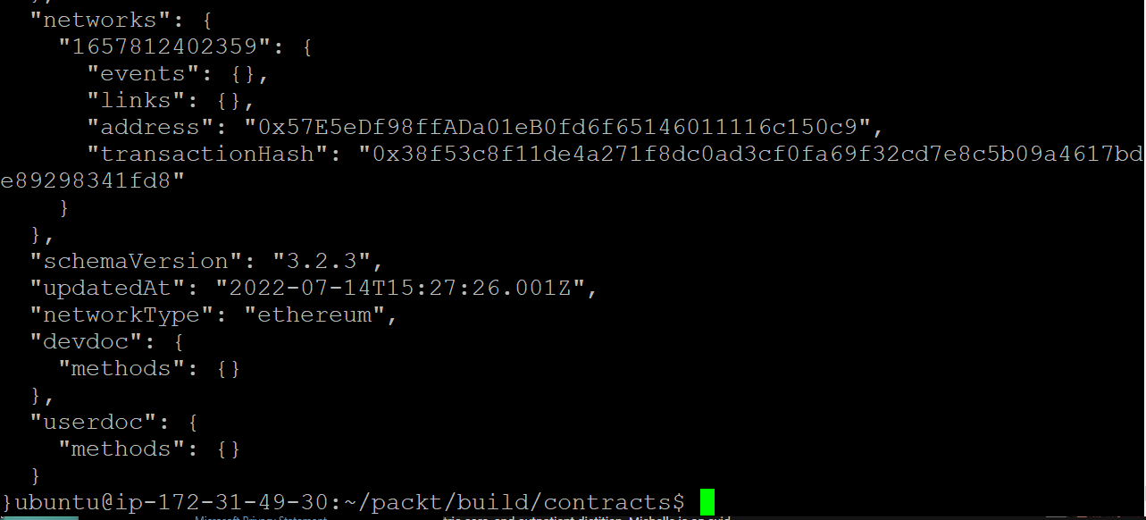

Slide 26
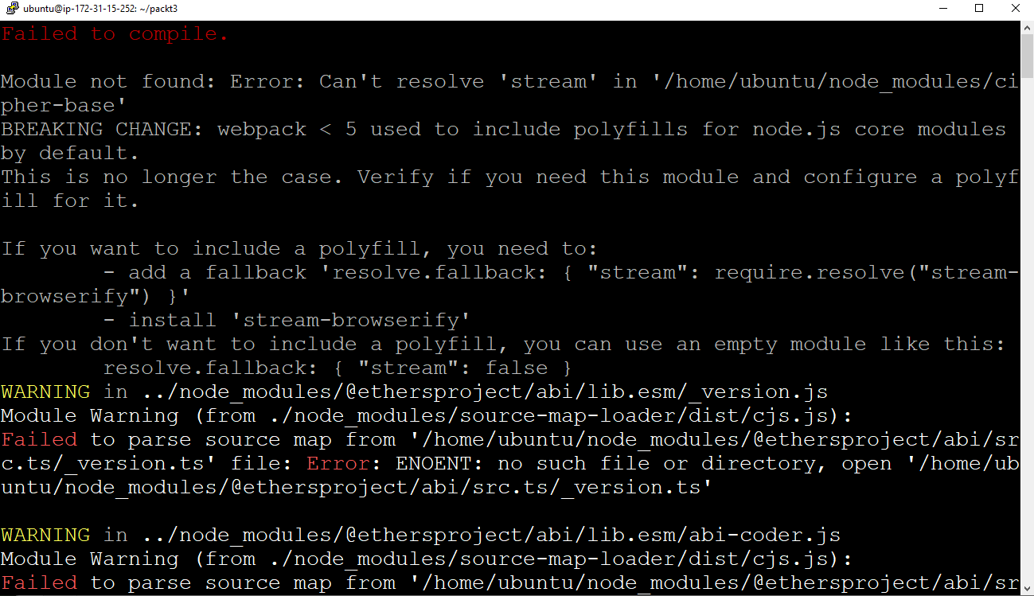

Slide 28
https://www.alchemy.com/blog/how-to-polyfill-node-core-modules-in-webpack-5
https://www.alchemy.com/blog/how-to-polyfill-node-core-modules-in-webpack-5

Slide 29
npm install --save-dev react-app-rewired
npm install --save-dev crypto-browserify stream-browserify assert stream-http https-browserify os-browserify url buffer process

Slide 30
Override the create-react-app webpack config file In the root folder of your project, create a new file called config-overrides.js, and add the following code to it:
const webpack = require('webpack');
module.exports = function override(config) {
const fallback = config.resolve.fallback || {};
Object.assign(fallback, {
"crypto": require.resolve("crypto-browserify"),
"stream": require.resolve("stream-browserify"),
"assert": require.resolve("assert"),
"http": require.resolve("stream-http"),
"https": require.resolve("https-browserify"),
"os": require.resolve("os-browserify"),
"url": require.resolve("url")
})
config.resolve.fallback = fallback;
config.plugins = (config.plugins || []).concat([
new webpack.ProvidePlugin({
process: 'process/browser',
Buffer: ['buffer', 'Buffer']
})
])
return config; }

Slide 31
Replace in package.json
"scripts": {
"start": "react-scripts start",
"build": "react-scripts build",
"test": "react-scripts test",
"eject": "react-scripts eject"
},

Slide 32
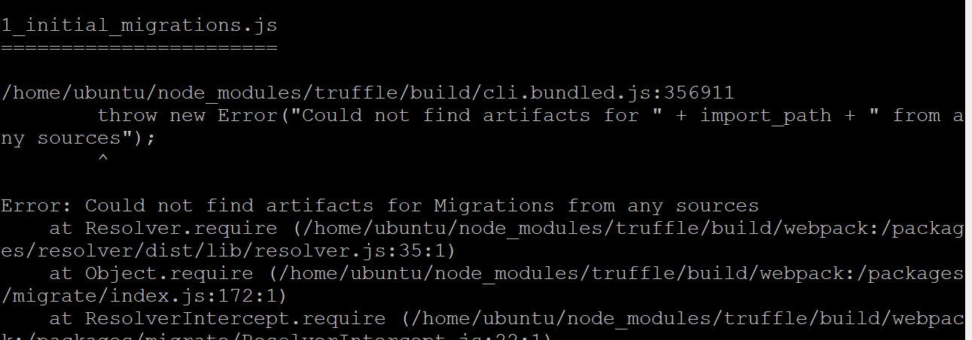
Solution: I need to get an accurage migration / deploy file
Added with the appropriate constructor

Slide 33
When I perform a migration / deploy
It will generate the output *.json file and the contract number in migration directory - these are going to have to be placed in the DAPP to make it work appropriately.

Slide 34
Latest note:
Cd packt3
npm run start
ubuntu@ip-172-31-15-252:~$ ./node_modules/.bin/ganache-cli --port 8545 --chainId 5777 -h ec2-52-43-83-229.us-west-2.compute.amazonaws.com
Vi App.js

Slide 35
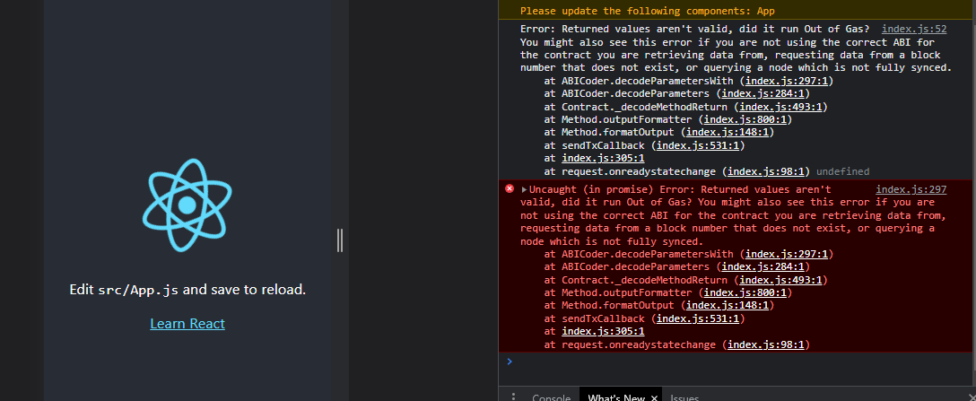

Slide 36
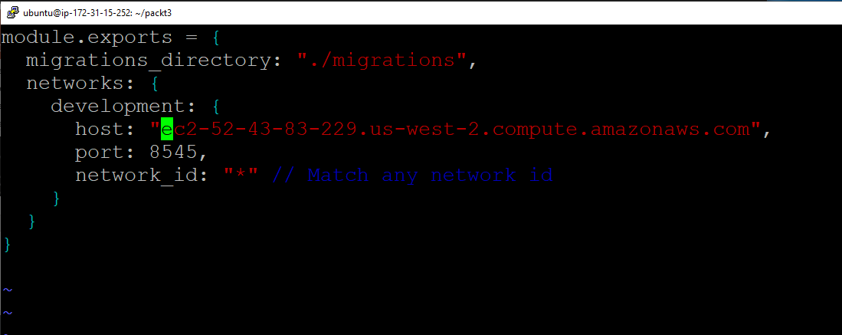
Update truffle-config

Slide 37
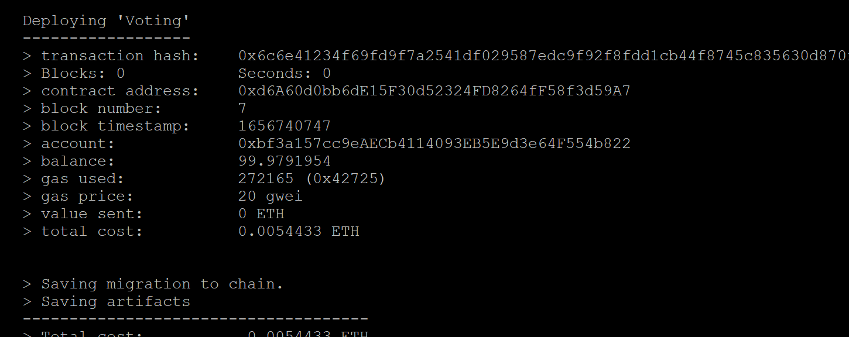

Slide 38
Solution: I need to do another deployment and copy over the ABI from the build directory.

Slide 39
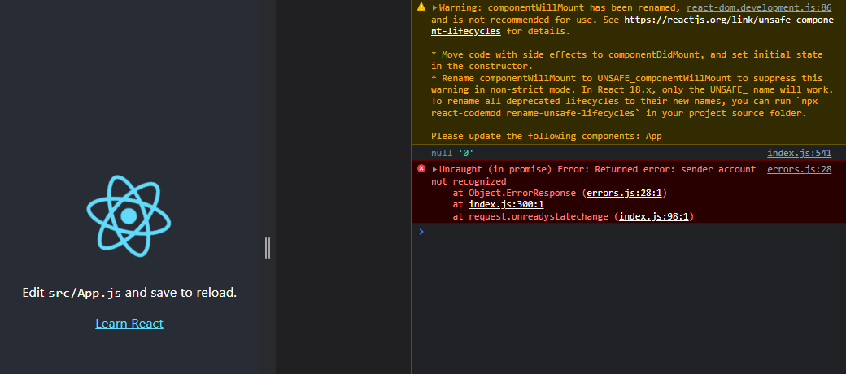
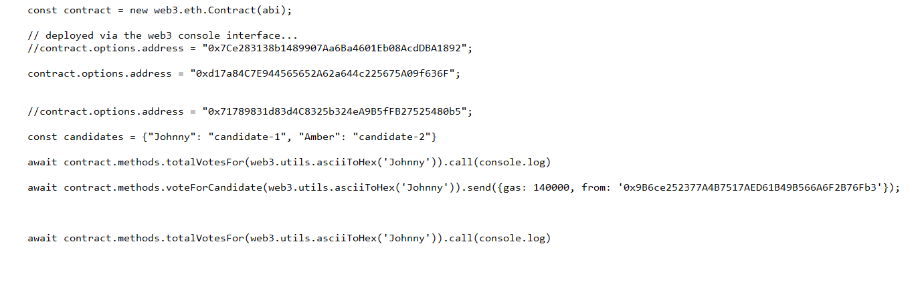

Slide 40
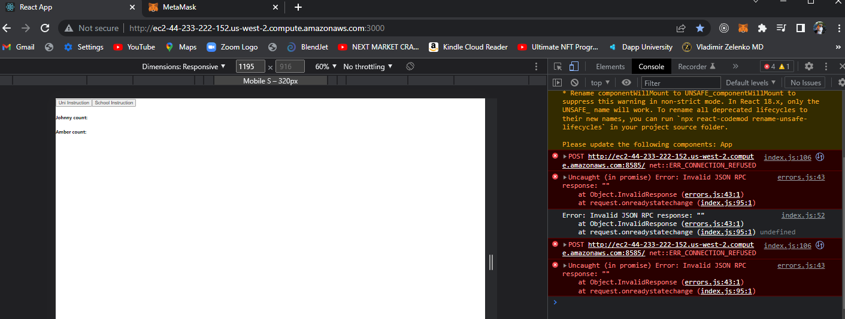
PROBLEM – CONNECTION REFUSED DUE TO NO CONNECTION WITH METAMASK.

Slide 41
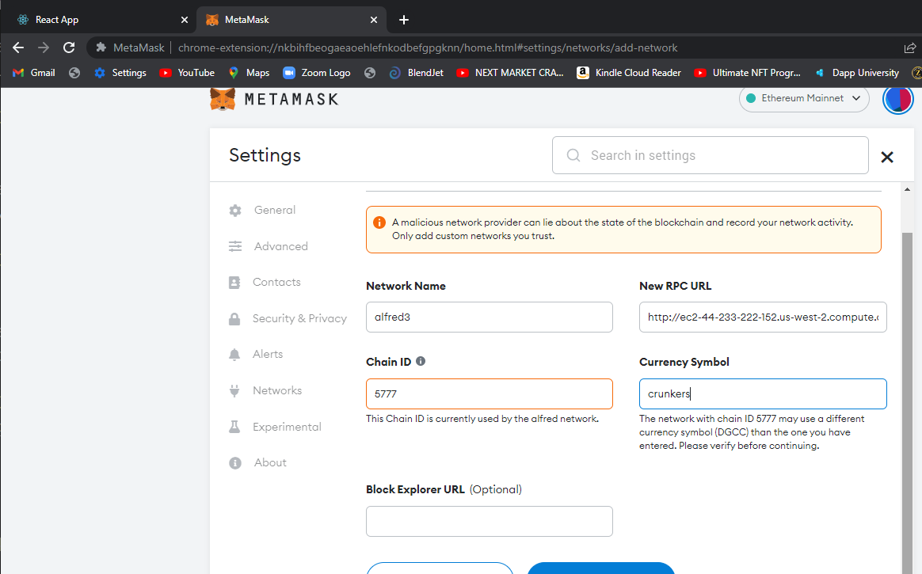

Slide 42
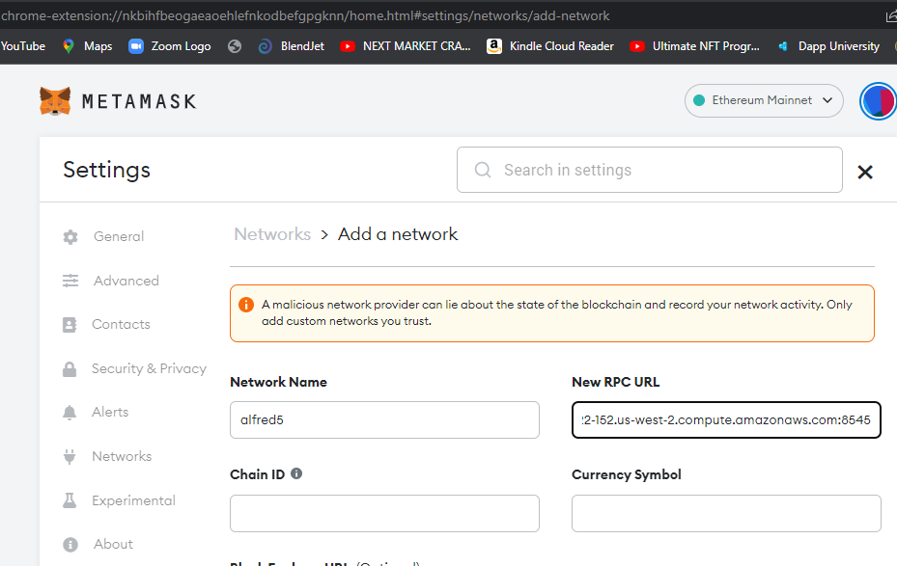
DO not forget to put in the entire DNS including the 8545 port

Slide 43
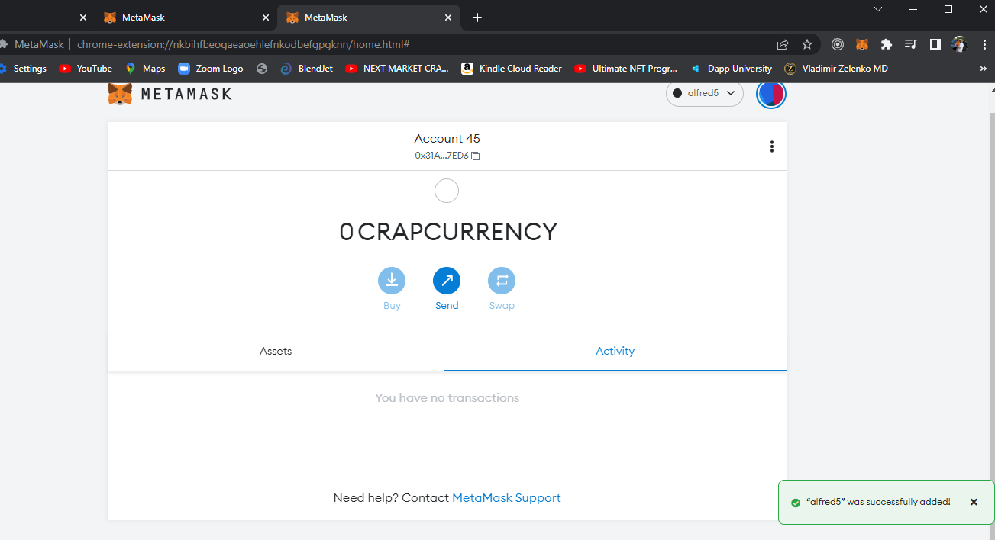

Slide 44
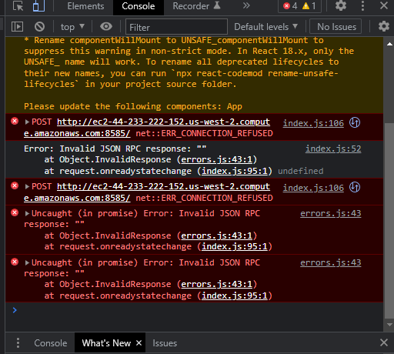

Slide 45
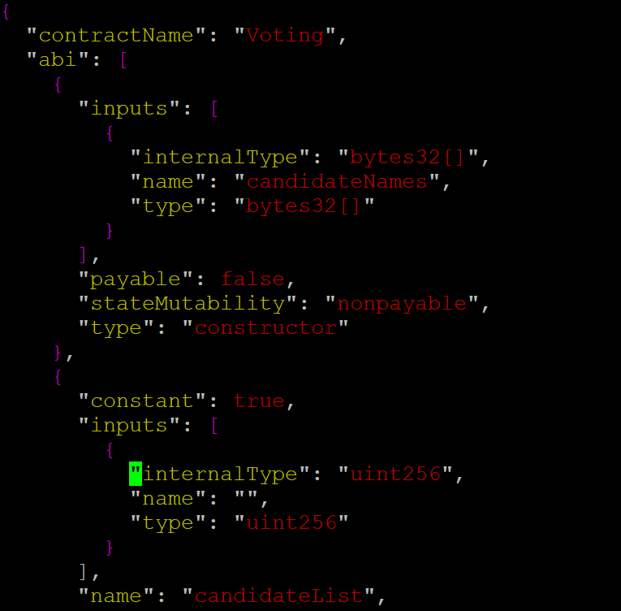
Go into <root> / build/contracts/Voting.json
And take the contents from the “abi”: [ <all contents here> ]

Slide 46
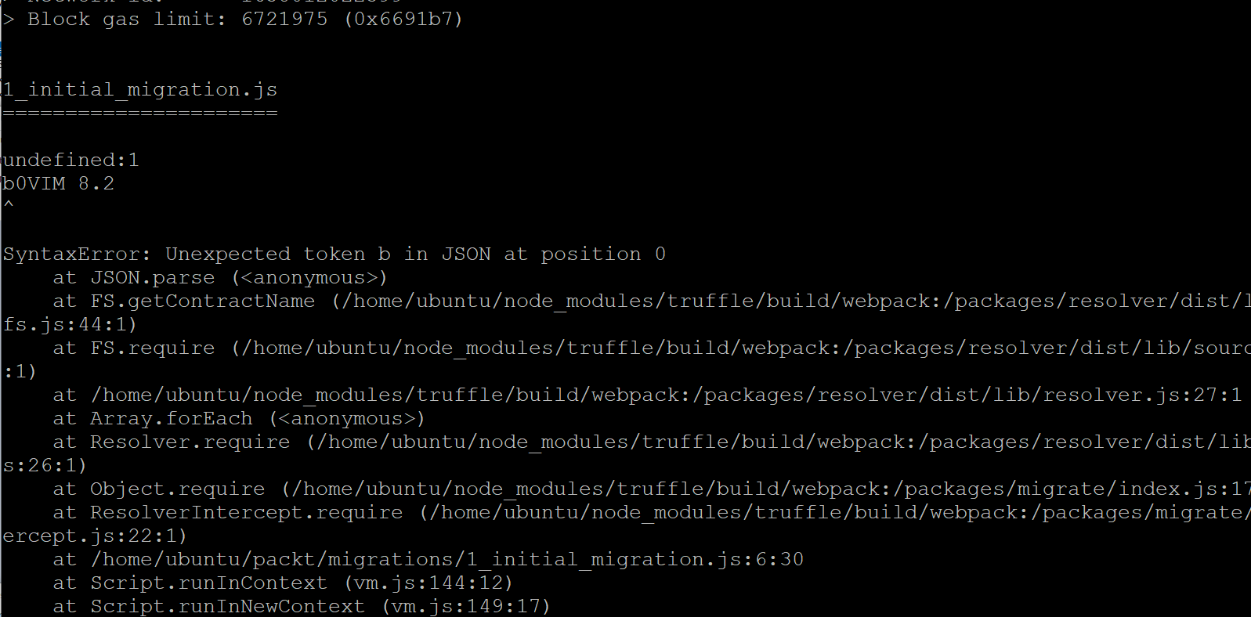

Slide 47
Next steps to fix is to re-install create-react
Do a completely new truffle init
Load in 2_deploy module
Replace the truffle-config. Module

Slide 48
I did a new create-react and reinstalled and it all worked – so what was the original problem?
280 cd migrations
281 ls
282 cat 1_initial_migration.js
283 vi 2_deploy_contracts.js
284 ls
285 cd ..
286 ls
287 rm truffle-config.js
288 vi truffle-config.js
289 cat truffle-config.js
290 ls
291 cd contracts
292 ls
293 vi Voting.sol
294 cd ..
295 /home/ubuntu/node_modules/.bin/truffle deploy
296 cd contracts/
297 ls
298 vi Voting.sol
299 cd ..
300 /home/ubuntu/node_modules/.bin/truffle deploy
301 history

Slide 49
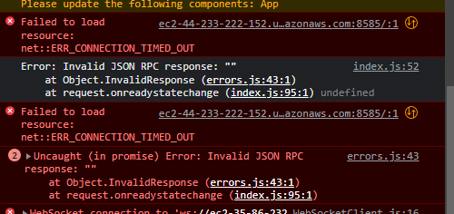

Slide 50
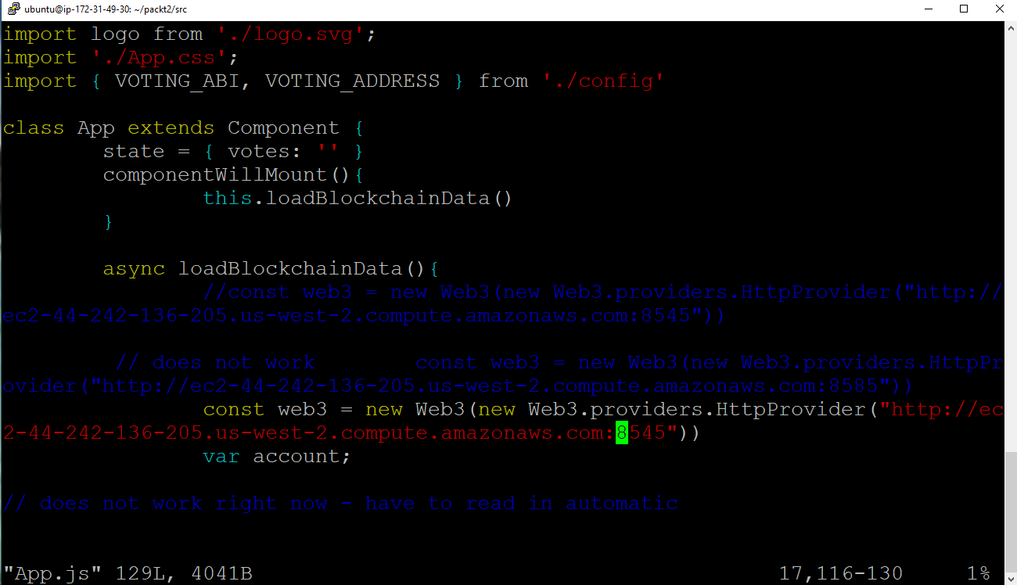
The only explanation is that I copied in an invisible character from the
DNS copy from amazon web site.
The “does not work” line when copied by hand below – now WORKS

Slide 51
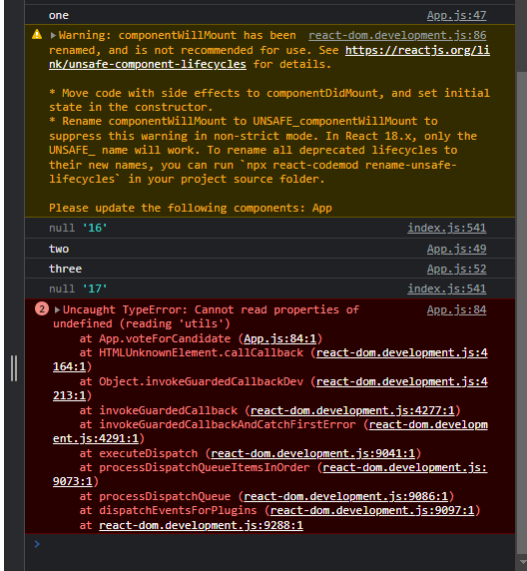

Slide 52
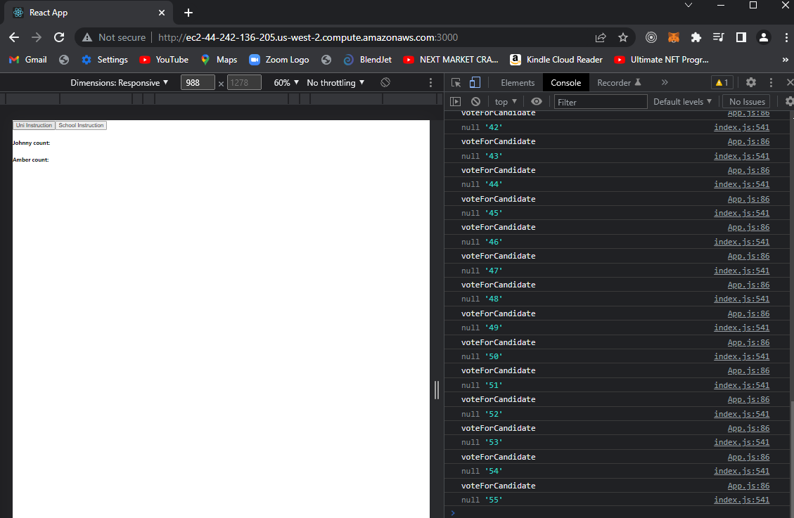

Slide 53
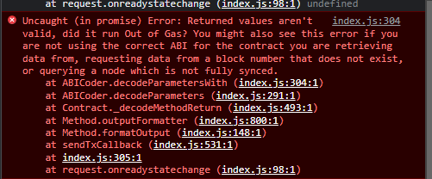
Wrong ABI file

