Slide 1
가상환경 조작 API

Slide 2
K8s
GET (List)
GET (select one)
POST (create one)
DELETE (delete one)
vCenter
GET (get a new ticket)
POST (create one)
DELETE (delete one)

Slide 3

Service
Node Port : 30000
:80
app : shell1
Deployment
app : shell1
node1.example.com
10.100.0.101
Service
Service
Replica Set
:30000
:30001
app : shell1
Pod
Deployment
Deployment
ubuntu:14.x.x
Shell In A Box : lastest
:4200
node2.example.com
Service
10.100.0.102
master.example.com
:30002
Deployment
192.168.xxx.xxx
10.100.0.100
node3.example.com
10.100.0.103
Service
:30003
Deployment
Control API Server

Slide 4
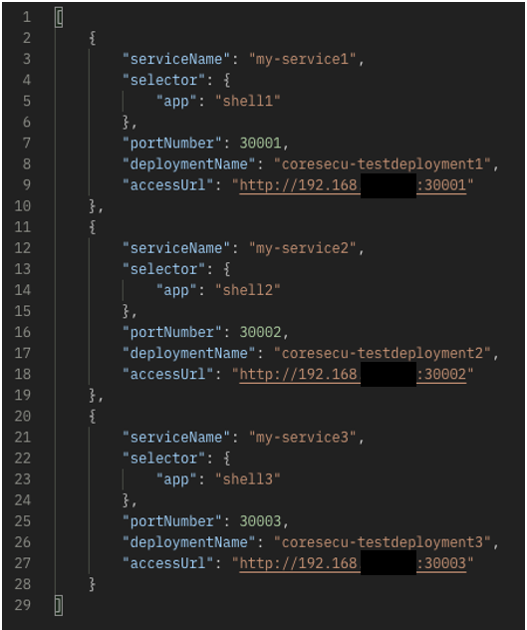
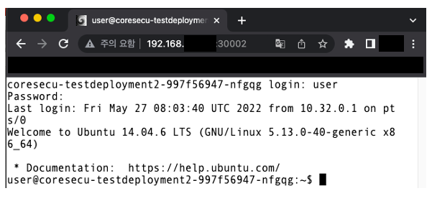
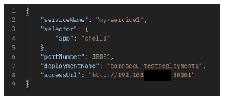
K8s – GET (List) | GET(select one)

Slide 5
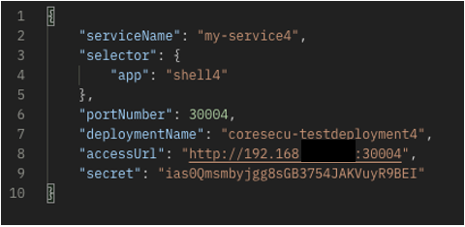
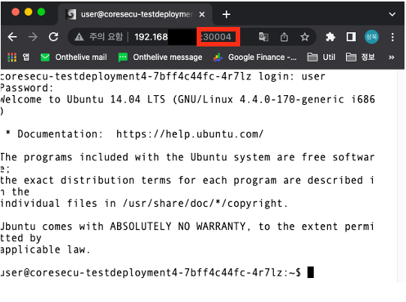
K8s – POST (create one)

Slide 6
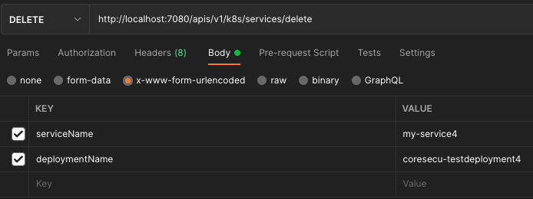
K8s – DELETE (delete one)

Slide 7
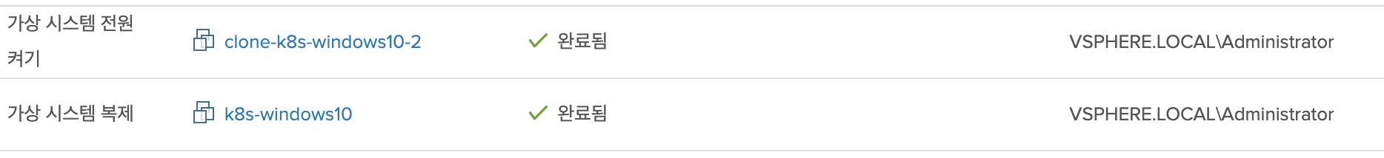

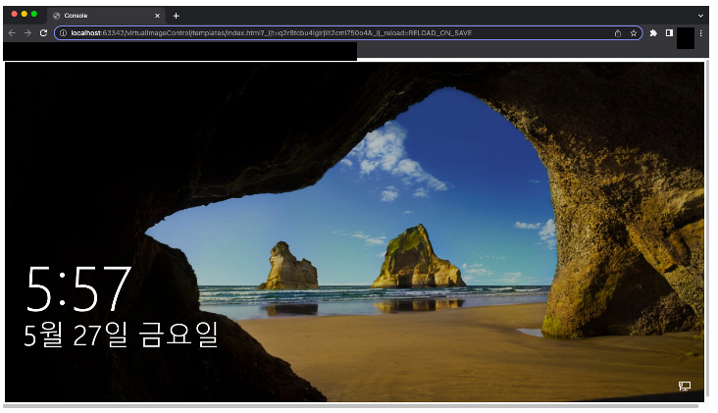
vCenter – POST (create one)

Slide 8

vCenter – GET (get a new ticket)
Previous
Get a new ticket URL

Slide 9
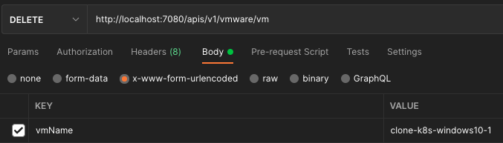
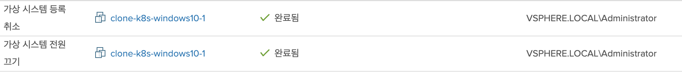
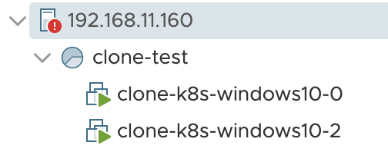
vCenter – DELETE (delete one)

