Slide 1
Sky Survey Map Project
Ryan Hickox
Nicky Golini

Slide 2
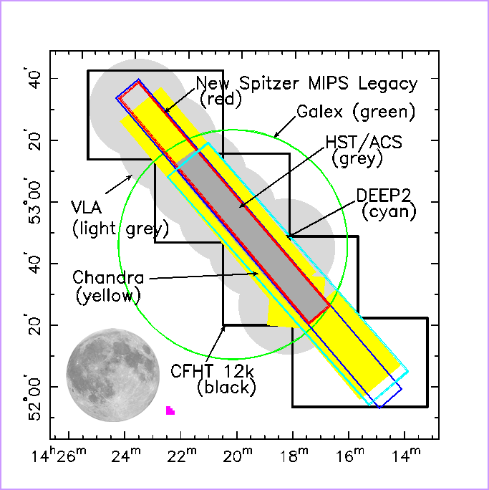
Data
AEGIS surveys over Groth Strip Region of the sky, all representing surveys with different datasets.
Any patch of sky may be covered by different surveys, but without a universal source of data, it would be very difficult to find all the data for a particular area in the sky.
http://localhost/~Nicky/VirtualSky-master/testnew.html
Notes:
A major problem for astronomers for planning new observations is knowing which areas of the sky have already been observed through other observations, because the information from completed surveys are not all in one accessible location. We would like to build an online database that contains survey coverage maps and metadata for as many survey fields as possible. The above image is one example of a portion of the sky with multiple surveys taken. We want to display surveys across the sky in a similar manner as the surveys are presented above, and we would like to add user functionality to make it as convenient and informative as possible.
** Show how AEGIS surveys are displayed in VirtualSky

Slide 3
What We Have Now:
Means of drawing polygons onto Virtual-Sky
On/off toggle for survey data
Move-to boxes
Single Json file with all survey data
Simple means of showing metadata

Slide 4
What We Would Like:
Dynamic means to store and add new survey data (parse.com?)
Strategic means of clumping surveys together (same colors for same surveys, on/off buttons for whole surveys)
More meaningful way of displaying data
Make the polygons interactive?
Move-to functionality from user input RA and Dec
Manual zoom in/out buttons
General UI/design – web page
Will need a deeper star catalog

