Slide 1

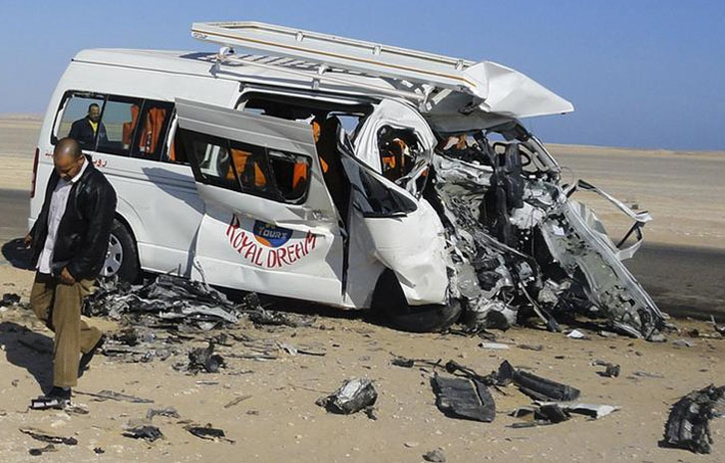
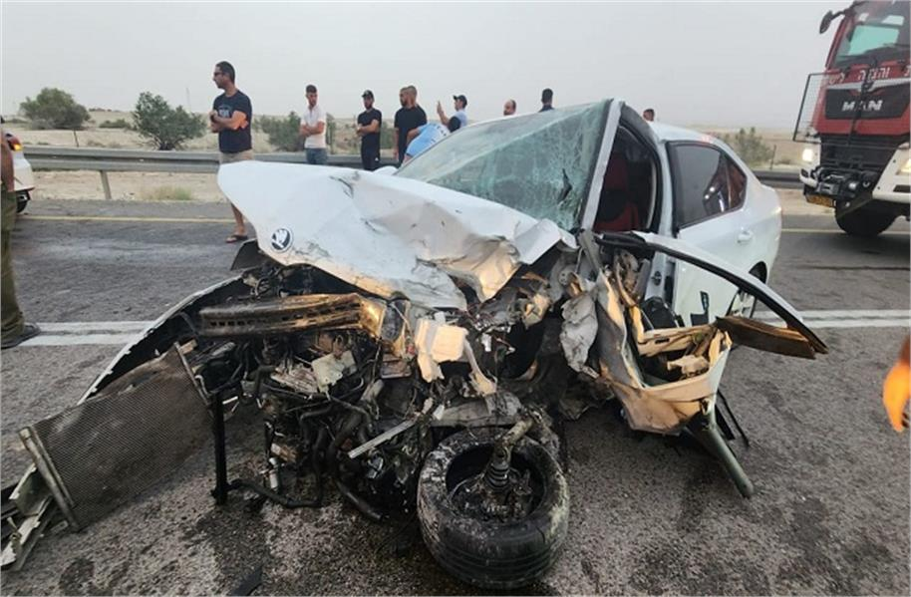
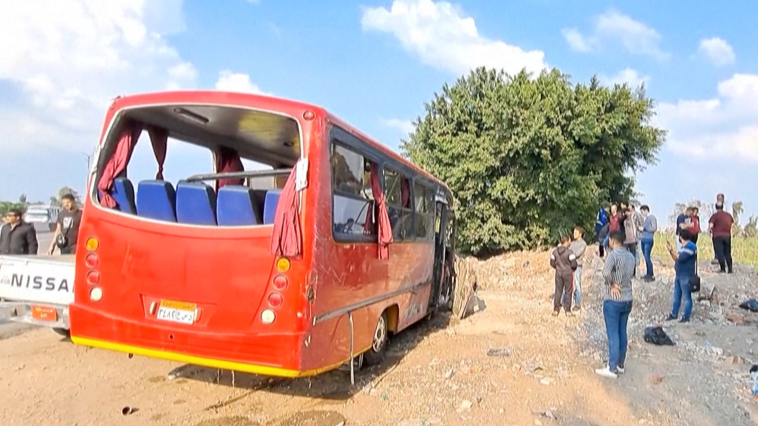
ROAD ACCIDENT ANALYSIS IN EGYPT
TURNING HISTORICAL DATA INTO ACTIONABLE INSIGHTS
NTI’S GRADUATION PROJECT | AUG 22, 2026

Slide 2
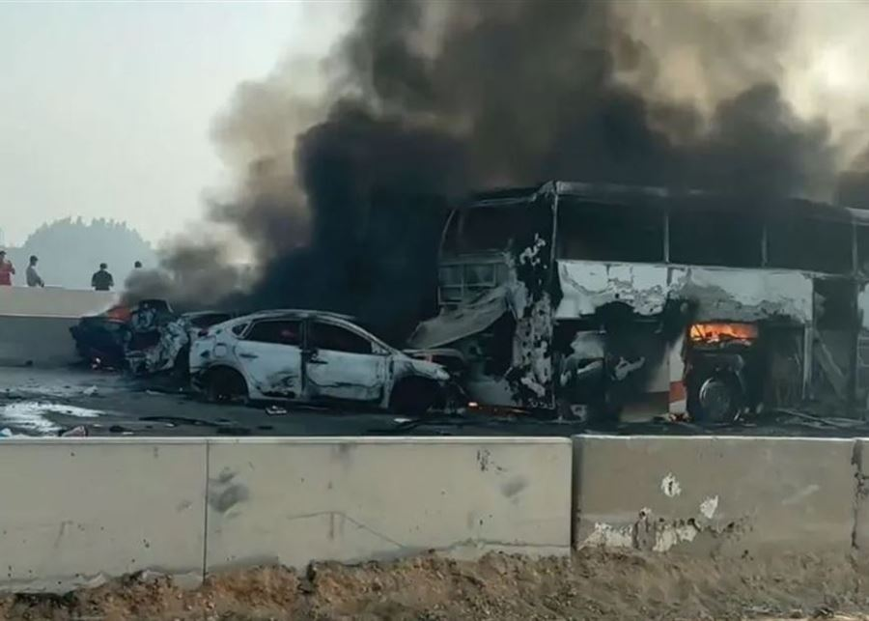
ROAD ACCIDENTS IN EGYPT
371k
Total Affected people
32k
Total Deaths
339k
Total Inguries
Road accidents are not just numbers.
They represent lives ,injuries, and economic losses
01

Slide 3
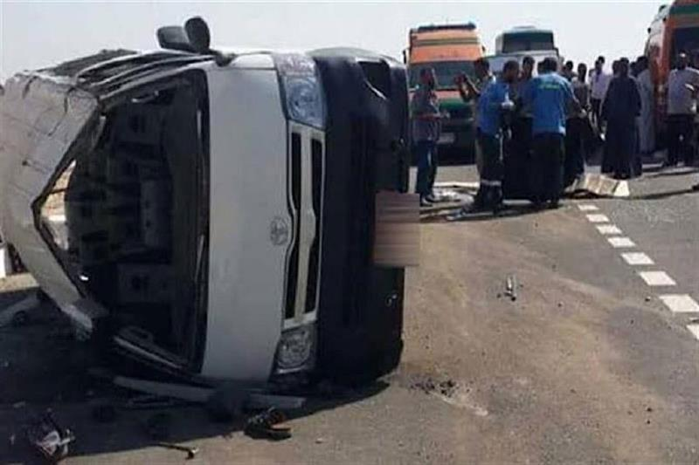
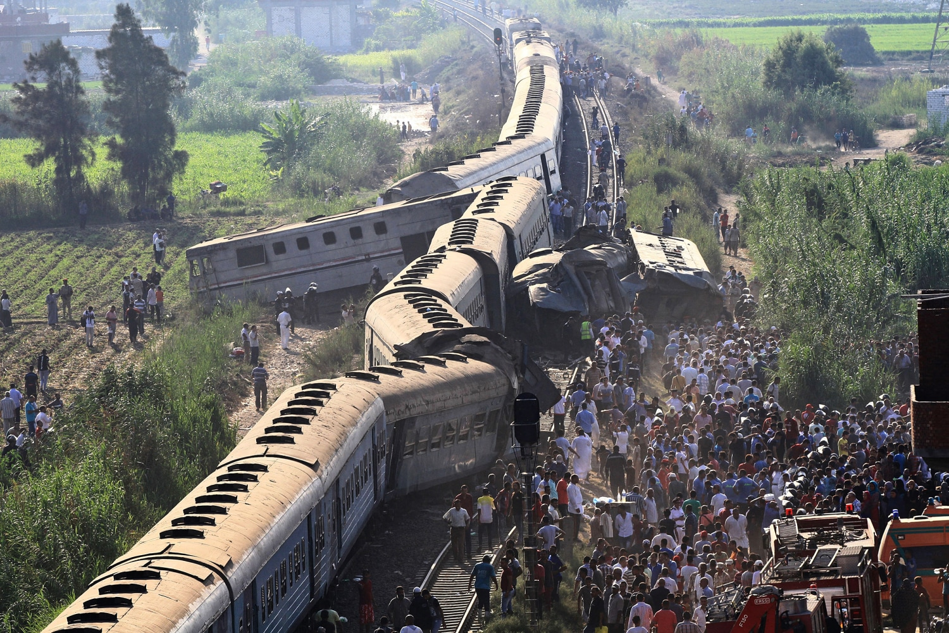
WHY THIS PROJECT?
01 — A Serious Issue
Road accidents happen every day and cost many lives.
02 — Understanding the Trend
We wanted to know: Are accidents increasing or decreasing over time?
03 — Looking Ahead
Understanding these trends can help us think about how road safety can be improved in the future.
02
Our goal is to understand the problem today, to help reduce it tomorrow.

Slide 4



THE DATA CHALLENGE
NO READY -TO-USE DATASET
2021 ⟶ 2022 ⟶ 2023 ⟶ 2024 ⟶ 2025
03

Slide 5
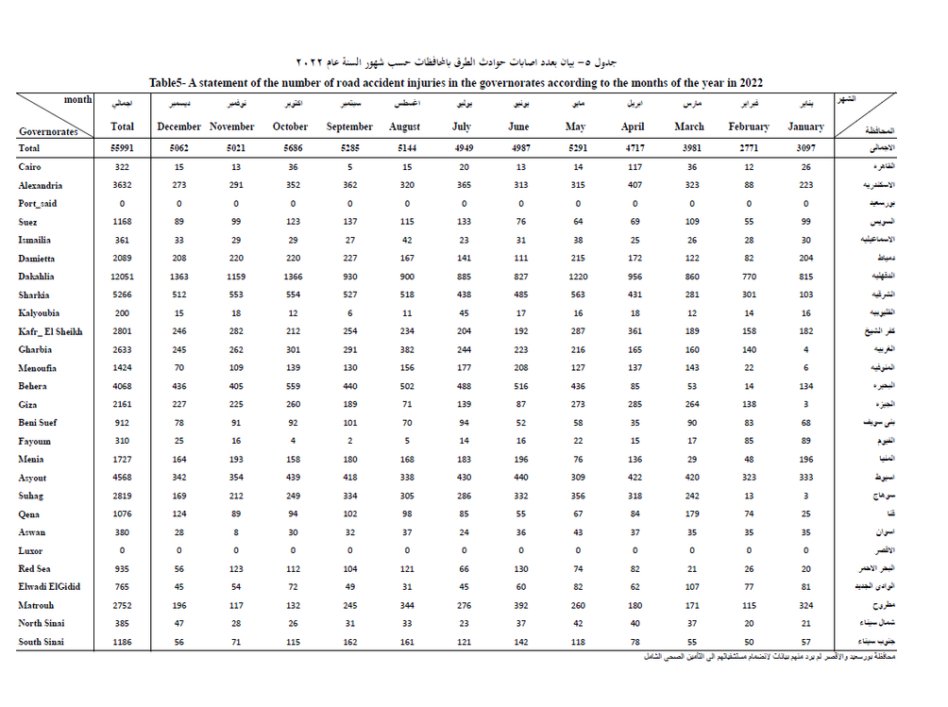
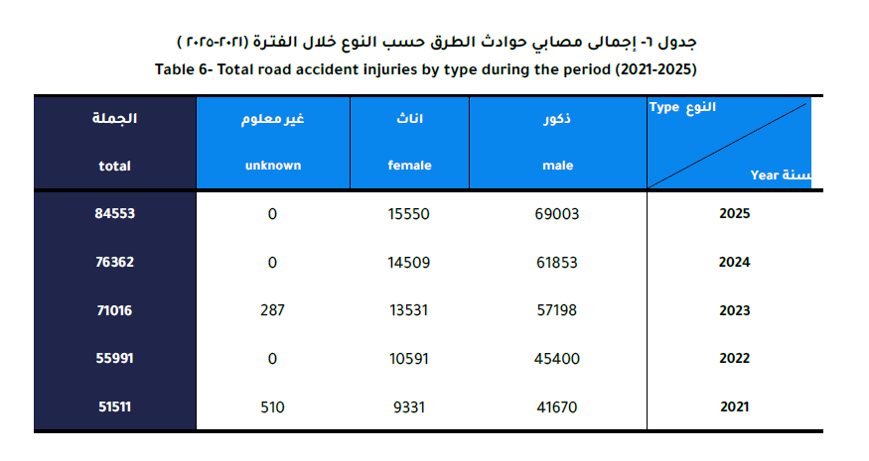
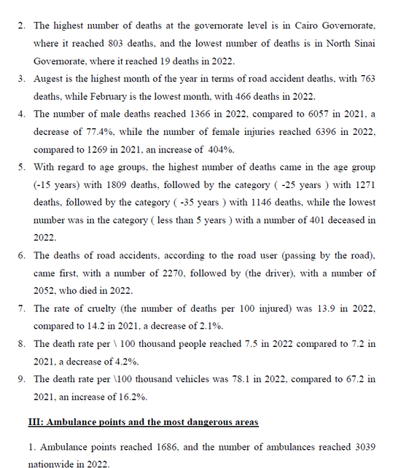
THE DATA CHALLENGE
NO READY -TO-USE DATASET
2021 ⟶ 2022 ⟶ 2023 ⟶ 2024 ⟶ 2025
04

Slide 6
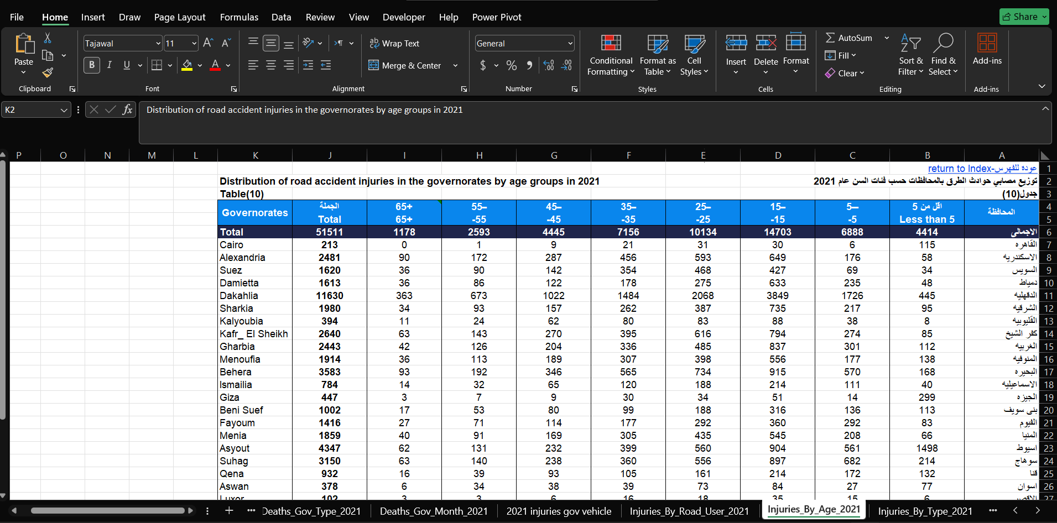
FROM PDF REPORTS TO EXCEL TABLES
1. Verify the Data
We checked the extracted numbers against the original PDF reports.
2. Rename & Organize Sheets
We renamed the sheets to make the data clear and easy to identify.
3. Prepare for Analysis
We organized the tables before moving to the next data-processing stage.
PDF REPORTS
EXCEL TABLES
VERIFICATION & ORGANIZATION
05

Slide 7
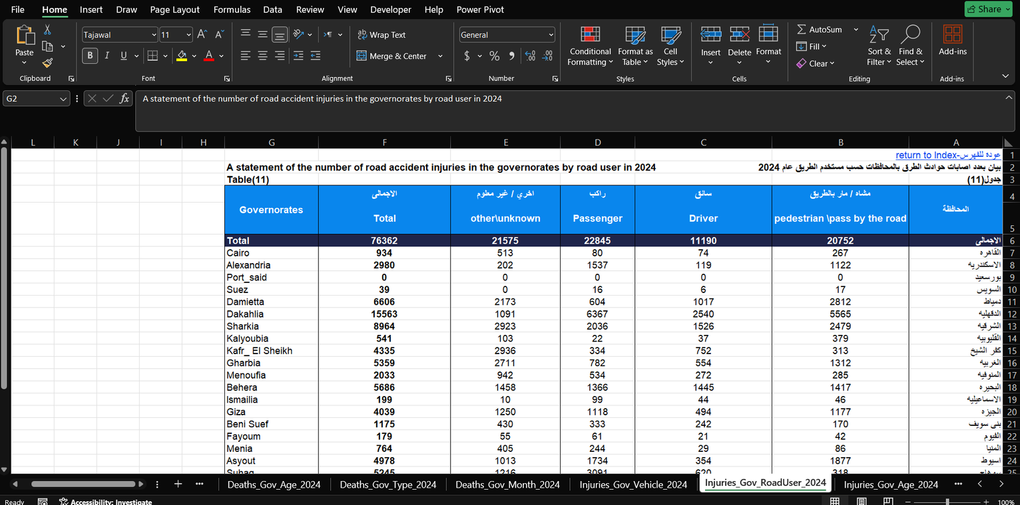
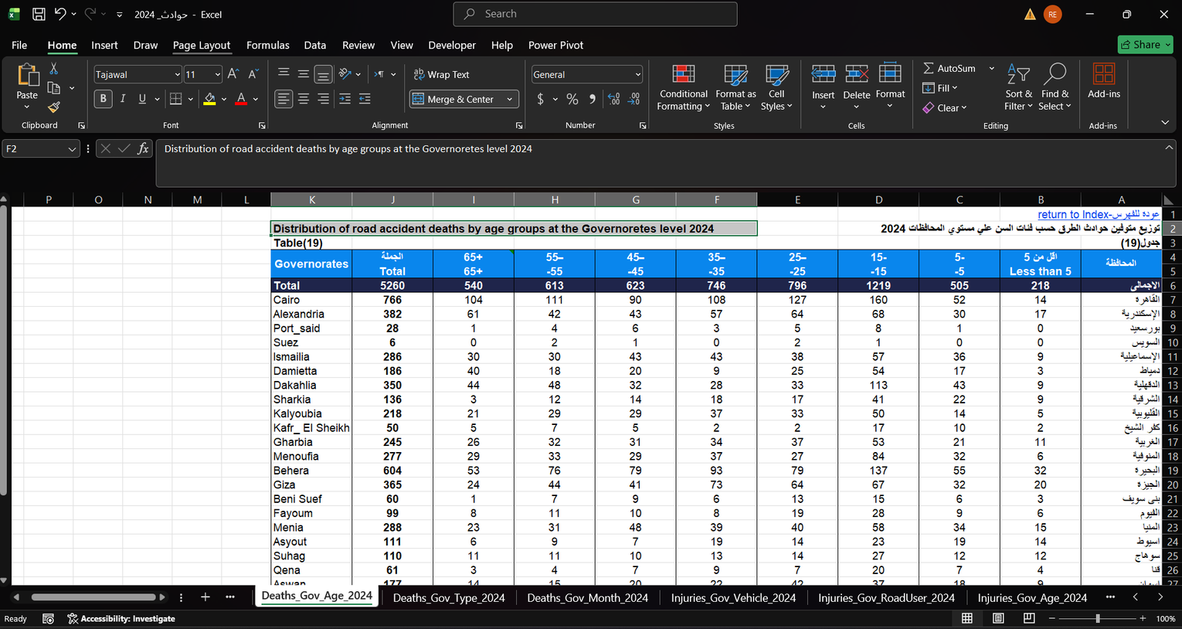
FROM PDF REPORTS TO EXCEL TABLES
1. Verify the Data
We checked the extracted numbers against the original PDF reports.
2. Rename & Organize Sheets
We renamed the sheets to make the data clear and easy to identify.
3. Prepare for Analysis
We organized the tables before moving to the next data-processing stage.
06
PDF REPORTS → EXCEL TABLES → VERIFICATION & ORGANIZATION

Slide 8
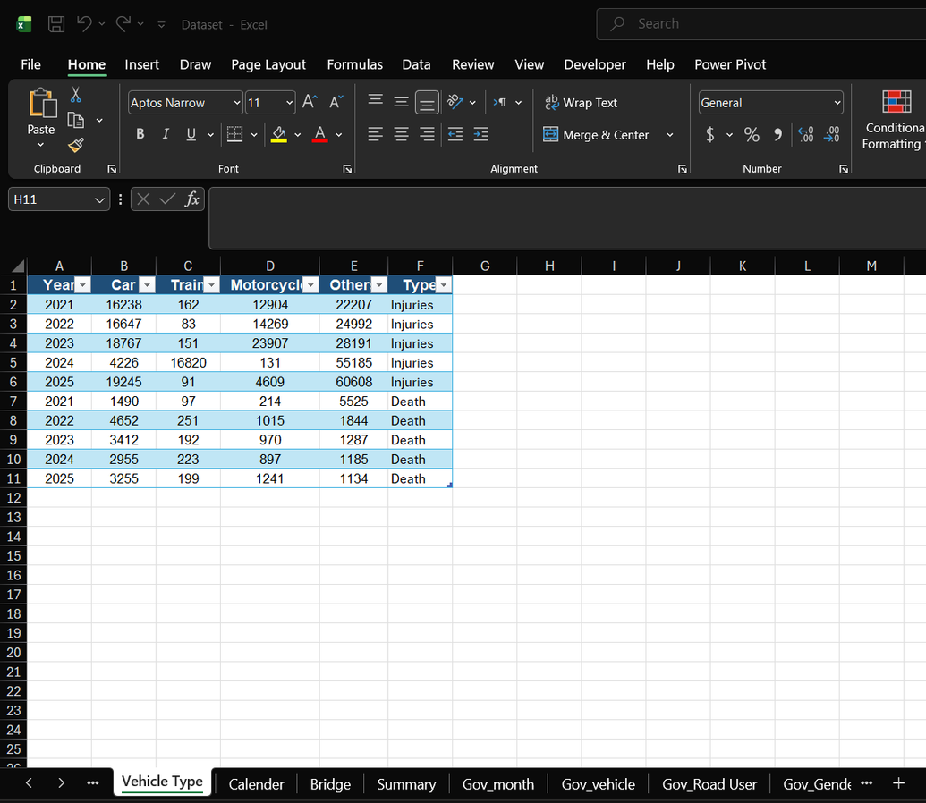
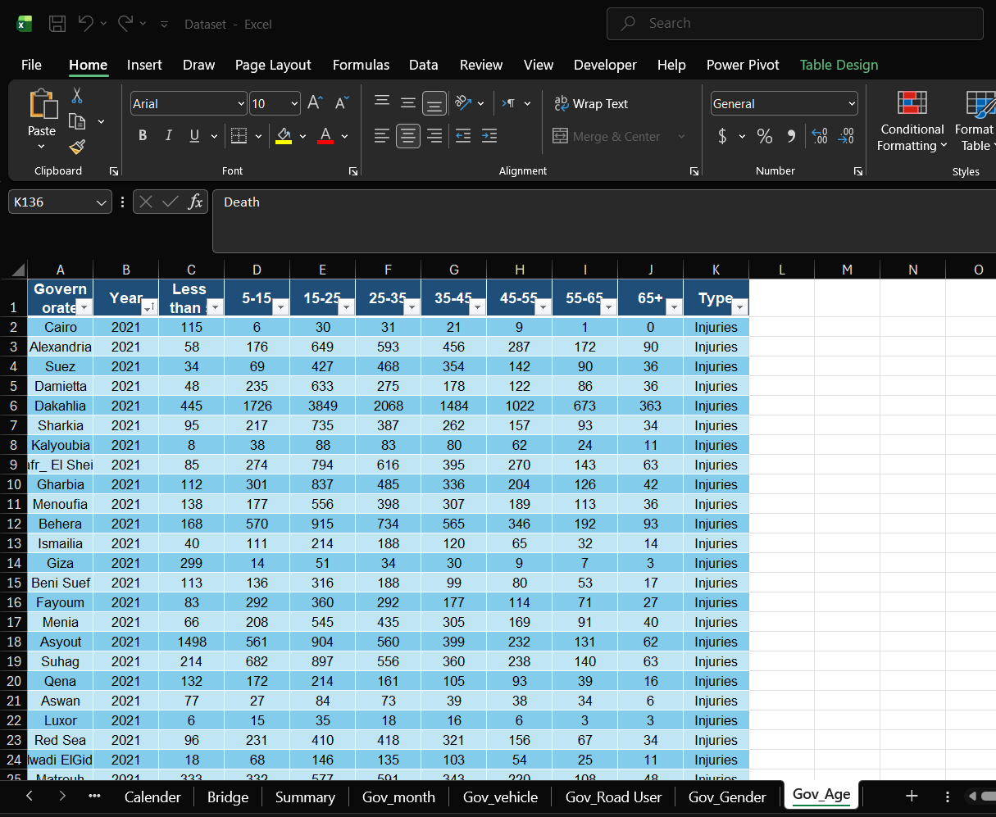
DATA MERGING &TABLE SELECTION
  ⟶ We selected the relevant tables and merged the data from different reports into a unified dataset.
07

Slide 9
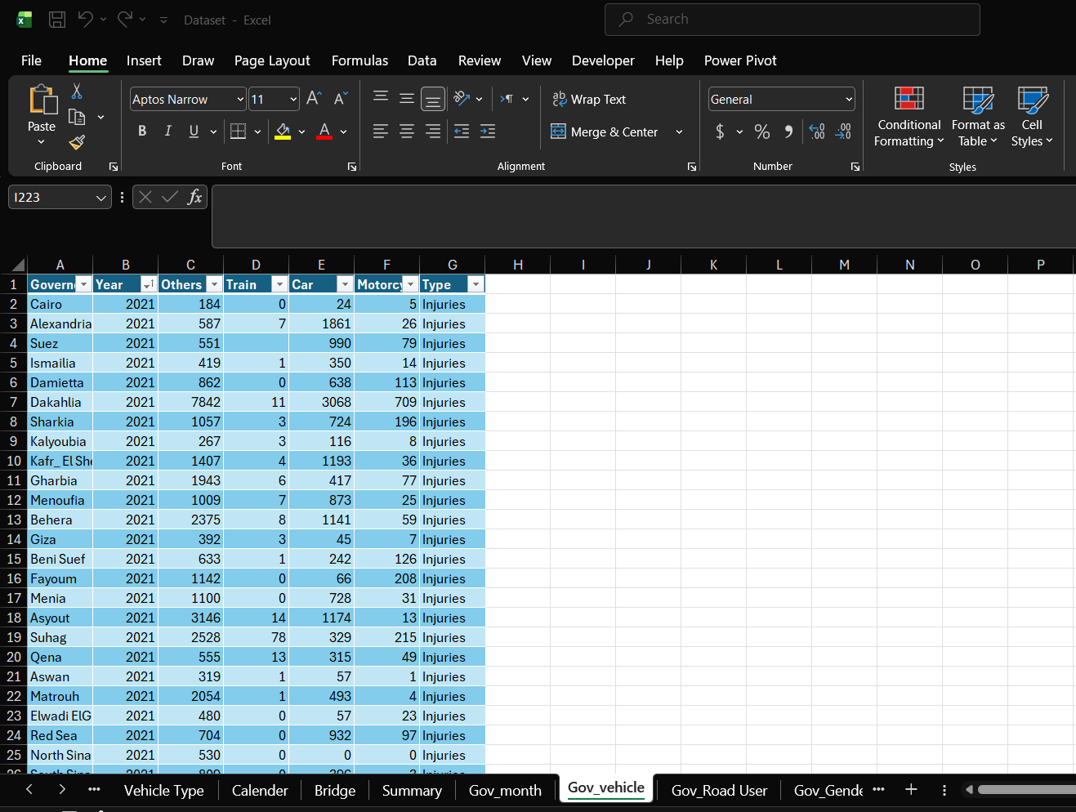
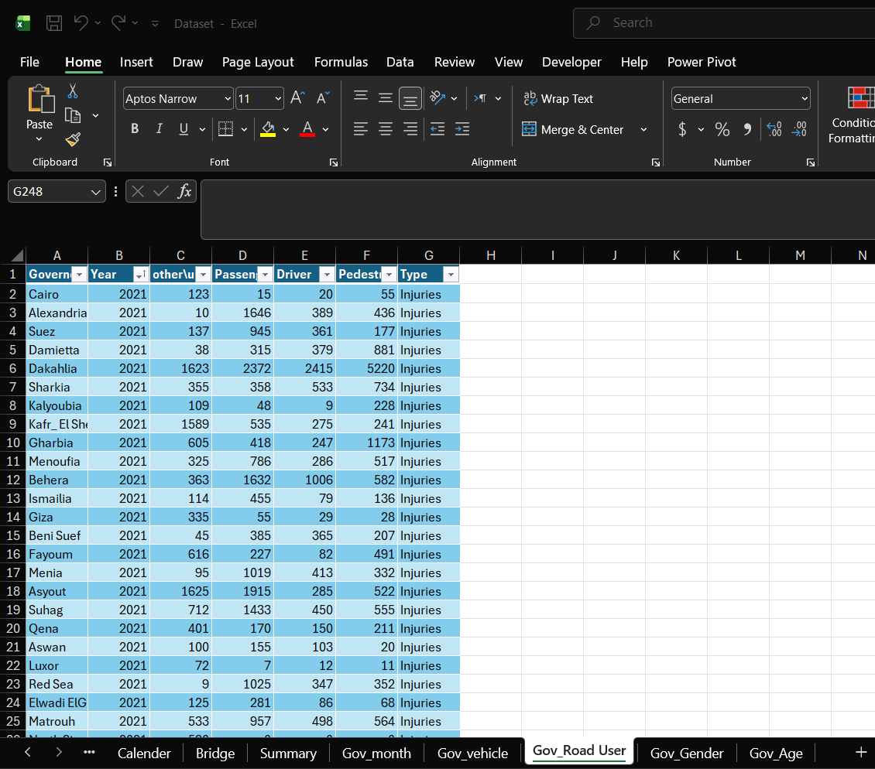
DATA MERGING &TABLE SELECTION
⟶ We selected the relevant tables and merged the data from different reports into a unified dataset.
08

Slide 10
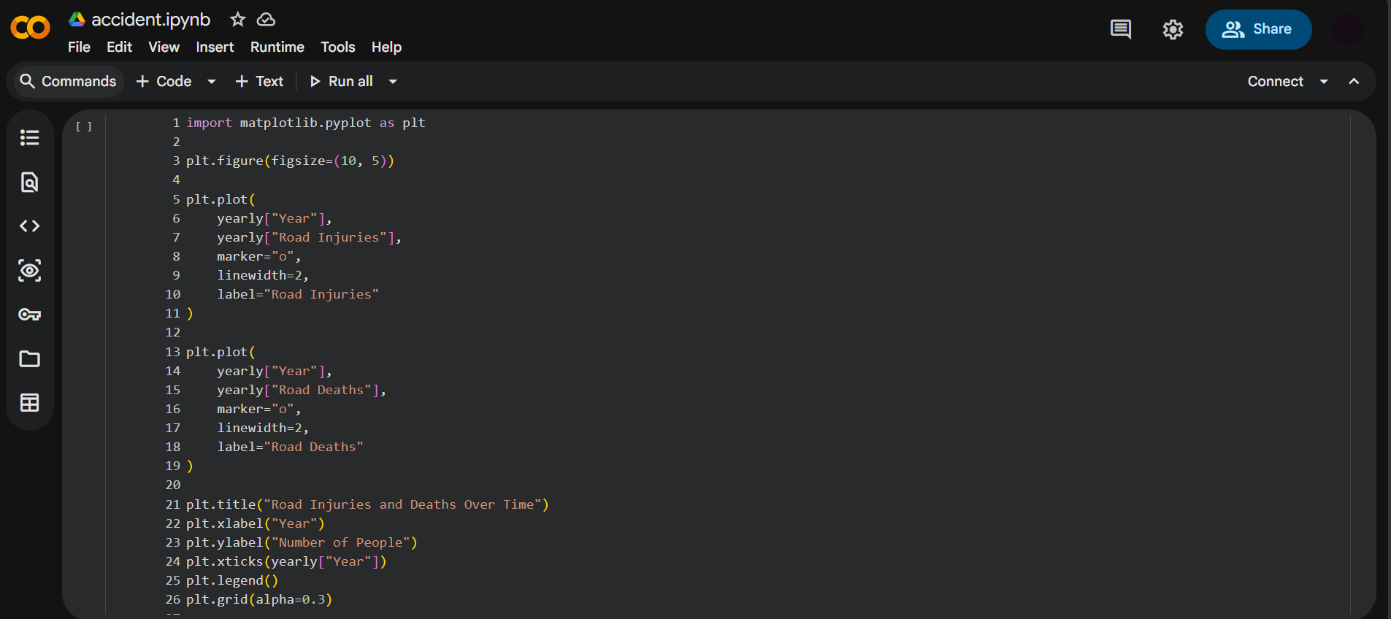
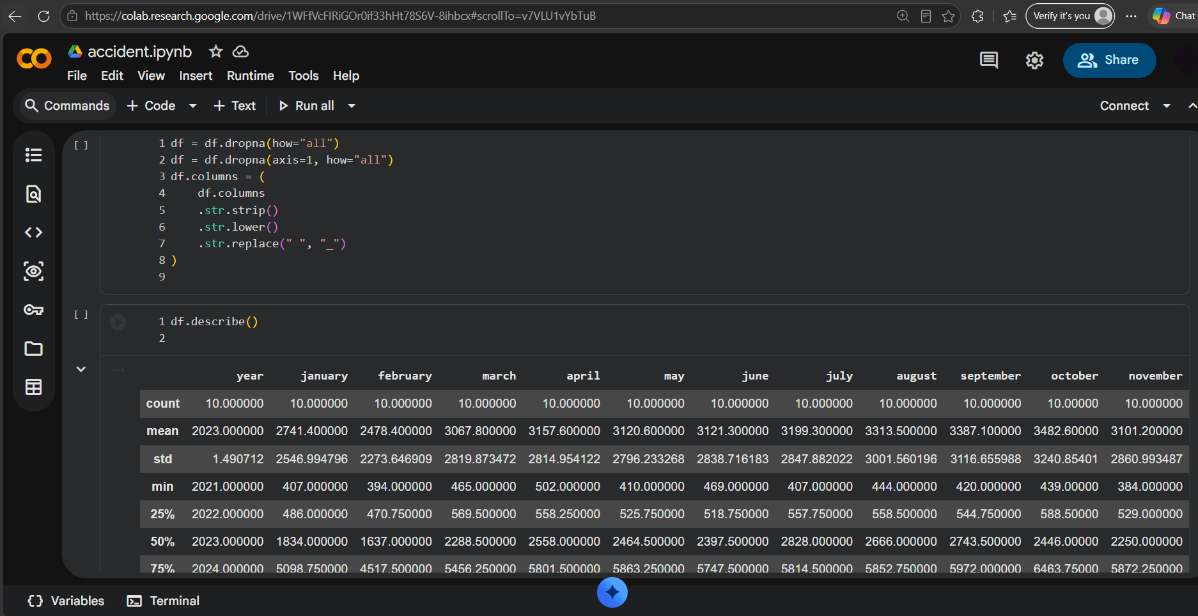
PYTHON: DATA CLEANING & VISUALIZATION
⟶ Cleaned, standardized, and visualized the merged dataset to identify patterns and trends.
09

Slide 11
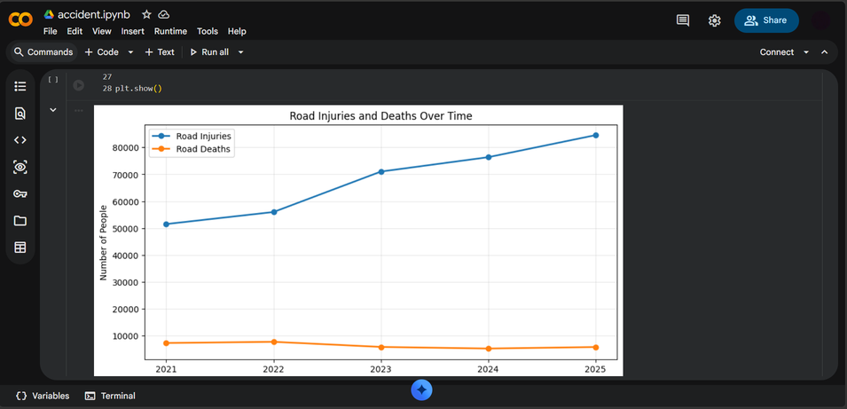
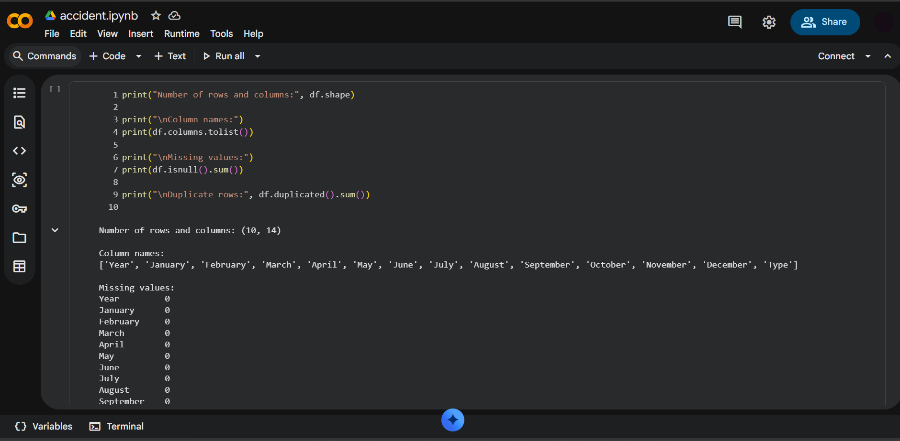
PYTHON: DATA CLEANING & VISUALIZATION
⟶ Cleaned, standardized, and visualized the merged dataset to identify patterns and trends.
10

Slide 12
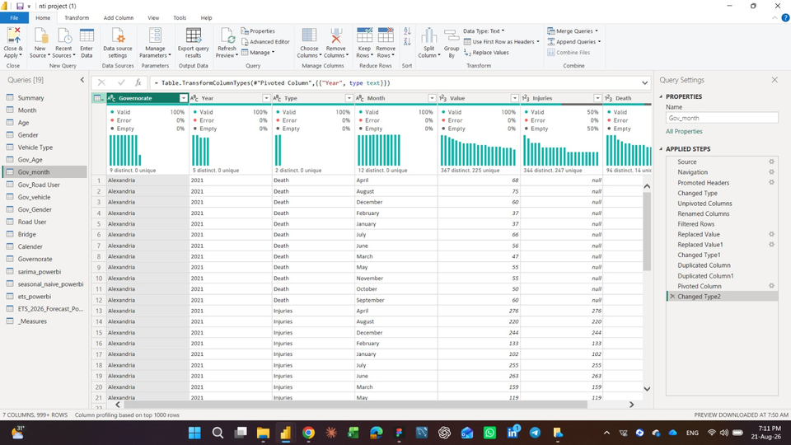
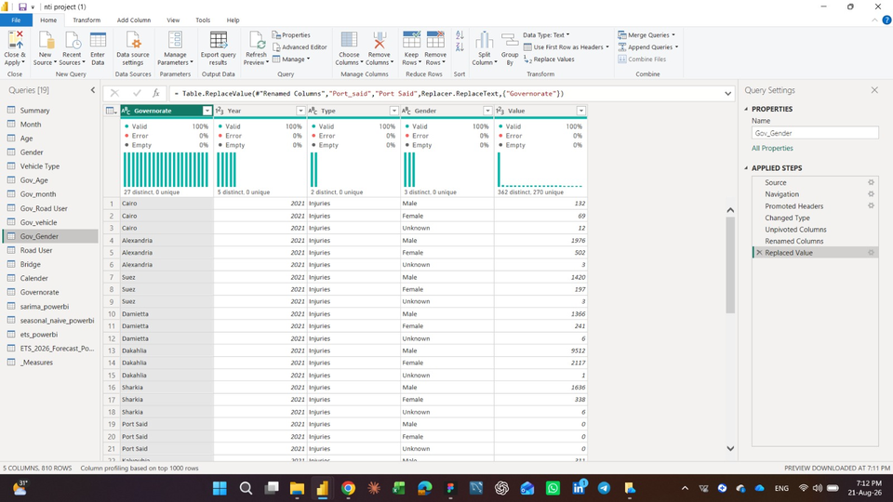
POWER QUERY – DATA TRANSFORMATION
⟶ Changed Data Types
⟶ Standardized Data Formats
⟶ Standardized Governorates
⟶ Unpivoted Columns to restructure the data for analysis
11

Slide 13
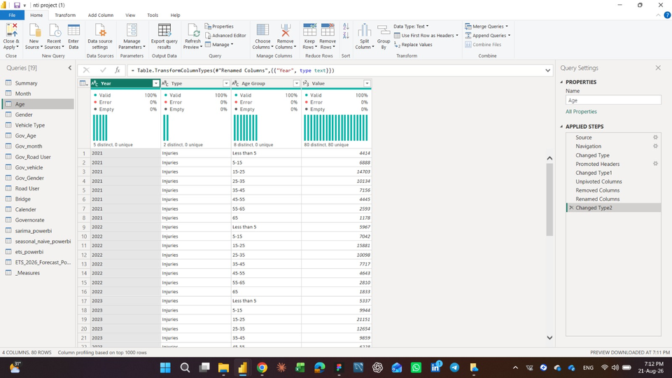
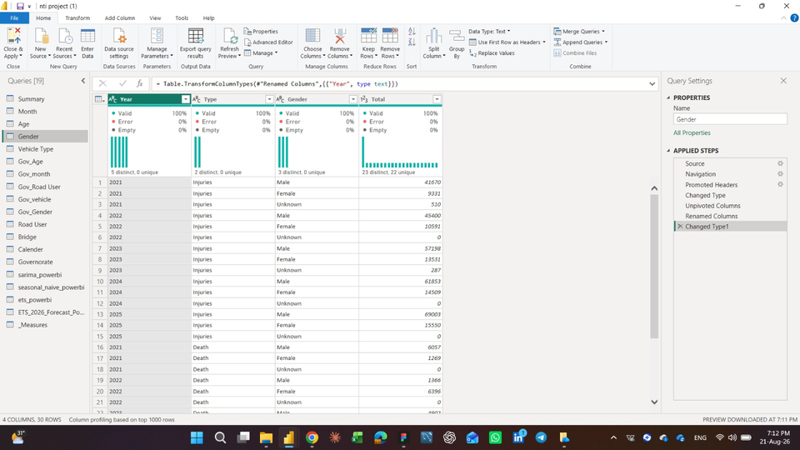
POWER QUERY – DATA TRANSFORMATION
⟶ Changed Data Types
⟶ Standardized Data Formats
⟶ Standardized Governorates
⟶ Unpivoted Columns to restructure the data for analysis
12

Slide 14
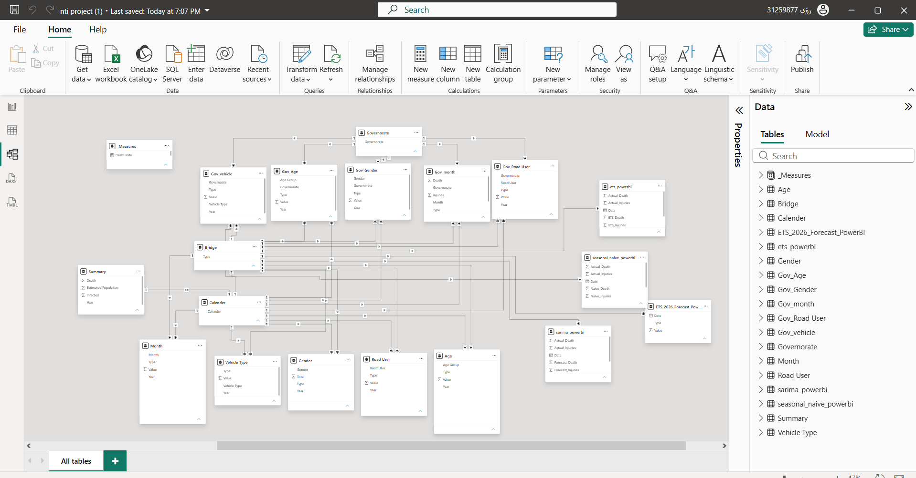
DATA MODELING
⟶ Built a structured Data Model
⟶ Created Relationships between tables
⟶ Built Dimension Tables for analysis
⟶ Used a Bridge Table to manage relationships
⟶ Added a Calendar Table for time-based analysis
13

Slide 15
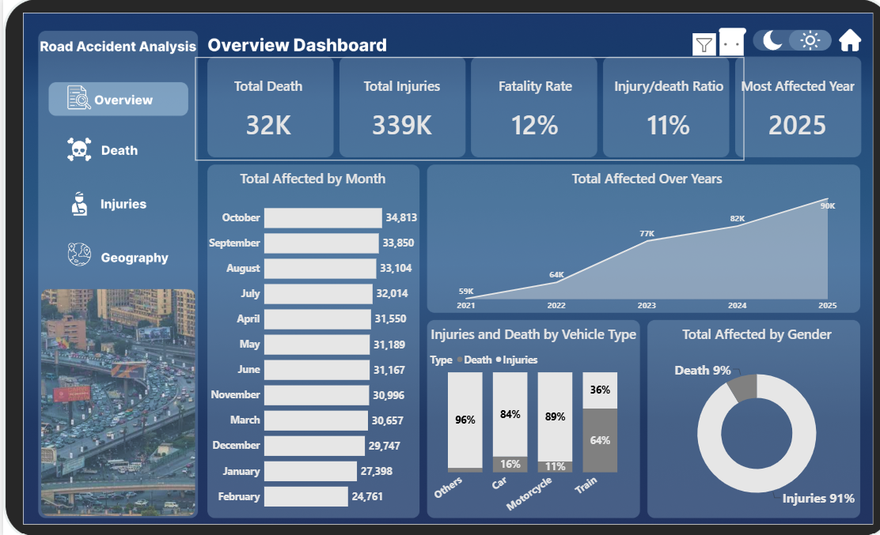
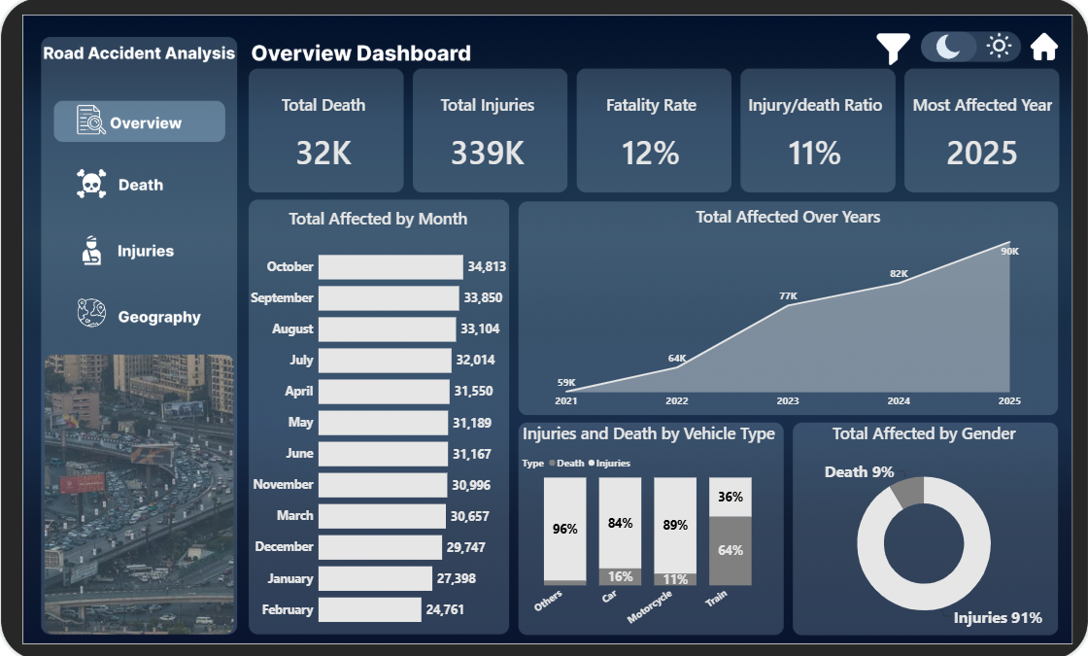
OUR DASHBOARD
⟶ Built 4 Dashboards: (Overview, Death, Injuries, Geography), Home Page, Forecast Page, Insights & Recommendations Page, tooltip hover, drill-through Page
14

Slide 16

DASHBOARD FEATURES
Customized figma background
01
02
Dark vs light mode
03
Bookmarks
04
Drill through,Drill Down
05
Tooltip
06
Slicers
07
Navigation buttons
08
Custom map
09
Measures
15
10
Forecast

Slide 17
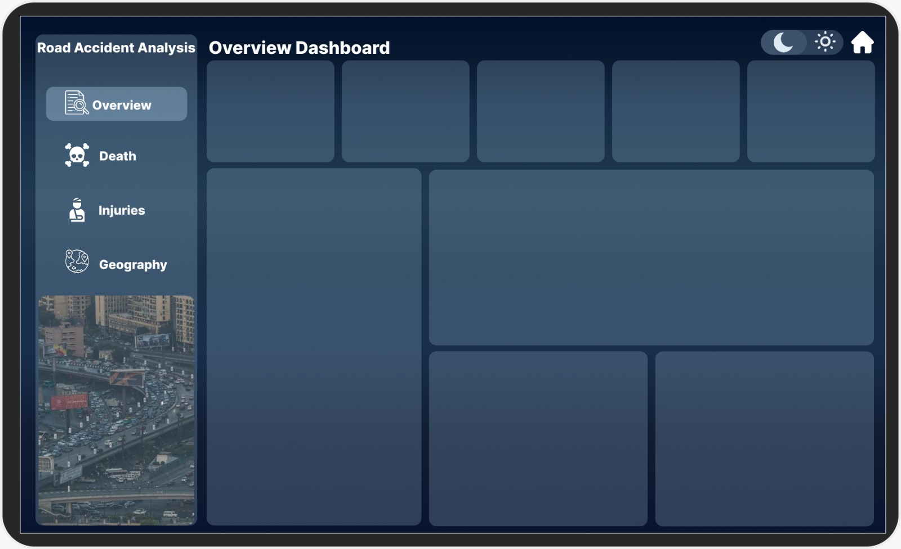
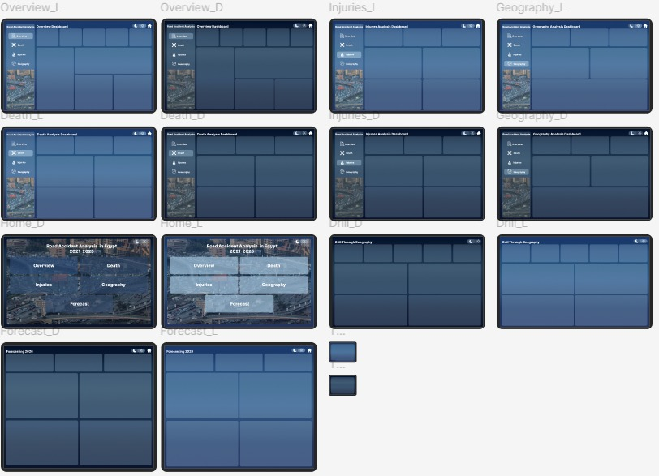
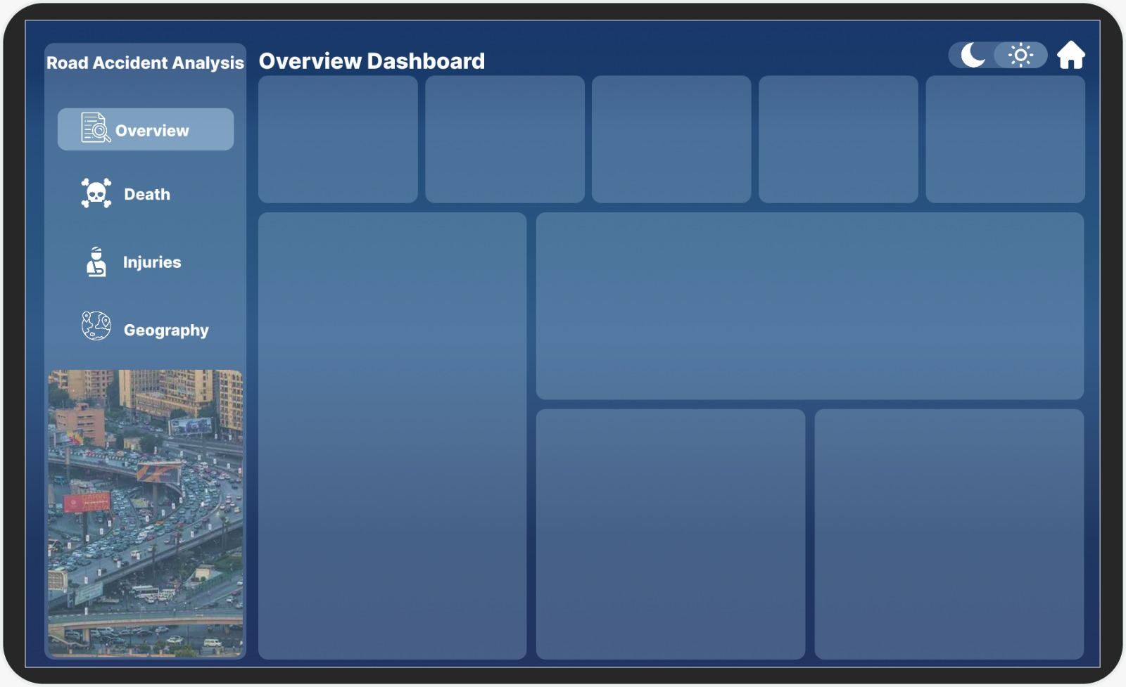
CUSTOMIZED FIGMA BACKGROUND
DARK VS LIGHT MODE
16

Slide 18
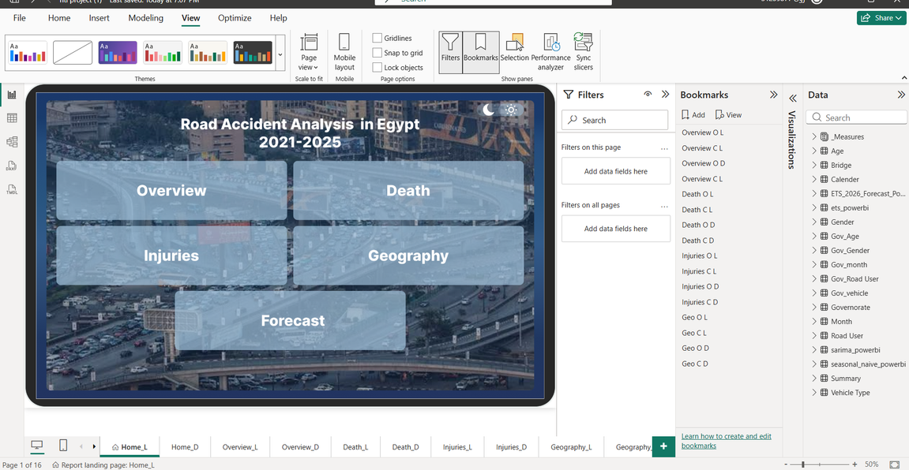
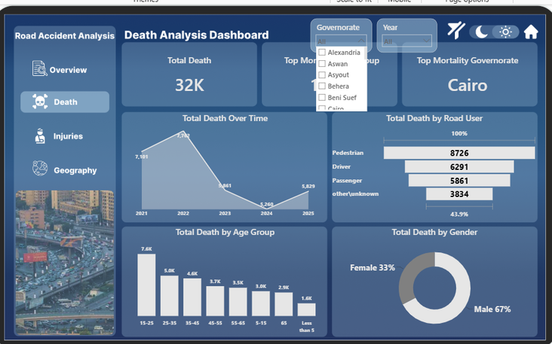
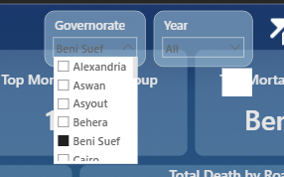
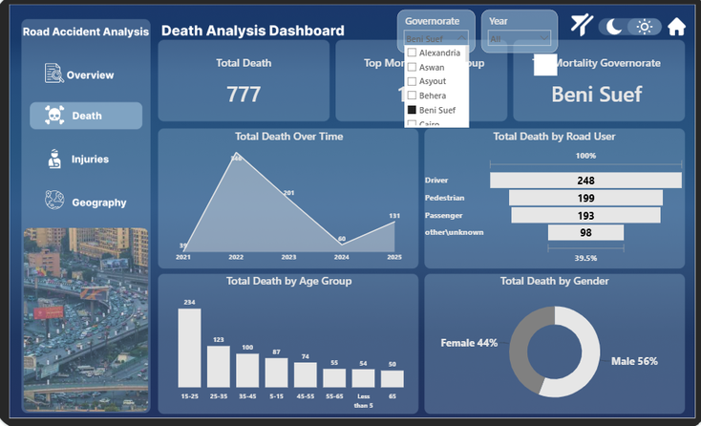
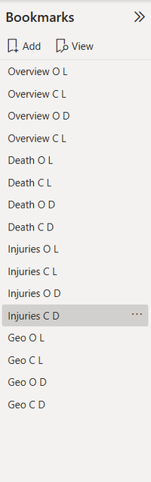
BOOKMARK
FILTERS
⟶ we created Filters to Allow users to select a specific Governorate and explore its analysis across different years.
⟶ we created Bookmarks to make it easy to navigate between different dashboard views and sections.
17

Slide 19
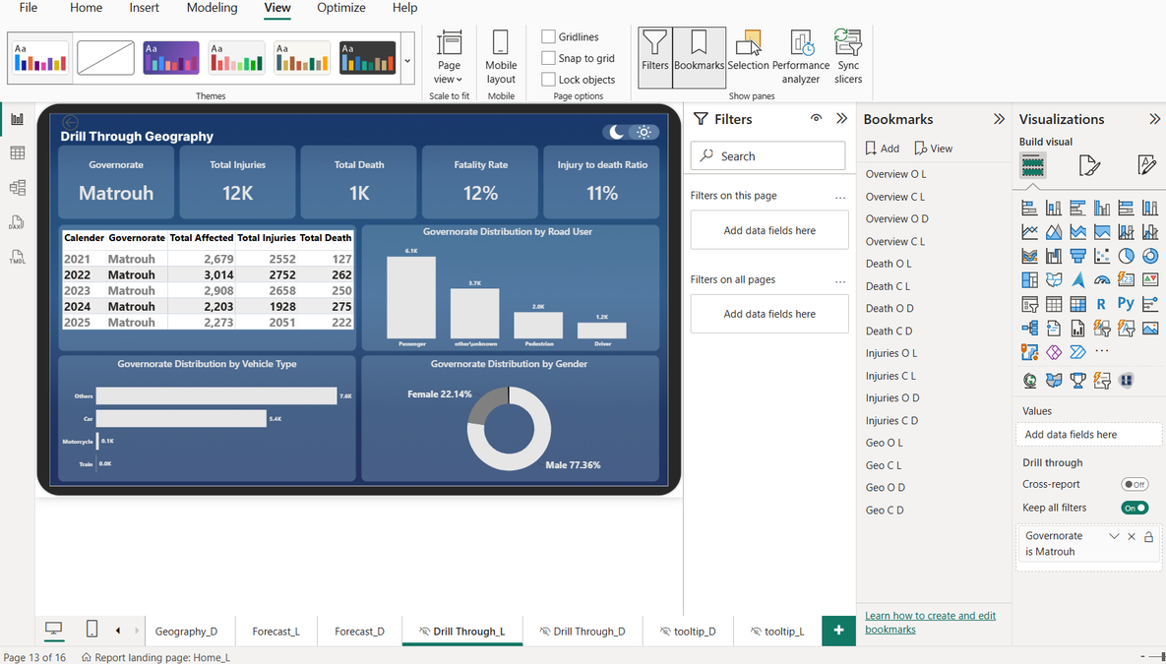
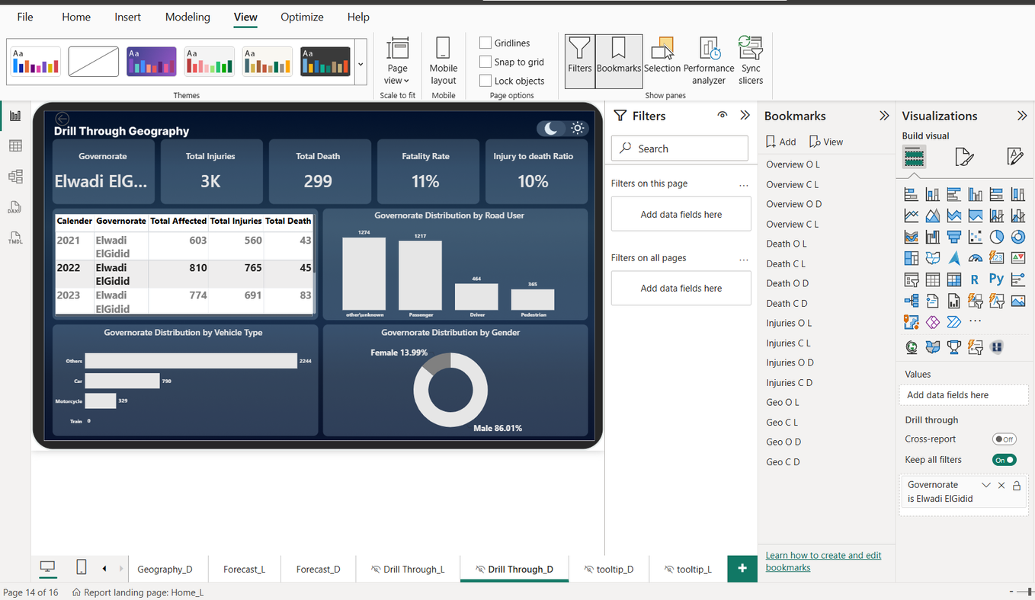
DRILL THROUGH
⟶ Drill-through functionality provides a detailed view of accident patterns and statistics for the selected governorate.
18

Slide 20
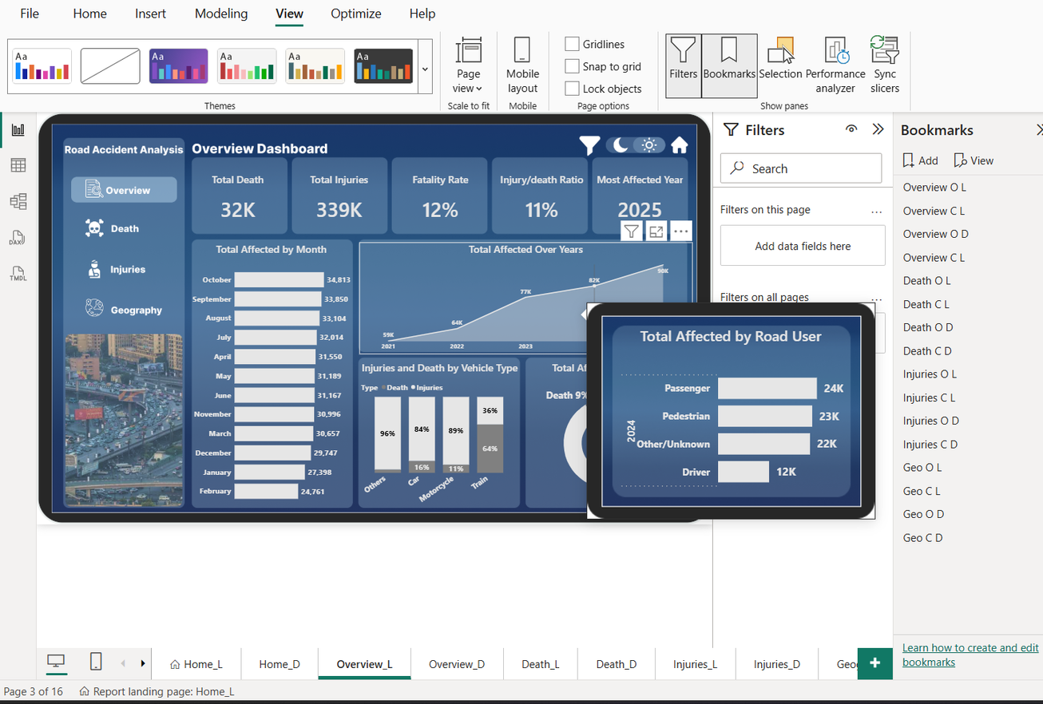
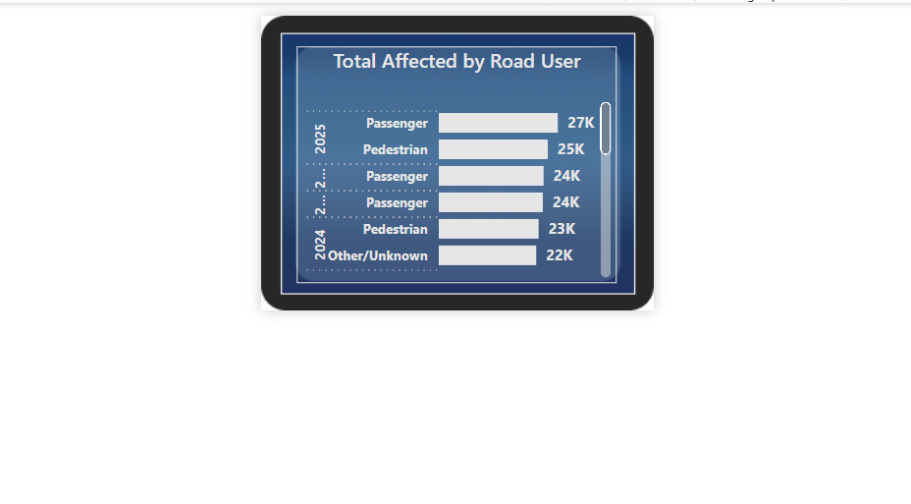
TOOLTIP
⟶ Custom Tooltip: Provides additional context on the yearly total of affected individuals by showing their distribution across different road user categories without adding extra visuals to the main dashboard.
19

Slide 21
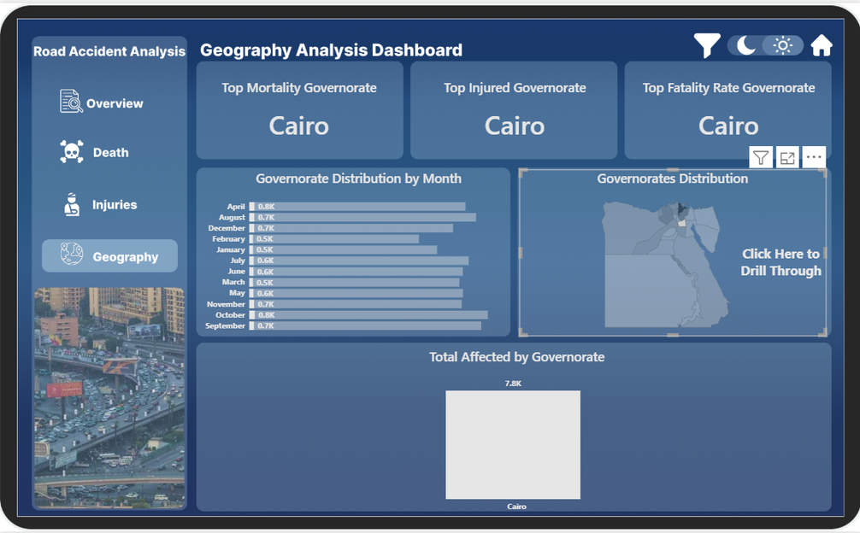
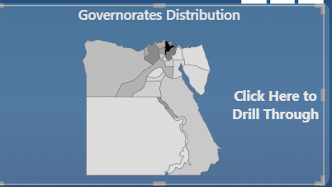
CUSTOME SHAPE MAP
⟶ Custom Shape Map: Built a customized geographic map by preparing and integrating a GeoJSON file for Egyptian governorates, allowing the dashboard to display and analyze accident data at the governorate level.
20

Slide 22
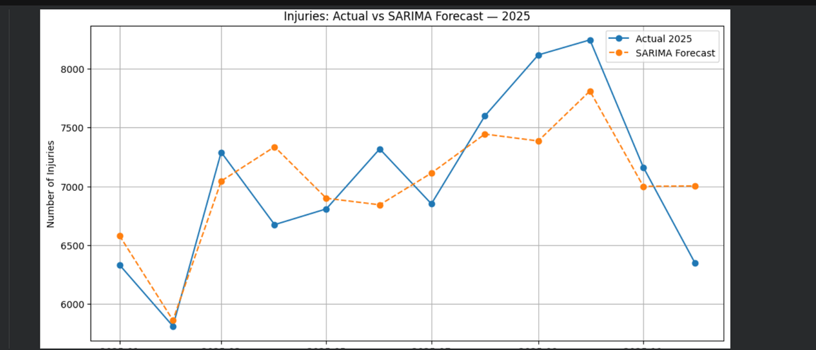
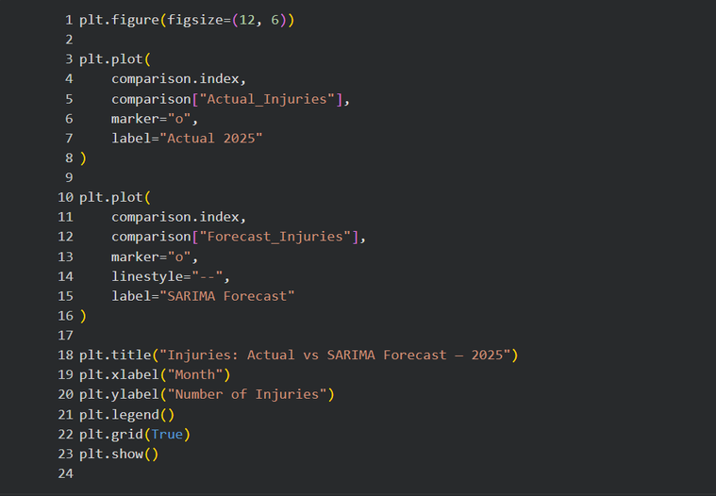
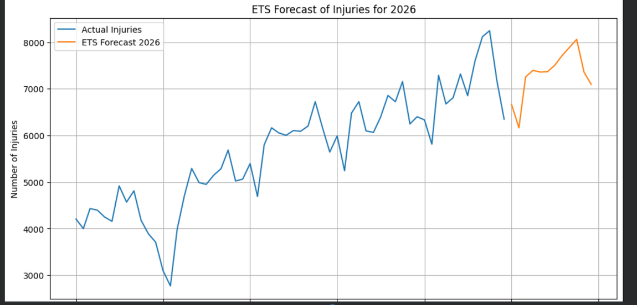
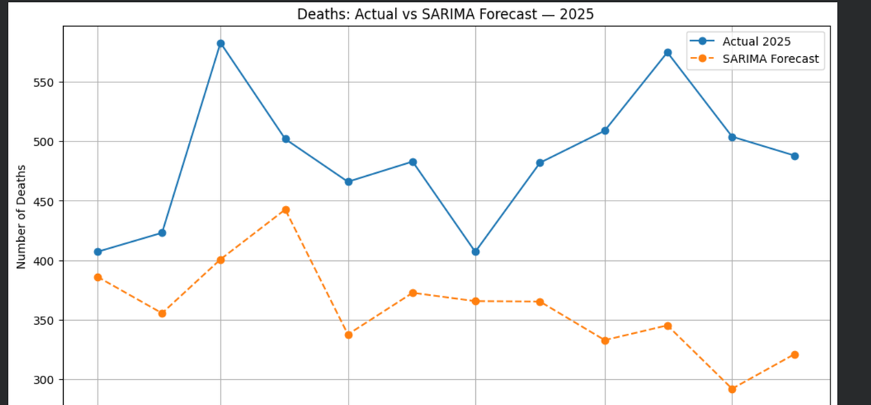
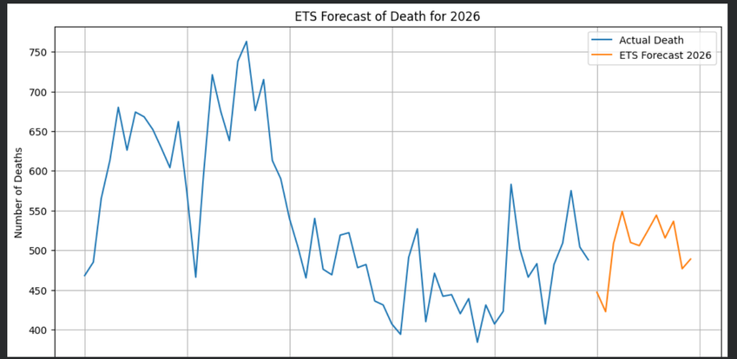
FORECASTING
21

Slide 23
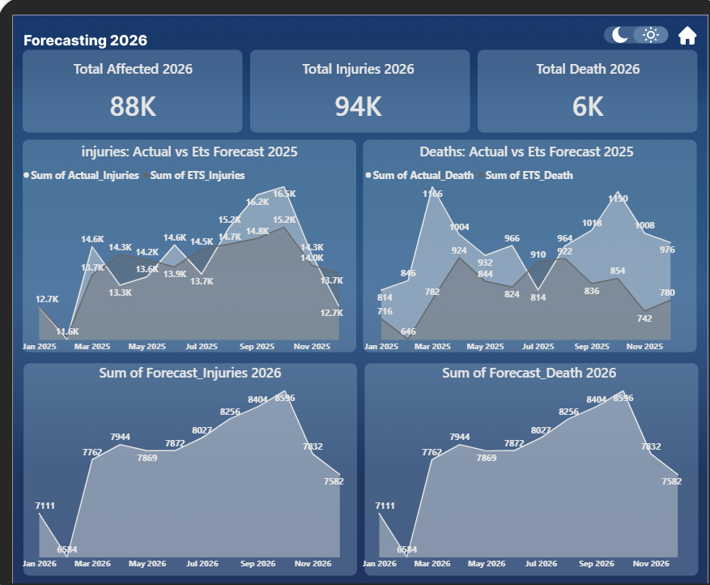
FORCASTING
To forecast future trends, historical data for 2025 was extracted from the “Months” sheet and evaluated using three forecasting models: ETS, Seasonal Naïve, and SARIMA. The models were compared against the actual 2025 values for both Deaths and Injuries to assess their accuracy. ETS achieved the best overall performance for both variables, so it was selected to generate the final forecasts for 2026.
22

Slide 24
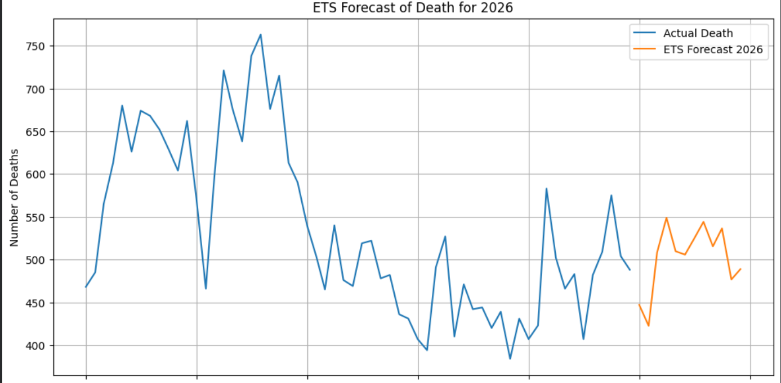
FORCASTING
To forecast future trends, historical data for 2025 was extracted from the “Months” sheet and evaluated using three forecasting models: ETS, Seasonal Naïve, and SARIMA. The models were compared against the actual 2025 values for both Deaths and Injuries to assess their accuracy. ETS achieved the best overall performance for both variables, so it was selected to generate the final forecasts for 2026.
23

Slide 25
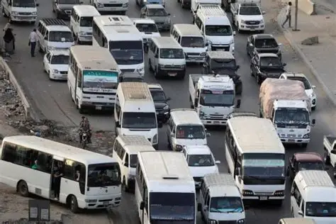
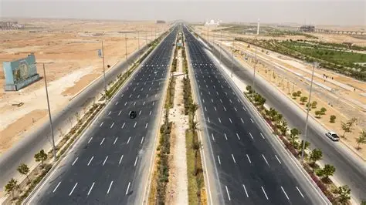
CONCLUSTION
This project goes beyond numbers. Every data point represents a real life, a family, and a story.
Through data cleaning, transformation, analysis, and interactive visualization, we turned raw accident data into meaningful insights. By comparing ETS, Seasonal Naïve, and SARIMA, we identified ETS as the most accurate model and used it to forecast Deaths and Injuries for 2026.
These insights help us understand accident patterns, compare trends across governorates and years, and support data-driven decisions.
Because behind every number, there is a life, and better data can help us build a safer future.
24

Slide 26

THANK YOU
Tools Used:
Excel
Python
Power BI
Machine Learning & Forecasting
Figma
Represented by :
Mariam Mostafa
Dalia Mohamed
Roaa Elnaggar
Roaa Elsadany
Represented to:
Instructor Donia Sakr

