Slide 1

Introduction to Machine Learning

Slide 2
What is the Objective of Machine Learning
Before ML people tended to use rule-based systems
Rule-based system depends on
Understanding data with domain expert
Make analysis for that data
Set rules
Validate rules

Slide 3
What is the Objective of Machine Learning
Rule based simulates human logic, so it is very successful technique
What about very huge with different aspects
What if we do not have the domain expert
What if was the data is varying frequently

Slide 4
What is the Objective of Machine Learning
ML targets automate the process of learning from data
But how...?

Slide 5
Machine Learning Algorithms Types
Supervised Learning
Unsupervised Learning
Reinforcement Learning

Slide 6
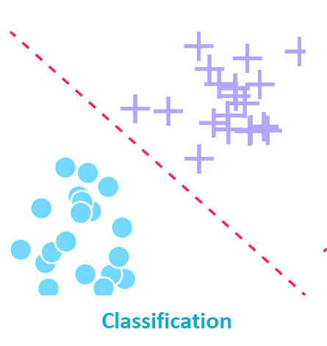
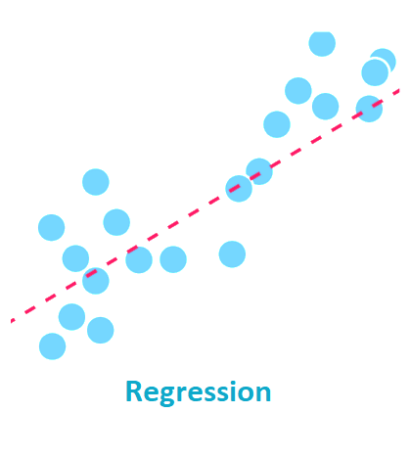
Machine Learning Algorithms Types
Supervised Learning
Algorithm learns from labelled data
Data comes in form of Features and labels
Features is the descriptors of your systems
Labels are classes in classification and function value in regression

Slide 7
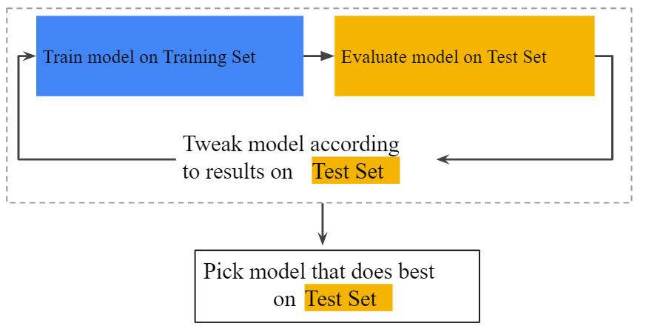
Ref: https://developers.google.com/machine-learning/crash-course/validation/another-partition

Slide 8

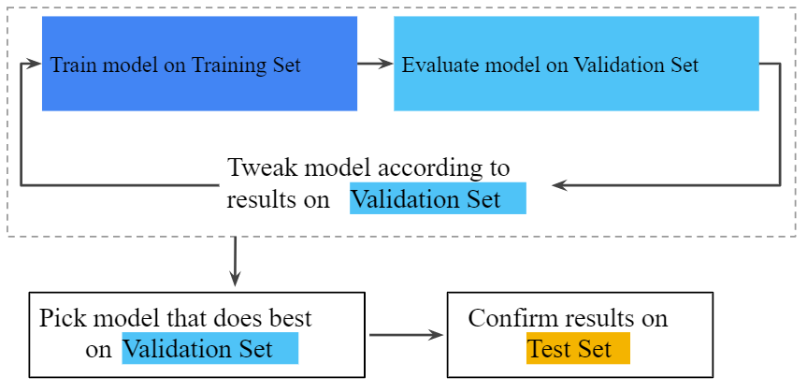
Ref: https://developers.google.com/machine-learning/crash-course/validation/another-partition

Slide 9

Machine Learning Algorithms Types
Supervised Learning
Algorithm learns from labelled data
Data comes in form of Features and labels
Features is the descriptors of your systems
Labels are classes in classification and function value in regression

Slide 10
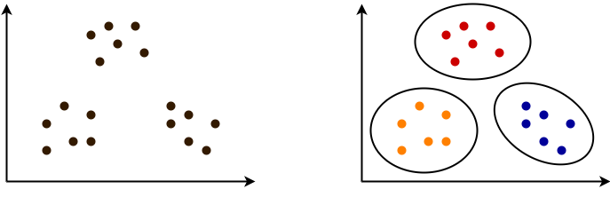
Machine Learning Algorithms Types
Unsupervised Learning
Algorithm learns to join similar data to groups
Data comes in form of Features ONLY
Features is the descriptors of your systems
Clustering evaluation usually depends on human experts

Slide 11
Machine Learning Algorithms Types
Unsupervised Learning
Algorithm learns to join similar data to groups
Data comes in form of Features ONLY
Features is the descriptors of your systems
Clustering evaluation usually depends on human experts

Slide 12
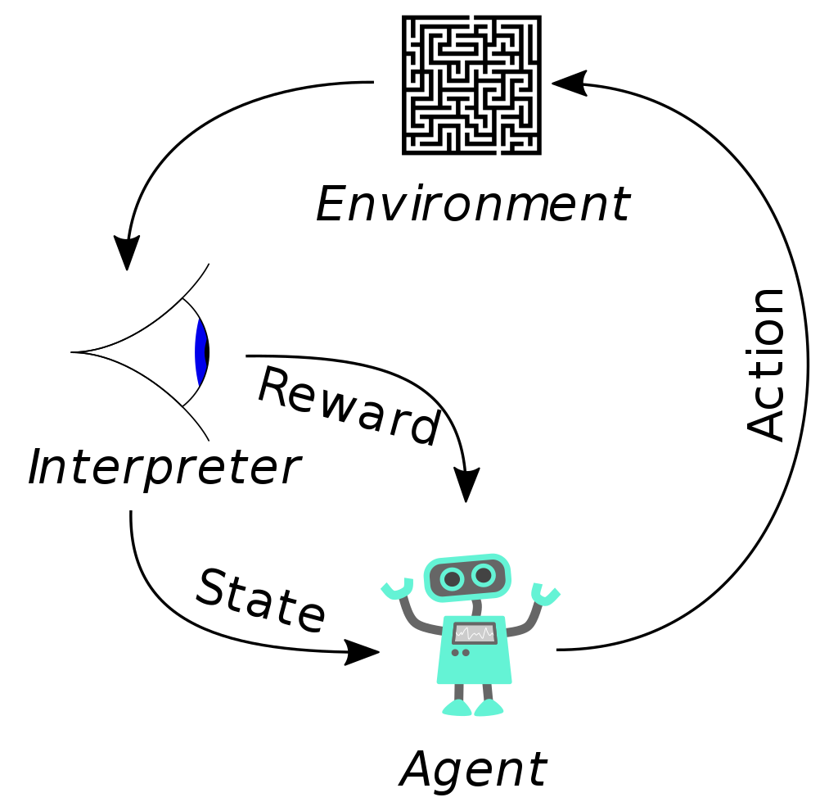
Machine Learning Algorithms Types
Reinforcement Learning
The goal of a reinforcement learning agent is to learn a policy which maximizes the expected cumulative reward
The problem is defined in the form of an agent which have a certain available states, and it should take an action that maximizes the reward
Suited to problems that include a long-term versus short-term reward trade-off
Suits fields like game theory, control theory, operations research, information theory, and so on
Notes:
Ref: https://en.wikipedia.org/wiki/Reinforcement_learning

Slide 13
Machine Learning Algorithms Types
Reinforcement Learning
The goal of a reinforcement learning agent is to learn a policy which maximizes the expected cumulative reward
The problem is defined in the form of an agent which have a certain available states, and it should take an action that maximizes the reward
Suited to problems that include a long-term versus short-term reward trade-off
Suits fields like game theory, control theory, operations research, information theory, and so on

Slide 14
Test Your Understanding
Describe the following business problems as a machine learning system
Recommender system
Identify users’ complaints from tweets
Detect fraud attacks
Detect the most effective factors that affect customers decision in buying a certain product
Dynamic pricing of products
Automatic customer segmentation
Customized landing page
Product Matching
Furniture customization

