Slide 1

Feature Engineering

Slide 2
What is Feature Engineering
Features are the actual input for the machine learning system
Feature engineering may contains:
Features Creation
Features Cleaning
Data augmentation
Feature Engineering increases the ability of the machine learning to perform its task
If the feature engineering process is significantly different between the training phase and the production phase, we will get the worst results

Slide 3


Feature Engineering for Images
For images Feature creation became some how became a historical topic because of the progress in deep learning fields
But Why?????
At the beginning the features in computer vision was all about how to extract information from edges and curvatures like SIFT, LBP, Harris descriptors and others.

Slide 4
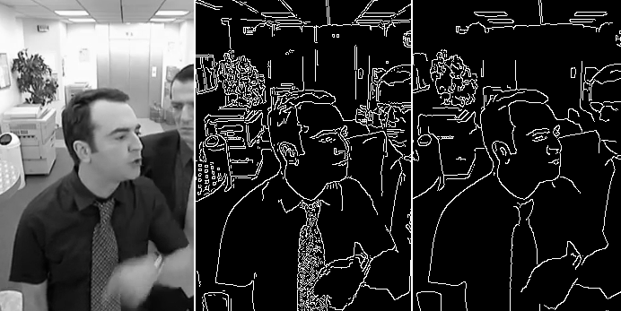
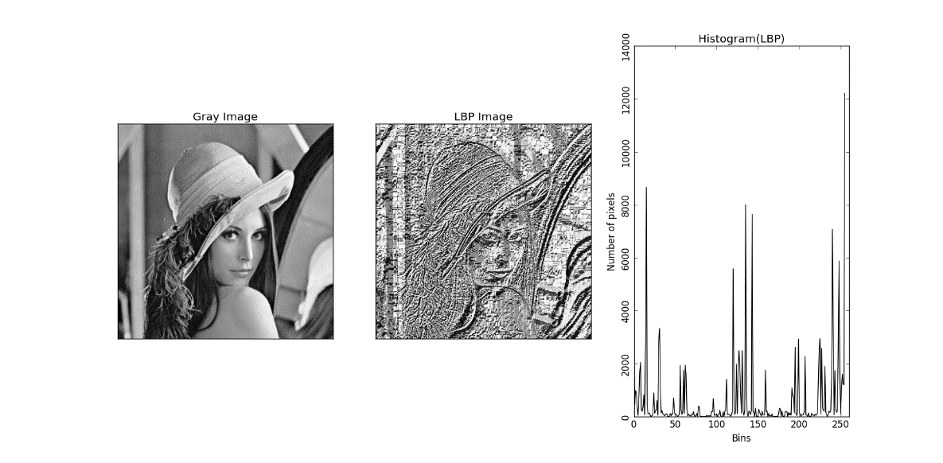
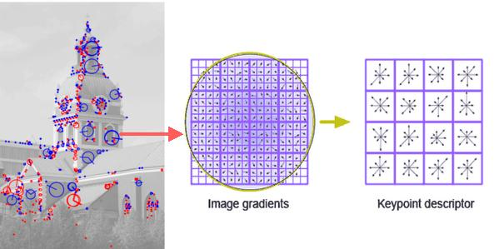
Feature Engineering for Images
Edge Detectors
Local Binary Patterns
Scale Invariant Features

Slide 5
Feature Engineering for Images
Now the concentration became on data preparation and data augmentation
The target of data preparation is unifying the form of images that will enter the network
Data augmentation target increase the ability of the model to deal with different shapes of the object and increase the number of the sample that would be recognized by the machine learning model

Slide 6
Feature Engineering for Images
Resize the input images to unify the input shape
Adding noise for image
Apply affine transformation to resist image pose bias
Add random exposure to coup with different lightening conditions
Check the notebook!

Slide 7
For Data Science
How to deal with missing data?
1
How to deal with categorical data?
2
How to deal with continuous values?
3

Slide 8

For Data Science
What to do with missing data?
Drop column
Use zero for missing values
Use min, or max, or avg value
Predict value from other features
Predict value with other estimator

Slide 9
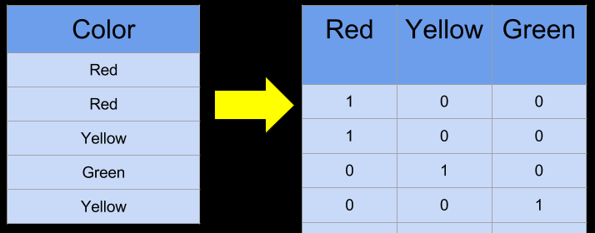
For Data Science
Categorical Features
One-hot encoding
Count the number of unique categorical values
Represent each value with a vector of dimensions that equals to the unique values
This vector contains value of one in a only one unique place of this vector

Slide 10
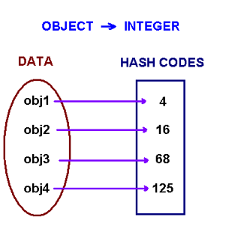
For Data Science
Categorical Features
Feature Hashing
Find a unique hashing value for each category
To avoid collision set the number of hashed values a bit bigger than the unique values
If you want to optimize memory you may scarify with collision and make the number of hashed values lower than the number of unique words

Slide 11
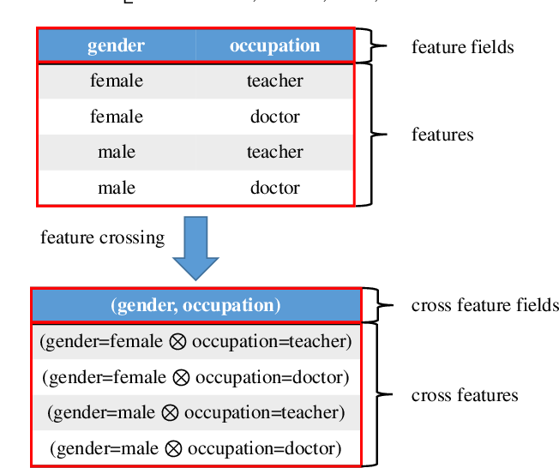
For Data Science
Categorical Features
Feature Crossing
If there is strong correlation between two feature column you can combine them in one feature column

Slide 12
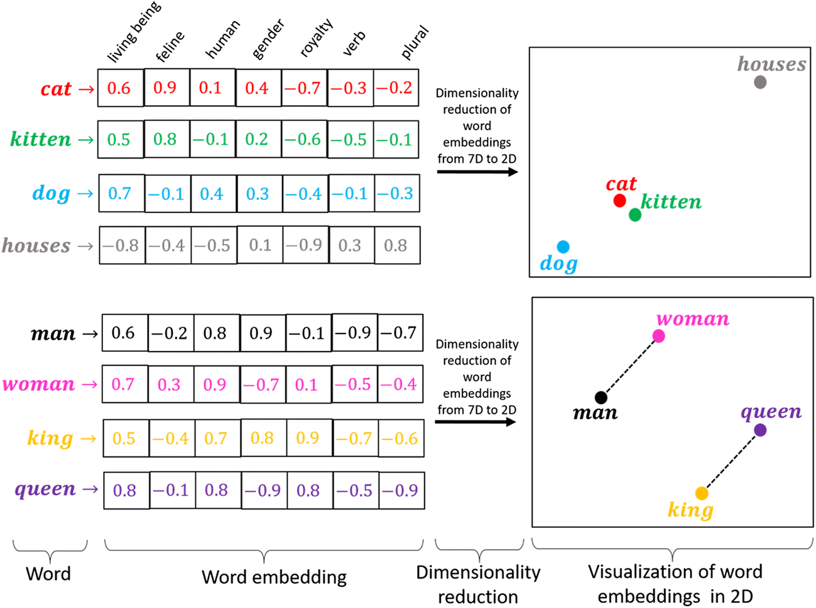
For Data Science
Categorical Features
Feature Embedding
Finding a dense representation for categories
This dense representation capture sematic relations between categories

Slide 13
For Data Science
Numerical Features
Continuous values may capture a relation with the target
In some cases there is a complex relation between the values and the target like the relation between age and the income
Bucketizing the values some times help

Slide 14
For Text
Text analysis
Tokenization
The process of converting the full text to tokens
Hello Friends!we will proceed.
Go to school,then study
Remove stopping words (what is stopping words)
Stopping words is the tokens that are repeated frequently
For example: the, are, and, …..
Stemming
The process of removing infliction
Q: what is the difference between infliction and derivation
Part of speech tagging
Tag words as part of speech (verb, noun, …..)

Slide 15
For Text
How to digitize words?
Bag of words
Represent the document as a vector its dimensions is the unique words. And the value of each dimension is the frequency of this words
N-grams
Solves the drawback of the bag of words which is ignoring context
This method increase computational complexity
Tf-idf transformation
compute a score for each word to signify its importance in the document and corpus
tf(t,d) = count of t in d / number of words in d
df(t) = occurrence of t in N documents
idf(t) = N/df → idf(t) = log(N/(df + 1))
tf-idf(t, d) = tf(t, d) * log(N/(df + 1))
Word-vectors
Get a dense vector for the words

Slide 16
Feature Selection
The process of reducing the number of input variables when developing a predictive model
Why?
reduce the computational cost of modelling
improve the performance of the model
How?
selecting those input variables that have the strongest relationship with the target variable
Types of Feature Selection algorithms
Filter methods: find a measurement to find the contribution of each feature in the problem space
Wrapper Methods: find the effect of each feature in the classification decission
Stay tuned!

