Slide 1
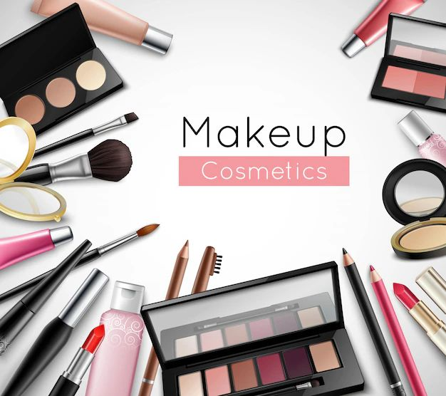

Principle Of Marketing / Principle Of Management E-commerce of a Makeup Cosmetic
Present By: Rita Sabbagh
Maryan Toma
Dalia Adnan

Slide 2

Content:
Introduction to E Commerce
Components of an Internet Business
Business Model
SWOT Analysis
Business to Consumer (B2C)
How to Benefit Business to Consumer (B2C)

Slide 3

Introduction
In the ever-evolving world of beauty, makeup e-commerce has revolutionized the way consumers access and discover beauty products. The online platform provides convenience and a variety of options, breaking down traditional barriers and fostering a global community.

Slide 4
Components Of An Internet Business
Product selection: Cosmetics, for example, must be of high quality
User-friendly website: allows for easy navigation including clear categorization of products
Customer Support: Providing excellent customer service, such as e-mail and social networking sites, and providing assistance during the purchasing process
Secure Payment: Providing a secure online payment option to ensure smooth transactions
Supply chain management: to ensure timely delivery of products to customers

Slide 5
Business Model:
Supplier participation: Identify reliable suppliers and negotiate terms.
Implementing innovation: Regularly update product offerings based on trends.
E-commerce setup: Develop and launch a secure and easy-to-use online store.
Direct sales and marketing: Engage consumers through targeted marketing efforts.
Sustainability Integration: Adopting environmentally friendly practices in product development.
Revenue generation: Generate revenue through direct product sales.
cost management: Control procurement costs and allocate budgets effectively.
Enhance your value proposition: Continuously improve product quality and stay responsive to trends.

Slide 6
SWOT Analysis:
Strength:
Brand Reputation: A strong reputation based on product quality, cruelty-free formulations, and positive reviews.
Product Innovation: Continuous innovation in formulations, colors and packaging to survive
Weaknesses:
Relying on trends: Vulnerability to rapidly changing beauty trends, requiring frequent product updates.
Intense Competition: Need for distinctive strategies to stand out in the competitive beauty market.

Slide 7
SWOT Analysis:
Opportunities:
E-commerce growth: Leveraging the global reach of e-commerce to expand online sales.
Focus on Sustainability: Meeting the demand for sustainable and environmentally friendly beauty products.
Threats:
Regulatory Challenges: Maintaining compliance with evolving cosmetics industry regulations to mitigate legal threats.
Market Saturation: Differentiate the brand through unique selling propositions and effective marketing to combat market saturation.

Slide 8
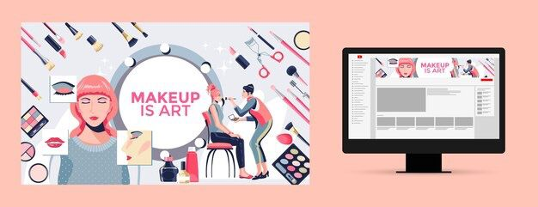

Business To Consumer (B2C):
Business to consumer (B2C). It involves marketing and selling cosmetics directly to consumers through online platforms, outlet stores, or even direct sales. The focus is on creating attractive products and positive customer experiences to increase sales in the market

Slide 9
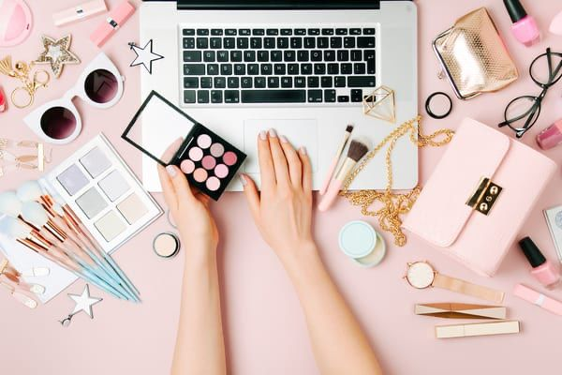
How To Benefit Business To Consumer (B2C):
Innovative Product Launches
Effective Online Presence
Excellent customer service
Encourage customers to share their experiences with our products
Participating with beauty experts to promote our beauty products can help increase brand visibility and reach a wider audience

Slide 10
Assuming The Client Wishes To Expand The Business And Conjoin With Other Businesses Of The Same Kind Through A Network Of Suppliers, How Would You Advise The Client?
He expands his makeup business by partnering with similar companies through his supplier network. Research markets, set clear objectives, select reliable suppliers, build industry connections, ensure legal compliance, maintain product quality, improve logistics, explore collaborative marketing, integrate technology, collect customer feedback, manage risks, provide training, consider sustainability, evaluate Regularly evaluate coping strategies.

Slide 11
For An E-commerce Application Dealing With Orders From Customers Outside The Region Or State:
International Shipping: Enable reliable international shipping.
Transparent costs: Clearly communicate potential shipping costs and fees.
Localization: Offering currency options, multilingual support, and global payment methods.
Accurate Delivery Estimates: Providing realistic delivery timelines for international orders.
Return Policy: Clearly outlines international returns procedures.
Translated product information: Include product details in multiple languages.

Slide 12
Conclusion
In summary, makeup cosmetics e-commerce thrives on convenience and personalization. Success requires seamless user experiences, transparent logistics, and adaptability to global markets. Prioritizing customer satisfaction, sustainability, and technology integration is crucial for future growth.

Slide 13
Reference
Books: "E-commerce 2023" by Kenneth C. Laudon and Carol Guercio Traver. "The Business of Beauty: A Practical Guide to Salon Success" by Liz McKeon.

Slide 14
Thank you

