Slide 1
Crimes and accidents in toronto
Tigran
Sue
Dian
Dalia

Slide 2
It feels like crimes and accidents are on the rise in Toronto, But what does the data say?
What are the most common types of crime in toronto?
Which neighborhoods experience the highest crime rates?
How do crime rates fluctuate over time?
How does the income level in a neighborhood affect crime rates?
How does the education level in a neighborhood affect crime rates?
Which location types are most prone to traffic accidents?
How did the number of traffic accidents and their class change over time?

Slide 3
DATA
TORONTO POLICE APIS
MCI - MAJOR CRIME INDICATORS
ARGUMENTS FOR MONTH AND YEAR TO GET AROUND 2000-RECORD LIMIT
KSI - TRAFFIC INCIDENTS
STATS CANADA CENSUS API
ARGUMENTS FOR GEOCODE AND TOPIC
MAPBOX API
ADDITIONAL DATASETS
NEIGHBORHOODS-TRACTS CONVERSION CSV

Slide 4
MOST COMMON CRIME TYPES

Slide 5
Highest crime rates per neighborhood

Slide 6
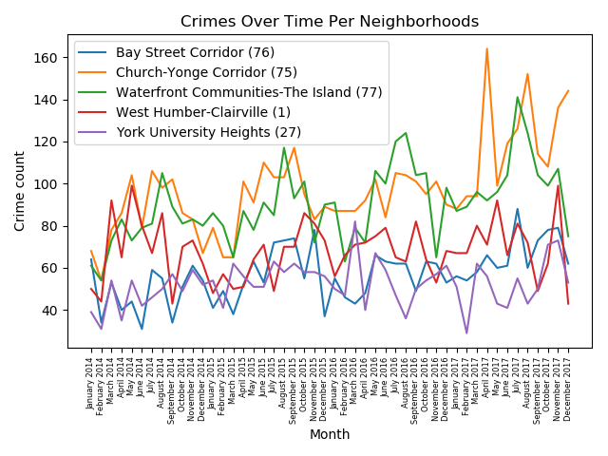
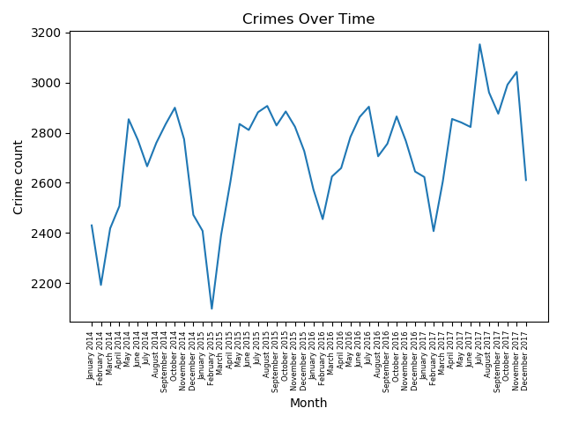
CRIMES OVER TIME

Slide 7
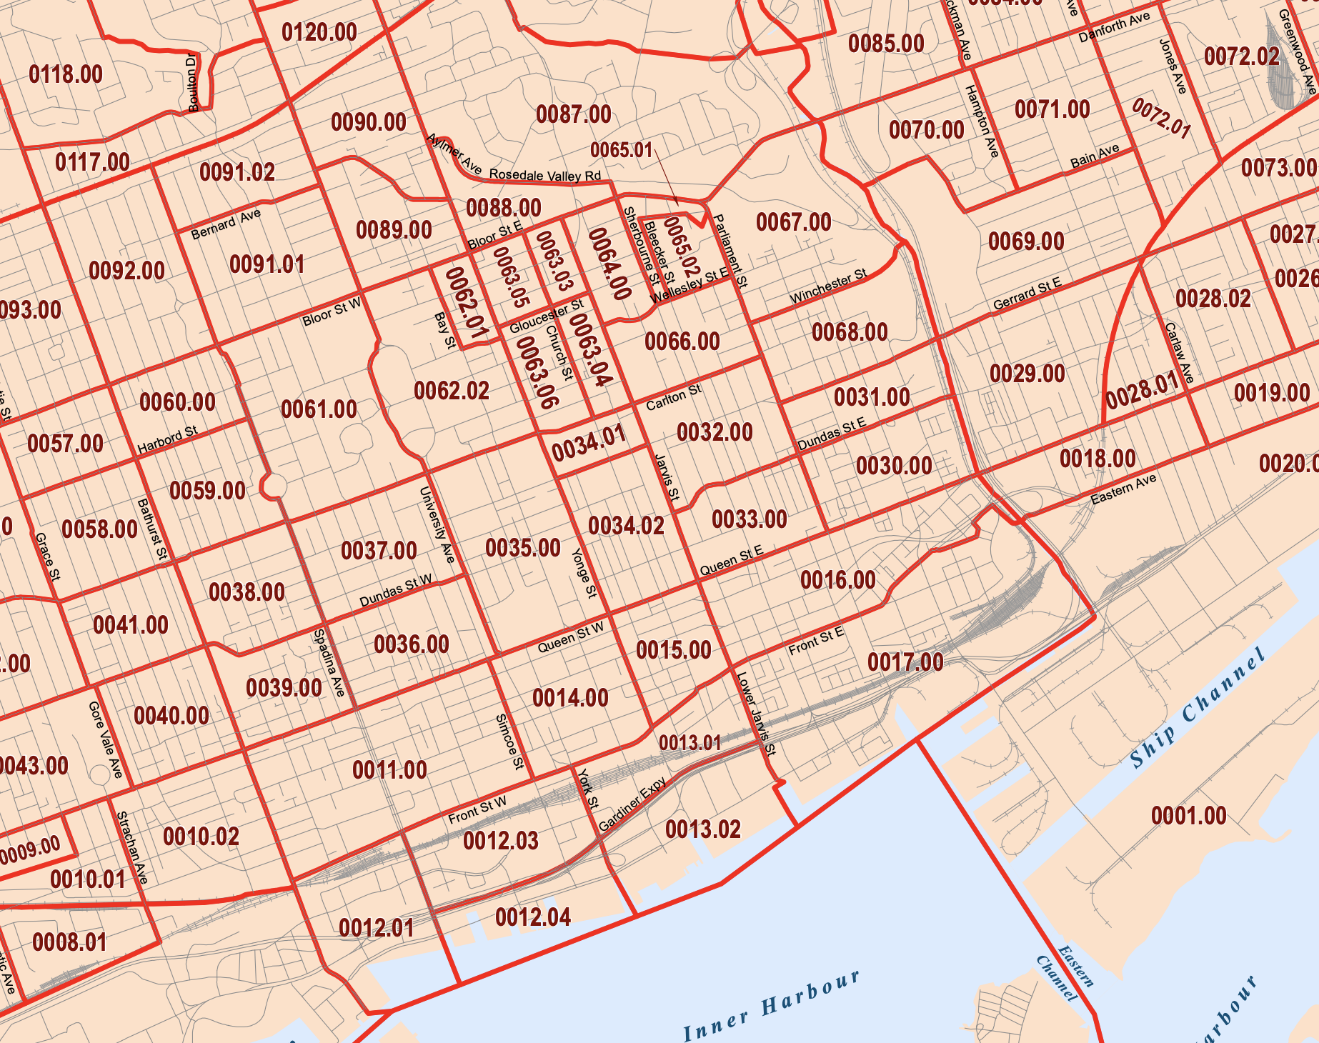
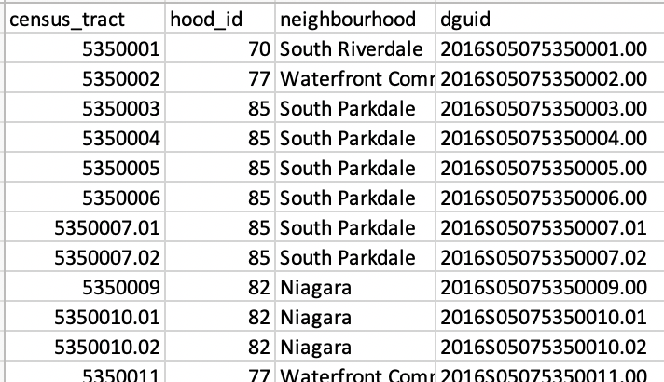
CRIMES VS INCOME and education
POLICE API
ALL INCIDENTS
W/ NEIGHBORHOOD ID
CENSUS API
PULL DATA PER GEOCODE (CENSUS TRACT)
?
https://www12.statcan.gc.ca/rest/census-recensement/ CPR2016.json?lang=E&dguid={dguid}&topic=7

Slide 8
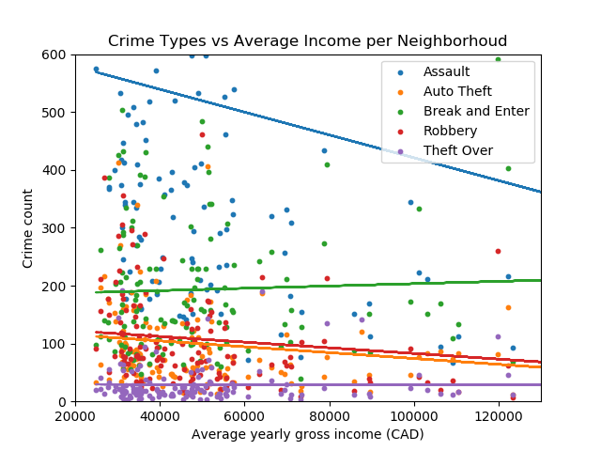
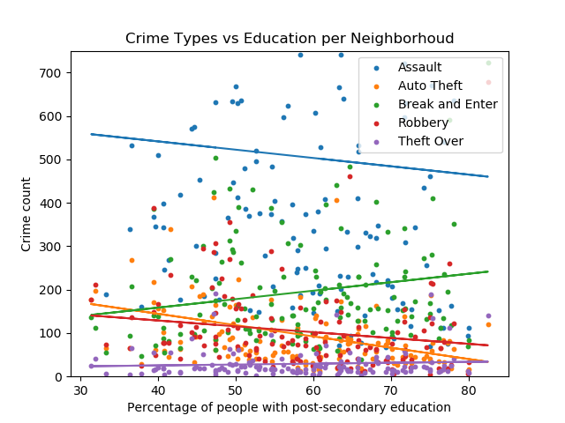
CRIMES VS INCOME AND EDUCATION

Slide 9
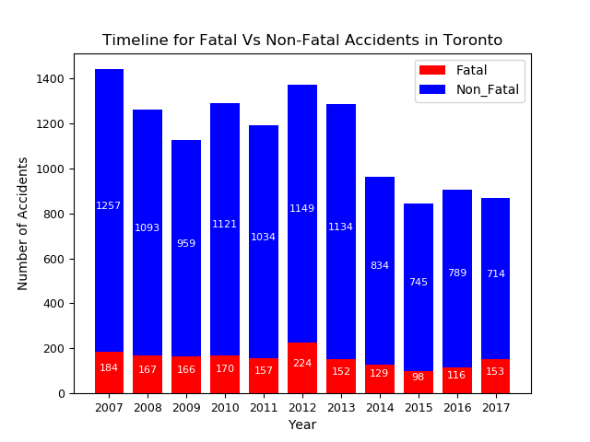
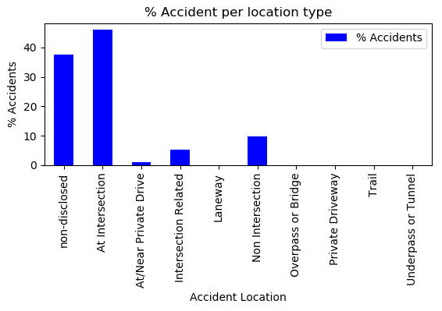
KSI(Killed and Seriously injured)

Slide 10
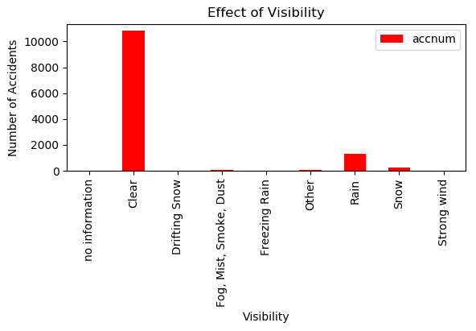

Slide 11
LIMITATIONS
STATS CANADA DATA IS FOR 2015 ONLY, POLICE DATA IS 2014-2017

