Slide 1
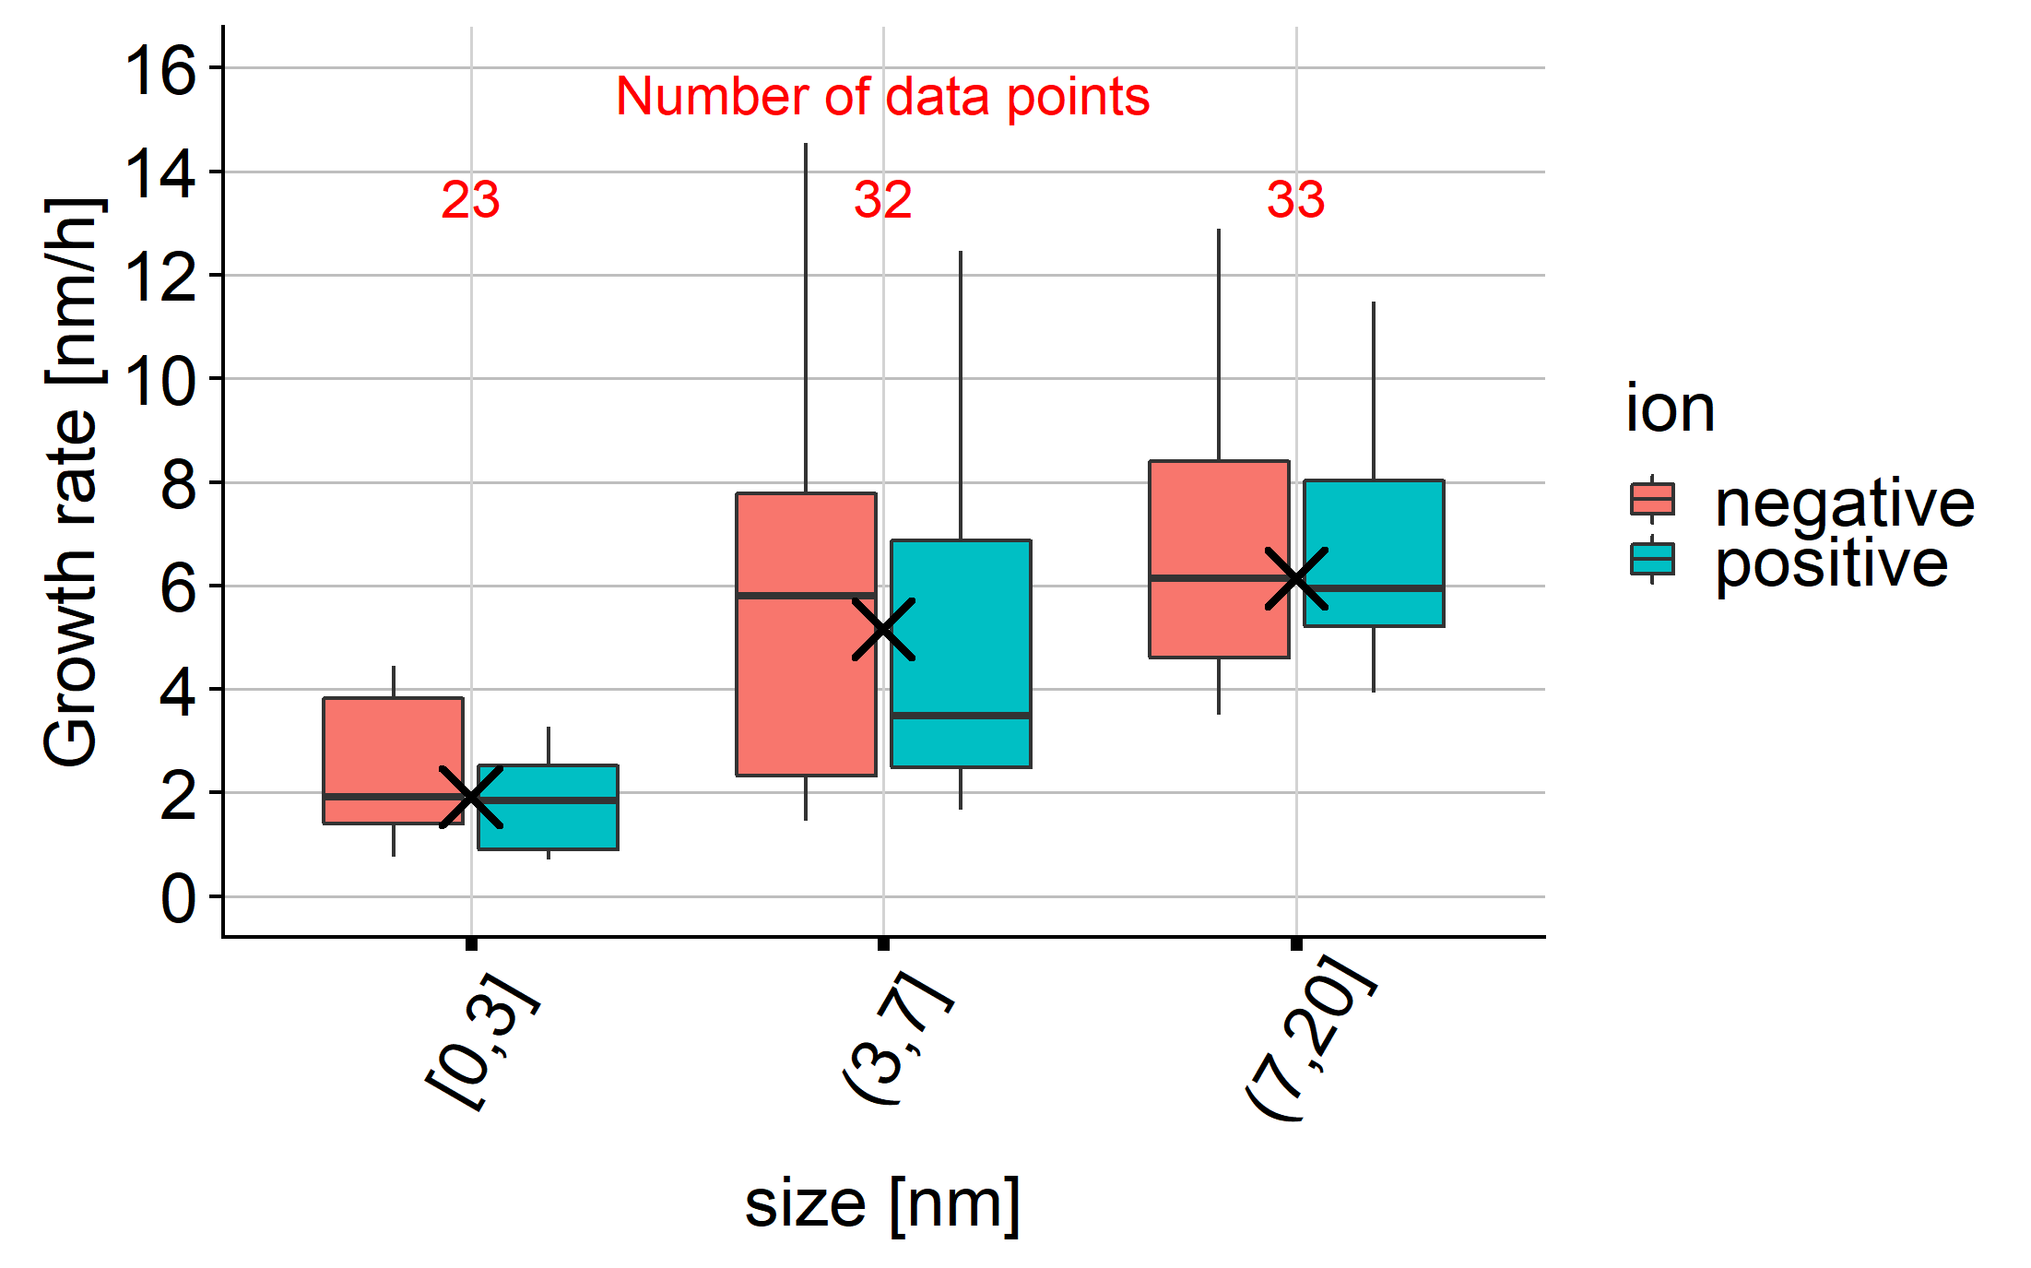
GR at CHC, "Classical" approach
Particle diameters have been altitude-corrected by comparing to SMPS (courtesy of Joonas)

Slide 2
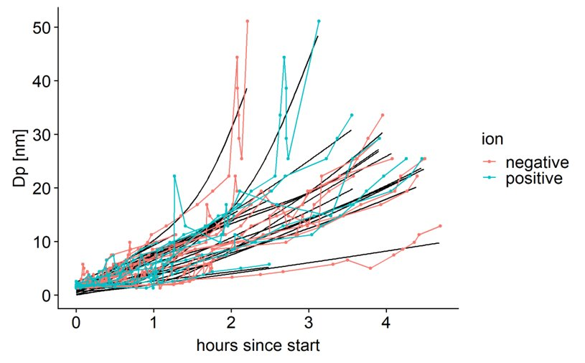
"Splined trajectory" approach
Each growing event gets represented by a "trajectory"
Then, a smoothing spline is drawn through each trajectory
A function is obtained for each trajectory.
Derivating this function gives the instantaneous growth rate.

Slide 3
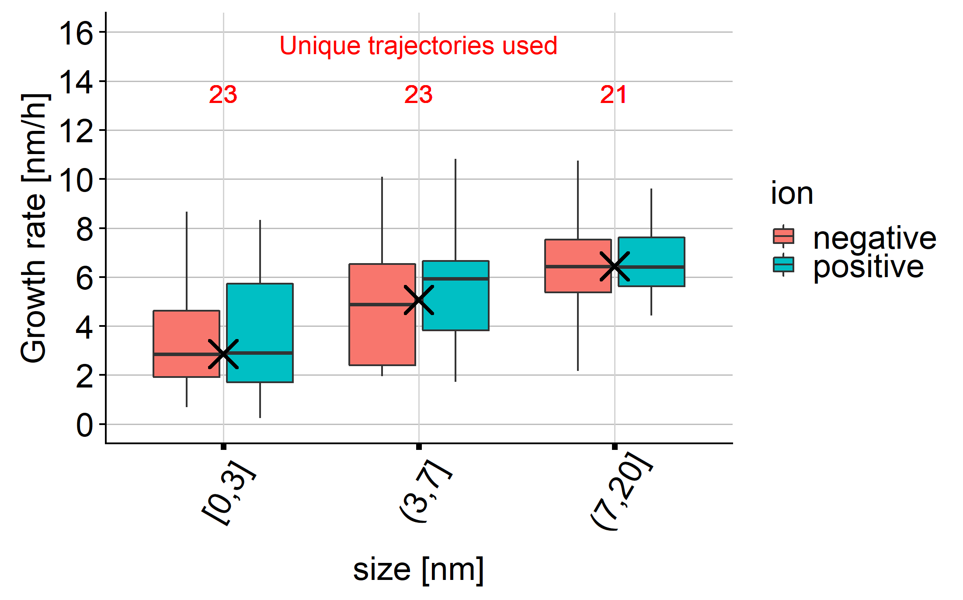
How do the results compare?
"Classical" approach
"Splined trajectories" approach

Slide 4
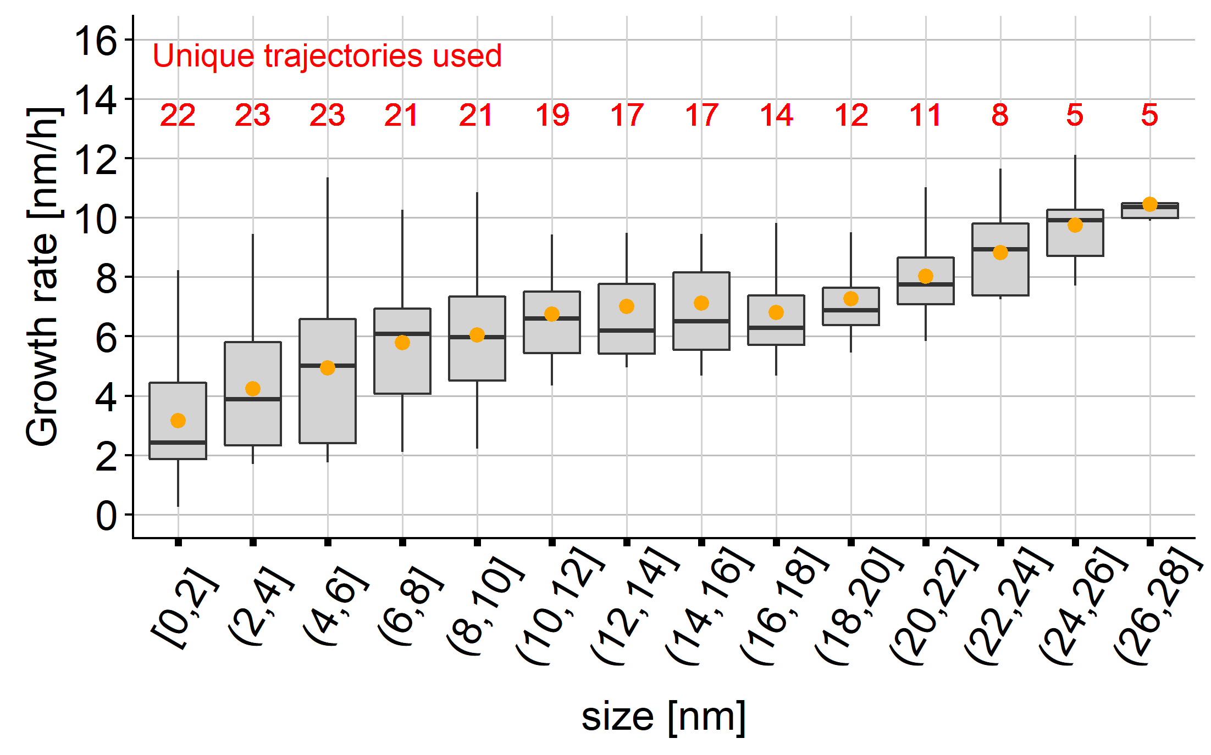
The "splined trajectories" might give a deeper insight
…..but how "real" are the results?

Slide 5
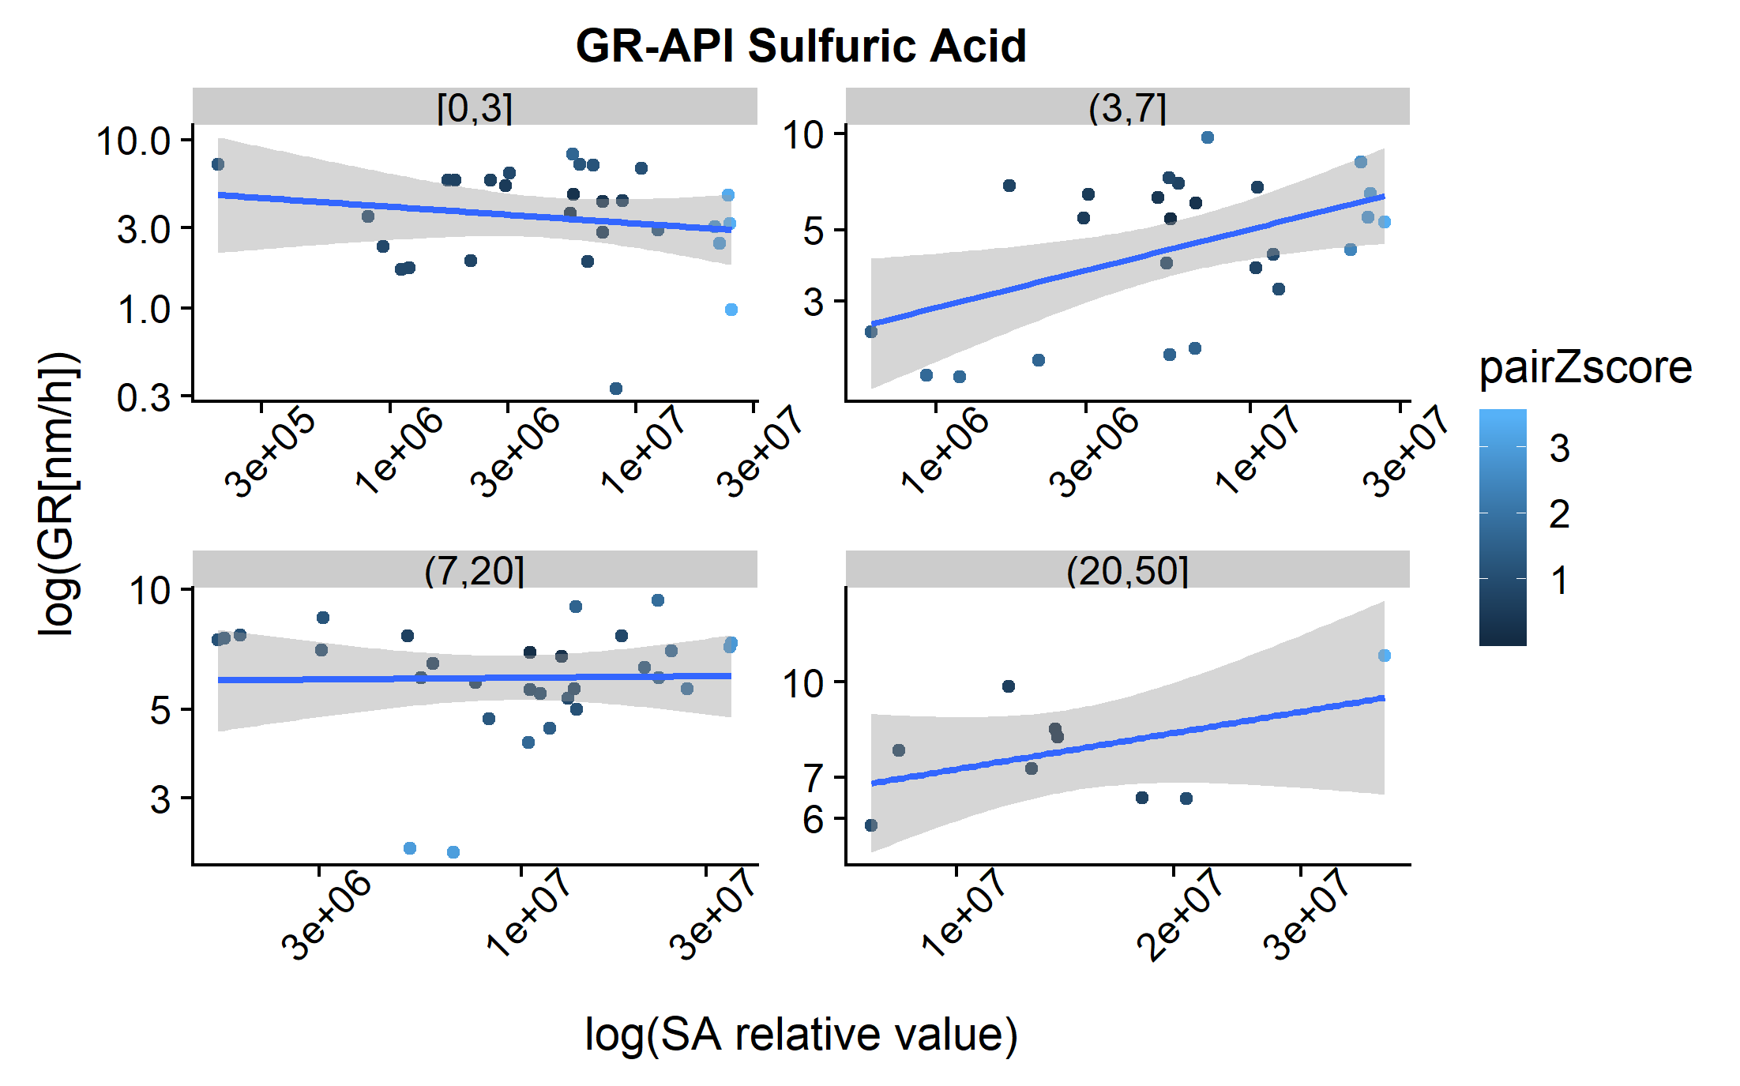
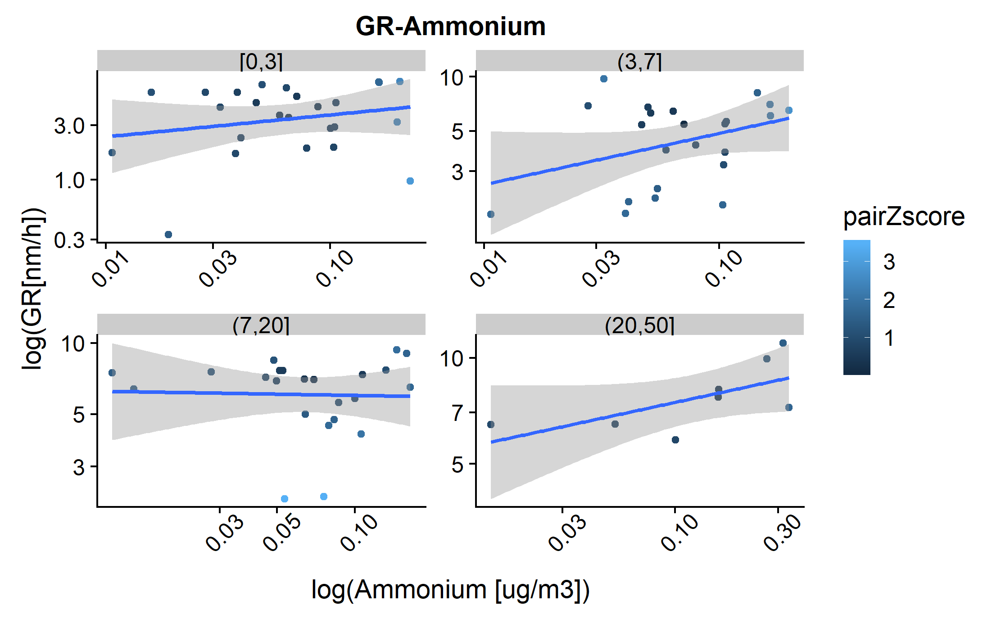
...and can allow to look a bit differently at the data
…..but again: Some more quality analysis has to be done...

