Slide 2
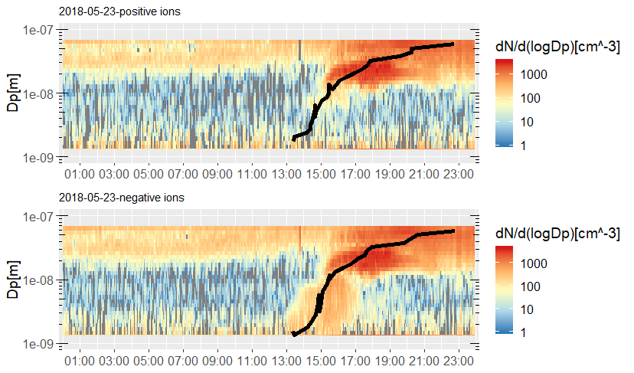
NAIS data
Objectives: Compare NAIS data from CHC and airport
Calculate and compare growth rates for event-days
Investigate on airmass influence on growth rates frequency of events

Slide 3
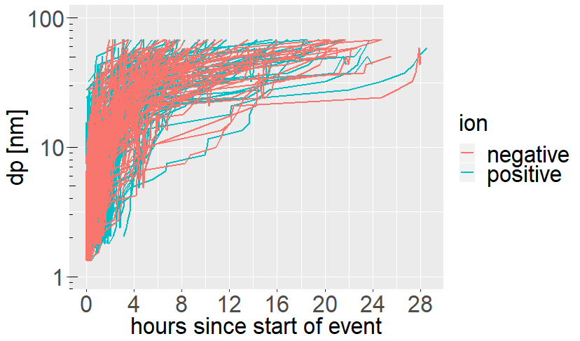
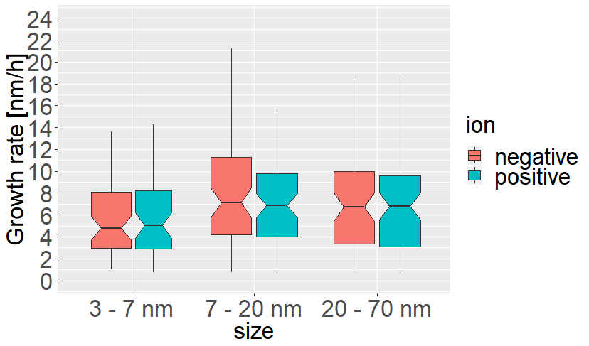
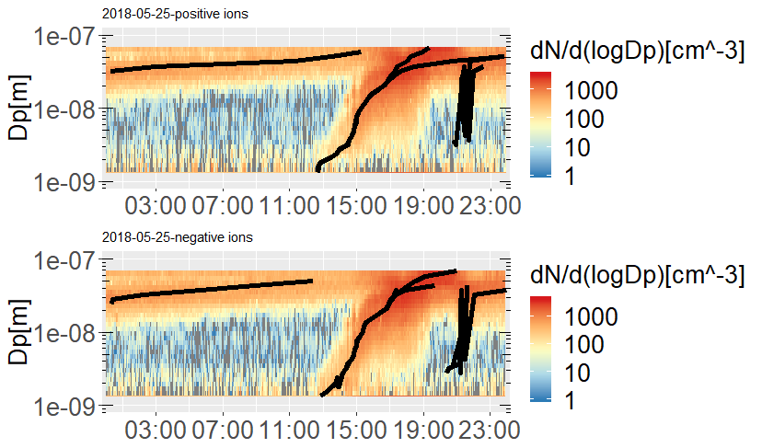
preliminary
BUT
Have to classify and filter "events"

