Slide 1
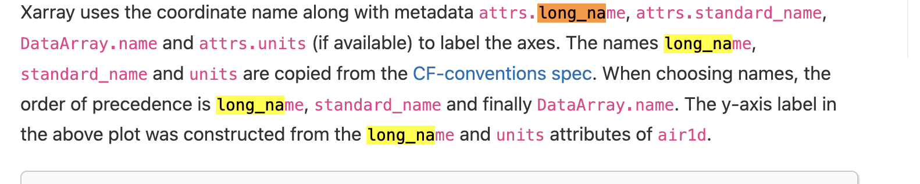
Missing functions
Modules
Bnn_cut_dp
bnn_xarray
add the bnn extension to xarrya
basic_funs
funs that are both by bnn_xarray and funs
funs
contains user friendly funs
Bnn-tools-repo
par_pos positive particle
par_neg negative particle
ion_pos positive ion
ion_neg negative ion
par particle
name
units
dN/dlog(Dp)
1/cm3

Slide 2
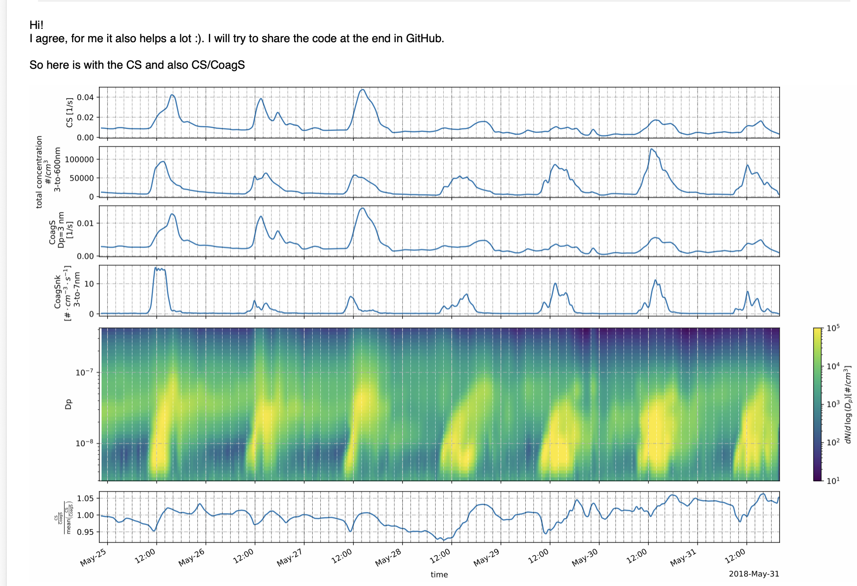
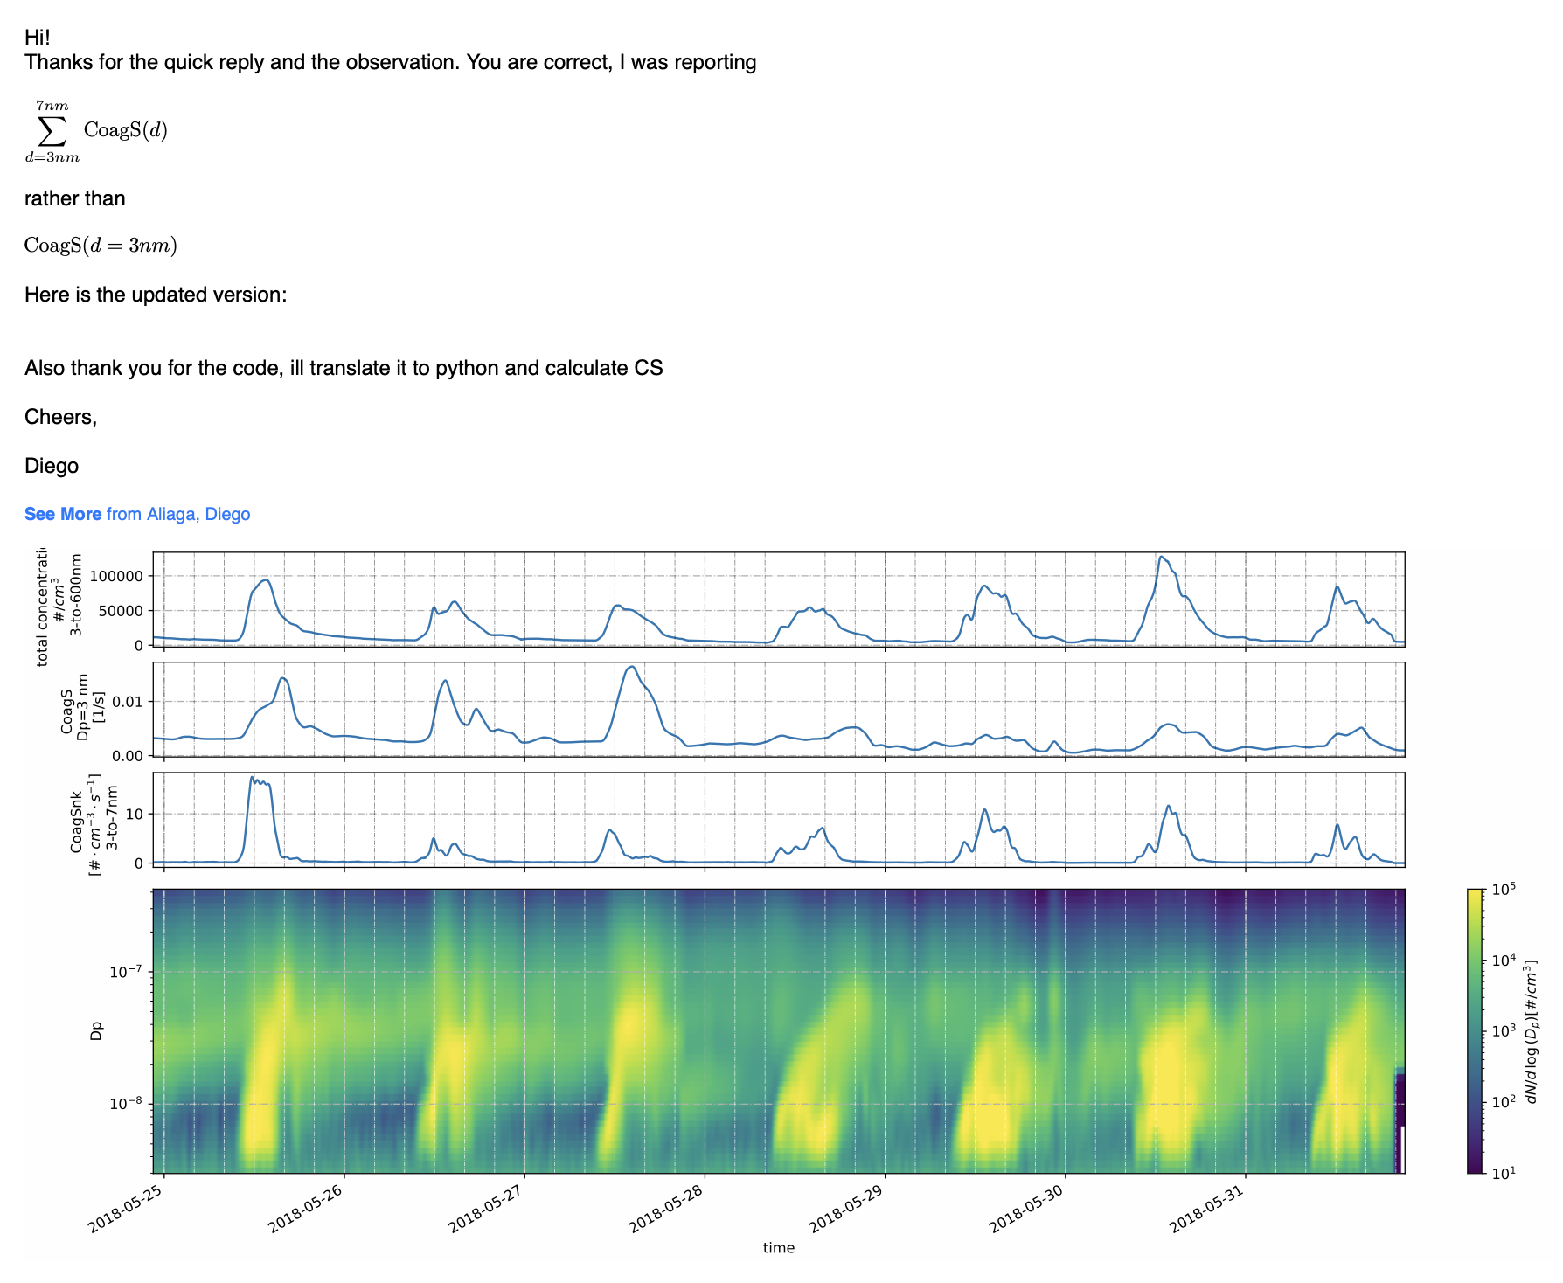


Slide 3
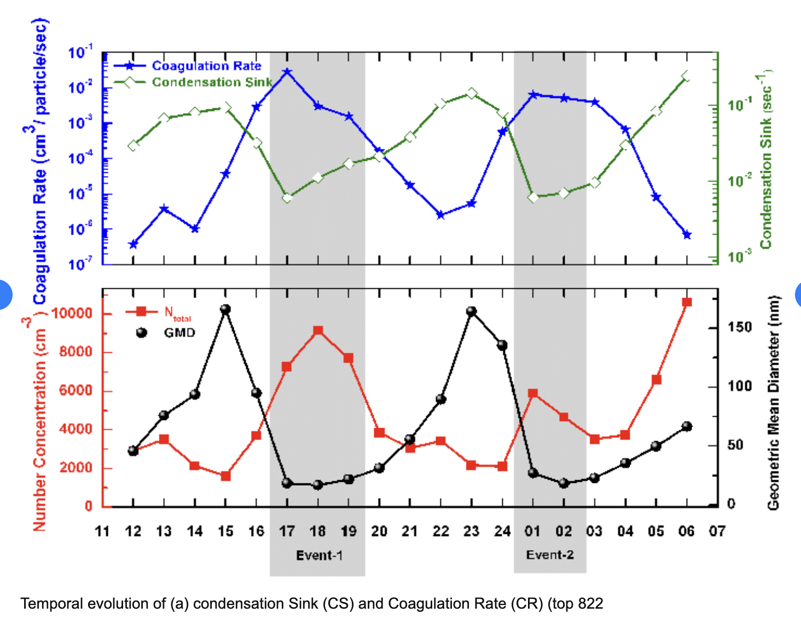
0,01
4.5

