Slide 1
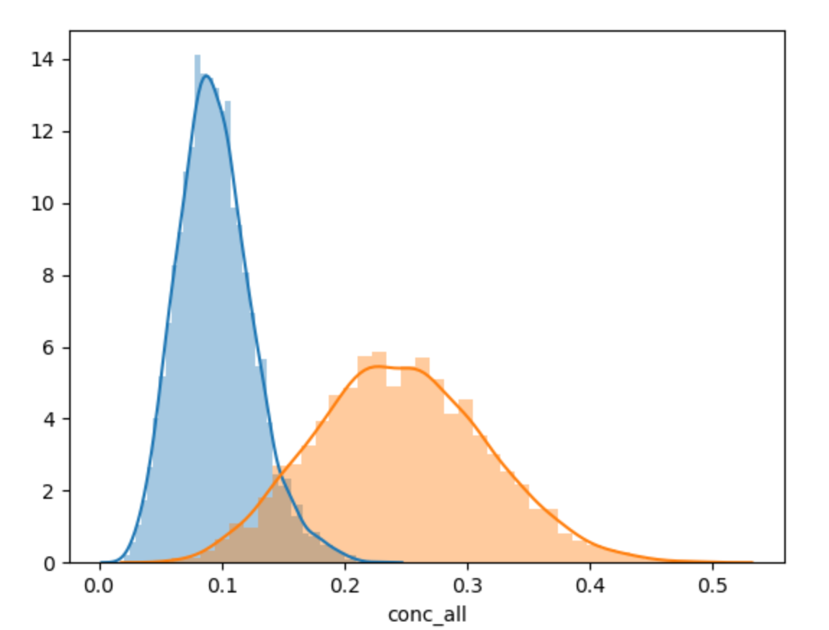
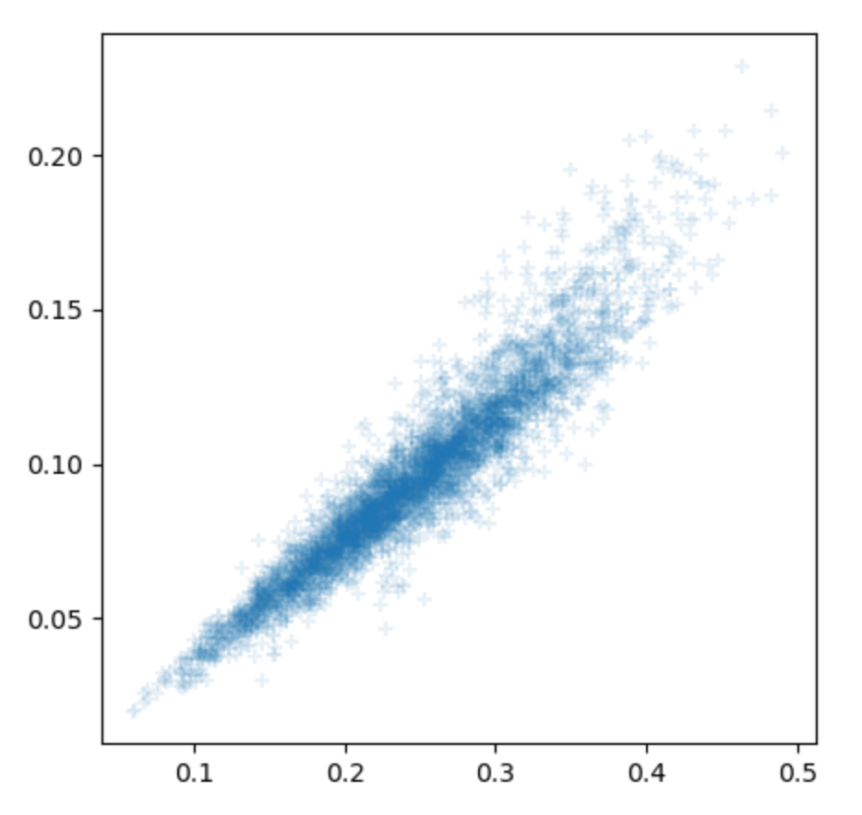
Lev 0
Lev 0
BL
BL

Slide 2


Lev0 – (detrend day)

Slide 3
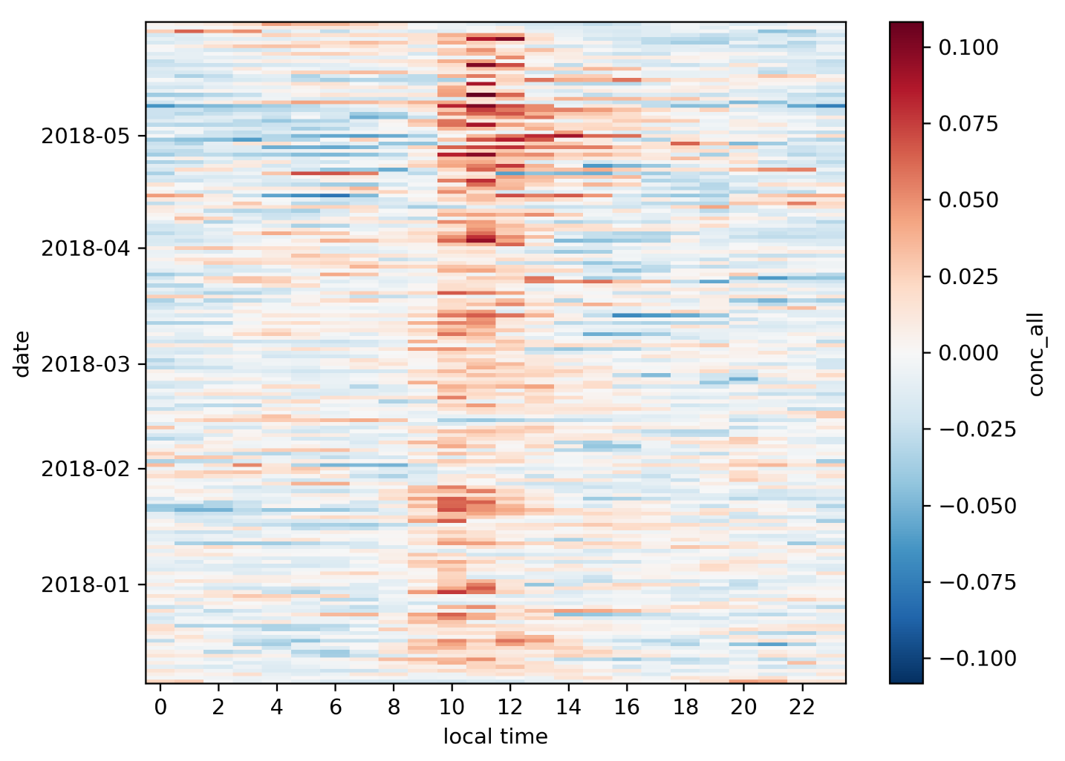
Daily variation

Slide 4
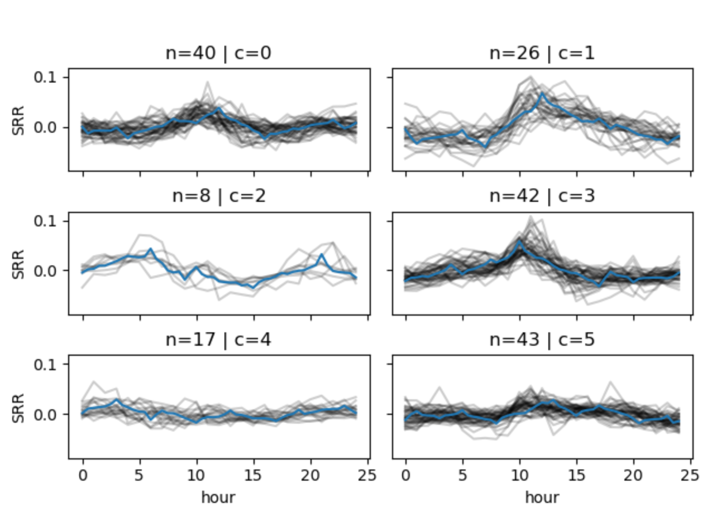

Slide 5
Lev 0
Lev 0
BL
BL

