Slide 1
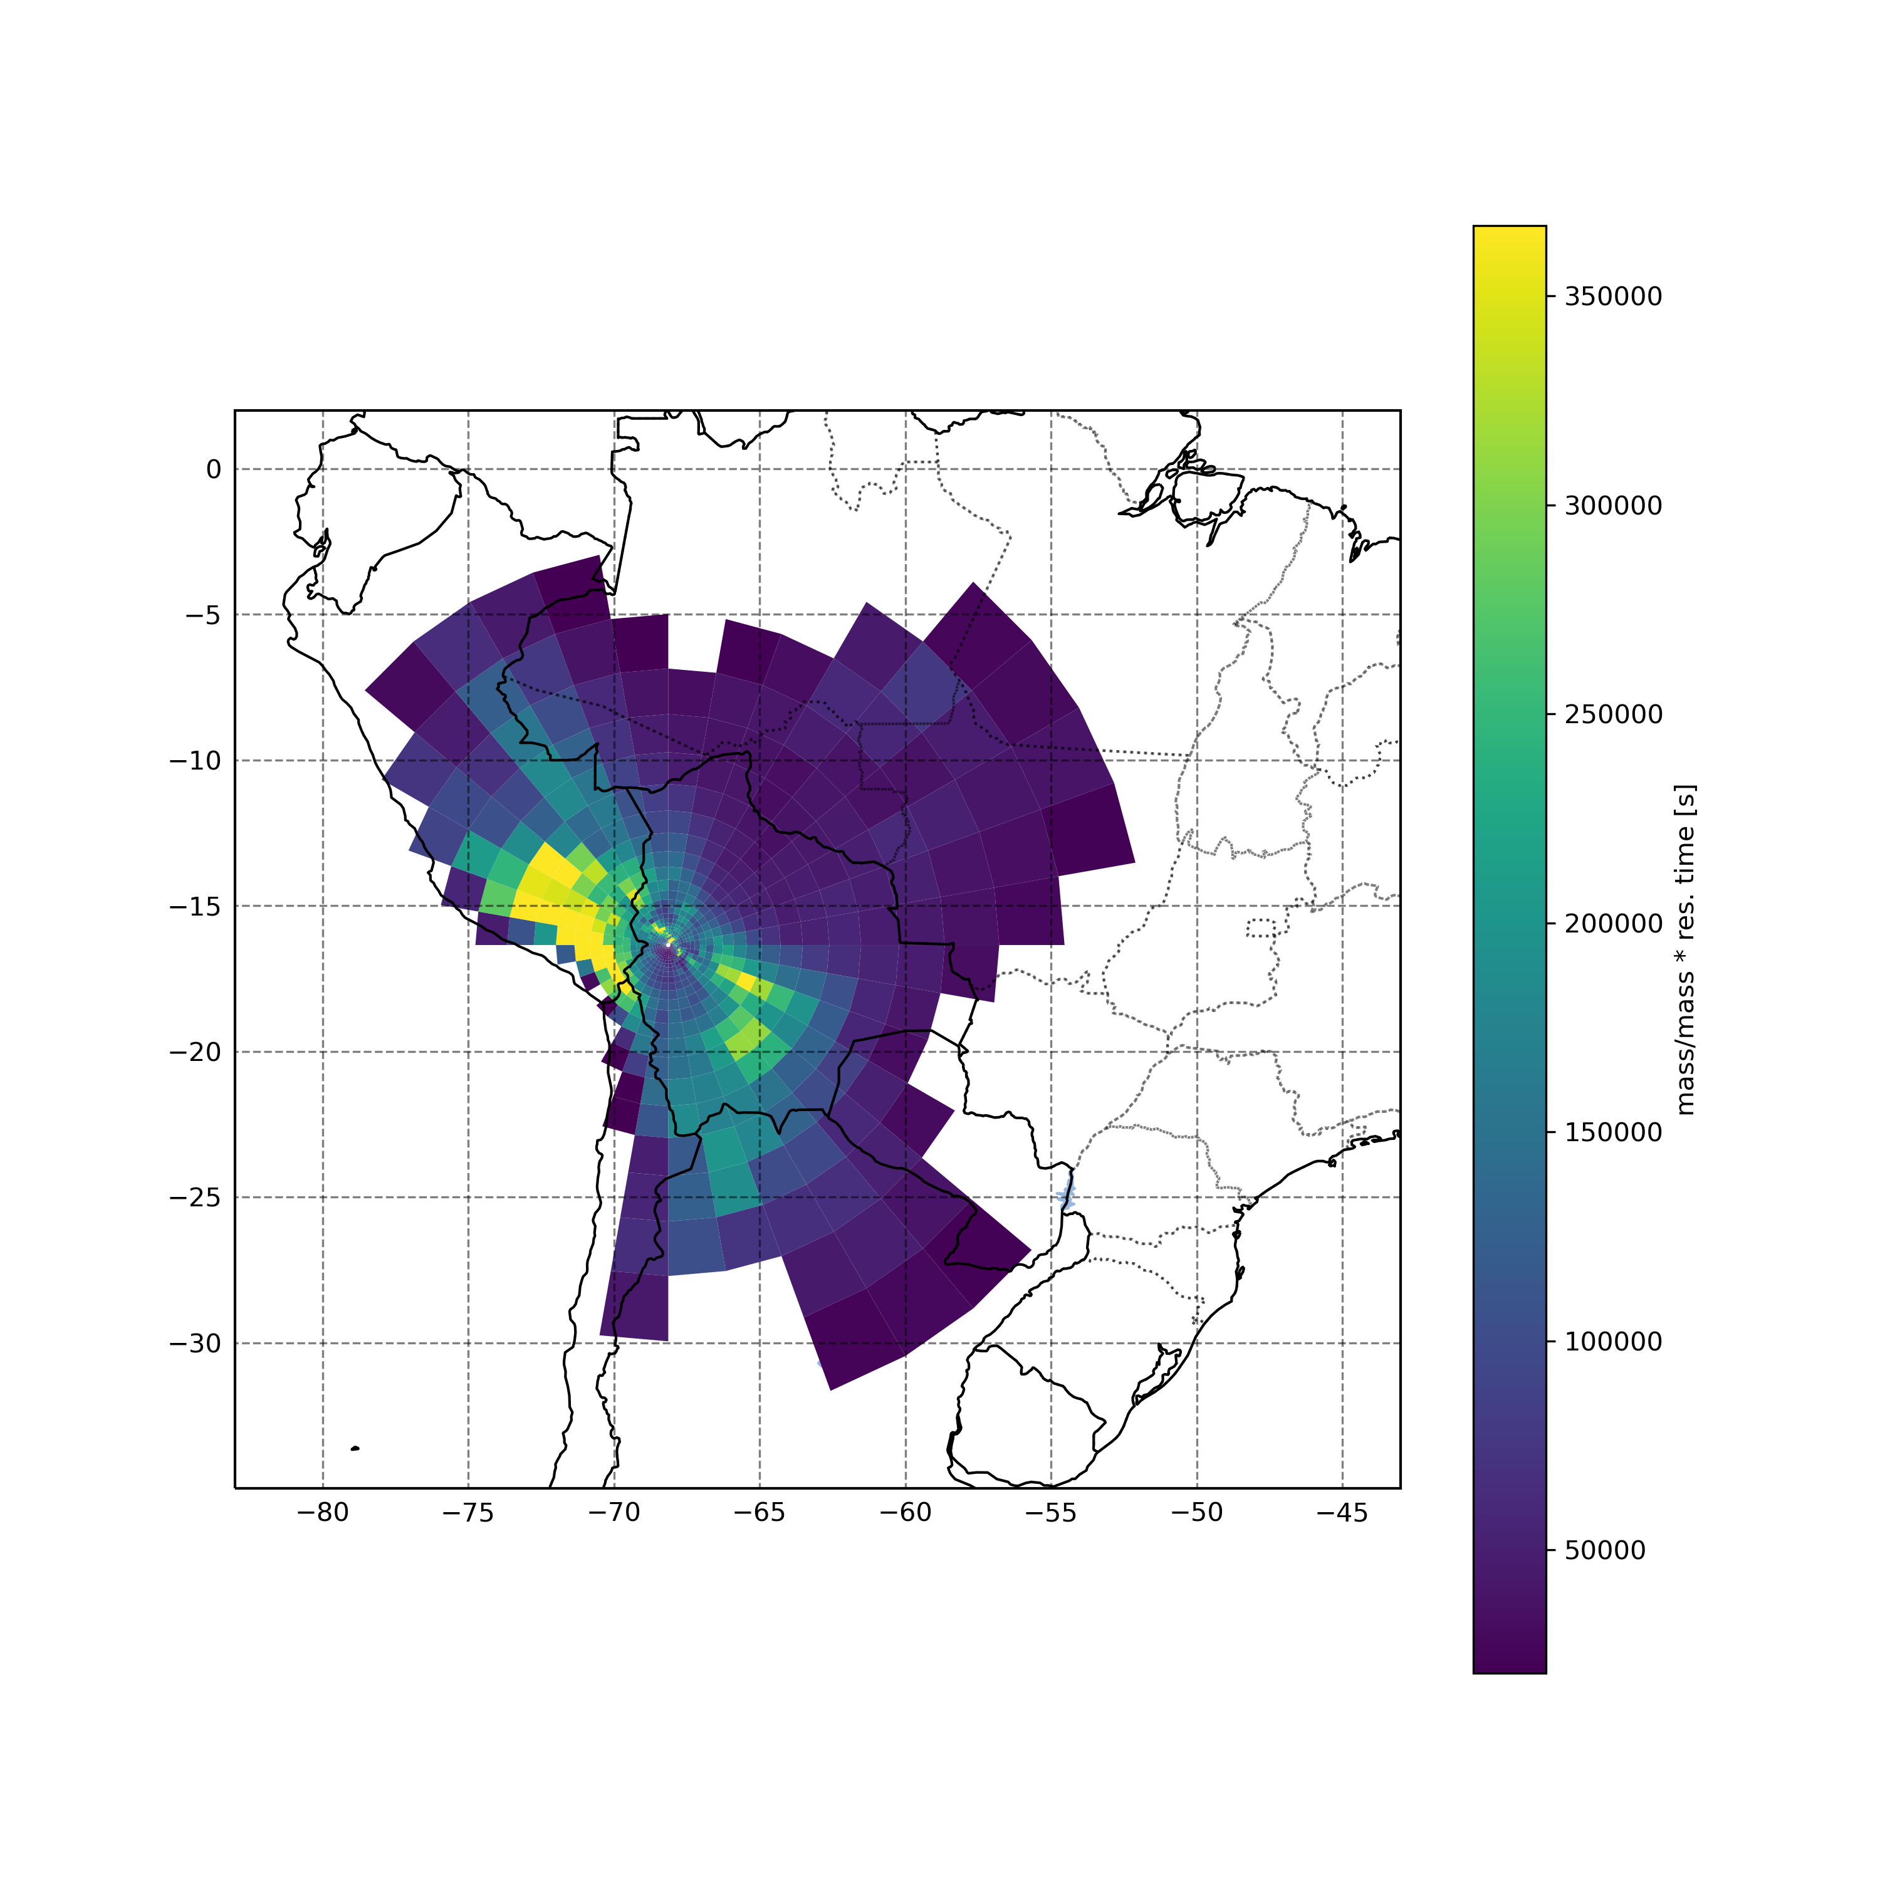
Flexpart surface foot print (residence time * N. particles) aggregate over modeling period (2017.12.1~2018.6.1)
Compared to other regions, La Paz surface foot print does not significantly influence CHC
La Paz

Slide 2
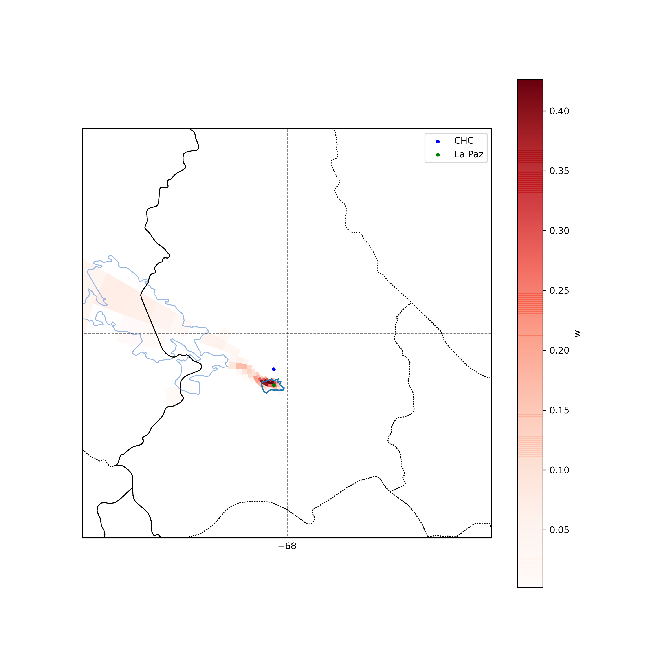
Elastic Net source attribution (w)
Zoomed in (from slide 1) Flexpart surface foot print (residence time * N. particles) aggregate over modeling period (2017.12.1~2018.6.1)
However, when doing an inverse modeling ElasticNet regression for sources of BC sampled at CHC,
La Paz polygon clearly stands out.

Slide 3
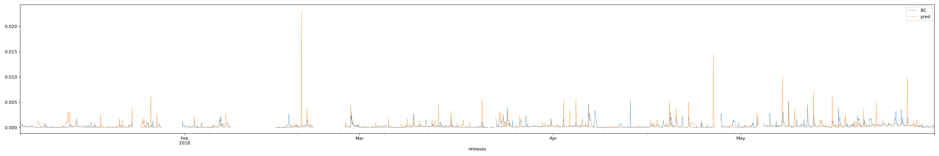
Timeseries sample BC vs Modeled (pred) BC from La Paz polygon using Elastic net source receptor regression

