Slide 1

01 / 11
FUNDAMENTALS OF DATABASES · BIOTECHNOLOGY
Biobank and Biospecimen Management System
A MySQL database for donor consent, biospecimen traceability, aliquot storage, and research requests.
Student name: Dalia salah othman Student ID: 221091944
BIO

Slide 2
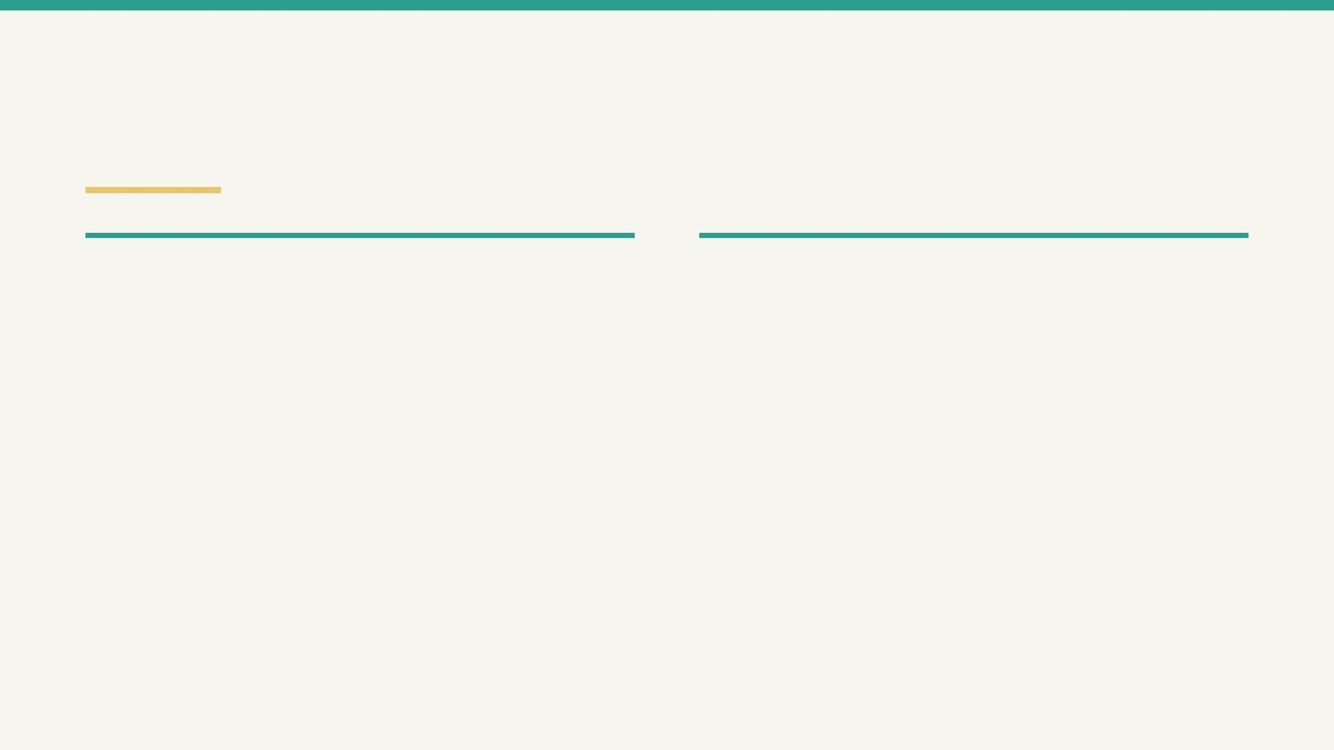
The Biobank Traceability Problem
02
OPERATIONAL CHALLENGE
DATABASE RESPONSE
A biobank must connect donor identity, consent status, biospecimen collection, aliquot location, and research usage without duplicating facts.
BiobankDB separates each subject into a normalized entity and preserves the links with foreign keys, an associative request table, views, a trigger, and a stored procedure.
DONOR CONSENT · SAMPLE TRACEABILITY · STORAGE · RESEARCH REQUESTS

Slide 3

Scope and Business Rules
03
SCOPE
Donors, consent, sample types, storage locations, biospecimens, aliquots, researchers, test requests, and request–aliquot assignments.
INTEGRITY
Unique emails and sample-type names; controlled ENUM values; required foreign keys; cascading deletion for dependent records; indexes for email, collection date, and aliquot status.
ALIQUOT RULE
When an update reduces volume to zero or below, trg_check_aliquot_volume normalizes volume to 0 and changes status to Used.
DATABASE-ENFORCED RULES · NO USER INTERFACE REQUIRED

Slide 4
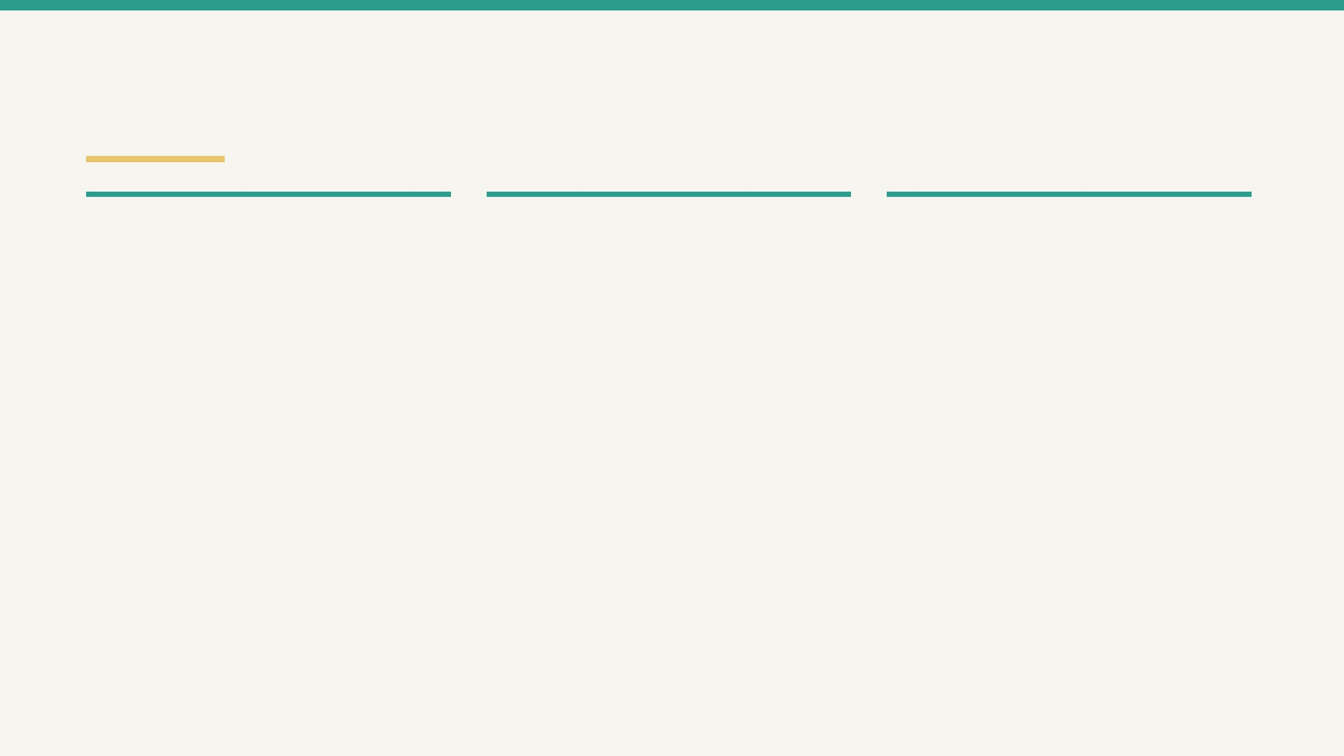
Nine Entities and One Associative Table
04
DONOR AND CONSENT
SPECIMEN AND STORAGE
RESEARCH REQUESTS
donors
sample_types
test_requests
donor_id PK, identity fields, blood type,
Unique type name, description,
Request date, status, purpose, and
unique email.
storage temperature.
researcher FK.
consents
storage_locations
request_aliquots
consent_id PK, donor_id FK, consent
Freezer, shelf, box, and capacity
Assignment date and two-column
type, status, signed date.
coordinates.
composite key.
researchers
biospecimens / aliquots
Views
researcher_id PK, institution, unique
Collection records are divided into
Available aliquots and researcher
email, phone.
stored portions.
request summaries.
request_aliquots
The table resolves the many-to-many relationship between test_requests and aliquots. Its composite primary key (request_id, aliquot_id) prevents the same aliquot from being assigned twice to the same request.
BIOBANKDB · NORMALIZED ENTITIES · TRACEABLE SAMPLE ASSIGNMENTS

Slide 5
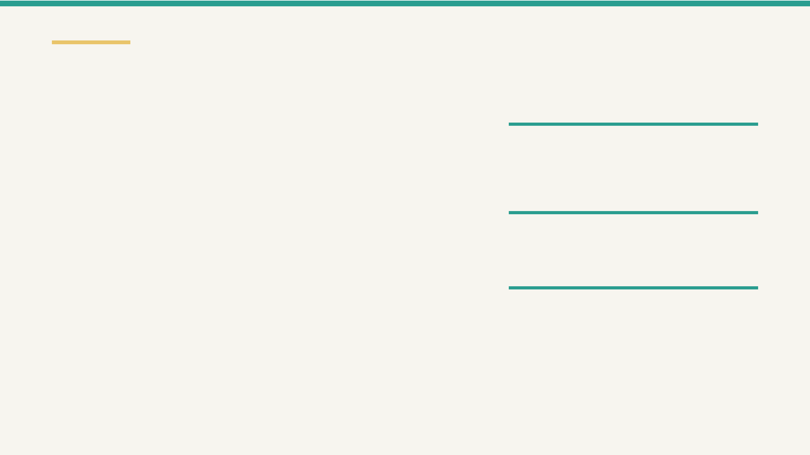
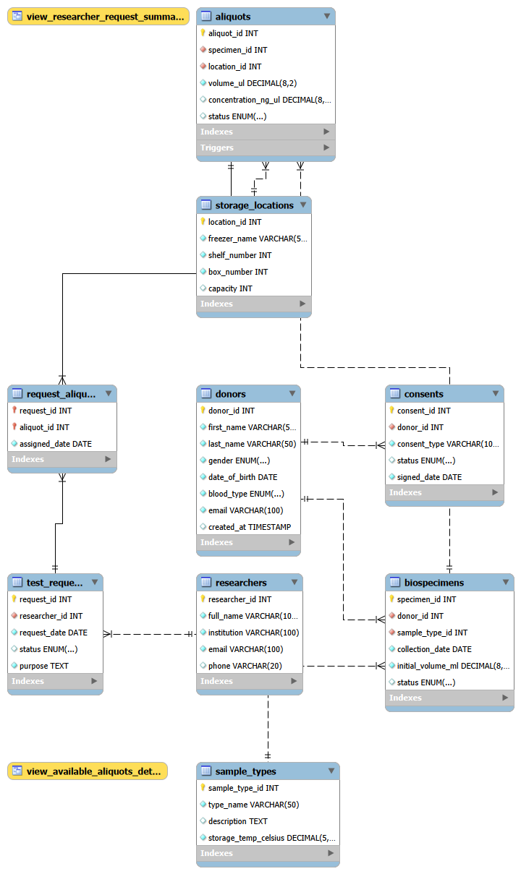
ERD and Cardinality
05
RELATIONSHIP MAP
Donor and specimen chain
donors 1:N consents and donors 1:N biospecimens. Each consent and biospecimen must reference one donor; a donor may have zero or many records.
Sample and storage chain
sample_types 1:N biospecimens, then biospecimens 1:N aliquots. Each aliquot must identify one specimen and one storage location.
Requests and aliquots
test_requests M:N aliquots is resolved by request_aliquots. Its composite key prevents assigning the same aliquot twice to one request.

Slide 6
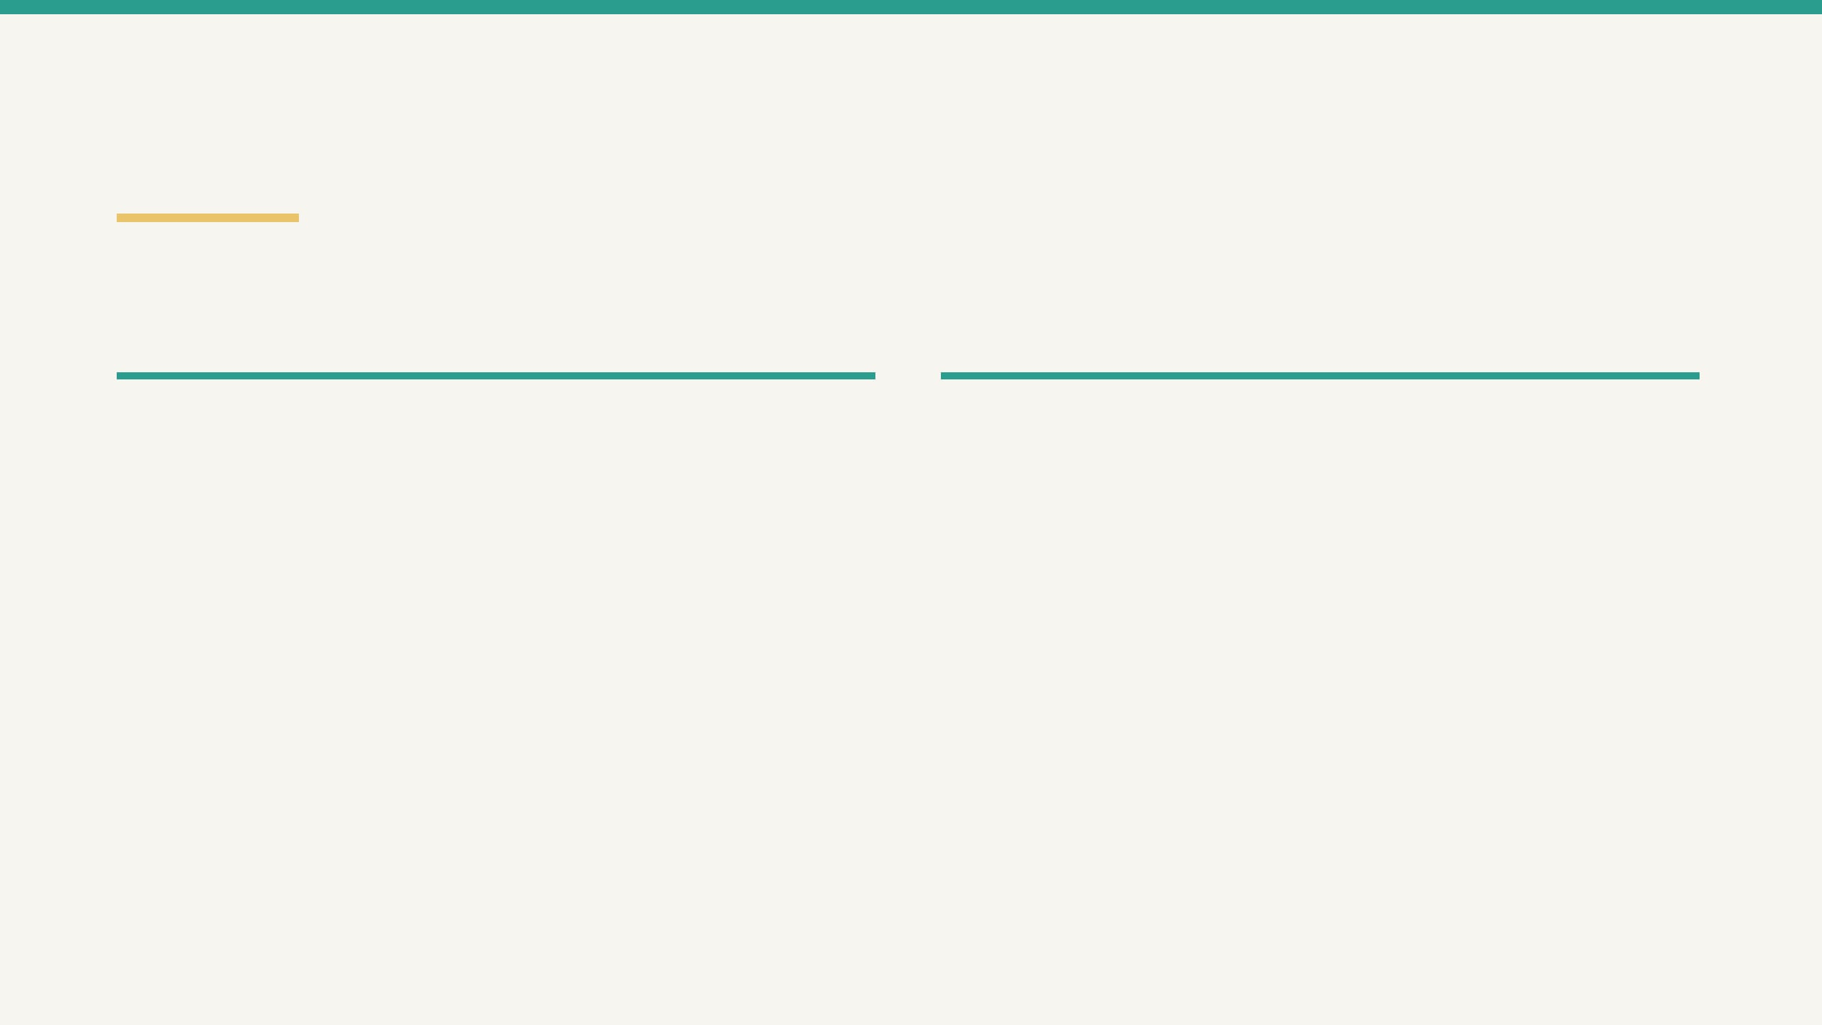
Relational Schema and Constraints
06
The DDL maps the ER model into nine tables plus one associative table, with explicit identity, referential integrity, controlled domains, and performance indexes.
KEYS AND RELATIONSHIPS
DOMAINS AND PERFORMANCE
Surrogate primary keys donor_id, consent_id, sample_type_id, location_id, specimen_id, aliquot_id, researcher_id, and request_id identify individual records.
Unique constraints donors.email, researchers.email, and sample_types.type_name are UNIQUE and NOT NULL.
Controlled values ENUM domains constrain gender, blood type, consent status, specimen status, aliquot status, and request status.
Composite primary key request_aliquots(request_id, aliquot_id) prevents a request–aliquot pair from being assigned twice.
Defaults and indexes created_at and lifecycle statuses have defaults. Indexes support donor email, specimen collection date, and aliquot status.
Foreign-key actions Donor, specimen, and request deletion cascades remove dependent records. Aliquot storage references must point to existing locations.
PRIMARY KEYS · FOREIGN KEYS · UNIQUE VALUES · ENUM DOMAINS · INDEXED SEARCHES

Slide 7
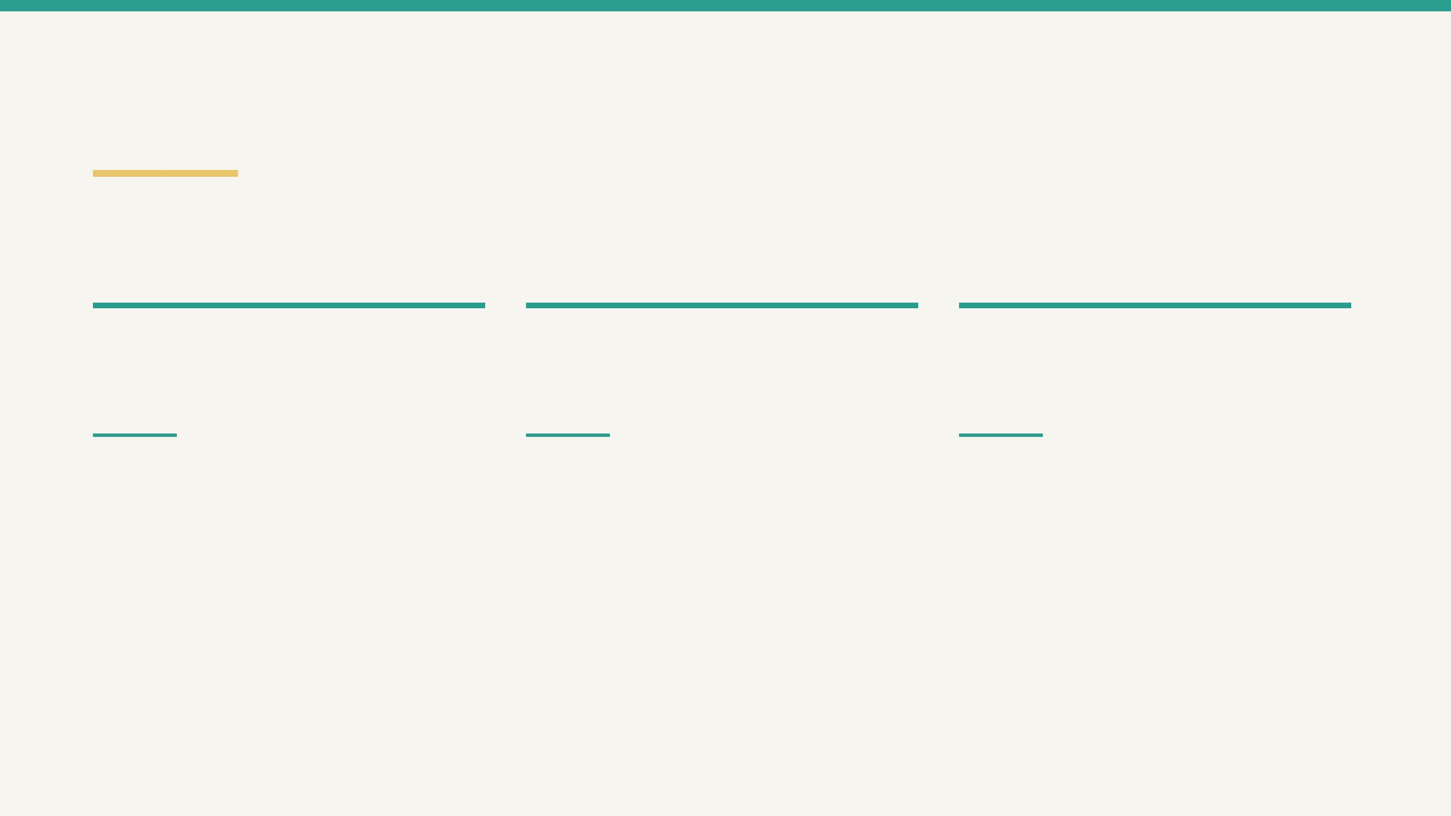
Normalization to 3NF
07
BiobankDB separates facts by subject and keeps request–aliquot assignment data at the correct level of dependency.
01
02
03
First Normal Form
Second Normal Form
Third Normal Form
Attributes are atomic. Repeated specimen portions are stored as separate rows in aliquots, while repeated request assignments are rows in request_aliquots.
In request_aliquots, the attribute assigned_date depends on the complete composite key (request_id, aliquot_id), not on only one key part.
Donor, sample-type, storage, researcher, specimen, and request facts are separated. Non-key attributes depend on their table’s key rather than on another non-key attribute.
request + aliquot → assigned_date
one row = one aliquot assignment
sample_types → temperature storage_locations → coordinates
Result: fewer update, insertion, and deletion anomalies because each business fact has one logical home.
ATOMIC DATA · FULL-KEY DEPENDENCY · SUBJECT-BASED SEPARATION

Slide 8

Views, Trigger, and Procedure
08
The advanced objects turn normalized records into reusable operational summaries and enforce an aliquot-inventory rule at the database layer.
view_available_aliquots_detail
Joins aliquots, biospecimens, sample types, storage locations, donors, and consents. Returns aliquots that are In Storage and linked to donors with Active consent.
STORAGE AVAILABILITY
view_researcher_request_summary
Uses a LEFT JOIN and grouped counts to show each researcher’s total, approved, pending, and rejected test requests, including researchers with no requests.
REQUEST ANALYTICS
trg_check_aliquot_volume
Runs before an aliquot update. When NEW.volume_ul <= 0, it sets volume to 0 and status to Used.
INTEGRITY TRIGGER
sp_GetDonorFullHistory
Accepts a donor ID and returns donor/consent information first, followed by biospecimen, aliquot, sample-type, and freezer history.
TWO RESULT SETS
REUSABLE SUMMARIES · DATABASE-ENFORCED INVENTORY RULE · DONOR TRACEABILITY

Slide 9
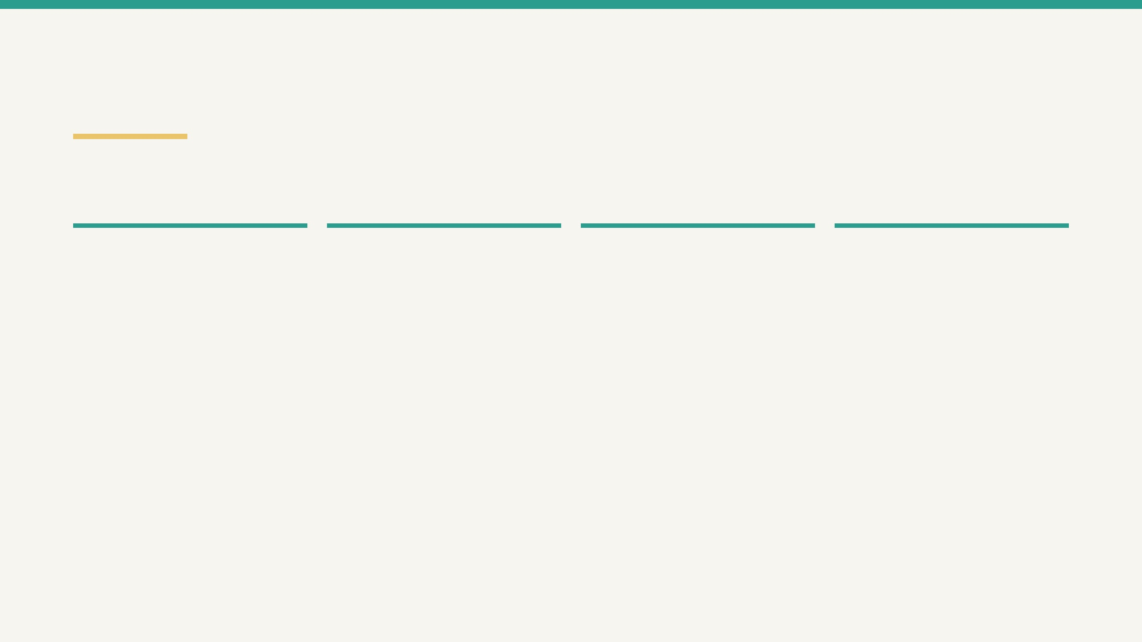
SQL Operations and Testing
09
The query script demonstrates the required SQL categories and the testing script confirms that views, the procedure, indexes, and the aliquot trigger behave as designed.
01
02
03
04
Retrieve and join
Aggregate
Nested query
Modify data
Selects DNA Extract aliquots in storage with donor and sample-type context.
Groups specimens by sample type and calculates total specimens and average initial volume.
Finds donors with Active consent but no collected biospecimens.
INSERTs a storage location, UPDATEs request 3, and DELETEs an expired consent.
VALIDATION SEQUENCE
Views
Procedure
Trigger and indexes
Run both
view_available_aliquots_detail
Call
sp_GetDonorFullHistory(1)
and
Update aliquot 1 to volume 0 and confirm
and
view_researcher_request_summary
confirm that two result sets are returned:
status becomes
Used
; use SHOW INDEX
to verify filtered and grouped outputs.
donor/consent data and specimen/aliquot
to verify the three performance indexes.
SELECT * FROM view_researcher_request_summary;
history.
UPDATE aliquots SET volume_ul=0 WHERE aliquot_id=1;
CALL sp_GetDonorFullHistory(1);

Slide 10
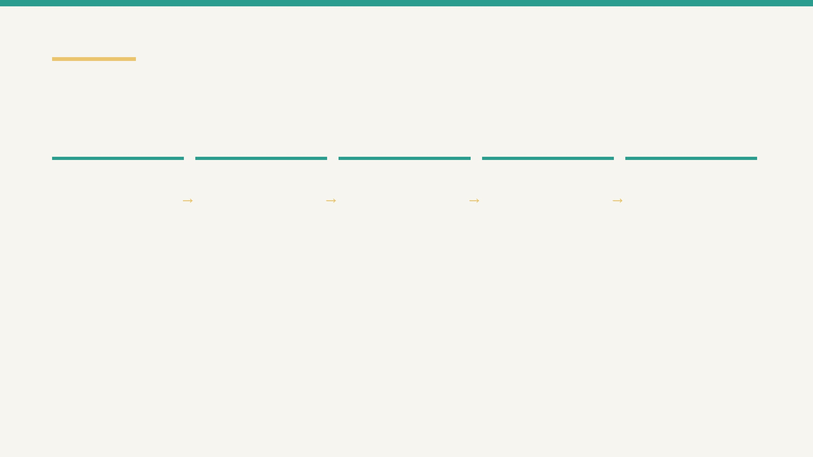
10
Demonstration Sequence and Conclusion
A clean execution sequence demonstrates the database lifecycle and produces the evidence required for submission.
01
02
03
04
05
Create
Load
Inspect
Test
Evidence
Run create_tables.sql to recreate BiobankDB, keys, constraints, and indexes.
Run load_data.sql and verify donors, specimens, aliquots, researchers, and requests.
Query both views: available aliquots and researcher request summaries.
Call sp_GetDonorFullHistory and update volume to show the trigger marks an aliquot Used.
Capture screenshots for setup, data, views, procedure, trigger, and INSERT/UPDATE/DELETE operations.
BiobankDB provides normalized donor-to-aliquot traceability with consent-aware views, controlled storage data, request assignments, and database-enforced inventory behavior.
LIMITATIONS

Slide 11
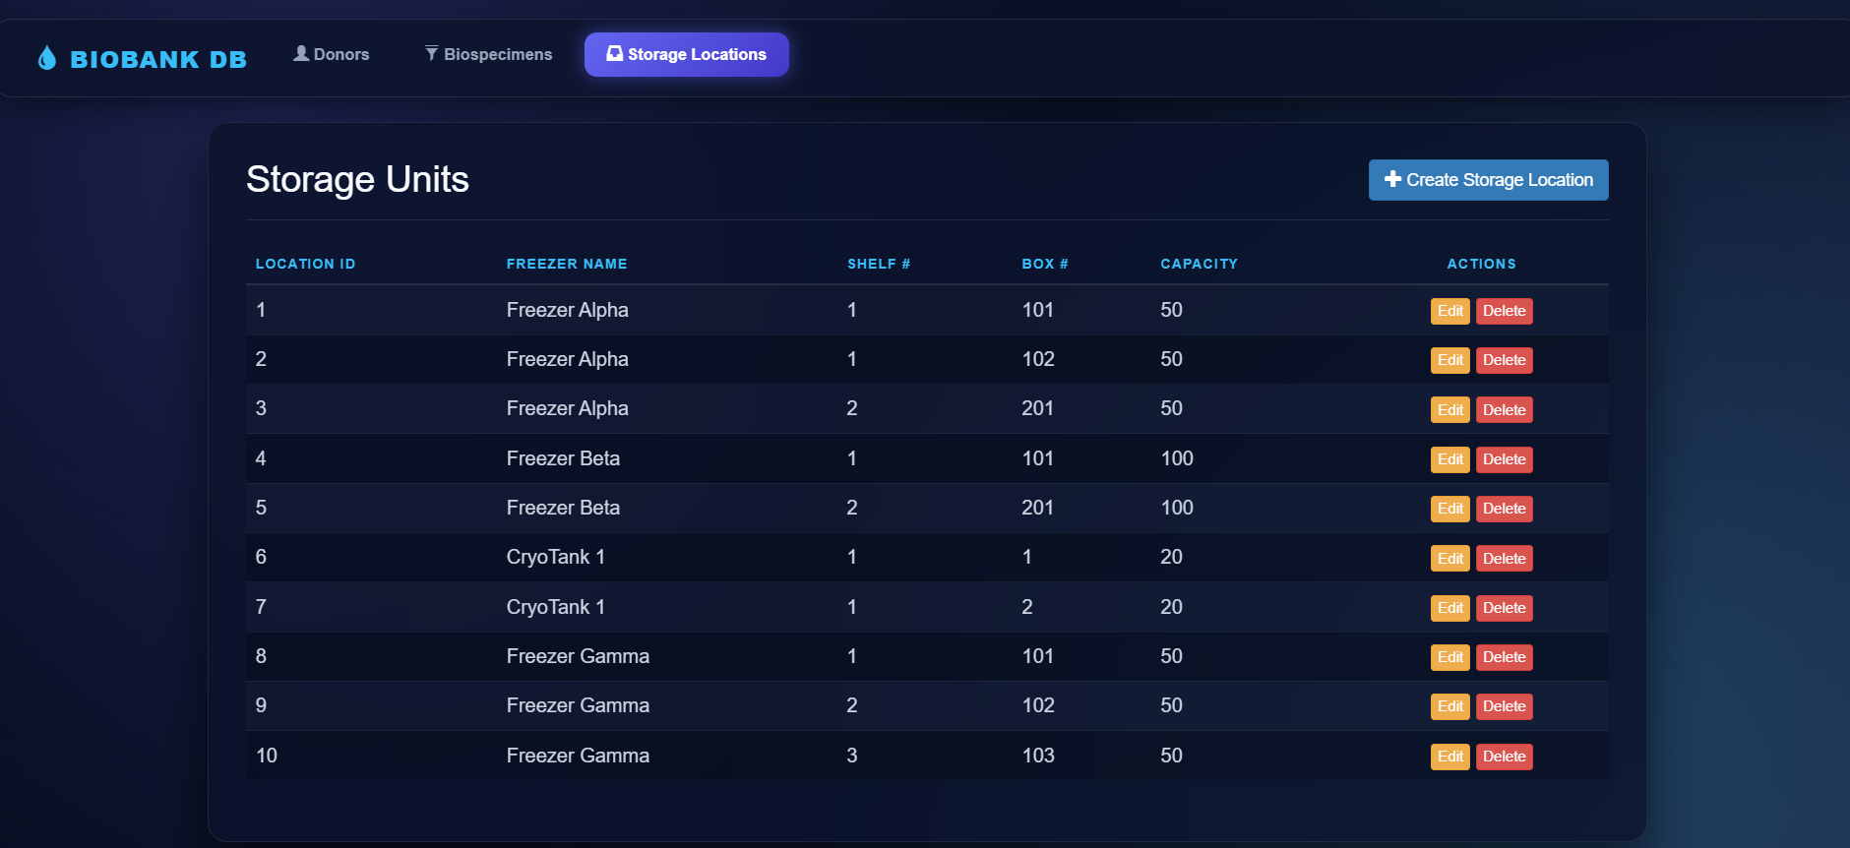
UI

