Slide 1
Introduction to Python

Slide 2
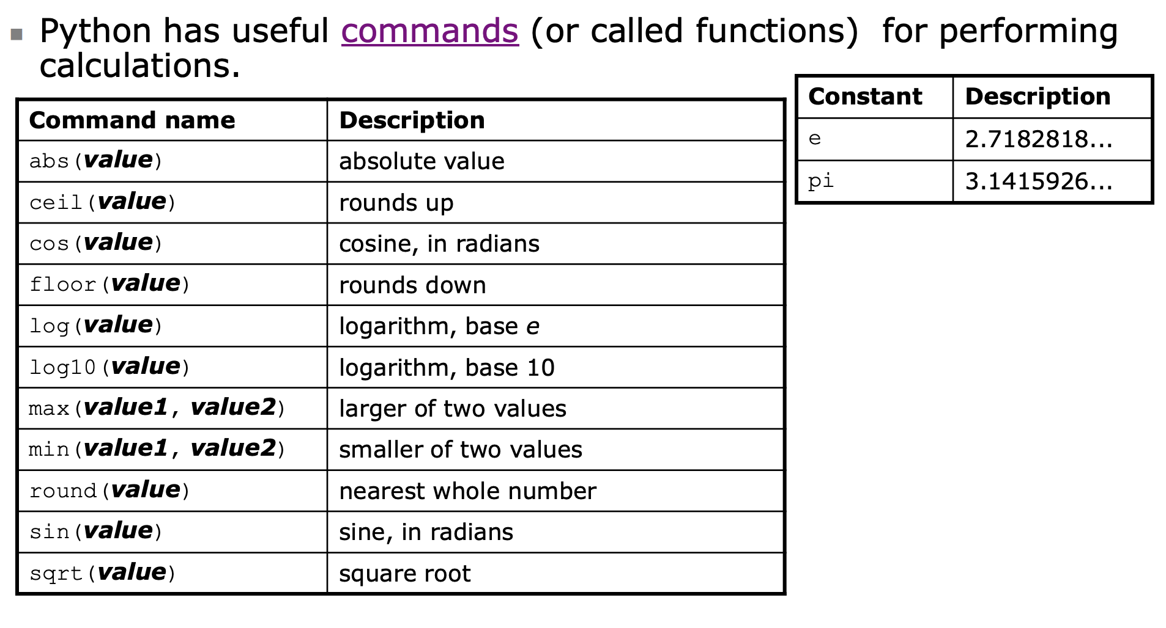
Recall

Slide 3
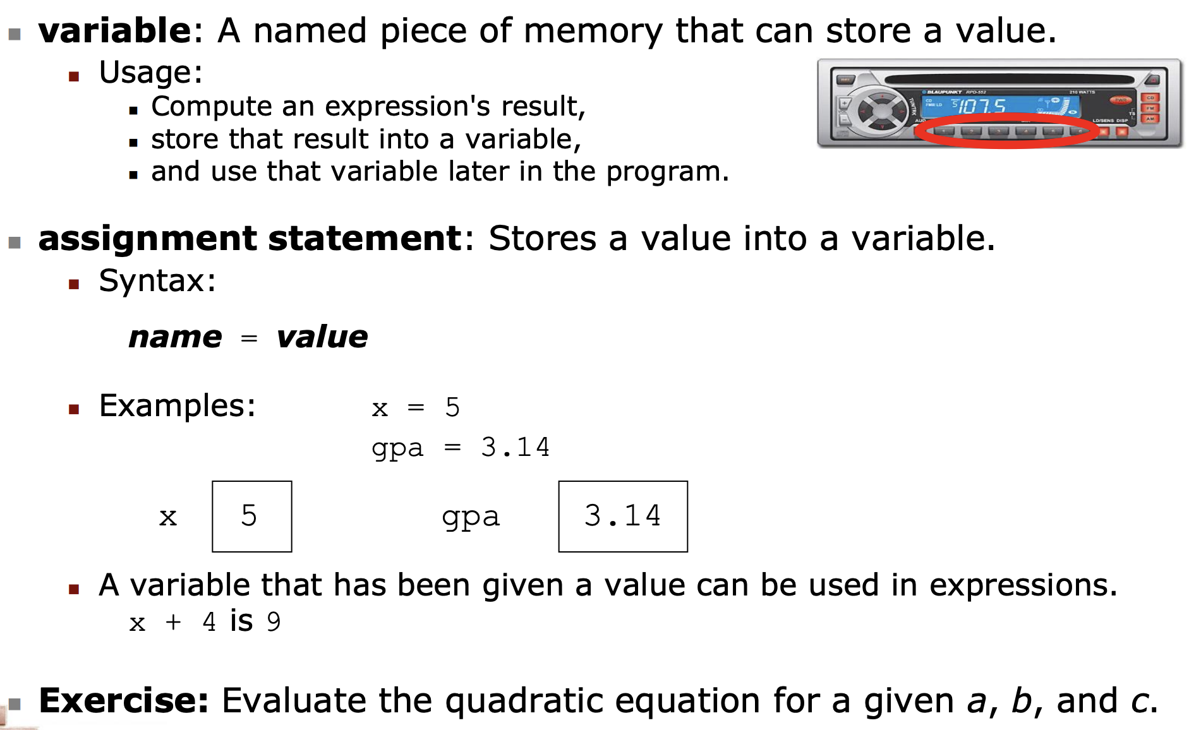
Variables

Slide 4
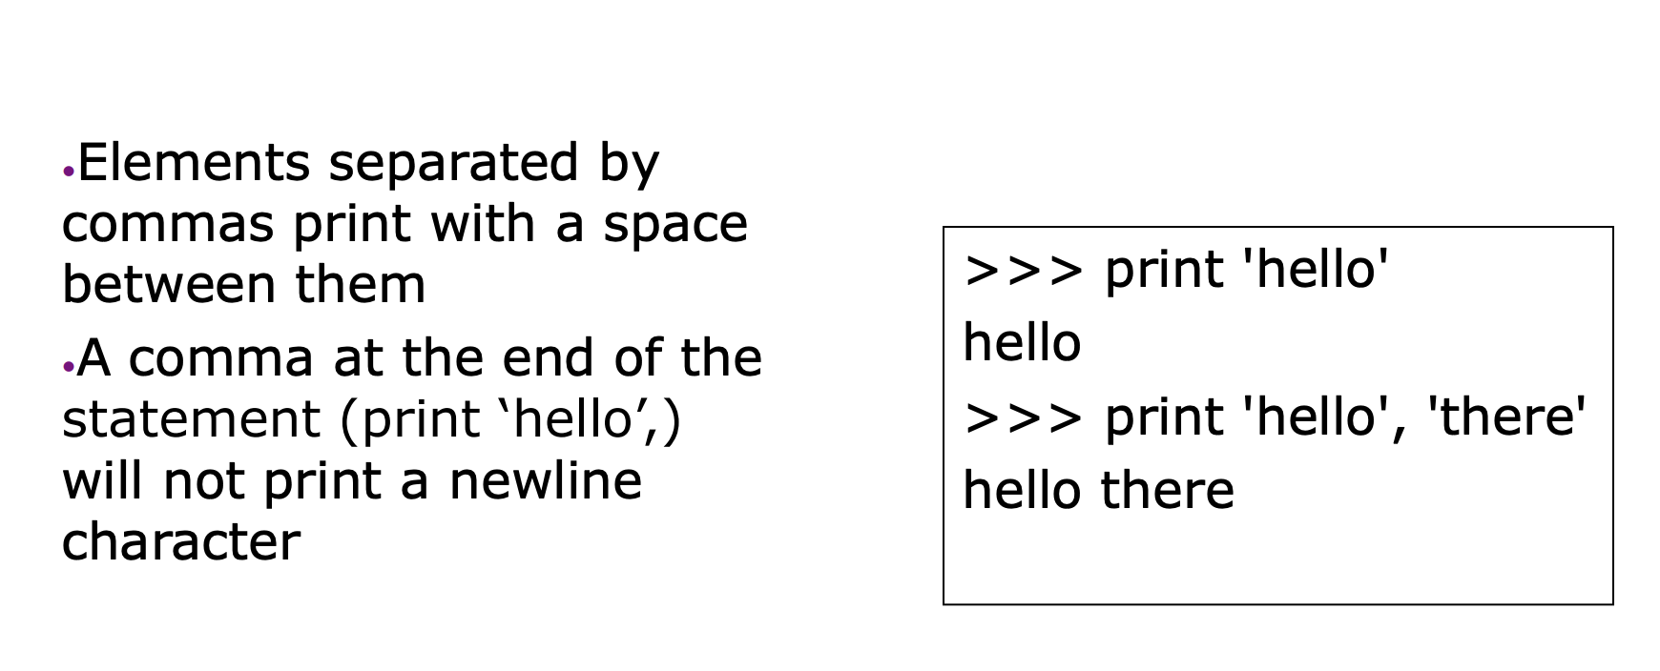
Print Function
Looking at Types
Indentation
Basic Operators

Slide 5
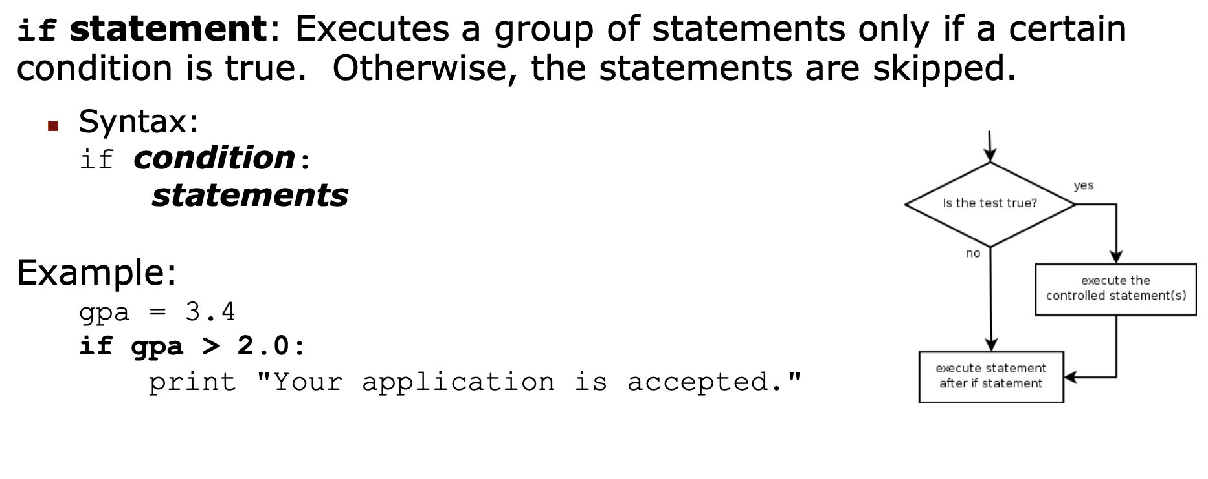
Conditional Statements

Slide 6
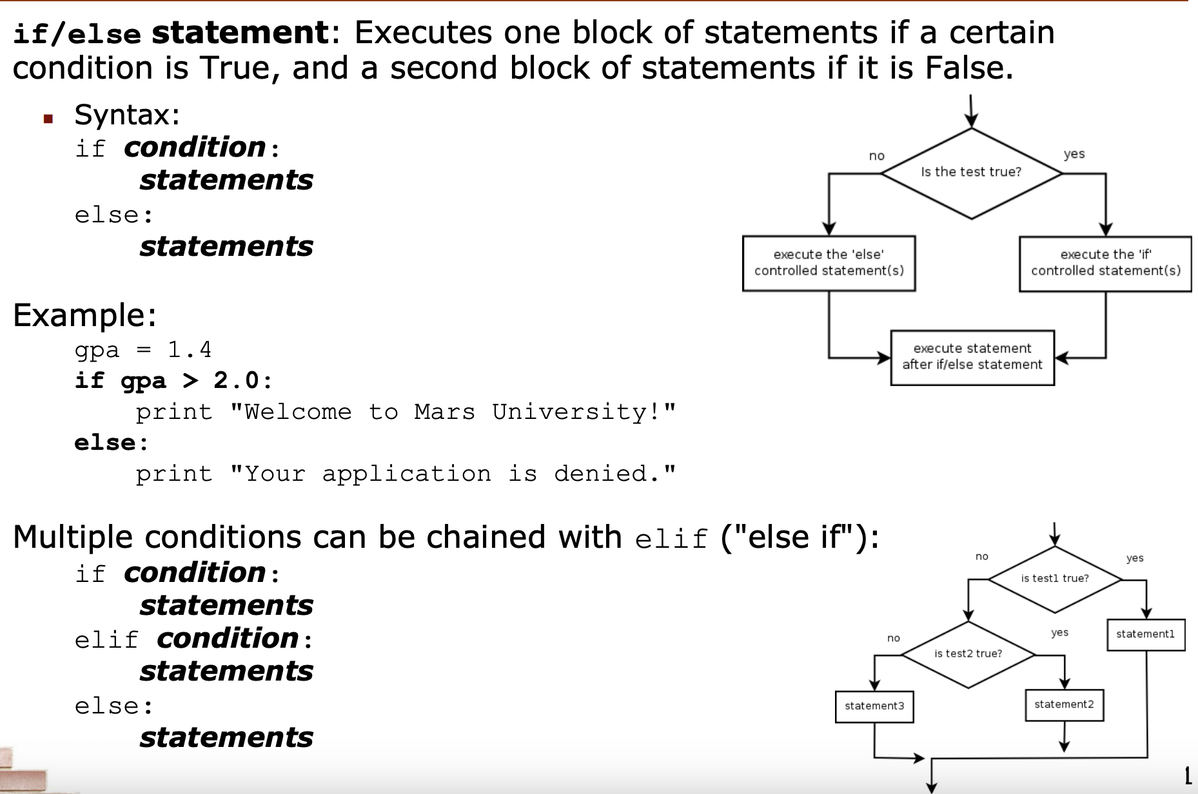

Slide 7
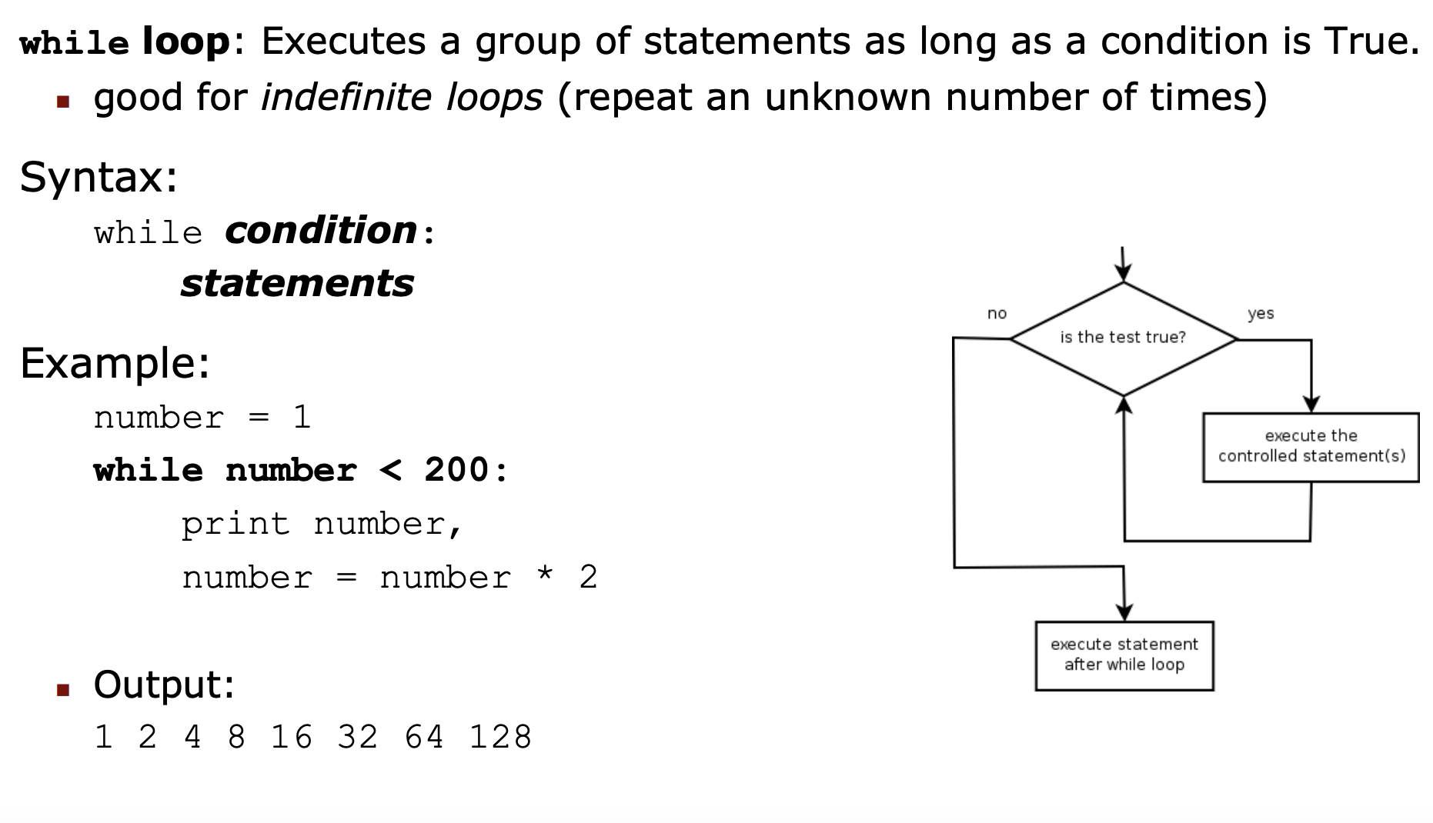

Slide 8
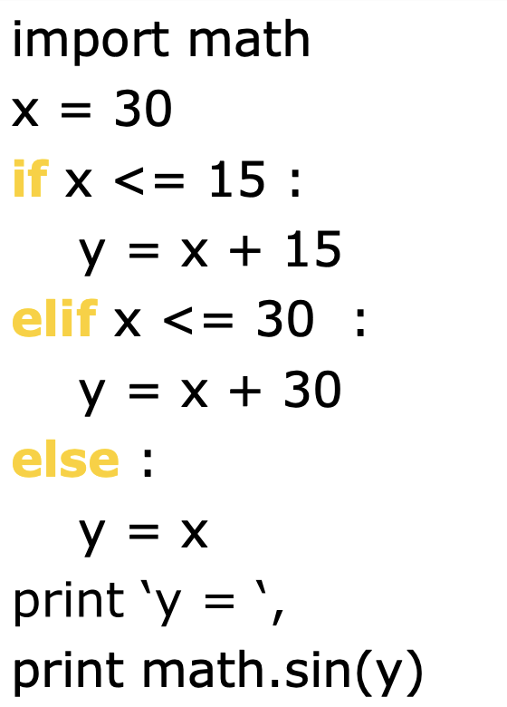

Slide 9
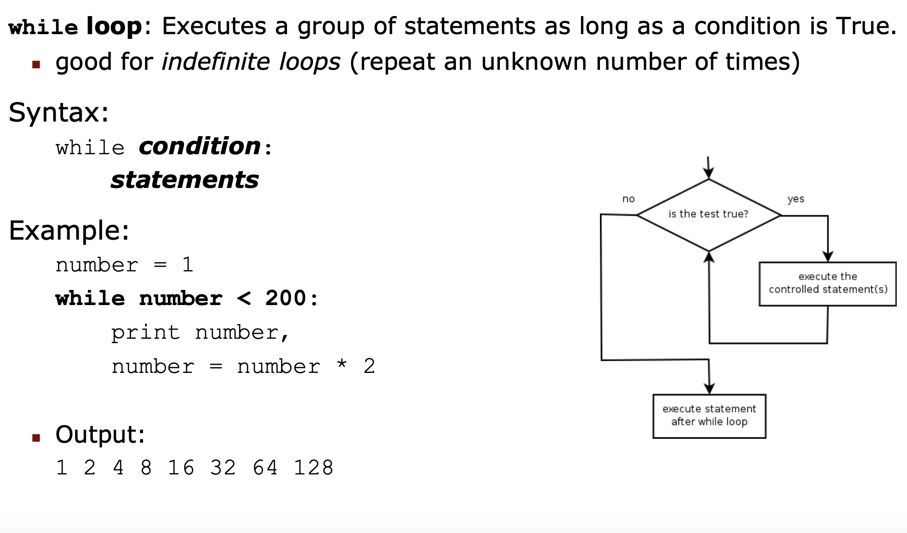

Slide 10
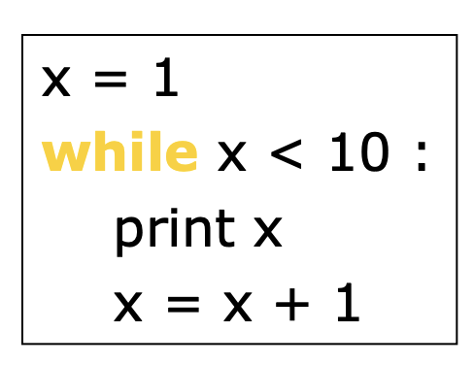
Loops

Slide 11
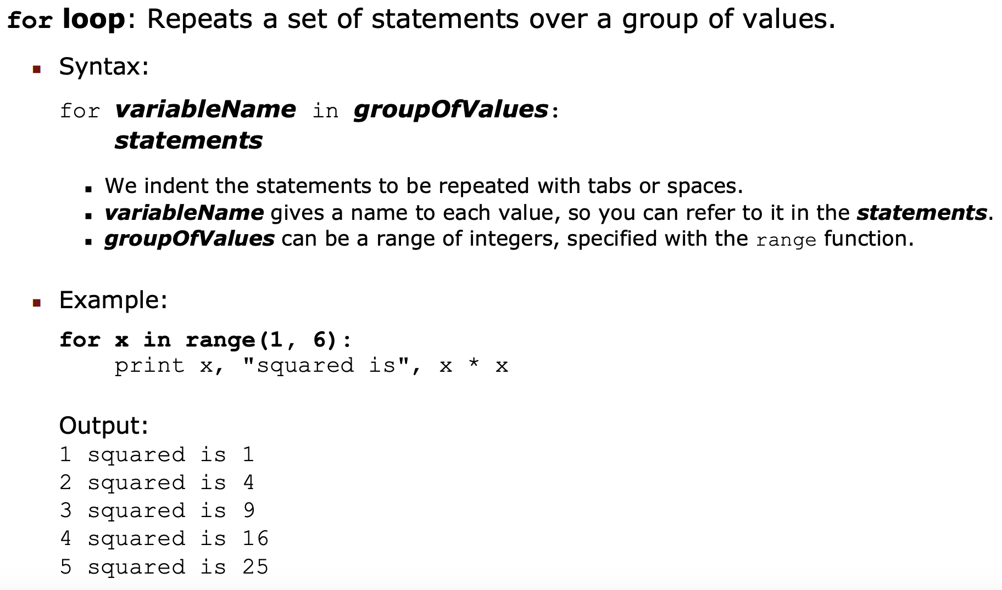

Slide 12
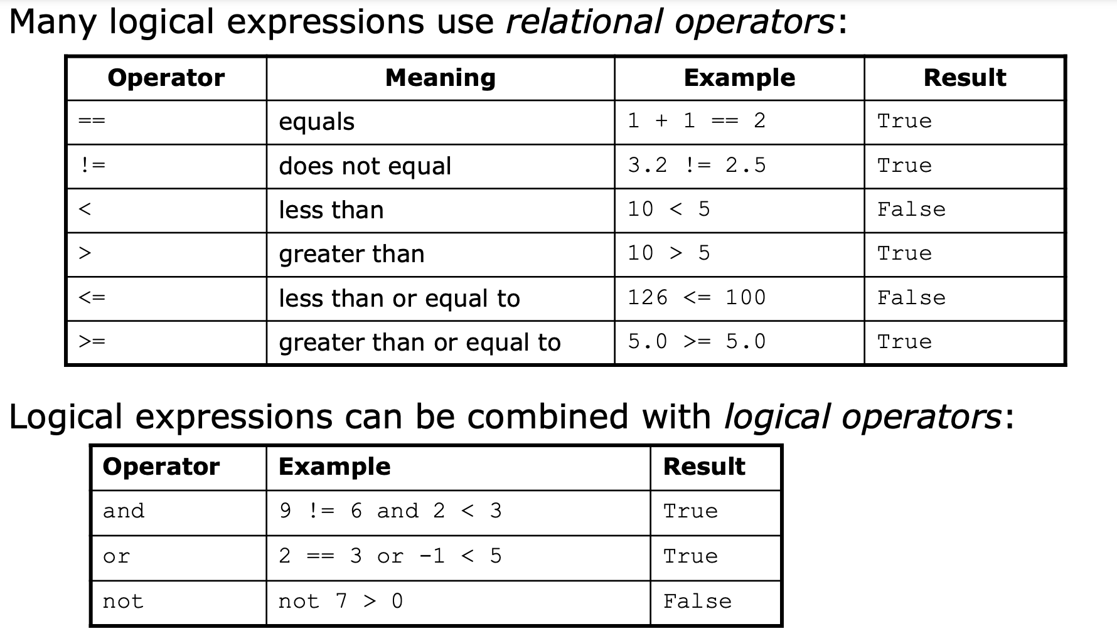
Logical Expressions

Slide 13
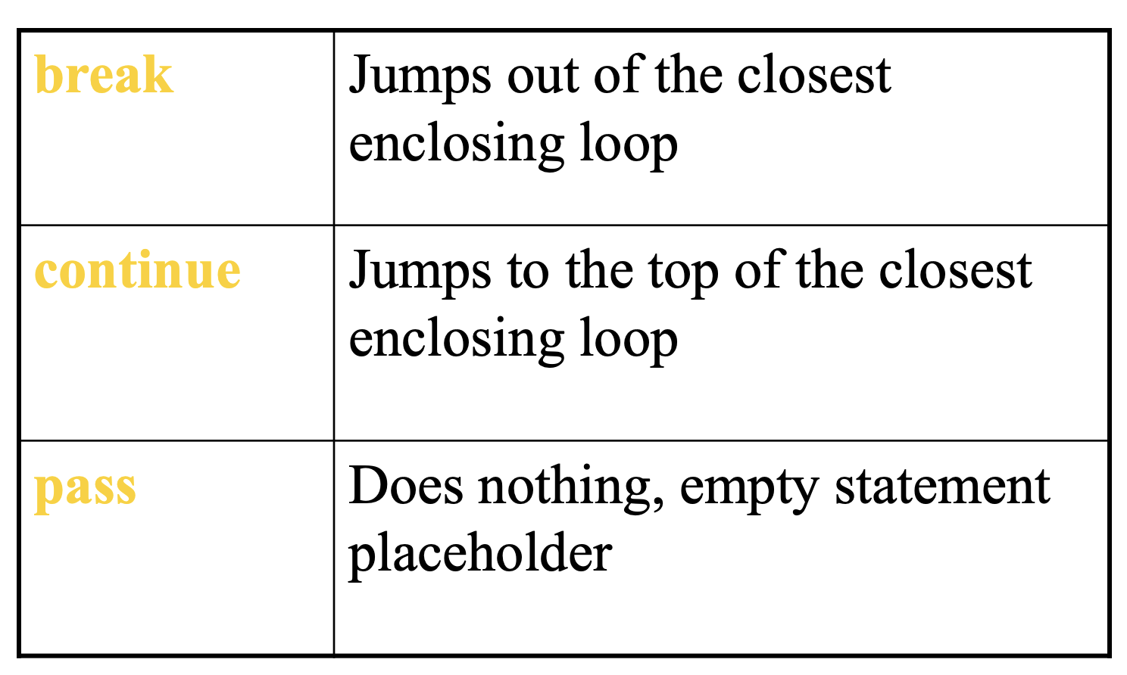
Loop Control Statement

Slide 14
String Operations

Slide 15
Functions

Slide 16
Assignment
Write a Python program that takes two integers as input, stores them in variables, and then swaps the values of these variables without using a temporary variable.
Write a Python program that prompts the user for his/her amount of name..
Write a Python program that uses a for loop to calculate the sum of all even numbers from 1 to 100 (inclusive). Print the result.
Write a Python program that asks the user to enter two numbers, then it:
Adds the number
Subtracts the smaller number from larger number.
Divides the smaller number by the larger number
Multiplies the number
Print results of each step using the print function.

